Slide 1
CSC103: Introduction to Computer and Programming
Lecture No 2

Slide 2
Today’s lecture outline
Computer software
  Operating system software
  Application software
Understanding computer operation
To become familiar with number system used by the microprocessors - binary numbers
To become able to perform decimal-to-binary conversions
Logic operations

Slide 3
Computer Software
Computer software is the key to use computer productively. Software can be categorized into two types:
  Operating system software
  Application software

Slide 4
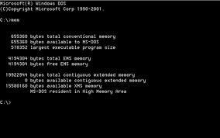
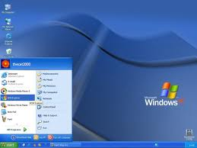
Operating System Software
Operating system software tells the computer
  how to perform the functions of loading, storing and executing an application and
  how to transfer data
Nowadays, computers use an operating system that has a graphical user interface (GUI)
Image 1
Image 2

Slide 5
Cont.
GUI provides visual clues such as icon symbols to help the user.
Microsoft Windows XP, Vista and 7 are widely used graphical operating system.
DOS (Disk Operating System) is an older

Slide 6
Application software
Application Software consists of programs that tell a computer how to produce information.
Some of the more commonly used packages are:
  Word processing
  Electronic spreadsheet
  Database
  Presentation graphics

Slide 7
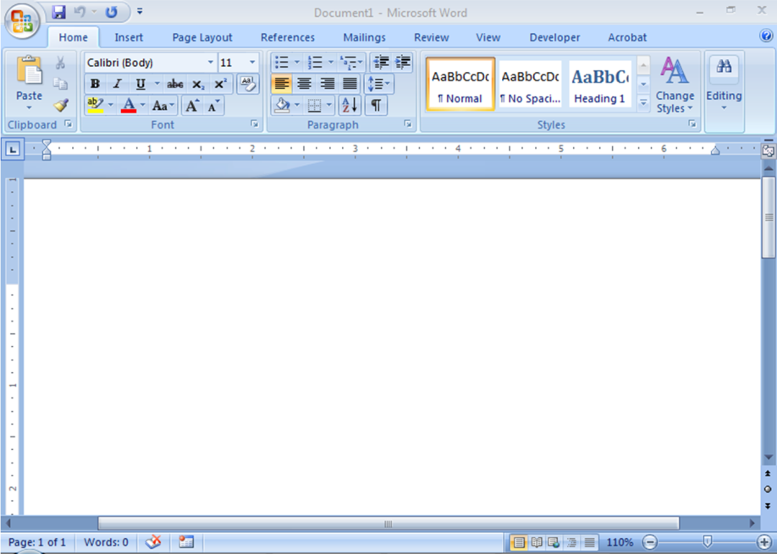
Word Processing
Word Processing software is used to create and print documents.
A key advantage of word processing software is that users easily can make changes in documents.

Slide 8
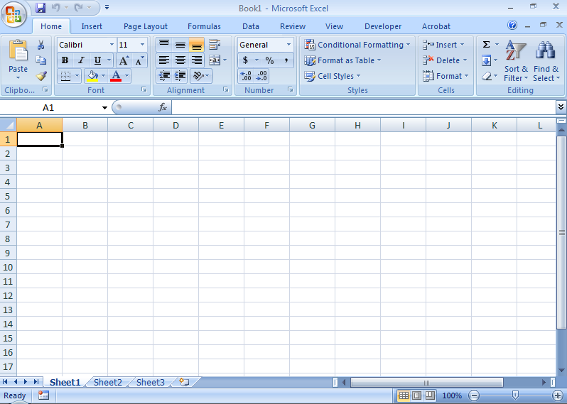
Electronic Spreadsheets
Electronic spreadsheet software allows the user to add, subtract, and perform user-defined calculations on rows and columns of numbers.

Slide 9
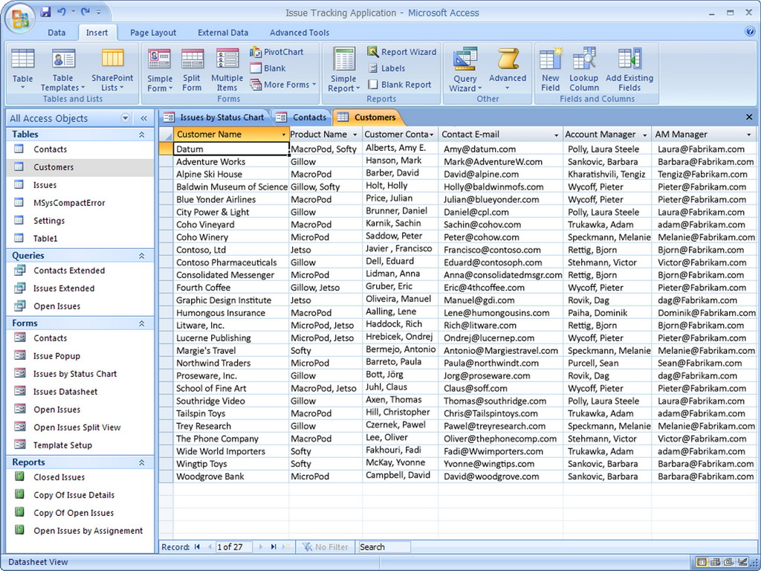
Database Software
Allows the user to enter, retrieve, and update data in an organized and efficient manner, with flexible inquiry and reporting capabilities.

Slide 10
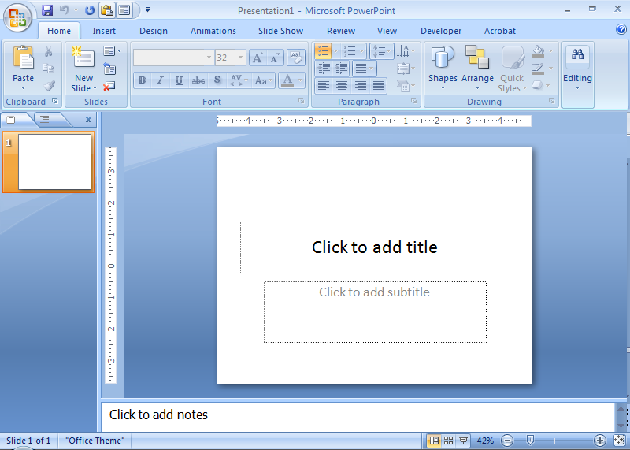
Presentation software
Presentation graphic software allows the user to create documents called slides to be used in making the presentations.
Using special projection devices, the slides display as they appear on the computer screen.

Slide 11
Computer Components and Operations
Input devices: allow data to enter in computer
  Mouse, keyboard, scanner
Processing: working on the data; such as:
  Organizing data
  Checking data for accuracy
  Mathematical or other manipulations on data
Central Processing Unit (CPU): hardware that performs the tasks

Slide 12
Cont.
Output devices: provide data to the user
  Printer, monitor, speakers
Programming language: special language containing instructions for the computer
  Visual Basic, Java, C , C#, C++, COBOL
Syntax: the rules governing word usage and punctuation in the language
Machine language: a language that controls the computer’s on/off circuitry
Compiler or interpreter: software that translates programming languages to machine language

Slide 13
Understanding Computer Operations
A program must be free of syntax errors to be run, or executed, on a computer
To function properly, the logic must be correct
What’s wrong with this logic for making a cake?
Stir
Add two eggs
Add a gallon of petrol
Bake at 250 degree for 45 minutes
Add three cup of flour

Slide 14
Understanding Computer Operations
Logic errors, or semantic errors, are more difficult to locate than syntax errors
Logic for multiplying a number by 2 (includes input, processing and output statements)
Get input a number
Calculate input number times 2
Print the calculated answer

Slide 15
Logic Building
Logic is very important in programming
Consider the following procedure of washing clothes using a washing machine
  Put the clothes in the washtub
  Pour water.
  Pour detergent powder.
  Switch on the washing machine.
  Set the timer and wait for a few minutes.
  Drain the water out.
  End.
This procedure gets the work done

Slide 16
Cont.
Now, suppose the same steps are performed in a slightly different order
  Put the clothes in the washtub.
  Switch on the washing machine.
  Set the timer and wait for a few minutes.
  Pour water.
  Pour detergent powder.
  Drain the water out.
  End.
In this case, your clothes may tear off, since you have switched on the washing machine before pouring water into it

Slide 17
Binary Numbers

Slide 18
How computer think
Computers handle two types of information:
  Instructions
  Data
The "words" of a machine language are called instructions; each of these gives a command to the CPU
A computer program (software) is a list of instructions that are executed by the CPU

Slide 19
Off and On
Computers only recognize off and on, like a light switch
These switches are represented as binary digits or… bits
Instructions and data are composed only of a series of bits

Slide 20
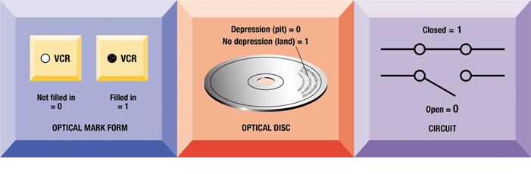
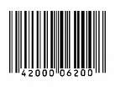
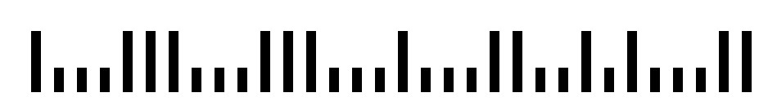
Binary Numbers (Bits)
Bits can be represented as:
  1 or 0
  On or Off
  Up or Down
  Open or Closed
  Yes or No
  Black or White
  Thick or Thin
  Long or Short

Slide 21
Number systems
Binary
  Base 2
  2 symbols (0, 1)
Decimal
  Base 10
  10 symbols ((0,1,2,3,4,5,6,7,8,9)
Octal
  base = 8
  8 symbols (0,1,2,3,4,5,6,7)
Hexadecimal
  base = 16
  16 symbols (0,1,2,3,4,5,6,7,8,9,A,B,C,D,E,F)

Slide 22
We count in Base 10 (Decimal)
15
16
17
18
19
0
1
2
3
4
5
6
7
8
9
10
11
12
13
14
95
96
97
98
99
100
101
20
21
22
23
24
Ran out of symbols (0-9), so increment the digit on the left by one unit.

Slide 23
Computers count in Base 2 (Binary)
Counting in Binary is the same, but with only two symbols
  On (1)
  Off (0)
1000
1001
1010
1011
1100
1101
1110
1111
10000
0
1
10
11
100
101
111
110

Slide 24
Counting in Decimal
Counting in Binary
0
1
2
3
4
5
6
7
8
9
10
11
12
13
14
15
16
17
18
19
20
21
22
23
24
25
26
27
28
29
30
31
32
33
34
35
36
.
.
.
0
1
10
11
100
101
110
111
1000
1001
1010
1011
1100
1101
1110
1111
10000
10001
10010
10011
10100
10101
10110
10111
11000
11001
11010
11011
11100
11101
11110
11111
100000
100001
100010
100011
100100
.
.
.

Slide 25
Converting Binary to Decimal
1 0 1 0 1 1 0 0
128
64
32
16
8
4
2
1
128
+
0
+
32
+
0
+
8
+
4
+
0
+
0
128 + 32 + 8 + 4 = 172

Slide 26
Converting Binary to Decimal
0 1 0 1 0 0 0 1
128
64
32
16
8
4
2
1
0
+
64
+
0
+
16
+
0
+
0
+
0
+
1
64 + 16 + 1 = 81

Slide 27
Converting Binary to Decimal
- - - ✓ - ✓ ✓ ✓
128
64
32
16
8
4
2
1
0
+
0
+
0
+
16
+
0
+
4
+
2
+
1
16 + 4 + 2 + 1 = 23

Slide 28
Converting Binary to Decimal
☺ ☹ ☺ ☺ ☹ ☺ ☺ ☺
128
64
32
16
8
4
2
1
128
+
0
+
32
+
16
+
0
+
4
+
2
+
1
128 + 32 + 16 + 4 + 2 + 1 = 183

Slide 29
Convert Decimal to Binary
2
75
remainder
2
37
1
2
18
1
2
9
0
2
4
1
2
2
0
1
0
1001011

Slide 30
Check
1001011 = 1x2⁰ + 1x2¹ + 0x2² + 1x2³ + 0x2⁴ + 0x2⁵ + 1x2⁶
= 1 + 2 + 0 + 8 + 0 + 0 + 64
= 75

Slide 31
Bytes
Eight bits form a single byte
  “00110011” is One Byte of Information
Byte Values:
  00000000 = 0
  11111111 = 255
As a result, binary numbers almost always written as a full byte (00000001).

Slide 32
Example
A
B
C
Decimal
1
2
3
45
6
7
8
0
0
0
0
0
0
1
1
0
1
0
2
0
1
1
3
1
0
0
4
1
0
1
5
1
1
0
6
1
1
1
7

Slide 33
ASCII (Character Set)
Acronym for the American Standard Code for Information Interchange
Provides a means for a byte to represent a number
  0100 0001 (41 Hex) (65 Decimal) = A
  0100 0010 (42 Hex) (66 Decimal) = B
Upper-case and lower-case have separate values.
Numbers and symbols are there too.

Slide 34
ASCII Table
1-31 Control Codes
32-64 Symbols
65-90 Uppercase
91-96 More Symbols
97-122 Lowercase
123-126 More Symbols
127 Delete
128-255 International Symbols

Slide 35
ASCII Table

Slide 36
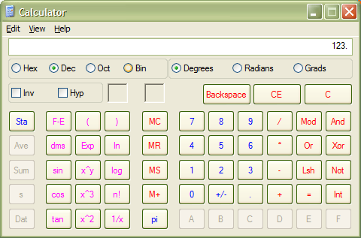
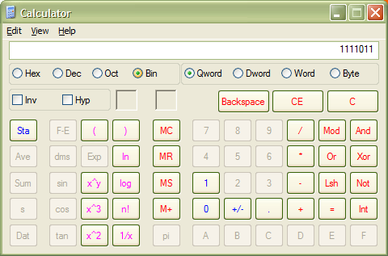
Windows Calculator for Binary
1. Type your number.
3. See new value.
2. Choose notation.

Slide 37
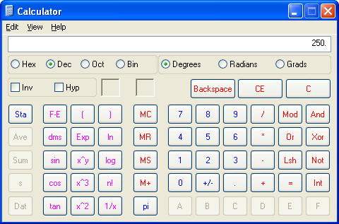
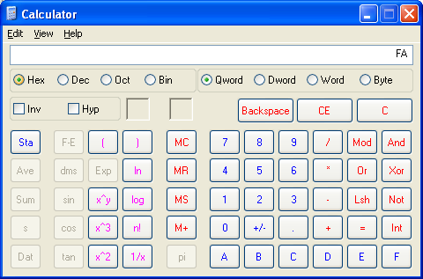
Windows Calculator for Hex
1. Type your number.
3. See new value.
2. Choose notation.

Slide 38
There are 10 types of people in the world... Those who understand binary, and those who don’t.

Slide 39
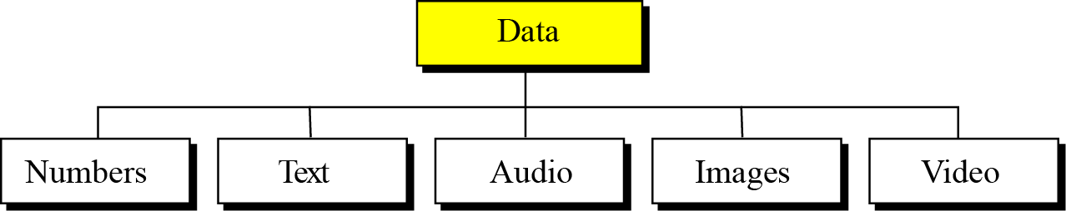
Data
Data today comes in different forms including numbers, text, audio, image and video
The computer industry uses the term “multimedia” to define data that contains numbers, text, images, audio and video.

Slide 40
Data inside the computer
All data types are transformed into a uniform representation when they are stored in a computer and transformed back to their original form when retrieved.
This universal representation is called a bit pattern.

Slide 41





Storage of different data types

Slide 42
Logic Operations
Data inside a computer is stored as patterns of bits.
Logic operations refer to those operations that apply the same basic operation on individual bits of a pattern or on two corresponding bits in two patterns.
This means that we can define logic operations at the bit level and at the pattern level.
A logic operation at the pattern level is n logic operations

Slide 43
Logical operation at bit level
A bit can take one of the two values: 0 or 1
If we interpret 0 as the value false and 1 as the value true, we can apply the operations defined in Boolean algebra to manipulate bits
Boolean algebra, named in honor of George Boole, belongs to a special field of mathematics called logic
Today we discuss four bit-level operations that are used to manipulate bits:
NOT, AND, OR, and XOR.

Slide 44
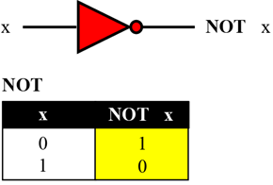
NOT operation
The NOT operator is a unary operator
It takes only one input bit
The output bit is the complement of the input

Slide 45
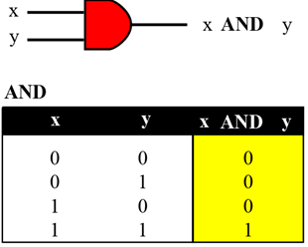
AND operation
The AND operator is a binary operator: it takes two inputs
The output bit is 1 if both inputs are 1s and the output is 0 in the other three cases
For x = 0 or 1
x AND 0 → 0
0 AND x → 0

Slide 46
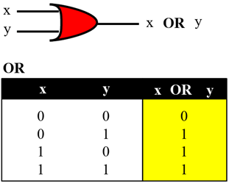
OR operation
The OR operator is a binary operator: it takes two inputs
The output bit is 0 if both inputs are 0s and the output is 1 in other three cases
For x = 0 or 1
x OR 1 → 1
1 OR x → 1

Slide 47
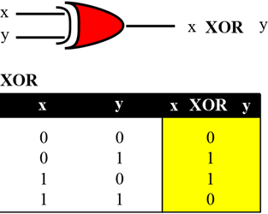
XOR operation
The XOR operator is a binary operator like the OR operator, with only one difference: the output is 0 if both inputs are 1s
For x = 0 or 1
1 XOR x → NOT x
x XOR 1 → NOT x

Slide 48
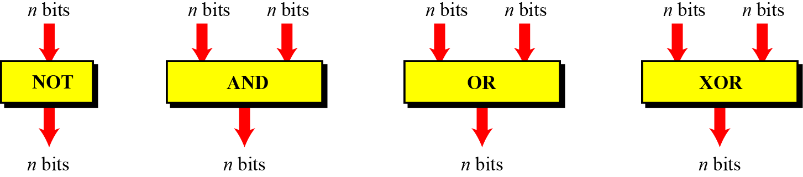
Logic operations at pattern level
The same four operators (NOT, AND, OR, and XOR) can be applied to an n-bit pattern
The effect is the same as applying each operator to each individual bit for NOT and to each corresponding pair of bits for the other three operators

Slide 49
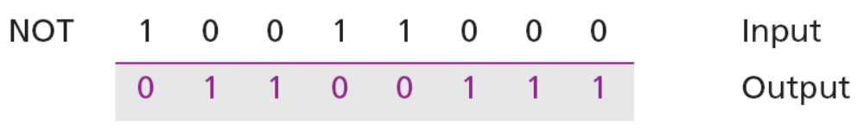
Example – NOT operation
Use the NOT operator on the bit pattern 10011000
Solution
The solution is shown below.
Note that the NOT operator changes every 0 to 1 and every 1 to 0.

Slide 50
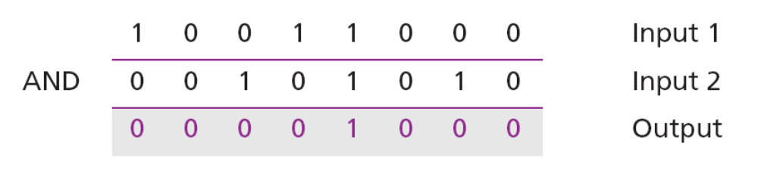
Example – AND operation
Use the AND operator on the bit patterns 10011000 and 00101010.
Solution
The solution is shown below.
Note that only one bit in the output is 1, where both corresponding inputs are 1s.

Slide 51
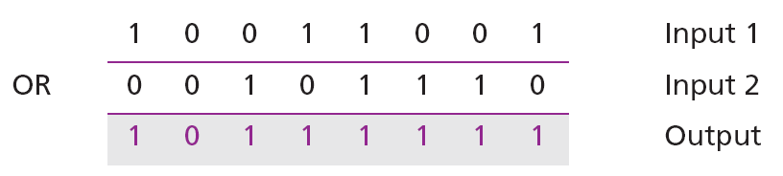
Example – OR operation
Use the OR operator on the bit patterns 10011001 and 00101110.
Solution
The solution is shown below.
Note that only one bit in the output is 0, where both corresponding inputs are 0s.

Slide 52
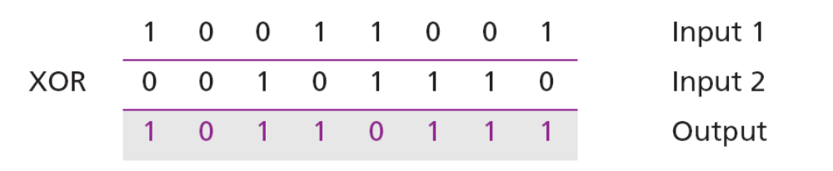
XOR operation
Use the XOR operator on the bit patterns 10011001 and 00101110.
Solution
The solution is shown below.
When the two inputs are 1s, the result is 0

