Slide 1
CSC103: Introduction to Computer and Programming
Lecture No 19

Slide 2
Previous lecture
A program to calculate percentage marks
Array initialization
Bound checking
Passing array elements to function
  By value
  By address
Pointer arithmetic
Printing value of array elements using pointer

Slide 3
Today’s lecture outline
Pointer arithmetic – a program
Sorting techniques – a program
Passing an Entire Array to a Function
Array and pointer
2 Dimensional Array

Slide 4
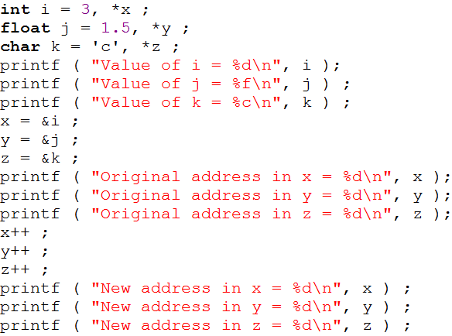
Pointer arithmetic - program
564
*x
560
i
3
560
564
794
*y
790
j
1.5
790
794
*z
321
320
k
c
320
321
Go to program

Slide 5
Sorting program
Sorting means arranging element of array in ascending or descending order
After arranging array elements in ascending order
After arranging array elements in descending order
0
1
2
3
4
5
24
34
12
44
56
17
500
504
508
512
516
520
0
1
2
3
4
5
12
17
24
34
44
56
500
504
508
512
516
520
0
1
2
3
4
5
56
44
34
24
17
12
500
504
508
512
516
520

Slide 6
Sorting techniques
Selection sort
Bubble sort
Insertion sort

Slide 7
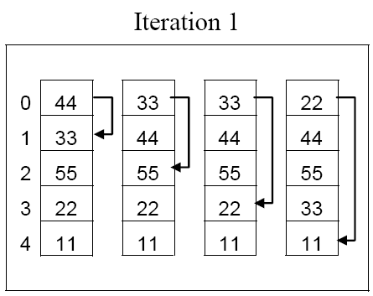
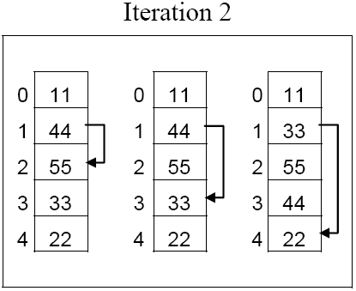
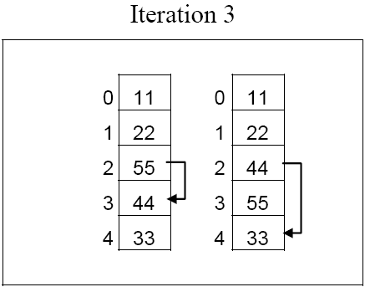
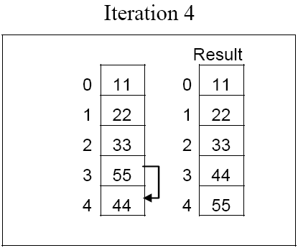
Selection sort

Slide 8
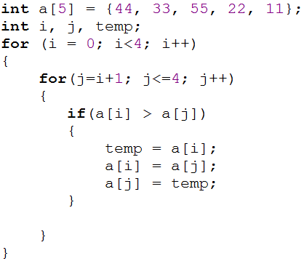
C program – Selection sort
0
1
2
3
4
44
33
55
22
11
i = 0
j = 1
if ( 44 > 33)
true
0
1
2
3
4
33
44
55
22
11
j = 2
if ( 33 > 55)
false
j = 3
if ( 33 > 22)
true
0
1
2
3
4
22
44
55
33
11
j = 4
if ( 22 > 11)
true
0
1
2
3
4
11
44
55
33
22

Slide 9
Cont.
0
1
2
3
4
11
44
55
33
22
i = 1
j = 2
if ( 44 > 55)
false
j = 3
if ( 44 > 33)
true
0
1
2
3
4
11
33
55
44
22
j = 4
if ( 33 > 22)
true
0
1
2
3
4
11
22
55
44
33

Slide 10
Cont..
0
1
2
3
4
11
22
55
44
33
i = 2
j = 3
if ( 55> 44)
true
0
1
2
3
4
11
22
44
55
33
j = 4
if ( 44 > 33)
true
0
1
2
3
4
11
22
33
55
44

Slide 11
Cont…
0
1
2
3
4
11
22
33
55
44
i = 3
j = 4
if ( 55 > 44)
true
0
1
2
3
4
11
22
33
44
55
Go to program

Slide 12
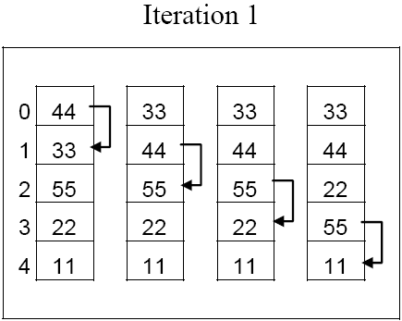
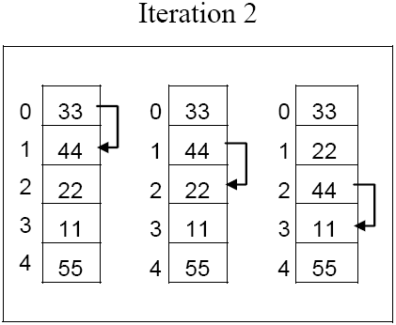
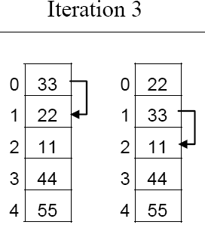
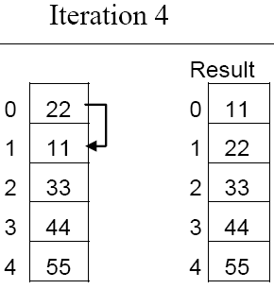
Bubble sort

Slide 13
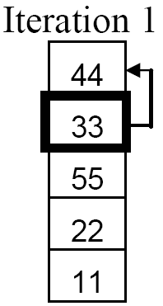
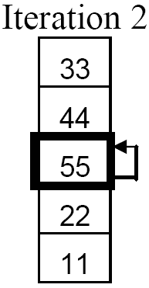
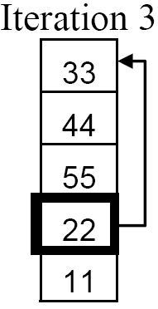
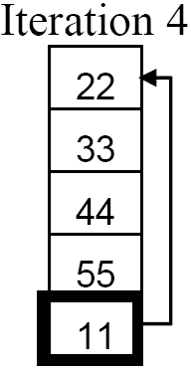
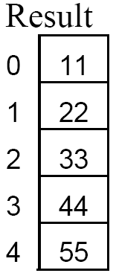
Insertion sort

Slide 14
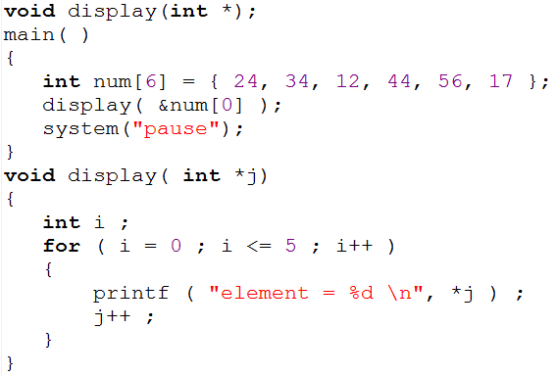
Passing array to a function
0
1
2
3
4
5
24
34
12
44
56
17
500
504
508
512
516
520
*j
504
500
524
512
520
516
508
5
1
6
0
3
i
2
Program output
4
element = 24
element = 34
element = 12
Go to program
element = 44
element = 56
element = 17

Slide 15
Example functions
void display(int *p, int size);
void sort_ascending (int *p, int size);
void sort_descending (int *p, int size);

Slide 16
Array and pointer
int num[ ] = { 24, 34, 12, 44, 56, 17 } ;
Mentioning the name of the array we get its base address
by saying *num we would be able to refer to the zeroth element of the array,
*num and *( num + 0 ) both refer to 24
0
1
2
3
4
5
24
34
12
44
56
17
500
504
508
512
516
520
that is num → 500
that is, *(500) = 24

Slide 17
Cont.
*( num + 1 ) refer the first element of the array
This means that all the following notations are same
    num[i]
    *( num + i )
    *( i + num )
Go to program

Slide 18
Two Dimensional Arrays
It is also possible for arrays to have two or more dimensions
For example you want to input roll no and mark of 4 students.
Since we know 1D array, so for this problem we can have two 1D array
  One for roll number
  Second for marks
One 2D array can be used to store these values

Slide 19
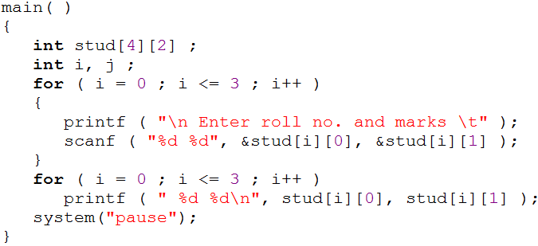
Example program
row
column
0
1
0
10
85
1
12
65
stud[3][1]
stud[2][1]
stud[0][1]
stud[2][0]
stud[1][1]
stud[3][0]
stud[0][0]
stud[1][0]
2
13
89
3
14
92
Go to program
Roll Number
Marks

Slide 20
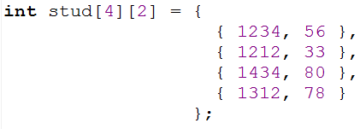
Initializing a 2-Dimensional Array

Slide 21
Example program
Write a program that adds two 4 x 4 matrices.
3 | 5 | 6 | 1
5 | 3 | 2 | 9
1 | 0 | -3 | 4
7 | 2 | 3 | -9
4 | 2 | -7 | 0
5 | 7 | 3 | 1
6 | 3 | -1 | 0
8 | 9 | -2 | 3
7 | 7 | -1 | 1
10 | 10 | 5 | 10
7 | 3 | -4 | 4
15 | 11 | 1 | -6
+
=
Write a program

