Slide 1
CSC103: Introduction to Computer and Programming
Lecture No 18

Slide 2
Previous lecture
Recursive functions
Introduction to Array
Accessing elements of array
A simple array program

Slide 3
Today’s lecture outline
A program to calculate percentage marks
Array initialization
Bound checking
Passing array element to a function
Pointer arithmetic

Slide 4
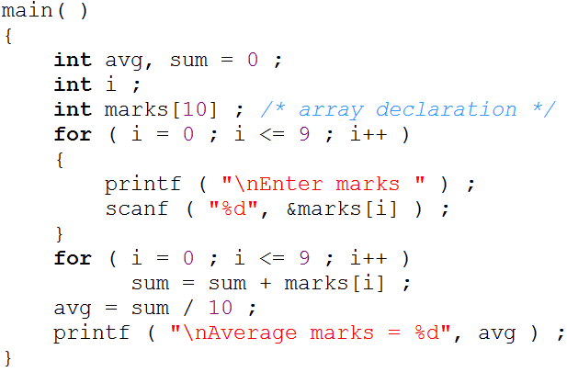
Marks program
Go to program

Slide 5
Value and address of array elements
Write a program

Slide 6
Array initialization

Slide 7

Bounds Checking
In C there is no check to see if the subscript used for an array exceeds the size of the array
Data entered with a subscript exceeding the array size will simply be placed in memory outside the array
To see to it that we do not reach beyond the array size is entirely the programmer’s botheration and not the compiler’s
0
1
2
3
4
5
6
7
8
9
500
504
508
512
516
520
524
528
532
530

Slide 8
Passing Array Elements to a Function
Array elements can be passed to a function by calling the function by value, or by address
In the call by value we pass values of array elements to the function
In the call by reference we pass addresses of array elements to the function

Slide 9
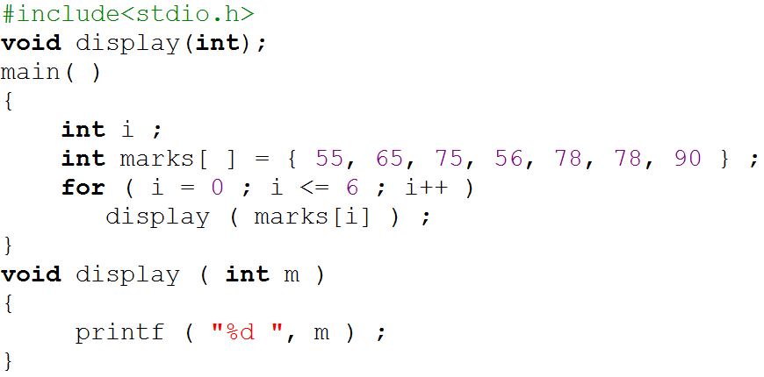
Value of array element pass to a function
0
1
2
3
4
5
6
55
65
75
56
78
78
90
500
504
508
512
516
520
524
i = 0
i = 2
i = 3
i = 1
i =4
i = 5
i = 6
i = 7
display(marks[6])
display(90)
display(marks[2])
display(75)
display(marks[5])
display(78)
display(marks[3])
display(56)
display(marks[4])
display(78)
display(marks[o])
display(55)
display(marks[1])
display(65)
Program output
55
65
75
56
78
78
90

Slide 10
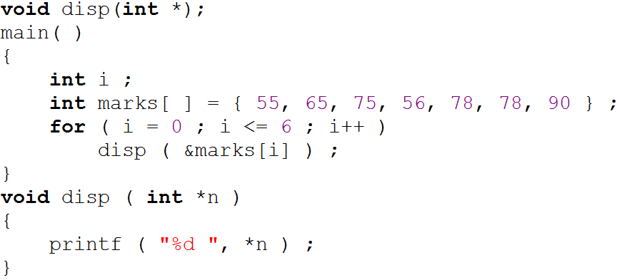
Address of array element pass to a function
0
1
2
3
4
5
6
55
65
75
56
78
78
90
500
504
508
512
516
520
524
i = 0
i = 2
i = 3
i = 1
i =4
i = 5
i = 6
i = 7
display(&marks[4])
display(516)
display(&marks[2])
display(508)
display(&marks[3])
display(512)
display(&marks[1])
display(504)
display(&marks[5])
display(520)
display(&marks[6])
display(524)
display(&marks[o])
display(500)
Program output
55
*n
*n
*n
*n
*n
512
*n
520
*n
524
516
504
508
65
500
75
*(512) = 56
*(520) = 78
*(524) = 90
*(516) = 78
*(504) = 65
*(508) = 75
*(500) = 55
56
78
78
90

Slide 11
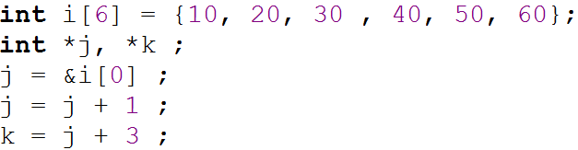
Pointer arithmetic
Addition of a number to a pointer
*j
504
*k
516
500
*j → 10
j → 500
0
1
2
3
4
5
10
20
30
40
50
60
500
504
508
512
516
520

Slide 12
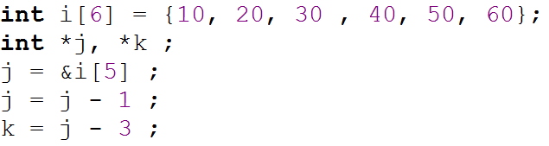
Cont.
Subtraction of a number from a pointer
*j
520
*k
504
516
0
1
2
3
4
5
10
20
30
40
50
60
500
504
508
512
516
520

Slide 13
Cont.
Subtraction of one pointer from another
    One pointer variable can be subtracted from another provided both variables point to elements of the same array
    The resulting value indicates the number of bytes separating the corresponding array elements

Slide 14
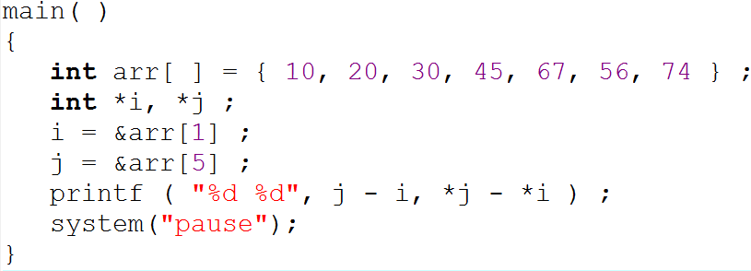
Cont.
Go to program
*i
504
*j
520
0
1
2
3
4
5
6
10
20
30
45
67
56
74
500
504
508
512
516
520
524

Slide 15
Cont.
Comparison of two pointer variables
    Pointer variables can be compared provided both variables point to elements of the same data type
Go to program

Slide 16
Caution
Following would not work
  Addition of two pointers
  Multiplication of a pointer with a constant
  Division of a pointer with a constant

Slide 17
Points to remember
Array elements are always stored in contiguous memory locations.
A pointer when incremented always points to an immediately next location of its type
A pointer when decremented always points to the immediate previous location of its type
Comparison between pointers can test for either equality or inequality

Slide 18
Display array value using pointer
Method of accessing array elements by using subscripted variables is already known to us
Now let see how we can access the array elements using a pointer.
Write a program

