Slide 1
CSC103: Introduction to Computer and Programming
Lecture No 17

Slide 2
Previous lecture
Function call by address or pointer
Function return value
Use pointers to get results in calling function from called function

Slide 3
Today’s lecture outline
Recursive functions
Introduction to Array
Accessing elements of array
A simple array program
Write a program

Slide 4
Recursive function
In C, it is possible for the functions to call themselves
A function is called ‘recursive’ if a statement within the body of a function calls the same function

Slide 5
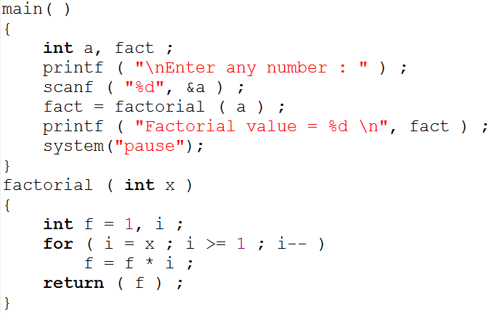
Example program - factorial
Go to program

Slide 6
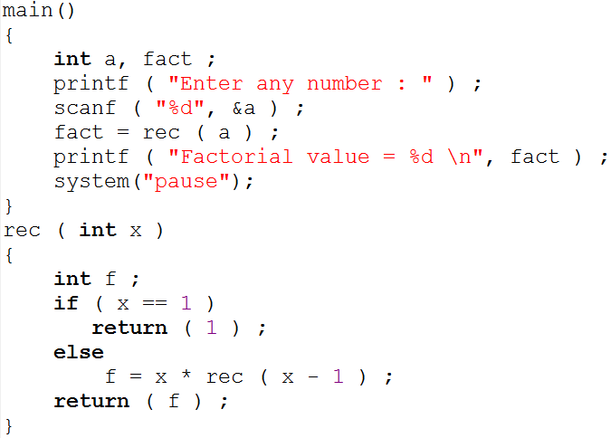
Example program – factorial using recursion
Go to program

Slide 7
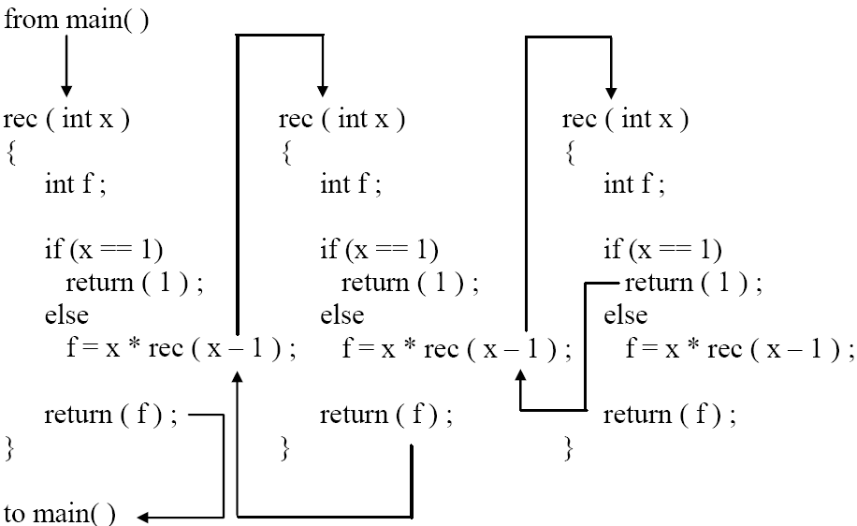
Cont.

Slide 8
Cont.
main()
{
….
….
fact = rec(3);
printf ( "%d ", fact);
}
rec ( 3 )
{
int f ;
if ( 3 == 1 )
return ( 1 ) ;
else
f = 3 * rec ( 3 - 1 ) ;
return ( f ) ;
}
rec ( 2 )
{
int f ;
if ( 2 == 1 )
return ( 1 ) ;
else
f = 2 * rec ( 2 - 1 ) ;
return ( f ) ;
}
false
false
rec ( 1 )
{
int f ;
if ( 1 == 1 )
return ( 1 ) ;
else
f = 2 * rec ( 2 - 1 ) ;
return ( f ) ;
}
f = 3 * 2;
f = 6
f = 2 * 1;
f = 2
true
fact = 6
Go to program

Slide 9
Example program 2
Write a definition of a function that adds n integers using recursion and then return the sum. Prototype of the function is below
  int sum_number(int);
Write a program

Slide 10
Array
Offers a simple way of grouping like variables for easy access
It is a group of elements having same data type
An array is a collective name given to a group of ‘similar quantities’
Arrays in C share a few common attributes
    Variables in an array share the same name
    Variables in an array share the same data type
    Individual variables in an array are called elements
    Elements in an array are accessed with an index number

Slide 11
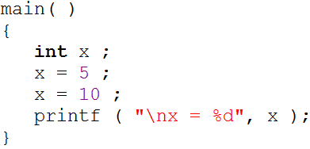
Cont.
Ordinary variables are capable of holding only one value at a time
There are situations in which we would want to store more than one value at a time in a single variable

Slide 12
Cont.
For example, suppose we want to arrange the percentage marks obtained by 100 students in ascending order
In such a case we have two options to store these marks in memory:
    Declare 100 variables to store percentage marks obtained by 100 different students, i.e. each variable containing marks of single student
    int m1, m2, m3 ……… m100;
    Declare one variable (called array or subscripted variable) capable of storing or holding all the hundred values

Slide 13
Array declaration
int marks[10];
type
size
Array name
Like any other variable, arrays occupy memory space
marks [10]
Index of elements in array
0
1
2
3
4
5
6
7
8
9
500
504
508
512
516
520
524
528
532
530
Memory address of array elements

Slide 14
How to access array elements
int x;
int marks[10];
x= 2;
marks[0] = 2;
scanf(“%d”, &x);
marks[1] = 3;
printf(“x = %d”, x);
scanf (“%d”, &marks[2])
printf (“marks [2] = %d”, marks[2])
x
2
43
Output
x = 43
695
Output
marks [2] = 16
0
1
2
3
4
5
6
7
8
9
2
3
16
500
504
508
512
516
520
524
528
532
530

Slide 15
Points to remember
Array is a collection of elements having same data type
Memory allocate to array elements are continuous
Array size must be mentioned in array declaration ( int marks [10]; )
Array index always starts with 0
In 10 elements array, index of first elements is 0 and index of last element is 9
Array element can be access using array index

Slide 16
A Simple Program Using Array
Write a program that take 10 integer from user and then display those integers
Write a program

Slide 17
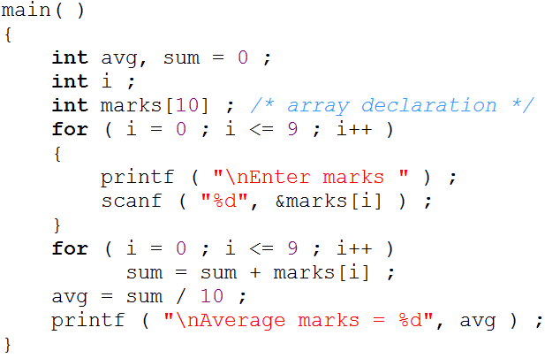
Marks program
Go to program

