Slide 1
CSC103: Introduction to Computer and Programming
Lecture No 14

Slide 2
Previous lecture
Introduction to structure programming
Function definition
Function call
Function prototype

Slide 3
Today’s lecture outline
Menu driven program using functions
Function call by value
Scope of variable
  Local
  Global

Slide 4
Menu driven program using functions
Menu is
  Factorial of a number
  Prime number
  Even or odd
  Exit
Write a program

Slide 5
Passing Values between Functions
The mechanism used to convey information to the function is the ‘argument’ or ‘parameter’
You have already used the arguments in the printf( ) and scanf( ) function
    the format string and the list of variables used inside the parentheses in these functions are arguments

Slide 6
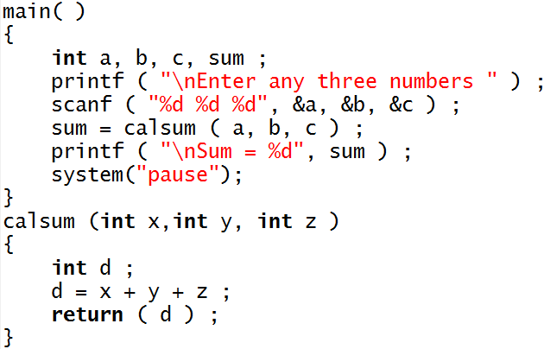
Example program
a
5
b
6
c
2
sum
13
Sum = 13
x
5
Program Output
y
6
Enter any three number:
5
6
2
z
2
Sum = 13
d
13
Go to program
Press any key to continue . . .

Slide 7
Points to remember
The variables a, b and c are called ‘actual arguments’, whereas the variables x, y and z are called ‘formal arguments’
Any number of arguments can be passed to a function being called. However, the type, order and number of the actual and formal arguments must always be same
The return statement serves two purposes
  On executing the return statement it immediately transfers the control back to the calling program
  It returns the value present in the parentheses after return, to th3e calling program

Slide 8
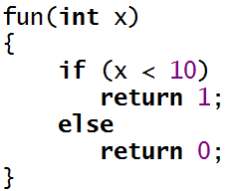

Cont.
There is no restriction on the number of return statements that may be present in a function.
The return value should be accepted in the calling function

Slide 9
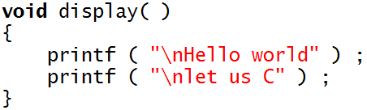

If called function should not return any value, the it must be mentioned by using the keyword void
A function can return only one value at a time. Thus, the following statements are invalid.

Slide 10
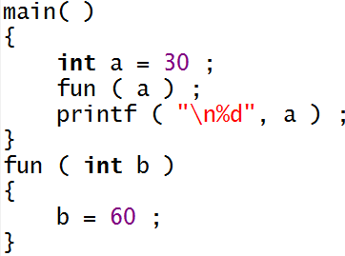
Cont.
If the value of a formal argument is changed in the called function, the corresponding change does not take place in the calling function. For example
a
30
b
60

Slide 11
Menu driven program using functions call by value
Menu is
  Factorial of a number
  Prime number
  Even or odd
  Exit
Write a program

Slide 12
Variable Scope
Variable scope identifies and determines the life span of any variable in any programming language
When a variable loses its scope, it means its data value is lost
Common types of variables scopes in C,
  local and
  global

Slide 13
Local Scope
You have unknowingly been using local scope variables
Scope of variable a, b, c and sum
Scope of variable x, y, z and d
Go to program

Slide 14
Global variable
Locally scoped variables can be reused in other functions without harming one another’s contents
You might want to share data between functions
To support the concept of sharing data, you can create and use global variables

Slide 15
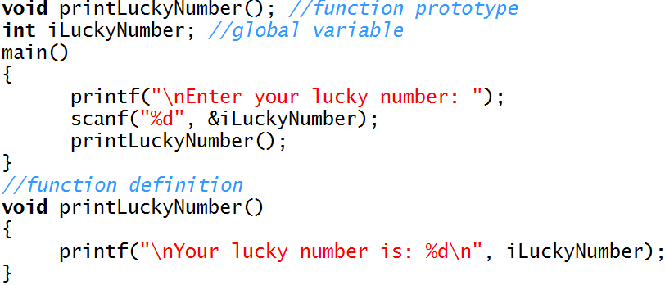
Example program
Write a program
iLuckyNumber
printLuckyNumber()
{
}
main()
{
}

Slide 16
Calling Convention
Calling convention indicates the order in which arguments are passed to a function when a function call is encountered
There are two possibilities here:
  Arguments might be passed from left to right.
  Arguments might be passed from right to left.
C language follows the second order
Consider the following function call:
    fun (a, b, c, d ) ;

Slide 17

Cont.
In some function call the order of passing arguments becomes an important
It appears that output is 1, 2, 3
Surprisingly, it outputs 3 3 1.

