Slide 1
CSC103: Introduction to Computer and Programming
Lecture No 13

Slide 2
Previous lecture
A menu driven program using
  if else
  switch case
Nested case control structure
  A calculator (add, subtract, multiply)
  Factorial, prime, even/odd

Slide 3
Today’s lecture outline
Introduction to structure programming
Function definition
Function call
Function prototype

Slide 4
Structured programming
It enables programmers to break complex systems into manageable components
In C, these components are known as functions
A function is a block of statements that perform a task
Every C program can be thought of as a collection of these functions

Slide 5
Structured programming concepts
Top-down design
Code reusability
Information hiding

Slide 6
Top-down design
To demonstrate let see ATM (Automated Teller Machine) as an example
Suppose your boss assigns you to program the software for a ATM system
Question for you is where to begin as it's a large task filled with complexities and many details

Slide 7
ATM example - Cont.
Top-down design helps you to design complex program
The following steps demonstrate the top-down design process
  Break the problem into small, manageable components, starting from the top.
  In C, the top component is the main() function from which other components are called

Slide 8
ATM example - Cont.
2. Identify all major components. For the ATM example, assume there are four major components:
    Display balance
    Deposit funds
    Transfer funds
    Withdraw funds
3. Decompose one major component at a time and make it more manageable and less complex

Slide 9
ATM example – Cont.
4. The withdraw funds component can be decomposed into following sub-components
Get available balance
Compare available balance to amount requested
Update customer’s account
Distribute approved funds
Reject request
Print receipt

Slide 10
ATM example – Cont.
5. Go even further with the decomposition process and divide the “distribute approved funds” component even smaller:
    Verify ATM funds exist
    Initiate mechanical processes
    Update bank records

Slide 11
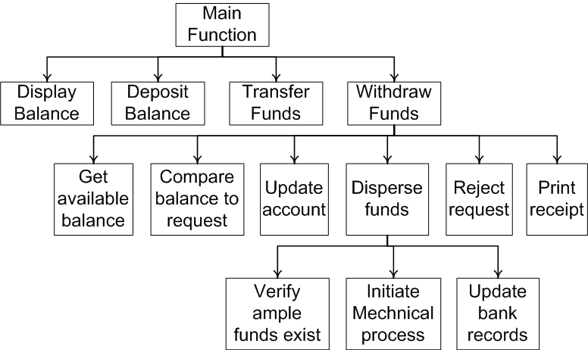
Decomposing ATM system—top-down design

Slide 12
C programming
main()
{
  ….
  ….
  DisplayBalance()
  ….
  ….
  ….
  ….
  ….
  TransferFunds()
  ….
  ….
}
DisplayBalance()
{
…..
…..
}
TransferFunds()
{
…..
…..
}

Slide 13
Cont.
main()
{
  ….
  ….
  printf(“Enter a No. ”);
  scanf(“%d”, &x);
  ….
  ….
  ….
  ….
  ….
  ….
}
printf( ….. )
{
…..
…..
}
scanf( …. )
{
…..
…..
}

Slide 14
Code Reusability
Code reusability is implemented as functions in C
Consider the following list of components and subcomponents from the ATM example in the previous section
  Get available balance
  Compare available balance to amount requested
  Update customer’s account
  Distribute approved funds
  Reject request
  Print receipt

Slide 15
Cont.
A possible number of transactions a customer might perform at a single visit to an ATM
  Deposit money in account
  Transfer funds from his account to his other account
  Withdraw money from checking
  Print balance
  At least four occasions require to access the customer’s balance

Slide 16
Code reusability – other examples
printf(….) function
scanf(….) function
system function
  system(“pause”);
  system(“cls”);

Slide 17
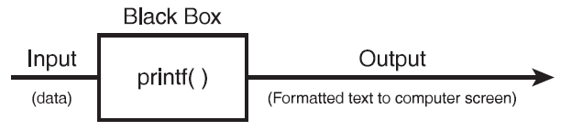
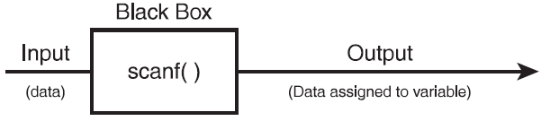
Information Hiding
Information hiding is a conceptual process by which programmers hide implementation details into functions
Functions can be seen as black boxes
Black box is simply a component that performs a task
You don't know how the black box performs the task
data
Formatted text to screen
data
Data assigned to variable

Slide 18
Function
A function is a self-contained block of statements that perform a task
Every C program can be thought of as a collection of these functions
using a function is like hiring a person to do a specific job
Sometimes the interaction with this person is very simple; sometimes it’s complex.
  Suppose task is always performed exactly in the same way e.g. bimonthly servicing of your motorbike

Slide 19
Function call and definition
main()
{
  message();
  printf(“Hello world \n”);
}
Function call
Waiting
message()
{
printf(“Message function \n”);
}
Function definition

Slide 20
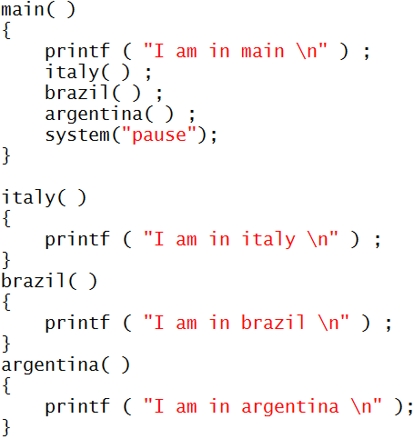
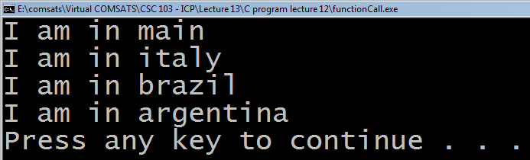
Example program 1
Go to program

Slide 21
Points to remember
C program must contains at least one function
Execution of C program begins with main() function.
If there are more than one function then one function must be main()
There is no limit on number of functions in C program
Functions in a program are called in sequence as mentioned in main() function
After the execution of function control returns to main()

Slide 22
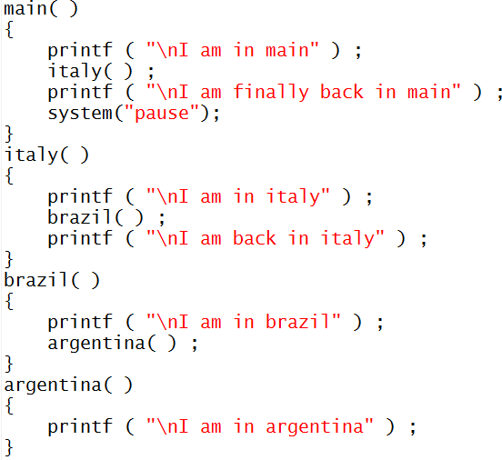
Example program 2
I am in main
I am in italy
I am in brazil
I am in argentina
I am back in italy
I am finally back in main
Press any key to continue

Slide 23
Function prototype
Function prototypes tell C how your function will be built and used
Function prototype contains following things about the function:
  The data type returned by the function
  The number of parameters received
  The data types of the parameters
  The order of the parameters

Slide 24

Cont.
It is not always necessary
  to send input as parameters to functions
  to have functions return values
In such case programmer mention that function are void of parameter and return value

Slide 25
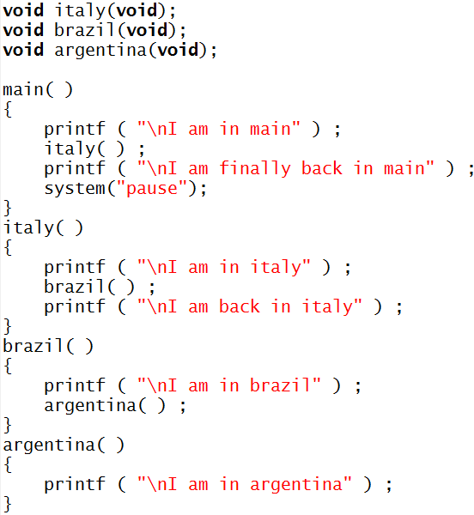
Complete program
Function prototype
Function call
Function definition

Slide 26

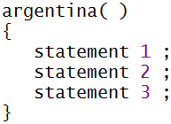
Important points
C program is a collection of one or more functions
A function gets called when the function name is followed by a semicolon. For example,
A function is defined when function name is followed by a pair of braces in which one or more statements may be present

Slide 27
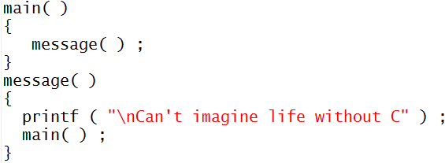
Cont.
Any function can be called from any other function. Even main( ) can be called from other functions. For example,

Slide 28
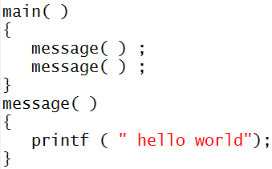
Cont.
A function can be called any number of times. For example

Slide 29
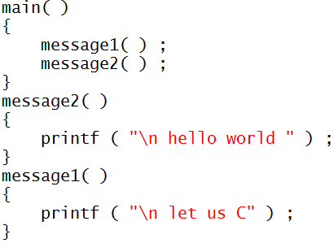
Cont.
The order in which the functions are defined in a program and the order in which they get called need not necessarily be same. For example,

Slide 30
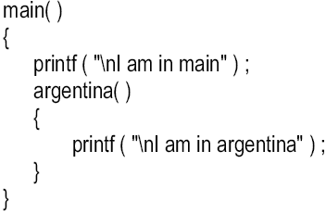
Cont.
A function can call itself. Such a process is called ‘recursion’
A function cannot be defined in another function
There are basically two type of functions
  Library functions Ex. printf( ), scanf( ) etc.
  User-defined functions Ex. argentina( ), brazil( ) etc.

