Slide 1
CSC103: Introduction to Computer and Programming
Dr. Malik Najmus Saqib
najam.malik@comsats.edu.com

Slide 2
Aim of Course
The course aim to provides knowledge about
  What is a computer system and how it works
  Flow charts
  Computer programming concepts and their implementation in C language

Slide 3
Course book
Text book
  Let us C by Yashavant P. Kanetkar
Reference books
  Waite Group’s Turbo C Programming for the PC, Robert Lafore
  C programming for absolute beginners, 2nd edition, Micheal Vine

Slide 4
Marks distribution
Assignments: 10%
Quizzes: 15%
Sessional exam 01: 10%
Sessional exam 02: 15%
Terminal Exam: 50%

Slide 5
Course contents
Introduction to Computer and Flow charts
Introduction to C programming language
Data types, variables, arithmetic Expression
Decision making: if- statement, if-else statement, nested if statements, switch statement, conditional operators
Loops: for-loop, while loop, do-while loop, break and continue statement
Arrays, Multidimensional arrays
User define Function: Function prototype, function call and function return type, recursive functions

Slide 6
Cont.
Structure, Arrays of structure
String (character array) string functions, Null string
Pointers: Pointer and structures, Pointer and functions, Pointer to functions Pointer and array, Pointer arithmetic
Bit wise operators
The preprocessor
Input /Output (I/O): File I/O (reading, writing, appending, modifying file content)
Dynamic memory allocation

Slide 7
Today’s lecture outline
Introduction to computers
  Various parts of computer system
  How computer works
  Various storage media and their structures
Computer software
  Operating system software
  Application software
Understanding computer operation

Slide 8
Introduction to Computers

Slide 9
What is a computer
Computer is an electronic device that
  operates under the control of instruction (software)
  accepts data (input)
  Manipulate data (process)
  Generates information (output)
Generally, the term is used to describe a collection of devices that function together as a system.

Slide 10
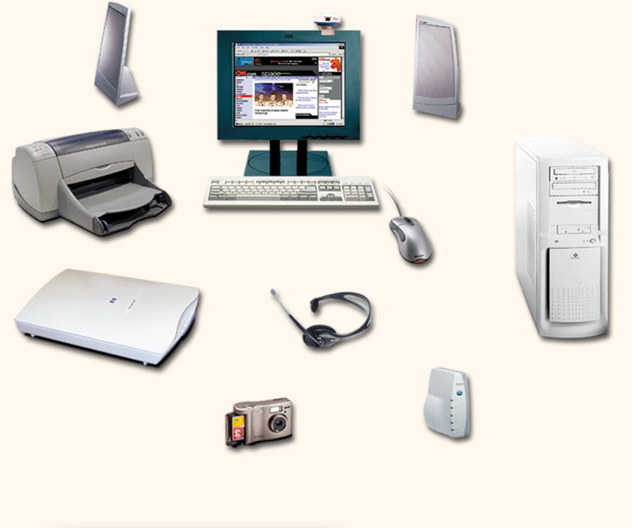
A computer system
Monitor (output)
Speaker (output)
System unit (processor, memory)
Printer (output)
Scanner (input)
Storage devices (CD-RW, Floppy, Hard disk)
Keyboard (input)
Mouse (input)
Modem

Slide 11
What task a computer perform
Computers can perform four general operations, which comprise the information processing cycle.
  Input
  Process
  Output
  Storage

Slide 12
Data vs. information
Computer processing requires data that is given to it during input phase
Data is a
  collection of raw facts, figures and symbols,
  e.g. numbers, words, images video and sound
Computers manipulate data to create information
Information is organized, meaningful and useful

Slide 13
Cont.
During the output phase, the information is displayed or printed for the user.
The information can also be put in computer storage for future use.

Slide 14
Why is computer so powerful?
Computers are
  able to perform information processing cycle with amazing speed.
  reliable (low failure rate)
  accurate
  able to store huge amounts of data and information
  able to communicate with other computers

Slide 15
How Computer knows what to do?
It must be given a list of instructions, called a compute program or software, that tells it exactly what to do
Before processing a specific job, the computer program corresponding to that job must be stored in memory
Once the program is stored in memory the computer can start the operation by executing the program instructions one after the other

Slide 16
Primary components of Computer
Input devices
Central Processing Unit (containing the control unit and the arithmetic/logic unit)
Memory
Output devices
Storage devices

Slide 17
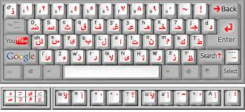
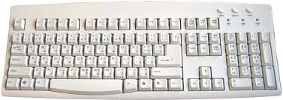
Input devices
Keyboard
  Using keyboard data is input by user manually keying in or typing certain keys
  A keyboard typically has 101 or 105 keys

Slide 18
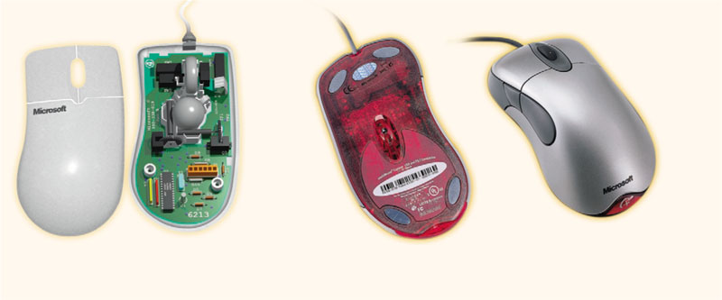
Input devices (Cont.)
Mouse
  Mouse is a pointing device which is used to control the movement of a mouse pointer on the screen and to make selections from the screen
  Mouse has one to five buttons
  The bottom of mouse is flat and contains a mechanism that detects movement of the mouse

Slide 19
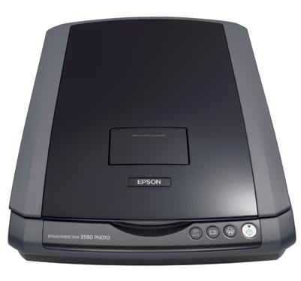
Input devices (Cont..)
Scanner
  Scans documents such as photographs and pages of text. When a document is scanned, it is converted into a digital format.
  Creates an electronic version of the document that can be viewed and edited on a computer.

Slide 20
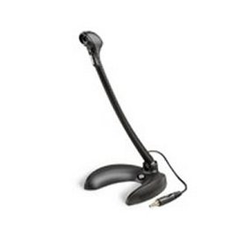
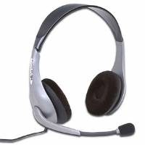
Input devices (Cont…)
Microphone
  an instrument capable of transforming sound waves into changes in electric currents or voltage, used in recording or transmitting sound.

Slide 21
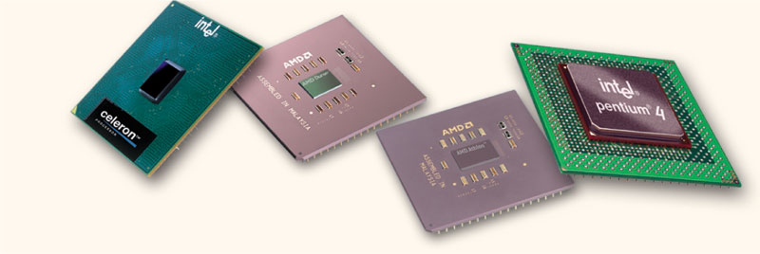
Central Processing Unit (CPU)
CPU contains electronic circuits that cause processing to occur.
The CPU interprets instructions to the computer, performs the logical and arithmetic processing operations
It causes the input and output operations to occur

Slide 22
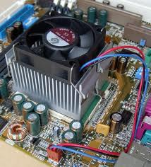
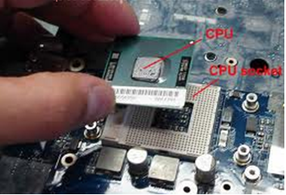
CPU on mother board
Image 1
Image 2

Slide 23
Parts of CPU
CPU consists of two parts
  Arithmetic logic unit (ALU)
  Control unit (CU)
Both contains register or high speed storage area

Slide 24
Parts of CPU (Cont.)
Arithmetic logic unit
  The ALU performs arithmetic and logical operations.
Control unit
  Translates each instruction and then carries out the instruction
  Directs electronic signals between memory and ALU and also between memory and Input and Output devices.

Slide 25
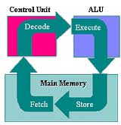
Machine cycle
Each time the CPU executes an instruction, it takes a series of steps. The complete series of steps is called a machine cycle
It consists of 4 basic operations for every instruction
Fetch an instruction
Decode an instruction
Execute the instruction
Stores the result

Slide 26
Machine cycle (cont.)
Fetch an instruction
Before the CPU can execute an instruction, the control unit must retrieve or fetch a command or data from the computer's memory
Decode an instruction
Before a command can be executed, the control unit must translate the command into instruction set.
Execute the instruction
Executing the instruction
Stores the result
The CPU may be required to store the result of an instruction in memory

Slide 27
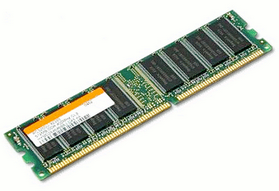
RAM
Random Access Memory (RAM) is the main memory of the computer.
It consists of electronic components that store data including numbers, letters of the alphabet, graphics and sound.
Any information stored in RAM is lost when the computer is turned off.

Slide 28
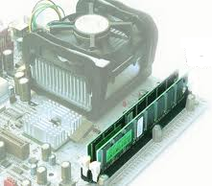
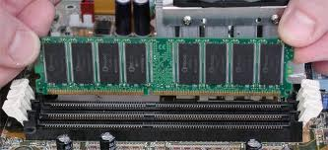
RAM on motherboard
Image 1
Image 2

Slide 29
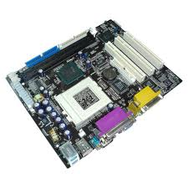
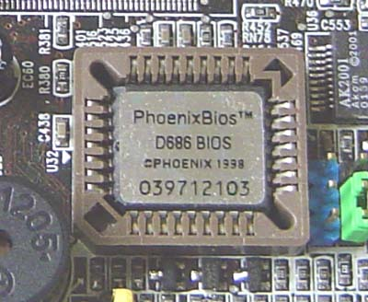
Read only memory (ROM)
Read Only Memory or ROM is memory that is attached on a chip that has start-up directions for your computer.
It is permanent memory

Slide 30
Amount of RAM in computer
It is measured in kilobytes or megabytes
One kilobyte (KB) equals approximately 1,000 memory locations and one megabyte (M or MB) equals approximately one million locations
A memory location, or byte, usually stores one character
Computer with 8 MB of memory can store approximately 8 million characters
One megabyte can hold approximately 500 pages of text information

Slide 31
Cache
It is temporary storage for instructions and data for processor
Usually has two level
  Level 1 (L1) cache - built into the microprocessor, capacities range from 8 to 256 kilobytes.
  Level 2 (L2) cache – it lies outside microprocessor and ranges from 64 kilobytes to 2 megabytes.
Cache is not upgradeable; it is set by the type of processor purchased with the system

Slide 32
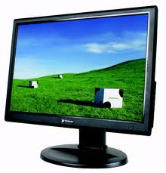
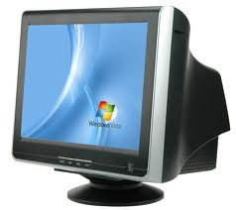
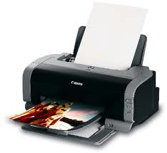
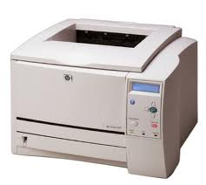
Output devices
Output devices make the information available for use
Two output devices more commonly used are the printer and the computer screen
Printer produces a hard copy of your output
Computer screen produces a soft copy of your output

Slide 33
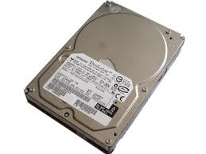
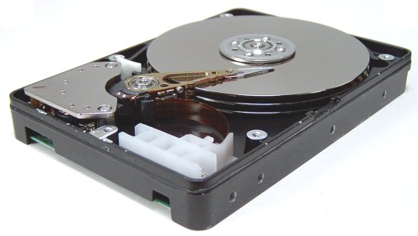
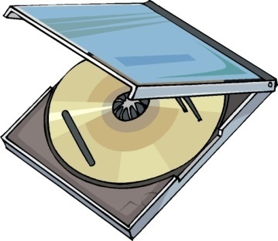
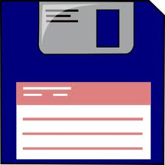
Storage devices
These devices are used to store data when they are not being used in memory.
The most common types of auxiliary storage used on personal computers are floppy disks, hard disks and CD, DVD etc.
Hard disk
CD or DVD
Floppy disk

Slide 34
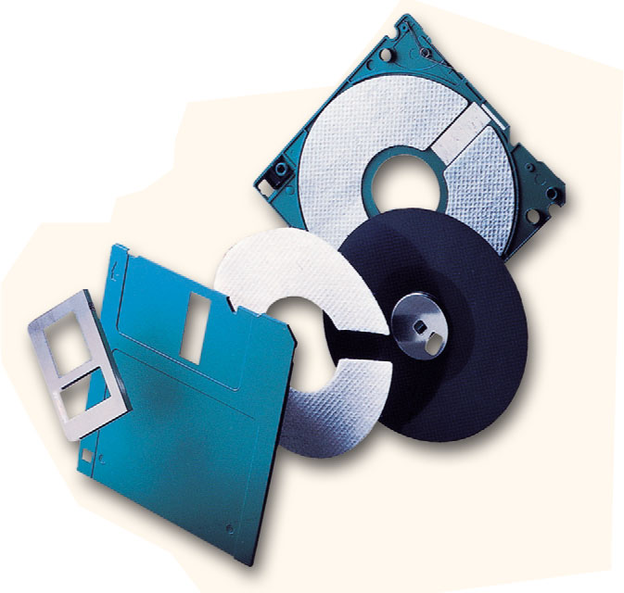
Floppy Disks
A floppy disk is a portable, inexpensive storage medium
It consists of a thin, circular, flexible plastic disk with a magnetic coating enclosed in a square-shaped plastic shell.
Plastic disk
Plastic disk

Slide 35
Hard disk
It consists of one or more rigid metal plates coated with a metal oxide material allows data to be magnetically recorded on the surface of plates.
The hard disk plate spin at a high rate of speed, typically 5400 to 7200 revolutions per minute (RPM).
Storage capacities of hard disks for personal computers range from 10 GB to 120 GB (one billion bytes are called a gigabyte).

Slide 36
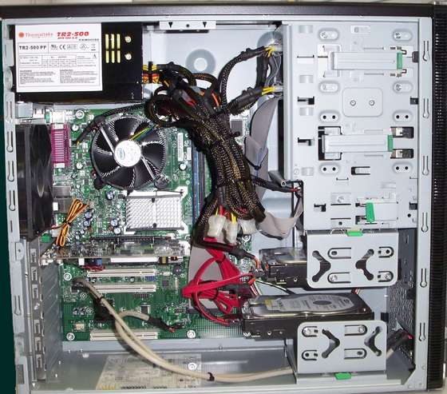
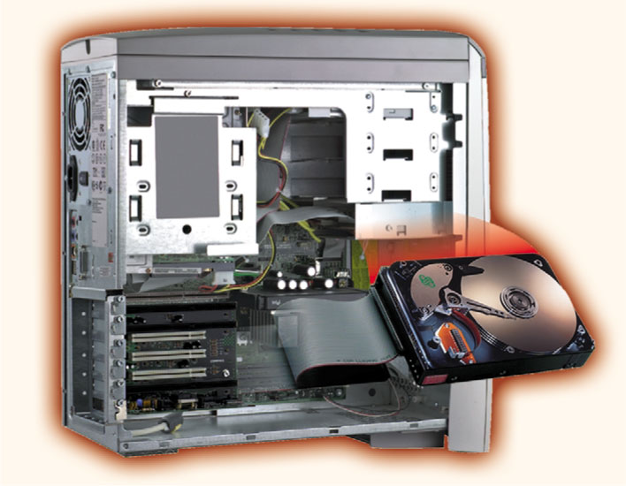
Hard disk in computer system
Image 1
Image 2

Slide 37
Compact Discs
A compact disk (CD), also called an optical disc, is a flat round, portable storage medium that is usually 4.75 inch in diameter.
A CD-ROM (read only memory), is a compact disc that used the laser technology for recording music. In addition it can contain other types of data such as text, graphics, and video.
The capacity of a CD-ROM is 650 MB of data.

Slide 38
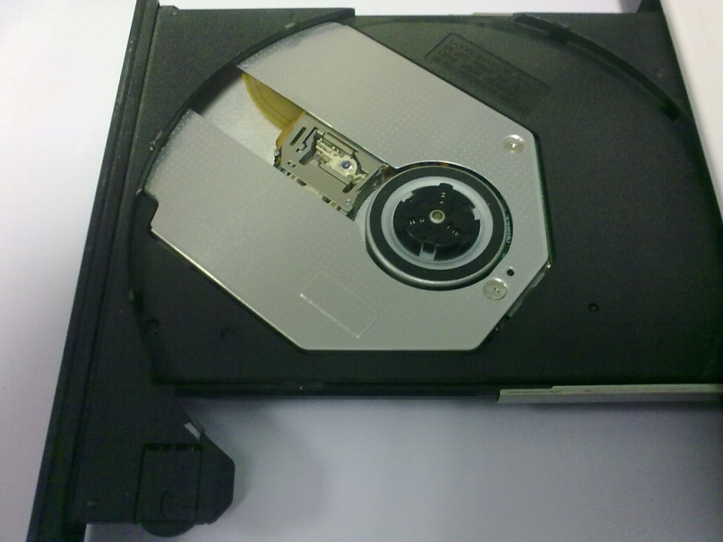
Structure of CD
A CD-ROM Drive uses a small plastic-encapsulated disk that can store data
This information is retrieved using a Laser Beam
A CD can store vast amounts of information because it uses light to record data in a tightly packed form
Laser lens
Drive motor

Slide 39
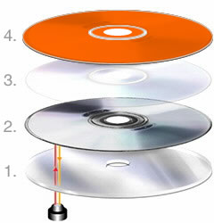
CD Layers
The thickness of a CD can vary between 1.1 and 1.5mm
A CD consists of four layers
  The biggest part is clear polycarbonate (nominally 1.2mm)
  There is a very thin layer of reflective metal (usually aluminum) on top of the polycarbonate
  Then a thin layer of some protective material covering the reflective metal
  A label or some screened lettering on top of protective material

Slide 40
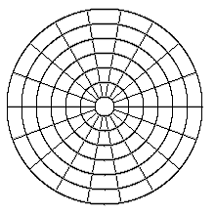
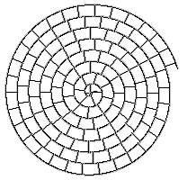
CD vs. Magnetic Media
In Magnetic Media (like floppy/hard disk) the surface is arranged into concentric circles called “tracks”
Number of sectors per track is constant for all tracks
CD has one single track, starts at the center of the disk and spirals out to the circumference of the disk
This track is divided into sectors of equal size

Slide 41
How CD drive works
Information is recorded on a CD using a series of bumps
These bumps are called “pits” because they are looking like pits in the polycarbonate layer
The unmarked areas between pits are called "lands”
Lands are flat surface areas
The information is stored as pits and lands on the CD-ROM.
It cannot be changed once the CD-ROM is mastered, this is why its called CD-ROM

Slide 42
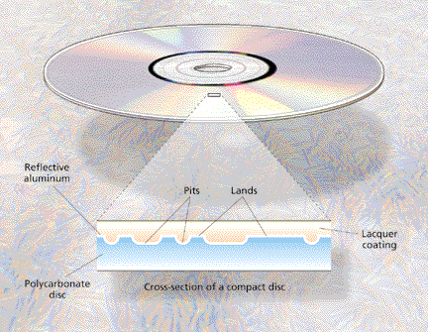
Cont.

Slide 43
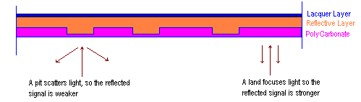
Cont..
A laser beam is thrown on the surface of the disk
The light is scattered by the pits and reflected by the lands, these two variations encode the binary 0's and 1's
A light sensitive diode picks up the reflected laser light and converts the light to digital data

Slide 44
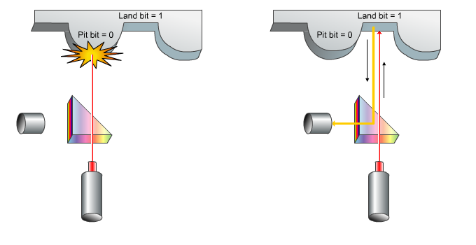
Cont…

Slide 45
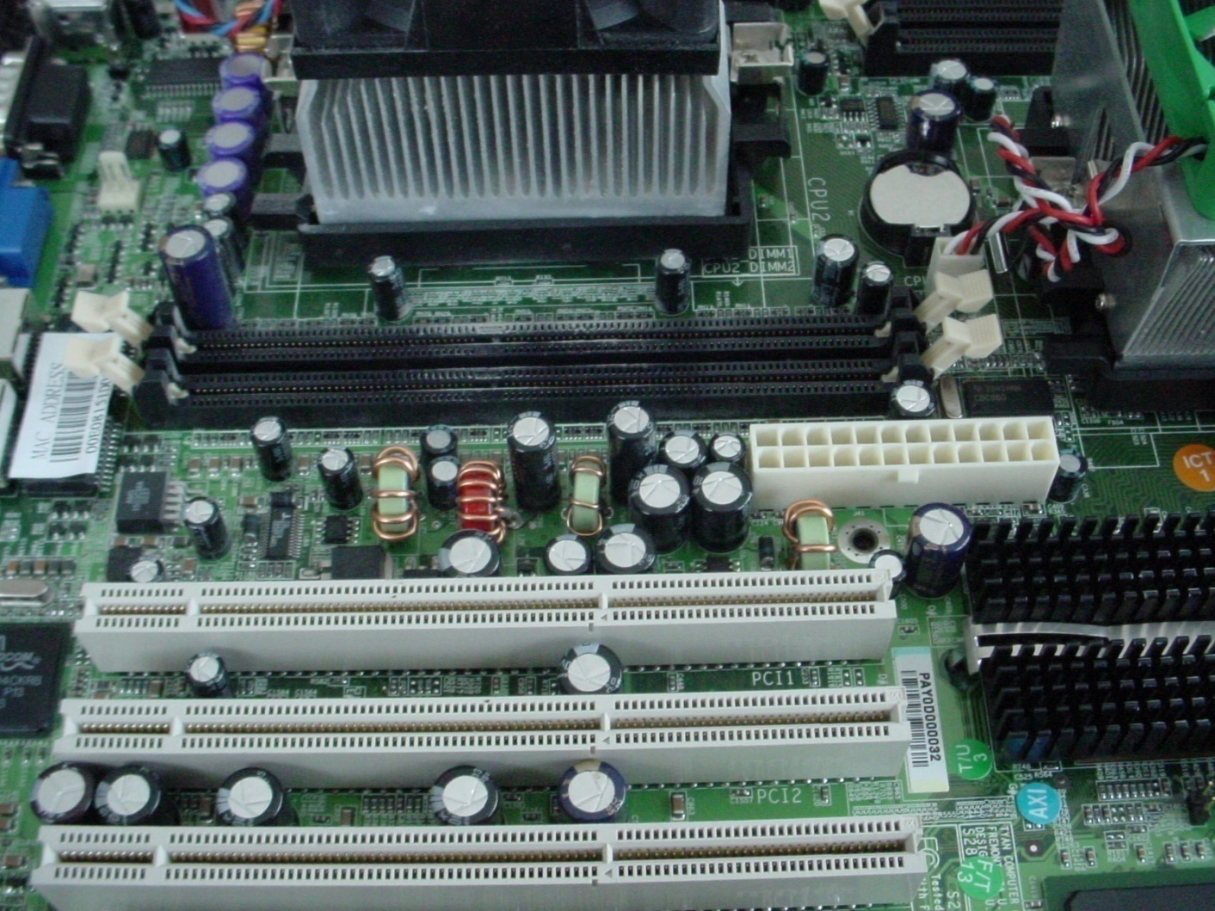
The Motherboard

Slide 46
Cont.
Your computer couldn’t work without the motherboard.
It ties everything together!
It allows every part of your computer to receive power and communicate with each other.
Everything that runs the computer or enhances it’s performance is either part of the motherboard or plugs into one of its expansion slots or ports.

Slide 47
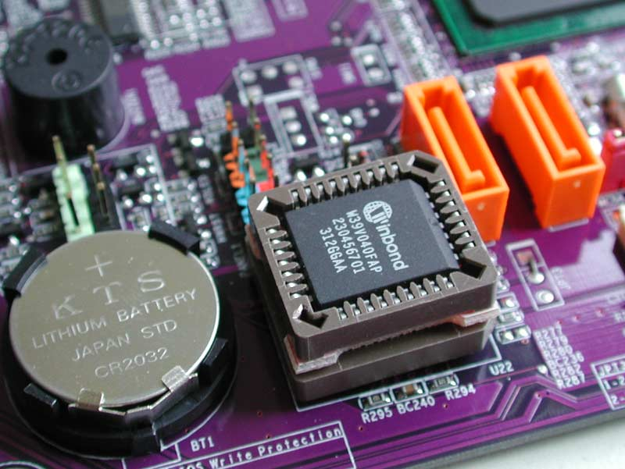
BIOS CHIP
A BIOS chip (Basic Input Output System) is a very important computer component.
In simple terms, the BIOS chip wakes up the computer when you turn it on and reminds it what parts it has and what they do!

Slide 48
Unit of memory
Byte 8 Bits = 1 byte
KB Kilobyte = 1,000 bytes
MB Megabyte = 1,000,000
(1 million) bytes
GB Gigabyte = 1,000,000,000
(1 billion) bytes

Slide 49
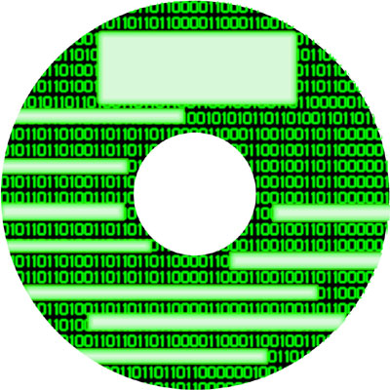
what’s a Byte??
All the information that moves through your computer is based on 2 commands.
That’s all, just two. The two commands are ON and OFF. They are symbolized by 1’s and 0’s.

Slide 50
Cont.
The memory chips in your computer are divided into thousands of tiny compartments called bits.
Each and every bit has an electronic switch, or gate.
ON means the gate is open and letting electricity through.

Slide 51
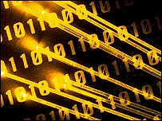
Cont..
The computer reads ON or open bits or switches as the number 1.
Closed switches are OFF because electricity can’t get through.
The computer reads OFF bits or switches as 0.
8 such kind of switches
make a byte

Slide 52
Cont…
In that group of 8 bits, there are 256 possible combinations of 1s and 0s.
The grouping of 1/0 within a byte is called Binary Code. E.g. 11010101
Binary Code is the language of computers.

Slide 53
How to make combinations
Suppose you have 2 bits
How many possible combinations you can make using two bits
Answer is 2² = 4
Therefore if we have
8 bits then
2⁸ = 256
A
B
1
2
3
4
0
0
0
1
1
0
1
1

Slide 54
Example of Binary Code
When you type in the letter A on your keyboard, What happens?
Electrical signals are sent from the keyboard to the CPU.
The CPU turns the signals into a Binary Code.
Then CPU sends binary code on to the monitor to display the letter A.
All of that happens in an instant!

Slide 55
Megabytes and Gigabytes
One megabyte equals one million bytes.
A computer with 512 megabytes of RAM (Random Access Memory) means the computer can handle 512,000,000
(512 million) bytes of RAM.
Hard disk space is also measured in bytes.
A 200 GB Hard Disk Drive has 200,000,000,000 (200 billion) bytes for storing memory!

Slide 56
Cont.
To get an idea of how much on/off (1/0) data a computer can store, imagine pressing any key 1 billion times. How long would it take?

Slide 57
Cont..
You would have to press a key 5 times a second non-stop for over 6 YEARS to reach 1 billion keystrokes.
One billion keystrokes equals just
1 GB of memory!
Think about that the next time you think a webpage is loading too slowly!

Slide 58
Computer Software
Computer software is the key to productive use of computers. Software can be categorized into two types:
  Operating system software
  Application software

Slide 59
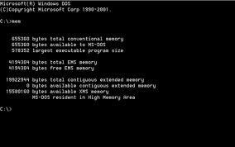
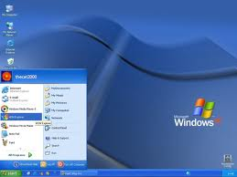
Operating System Software
Operating system software tells the computer
  how to perform the functions of loading, storing and executing an application and
  how to transfer data
Nowadays, computers use an operating system that has a graphical user interface (GUI)

Slide 60
Cont.
GUI provides visual clues such as icon symbols to help the user.
Microsoft Windows XP, Vista and 7 are widely used graphical operating system.
DOS (Disk Operating System) is an older

Slide 61
Application software
Application Software consists of programs that tell a computer how to produce information.
Some of the more commonly used packages are:
  Word processing
  Electronic spreadsheet
  Database
  Presentation graphics

Slide 62
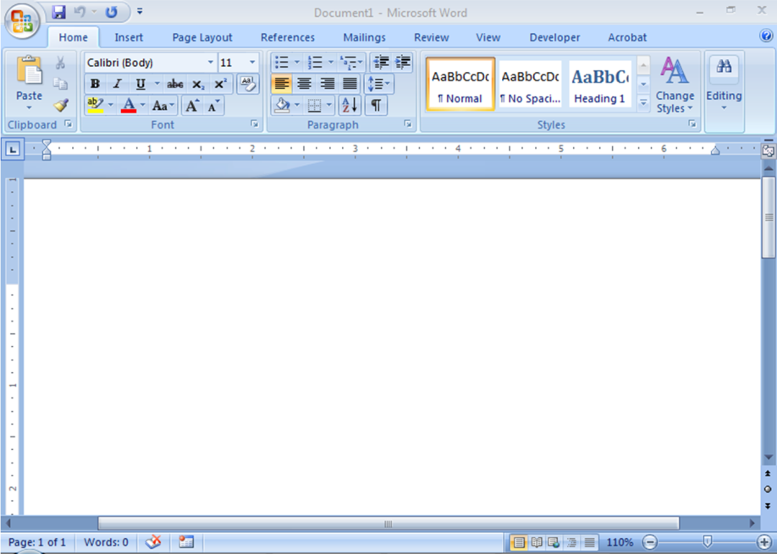
Word Processing
Word Processing software is used to create and print documents.
A key advantage of word processing software is that users easily can make changes in documents.

Slide 63
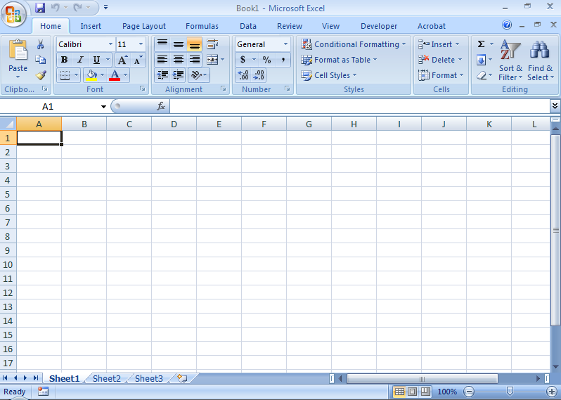
Electronic Spreadsheets
Electronic spreadsheet software allows the user to add, subtract, and perform user-defined calculations on rows and columns of numbers.

Slide 64
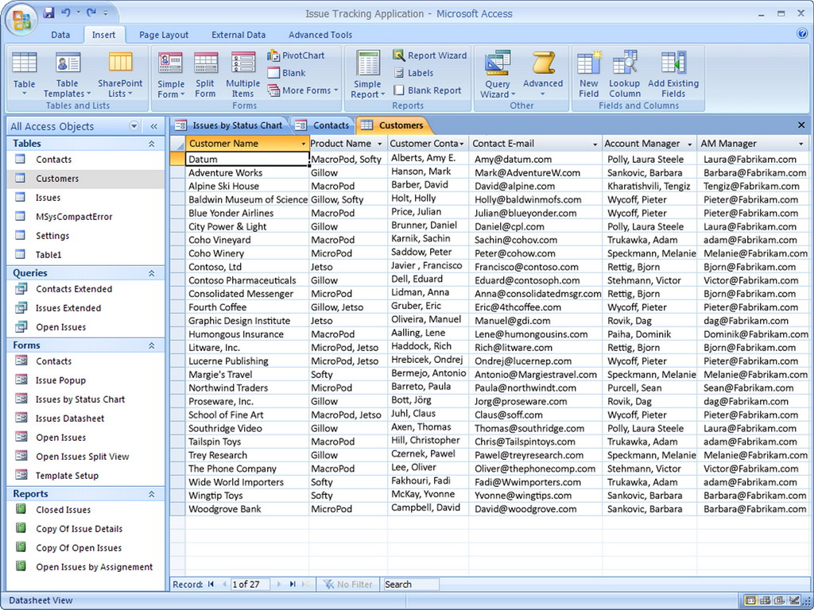
Database Software
Allows the user to enter, retrieve, and update data in an organized and efficient manner, with flexible inquiry and reporting capabilities.

Slide 65
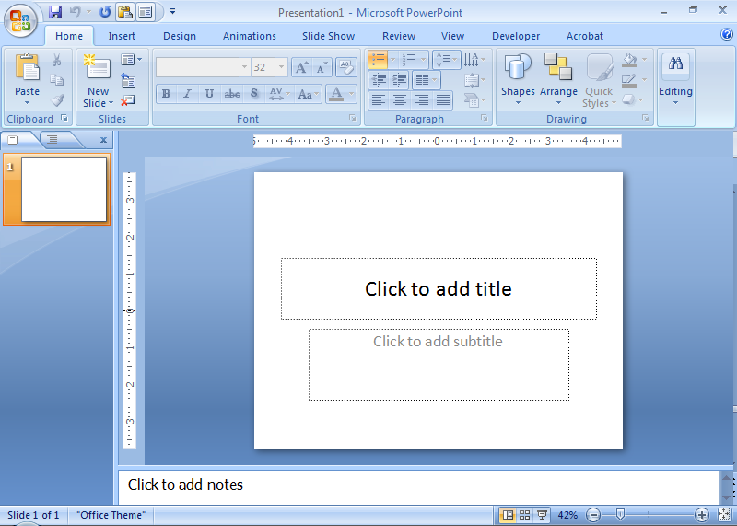
Presentation software
Presentation graphic software allows the user to create documents called slides to be used in making the presentations.
Using special projection devices, the slides display as they appear on the computer screen.

Slide 66
Computer Components and Operations
Input devices: allow data to enter the computer
  Mouse, keyboard, scanner
Processing: working on the data; such as:
  Organizing data
  Checking data for accuracy
  Mathematical or other manipulations on data
Central Processing Unit (CPU): hardware that performs the tasks

Slide 67
Cont.
Output devices: provide data to the user
  Printer, monitor, speakers
Programming language: special language containing instructions for the computer
  Visual Basic, Java, C , C#, C++, COBOL
Syntax: the rules governing word usage and punctuation in the language
Machine language: a language that controls the computer’s on/off circuitry
Compiler or interpreter: software that translates programming languages to machine language

Slide 68
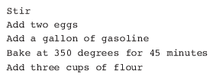
Understanding Computer Operations
A program must be free of syntax errors to be run, or executed, on a computer
To function properly, the logic must be correct
What’s wrong with this logic for making a cake?

Slide 69

Understanding Computer Operations
Logic errors, or semantic errors, are more difficult to locate than syntax errors
Logic for multiplying a number by 2 (includes input, processing and output statements)

Slide 70
Logic Building
Logic is very important in programming
Consider the following procedure of washing clothes using a washing machine
  Put the clothes in the washtub
  Pour water.
  Pour detergent powder.
  Switch on the washing machine.
  Set the timer and wait for a few minutes.
  Drain the water out.
  End.
This procedure gets the work done

Slide 71
Cont.
Now, suppose the same steps are performed in a slightly different order
  Put the clothes in the washtub.
  Switch on the washing machine.
  Set the timer and wait for a few minutes.
  Pour water.
  Pour detergent powder.
  Drain the water out.
  End.
In this case, your clothes may tear off, since you have switched on the washing machine before pouring water into it

