Slide 1
(CSC 102)
Discrete Structures
Lecture 7

Slide 2
Previous Lectures Summary
Predicates
Set Notation
Universal and Existential Statement
Translating between formal and informal language
Universal conditional Statements
Equivalence Form
Implicit Qualification
Negations

Slide 3
Predicates and Quantified statements II

Slide 4
Today's Lecture
Statements containing “∀ ” and “∃”
Nested Quantifiers
Relations
Universal Instantiation statement
Universal Modus Ponens
Universal Modus Tollens
Quantified form of Converse and Inverse error

Slide 5
Interpreting Multiply-Quantified Statements
A college cafeteria line has four stations: salads, main courses, desserts, and beverages. The salad station offers a choice of green salad or fruit salad; the main course station offers spaghetti or fish; the dessert station offers pie or cake; and the beverage station offers milk, soda, or coffee. Three students, Uta, Tim, and Yuen, go through the line and make the following choices:
Uta: green salad, spaghetti, pie, milk
Tim: fruit salad, fish, pie, cake, milk, coffee
Yuen: spaghetti, fish, pie, soda
These choices are illustrated in Figure

Slide 6
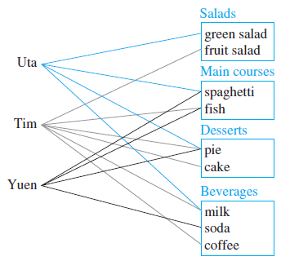
Interpreting Multiply-Quantified Statements
Write each of following statements informally and find its truth value.
a. ∃ an item I such that ∀ students S, S chose I .
b. ∃ a student S such that ∀ items I, S chose I .
c. ∃ a student S such that ∀ stations Z, ∃ an item I in Z such that S chose I .
d. ∀ students S and ∀ stations Z, ∃ an item I in Z such that S chose I .

Slide 7
Interpreting Multiply-Quantified Statements
Solution
There is an item that was chosen by every student. This is true; every student chose pie.
b. There is a student who chose every available item. This is false; no student chose all nine items.
c. There is a student who chose at least one item from every station. This is true; both Uta and Tim chose at least one item from every station.
d. Every student chose at least one item from every station. This is false; Yuen did not choose a salad.

Slide 8
Multiple Quantified Statements Informally
∀ positive numbers x, ∃ a positive number y such that y < x
∃ a positive number x such that ∀ positive numbers y , y < x
Sol: a. Given any positive number, there is another positive number that is smaller than the given number
b. There is a positive number with the property that all positive numbers are smaller than this number.

Slide 9
Multiple Quantified Statements formally
Every body loves some body
Some body loves every body
Any even integers equals twice some other integer
There is a program that gives the correct answer to every question that is posed to it.
Sol: a. ∀ people x, ∃ a person y such that x loves y.
b. ∃ a person x such that ∀ people y , x loves y.
c. ∀ even integers m, ∃ integers n, n = 2m.
d. ∃ a program P such that ∀ questions it gives correct answer.

Slide 10
Negations of Multiple Statements
The negation of
∀ x, ∃ y such that P(x ,y)
is logically equivalent to
∃ x such that ∀ y, ~P(x, y).
A similar sequence of reasoning can be used to derive the following:
The negation of
∃ x such that ∀ y, Q(x, y).
is logically equivalent to
∀ x, ∃ y such that ~Q(x ,y).

Slide 11
Examples
∀ integers n, ∃ an integer k such that n = 2k.
∃ a person x such that ∀ people y, x loves y.
Sol: a. ∃ an integer n such that ∀ integers k,
Or we can say
“ there is a some integer that is not even”
b. ∀ people x, ∃ a person y such that x does not love y.
Or we can say
“ Nobody Loves everybody”

Slide 12
Nested Quantifiers
Two quantifiers are nested if one is within the scope of the other, such as ∀ x ∃ y such that (x + y = 0).
Note that everything within the scope of a quantifier can be thought of as a propositional function.
For example, ∀ x ∃ y such that (x + y = 0), is the same thing as ∀ x, Q(x), where Q(x) is ∃ y P(x, y), where P(x, y) is x + y = 0. Nested quantifiers commonly occur in mathematics and computer science.
To understand these statements involving many quantifiers, we need to unravel what the quantifiers and predicates that appear mean.

Slide 13
Example
Translate into English the statement
∀ x ∀ y {(x > 0) ∧ (y < 0) → (x·y < 0)},
where the domain for both variables consists of all real numbers.
Solution: This statement says that for every real number x and for every real number y, if x > 0 and y < 0, then x·y < 0. That is, this statement says that for real numbers x and y. This can be stated more succinctly as
"The product of a positive real number and a negative real number is always a negative real number”.

Slide 14
Cont….
Write the following statements in English, using the predicate S(x, y): “x shops in y”, where x represents people and y represents stores:
(a) ∀ y S(john, y).
(b) ∃ x∀ y S(x, y).
Sol: (a) The predicate states that if y is a store, then john shops there. i.e., “john shops in every store.”
(b) The predicate states that there is a person x with the property that x shops in every store y. That is,
“There is a person who shops in every store.”

Slide 15
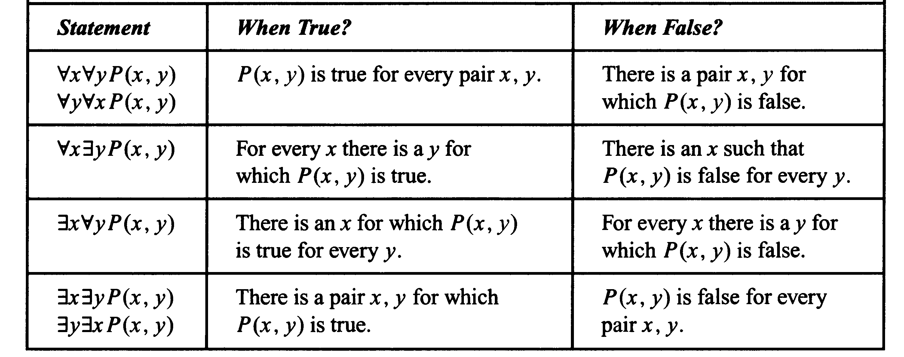
Table for the Quantification of two variables

Slide 16
Example
Write the following statement in English, using the predicates
C(x): “x is a Computer Science major”
T (x, y): “x is taking y”
where x represents students and y represents courses:
∀y ∃x (~C(x) ∧ T (x, y)).
Solution:
The statement ∀y ∃x (~C(x) ∧ T (x, y)) says that for every course y there is a student x such that x is not a
Computer Science major and x is taking y. That is, “In every course there is a student who is not a Computer Science major.”

Slide 17
Relations among ∀ ∃,∧, and ∨
If Q(x) is a predicate and the domain D of x is the set
then the statements
are logically equivalent.
Example
Let Q(x) be “ x ˄ x = x” and suppose D ={ 0,1} the ∀ x belongs to D, Q(x), can be written as ∀ binary digits x, x˄x=x. This is equivalent to 0˄0=0 and 1˄1=1.

Slide 18
Example
If Q(x) is a predicate and the domain D of x is the set
then the statements
are logically equivalent.
Example
Let Q(x) be “ x ˅ x = x” and suppose D ={ 0,1} the x belongs to D, Q(x), can be written as ∀ binary digits x, x ˅ x = x.
This is equivalent to 0 ˅ 0 = 0 and 1 ˅ 1=1.

Slide 19
Rule of Instantiation
The rule says:
“if some property is true of everything in a domain, then it is true of any particular thing in the domain”
Example
All human beings are mortal,
Socrates is human being,
Socrates is mortal.

Slide 20
Cont….
Suppose you are doing a problem that requires you to simplify where r is a particular real number and k is a particular integer. For basic algebra we know that
1.
2.
So we proceed as fallows
(by 1).
(by 2).
Both argument 1 and 2 are examples of universal instantiation.

Slide 21
Universal Modus Ponens
The rule of universal instantiation can be combined with modus ponens to obtain the rule of universal Modus Ponens.
Formal Version Informal Version
∀ x, P(x) → Q(x), If x makes P(x) true,
P(a), (for a particular a) then x makes Q(x) true,
Q(a). a makes P(x) true,
a makes Q(x) true.

Slide 22
Example
If a number is even, then its square is even.
K is a particular number that is even.
square of k is even.
Solutions: Let E(x) = x is even, S(x) = square of x is even. Let k stand for a particular number that is even. Then the argument is of the form
∀ x, E(x) → S(x)
E(k), for particular k.
S(k).
This form of argument is valid by universal modus ponens.

Slide 23
Universal Modus Tollens
The rule of universal instantiation can be combined with modus ponens to obtain the rule of universal Modus Ponens.
Formal Version Informal Version
∀ x, P(x) → Q(x). If x makes P(x) true,
~Q(a) for a particular a. then x makes Q(x) true.
~P(a) a does not makes Q(x) true.
a does not makes P(x) true

Slide 24
Example
All human beings are mortal,
Zeus is human being,
Zeus is mortal.
Sol: Let H(x) = “ x is human”, M(x) = “ x is mortal”, and let Z stands for Zeus. The argument becomes
∀ x , if H(x) then M(x)
~M(Z)
~H(z).
This is valid by universal modus Tollens.

Slide 25
Converse Error (Quantified Form)
The following argument form is invalid
Formal Version Informal Version
∀ x, if P(x) then Q(x), If x makes P(x) true
Q(a), for a particular a, then x makes Q(x)true,
P(a). a makes Q(x) true,
a makes P(x) true.

Slide 26
Example
All healthy people eat an apple a day
Alan eats an apple a day
Alan is a healthy person
Sol: Let M(x) = “ x is healthy people”, H(x) = “ x eat apple a day”, and let A stands for Alan. The argument becomes
∀ x, if M(x) then H(x)
H(A)
M(z).

Slide 27
Inverse Error (Quantified Form)
The following form argument form is invalid:
Formal Version Informal Version
∀ x, if P(x) then Q(x). If x makes P(x) true,
~P(a), for a particular a, then x makes Q(x)true.
~Q(a) a does not makes P(x) true.
a does not makes Q(x) true

Slide 28
Example
All healthy people eat an apple a day,
Smith is not a healthy person,
Smith does not eat apple a day.
Sol: Let H(x) = “ x is healthy people”, M(x) = “ x eat apple a day”, and let S stands for Smith. The argument becomes
∀ x , if H(x) then M(x),
~H(S),
~M(S).

Slide 29
Lecture Summary
Statements containing “∀ ” and “∃”
Nested Quantifiers
Relations
Universal Instantiation statement
Universal Modus Ponens
Universal Modus Tollens
Quantified form of Converse and Inverse error

