Slide 1
(CSC 102)
Discrete Structures
Lecture 5

Slide 2
Previous Lecture Summery
Basic Logic gates
Constructing Circuits using logic gates
Designing Circuits for given Inputs/outputs
Equivalent Circuits
Reductions of circuits

Slide 3
Applications of Logic

Slide 4
Todays Lecture Outline
NAND and NOR Gates
Basics of Boolean Algebra
Decimal and Binary numbers
Half Adders
Circuits using Half adders
Full adder circuits
Parallel Adder Circuits

Slide 5
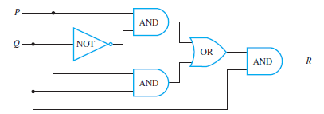
Equivalent Circuits
Following is the circuit representations of the statement
[(P∧ ∼Q) ∨ (P ∧ Q)] ∧ Q

Slide 6
Equivalent Circuits
[(P ∧ ∼Q) ∨ (P ∧ Q)] ∧ Q
≡ (P ∧ (∼Q ∨ Q)) ∧ Q ; by the distributive law
≡ (P ∧ (Q ∨ ∼Q)) ∧ Q ; by the commutative law for ∨
≡ (P ∧ t) ∧ Q ; by the negation law
≡ P ∧ Q ; by the identity law.

Slide 7

Equivalent Circuits
Thus the two circuits are logically equivalent.

Slide 8
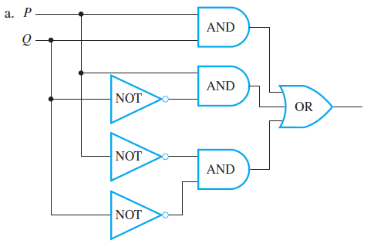

Equivalent Circuits
Find the Boolean expressions for the circuits and show that they are logically equivalent

Slide 9
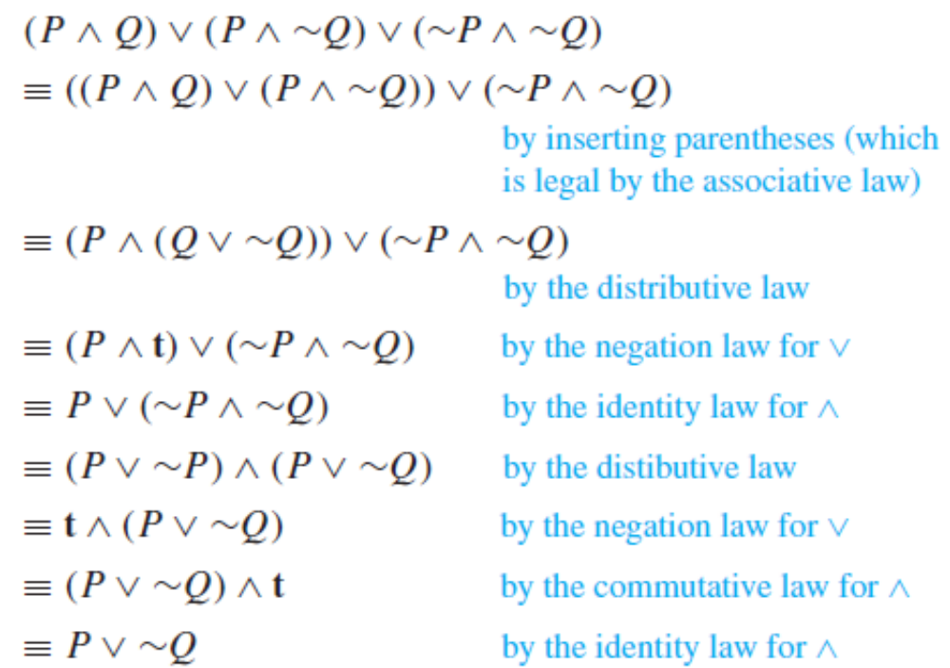
Equivalent Circuits
Find the Boolean expressions for the circuits and show that they are logically equivalent

Slide 10
NAND and NOR Gates
Another way to simplify a circuit is to find an equivalent circuit that uses the least number of different kinds of logic gates. Two gates not previously introduced are useful for this: NAND-gate and NOR-gate.
A NAND-gate is a single gate that acts like an AND-gate followed by a NOT-gate.
A NOR-gate acts like an OR-gate followed by a NOT-gate.
Thus the output signal of a NAND-gate is 0 when, and only when, both input signals are 1, and the output signal for a NOR-gate is 1 when, and only when, both input signals are 0.
The logical symbols corresponding to these gates are | (for NAND) and ↓ (for NOR), where | is called a Sheffer stroke and ↓ is called a Peirce arrow. Thus
P | Q ≡ ∼(P ∧ Q) and P ↓ Q ≡ ∼(P ∨ Q).

Slide 11
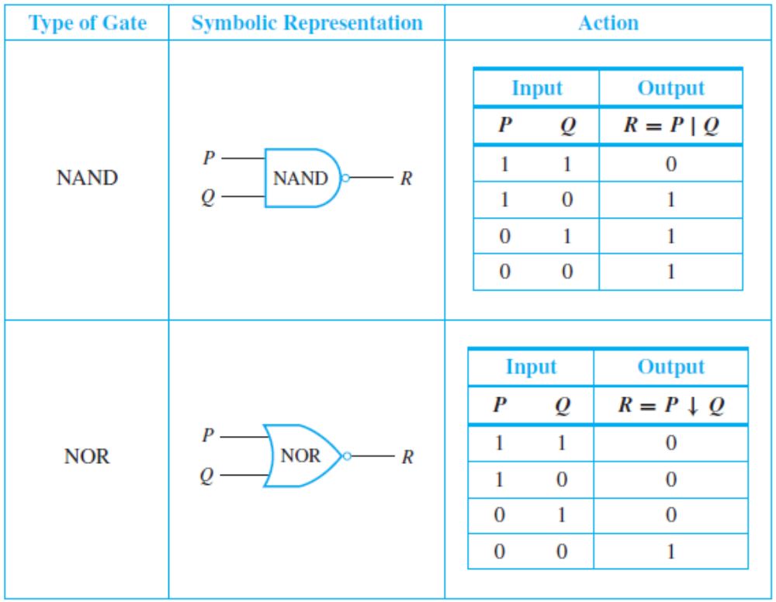
NAND and NOR Gates

Slide 12
NAND and NOR Gates
It can be shown that any Boolean expression is equivalent to one written entirely with Sheffer strokes or entirely with Peirce arrows. Thus any digital logic circuit is equivalent to one that uses only NAND-gates or only NOR-gates.

Slide 13
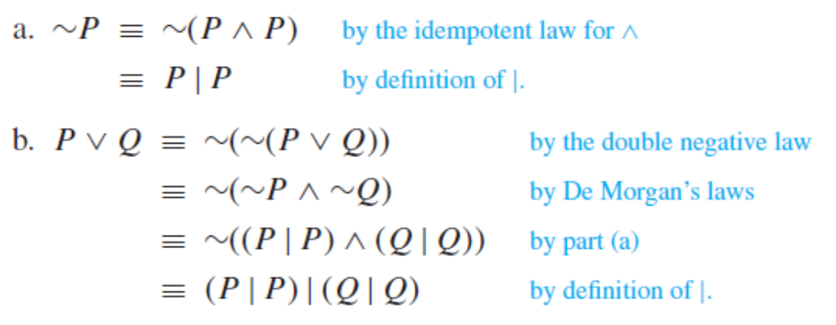
Rewriting Expressions Using the Sheffer Stroke
Use the definition of Sheffer stroke to show that
a. ∼P ≡ P | P b. P ∨ Q ≡ (P | P) | (Q | Q).

Slide 14
Rewriting Expressions Using the Peirce Arrow
Show that the following logical equivalences hold for the Peirce arrow ↓, where P ↓ Q ≡ ∼(P ∨ Q).
a. ∼P ≡ P ↓ P
b. P ∨ Q ≡ (P ↓ Q) ↓ (P ↓ Q)
c. P ∧ Q ≡ (P ↓ P) ↓ (Q ↓ Q)
b. (P ↓ Q) ↓ (P ↓ Q)
≡ ∼(P ↓ Q) by part (a)
≡ ∼[∼(P ∨ Q)] by definition of ↓
≡ P ∨ Q by the double negative law

Slide 15
Boolean Algebra
Decimal representations
6152 = 6*1000 + 1*100 + 5*10 + 2*1
= 6*10³ + 1*10² + 5*10¹ + 2*10⁰.
More generally, decimal notation is based on the fact that any positive integer can be written uniquely as a sum of products of the form
d ·10^{n}
where each n is a nonnegative integer and each d is one of the decimal digits 0, 1, 2, 3, 4, 5, 6, 7, 8, or 9. The word decimal comes from the Latin root deci, meaning “ten.”

Slide 16
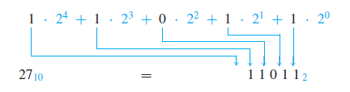

Boolean Algebra
Converting decimal to binary representations
27 = 16 + 8 + 2 + 1
= 1·2⁴ + 1·2³ + 0·2² + 1·2¹ + 1·2⁰.

Slide 17
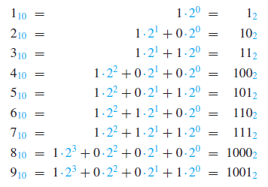
Boolean Algebra
Any integer can be represented uniquely as a sum of products of the form
d ·2^{n}
where each n is an integer and each d is one of the binary digits (or bits) 0 or 1.

Slide 18

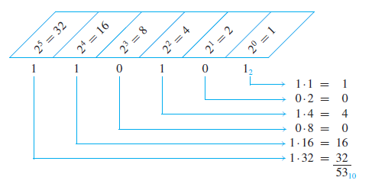
Converting binary to decimal
Represent 110101 in decimal notation.

Slide 19

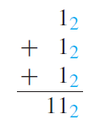
Addition in Binary Notation
Add 11012 and 1112 using binary notation.
Solution: Because 2₁₀ = 10₂ and 1₁₀ = 1₂, the translation of 1₁₀ + 1₁₀ = 2₁₀ to binary notation is
It follows that adding two 1’s together results in a carry of 1 when binary notation is used. Adding three 1’s together also results in a carry of 1 since 3₁₀ = 11₂ (“one one base two”).

Slide 20
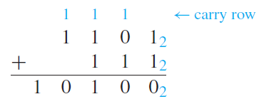
Addition in Binary Notation
Thus the addition can be performed as follows:

Slide 21
Boolean Algebra
Just like Boolean logic, variables can only be 1 or 0, instead of true/false
Not
  ~0 = 1
  ~1 = 0
Or is used as a plus And is used as a multiplication 0+0 = 0 0 * 0 = 0
0+1=1 0 * 1 = 0
1+0=1 1 * 0 = 0
1+1= ? 1 * 1 = 1

Slide 22
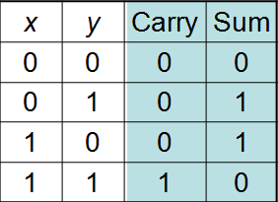
Half Adder
Consider adding two 1-bit binary numbers x and y
  0+0 = 0
  0+1 = 1
  1+0 = 1
  1+1 = 10
Carry is x AND y
Sum is x XOR y
The circuit to compute this is called a half-adder.

Slide 23
Circuit of Half Adder
Sum = x XOR y
Carry = x AND y

Slide 24
Using Half adders
We can then use a half-adder to compute the sum of two Boolean numbers
1
0
0
1 1 0 0
+ 1 1 1 0
?
0
1
0

Slide 25
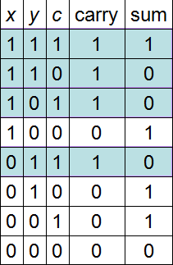
How to fix that
We need to create an adder that can take a carry bit as an additional input
  Inputs: x, y, carry in
  Outputs: sum, carry out
This is called a full adder
  Will add x and y with a half-adder
  Will add the sum of that to the
  carry in
What about the carry out?
  It’s 1 if either (or both):
  x+y = 10
  x+y = 01 and carry in = 1

Slide 26
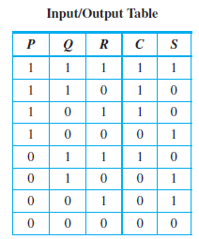
The Full adder

Slide 27
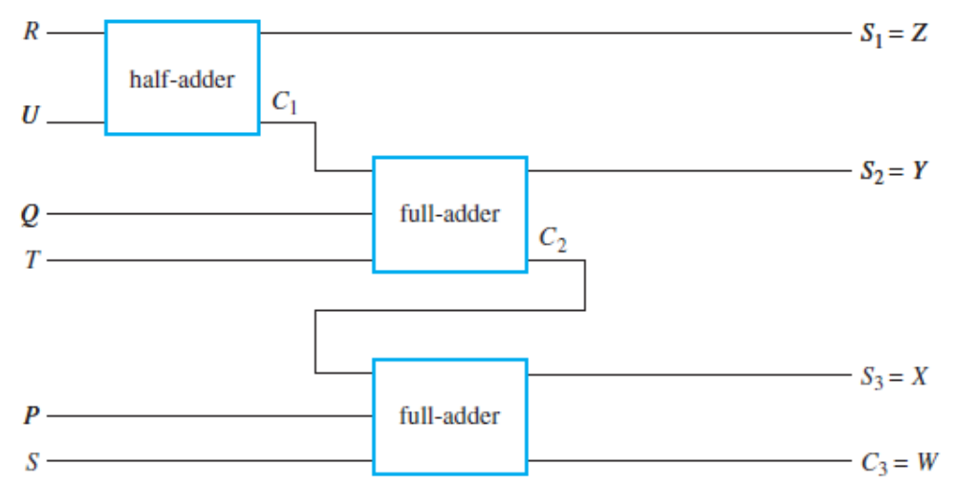
Parallel Adder Circuits
Two full-adders and one half-adder can be used together to build a circuit that will add two three-digit binary numbers PQR and STU to obtain the sum WXYZ. Such a circuit is called a parallel adder. Parallel adders can be constructed to add binary numbers of any finite length.

Slide 28
The Full adder
The full circuitry of the full adder

Slide 29
Lecture summary
Basic Logic gates
Circuits using logic gates
Boolean Algebra
Adders (Half and Full)

