Slide 1
CSC 101
Introduction to Computing
Lecture 9
Dr. Iftikhar Azim Niaz
ianiaz@comsats.edu.pk
1

Slide 2
Last Lecture Summary
Number System
  Decimal
  Binary
  Octal
  Hexadecimal
Number conversion
2

Slide 3
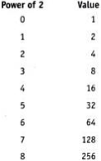
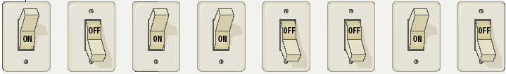
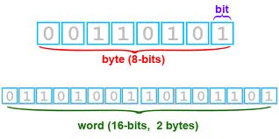
Bits and Bytes
Binary numbers are made of bits
Bit represents a switch
A byte is 8 bits
Byte represents one character
3

Slide 4
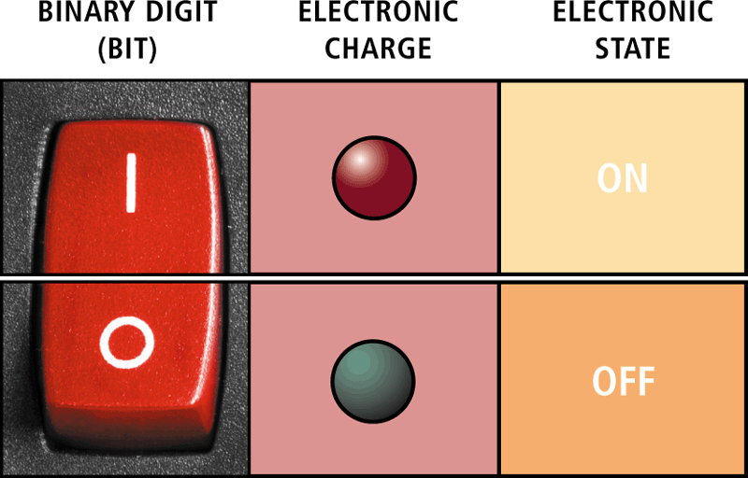
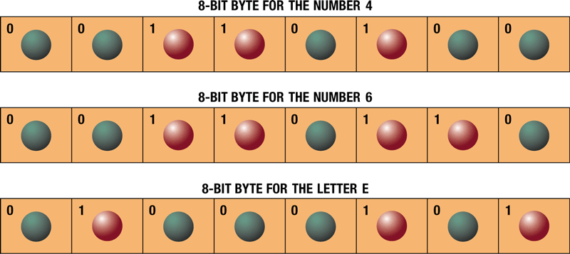
Bit and Byte
4

Slide 5
Text Codes
Converts letters, numbers, special symbols into binary numbers
Standard codes necessary for data transfer
Same combinations of numbers to represent the same individual pieces of data
Four most popular codes
  EBCDIC
  ASCII
  Extended ASCII
  Unicode
5
Notes:
Insider information
Windows XP, Mac OS X and newer flavors of Linux are fully Unicode compatible.

Slide 6
EBCDIC
Extended Binary Coded Decimal Interchange Code
8-bit code to represent 256 symbols
Still used in IBM mainframes and mid range computers
Rarely used in PCs
6
Notes:
Insider information
Windows XP, Mac OS X and newer flavors of Linux are fully Unicode compatible.

Slide 7
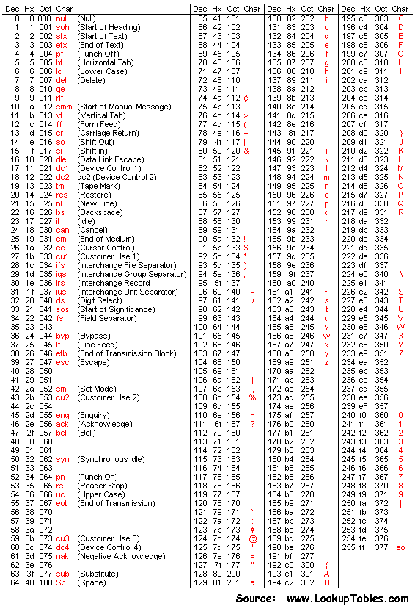
EDCDIC
7

Slide 8
ASCII
American Standard Code for Information Interchange
Most popular and widely used character set
Used to represent English symbols
7-bit code to represent 128 characters
  From 0 to 127
  33 are non-printing control characters (now mostly obsolete)
  95 printable characters including space (invisible graphic character)
8
Notes:
Insider information
Windows XP, Mac OS X and newer flavors of Linux are fully Unicode compatible.

Slide 9
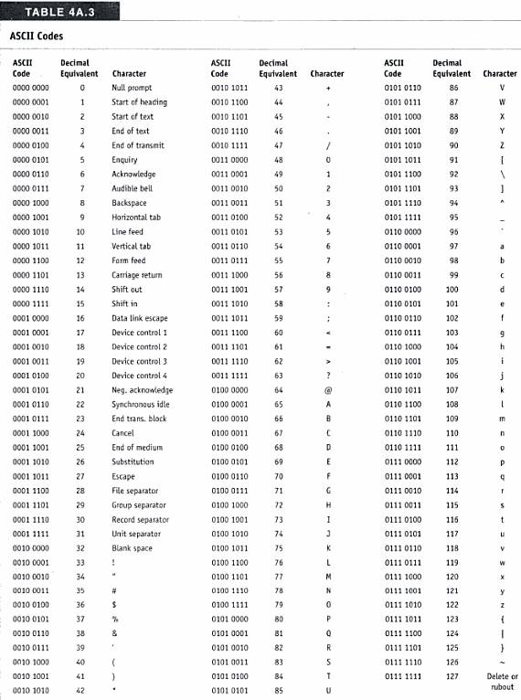
ASCII Codes
9

Slide 10
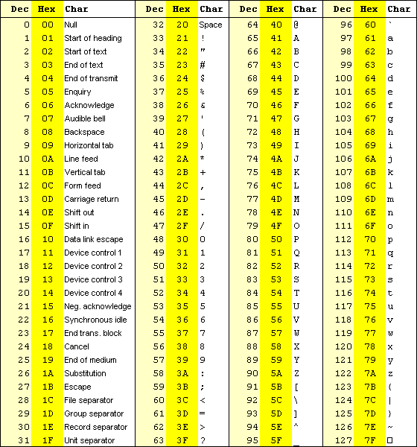
ASCII Code
10

Slide 11
Extended ASCII
8-bit code that specifies the characters for values from 128 to 255.
First 40 symbols represent pronunciation and special punctuation symbol
  128 to 167
Remaining are for graphics and other symbols
11
Notes:
Insider information
Windows XP, Mac OS X and newer flavors of Linux are fully Unicode compatible.

Slide 12
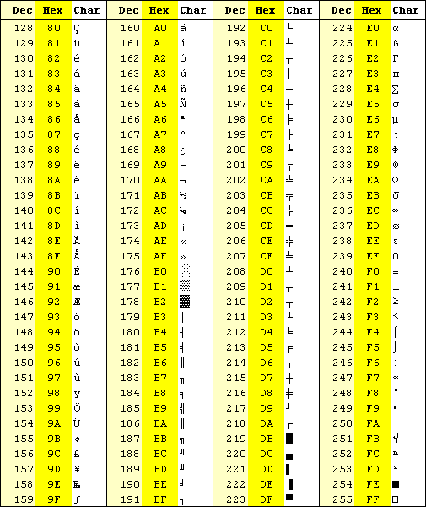
Extended ASCII Code
12

Slide 13
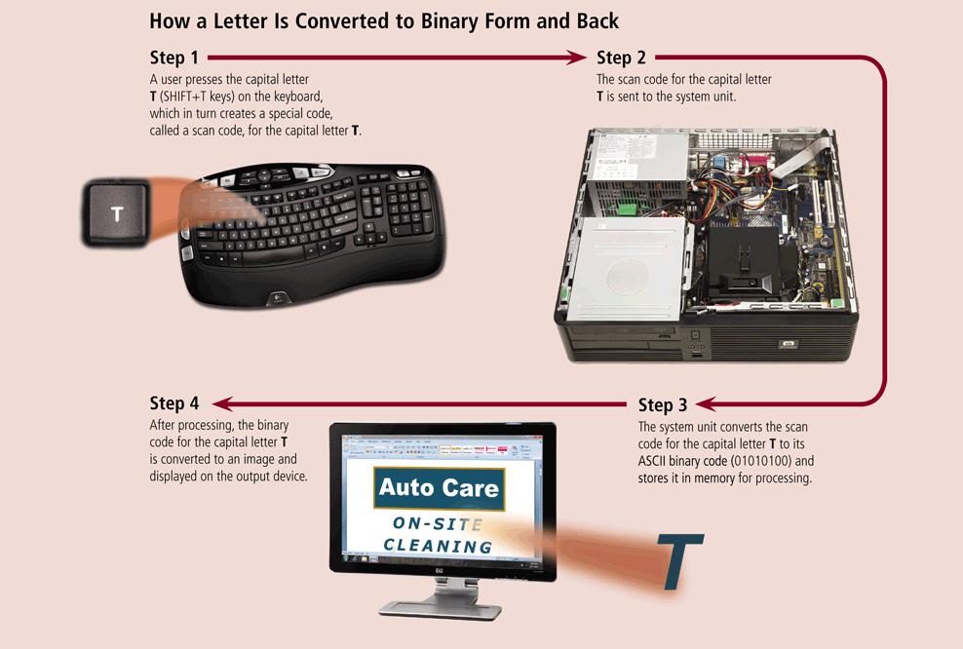
Letter Conversion to Binary
13

Slide 14
Unicode
Unicode Worldwide Character Standard provides up to 4-bytes—32 bits
Can represent more than 4 billion characters or symbols
  2³² = 1,073,741,832
Enough for every unique character and symbol in the world
  Chinese, Korean and Japanese Languages
Codes for special mathematical and scientific symbols
First 256 characters are same as ASCII
Current version (Jan 2012) is 6.1
  Contains 110,181 characters from 100 different languages and scripts
14
Notes:
Insider information
Windows XP, Mac OS X and newer flavors of Linux are fully Unicode compatible.

Slide 15
Binary Arithmetic
Similar to arithmetic in decimal number system
Operations performed
  Addition
  Subtraction
  Multiplication
  Division

Slide 16
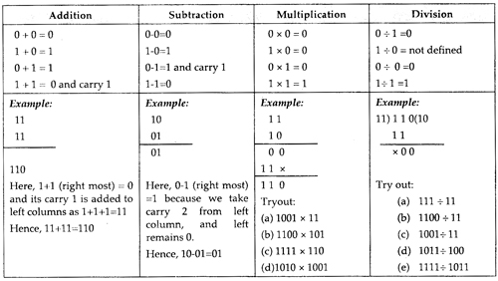
Binary Arithmetic
i

Slide 17
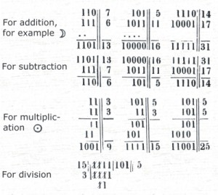
Binary Arithmetic
i

Slide 18
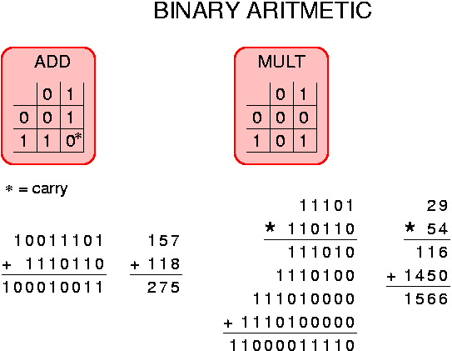
Binary Arithmetic
i

Slide 19
Boolean Algebra
Describes the relationship between the inputs and outputs of a digital circuit
George Boole, an English Mathematician in 1854 proposed the basic principles of algebra
Uses Variables and operations
Boolean variable has only two possible values
  0 or 1 or False or True
Basic Logical operations are
  AND, OR and NOT

Slide 20

Basic Logical Operations
AND operation
  yields true in case when both of its operands are true
OR operation
  yields true in case when either or both of its operands are true
NOT operation
  Used to invert the value of its operand

Slide 21
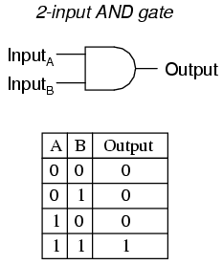
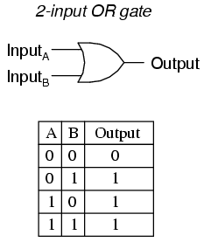
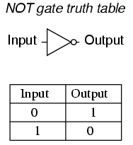
Logical Operations
Truth Table is a list of all possible input values and the output for each input combination

Slide 22
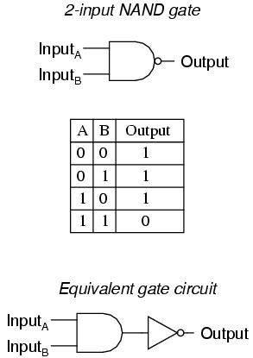
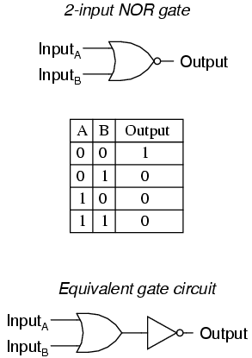
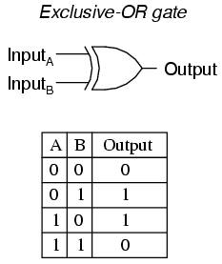
Logical Operations

Slide 23
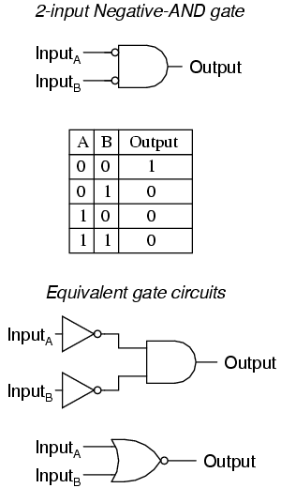
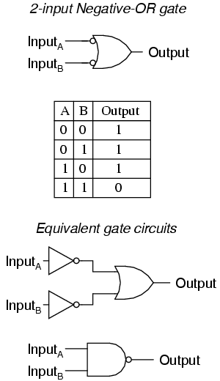
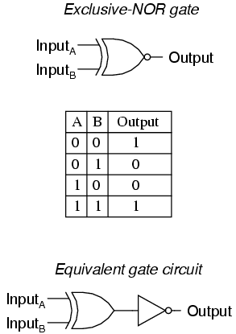
Logical Operations

Slide 24
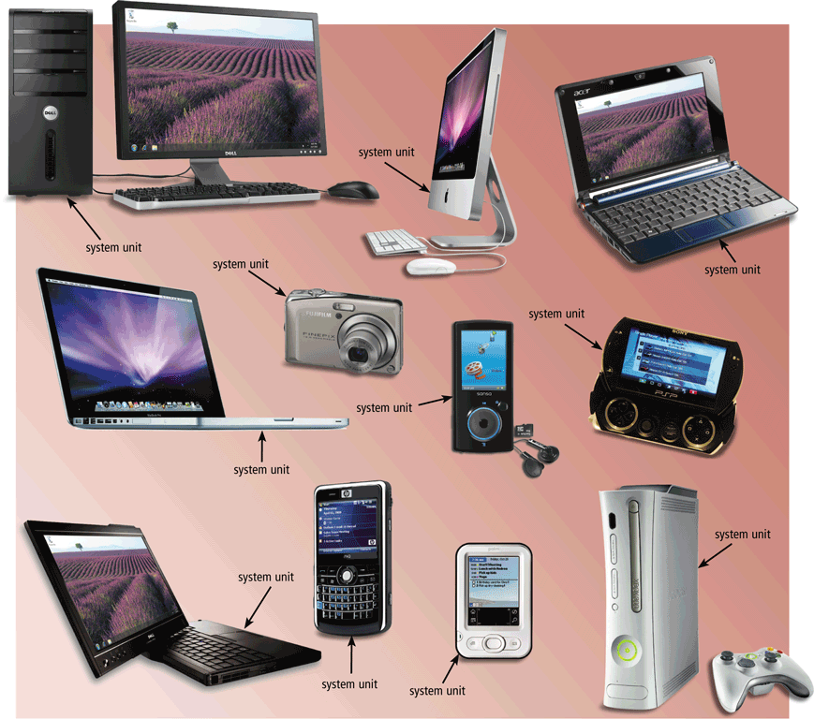
The System Unit
The system unit is a case that contains electronic components of the computer used to process data
24

Slide 25
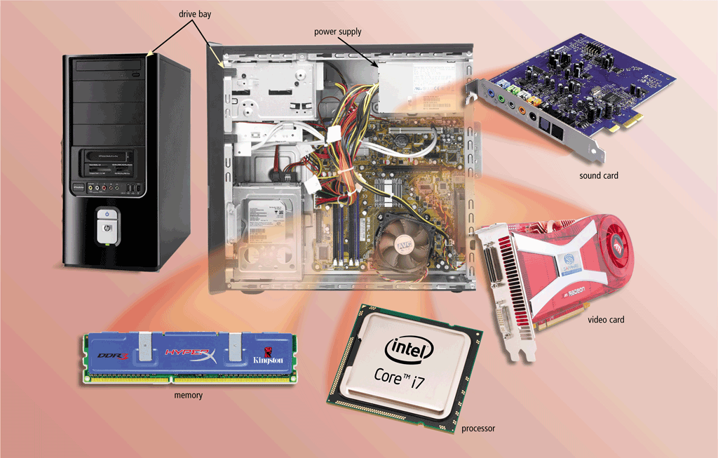
The System Unit
The inside of the system unit on a desktop personal computer includes:
Drive bay(s)
Power supply
Sound card
Video card
Processor
Memory
25

Slide 26
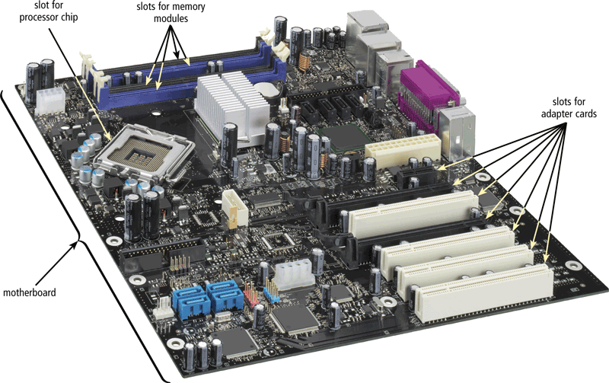
The System Unit
The motherboard is the main circuit board of the system unit
  A computer chip contains integrated circuits (IC)
26

Slide 27
Structure - Top Level
Computer
Peripherals
Central
Processing
Unit
Main
Memory
Computer
Systems
Interconnection
Input
Output
Communication
lines

Slide 28
Structure - The CPU
CPU
Computer
Arithmetic
and
Login Unit
I/O
Registers
System
Bus
CPU
Internal CPU
Interconnection
Memory
Control
Unit

Slide 29
Structure - The Control Unit
Control Unit
CPU
ALU
Sequencing
Login
Internal
Bus
Control
Unit
Control Unit
Registers and
Decoders
Registers
Control
Memory

Slide 30
CPU
Central Processing Unit
Brain of the computer
Control unit
  Controls resources in computer
  Instruction set
Arithmetic logic unit
  Simple math operations
  Comparisons
  Logic operations
  Registers
30
Notes:
Teaching tip
Table 4A.4 on page 190 lists the operations handled by the common ALU.

Slide 31
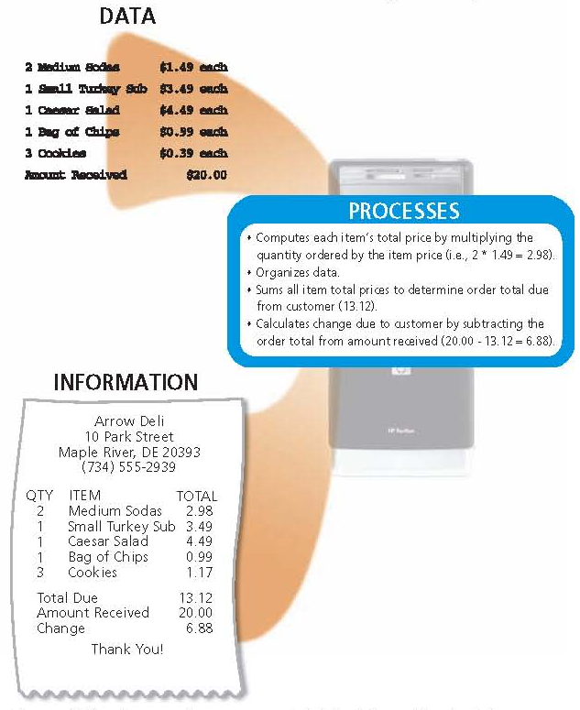
Function of CPU
31

Slide 32
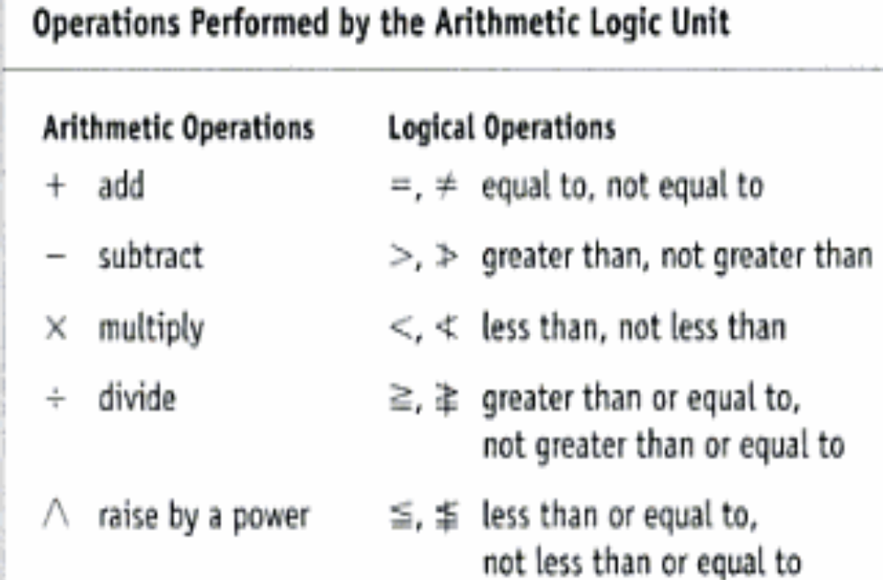
ALU Operations
Registers
32
Notes:
Teaching tip
Table 4A.4 on page 190 lists the operations handled by the common ALU.

Slide 33
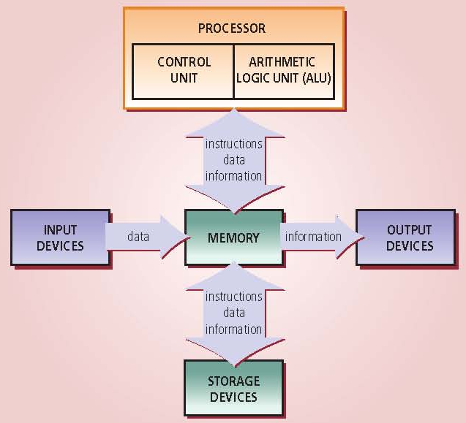
Movement of Instruction and Data
33

Slide 34
Machine Cycle
Steps by CPU to process data
Instruction cycle
  CPU fetches the instruction
  Decodes the instruction
Execution cycle
  CPU performs the instruction
  Stores the result (sometimes required)
Million Instructions per second (MIPS)
Billions of cycles per second (BIPS)
34
Notes:
Insider information
More pipelines mean a faster and more efficient CPU. The current fastest CPU on the market, the Apple G4 has 80 pipelines!

Slide 35
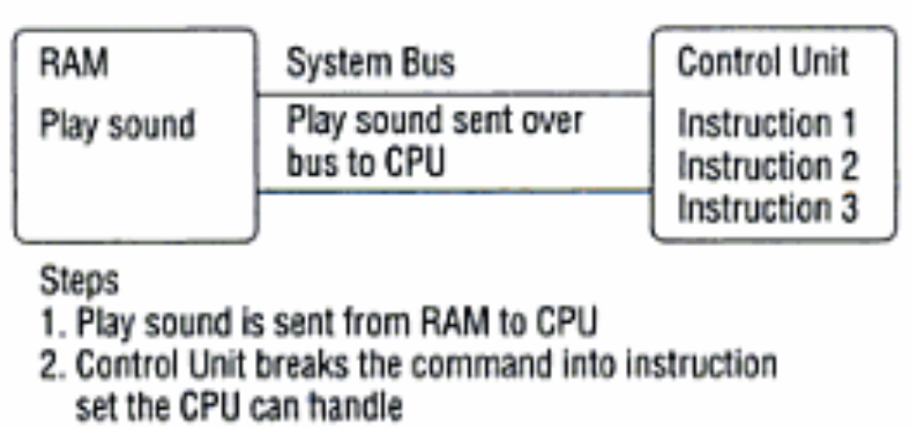
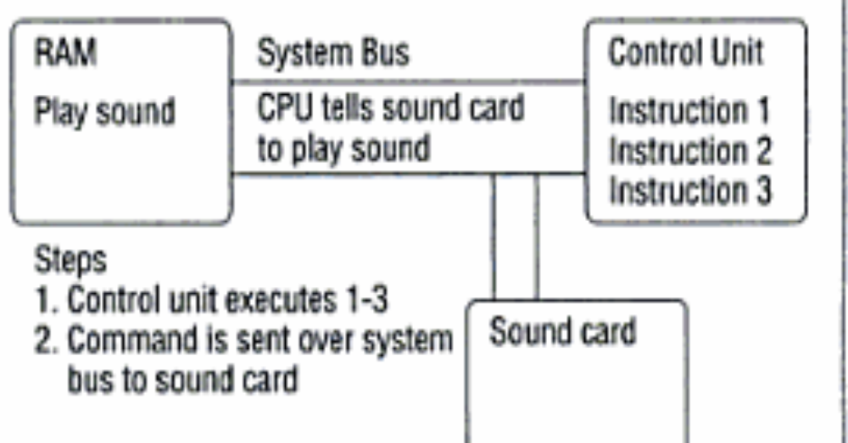
Machine Cycle
Instruction cycle
Execution cycle
35
Notes:
Insider information
More pipelines mean a faster and more efficient CPU. The current fastest CPU on the market, the Apple G4 has 80 pipelines!

Slide 36
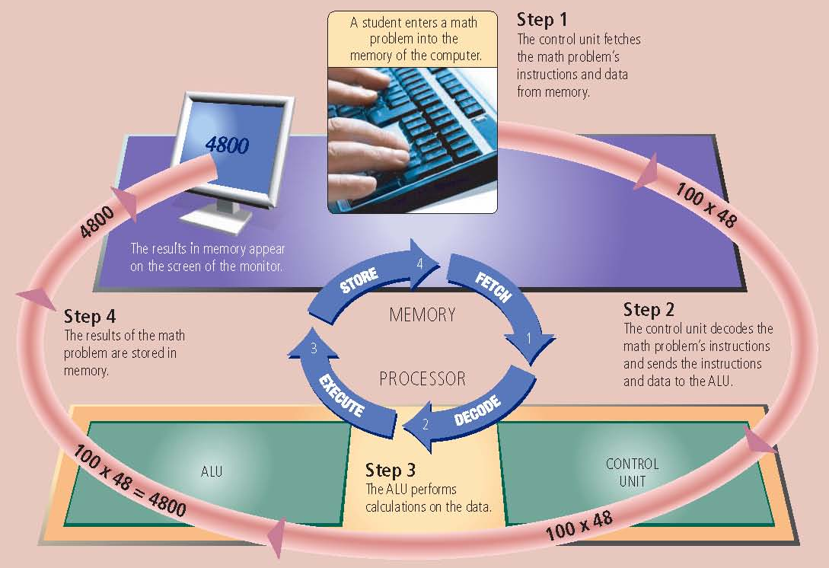
Steps In a Machine Cycle
36

Slide 37
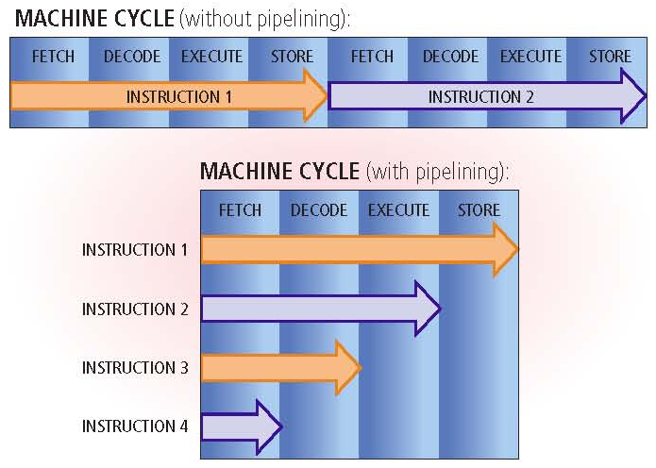
Machine Cycle Pipelining
Pipelining
  Processor begins fetching a second instruction before it completes the machine cycle for the first instruction
37

Slide 38
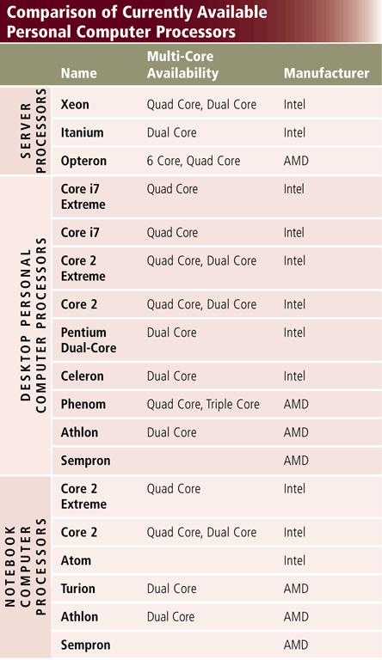
Leading Processor Manufacturer
38

Slide 39
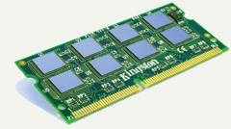
Memory
Von Neumann Architecture
  Concept of stored program
Stores open programs and data
Small chips on the motherboard
More memory makes a computer faster
39

Slide 40
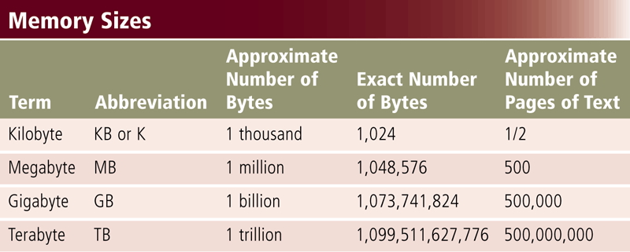
Memory Address and Size
Each Memory has an address
Memory size is measured in KB, MB, GB or TB
40

Slide 41
What Memory Stores?
Store Instructions waiting to be executed by the processor
Data needed by those instructions, and
Results of processing the data
Stores three basic categories of items:
The operating system and other system software
Application programs
Data being processed and the resulting information
41

Slide 42
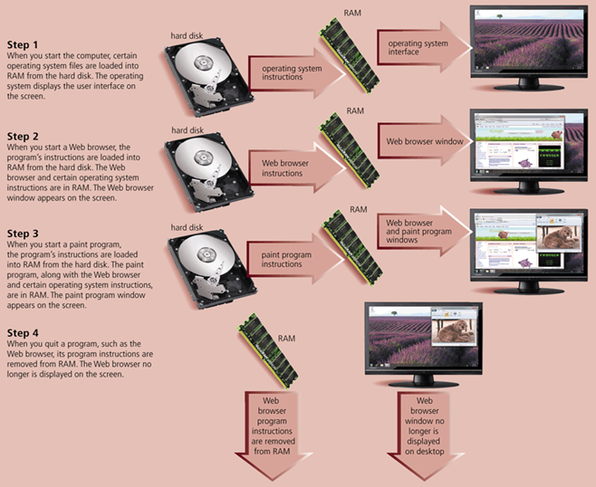
How Instruction Moves In and Out of Memory
42

Slide 43
Summary
How Computer Stores Data
Text Codes
  EBCDIC, ASCII, Extended ASCII and Unicode
Binary Arithmetic
Boolean Algebra
Central Processing Unit (CPU)
  Control Unit and ALU
Machine Cycle
Memory
43

Slide 44
Summary
How Computer Stores Data
Text Codes
  EBCDIC, ASCII, Extended ASCII and Unicode
Binary Arithmetic
Boolean Algebra
Central Processing Unit (CPU)
  Control Unit and ALU
Machine Cycle
44

