Slide 1
CSC 101
Introduction to Computing
Lecture 8
Dr. Iftikhar Azim Niaz
ianiaz@comsats.edu.pk

Slide 2
Last Lecture Summary I
Impact Printers and Non Impact Printers
Impact Printers
  Dot Matrix
  Line Printers
  Band Printers
Impact Printer Advantages and disadvantages
Non Impact Printers
  Ink jet , Laser , All-in-One Peripherals
Comparing Printers

Slide 3
Last Lecture Summary II
High Quality Printers
  Photo printer
  Thermal printer
  Dye Sublimation
  Solid Ink
  Plotter
Care and Feeding of Printers

Slide 4
Transforming Data Into Information
Understands only two states either On or Off
  Makes different patterns of 0s and 1s
Data vs Information
How Computers Represent Data

Slide 5
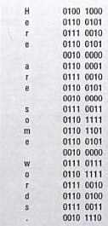
How Computer Represent Data
Number system
  Manner of Counting
  Several different number systems exist
To Computer everything is a number
  Alphabets, numbers, punctuation marks, sound, pictures, computer instructions
  For example
    “Here are some words.”

Slide 6
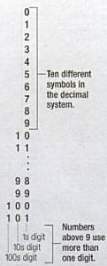
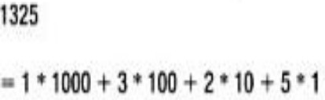
Decimal Numbers
Used by humans to count
Latin word deci mean 10
Also called Base 10
Have 10 distinct digits
  0 1 2 3 4 5 6 7 8 9
10 is a two-digit number
Digits combine to make larger numbers

Slide 7

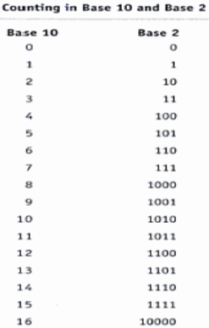
Binary Number System
Switch has two states
  Off represents 0, On is 1
Latin bi means 2
Used by computers to count
Two distinct digits, 0 and 1
  0 and 1 combine to make numbers
represent a quantity >1 it uses two (or more) digits
Pattern repeats indefinitely

Slide 8
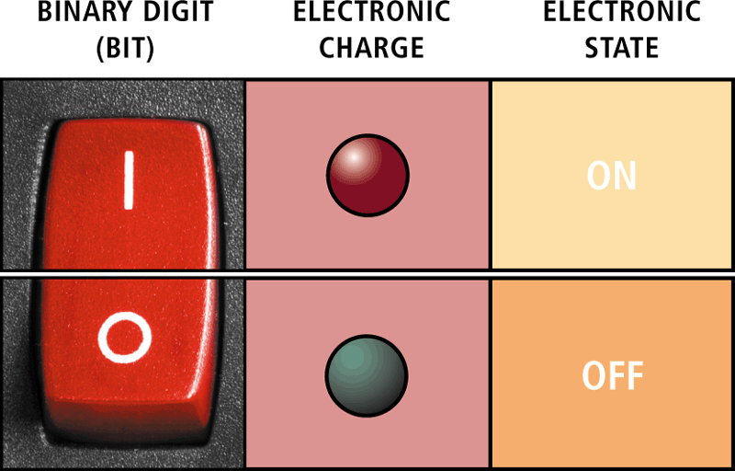
Data Representation
A computer circuit represents the 0 or the 1 electronically by the presence or absence of an electrical charge

Slide 9
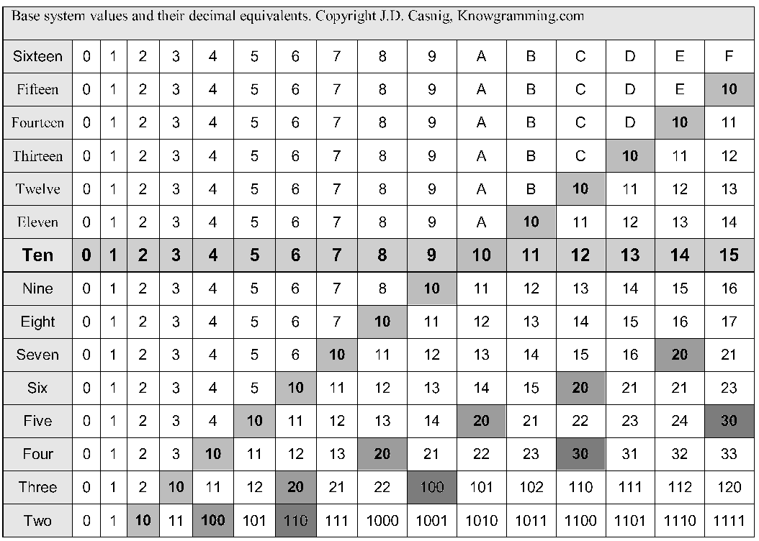
Comparison Base 2 to Base 16

Slide 10
Number Conversion
Decimal to Binary and Binary to Decimal
Decimal to Octal and Octal to Decimal
Decimal to Hexadecimal and Hexadecimal to Decimal
Binary to Hexadecimal
Octal to Hexadecimal
Hexadecimal to Binary and Octal

Slide 11
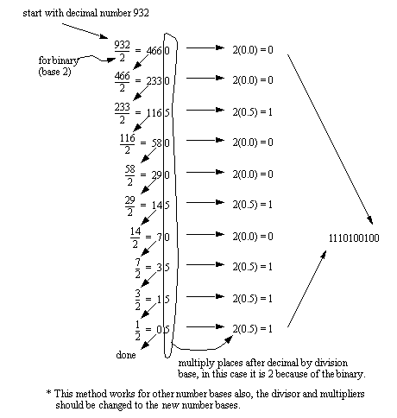
Decimal To Binary
1

Slide 12
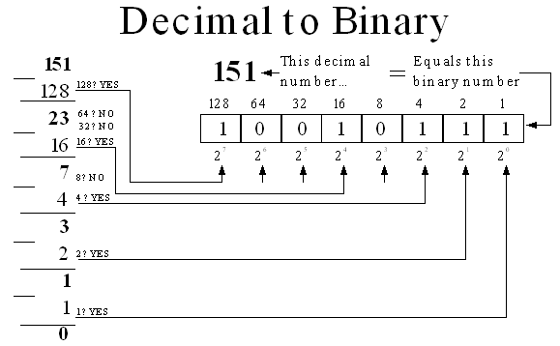
Decimal To Binary
(151)₁₀ = (10010111)₂

Slide 13
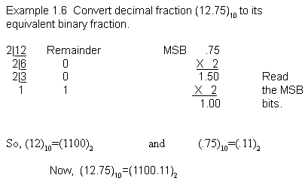
Decimal to Binary (with Fractions)
(12.75)₁₀ = (1100.11)₂

Slide 14
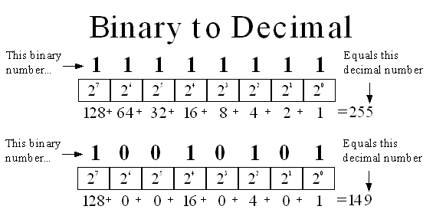
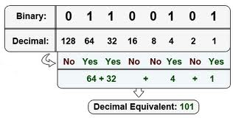
Binary to Decimal

Slide 15
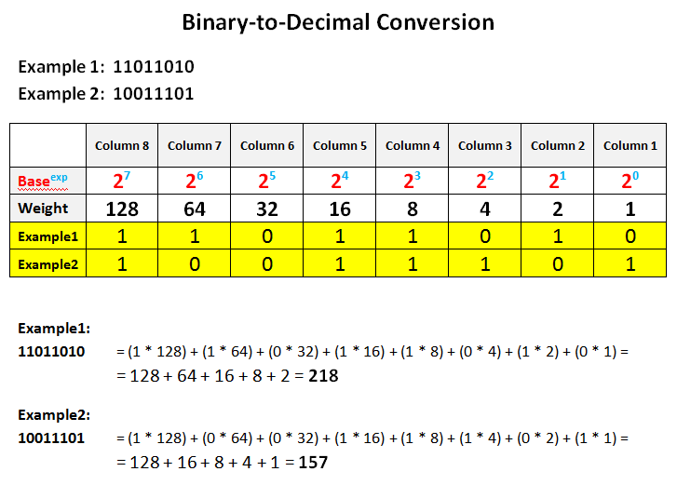
Binary to Decimal

Slide 16
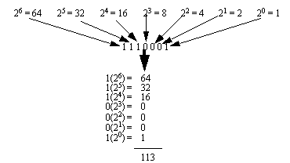
Binary to Decimal
1110001₂ = 113₁₀

Slide 17
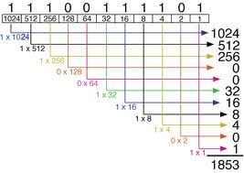
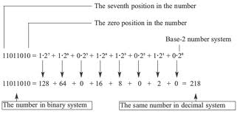
Binary to Decimal
11100111101₂ = 1853₁₀
11011010₂ = 218₁₀

Slide 18
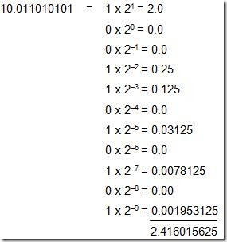
Binary to Decimal (with Fractions)
(10.011010101)₂ = (2.416015625)₁₀

Slide 19
Exercise Decimal to Binary

Slide 20
Exercise Decimal to Binary

Slide 21
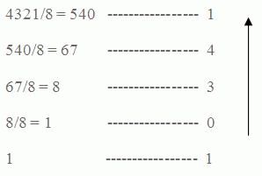
Decimal to Octal
4321₁₀ = 10341₈

Slide 22
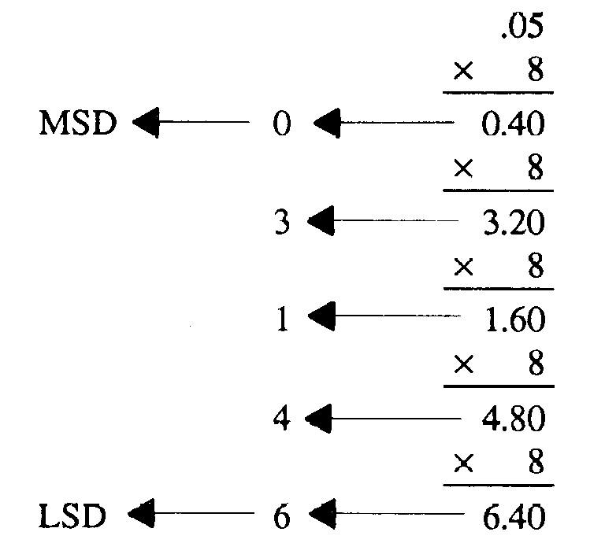
Decimal to Octal (Fractions)
0.05₁₀ = 0.03146₈

Slide 23
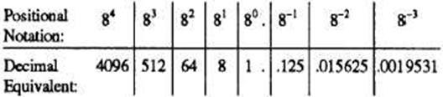
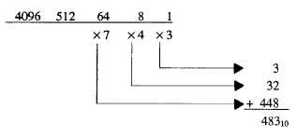
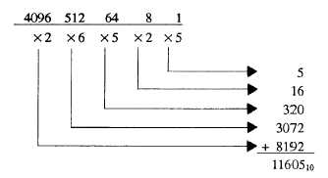
Octal to Decimal
743₈ = 483₁₀ 26525₈ = 11605₁₀

Slide 24
Exercise Decimal to Octal

Slide 25
Exercise Octal to Decimal
26601₈ =
1422₈ ₌

Slide 26
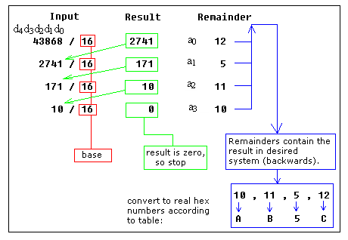
Decimal to Hexadecimal

Slide 27
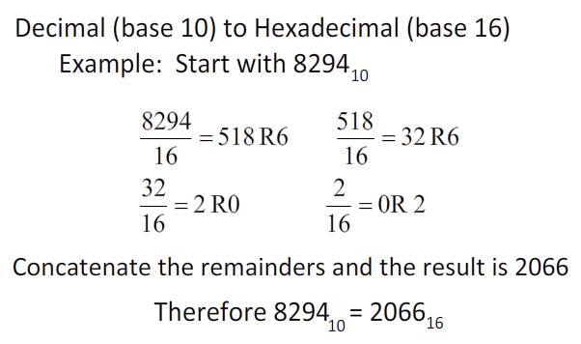
Decimal to Hexadecimal

Slide 28
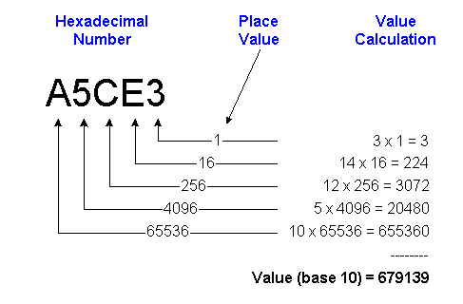
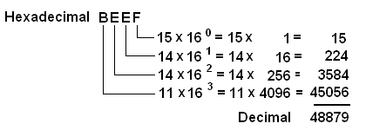
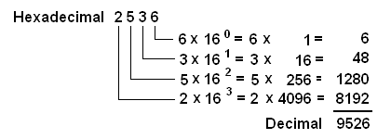
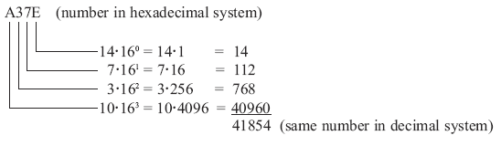
Hexadecimal to Decimal

Slide 29
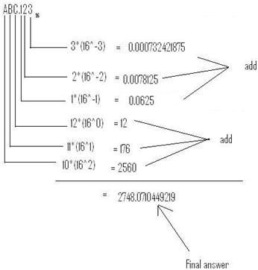
Hexadecimal to Decimal
(ABC.123)₁₆ = (2748.0710449219)₁₀

Slide 30
Comparison Base 2 to Base 16

Slide 31
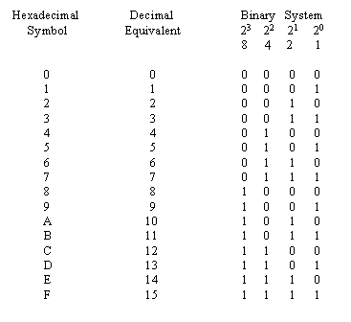
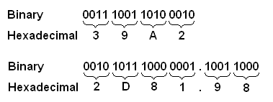
Binary to Hexadecimal

Slide 32
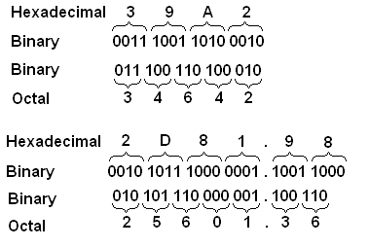
Hexadecimal to Binary and Octal

Slide 33
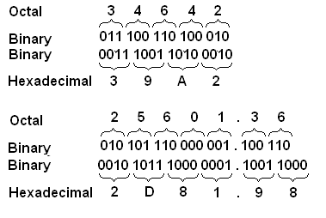
Octal to Hexadecimal

Slide 34
Exercise Binary to Hexadecimal
(10110101010101)₂
(1100010010)₂

Slide 35
Exercise Octal to Hexadecimal
(344)₈
(1422)₈

Slide 36
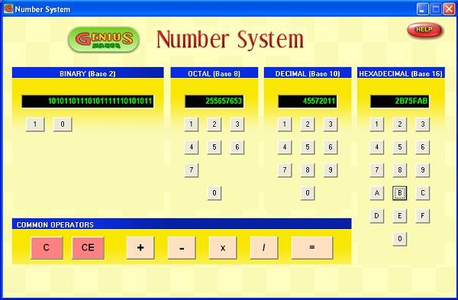
Number System Program
Genius Maker
Free software
Use the number system
http://www.goldenkstar.com/number-system-school-software-maths.htm

Slide 37
Summary
Number System
  Decimal
  Binary
  Octal
  Hexadecimal
Number conversion

Slide 38
Recommended Websites
http://www.cdrummond.qc.ca/cegep/informat/Professeurs/Alain/files/ascii.htm
http://www.lookuptables.com/ebcdic_scancodes.php
http://math.comsci.us/radix/hexadecimal.html

Slide 39
Number System - Exercise
Decimal | Binary | Octal | Hexadecimal
(786)₁₀ | (1100010010)₂ | (1422)₈ | (312)₁₆
(555)₁₀ | (1000101011)₂ | (1053)₈ | (22B)₁₆
(228)₁₀ | (11100100)₂ | (786)₈ | (786)₁₆
(179)₁₀ | (10110011)₂ | (786)₈ | (786)₁₆
(483)₁₀ | (111100011)₂ | (743)₈ | (1E3)₁₆
(4012)₁₀ | (111110101100)₂ | (7643)₈ | (FAC)₁₆
(4321)₁₀ | (1000011100001)₂ | (10341)₈ | (10E1)₁₆
(1853)₁₀ | (11100111101)₂ | (3475)₈ | (73D)₁₆
(9526)₁₀ | (1001010011011)₂ | (22466)₈ | (2536)₁₆
(11605)₁₀ | (10110101010101)₂ | (26525)₈ | (2D55)₁₆
(48879)₁₀ | (111111011101111)₂ | (137357)₈ | (BEEF)₁₆

