Slide 1
CSC 101
Introduction to Computing
Lecture 6
Dr. Iftikhar Azim Niaz
ianiaz@comsats.edu.pk

Slide 2
Last Lecture Summary I
Ergonomics and input devices
Repetitive Stress Injuries
Carpel Tunnel Syndrome
Avoiding Keyboard related injuries
How to sit at a computer
Techniques to avoid RSI

Slide 3
Last Lecture Summary II
Alternate Input devices
Devices for the hand
  Pen, Touch Screens
Game controllers
  Joystick Game pad
Optical Input Devices
  Bar Code Reader, Image Scanners, OCR
Audio Input devices
  Microphone, Sound Card, MIDI
Video input devices
  Video Camera, Web Cam, Digital Camera

Slide 4
Output Devices
Display screens were uncommon till 1960’s
Now, computers can communicate information to you in several ways
  Reading, Seeing, watching and listening
Modern display and sound systems
  computers are easier to use
  data is easier to manage, and
  information is easier to access
Monitors and Sound Systems

Slide 5
Outline
Two most commonly used types of computer monitors.
How a CRT monitor displays images?
Two types of flat-panel monitors and explain their differences.
Various characteristics for comparing monitors.
How data projectors are used?
How a computer outputs sound?

Slide 6
Monitors
Most common output device
Connects to the video card or controller
Two types
  Cathode Ray Tube (CRT)
  Flat-panel
Categorized by color output
  Monochrome
    One color with black background
  Grayscale
    Varying degrees of gray
  Color
    Display 4 to 16 million colors

Slide 7
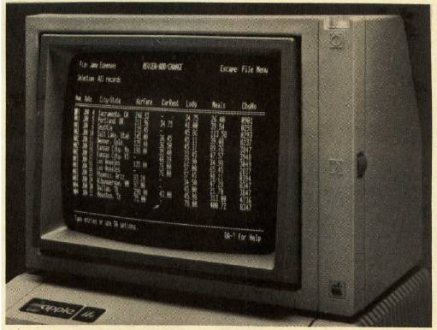
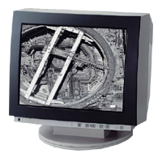
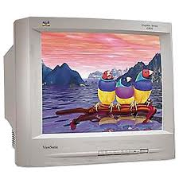
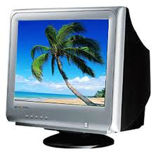
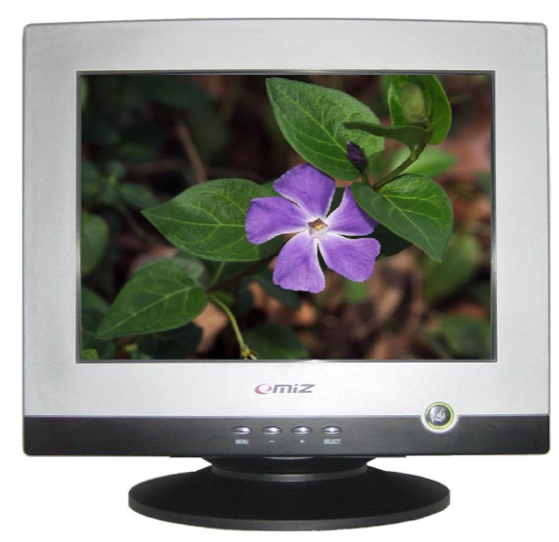
Cathode Ray Tube (CRT)
Most common type of monitor

Slide 8
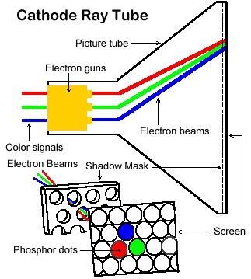
How CRT creates an image
Electron gun shoots streams of electrons towards the screen.
Magnetic yoke guides the streams of electrons across and down the screen.
Phosphor dots on the back of the screen glow when the electron beams hit them.

Slide 9
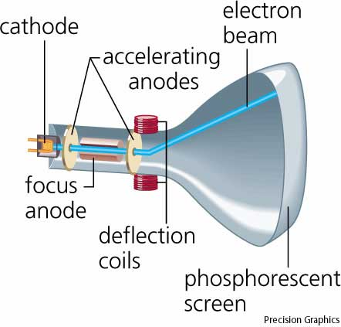
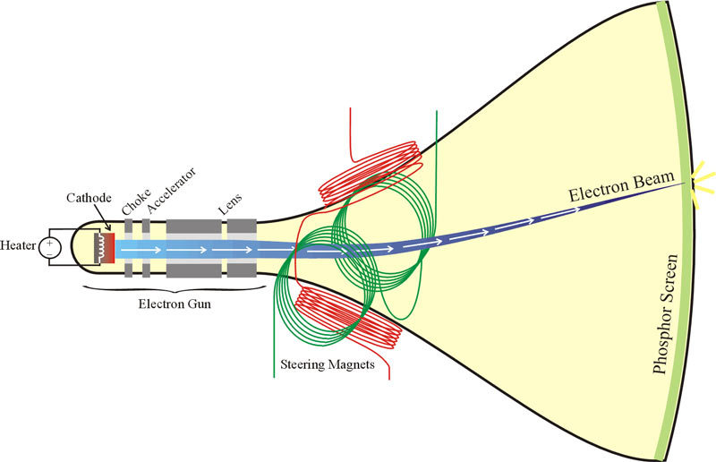
Parts of CRT Monitor

Slide 10
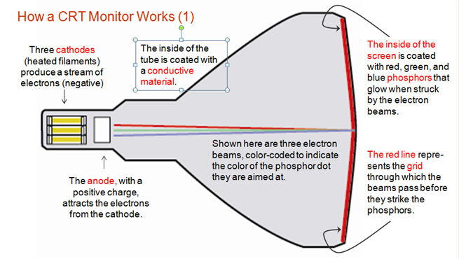
How CRT monitor works

Slide 11
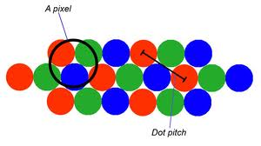
CRT Color
Phosphor dots arranged in triads
Red, green, and blue dots
Three colors blend to make colors
Varying the intensity creates new colors
Exercise
  Custom color with MS Paint
Notes:
Teaching tip
Unless your students have spend a lot of time with HTML or graphics colors, they will have a hard time grasping how RGB values work. The best methods are to show them various colors and then let them experiment. The website www.lynda.com/hue.html provides decimal-value examples of RGB values. Once the students have seen different colors, open MS Paint and let the students develop their own colors. Challenge them to build pink, orange, brown and any of their favorite colors

Slide 12
CRT Disadvantages
Very large
Very heavy
Use a lot of electricity

Slide 13
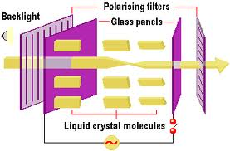
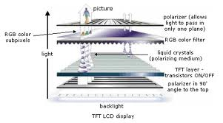
Liquid Crystal Display (LCD)
Commonly found on laptops
Desktop versions exist
Solve the problems of CRT
Fluorescent lights provide illumination

Slide 14
Types of LCD
Passive Matrix LCD
Active Matrix LCD

Slide 15
Passive Matrix LCD
Pixels arranged in a grid
Pixels are activated indirectly
Row and column are activated
Disadvantages
  Narrow viewing angle
  Don’t refresh pixels quickly
    Submarining
    Animation can be blurry
Now uses dual scan LCD technology

Slide 16
Active Matrix LCD
Each pixel is activated directly by a transistor
use Thin-Film Transistor (“TFT”) technology,
  Pixels have 4 transistors
    One each for red, green, blue and opaqueness
Transistors arranged in a thin film
Animation is crisp and clean

Slide 17
Drawbacks of LCD
Image can be difficult to see in bright light
Smaller viewing angle
  Must sit directly in front of screen
More expensive than CRT
Can be more fragile than CRT
Notes:
Insider information
The limited viewing angle can be an advantage. For high security systems, low viewing angles stop casual glances at the screen.

Slide 18
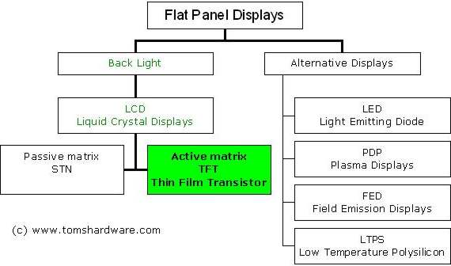
Various Flat Panel Displays

Slide 19
Plasma Display Panel (PDP)
Utilizes small cells containing electrically charged ionized gases called fluorescent lamps
Advantages
  Better picture quality
  Wider viewing angles
  Less visible motion blur
Disadvantages
  Screen burn-in
  Uses more electricity than LCDs

Slide 20
Light Emitting Diodes (LED)
uses light-emitting diodes as a video display
produce images with greater dynamic contrast;
can be extremely slim, some screens less than half an inch (0.92 cm) thick;[6]
produce less environmental pollution on disposal;
are more expensive;
have typically 20 to 30% lower power consumption

Slide 21
Other Types of Monitors
Paper-white displays
  High contrast between fore and background
Electro-luminescent displays (ELD)
  Similar to LCD
  phosphorescent film held between two sheets of glass.
  A grid of wires sends current through the film to create an image

Slide 22
Comparing Monitors
Monitors impacts user effectiveness
Monitors should have
  Crisp text
  Clear graphics
  Adjustable controls
  Clear edges
Comparison specifications
  Size
  Resolution
  Refresh rate
  Dot Pitch

Slide 23
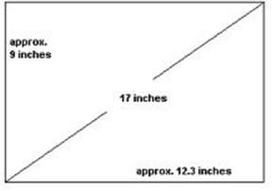
Size of Monitor
Measured in inches
Measured diagonally
Actual size
  Distance from corner to corner
Viewable size
  Useable portion of the screen
As a rule of thumb, buy the largest monitor you can afford.
17 Inch Monitor
Notes:
Teaching tip
It is helpful to draw the relationship between viewable and actual size.

Slide 24
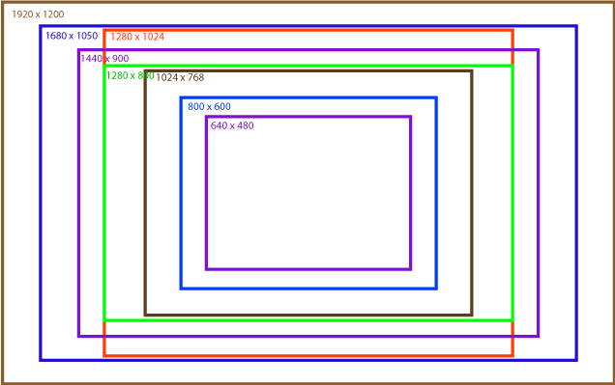
Resolution
Refers to sharpness of image
Number of pixels on the screen
Higher number creates sharper images
Higher number creates smaller images
Notes:
Insider information
Many CRT’s are capable of supporting several resolutions. LCD monitors in contrast often can only support one or two resolutions. The reason are the transistors on the LCD cannot move, while the electron gun on the CRT can simply aim for a smaller pixel.
If you are in a computer class, stop and have students adjust their resolution on the screen. The simplest method is to right click the desktop and select properties. Click the settings tab, and adjust the slider. As the students are experimenting, have a student answer why larger resolution numbers make smaller images. The answer is higher resolutions draw with smaller pixels.

Slide 25
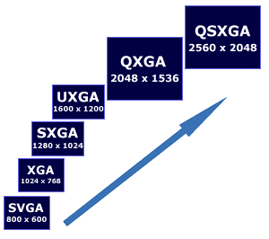
Various Screen Resolution
Color Graphics Adapter (CGA)
  300 X 200
Enhanced Graphic Adapter (EGA)
  640 X 350
Video Graphic Array (VGA)
  640 x 480

Slide 26
Refresh Rate
Number of time the screen is redrawn
Measured in Hertz (Hz)
Modern equipment sets this automatically
Improper settings can cause eyestrain
Whenever a TV camera films a computer monitor, the monitor seems to have a line moving up the screen.
  This is the monitor refreshing the pixels.
  The camera films faster than the eye can see, which is why the refresh is noticeable.
Notes:
Insider information
Whenever a TV camera films a computer monitor, the monitor seems to have a line moving up the screen. This is the monitor refreshing the pixels. The camera films faster than the eye can see, which is why the refresh is noticeable.

Slide 27

Dot Pitch
Distance between the same color dots
Ranges between .15 mm (fine) and .40 mm (coarse)
Smaller creates a finer picture
Should be less than .22

Slide 28
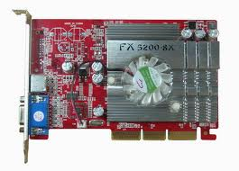
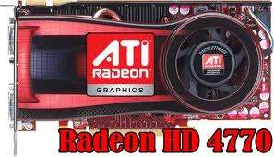
Video Cards
Device between the CPU and monitor
Better cards result in better output
Removes burden of drawing from CPU
Have their own processor and RAM
Modern cards have up to 8GB VRAM
Capable of rendering 3D images
ATI’s Radeon and NVIDIA’s GeForce
Notes:
Insider information
The two leading video card families are ATI’s Radeon and NVIDIA’s GeForce line. Both offer exceptional graphics cards ranging from $50 to $600.

Slide 29
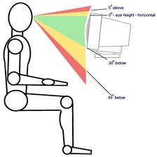
Ergonomics and Monitors
Eyestrain
  Fatigue of the eyes
  Steps to avoid
    Choose a good monitor
    Place the monitor 2 – 3 feet away
    Center of screen below eye level
    Avoid reflected light

Slide 30
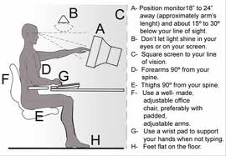
Ergonomics and Monitors

Slide 31
Electronic Magnetic field (EMF)
Generated by all electronic devices
EMF may be detrimental to health
Steps to avoid
  Keep the computer at arms length
  Take frequent breaks
  Use an LCD monitor
Notes:
Teaching tip
Point out to the students that no conclusive study exists that directly list EMF as a cause of cancer, reduced muscle tone or reduced brain function. For more information see http://www.hhs.gov/ and search for EMF.

Slide 32
Data Projectors
Replaced overhead and slide projectors
Project image onto wall or screen
LCD projectors
  Most common type of projector
  Small LCD screen
  Very bright light
  Require a darkened room

Slide 33
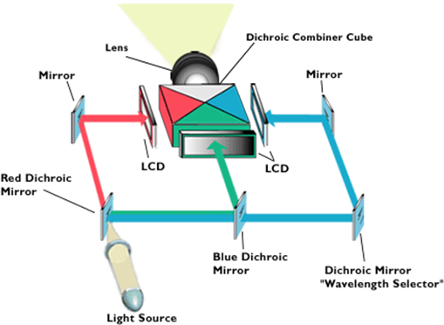
LCD Projectors
A series of mirrors control the display
May be used in a lighted room

Slide 34
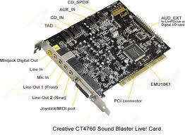
Sound Systems
Integral part of the computer experience
Capable of recording and playback

Slide 35
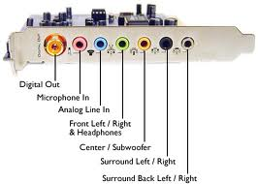
Sound Cards
Device between the CPU and speakers
Converts digital sounds to analog
Can be connected to several devices
Modern cards support Dolby Surround Sound
Notes:
Insider Information
Sound Blaster is the primary manufacturer of sound cards. Exceptional models start at around $30.00.

Slide 36

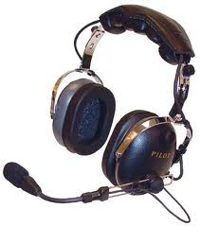
Headphones and Headsets
Replacement for speakers and microphones
Offer privacy
Does not annoy other people
Outside noise is not a factor
Headsets have speakers and a microphone
Notes:
Insider information
The PS2 game SOCOM II Navy Seals includes a USB headset to allow verbal communication with other team members.

Slide 37
Summary
Output Devices
Monitors
  CRT, LCD, PDP
Comparing Monitors
  Size
  Resolution
  Refresh rate
  Dot pitch

Slide 38
Summary
Video Cards
Ergonomics and Monitors
Electronic Magnetic Field (EMF)
Data Projectors
LCD Projector
Speakers and Sound Systems
Sound Cards
Headphone and Headsets

Slide 39
Recommended Websites
http://www.lynda.com/resources/hexpalette/hue.html
https://en.wikipedia.org/wiki/Plasma_display
https://en.wikipedia.org/wiki/LED_display
https://en.wikipedia.org/wiki/Video_card
http://www.tech-faq.com/how-lcd-projectors-work.html

