Slide 1
CSC 101
Introduction to Computing
Lecture 5
Dr. Iftikhar Azim Niaz
ianiaz@comsats.edu.pk

Slide 2
Last Lecture Summary I
Using Keyboard and Mouse
Keyboard
  Keyboard Layout
  Five Groups of Keys
    Alphanumeric, Numeric Keypad, Function, Modifier, Cursor movement
  Special Purpose keys
  Internet and multimedia controls
  How keyboard works
  Dvorak and other non-standard keyboard layoputs

Slide 3
Last Lecture Summary II
Mouse
  Types of Mouse
    Mechanical mouse
    Optical Mouse
  Interacting with the Mouse
    Five techniques
    pointing, clicking, double-clicking, dragging, and right-clicking
  Track Ball
  Track Pad
  Track Point

Slide 4
Ergonomics and Input Devices
Ergonomics
  which is the study of the physical relationship between people and their tools—such as computers— addresses these issues.
People recognize the importance of having ergonomically correct computer furniture
Ergonomically correct
  means that a tool or a workplace is designed to work properly with the human body, and
  thus reduces the risk of strain and injuries.

Slide 5
Repetitive Strain Injury (RSI)
an injury of the musculoskeletal and nervous systems that may be caused by
  repetitive tasks,
  forceful exertions,
  vibrations,
  mechanical compression (pressing against hard surfaces),
  sustained, or
  awkward positions
Caused by continuous misuse of the body in ways it was not designed to work
Many professions suffer from RSI

Slide 6
Carpel Tunnel Syndrome
Carpal tunnel is a passage way in the wrist through which nerves pass
Holds nerves and tendons
Prolonged keyboarding swells tendons
Median nerve is compressed at wrist
Resulting in numbness or pain or the inability to use the hands
victims can miss weeks or months of work.
In extreme cases, surgery is required.
Notes:
Teaching tip
Hairstylists often suffer from carpal tunnel. Bicyclists can suffer from overuse injuries of the knee.
Page 116 of the text has a diagram of the carpal tunnel.

Slide 7
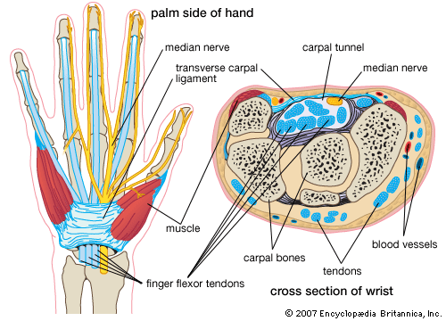
Carpal Tunnel Syndrome
http://kids.britannica.com/comptons/article-9318834/carpal-tunnel-syndrome

Slide 8
Avoiding Keyboard Related Injuries
To avoid RSIs set the workspace in an ergonomically friendly way
Choose comfortable office furniture
Office chair should:
  Allow you to adjust its height.
  Provide good lower-back support.
  Have adjustable armrests
The desk should
  hold your keyboard and mouse at the proper height,
  your hands are at the same height as your elbows (or a few inches lower) when you hold them over the keyboard.

Slide 9
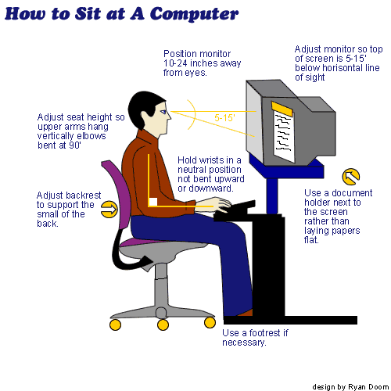
Avoiding Keyboard Related Injuries

Slide 10
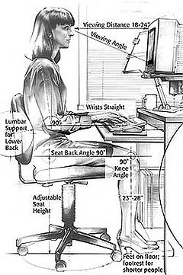
How To Sit At a Computer

Slide 11
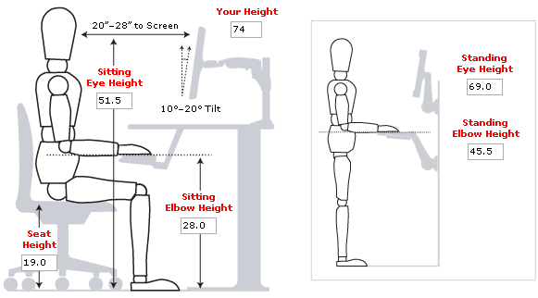
How To Sit At a Computer

Slide 12
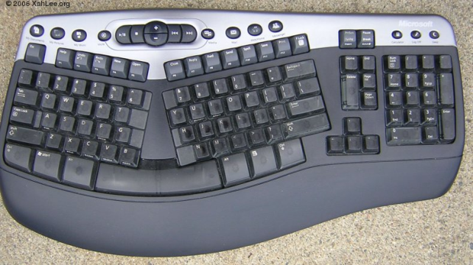

Techniques to Avoid RSI
Use an ergonomic keyboard
Sit up straight
Have a padded wrist support
Keep your arms straight
Keyboard properly
Take frequent breaks

Slide 13
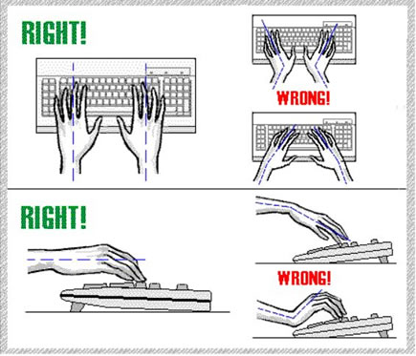
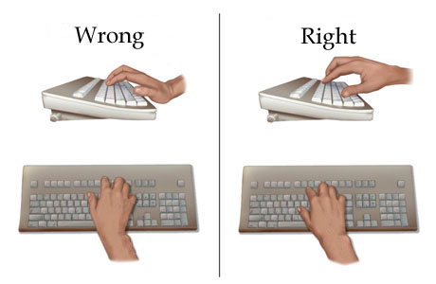
Keep Your Wrists Straight

Slide 14
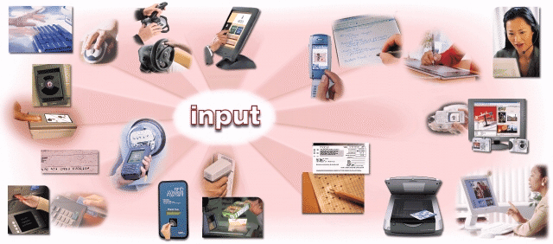
Alternate Input Devices

Slide 15
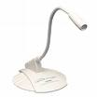
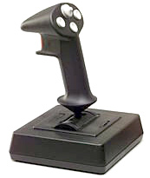

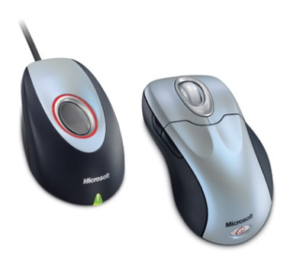
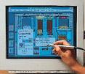

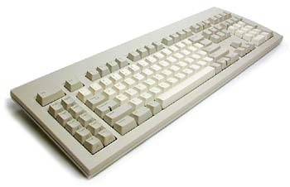

Few Basics: Input Devices
Mouse
Keyboard
Joystick
Light pen
Bar Code Reader
Tablet
Camera
Microphone

Slide 16

Devices for the Hand - Pen
  Tablet PCs, PDA
  Pen used to
  write data
  Pen used as
  a pointer
  Handwriting recognition is difficult
  On screen keyboard
  Not used for inputting large volume of data
Notes:
Teaching tip
Microsoft has a demonstration of the tablet PC pen based input. Point your browser to http://www.microsoft.com/windowsxp/tabletpc/evaluation/tours/default.mspx and follow the tours.

Slide 17
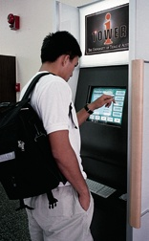
Touch Screens
accept input by allowing the user to place a fingertip directly on the computer screen
Use sensors to detect touch
Well suited for simple applications
  ATM
  Public information kiosk
Notes:
Discussion point
Discuss the information kiosks at local malls. Many offer limited Internet access. Have students discuss what could happen to the computers if the malls were to provide keyboards to the mall shoppers.

Slide 18
Touch Screens
work well in environments where dirt or weather would render keyboards and pointing devices useless, and
where a simple, intuitive interface is important.
Touch screens have become common in
  fast-food restaurants,
  department stores,
  drugstores, and supermarkets,
  where they are used for all kinds of purposes, from creating personalized greeting cards to selling lottery tickets.
Notes:
Discussion point
Discuss the information kiosks at local malls. Many offer limited Internet access. Have students discuss what could happen to the computers if the malls were to provide keyboards to the mall shoppers.

Slide 19
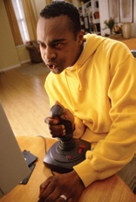
Game Controllers
Enhances gaming experience
Provide custom input to the game
Modern controllers offer feedback
Two broad Categories
  Joystick
  Game pad
Notes:
Teaching tip
Microsoft’s Force Feedback joysticks vibrate. In driving games, when the player hits another car, the joystick will vibrate.

Slide 20
Joystick
Around for long time
Can be used other than games
enable the user to “ fly” or “ drive” through a game, directing a vehicle or character
popular in racing and flying games
One variant is the racing game controller, which includes an actual steering wheel
some racing game controllers even include foot pedals and gearshifts
Notes:
Teaching tip
Microsoft’s Force Feedback joysticks vibrate. In driving games, when the player hits another car, the joystick will vibrate.

Slide 21
Game Pad
is a small, flat device that usually provides two sets of controls— one for each hand.
extremely flexible and are used to control many kinds of games
If you do not have a joystick, you can use a game pad to control most racing and flying games.
Many computer games still provide support for a mouse or keyboard, so a dedicated game controller is not always required
Notes:
Teaching tip
Microsoft’s Force Feedback joysticks vibrate. In driving games, when the player hits another car, the joystick will vibrate.

Slide 22
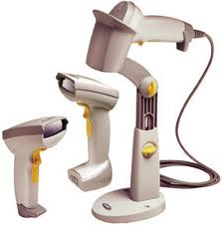
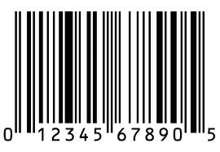
Optical Input Devices
Allows the computer to see input
Bar code readers
  Converts bar codes to numbers
    UPC Universal Product Code
  Computer find number in a database
  Works by reflecting light
    Amount of reflected light indicates number
Notes:
Insider information
For more information on the UPC code and a searchable database, visit http://www.upcdatabase.com/. A working UPC is 071662000240, which represents a 24 count box of Crayola Crayons.

Slide 23
Bar Code Reading Process
reader emits a beam of that is reflected by the bar code image
light-sensitive detector identifies the bar code image by recognizing special bars at both ends of the image
special bars are different, so the reader can tell whether the bar code has been read right-side up or upside down
After detector has identified the bar code, it converts the individual bar patterns into numeric digits code the computer can understand
reader then feeds the data into the computer
Notes:
Insider information
For more information on the UPC code and a searchable database, visit http://www.upcdatabase.com/. A working UPC is 071662000240, which represents a 24 count box of Crayola Crayons.

Slide 24
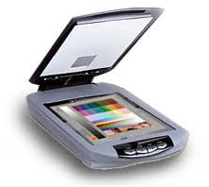
Image Scanners
Converts printed media into electronic
Reflects light on the image
Sensors read the intensity
Filters determine color depths
Notes:
Teaching tip
Spend a few minutes here discussing computer screen colors. A good website to look at colors is http://www.radok.com/web-safe-colors_rgb.html. To demonstrate how computers generate color, use the custom color creator in Paint.

Slide 25
How an Image is Scanned
A light source is moved across a printed page
The light bounces off the page and is passed through a lens
And onto the light sensitive diodes which converts light to electricity. There are usually 300-600 diodes per inch.
A circuit board converts the electricity to numbers and send the information to the computers
Notes:
Teaching tip
Spend a few minutes here discussing computer screen colors. A good website to look at colors is http://www.radok.com/web-safe-colors_rgb.html. To demonstrate how computers generate color, use the custom color creator in Paint.

Slide 26
Color Scanners
use filters to separate the components of color into the primary additive colors (red, green, and blue) at each point
Red, Green, and Blue (RGB) are primary additive colors because they can be combined to create any other color
The image scanner is useful because it translates printed images into an electronic format that can be stored in a computer’s memory
Notes:
Teaching tip
Spend a few minutes here discussing computer screen colors. A good website to look at colors is http://www.radok.com/web-safe-colors_rgb.html. To demonstrate how computers generate color, use the custom color creator in Paint.

Slide 27
Optical Character Recognition (OCR)
Converts scanned image into editable text
Image is stored in the computer’s memory as a bitmap.
Bitmap is a grid of dots, each dot represented by one or more bits
translate that array of dots into text that the computer can interpret as letters and numbers
Notes:
Teaching tip
Many companies ask for a plaintext resume. This is a resume, typed in Courier or other easy to read font, with no formatting. The intent is to allow the company to scan the resume for future searching. OCR technology makes this possible. For more information, see the website http://www.quintcareers.com/scannable_resumes.html.

Slide 28
Optical Character Recognition (OCR)
Each letter is scanned
Letters are compared to known letters
Best match is entered into document
Rarely 100% accurate
Notes:
Teaching tip
Many companies ask for a plaintext resume. This is a resume, typed in Courier or other easy to read font, with no formatting. The intent is to allow the company to scan the resume for future searching. OCR technology makes this possible. For more information, see the website http://www.quintcareers.com/scannable_resumes.html.

Slide 29
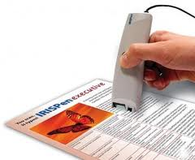
Scanner types
Handheld scanners
  more portable but typically require multiple passes to scan a single page
Flatbed scanners
  offer higher-quality reproduction than do handheld scanners and
  can scan a page in a single pass
Notes:
Teaching tip
Many companies ask for a plaintext resume. This is a resume, typed in Courier or other easy to read font, with no formatting. The intent is to allow the company to scan the resume for future searching. OCR technology makes this possible. For more information, see the website http://www.quintcareers.com/scannable_resumes.html.

Slide 30
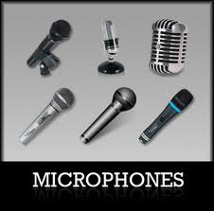
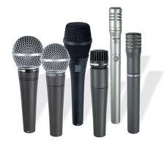
Audiovisual Input Devices
Microphones
  Used to record speech
  Speech recognition
    “Understands” human speech
    Allows dictation or control of computer
    Matches spoken sound to known phonemes
    Enters best match into document
Notes:
Insider information
Two common products are IBM’s Via Voice and Scansoft Dragon NaturallySpeaking. More information for ViaVoice can be found at http://www-306.ibm.com/software/voice/viavoice/. More information regarding Dragon is located at http://www.scansoft.com/naturallyspeaking/.

Slide 31
Speech Recognition
demand for translating spoken words into text
Translating voice to text is a capability known as speech recognition (or voice recognition).
With it, you can dictate to the computer instead of typing, and you can control the computer with simple commands
translates Phonemes into text or commands
Notes:
Insider information
Two common products are IBM’s Via Voice and Scansoft Dragon NaturallySpeaking. More information for ViaVoice can be found at http://www-306.ibm.com/software/voice/viavoice/. More information regarding Dragon is located at http://www.scansoft.com/naturallyspeaking/.

Slide 32
Other type of Audio Input
Computers can accept many kinds of audio input
Sound card with the appropriate plugs
  a compact disc
  a tape player
  a radio or
  even a record player
If the audio source outputs sounds in the form of analog, sound card must convert the analog signals into digital code so the computer can store and use it.
Notes:
Insider information
Two common products are IBM’s Via Voice and Scansoft Dragon NaturallySpeaking. More information for ViaVoice can be found at http://www-306.ibm.com/software/voice/viavoice/. More information regarding Dragon is located at http://www.scansoft.com/naturallyspeaking/.

Slide 33
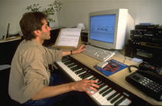
Musical Instrument Digital Interface (MIDI)
Connects musical instruments to computer
Digital recording or playback of music
Musicians can produce professional results

Slide 34
Video Input
With growth of multimedia and the Internet, computer users are adding video input capabilities to their systems in great numbers
Applications such as video conferencing enable people to use full-motion video images
Videos are commonly used in presentations and on Web pages

Slide 35
Video Camera and Webcam
video cameras used with computers digitize images by breaking them into individual pixels
pixel is one or more dots that express a portion of an image
Each pixel’s color and other characteristics are stored as digital code
With Webcam the user can “capture” images of himself or herself while working at the computer

Slide 36
Digital Cameras
portable, handheld devices that capture still images
digitizes the image
compresses it, and
stores it on a special memory card.
user can then copy the information to a PC, where the image can be edited, copied, printed, embedded in a document, or transmitted to another user

Slide 37
Digital Cameras
Digital cameras have become standard equipment for designers of all kinds.
In Web page design,digital cameras enable designers to shoot a subject and quickly load the images onto their computers.
This process saves the step of acquiring existing photographs or developing and printing film-based photos—which must be scanned into the computer.
Designers can update a Web site’s illustrations quickly and regularly using digital cameras.
Graphic designers can edit and enhance digital photographs in innumerable ways, using photo-editing software

Slide 38
Summary
Ergonomics and input devices
Repetitive Stress Injuries
Carpel Tunnel Syndrome
Avoiding Keyboard related injuries
How to sit at a computer
Techniques to avoid RSI

Slide 39
Summary
Alternate Input devices
Devices for the hand
  Pen, Touch Screens
Game controllers
  Joystick Game pad
Optical Input Devices
Audio Input devices
Video input devices

Slide 40
Recommended Websites
https://en.wikipedia.org/wiki/Repetitive_strain_injury
https://en.wikipedia.org/wiki/Carpal_tunnel_syndrome

