Slide 1
CSC 101
Introduction to Computing
Lecture 4
Dr. Iftikhar Azim Niaz
ianiaz@comsats.edu.pk

Slide 2
Last Lecture Summary I
Parts of the Computer System
  Hardware
  Software
  Data
  People
Information Processing Cycle
  Input
  Processing
  Output
  Storage

Slide 3
Last Lecture Summary II
Computer Hardware
  Processor, Memory, Motherboard
  Input Devices
  Output Devices
    Communication devices
  Storage Devices
    Magnetic storage devices, Floppy Hard disk
    Optical storage devices, CD, DVD, Blu Ray
Computer Software
  System software and Application software
Computer Users

Slide 4
Using the input devices
CPU is computer brain the input devices are its sensory organs
From user point of view, input device are important
Enables user to enter information and commands into the computer
Two common input devices
  Keyboard
  Mouse

Slide 5
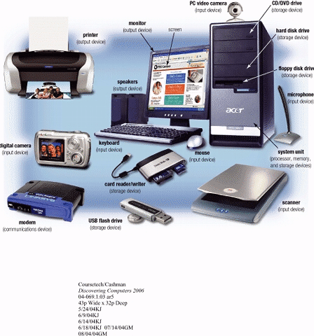
Input Devices
Hardware used to enter data and instructions

Slide 6
Two Common Input Devices
Keyboard
Mouse

Slide 7
The Keyboard
First peripheral to be used with computers
The most common input device for inputting text and numbers
About 100 keys
Must be proficient with keyboard
Skill is called keyboarding

Slide 8
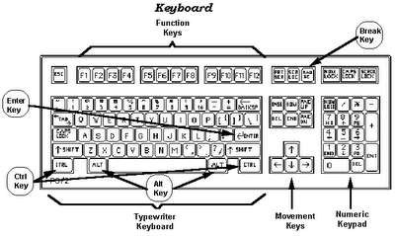
Standard Keyboard Layout
IBM Enhanced Keyboard with 101 keys

Slide 9
Five Groups of Keys
Alphanumeric Keys
Modifier Keys
Numeric Keypad
Function Keys
Cursor Movement keys

Slide 10
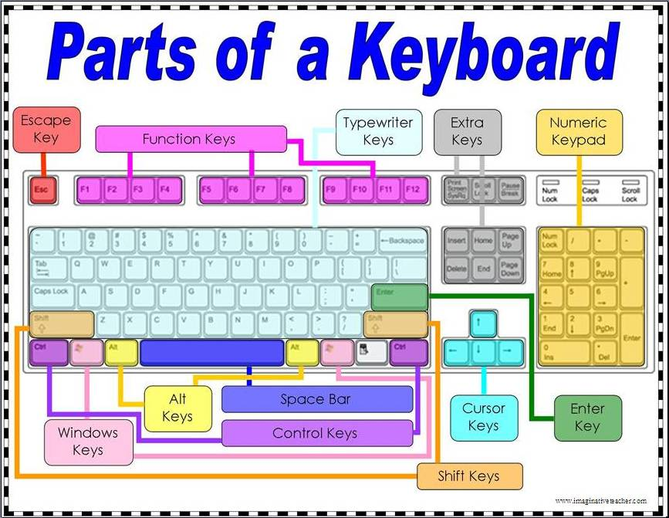

Slide 11
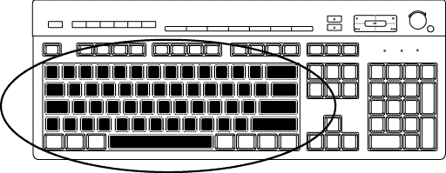
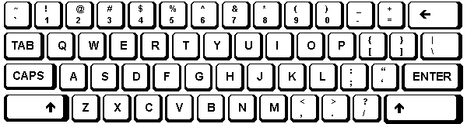
Alphanumeric Keys
Area of computer that looks like a typewriter
Sometimes called QWERTY
Keys having specific functions
  Tab
  Caps Lock
  Backspace
  Enter

Slide 12
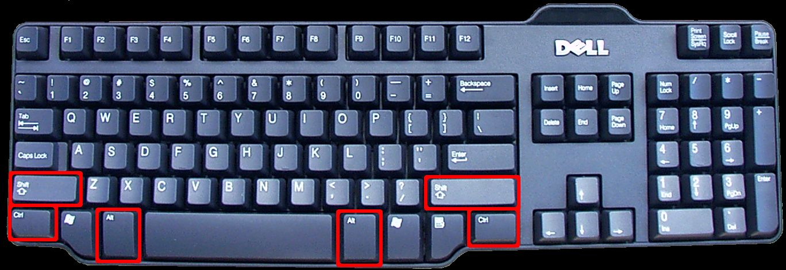
Modifier Keys
Shift
Alt (Alternate)
Ctrl (Control)
Modify the input of other keys

Slide 13
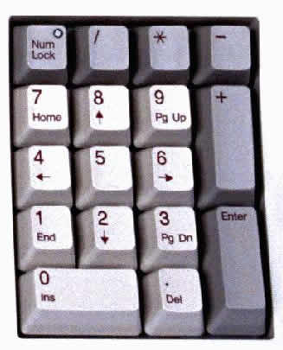
Numeric Keypad
usually located on the right side of the keyboard,
Has 10 digits and mathematical operators (+, -, *, and /).
also features a NumLock key
  On - forces the numeric keys to input numbers.
  Off - perform cursor movement control and other functions.

Slide 14
Function Keys
labeled F l, F2, and so on
  in a row along the top of the keyboard.
allow you to input commands without typing long strings of characters or navigating menus or dialog boxes.
Each key's purpose depends on the program you are using.
Many programs use function keys along with modifier keys to give the function keys more capabilities.

Slide 15
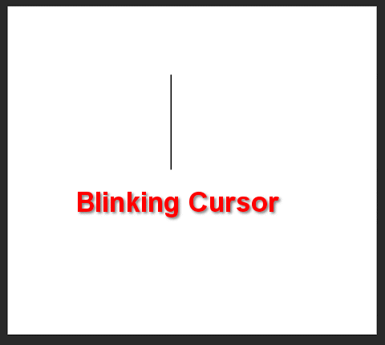
Cursor Movement Keys
let you move around the screen without using a mouse.
Cursor is a mark on the screen indicates where the characters you type will be entered
Arrow Keys
Home and End
PgUp and PgDn

Slide 16
Special Purpose Keys
Esc (Escape)
Insert
Delete
PrtSc (Print Screen)
ScrLk (Scroll Lock)
Pause
Two special for Microsoft Windows
  Start
  Shortcut

Slide 18
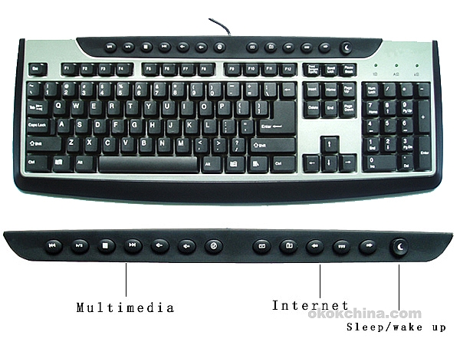
Internet and Multimedia Controls
One of the latest trends is the addition of Internet and multimedia controls.
Microsoft's Internet Keyboard and MultiMedia Keyboard,
  e.g. you can use the buttons to launch a Web browser, check e-mail and start your most frequently used programs.
Multimedia buttons
  control the computer’s CD-ROM or DVD drive
  adjust the speaker volume

Slide 19
How Keyboard Works
Key is pressed on keyboard
Keyboard controller detects a key press
  Keeps the code in its memory, Keyboard buffer
  Code represents the key pressed
Controller notifies the operating system via an interrupt
Operating system responds the interrupt by the reading the code from buffer
OS passes the code to CPU
Notes:
Teaching tip
Table 5A.3 presents the ASCII code. An exercise that never fails to amuse students is to use the Alt and the number pad to enter letters into an application. As before, open MS Word. Have students hold down the Alt key and type an ASCII value into the number pad. Once they release the Alt, the letter appears. This is a useful skill when the keyboard breaks. Challenge the students to explore numbers above 128.

Slide 20
Dvorak Keyboards
For people who type with one hand or finger
Reduce the amount of motion required to type common English text
Increase typing rate
Reduced errors
But Qwerty is still popular

Slide 21
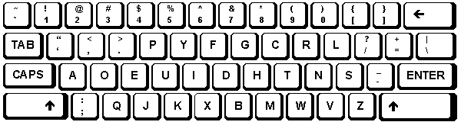
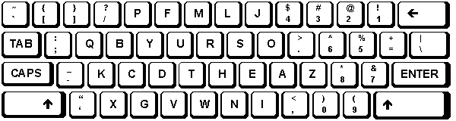
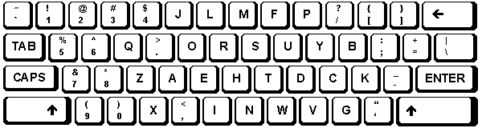
Dvorak Keyboards
Both Hands
Left Hand
Right Hand
http://www.microsoft.com/enable/products/altkeyboard.aspx

Slide 22
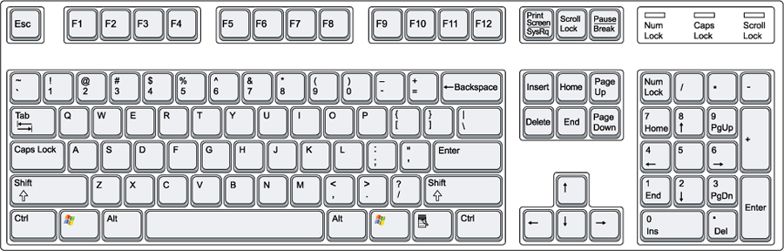
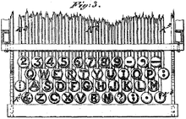
QWERTY Keyboard Layout
Latham Sholes' 1878 QWERTY keyboard layout

Slide 23
Non-standard layout and special-use
Chorded keyboard
Software or virtual keyboard
Foldable keyboard
Projection (as by Laser)

Slide 24
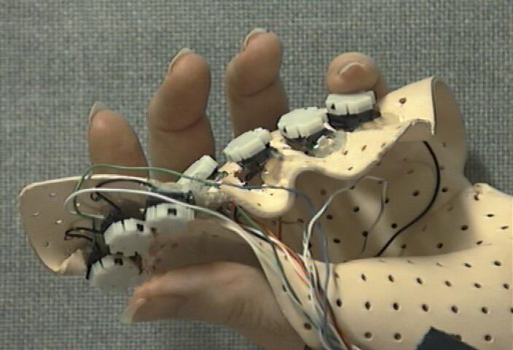
Chorded Keyboard
Associate actions with combinations of key presses
As many combinations available, chorded keyboards can effectively produce more actions on a board with fewer keys
Court reporters mostly use them

Slide 25
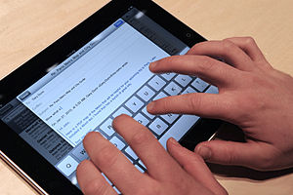
Software or Virtual Keyboards
is a software component that allows a user to enter characters.
usually be operated with multiple input devices,
  Touch screen,
  Actual keyboard and
  Mouse.

Slide 26
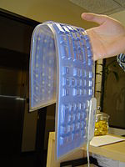
Foldable Keyboards
made of soft plastic or silicone which can be rolled or folded on itself for travel
When in use, these keyboards can conform to uneven surfaces, and
are more resistant to liquids than standard keyboards.
connected to portable devices and smart phones.

Slide 27
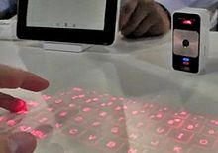
Projection Keyboard
project an image of keys, usually with a laser, onto a flat surface.
The device then uses a camera or infrared sensor to "watch" where the user's fingers move
Projection keyboards can simulate a full size keyboard from a very small projector.

Slide 28
Wireless Keyboard
provides increased user freedom
includes a required combination transmitter and receiver unit that attaches to the computer's keyboard port.
The wireless aspect is achieved either by radio frequency (RF) or by infrared (IR) signals sent and received from both the keyboard and the unit attached to the computer.
A wireless keyboard may use an industry standard RF, called Bluetooth.

Slide 29
The Mouse
All modern computers have a variant
Allows users to select objects
  Pointer moved by the mouse
Mechanical mouse
  Rubber ball determines direction and speed
  The ball often requires cleaning
Optical mouse
  Light shown onto mouse pad
  Reflection determines speed and direction
  Requires little maintenance

Slide 30
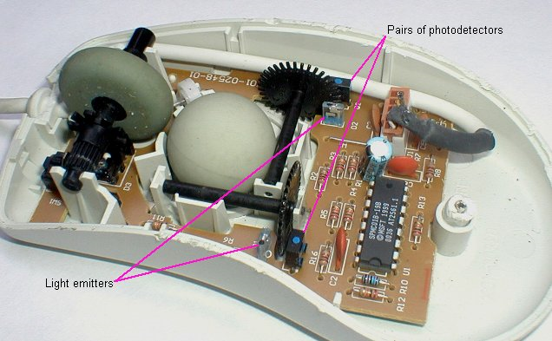
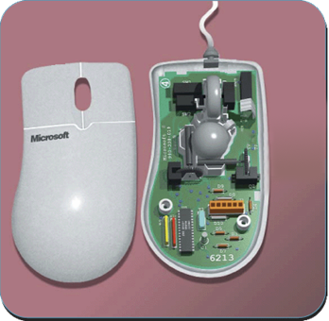
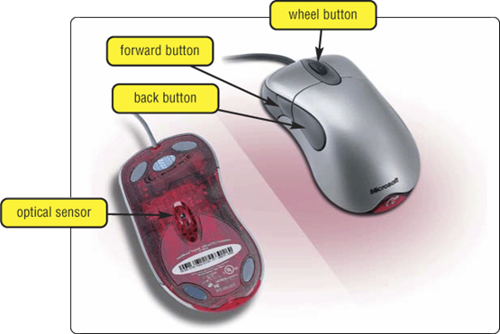
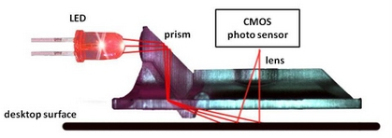
The Mouse
mouse buttons
wheel button
ball

Slide 31
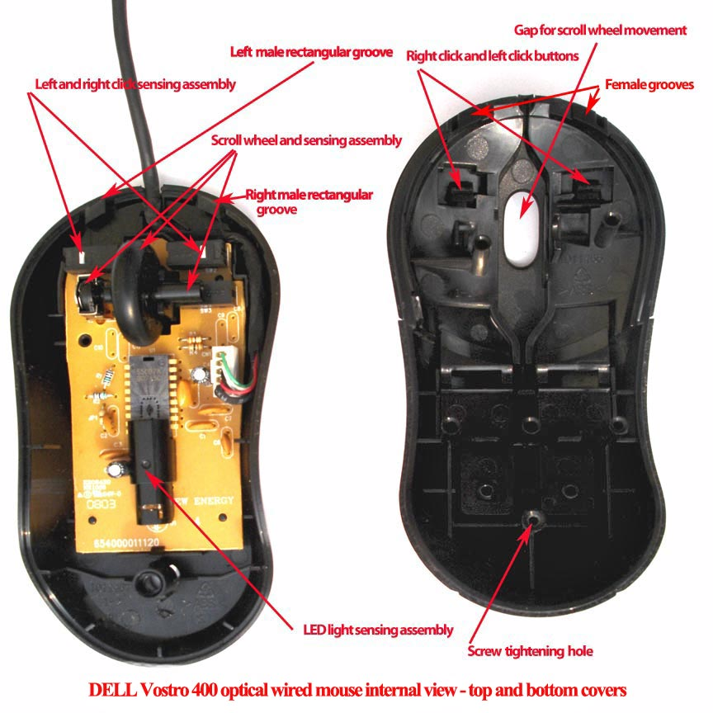
Optical Mouse

Slide 32
Benefits of Using Mouse
Pointer positioning is fast
Menu interaction is easy
Users can draw electronically

Slide 33
Interacting With a Mouse
Actions involve pointing to an object
Clicking selects the object
Double clicking the object
Clicking and holding drags the object
Releasing an object is a drop
Right clicking activates the shortcut menu
Modern mice include a scroll wheel
Notes:
Insider information
Douglas Englebart patented the first mouse in 1970 as the “X-Y position indicator for a display system.” The name mouse comes from the tail on the device.

Slide 34
Mouse Button Configuration
Configured for a right-handed user
  Can be reconfigured for left handed
Between 1 and 6 buttons
Extra buttons are configurable

Slide 35
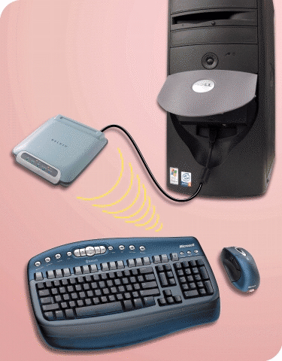
Cordless Keyboard and Mouse
  Communicate with a receiver attached to a port on the system unit
  Use infra-red (IR) or radio frequency (RF) technology

Slide 36
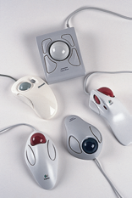
Variants of the Mouse
Trackballs
  Upside down mouse
  Hand rests on the ball
  User moves the ball
  Uses little desk space
  Mostly two buttons
  Can be configured for both
    right-handed and
    Left-handed use

Slide 37
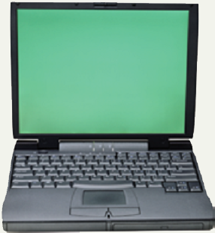
Track Pads
Stationary pointing device
Small plastic rectangle
Finger moves across the pad
Pointer moves with the pointer
Popular on laptops

Slide 38
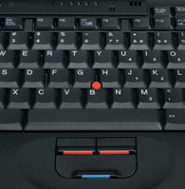
Track Point
Track point
  Little joystick on the keyboard between G, H & B keys
  Move pointer by moving the joystick
  Two buttons beneath Spacebar same as mouse
  Save great of time and effort
Notes:
Insider information
The term track point is copyrighted by IBM.

Slide 39
Summary
Standard input devices
Standard Keyboard
Five groups of Keys
How Keyboard works ?
Dvorak Keyboard
Non standard layout and Special Use
The Mouse
Five Techniques of using Mouse
Variants of Mouse

Slide 40
Recommended Websites
https://en.wikipedia.org/wiki/Computer_keyboard
https://en.wikipedia.org/wiki/Function_Keys
https://en.wikipedia.org/wiki/Chorded_keyboard
https://en.wikipedia.org/wiki/Virtual_Keyboard
https://en.wikipedia.org/wiki/Flexible_electronics
https://en.wikipedia.org/wiki/Projection_keyboard
https://en.wikipedia.org/wiki/Keyboard_technology
https://en.wikipedia.org/wiki/Computer_mouse
https://en.wikipedia.org/wiki/Trackball
https://en.wikipedia.org/wiki/Optical_mouse
https://en.wikipedia.org/wiki/Track_point

