Slide 1
CSC 101
Introduction to Computing
Lecture 32
Dr. Iftikhar Azim Niaz
ianiaz@comsats.edu.pk
1

Slide 2
Last Lecture Summary I
Countermeasures
Avoiding Identity Theft
Protecting your privacy
Managing Cookies and spyware
Protection from Malware
Protecting your System
Backup your system
Unauthorized Access and Use
Preventing Unauthorized Access and Use
2

Slide 3
Last Lecture Summary II
Digital Forensics
Hardware Theft and Vandalism
Software Theft
Information Theft
Handling Storage Media
Health Concerns of Computer Use
Ethics and Society
  Computer Ethics, Copyright and Intellectual Property Rights, IT Code of Conduct
  Green computing, Information privacy
3

Slide 4
Objectives Overview
Discuss the special information requirements of an enterprise-sized corporation
Identify information systems and software used in the functional units of an enterprise
Describe and list general purpose and integrated information systems used throughout an enterprise
Describe and list types of technologies used throughout an enterprise
Describe virtualization, cloud computing, and grid computing

Slide 5
Objectives Overview
Discuss the computer hardware needs and solutions for an enterprise
Discuss high availability, scalability, and interoperability
Determine why computer backup is important and how it is accomplished
Discuss the steps in a disaster recovery plan

Slide 6
Enterprise
Enterprise is large organization such as multinational corporation, university, hospital, research laboratory, or government organization
Requires special computing solutions because of its size
Enterprise manages large amounts of information over an extensive geographical area and disparate groups of people

Slide 7
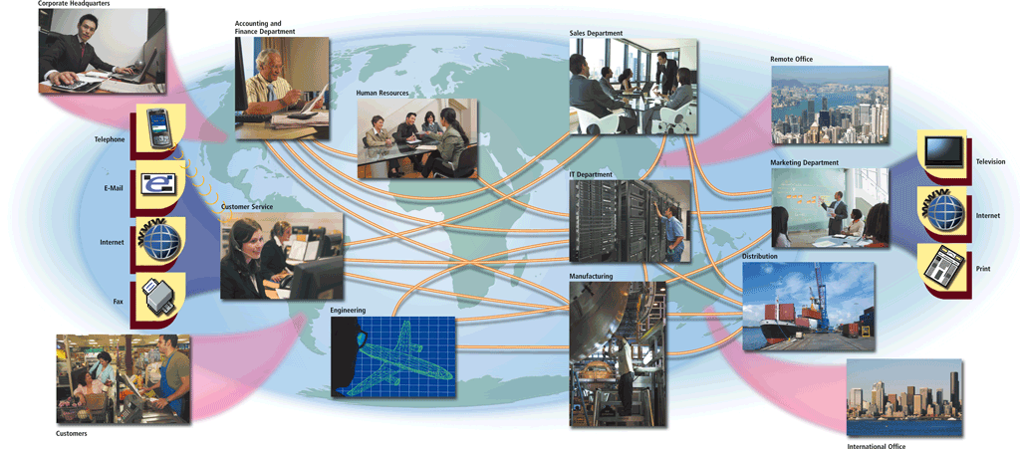
Enterprise Computing
Enterprise computing involves the use of computers in networks, such as LANs and WANs, or a series of interconnected networks that encompass a variety of different operating systems, protocols, and network architectures
Notes:
Figure 14-1
Enterprise is large organization such as multinational corporation, university, hospital, research laboratory, or government organization
Requires special computing solutions because of its size
How does information flow within an enterprise?
Enterprise manages large amounts of information over an extensive geographical area and disparate groups of people

Slide 8
Enterprise Types
Types of enterprises include
Retail
Manufacturing
Service
Wholesale
Government
Educational
Transportation

Slide 9
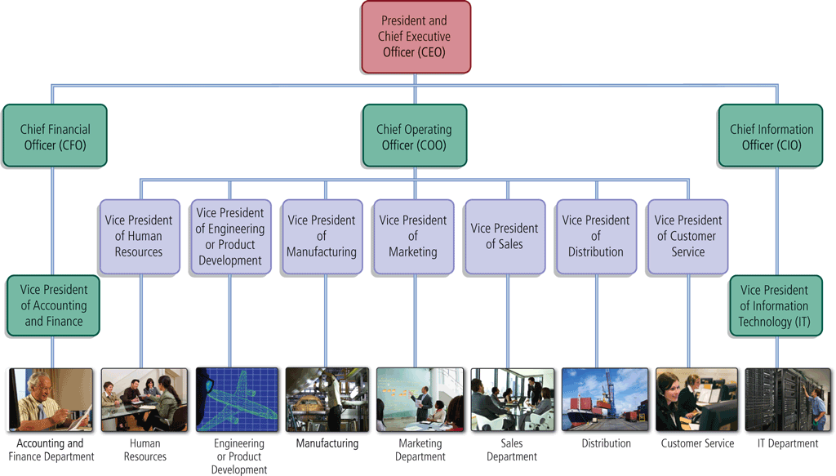
Enterprise Organization
Most traditional enterprises are organized in a hierarchical manner
Centralized vs Decentralized Approach
Notes:
Figure 14-2

Slide 10
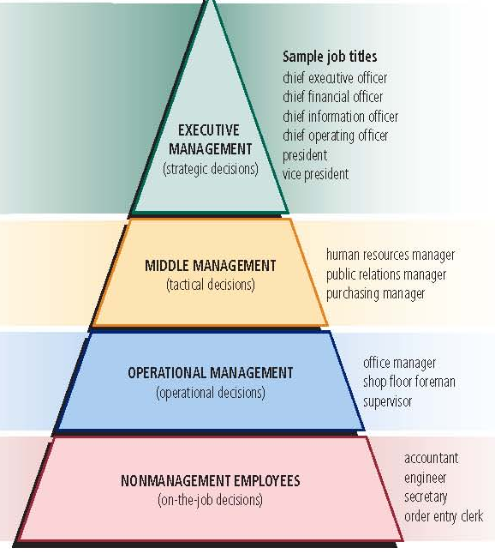
Levels of Users in Enterprise
In an enterprise, users typically fall into one of four categories:
Notes:
Figure 14-3

Slide 11
Enterprise Information
Enterprise information is the information gathered in the ongoing operations of an enterprise-sized organization
Collected, combined and analyzed overtime
Allows managers to make better decisions
  Business intelligence
  Business process management
  Business process automation

Slide 12
Enterprise Management Activities
Managers coordinate resources by performing four activities
1. Planning
objectives
strategies
tactics
2. Organizing
money
people
management structure
3. Leading
communications
instructions
motivation
4. Controlling
performance
measurement
corrective action
Notes:
Figure 14-4

Slide 13
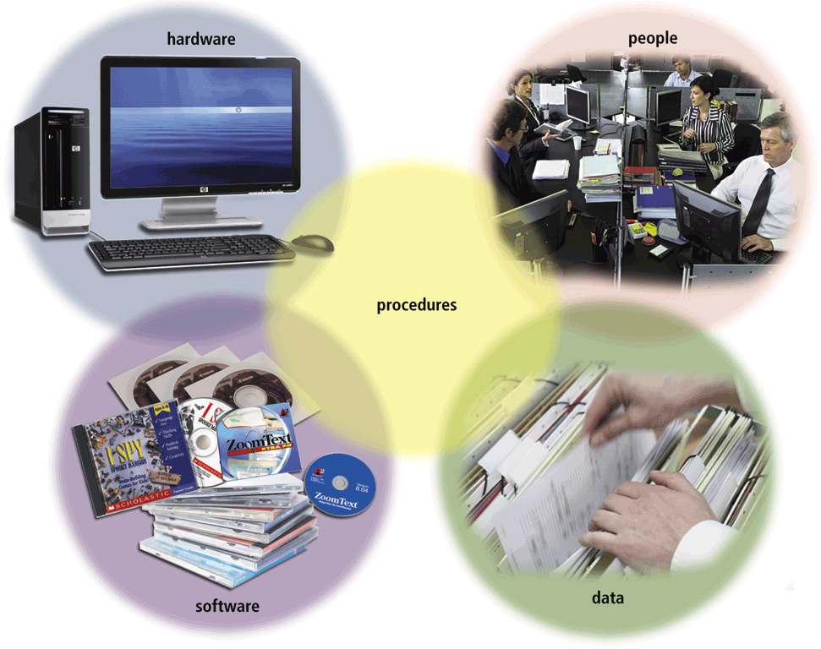
Information Systems in the Enterprise
An information system is a set of hardware, software, data, people, and procedures that work together to produce information
Procedures are instructions users follow to accomplish activities
An IS supports daily, short-term, and long-range activities of users in a company
Notes:
Figure 14-5

Slide 14
Functional Units
  Functional units is an Individual operating entity, which can include departments, centers, and divisions
  Within an enterprise might include:
Enterprise
Accounting and Finance
Human Resources
Engineering or Product Development
Manufacturing
Marketing
Sales
Distribution
Customer Service
Information Technology

Slide 15
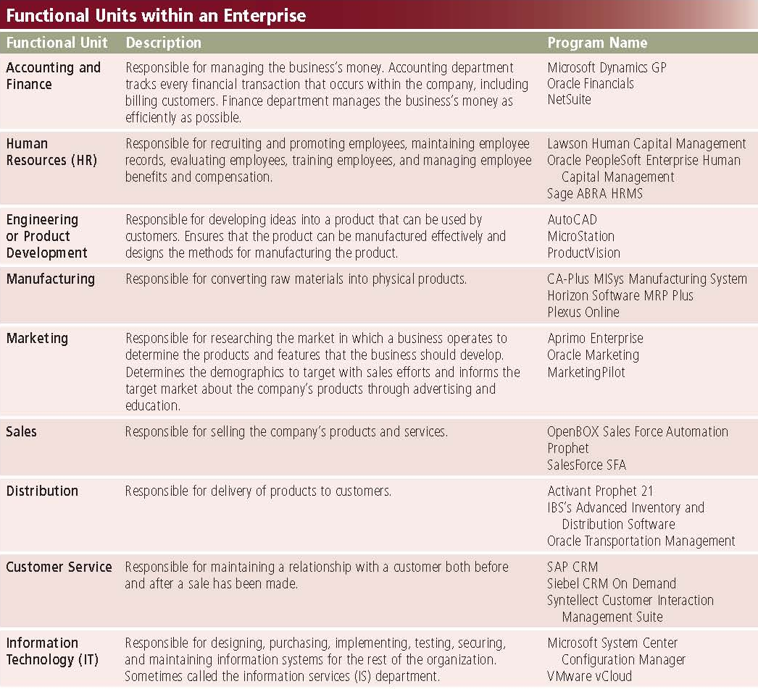
Functional Units
Notes:
Figure 14-6

Slide 16
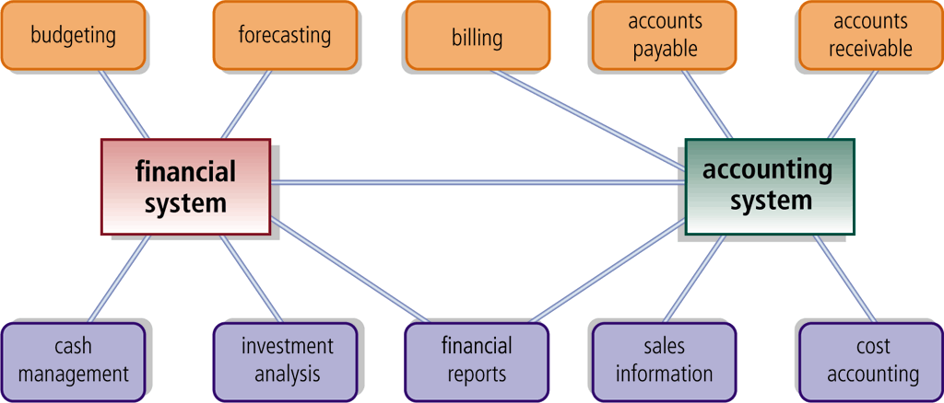
Financial and Accounting Systems
Accounting software manages everyday transactions
Billing software helps the company reconcile purchases with customer payments
Financial software helps managers budget, forecast, and analyze
Notes:
Figure 14-7

Slide 17
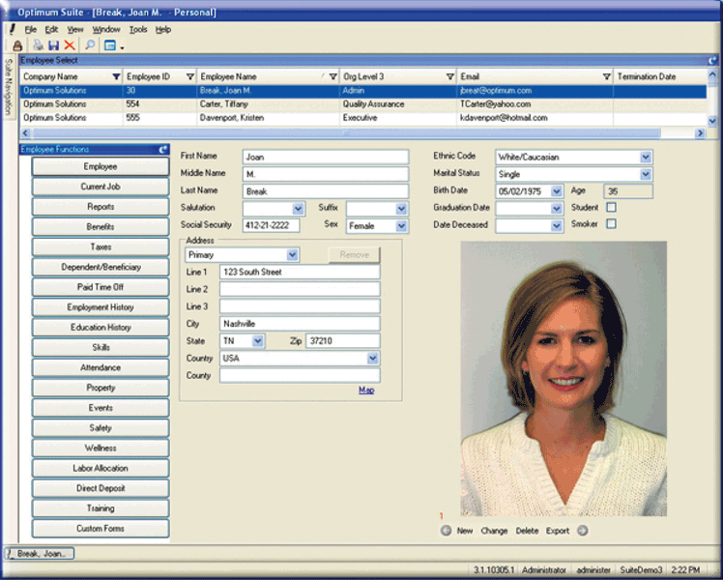
Human Resource Information System
A human resources information system (HRIS) manages one or more human resources functions
Employee relationship management (ERM) systems automate and manage communication between employees and the business
Notes:
Figure 14-8

Slide 18
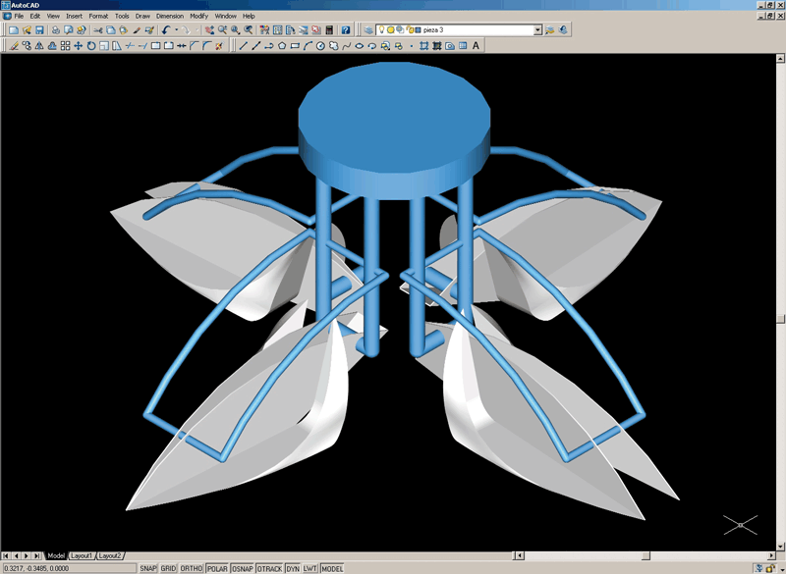
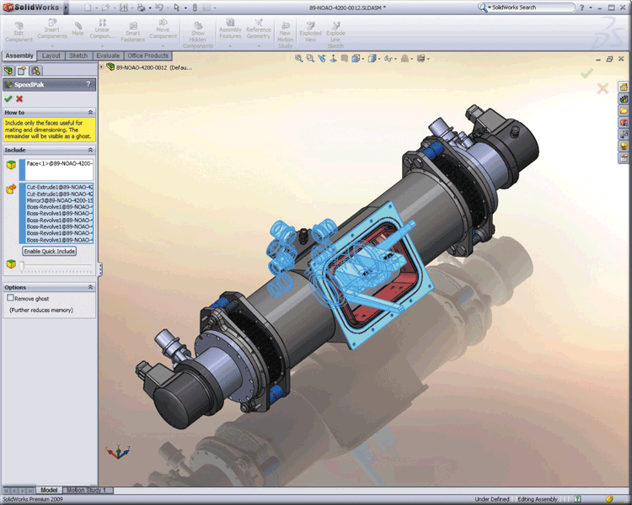
CAD and CAE
Computer-aided design (CAD) uses a computer and special software to aid in engineering, drafting, and design
Computer-aided engineering (CAE) uses computers to test product designs
Notes:
Figure 14-9

Slide 19
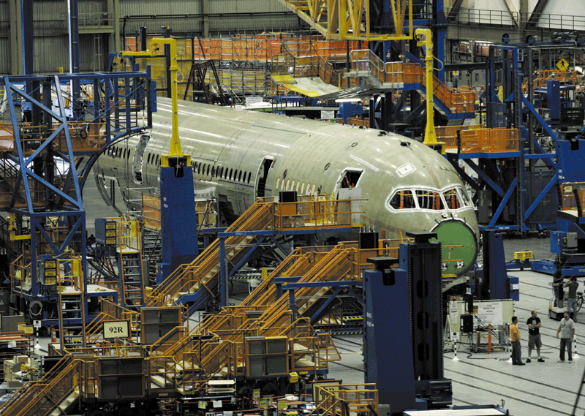
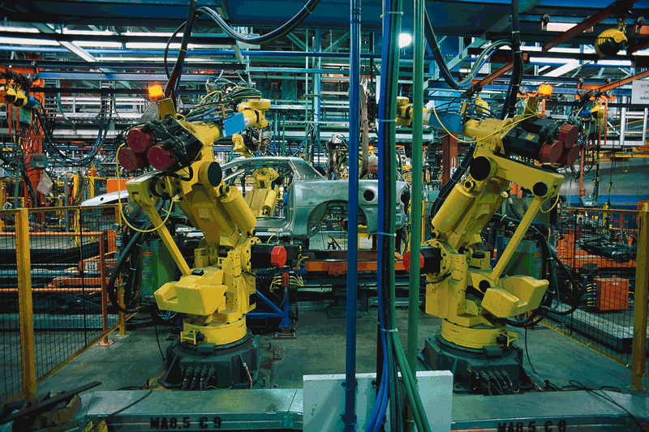
CAM and CIM
Computer-aided manufacturing (CAM) is the use of computers to control production equipment
Computer-integrated manufacturing (CIM) uses computers to integrate the many different operations of the manufacturing process
Notes:
Figure 14-10

Slide 20
MRP and MRP II
Material Requirements Planning (MRP) uses software to help monitor and control processes related to production
Manufacturing Resource Planning II (MRP II) is an extension of MRP and also includes software that helps in
Focuses on inventory of parts
Scheduling, tracking, production and monitoring product quality

Slide 21
Information Systems in the Enterprise
A quality control system helps an organization maintain or improve the quality of its products or services
A marketing information system serves as a central repository for the tasks of a marketing department. Market research software analyzes data gathered from surveys

Slide 22
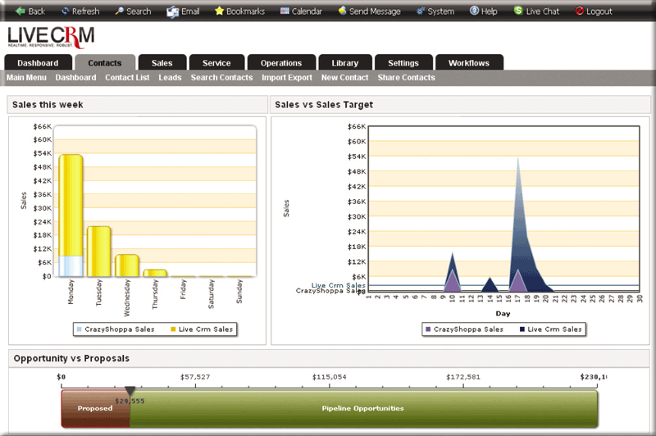
Sales Force Automation
Sales force automation (SFA) software equips traveling salespeople with the electronic tools they need to be more productive
Notes:
Figure 14-12

Slide 23
Distributed Systems
Distribution systems perform the following functions:
Provide forecasting for inventory control
Manage and track shipping of products
Provide information and analysis on inventory in a warehouse

Slide 24
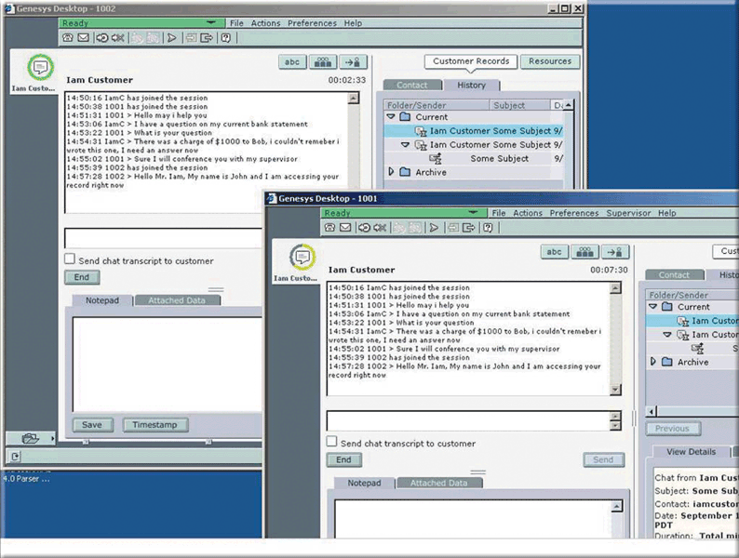
Customer Interaction Management
Customer interaction management (CIM) software manages the day-to-day interactions with customers
Telephone calls
E-mail
Web interactions
Instant Messaging sessions
Notes:
Figure 14-13

Slide 25
Information Technology Department
The information technology (IT) department makes technology decisions for the enterprise
Whether to build or buy new information systems
When a computer or information system has outlived its useful life
IT department uses software to maintain hardware and software
Web site management programs collect data designed to help organizations make informed decisions regarding their Web presence
Security software enables the department to limit access to sensitive information

Slide 26
Categories Information Systems
General purpose information systems generally fall into one of five categories
Office Information System
Transaction Processing System
Management Information System
Decision Support System
Expert System

Slide 27
Office Information Systems
Office Information System (OIS) sometimes called Office Automation
  Enables employees to perform tasks using computers and other electronic devices instead of manually
  Users create graphics and documents, send messages, schedule appointments, and browse the Web
Transaction Processing System (TPS) captures and processes data from day-to-day transactions (individual business activity)

Slide 28
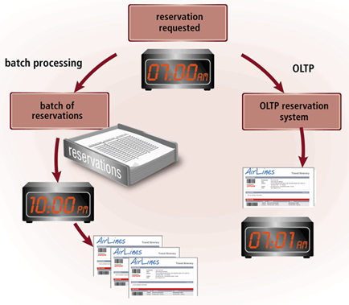
Batch Processing vs TPS
Batch processing vs. online transaction processing
Notes:
Figure 14-14

Slide 29
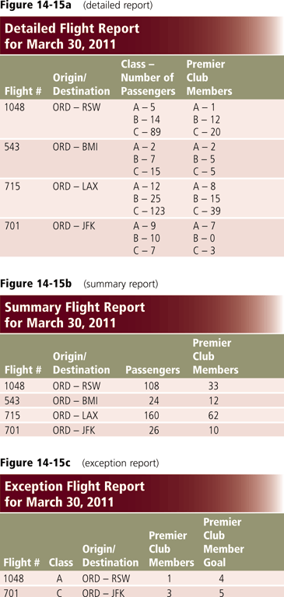
Management Information Systems
Management Information System (MIS) generates accurate, timely, and organized information so managers can track progress and make decisions, solve problems, supervise activities and track progress
Notes:
Figure 14-15a, b, c

Slide 30
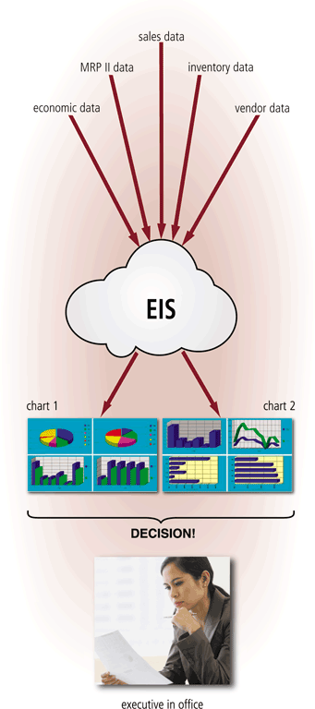
Decision Support Systems
Decision Support System (DSS)
  Helps users analyze data and make decisions
  Uses data from internal and external sources, as needed
  Executive information system (EIS) supports the strategic information needs of executive management
Notes:
Figure 14-16

Slide 31
Information Systems in the Enterprise
Expert System captures and stores knowledge of human experts and then imitates human reasoning and decision making
Consists of two components
knowledge base—combined subject knowledge and experiences of human experts
inference rules—set of logical judgments applied to the knowledge base each time a user describes a situation to the expert system
Expert systems help all levels of users make decisions. Non management employees use them to help with job-related decisions.

Slide 32
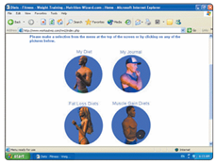
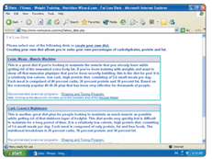
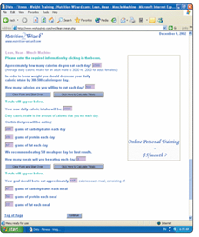
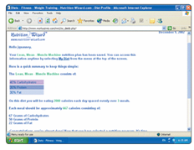
Expert System Example
Step 2.
Select the type of
fat-loss diet based
on the initial selection.
Step 1. Select from a menu or click a picture for a diet program.
Step 4. Review the diet summary.
Step 3. Specify the caloric goals and current calorie intake.

Slide 33
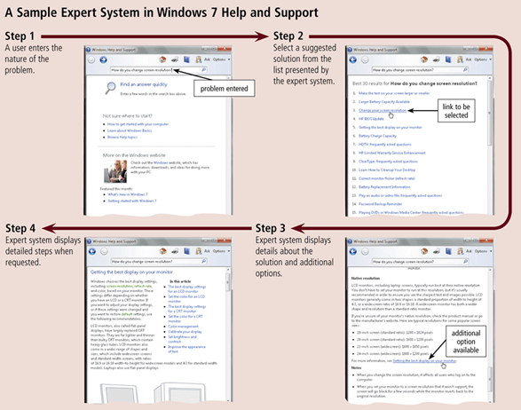
Information Systems in the Enterprise
Notes:
Figure 14-17

Slide 34
Common types of Experts Systems
Artificial Intelligence is application of human intelligence to computers
  AI technology senses a person’s actions and, based on logical assumptions and prior experience, takes the appropriate action to complete the task
  has a variety of capabilities, including speech recognition, logical reasoning, and creative responses
Knowledge management is process by which enterprise collects, archives, indexes and retrieve knowledge
Knowledge management software (KMS) captures expertise of workers

Slide 35
Integrated Information Systems
Integrated Information Systems
Customer relationship management manages information about customers, interactions with customers, past purchases, and interests
Enterprise resource planning provides centralized, integrated software to help manage and coordinate ongoing activities of the enterprise
Content management systems are information systems that combine databases, software, and procedures

Slide 36
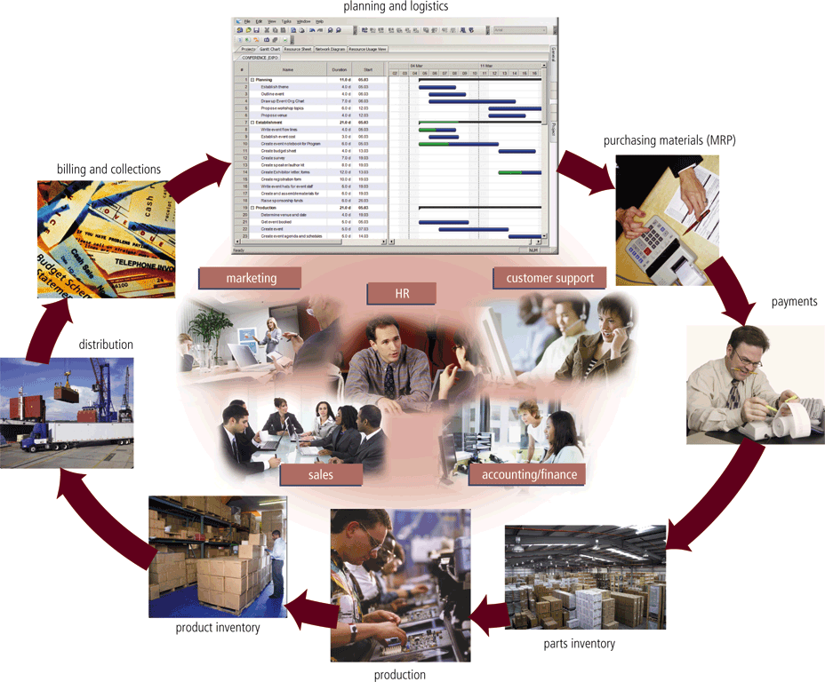
Enterprise Resource Planning (ERP)
Notes:
Figure 14-18

Slide 37
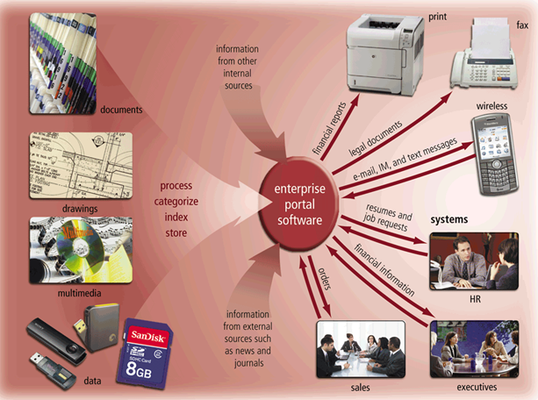
Content Management Systems (CMS)
Notes:
Figure 14-19

Slide 38
Enterprise-Wide Technologies and Methodologies
Some technologies used in enterprises include:
Portals
Data warehouses
Electronic data interchange
Extranets
Web services
Document management systems
Workflow
Virtual private networks

Slide 39
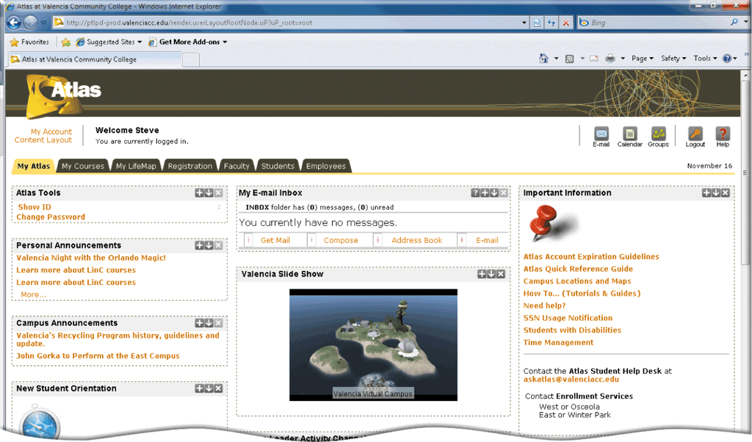
Portal
A portal is a collection of links, content, and services presented on a Web page that are interesting for a particular job function
Notes:
Figure 14-20

Slide 40
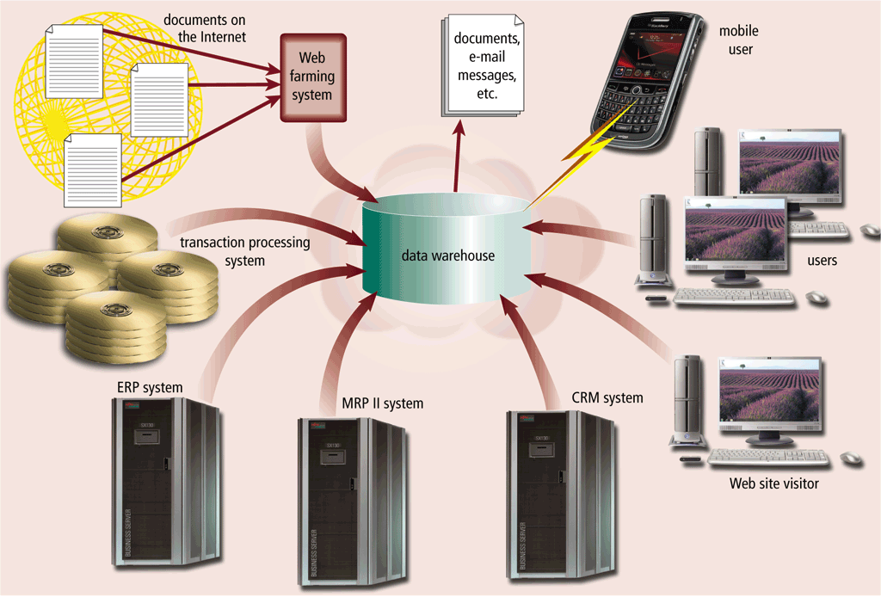
Data Warehouse
A data warehouse is a huge database that stores and manages the data required to analyze historical and current transactions
Notes:
Figure 14-21

Slide 41
EDI and Extranet
EDI (Electronic Data Interchange) is a set of standards that controls the transfer of business data and information among computers both within and among enterprises
An extranet is the portion of a company’s network that allows customers or suppliers of a company to access parts of an enterprise’s intranet

Slide 42
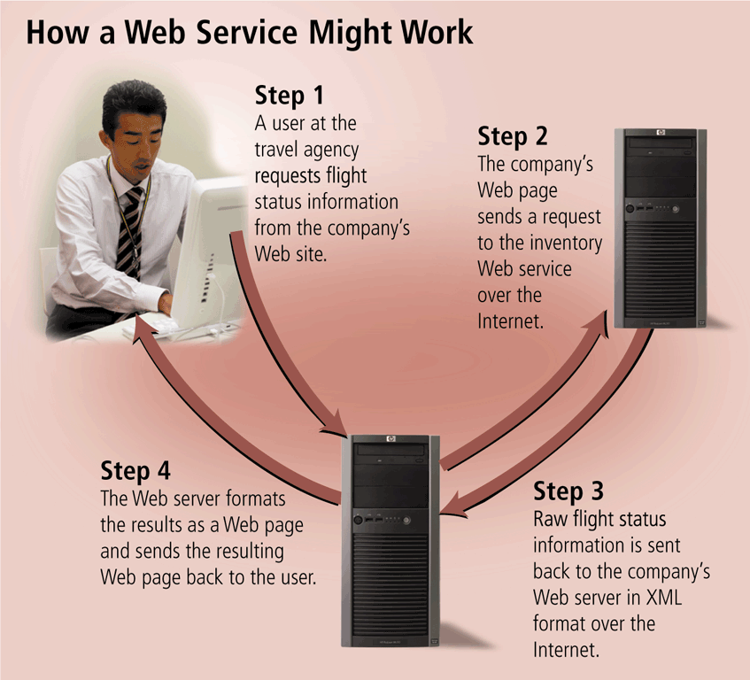
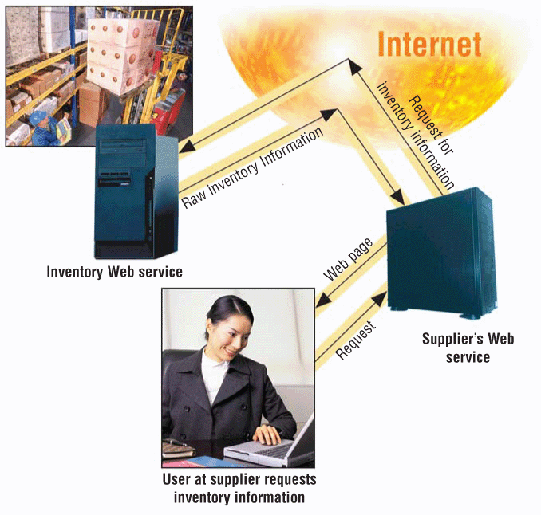
Web Services
Web services allow businesses to create products and B2B interactions over the Internet
Notes:
Figure 14-22

Slide 43
Document Management System
In a service-oriented architecture, information systems provide services to other information systems in a well-defined manner over a network
A document management system (DMS) allows for storage and management of a company’s documents
  Stored in a repository
  has the benefit of tracking a document throughout its life cycle, from creation, through changes, and finally to archival.
  Additional information can be stored along with the document that describes the uses and history of the document.

Slide 44
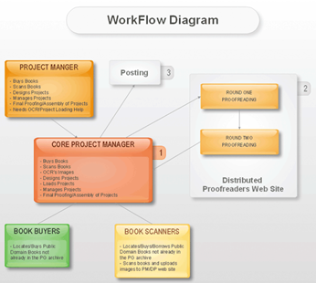
Work Flow
A workflow is a defined process that identifies the specific set of steps involved in completing a particular project or business process
A workflow application is a program that tracks process from start to finish
Enterprises use workflow applications to assist in defining complex workflows
Notes:
Figure 14-23

Slide 45
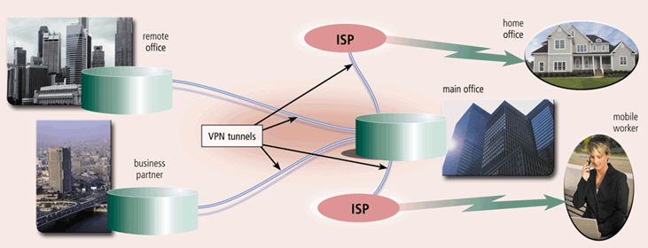
Virtual Private Network
A virtual private network (VPN) provides mobile users, vendors, and customers with a secure connection to the company network server using internet
Notes:
Figure 14-24

Slide 46
Virtualization
Virtualization is the practice of sharing or pooling computing resources such as servers and storage devices
Server virtualization
Provides the capability to divide a physical server logically into many virtual servers
Storage virtualization
Provides the capability to create a single logical storage device from many physical storage devices

Slide 47
Cloud and Grid Computing
Two new technologies that provide flexible and massive online computing power
Grid computing combines many servers and/or personal computers on a network to act as one large computer
Cloud computing is an Internet service that provides computing needs to computer users

Slide 48
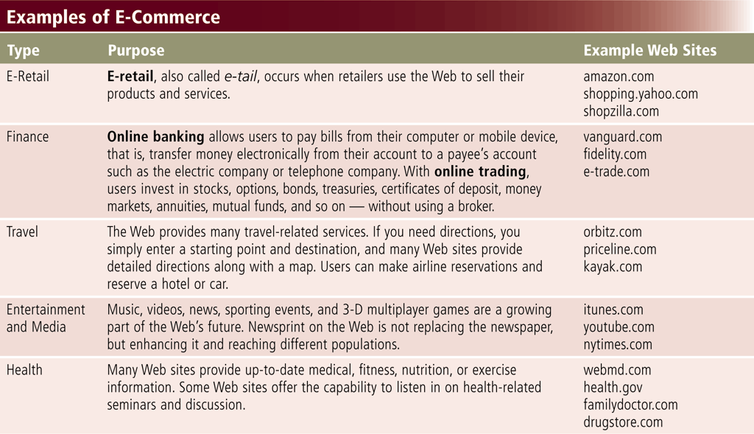
E-Commerce
Notes:
Figure 14-25

Slide 49
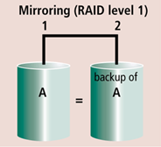
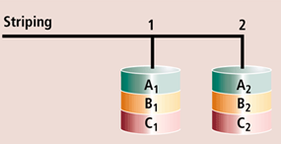
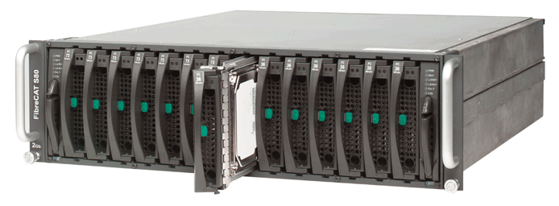
Enterprise Hardware
Enterprise hardware allows large organizations to manage and store information and data using devices geared for:
  Heavy use
  Maximum availability
  Maximum efficiency
RAID duplicates data and
implements duplication
in different ways
Notes:
Figure 14-26 Figure 14-27a Figure 14-27b

Slide 50
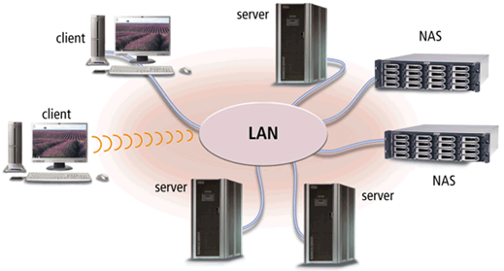
Network Attached Storage
Network attached storage (NAS) is a server that provides storage to users and information systems attached to the network
Often called a storage appliance because it is a piece of equipment with only one function — to provide additional storage
Administrators quickly add storage to an existing network simply by attaching a new network attached storage server to the network.
Notes:
Figure 14-28a

Slide 51
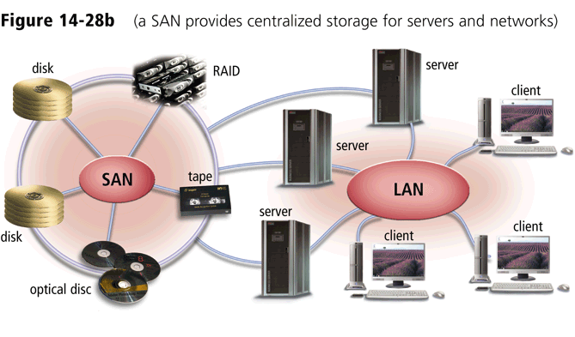
Storage Area Network
A storage area network (SAN) is a high-speed network that provides storage to other servers to which it is attached
Notes:
Figure 14-28b

Slide 52
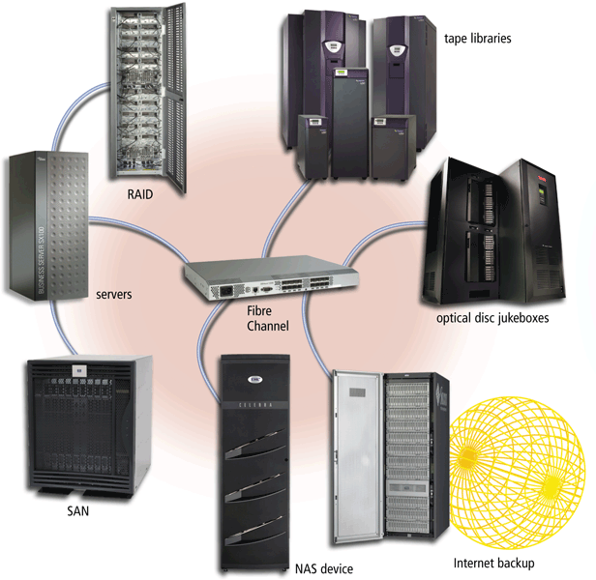
Enterprise Storage System
An enterprise storage system is a strategy that focuses on the availability, protection, organization, and backup of storage in a company
Goal is to consolidate storage
Use combination of techniques
Notes:
Figure 14-29

Slide 53
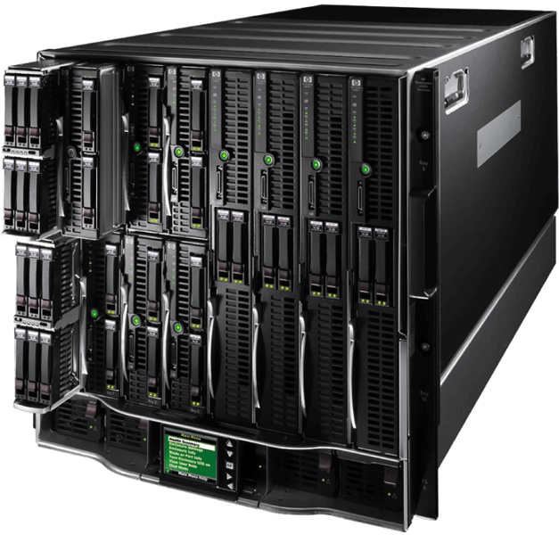
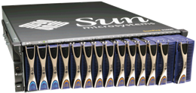
Blade Server
A blade server packs a complete computer server on a single card (called a blade) rather than a system unit
Saves space, requires less maintenance, uses less energy, generates less heat, and is easily replaced or upgraded
Blade server chassis holds many blades
The individual blades insert in a blade server chassis
Notes:
Figure 14-30

Slide 54
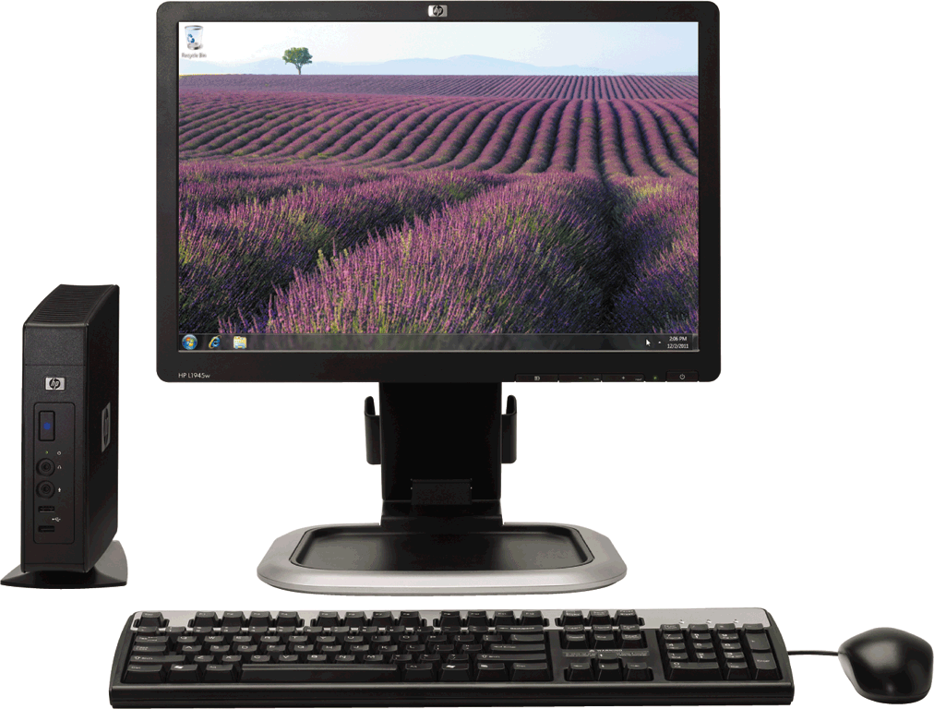
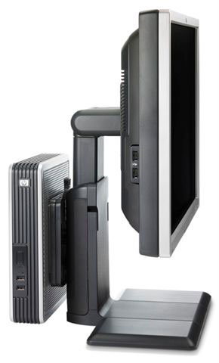
Thin Client
A thin client is a small terminal-like computer that mostly relies on a server for data storage and processing
The processing for a thin client usually is done on a server
Notes:
Figure 14-31

Slide 55
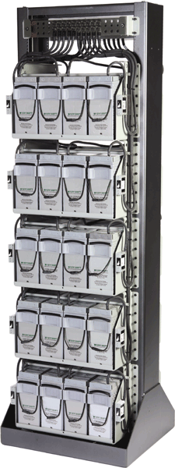
High-Availability System
A high-availability system continues running and performing tasks for at least 99 percent of the time
  May include hot-swapping
    allows components to be replaced while
    rest of system continues to perform tasks
  Redundant components
    When a component fails, another
    component takes over and the
    system continues to function
Notes:
Figure 14-32

Slide 56
Scalability and Interoperability
Scalability is a measure of how well computer hardware, software, or an information system can grow to meet increasing performance demands
  Adding hardware
  is often easiest
  method to grow
Interoperability is the ability for an information system to share information with other information systems within an enterprise
  System that shares information easily
  is said to be open

Slide 57
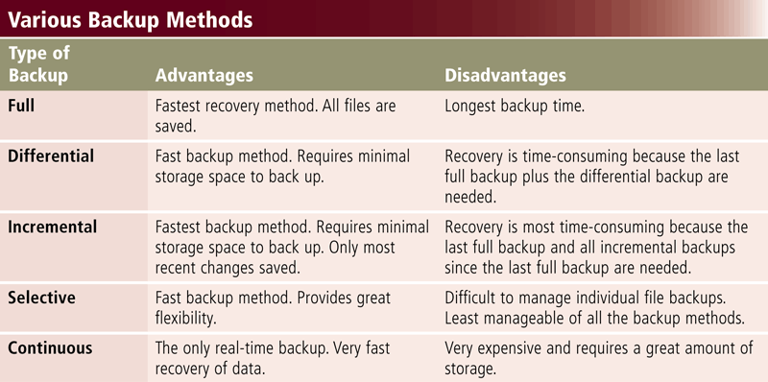
Back Up Procedures
Notes:
Figure 14-33

Slide 58
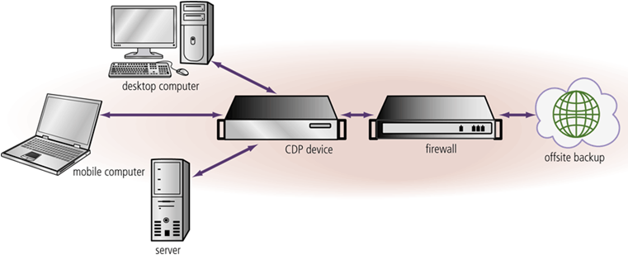
Back Up Procedures
Continuous data protection provides automatic data backup whenever data is changed in an enterprise
Notes:
Figure 14-34

Slide 59
Disaster Recovery Plan
A disaster recovery plan is a written plan describing the steps a company would take to restore computer operations in the event of a disaster
Contains four major components
Emergency Plan -steps to be taken immediately after disaster such as fire, flood or earthquake
Backup Plan - how backup files and equipment would be used to resume information processing
Recovery Plan actions to be taken to restore full information processing operations
Test Plan - simulates various levels of disasters and records ability to recover

Slide 60
Summary
Special computing requirements present in an enterprise-sized organization
Various types of users within an organization
Large information systems
Benefits of virtualization and cloud computing
Requirements for enterprise hardware
Backup procedures present in a large organization

Slide 61
Course Outline - I
Introduction to computers and computing
Classification of Computers
Elements of computers
Data Representation
Basic Computer Architecture
Control Unit
Registers
Arithmetic & Logical Unit (ALU operations)
Main Memory (ROM, RAM, Cache)
CPU Operations
Input devices
Output Devices
External Storage Media

Slide 62
Course Outline - II
Software Concepts; System Software
Operating Systems
Communication Systems and Networks
Internet; E-Commerce;
Application Software
Data Base Management Systems
Software Development Life Cycle
Program Development Life cycle
Security Issues; Threats to computers & communication systems,
Computer Ethics and Safety
Enterprise Computing
Artificial Intelligence

Slide 63
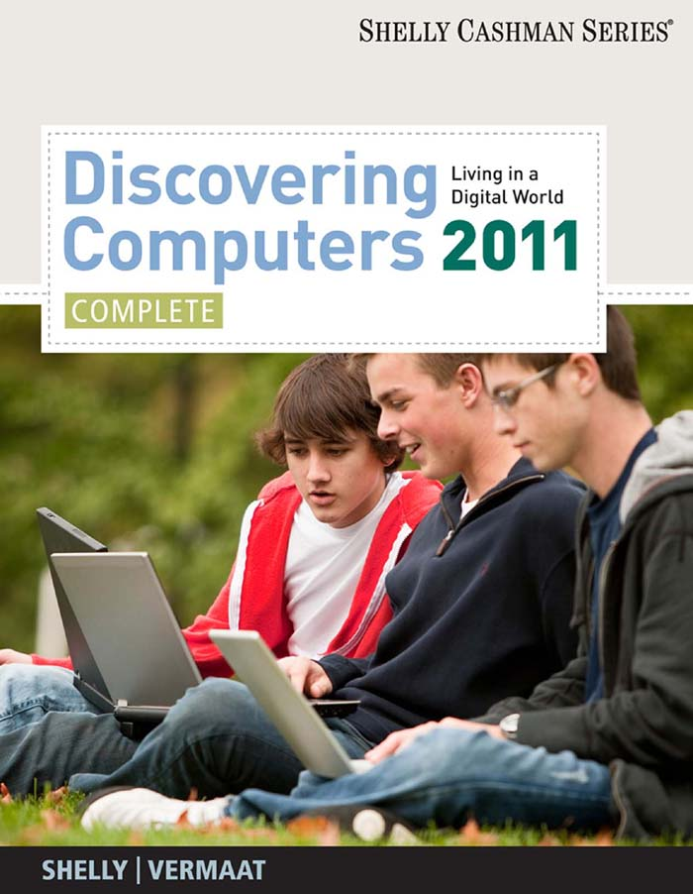
Recommended Text Book

Slide 64
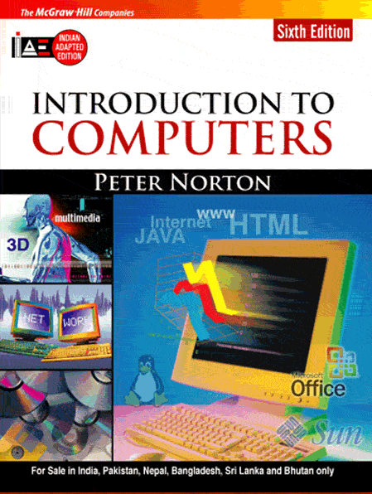
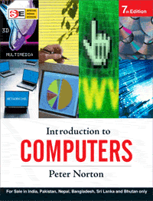
Recommended Text Books
64

