Slide 1
CSC 101
Introduction to Computing
Lecture 30
Dr. Iftikhar Azim Niaz
ianiaz@comsats.edu.pk
1

Slide 2
Last Lecture Summary I
System Development Life Cycle Phases
Ongoing Activities
  Project Management, Feasibility, Documentation
Planning
  Review, approve and prioritize project requests
Analysis
  Preliminary Investigation, Detailed analysis
Design
  Acquire Hardware and software, Develop details
Implementation
  Develop programs, install and test new system
Operation, Support and Security
  Maintenance Activities, System performance and security
2

Slide 3
Last Lecture Summary II
Program Development Life Cycle
Analyze requirements
  Review requirements, develop IPO charts
Design solution
  Design solution algorithm, Structured and OOP
  Flowchart and Pseudo code
Validate design
  Inspection and Desk check
Implement design
  Program development tool, writing code
Test solution
  Testing and Debugging
Document solution
  Review Program code and documentation
3

Slide 4
Objectives Overview
Discuss techniques to prevent unauthorized computer access and use
Describe various types of Internet and network attacks, and identify ways to safeguard against these attacks
Describe threats and Countermeasures
Identify threats to users, hardware and data
Define the term, computer security risks, and briefly describe the types of cybercrime perpetrators

Slide 5
Computer Security Risk
A computer security risk is any event or action that could cause a loss of or damage to computer hardware, software, data, information, or processing capability
Any illegal act involving a computer generally is referred to as a computer crime
A cybercrime is an online or Internet-based illegal act
Hackers
Crackers
Script Kiddies
Corporate Spies
Unethical Employees
Cyberextortionists
Cyberterrorists

Slide 6
Categories of Cybercrime
Hacker refers to someone who accesses a computer or network illegally
  Some hackers claim the intent of their security breaches is to improve security
Cracker also is someone who accesses a computer or network illegally but has the intent of destroying data, stealing information, or other malicious action
  Both hackers and crackers have advanced computer and network skills
Script kiddie has the same intent as a cracker but does not have the technical skills and knowledge
  often use prewritten hacking and cracking programs to break into computers

Slide 7
Categories of Cybercrime
Corporate spies have excellent computer and networking skills and are hired to break into a specific computer and steal its proprietary data and information, or to help identify security risks in their own organization
  Some companies hire corporate spies, a practice known as corporate espionage, to gain a competitive advantage
Unethical employees may break into their employers’ computers for a variety of reasons
  Some simply want to exploit a security weakness
  Others seek financial gains from selling confidential information
  Disgruntled employees may want revenge

Slide 8
Categories of Cybercrime
Cyberextortionist is someone who uses e-mail as a vehicle for extortion
  send an organization a threatening e-mail message indicating they will
    expose confidential information, exploit a security flaw, or launch an attack that will compromise the organization’s network — if they are not paid a sum of money
Cyber terrorist is someone who uses the Internet or network to destroy or damage computers for political reasons
  might target the nation’s air traffic control system, electricity-generating companies, or a telecommunications infrastructure
  Cyber warfare, describes an attack whose goal ranges from disabling a government’s computer network to crippling a country
Both Cyber terrorism and cyber warfare usually require a team of highly skilled individuals, millions of dollars, and several years of planning

Slide 9
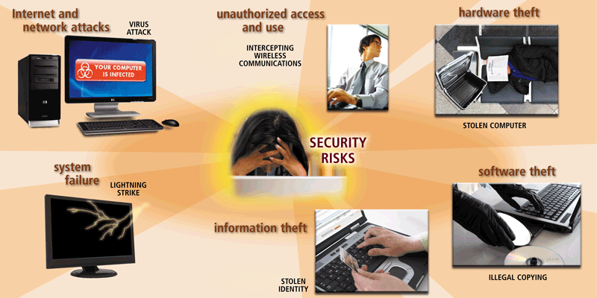
Computer Security Risk
Computers and computer users are exposed to several types of security risks
Notes:
Figure 11-1

Slide 10
Threats
Entire point of computer security is to eliminate or protect against threats
Anything that can cause harm
In the context of computer security, a threat can be
  a burglar, a virus, an earthquake, or a simple user error
Vulnerabilities are weaknesses in security
Vulnerability is a weakness—anything that has not been protected against threats, making it open to harm
Security attempts to neutralize threats

Slide 11
Degrees of Harm
Level of potential damage
Include all parts of system
  Potential data loss
  Loss of privacy
  Inability to use hardware
  Inability to use software
  Actual physical harm
  A nasty virus or hacker can wipe out your programs as well as your data.
  If your PC is connected to a network, other systems on the network could suffer similar problems.
  Damages to your home or office—such as a fire or flood—can easily extend to your computer and everything stored on it

Slide 12
Threats To Users
Identity Theft
Loss of Privacy
Cookie
Notes:
Teaching tip
The move Hackers includes scenes demonstrating most of these crimes in action.

Slide 13
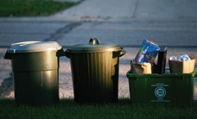
Identity Theft
Impersonation by private information to obtain documents and credit in your name
  Thief can ‘become’ the victim
Reported incidents rising
Methods of stealing information
  Shoulder surfing
  Snagging
  Dumpster diving
  Social engineering
  High-tech methods
Notes:
Teaching tip
The move Hackers includes scenes demonstrating most of these crimes in action.

Slide 14
Methods of Identity Theft
Shoulder Surfing
  Watching someone enter personal identification information for a private transaction such as at ATM machine
  Observing users typing their login credentials, credit/calling card numbers etc. into IT equipment located in public places
Snagging
  Snagging information by listening in on a telephone extension, through a wiretap or over a wall while the victim gives credit card or personal information to a legitimate agent

Slide 15
Methods of Identity Theft
Dumpster Diving
  Thieves can go through garbage cans, dumpsters or trash bins to obtain cancelled checks, credit card number, or bank account number of someone
  Rummaging through rubbish for personal information
Social engineering
  ID thief tricks victim into providing critical information under the pretext of something legitimate
  art of manipulating people into performing actions or divulging confidential information
  typically trickery or deception for the purpose of information gathering, fraud, or computer system access;
  In most cases the attacker never comes face-to-face with the victims

Slide 16
Methods of Identity Theft
High-tech methods
  Sophisticated ID thief can get information using a computer and Internet connection
  Trojan Horse can be planted on a system
Skimming information from bank or credit cards using compromised or hand-held card readers, and creating clone cards
Using 'contactless' credit card readers to acquire data wirelessly from RFID-enabled passports
Advertising bogus job offers in order to accumulate resumes and applications typically disclosing applicants' names, home and email addresses, telephone numbers and sometimes their banking details

Slide 17
Methods of Identity Theft
Infiltrating organizations that store and process large amounts or particularly valuable personal information
Brute-force attacking weak passwords and using inspired guesswork to compromise weak password reset questions
Befriending strangers on social networks and taking advantage of their trust until private information are given
Low security/privacy protection on photos that are easily clickable and downloaded on social networking sites

Slide 18
Loss of privacy
Personal information is stored electronically
Purchases are stored in a database
  Data is sold to other companies
Public records on the Internet
Internet use is monitored and logged
  monitoring activity can be carried out on your computer or a connected server
  Data about when you visited, what you looked at, and how long you stayed is used by most commercial Web sites “online profiling”
None of these techniques are illegal

Slide 19
Cookies
Cookies are named after the ‘magic cookie’
a small text file that a Web server asks your browser to place on your computer
Cookie contains information that identifies your computer (its IP address), you (your user name or e-mail address), and information about your visit to the Web site..
Files delivered from a web site
Originally improved a site’s function
Cookies now track history and passwords
Browsers include cookie blocking tools

Slide 20
Spyware
Software downloaded to a computer
Designed to record personal information
can track a computer user's activities and report them to someone else
Typically undesired software
Hides from users
Several programs exist to eliminate
Another common term for spyware is adware,
  Internet advertising is a common source of spyware

Slide 21
Web bugs
Small GIF format image file embedded in web page or HTML format e-mail
Behind the tiny image lies code that functions in much the same way as a cookie, allowing the bug’s creator to track many of your online activities.
A bug can record
  what Web pages you view
  keywords you type into a search engine
  personal information you enter in a form on a Web page, and other data.
Because Web bugs are hidden, they are considered by many to be eavesdropping devices
Gets around cookie blocking tools
Companies use to track usage
Blocked with spyware killers
Notes:
Teaching tip
More information regarding web bugs can be found at en.wikipedia.org/wiki/Web_bug.

Slide 22
Spam
is Internet “ junk mail.”
Unsolicited commercial email (UCE)
Almost all spam is commercial advertising
Networks and PCs need a spam blocker
  Stop spam before reaching the inbox
Spammers acquire addresses using many methods
  Purchasing lists of e-mail addresses through brokers.
  "Harvesting" e-mail addresses from the Internet.
  Generating random strings of characters in an attempt to match legitimate addresses
Notes:
Teaching tip
Spam is rumored to be named in honor of the Monty Python skit, Spam!. In the skit, a customer is forced to select spam in his lunch. Much like we are forced to accept a spam message. Visit www.detritus.org/spam/skit.html for the entire spam skit.
Discussion point
Spam is one topic that nearly everyone in the class can relate to. Have your students think about spam from the other side. Have them consider the point of view of the self proclaimed ‘Spam King’, Scott Richter. For some conversation fodder visit www.pcworld.com/news/article/0,aid,116807,00.asp.

Slide 23
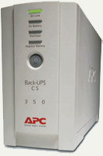
Threats to Hardware
Affect the operation or reliability
Power-related threats
  Power fluctuations
    Power spikes or browns out
  Power loss
  Can result in loss of data
Countermeasures
    Surge suppressors
    Line conditioners
    Uninterruptible power supplies
    Generators
Notes:
Teaching tip
Visit www.apc.com for information regarding UPS solutions.
Teaching tip
Larger installations use generators to protect networks. Hospitals, grocery stores and insurance companies may all use generators. Quite often the power solution is a combination of battery and generator. The batteries run long enough for the generators to start and stabilize. Then the batteries stop and the generators provide power to the facility.

Slide 24
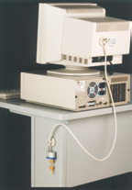
Threats to Hardware
Theft and vandalism
  Thieves steal the entire computer
  Accidental or intentional damage
  Countermeasures
    Keep the PC in a secure area
    Lock the computer to a desk
    Do not eat near the computer
    Watch equipment
    Chase away loiterers
    Handle equipment with care

Slide 25
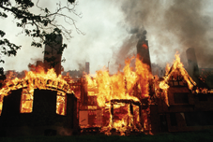
Threats to Hardware
Natural disasters
  Disasters differ by location
  Typically result in total loss
  Disaster planning
    Be aware that a disaster could strike
    Anticipate it when conditions are right
    Plan for recovery
    List potential disasters
    Plan for all eventualities
    Practice all plans
Notes:
Discussion point
In 2004 Hurricane Ivan caused massive damage to Florida and several other states. Network administrations in Florida are used to planning for hurricanes. However, computers in Southeastern Pennsylvania suffered massive loss of data due to Ivan. How culpable are the administrators in PA who did not plan for Ivan?

Slide 26
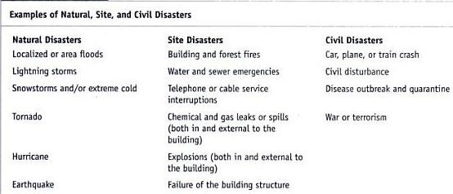
Examples of Natural Disaster

Slide 27
Threats to Data
The most serious threat
  Data is the reason for computers
  Data is very difficult to replace
  Protection is difficult
    Data and information is intangible
Malware, Virus and malicious programs
Trojan horses
Cybercrime
Hacking
Cyberterrorism

Slide 28
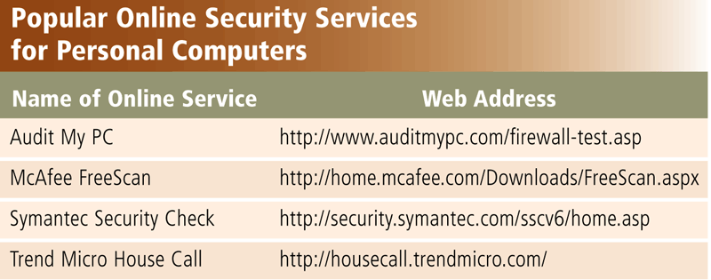
Internet and Network Attacks
Information transmitted over networks has a higher degree of security risk than information kept on an organization’s premises
An online security service is a Web site that evaluates your computer to check for Internet and e-mail vulnerabilities
Notes:
Figure 11-2

Slide 29
Internet and Network Attacks
Computer Virus
Affects a computer negatively by altering the way the computer works
Worm
Copies itself repeatedly, using up resources and possibly shutting down the computer or network
Trojan Horse
A malicious program that hides within or looks like a legitimate program until triggered
Rootkit
Program that hides in a computer and allows someone from a remote location to take full control
Can spread and damage files and system software including OS
Does not replicate itself on other computers

Slide 30
Internet and Network Attacks
An infected computer has one or more of the following symptoms:
Operating system runs much slower than usual
Available memory is less than expected
Files become corrupted
Screen displays unusual message or image
Music or unusual sound plays randomly
Existing programs and files disappear
Programs or files do not work properly
Unknown programs or files mysteriously appear
System properties change
Operating system does not start up
Operating system shuts down unexpectedly

Slide 31
How Malware Infects?
delivers its payload on a computer in a variety of ways: when a user
(1) opens an infected file
(2) runs an infected program
(3) boots the computer with infected removable media inserted in a drive or plugged in a port
(4) connects an unprotected computer to a network
(5) when a certain condition or event occurs, such as the computer’s clock changing to a specific date
(6) when users opening infected e-mail attachments.

Slide 32
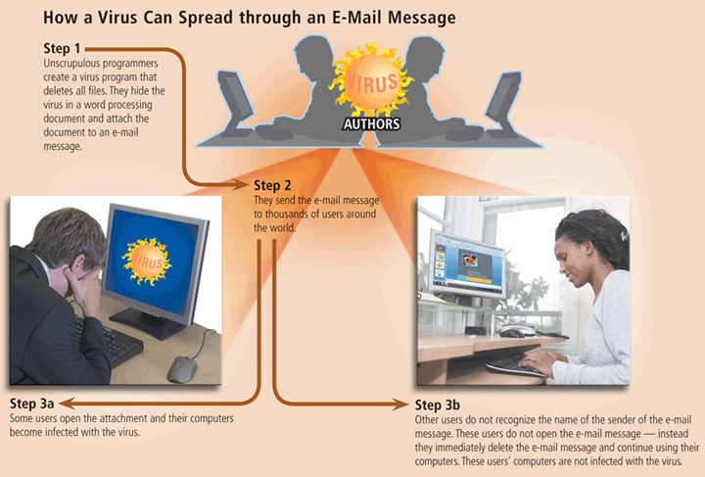
Internet and Network Attacks
Notes:
Figure 11-3

Slide 33
Malware, Virus and Malicious Programs
Malware describes viruses, worms, Trojan horse attack applets, and attack scripts.
  These virulent programs represent the most common threat to your information
Viruses
  Pieces of a computer program (code) that attach themselves to host programs.
  Software that distributes and installs itself
  Ranges from annoying to catastrophic
  Countermeasures
    Anti-virus software
    Popup blockers
    Do not open unknown email
Notes:
Teaching tip
For information on specific viruses visit securityresponse.Symantec.com/.
Teaching tip
Detailed information regarding the protection from viruses, see the Computing keynote at the end of the chapter.

Slide 34
Harm done by Virus
Copy themselves to other programs or areas of a disk.
Replicate as rapidly and frequently as possible, filling up
the infected system's disks and memory, rendering the system useless.
Display information on the screen.
Modify, corrupt or destroy selected files.
Erase the contents of entire disks.
Lie dormant for a specified time or until a given condition is met and then become active.
Open a 'back door" to the infected system that allows someone else to access and even take control of the system through a network or Internet connection.

Slide 35
Categories of Viruses
Bimodal, Bipartite, or Multipartite Viruses
  can infect both files and the boot sector of a disk
Time bomb
  hides on the victim's disk and waits until a specific date (or date and time) before running
Logic bomb
  may be activated by a date, a change to a file, or a particular action taken by a user or a program
Stealth Viruses
  take up residence in the computer's memory, making them hard to detect
  can conceal changes they make to other files, hiding the damage from the user and the operating system

Slide 36
Categories of Viruses
Boot Sector Viruses
  regarded as one of the most hostile types of virus
  infects the boot sector of a hard or floppy disk
  This area of the disk stores essential files the computer accesses during startup.
  moves the boot sector's data to a different part of the disk.
  When the computer is started, the virus copies itself into memory where it can hide and infect other disks
  allows the actual boot sector data to be read as though a normal start-up were occurring

Slide 37
Categories of Viruses
Cluster Viruses
  makes changes to a disk's file system
  If any program is run from the infected disk, the program causes the virus to run as well
  creates the illusion that the virus has infected every program on the disk
E-mail viruses
  transmitted via email messages sent across private networks or the Internet
  Some e-mail viruses are transmitted as an infected attachment—a document file or program that is attached to the message

Slide 38
Categories of Viruses
File-Infecting Viruses
  infects program files on a disk (such as .exe or .com files)
  When an infected program is launched, the virus's code is also executed
Macro virus
  designed to infect a specific type of document file, such as Microsoft Word or Excel files
  can do various levels of damage to data from corrupting documents to deleting data
Polymorphic, Self-Garbling, Self-Encrypting, or Self-Changing Viruses
  can change itself each time it is copied, making it difficult to isolate

Slide 39
Threats to Data
Trojan horses
  Program that poses as beneficial software
  User willingly installs the software
  Countermeasures
    Anti-virus software
    Spyware blocker
Worms
  are particular to networks, spreading to other machines on any network you are connected to and carrying out preprogrammed attacks on the computers
Attack Script
  specifically written, usually by expert programmers, to exploit the Internet

Slide 40
Threats to Data
Cybercrime
  Using a computer in an illegal act
  Fraud and theft are common acts
Internet fraud
  Most common cybercrime
  Fraudulent website
  Have names similar to legitimate sites

Slide 41
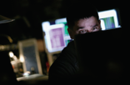
Threats to Data
Hacking
  Most common form of cybercrime
  Using a computer to enter another network to perform an illegal act
  may amount to simple trespassing or acts that corrupt, destroy, or change data.
  Hackers motivation
    Recreational hacking
    Financial hackers
    Grudge hacking
  Hacking methods
    Sniffing
    Social engineering
    Spoofing

Slide 42
Threats to Data
Distributed denial of service (DOS) attack
  Attempt to stop a public server
  Hackers plant the code on computers
  Code is simultaneously launched
  Too many requests stops the server
Cyber terrorism
  Attacks made at a nations information
  Targets include power plants
  Threat first realized in 1996
  Organizations combat cyber terrorism
    Computer Emergency Response Team (CERT)
    Department of Homeland Security

Slide 43
Countermeasures
Steps taken to block a threat
Protect the data from theft
  regularly backing up your data is a countermeasure against the threat of data loss.
Protect the system from theft
  A firewall is a countermeasure against hackers
Two classes of countermeasures
  first shields the user from personal harm, such as threats to personal property, confidential information, financial records, medical records, and so forth
  second safeguard protects the computer system from physical hazards such as theft, vandalism, power problems, and natural disasters or attacks on the data stored and processed in computers
No countermeasure is 100% effective all of the time
  A truly dedicated attacker will eventually break through any security

Slide 44
Safeguard against Malware
Do not start a computer with removable media inserted in the drives or plugged in the ports
Never open an e-mail attachment unless you are expecting the attachment and it is from a trusted source
Set the macro security level so that the application software warns users that a document they are attempting to open contains a macro
install an antivirus program and update it frequently

Slide 45
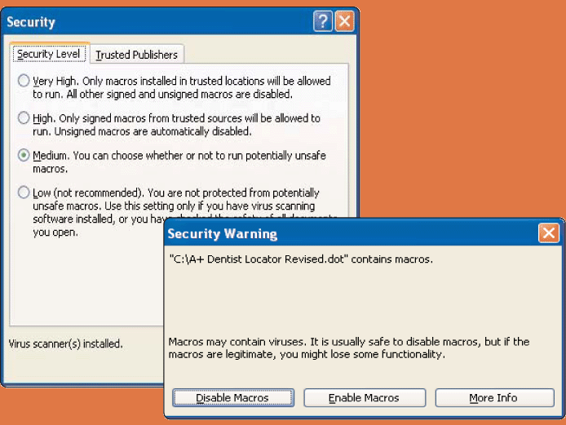
Computer Viruses, Worms, and Trojan Horses
How can you protect your system from a macro virus?
  Set macro security level in applications that allow you to write macros
  At medium security level, warning displays that document contains macro
    Macros are instructions saved in an application, such as word processing or spreadsheet program

Slide 46
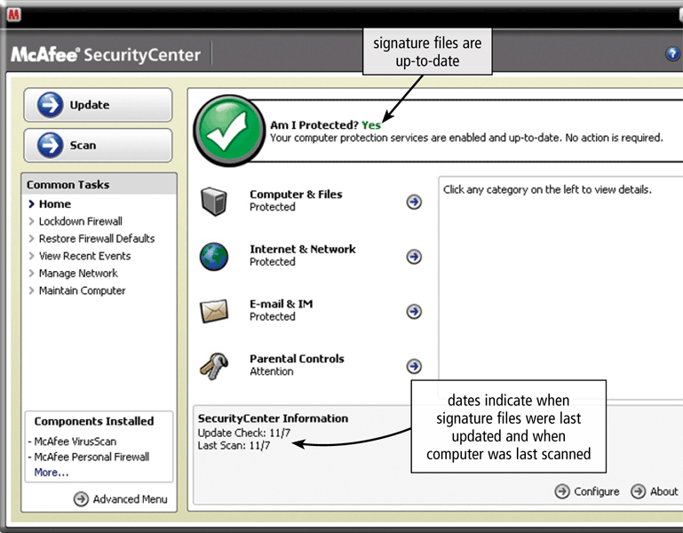
Internet and Network Attacks
Antivirus
  Identifies and removes computer viruses
  Most also protect against worms and Trojan Horses
Notes:
Figure 11-6

Slide 47
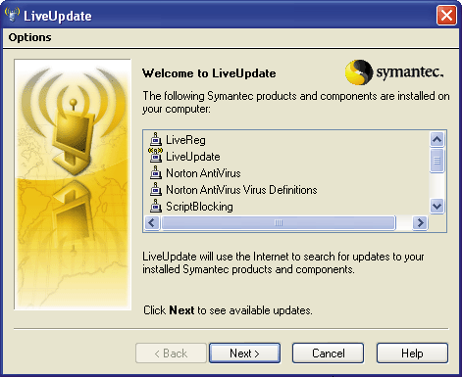
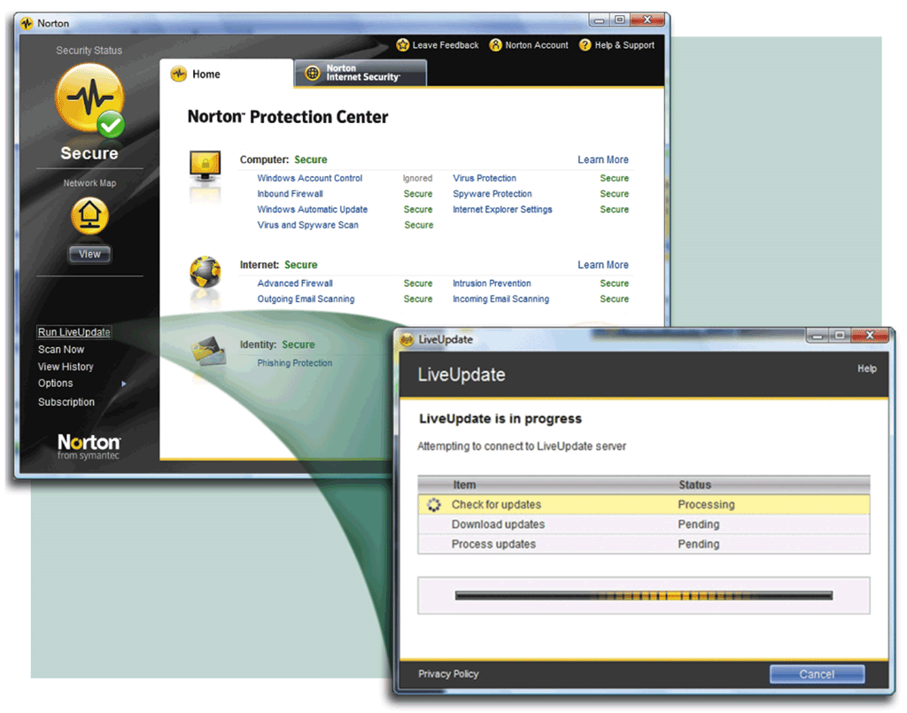
Virus Signature
Specific pattern of virus code
  Also called virus definition
Antivirus programs look for virus signatures
Should update antivirus program’s signature files regularly

Slide 48
Antivirus
How does an antivirus program inoculate a program file?
  Records information about program such as file size and creation date
  Uses information to detect if virus tampers with file
  Attempts to remove any detected virus
  Quarantines infected files that it cannot remove
    Keeps file in separate area of hard disk until the infection can be removed
    ensures other files will not become infected
    Users also can quarantine suspicious files themselves
    Quarantined files remain on your computer until you delete them or restore them
    Restore a quarantined file only if you are certain the antivirus program has removed the infection from the quarantined file.

Slide 49
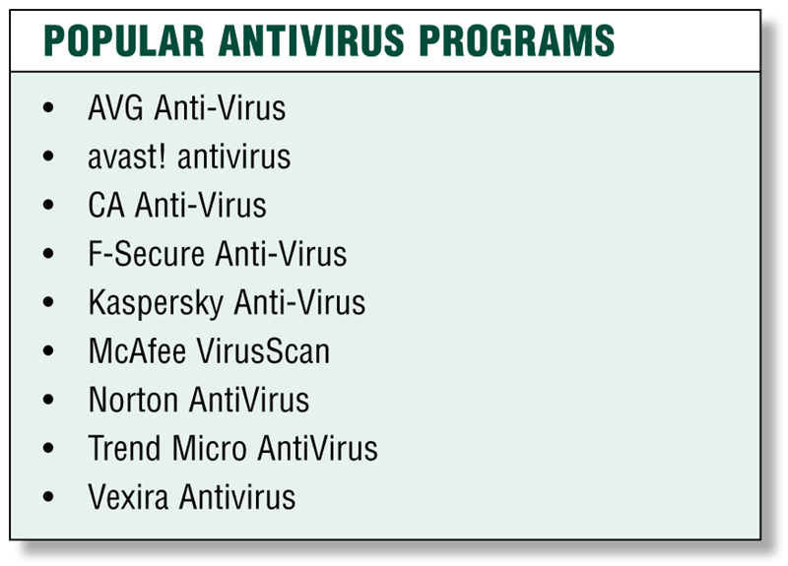
Popular Antivirus Programs
Notes:
Figure 11-5

Slide 50
How to protect
In extreme cases, you may need to reformat the hard disk to remove malware from an infected computer.
  Having uninfected, or clean, backups of all files is important
Stay informed about new virus alerts and virus hoaxes
  A virus hoax is an e-mail message that warns users of a nonexistent virus or other malware
  Often, these hoaxes are in the form of a chain letter that requests the user to send a copy of the e-mail message to as many people as possible
  Instead of forwarding the message, visit a Web site that publishes a list of virus alerts and virus hoaxes

Slide 51
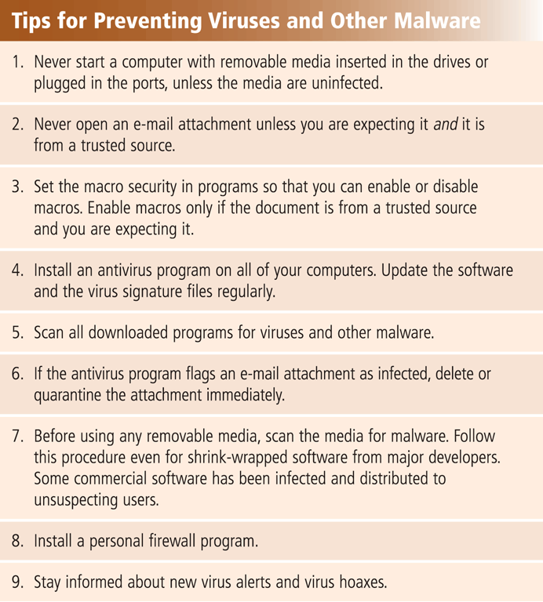
Preventing Viruses and Malware
Users can take several precautions to protect their home and work computers and mobile devices from these malicious infections
Notes:
Figure 11-7

Slide 52
Internet and Network Attacks
A botnet is a group of compromised computers connected to a network
  A compromised computer is known as a zombie, is one whose owner is unaware the computer is being controlled remotely by an outsider
  A bot is a program that performs a repetitive task on a network
  Cybercriminals install malicious bots on unprotected computers to create a botnet, also called a zombie army.
  The perpetrator then uses the botnet to send spam via e-mail, spread viruses and other malware, or commit a distributed denial of service attack
A denial of service attack (DoS attack) disrupts computer access to Internet services such as web or e-mail
Distributed DoS (DDoS) attack, in which a zombie army is used to attack computers or computer networks
Damage caused by a DoS or DDoS attack usually is extensive
Notes:
The number of zombie computers is increasing at a rapid rate. Your computer may be a zombie or part of a botnet if you notice unusually high disk activity, a slower than normal Internet connection, or devices connected to your computer becoming increasingly unresponsive. The chances of your computer
becoming a zombie or part of a botnet greatly increase if you do not have an effective firewall.

Slide 53
Internet and Network Attacks
A back door is a program or set of instructions in a program that allow users to bypass security controls when accessing a program, computer, or network
  Once perpetrators gain access to unsecure computers, they often install a back door or modify an existing program to include a back door, which allows them to continue to access the computer remotely without the user’s knowledge.
  A rootkit can be a back door. Some worms leave back doors, which have been used to spread other worms or to distribute junk e-mail from the unsuspecting victim computers
Spoofing is a technique intruders use to make their network or Internet transmission appear legitimate
  IP spoofing occurs when an intruder computer fools a network into believing its IP address is from a trusted source
  Perpetrators of IP spoofing trick their victims into interacting with a phony Web site
Notes:
The number of zombie computers is increasing at a rapid rate. Your computer may be a zombie or part of a botnet if you notice unusually high disk activity, a slower than normal Internet connection, or devices connected to your computer becoming increasingly unresponsive. The chances of your computer
becoming a zombie or part of a botnet greatly increase if you do not have an effective firewall.

Slide 54
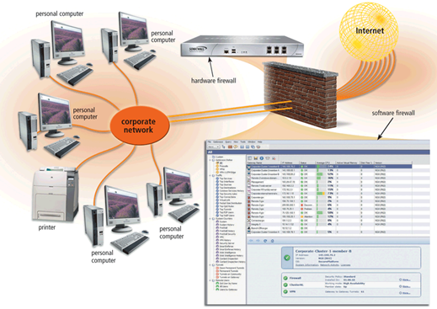
Internet and Network Attacks
A firewall is hardware and/or software that protects a network’s resources from intrusion
Notes:
Figure 11-8

Slide 55
Firewall
Organizations use firewalls to protect network resources from outsiders and to restrict employees’ access to sensitive data such as payroll or personnel records
They can implement a firewall solution themselves or outsource their needs to a company specializing in providing firewall protection
Large organizations often route all their communications through a proxy server, which typically is a component of the firewall
  A proxy server is a server outside the organization’s network that controls which communications pass into the organization’s network
  Proxy servers use a variety of screening techniques
    Some check the domain name or IP address of the message for legitimacy.
    Others require that the messages have digital signatures

Slide 56
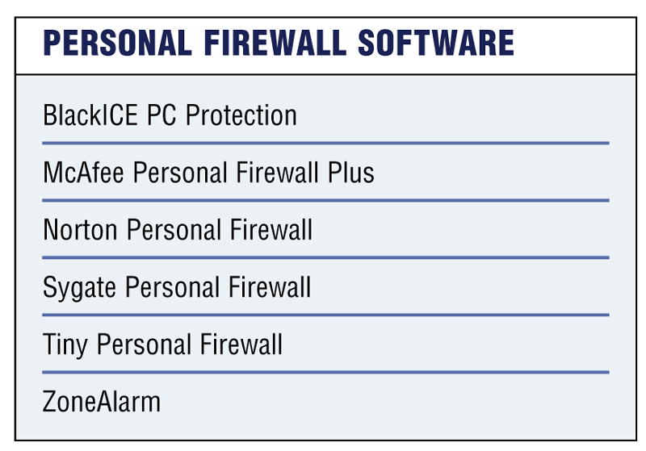
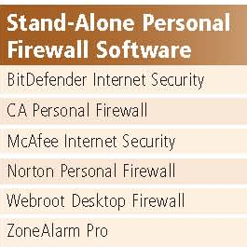
Personal Firewall Utility
Program that protects personal computer and its data from unauthorized intrusions
Monitors transmissions to and from computer
Informs you of attempted intrusion
Notes:
Figure 11-9

Slide 57
Internet and Network Attacks
Intrusion detection software
Analyzes all network traffic
Assesses system vulnerabilities
Identifies any unauthorized intrusions
Notifies network administrators of suspicious behavior patterns or system breaches
Honeypot
Vulnerable computer that is set up to entice an intruder to break into it
Audit Trail records successful and unsuccessful access attempts

Slide 58
Summary I
Computer Security Risk
Categories of Cybercrime
Threats and degrees of Harm
  Threats to User
  Threats to Hardware
  Threats to Data
Internet and Network Attack
Malware, Virus and Malicious Program
Categories of Viruses
58

Slide 59
Summary II
Countermeasures
Safeguard against Malware
Preventing Viruses and Malware
Preventing Internet and Network Attacks
Firewall
Intrusion Detection Software
Honey Pot
Audit Trail

