Slide 1
CSC 101
Introduction to Computing
Lecture 3
Dr. Iftikhar Azim Niaz
ianiaz@comsats.edu.pk

Slide 2
Last Lecture Summary I
Developments in Microcomputers
  From 1984 to 2008
  Intel, AMD, Motorola, IBM, Apple, Microsoft
  Internet
Computer for Individual Use
  Desktop Computers
  Workstations
  Notebook computers
  Tablet computers
  Handheld computers
  Smart phone

Slide 3
Last Lecture Summary II
Computer for Organizations
  Network servers
  Mainframes
  Minicomputers
  Supercomputers
Computers in Society
  Home
  Education
  Small business
  Industry
  Government
  Health Care

Slide 4
Looking Inside Computer System
Most people believe that computers must be extremely complicated devices, because they perform such amazing tasks
Computer is a collection of parts, which are categorized according to the kinds of work they do
Glimpse inside a standard desktop computer
How these components work together and allow you to interact with the system

Slide 5
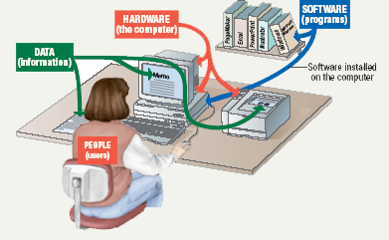
Parts of the Computer System
Computer systems have four parts
  Hardware
  Software
  Data
  User

Slide 6
Hardware
Mechanical devices in the computer
Anything that can be touched
  e.g. printer, keyboard, PDA etc.
consists of interconnected electronic devices that you can use to control the computer’s operation, input, and output.
generic term device refers to any piece of hardware

Slide 7
Software
Set of instructions that makes the computer perform tasks
Tell the computer what to do
Also called a program
Thousands of programs exist
  Some for computer’s own use
  Some for the service of the user
Reason majority of the people would want to purchase a computer
  E-mail, type letters, play games etc.

Slide 8
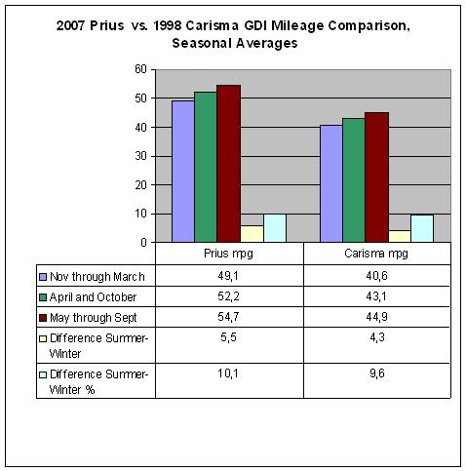
Data
Pieces of information / individual facts
By themselves do not make much sense
Computers organize and present data
Notes:
Teaching tip
A good exercise to relate the importance of making data meaningful is to list some random numbers on the board. Then ask what they mean. Without a title, the numbers have no meaning. Once a title is presented, the numbers make sense.

Slide 9
Users
People operating the computer
Most important part
Tell the computer what to do
  Userless computers?
  people still design, build, program, and repair computer systems.

Slide 10
Information Processing Cycle
Converts data into information
Data
  The raw facts and figures that are processed into information
Information
  Data that has been summarized or otherwise manipulated for use in decision making
Processing /
Computation
Input
Output

Slide 11
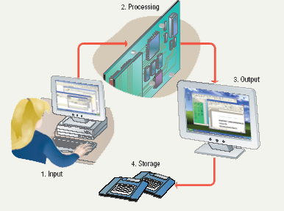
Steps to Process Data
Input
Processing
Output
Storage
Notes:
Teaching tip
It is helpful to walk through a simple program to demonstrate the cycle. I often use a simple arithmetic problem to show this cycle.

Slide 12
Steps to Process Data
Input
  Computer accepts data from some source
Processing
  Computers processing components perform actions on the data based on instructions from user or program
Output
  Computer conveys result to user.
  Text, numbers, graphic, image, video, sound
  Optional
Storage
  Permanently store result on some medium
  Optional

Slide 13
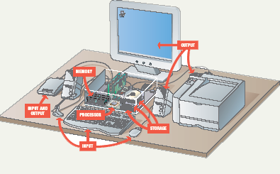
Essential Computer Hardware
Computers use the same basic hardware
Hardware categorized into four types
  Processor
  Memory
  Input and Output
  Storage

Slide 14
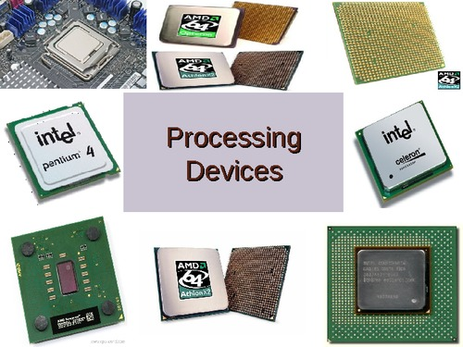
Processing Devices
Processing
  The procedure that transforms raw data into useful information
To perform this transformation, the computer uses two components:
  The Processor and
  Memory

Slide 15
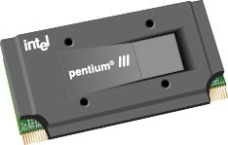
Processor
Brain of the Computer
Processor chip
  A tiny piece of silicon that contains millions of miniature electronic circuits.
Processor chip

Slide 16
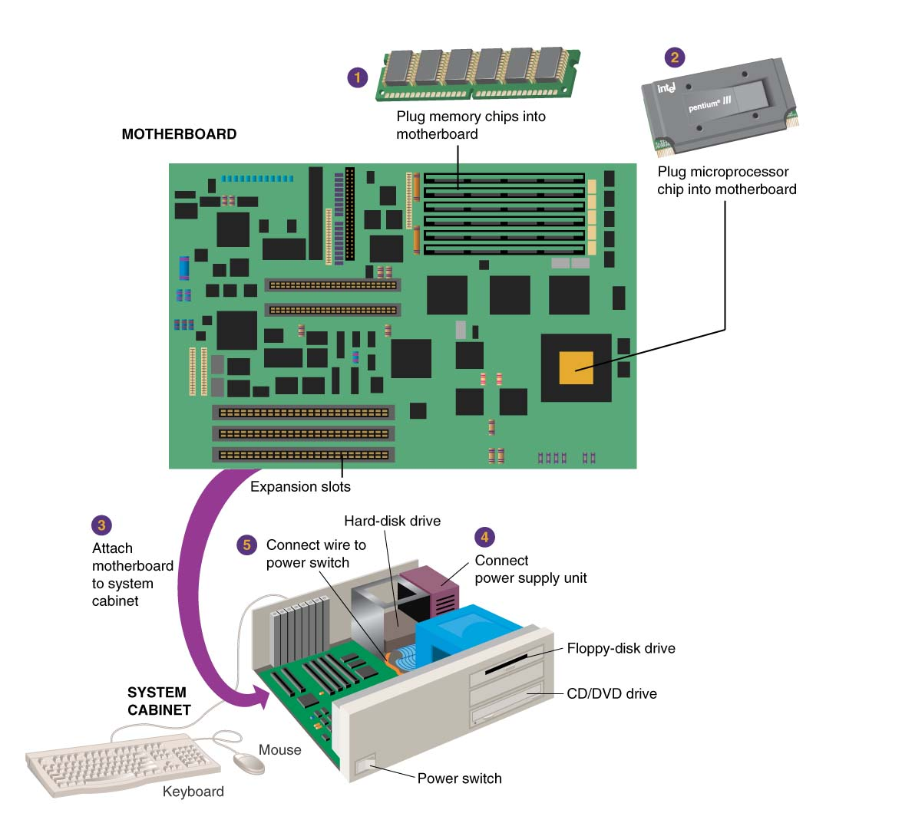
How does everything connect?
Motherboard
Notes:
Motherboard - the main circuit board in the computer.
Everything else attaches to the motherboard through connections called ports.
.

Slide 17
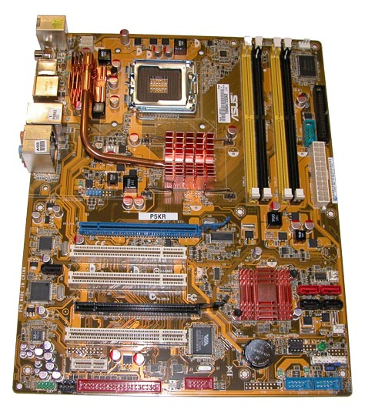
Motherboard
Main printed circuit board in the computer
Everything connects to the motherboard
Expansion slots - “plugs” on the motherboard for expanding the PC’s capabilities via additional circuit boards

Slide 18
Processor
Carries out instructions from the program
Manipulate the data
Most computers have several processors
Central Processing Unit (CPU)
Secondary processors
Processors made of silicon and copper

Slide 19
Memory
memory is one or more sets of chips that store data and/or program instructions, either temporarily or permanently.
Memory is a critical processing component in any computer
Two most important types
  Random access memory (RAM) and
  Read-Only memory (ROM).
work in very different ways and perform distinct functions

Slide 20
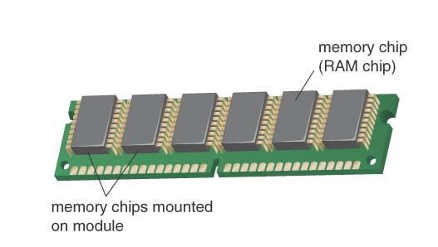
Random Access Memory
Also known as RAM or memory
Represent primary storage or temporary storage.
Hold data before processing and information after processing.
Volatile
More RAM results in a faster system
In MBs or GBs
RAM
Notes:
Memory chips:
Also known as RAM (Random Access Memory).
Represent primary storage or temporary storage.
Hold data before processing and information after processing.

Slide 21
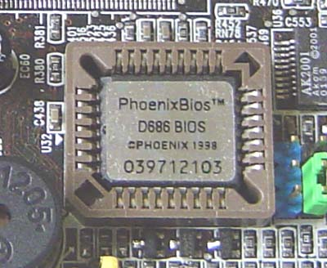
Read Only Memory
Also called ROM
Nonvolatile
  Permanent storage of programs
Holds the computer boot directions
Typically in KBs
ROM
Notes:
Memory chips:
Also known as RAM (Random Access Memory).
Represent primary storage or temporary storage.
Hold data before processing and information after processing.

Slide 22
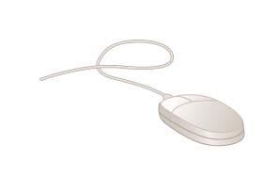
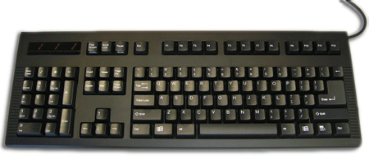
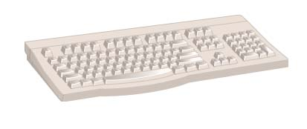
Input
Input hardware - devices that allow people to put data into the computer in a form that the computer can use
Allows the user to interact
Input devices accept data
Keyboard
Mouse
22
Notes:
Input - whatever is put into (“input”) a computer system.
Input hardware - devices that allow people to put data into the computer in a form that the computer can use.
Mouse - an input device that is used to manipulate objects viewed on the computer display screen.
Keyboard - an input device that converts letters, numbers, and other characters into electrical signals readable by the processor.
FACTOID (to accompany hyperlink for Keyboard): Most keyboards were designed with a right-handed computer user in mind. However, approximately 10% of the population is left-handed. Some manufacturers produce keyboards especially for the left-handed computer user. One Web site that offers such keyboards for sale is thelefthand.com. Notice the differences in the left-hand keyboard pictured on their site. The numeric pad has been moved from its normal position on the right-hand side of the keyboard to the left-hand side. Similarly, the arrow keys along with the help, home, page up, page down, etc., keys that are normally adjacent to the numeric pad have been moved to the left-hand side of the keyboard. These two changes would allow a left-handed user to do frequent operations such as numeric data-entry and up/down, left/right movements on the screen with his or her dominant hand—the left one.
FACTOID on mouse: A computer mouse may provide one, two, three or more buttons, depending on which system software it is to be used with. Most use two buttons since that is the minimum number needed for working with the popular Microsoft Windows operating system.

Slide 23
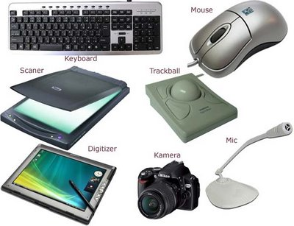
Other Input Devices
Track ball or touch pad
Joystick
Scanners
Digital Camera
Microphone
Webcam
Digitizer
23
Notes:
Input - whatever is put into (“input”) a computer system.
Input hardware - devices that allow people to put data into the computer in a form that the computer can use.
Mouse - an input device that is used to manipulate objects viewed on the computer display screen.
Keyboard - an input device that converts letters, numbers, and other characters into electrical signals readable by the processor.

Slide 24
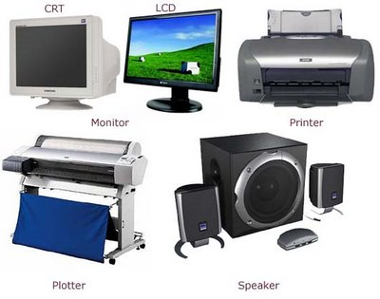
Output
Output devices return processed data to the user or to another computer system.
Most common
  Monitor
  Printer
  Speaker
Some devices are input and output
  Touch screens
Notes:
Teaching tip
It is helpful to have examples of input and output devices in class. Stories of obscure input output devices are typically well received by the students.

Slide 25
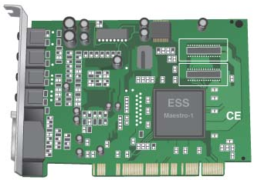
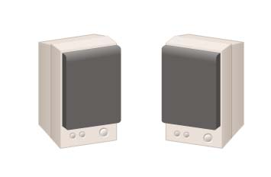
Output
Sound Card
Coverts audio signal from digital to analog and vice versa
Both Input and Output device
Speakers
the devices that play sounds transmitted as electrical signals from the sound card.
Notes:
Output hardware - devices which translate info processed by the computer into a form that humans can understand.
Peripheral device - any component or piece of equipment that expands a computer’s input, storage, and output capabilities.
Sound card - enhances the computer’s sound-generating capabilities by allowing sound to be output through speakers.

Slide 26
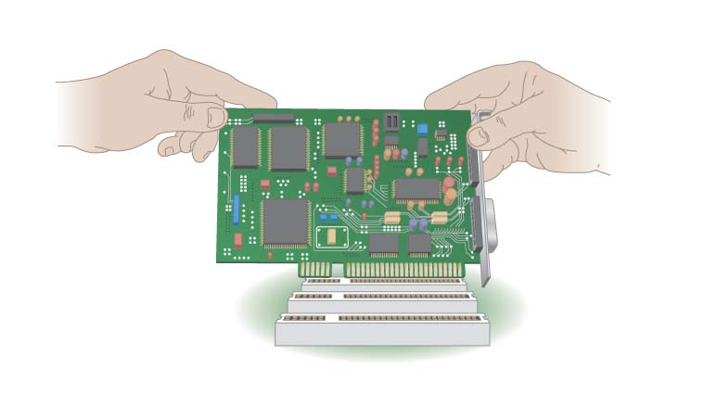
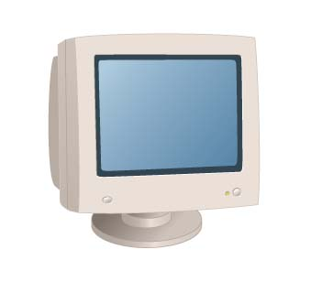
Output
Video card
converts the processor’s output information into a video signal that can be sent through a cable to the monitor
Monitor
the display device that takes the electrical signals from the video card and forms an image using points of colored light on the screen

Slide 27
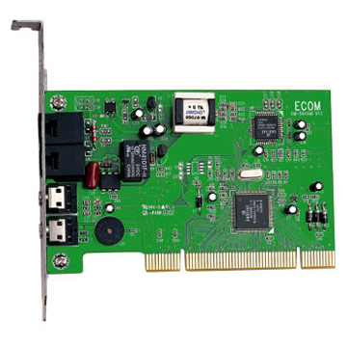
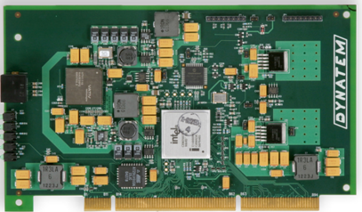
Communication Devices
Modem
  a device that sends and receives data over telephone lines to and from computers..
Network Interface Cards (NIC)
  Controls the flow of data on a network link

Slide 28
Storage Devices
Hold data and programs permanently
Electronic file cabinet
Difference between storage and memory
  More capacity in storage
  Contents are retained in storage even the power is off
  Storage is much cheaper
  Access speed is slow

Slide 29
Types of Storage Devices
Magnetic storage
Optical storage

Slide 30
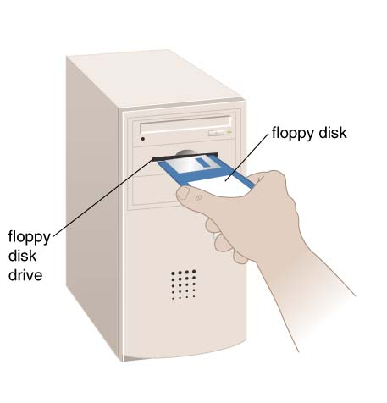


Magnetic Storage
Most common
Floppy disk
  stores data on removable 3.5-inch-diameter diskettes.
  Typical Capacity 1.4MB
Zip Disk
  stores data on floppy-disk cartridges with 70-170 times the capacity of the standard floppy
Floppy disk
Zip disk
Notes:
Insider information
A new CD technology is emerging. A shorter wavelength blue laser beam is being used to burn CD’s. This allows more data to be saved on a disk. The technology is in it’s infancy but should be mature in the near future.
Chapter 11 of the text provides more detail regarding storage devices.
DVD writers are available for purchase. They have not been standardized yet. Several competing formats are vying for acceptance. Of these, the DVD+RW seems to have the strongest support.

Slide 31
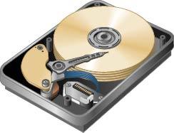
Hard disk drive
Storage device that stores billions of characters of data on a non-removable disk platter.
Capacity 40GB-750GB or even more in TBs

Slide 32
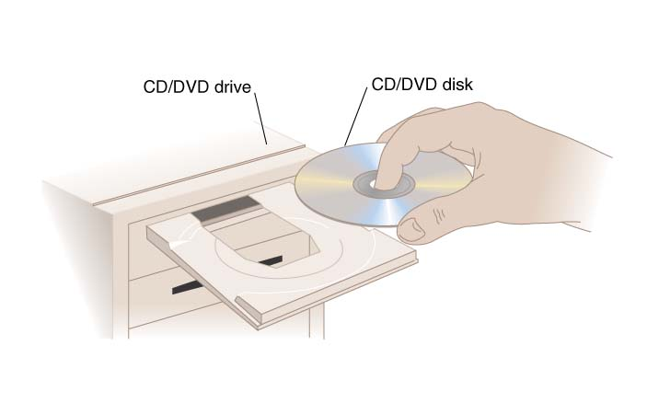
Optical Storage
CD (Compact Disk) drive
  a storage device that uses laser technology to read data from optical disks.
  700MB for CD
DVD
  4.7 to 17 GB
Notes:
FACTOID: Many people who have to travel often for work like to take along their laptop computers so that they can make good use of their time while flying in an airplane, waiting at airports, etc. The advent of DVD players in laptops made this an even more attractive alternative, as travelers could carry along a DVD movie for their own personal entertainment. More and more desktop and tower microcomputers are beginning to feature DVD players as well, which further blurs the distinction between a computer and a television. One company that has taken advantage of this increase in computer-based DVD players (accompanied by a similar increase in home-entertainment DVD players) is netflix.com. This WWW-based business is an online substitute for a video rental store. Netflix members pay a fixed amount per month for as many movie DVDs as they can order, watch, and return (in prepaid mailing envelopes) to the company.

Slide 33
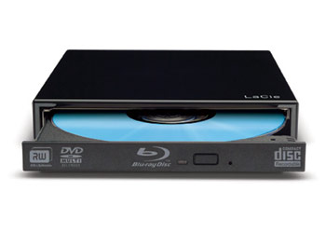
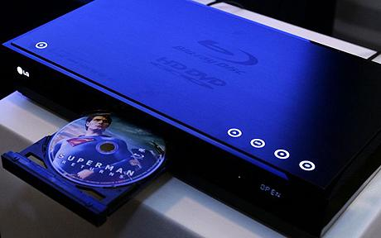
Blu Ray
optical disc storage
high-definition video and data storage.
same physical dimensions as standard DVDs and CDs.
  120 mm in diameter and
  1.2 mm thick
More storage capacity
  25 – 50 GB (single and double layer
  100 – 128 GB (triple and quad layer

Slide 34
Storage Capacity
  1 byte - 1 character of data.
  1 kilobyte – 2¹⁰ bytes/char; 1,024 characters.
  1 megabyte - 2²⁰ bytes/char 1,048,576 characters.
  1 gigabyte - more than 1 billion characters.
  1 terabyte - more than 1 trillion characters.

Slide 35
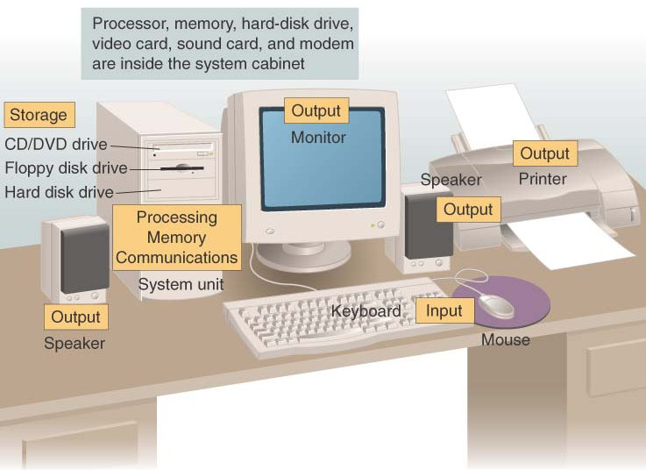
Put all the hardware together and…

Slide 36
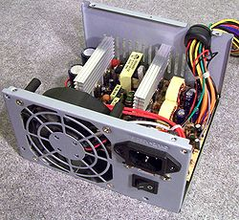
Power
What is Left? Power
  Inside system cabinet

Slide 37
Software Runs The Machine
Tells the computer what to do
Reason people purchase computers
Two types
  System software
  Application software

Slide 38
System Software
Most important software
controls the computer’s hardware
Operating system
  tells the computer how to use its own components.
    Windows XP
Network operating system (OS)
  allows computers to communicate and share data across a network
    Windows Server 2003
Utility
  makes the computer system easier to use or performs highly specialized functions.
    Norton Utilities

Slide 39
Application Software
Accomplishes a specific task
Most common type of software
  Word processors
  Spreadsheet
  Database Management
  Presentation
  Graphics
  Multimedia authoring
  Entertainment and Education
  Games
  Web Design tools and web browsers

Slide 40
Computer data
Fact with no meaning on its own
Stored using the binary number system
Data can be organized into files
  A file is simply a set of data that has been given a name.
  A file that the user can open and use is often called a document.
Notes:
Chapter 5 in the text explores data processing in greater detail.
Figure 1B.5 shows data in binary format.

Slide 41
Computer Users
User’s Role depends on ability
Setup the system
Install software
Running the Programs
Manage files
Maintain the system
Notes:
Teaching tip
Most computer problems are caused by user error. Given this fact, it is fun here to teach the student the acronym PEBKAC the Problem Exists Between Keyboard And Chair. A little humor can break up the lecture monotony.

Slide 42
Userless Computers
Run with no user input
Automated systems
  A car's on board computer
  Home appliances
    Washers and dryers
  Security systems
  Navigation systems
Typically controlled by their own operating systems
Notes:
Teaching tip
Most computer problems are caused by user error. Given this fact, it is fun here to teach the student the acronym PEBKAC the Problem Exists Between Keyboard And Chair. A little humor can break up the lecture monotony.

Slide 43
Summary
Parts of the Computer System
  Hardware, Software, Data, People
Information Processing Cycle
  Input, Processing, Output, Storage
Computer Hardware
  Processor, Memory, Motherboard
  Input Devices Output devices
  Storage Devices
Computer Software
Computer Users

