Slide 1
CSC 101
Introduction to Computing
Lecture 29
Dr. Iftikhar Azim Niaz
ianiaz@comsats.edu.pk
1

Slide 2
Last Lecture Summary I
Computer Programs
Programming Language Generations
  First Generations - Machine Language
  Second Generation - Assembly Language
  Third Generation - Procedural Languages
    FORTRAN, COBOL, C, C++, Java
  Fourth Generation
  Fifth Generation
Compilers and Interpreters
Visual Programming Environments

Slide 3
Last Lecture Summary II
WWW Development Languages
  HTML, XHTML
  XML
  Extensible HTML (XHTML)
  Extensible Style Sheet Language (XSL)
  Extensible HTML Mobile Profile (XHTML MP)
  CSS
CGI and Scripting Languages
Web Page Development
Web Authoring Environments

Slide 4
Objectives Overview
Steps in the program development life cycle and tools used to make this process efficient
Explain the basic control structures and design tools used in designing solutions to programming problems
Differentiate between structured design and object-oriented design
System development phases
Guidelines for system development
Activities that occur during system development
Activities performed during each system development phase

Slide 5
System Development
System development is a set of activities used to build an information system
A system is a set of components that interact to achieve a common goal. Businesses uses many types of systems
An information system (IS) is a collection of hardware, software, data, people, and procedures that work together to produce quality information
System development activities are grouped into phases, and is called the system development life cycle (SDLC)

Slide 6
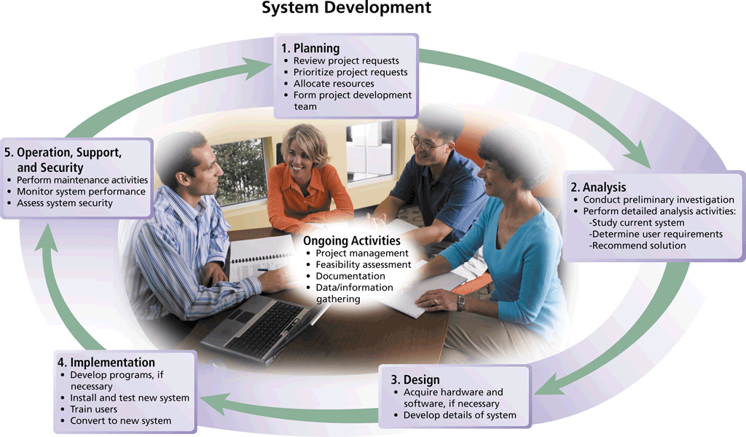
System Development Life Cycle SDLC
Notes:
Figure 12-1

Slide 7
System Development
System development should follow three general guidelines:
Group activities or tasks into phases
Involve users (anyone for whom system is built)
Develop clearly define standards (procedures company employees to follow)

Slide 8
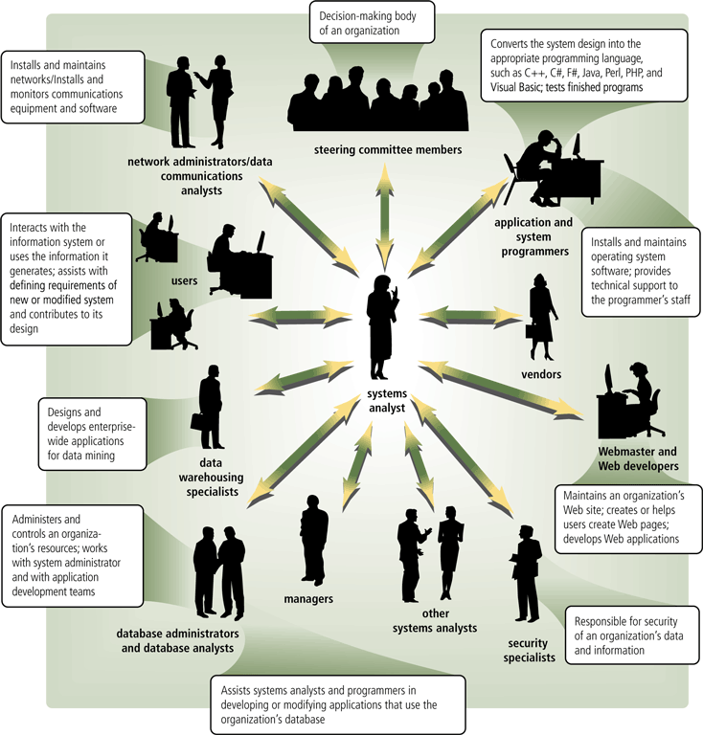
System Development
System development should involve representatives from each department in which the proposed system will be used
System analyst is responsible for designing and developing information system
Liaison between user and IT professionals
Notes:
Figure 12-2

Slide 9
On Going Activities
Project management is the process of planning, scheduling, and then controlling the activities during system development
To plan and schedule a project efficiently, the project leader identifies:
Project scope
Required activities
Time estimates for each activity
Cost estimates for each activity
Order of activities
Activities that can take place at the same time

Slide 10
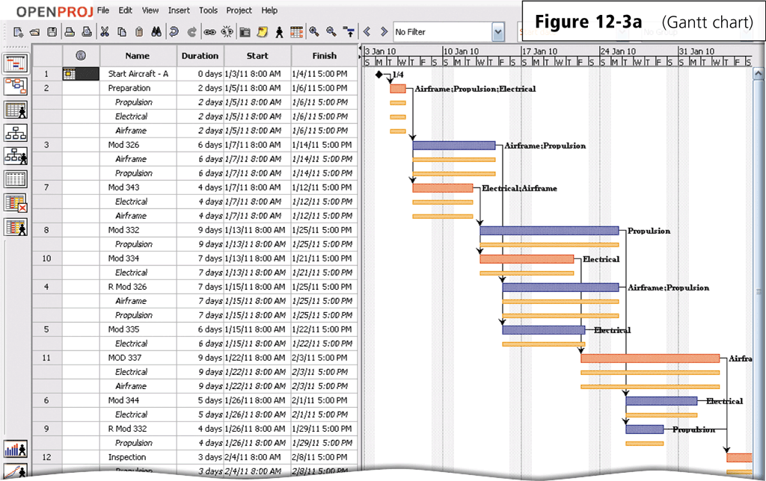
Gantt Chart
A popular tool used to plan and schedule the time relationships among project activities
Notes:
Figure 12-3a

Slide 11
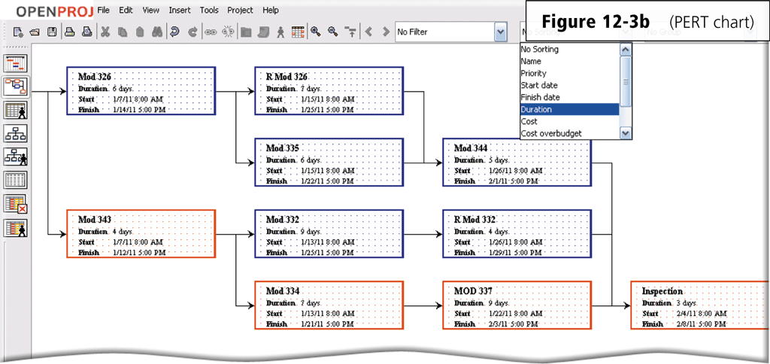
PERT Chart
A Program Evaluation and Review Technique (PERT) chart also can be used for planning and scheduling time
Notes:
Figure 12-3b

Slide 12
On Going Activities
Feasibility is a measure of how suitable the development of a system will be to the organization
A project that is feasible at one point during system development might become infeasible at a later point
Thus, systems analysts frequently reevaluate feasibility during the system development project.
Operational feasibility
Schedule feasibility
Technical feasibility
Economic feasibility

Slide 13
On Going Activities
Documentation is the collection and summarization of data and information
  Includes reports, diagrams, programs, and other deliverables
  A project notebook contains all documentation for a single project
Users and IT professionals refer to existing documentation when working with and modifying current systems
All documentation be well written, thorough, consistent, and understandable
Maintaining up-to-date documentation should be an ongoing part of system development

Slide 14

On Going Activities
Project team need accurate and timely data and information for many reasons
They must keep a project on schedule, evaluate feasibility, and be sure the system meets requirements
During system development, members of the project team gather data and information using several techniques
Review documentation
Observe
Survey (Questionnaire)
Interview
JAD Sessions (Focus group)
Research
Notes:
Figure 12-4

Slide 15
Who Initiates System Development Project
A user may request a new or modified system
Organizations may want to improve hardware, software, or other technology
Situations beyond an organization’s control might require a change
Management might mandate a change
A user may request a new or modified information system using a request for system services or a project request

Slide 16
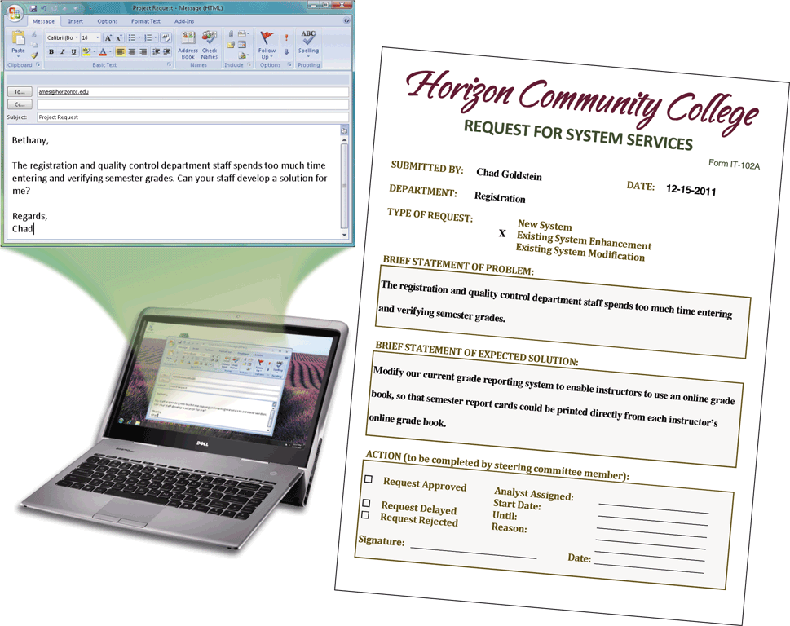
Project Request
Project Request is a formal request for new or modified information system
Notes:
Figure 12-5

Slide 17
1. Planning Phase
The planning phase for a project begins when the steering committee receives a project request
Four major activities are performed:
Review and approve the project requests
Prioritize the project requests
Allocate resources
Form a project development team

Slide 18
2. Analysis Phase
The analysis phase consists of two major activities:
Conduct a preliminary investigation
Perform detailed analysis
Determines and defines the exact nature of the problem or improvement
Interview the user who submitted the request
Study how the current system works
Determine the users’ wants, needs, and requirements
Recommend a solution

Slide 19
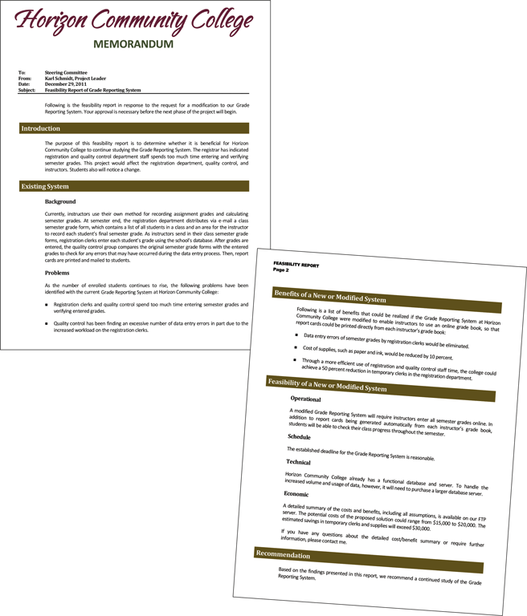
2. Analysis Phase
Preliminary Investigation
  Determine exact nature of problem or improvement and whether it is worth pursuing
  Findings are presented in feasibility report, also known as a feasibility study
Notes:
Figure 12-6

Slide 20
2. Analysis Phase
Detailed Analysis – sometimes called logical design
  Study how current system works
  Determine user’s wants, needs, and requirements
  Recommend solution
Analysts develop the proposed solution without regard to any specific hardware or software
Analysts make no attempt to identify the procedures that should be automated and those that should be manual
analysts use all of the data and information gathering techniques

Slide 21
2. Analysis Phase
Process modeling (structured analysis and design) is an analysis and design technique that describes processes that transform inputs into outputs
Entity-relationship diagrams
Data flow diagrams
Project dictionary

Slide 22
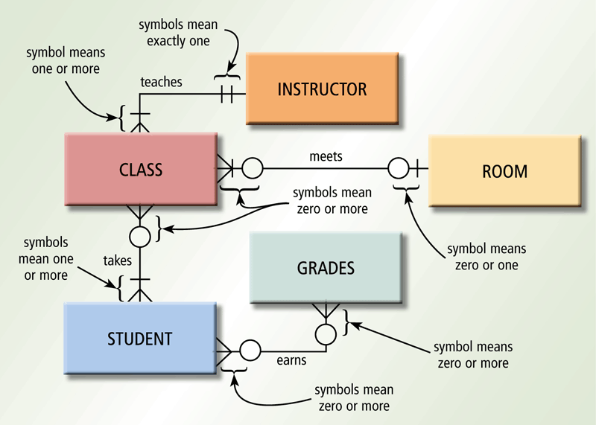
2. Analysis Phase
An entity-relationship diagram (ERD) is a tool that graphically shows the connections among entities in a system
Entities are objects in the system that have data
Entity names usually are nouns written in all capital letters.
Each relationship describes a connection between two entities
Notes:
Figure 12-7

Slide 23
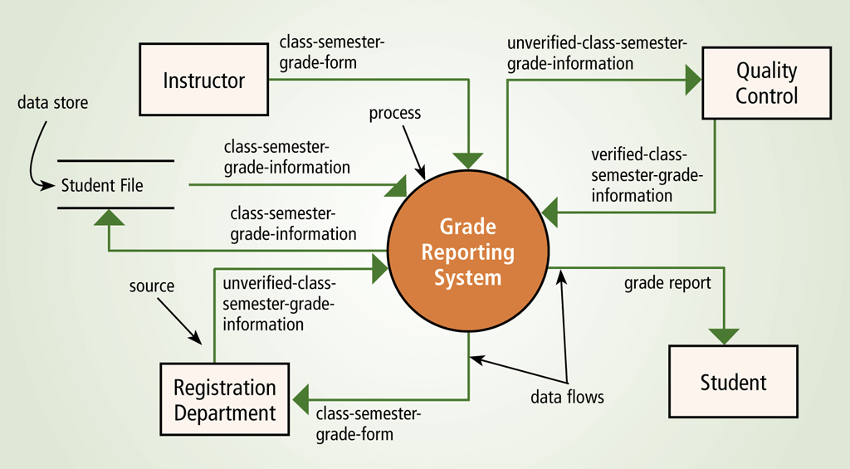
2. Analysis Phase
A data flow diagram (DFD) is a tool that graphically shows the flow of data in a system
  Data flows
  Processes
  Data stores
  Sources
  Top level context diagram, identifies only the major process
  lower-level DFDs contain sub processes
Notes:
Figure 12-8

Slide 24
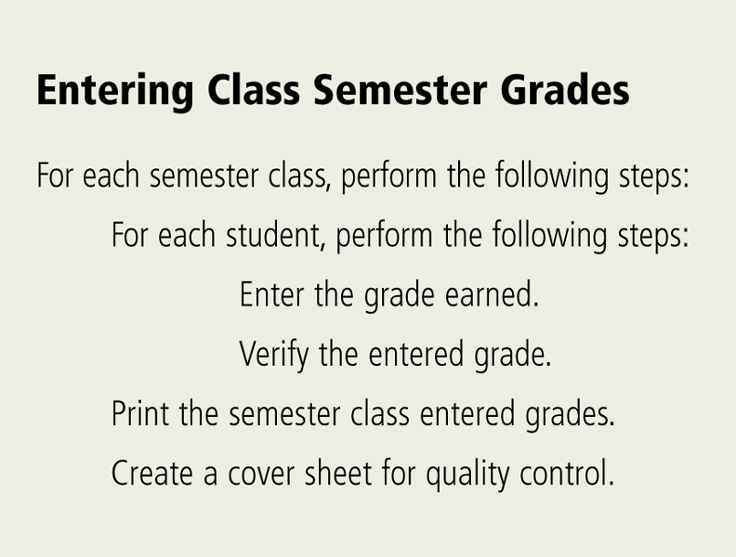
2. Analysis Phase
The project dictionary contains all the documentation and deliverables of a project
Helps keep track of huge amount of details in system. Various techniques to enter items in it.
Explains every item
found on DFDs
and ERDs.
Structured English is a
style of writing that
describes the steps in
a process
Notes:
Figure 12-9

Slide 25
2. Analysis Phase
A decision table is a table that lists a variety of conditions and the actions that correspond to each condition
A decision tree also shows conditions and actions, but it shows them graphically

Slide 26
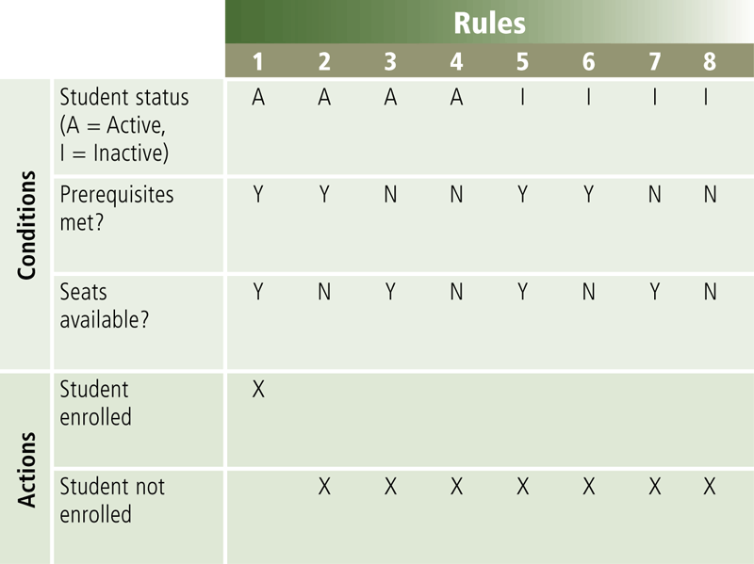
2. Analysis Phase
Decision table
Notes:
Figure 12-10

Slide 27
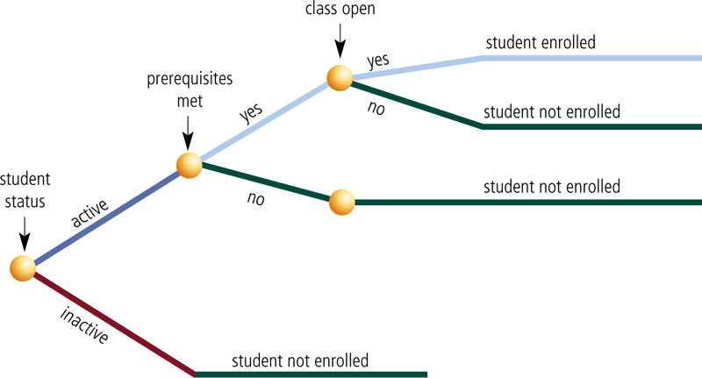
2. Analysis Phase
Decision tree
Notes:
Figure 12-11

Slide 28
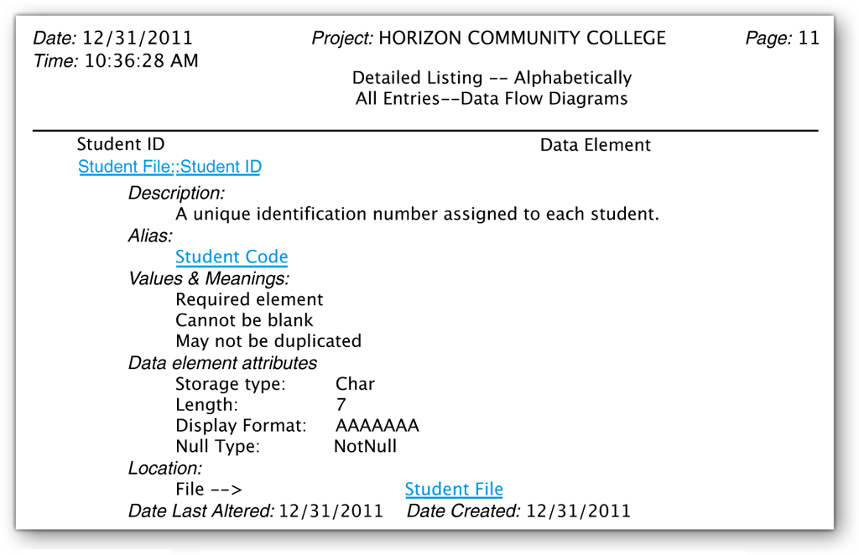
2. Analysis Phase
The data dictionary stores the data item’s name, description, and other details about each data item
Some DBMSs automatically generate the data dictionary. For others, the systems analyst creates the data dictionary
Notes:
Figure 12-12

Slide 29
2. Analysis Phase
Object modeling combines the data with the processes that act on that data into a single unit, called an object
UML (Unified Modeling Language) has been adopted as a standard notation for object modeling and development
  UML includes 13 different diagrams
  Each diagram conveys a view of the system
  Two diagrams include:
Use case diagram
Class diagram

Slide 30
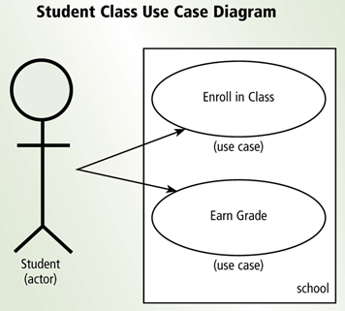
2. Analysis Phase
A use case diagram graphically shows how actors (users) interact with the information system
Diagrams are considered easy to understand
an ideal tool for communicating system requirements with users
An actor is a user or other entity such as a program.
The function that the actor can perform is called the use case
Notes:
Figure 12-13

Slide 31
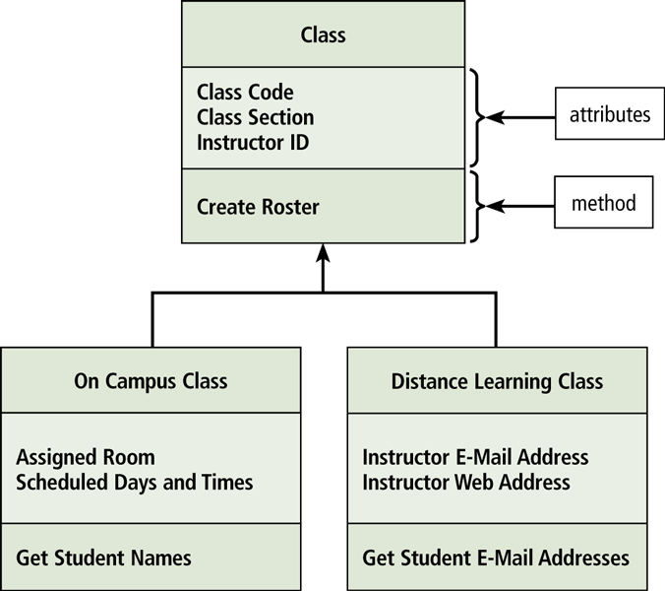
2. Analysis Phase
A class diagram graphically shows classes and subclasses in a system
Each class can have one or more subclasses
Subclasses use inheritance to inherit methods and attributes of higher levels
Notes:
Figure 12-14

Slide 32
2. Analysis Phase
The system proposal assesses the feasibility of each alternative solution
Recommends the most feasible solution for the project, which often involves modifying or building on the current system.
The steering committee discusses the system proposal and decides which alternative to pursue
Packaged software
Custom software
Outsourcing

Slide 33
Possible Solutions
Modify the existing system
Buy Packaged software – prewritten software available for purchase
  Horizontal market software – meets needs of many companies
  Vertical market software – designed for a particular industry
Develop own custom software – software developed at user’s request
Outsource – have outside source develop software

Slide 34
3. Design Phase
The design phase consists of two major activities
Acquire hardware and software
Develop all of the details of the new or modified information system

Slide 35
3. Design Phase
To acquire the necessary hardware and software:
Identify technical specifications
Solicit vendor proposals
Test and evaluate vendor proposals
Make a decision
Use research techniques such as e-zines
RFQ, RFP, or RFI is sent to potential vendors or VARs
Various techniques are used to determine the best proposal
Systems analyst makes recommendation to steering committee

Slide 36
3. Design Phase
The next step is to develop detailed design specifications
  Sometimes called a physical design because it specifies hardware and software components for automated procedures
Database design
Input and output design
Program design
Architectural design

Slide 37
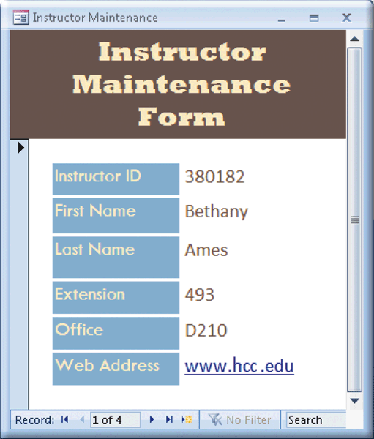
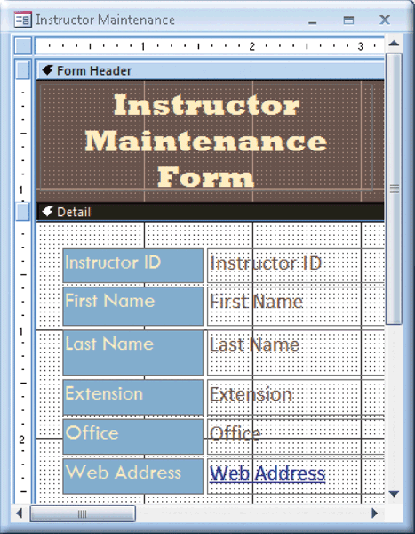
3. Design Phase
Systems analysts typically develop two types of designs for each input and output
Mockup
Layout chart
Notes:
Figure 12-18 Figure 12-19

Slide 38
3. Design Phase
A prototype (proof of concept) is a working model of the proposed system
  Prototypes have inadequate or missing documentation
  Users tend to embrace the prototype as a final system
  can be an effective tool if the development team and the users discipline themselves to follow all system development activities
  Should not eliminate or replace activities rather, it should improve the quality of these activities
  Beginning a prototype too early may lead to problems

Slide 39
Computer-Aided Software Engineering
CASE tools are designed to support one or more activities of system development
CASE tools sometimes contain the following tools:
Project repository
Graphics
Prototyping
Quality assurance
Code generator
Housekeeping
Notes:
Project repository—Stores diagrams, specifications, descriptions, programs, and other deliverables
Graphics—Enables drawing of diagrams
Prototyping—Creates models of proposed system
Quality assurance—Analyzes deliverables for accuracy
Code generators—Create actual computer programs from design specifications
Housekeeping—Establishes user accounts and provides backup and recovery functions

Slide 40
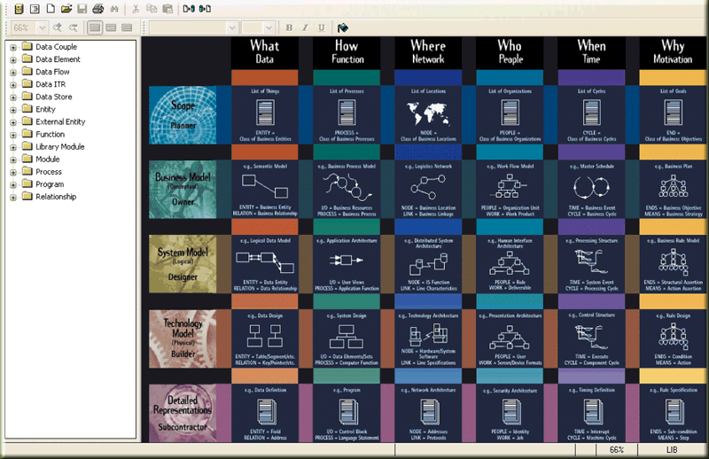
Case Tools
Notes:
Figure 12-20

Slide 41
3. Design Phase
Many people should review the detailed design specifications
An inspection is a formal review of any system development deliverable
  A team examines the deliverables to identify errors
  Step-by-step review by project team and users of any system development cycle deliverable
  Used to review detailed design specifications before they are given to programming team
  Identifies any errors and allows IT personnel to correct them
  Used throughout entire system development cycle to review a variety of deliverables

Slide 42
4. Implementation Phase
The purpose of the implementation phase is to construct the new or modified system and then deliver it to users
Develop programs
Install and test the new system
Train users
Convert to the new system

Slide 43
4. Implementation Phase
The program development life cycle follows these steps:
Analyze the requirements
Design the solution
Validate the design
Implement the design
Test the solution
Document the solution
1
2
3
4
5
6
Notes:
Programmers write programs from specifications

Slide 44
4. Implementation Phase
Various tests should be performed on the new system
Systems analysts and users develop test data so that they can perform various tests.
The test data should include both valid (correct) and invalid (incorrect) data.
When valid test data is entered, the program should produce the correct results. Invalid test data should generate an error.
Unit test
Verifies that each individual program or object works by itself
Systems test
Verifies that all programs in an application work together properly
Integration test
Verifies that an application works with other applications
Acceptance test
Checks the new system to ensure that it works with actual data

Slide 45


4. Implementation Phase
Training involves showing users exactly how they will use the new hardware and software in the system
  One-on-one sessions
  Classroom-style lectures
  Web-based training
Notes:
Figure 12-21

Slide 46
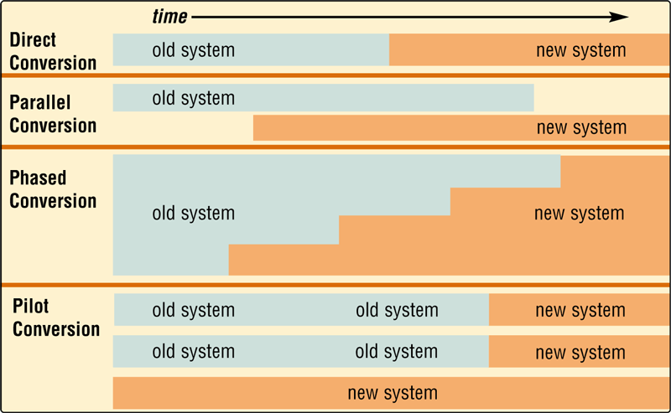
4. Implementation Phase
One or more of four conversion strategies can be used to change from the old system to the new system
Notes:
Figure 12-22

Slide 47
5.Operation, Support, and Security Phase
The purpose of the operation, support, and security phase is to provide ongoing assistance for an information system and its users after the system is implemented
Perform maintenance activities
Monitor system performance
Assess system security

Slide 48
5.Operation, Support, and Security Phase
A computer security plan should do the following:
  Summarizes in writing all of the safeguards that are in place to protect a company’s information assets
Identify all information assets of an organization
Identify all security risks that may cause an information asset loss
For each risk, identify the safeguards that exist to detect, prevent, and recover from a loss

Slide 49
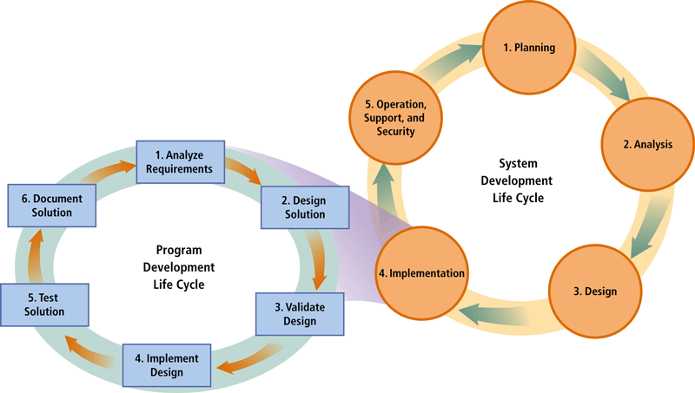
Program Development
Program development consists of a series of steps programmers use to build computer programs
Notes:
Figure 13-23

Slide 50
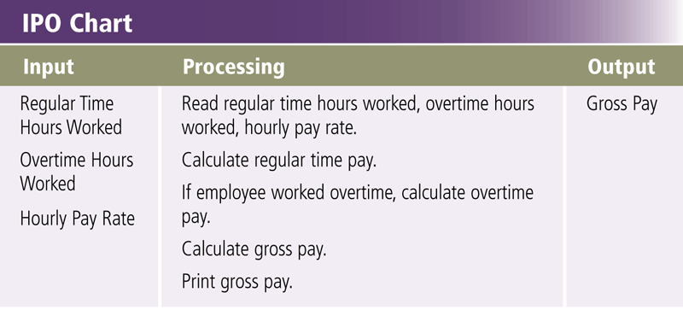
Step 1 – Analyze Requirements
To initiate program development, programmer:
  Reviews the requirements
  Meets with the systems analyst and users to understand the purpose of the requirements from the users’ perspective
  Identifies input, processing, and output
    IPO chart
Notes:
Figure 13-24

Slide 51
Step 2 – Design Solution
Design a solution algorithm, step by step procedure to solve problem
In structured design, sometimes called Top-Down design, the programmer typically begins with a general design and moves toward a more detailed design
Programmers use a hierarchy chart to show program modules graphically also called structure chart
Object-Oriented design

Slide 52
Step 2 – Design Solution
Algorithmic Solutions
  Set of finite steps
  Always leads to a solution
  Steps to finding the solution always remains the same
  Algorithms appear in all programs
  Operations must not be changed
  Operations must be effective
  Pseudo code can describe algorithms in English like statements
  Flowcharts can describe algorithms
    Structured tool for drawing algorithms
Notes:
Teaching tip
Figure 13A.8 on page 505 shows a flowchart.

Slide 53
Step 2 – Design Solution
Heuristic Solutions
  Sometimes, no algorithm exists to solve a problem, or the algorithm is so complex or time-consuming that it cannot be coded or run
  Set of steps for finding the solution to a problem
  Does not come with a guarantee of finding the best possible solution
  Offer a good chance of finding a solution, although not necessarily the best (optimal) one
  provide a best-guess approach to problem solving
  Appear in more complex applications
    Data mining
    Anti-virus software
Notes:
Teaching tip
Data mining was introduced in chapter 11B.

Slide 54
Structured Programming
Programming using defined structures
Creates easy to read code
Programs are efficient and run fast
Structured programs benefit from their simplicity, reliability, readability, reusability, and maintainability.
Several defined structures
Identify the major function of a program, sometimes called the main routine or main module.
Decompose main routine into smaller subroutines or modules
Analyzes each subroutine to determine if it can be decomposed further.
Notes:
Teaching tip
While lecturing, have a sample program open that incorporates all of the followings structures.

Slide 55
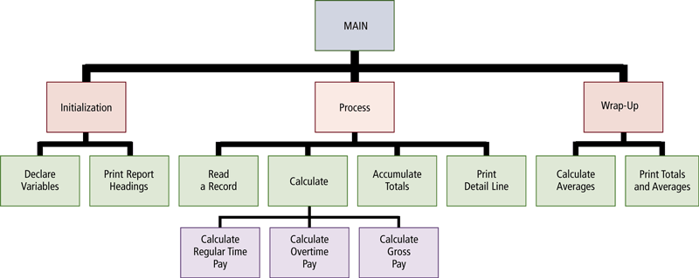
Step 2 – Design Solution
Hierarchy chart or Structure chart show program modules graphically
Notes:
Figure 13-25

Slide 56
Object Oriented Programming (OOP)
Enhances structured programming
Intuitive way of modeling the real world
programs become simpler, programming becomes faster, and the burden of program maintenance is lessened
Code reuse
  Code used in many projects
  Speeds up and simplifies program development
Develops objects
  All real world items are objects
  OOP develops code versions
  Contains data about the item
  Contains functionality
  Object encapsulates both into one package

Slide 57
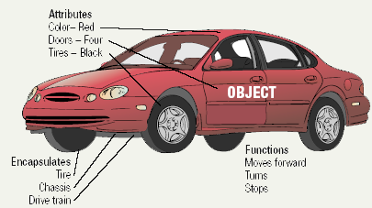
Object Oriented Programming
An object is an item that can contain both data and the procedures that read or manipulate that data
Each data element is called an attribute or property. The procedure in the object, called an operation or method, contains activities that read or manipulate the data
Notes:
Teaching tip
Provide an example of an object. I often use a lead pencil. Data includes the size and type of lead. Functionality includes write, erase, extendLead, extractLead and replenishLeadSupply.

Slide 58
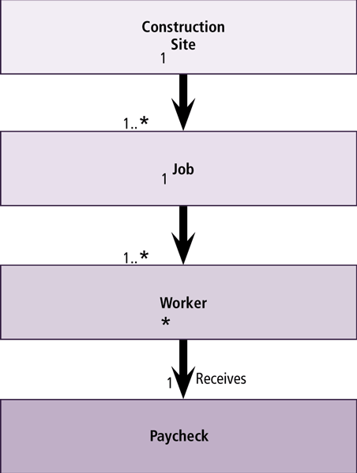
Step 2 – Design Solution
With object-oriented (OO) design, the programmer packages the data and the program into a single object
  Encapsulation
  Objects are grouped into classes
  Class diagram represents hierarchical relationships of classes graphically
Notes:
Figure 13-26

Slide 59
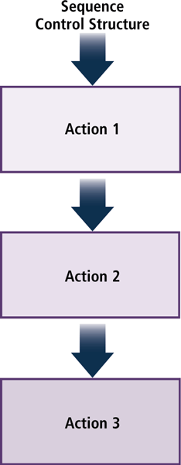
Step 2 – Design Solution
The sequence control structure shows one or more actions following each other in order
Control structure depicts logical order of program instructions
Describes the flow of the program
Typically executed in sequential order
Actions must be executed; that is, none can be skipped
Notes:
Figure 13-27

Slide 60
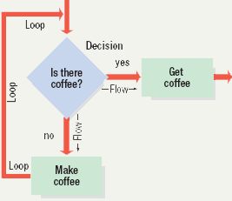
Structured Programming
Selection Structure
  Also called conditional statement
  Performs a true or false test
  Determines which code to execute next
  Branching statements allow multiple flows
Repetition structure
  Also called looping structures
  Repeats a section of code
    Until an exit condition is reached

Slide 61
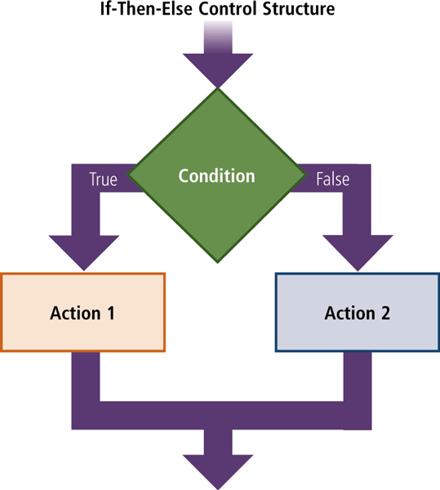
Step 2 – Design Solution
The selection control structure tells the program which action to take, based on a certain condition
  If-then-else —yields one of two possibilities: true or false
  Case - yields one of three or more possibilities
Notes:
Figure 13-28

Slide 62
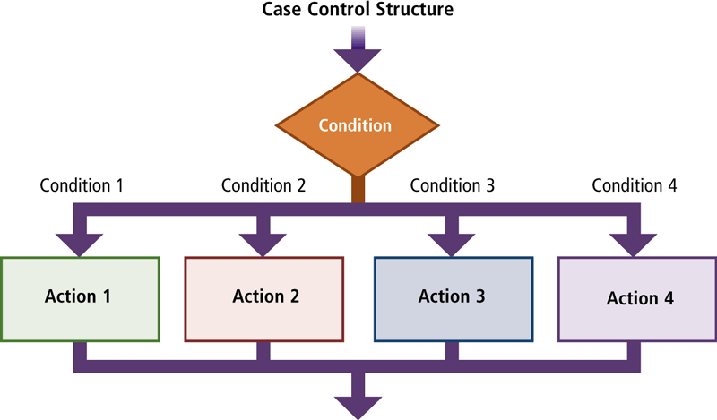
Step 2 – Design Solution
Case Control Structure — yields one of three or more possibilities
Notes:
Figure 13-29

Slide 63
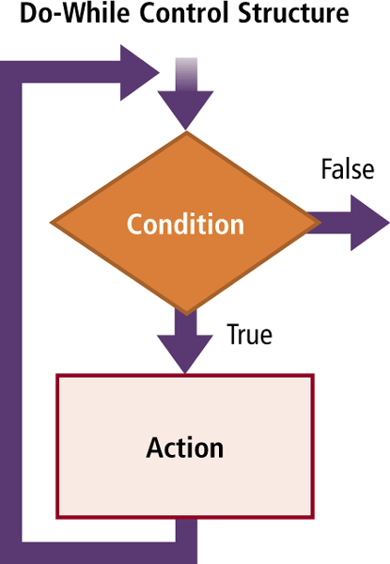
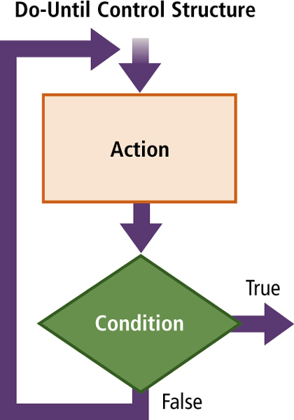
Step 2 – Design Solution
The repetition control structure enables a program to perform one or more actions repeatedly as long as a certain condition is met
Do-While control structure
  Pretest loop (0 or more)
  repeats as long as condition is true
Do-Until control structure
  Post test loop ( 1 or more)
  Repeats until condition is true
Notes:
Figure 13-30 Figure 13-31

Slide 64
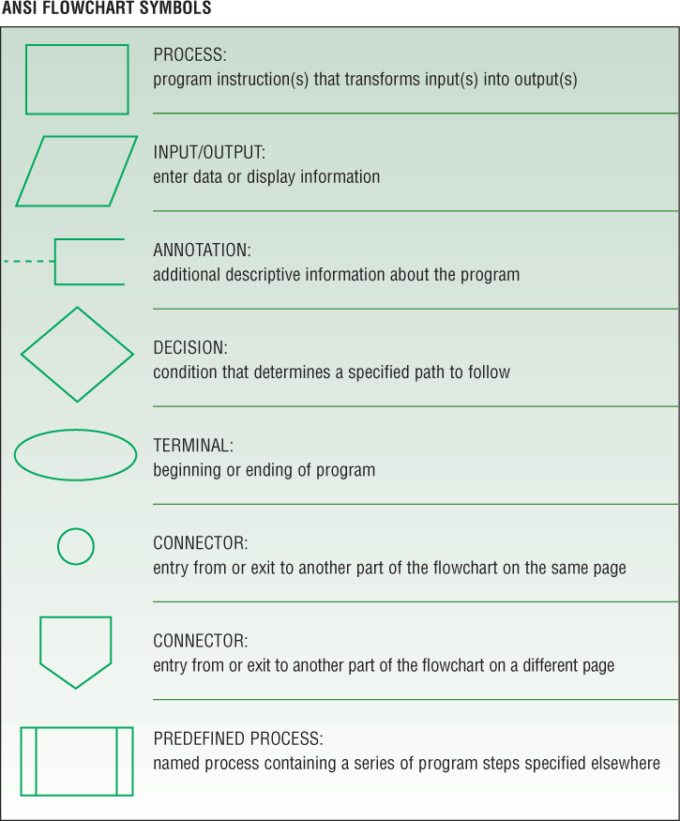
Step 2 – Design Solution
A program flowchart graphically shows the logic in a solution algorithm
Programmers connect most symbols on a program flowchart with solid lines
These lines show the direction of the program
Dotted lines on a flowchart connect comment symbols.

Slide 65
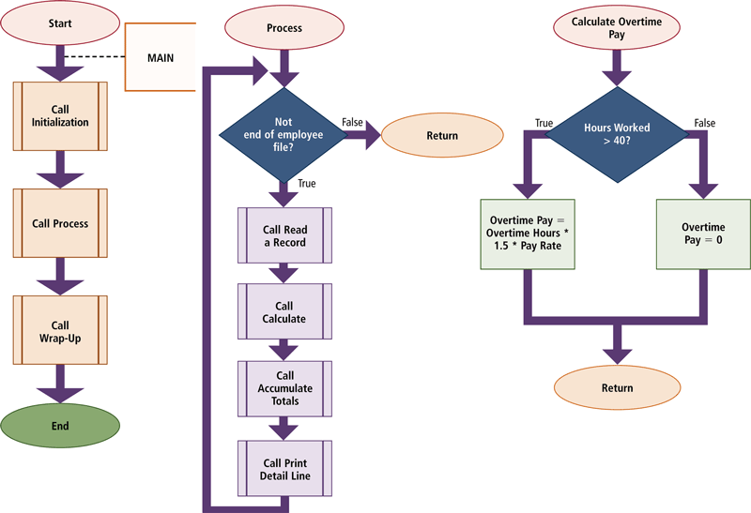
Program Flowchart
Notes:
Figure 13-33

Slide 66
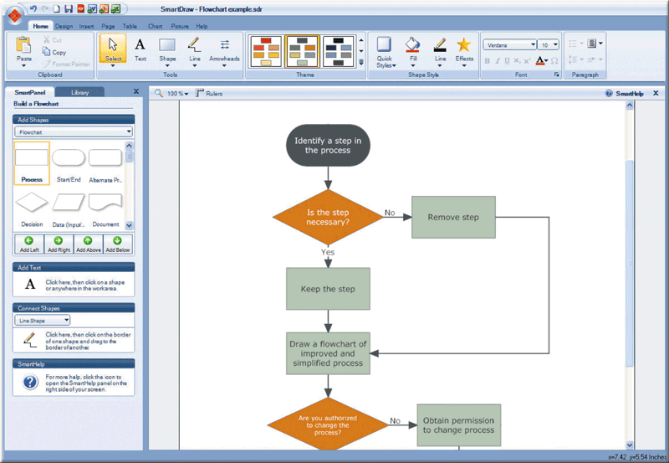
Step 2 – Design Solution
In the past, programmers used a template to trace the symbols for a flowchart on a piece of paper
Flowcharting software makes it easy to modify and update flowcharts
  SmartDraw
  Visio
Notes:
Figure 13-34

Slide 67
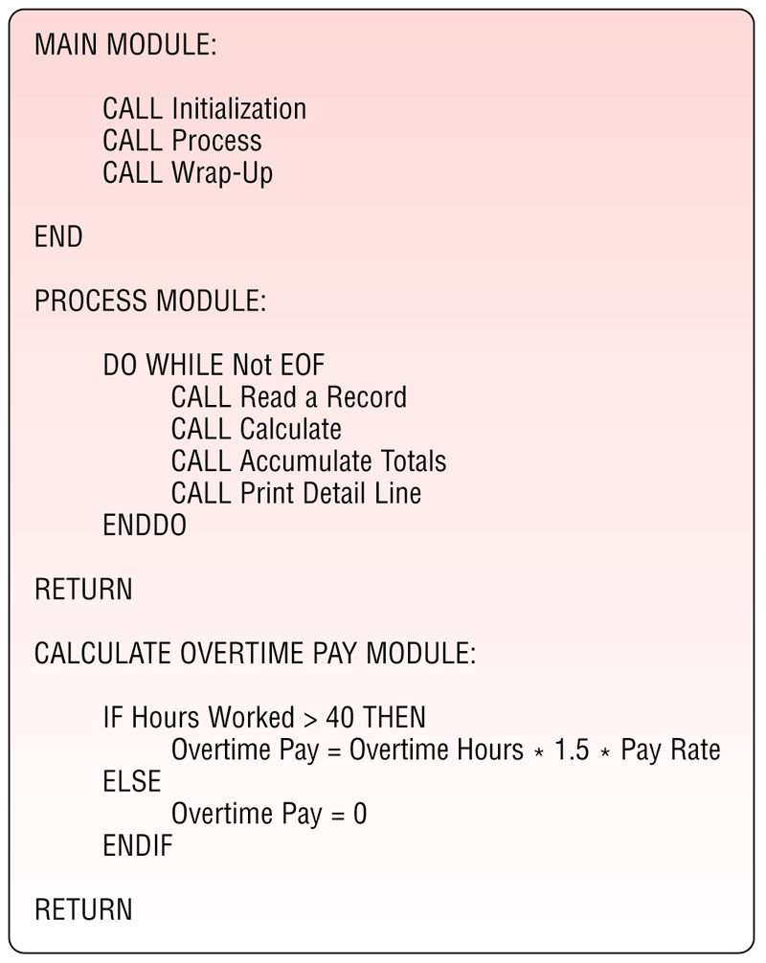
Step 2 – Design Solution
Pseudocode uses a condensed form of English to convey program logic
  Natural language statements that
  resemble code
  Describes what must be done
  uses indentation to identify the control structures
  Can be written by non programmers
  Programmers develop unique versions
Notes:
Figure 13-35

Slide 68
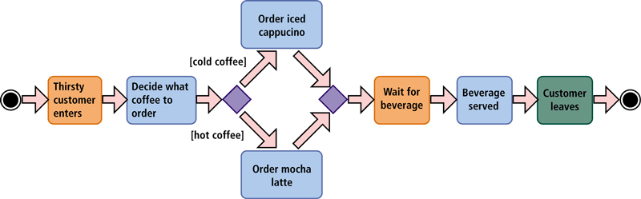
Step 2 – Design Solution
UML (Unified Modeling Language) has been adopted as a standard notation for object modeling and development
An activity diagram shows all the activities that occur within a use case.
Notes:
Figure 13-37

Slide 69
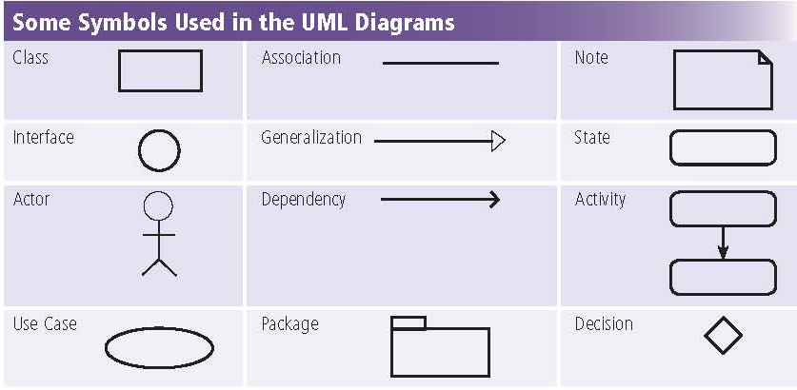
UML Diagrams
Notes:
Figure 13-36

Slide 70
Step 3 – Validate Design
Check program design for accuracy
Inspection – system analysts reviews deliverables during the system development cycle
Programmers checks logic for correctness and attempts to uncover logic errors
  Logic errors are design flaws that causes inaccurate results
Desk check – programmers use test data to step through logic
  Test data is sample data that mimics real data that program will process
  Users should assist in the development of test data.

Slide 71
Step 3 – Validate Design
Check for logic errors using test data
Desk checking involves five steps
Develop various sets of test data
Determine the expected result
Step through the algorithm
Compare the results
Repeat steps for each set of test data

Slide 72
Step 4 – Implement Design
Implementation of the design includes using a program development tool that assists the programmer by:
  Generating or providing some or all code
  Writing the code that translates the design into a computer program
  Creating the user interface
Extreme programming is a strategy where programmers immediately begin coding and testing solutions as soon as requirements are defined

Slide 73
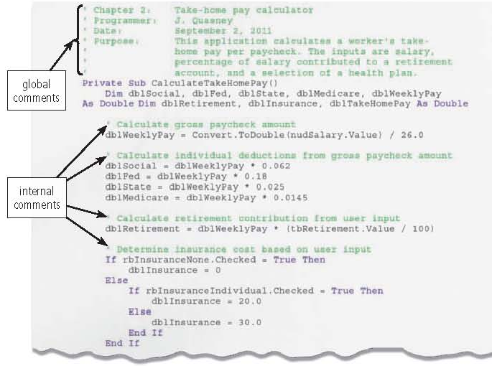
Step 4 – Implement Design
A language’s syntax is the set of grammar and rules that specifies how to write instructions for a solution algorithm
Code – rules that specify how to write instructions
Comments – program documentation
Code review is the process of programmers, quality control testers, and/or peers reviewing code in order to locate and fix errors so that the final programs work correctly
Notes:
Figure 13-38

Slide 74
Step 5 – Test Solution
The goal of program testing is to ensure the program runs correctly and is error free
Errors include syntax errors and logic errors
Debugging the program involves removing the bugs
A beta is a test copy of program that has most or all of its features and functionality implemented
Sometimes used to find bugs

Slide 75
Step 6 – Document Solution
In documenting the solution, the programmer performs two activities:
  Review the Program code to remove dead code, program instructions that program never executes
    programmers should run the program one final time to verify it still works
  Review all the documentation
    documentation includes all charts, solution algorithms, test data, and program code listings that contain global and internal comments.
    all documentation should be complete and accurate
    Proper documentation greatly reduces the amount of time a new programmer spends learning about existing programs

Slide 76
Summary I
System Development Life Cycle Phases
Ongoing Activities
  Project Management, Feasibility, Documentation
Planning
  Review, approve and prioritize project requests
Analysis
  Preliminary Investigation, Detailed analysis
Design
  Acquire Hardware and software, Develop details
Implementation
  Develop programs, install and test new system
Operation, Support and Security
  Maintenance Activities, System performance and security
76

Slide 77
Summary II
Program Development Life Cycle
Analyze requirements
  Review requirements, develop IPO charts
Design solution
  Design solution algorithm, Structured and OOP
  Flowchart and Pseudo code
Validate design
  Inspection and Desk check
Implement design
  Program development tool, writing code
Test solution
  Testing and Debugging
Document solution
  Review Program code and documentation

