Slide 1
CSC 101
Introduction to Computing
Lecture 28
Dr. Iftikhar Azim Niaz
ianiaz@comsats.edu.pk
1

Slide 2
Last Lecture Summary I
Working with DBMS
  Creating Tables, Data Dictionary
  Entering, Viewing and Sorting Records
Forms and Report Generator
Querying a Database
  SQL, xBase and QBE
Data Security
Backup and Recovery
Data Model

Slide 3
Last Lecture Summary II
Relational Databases
Object Oriented Databases
  Types of OO databases, GIS database
Multidimensional Databases
  Data warehouse
Web Databases
Common RDBMS
Database Design Guidelines, Normalization
Database Administration
Enterprise Software

Slide 4
Objectives Overview
Computer Program Differentiate between machine and assembly languages
Identify and discuss the purpose of procedural programming languages, and describe the features of C and COBOL
Identify and discuss the characteristics of these object-oriented programming languages and program development tools
Identify the uses of other programming languages and program development tools
Describe various ways to develop Web pages
Identify the uses of popular multimedia authoring programs

Slide 5

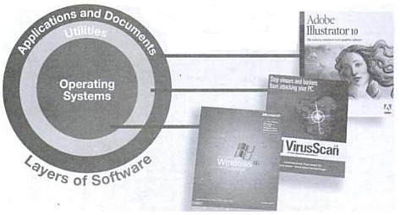
What Is a Computer Program?
Computer programs
  Also called software
  Are a list of instructions
  Instructions are called code
  CPU executes the instructions
  Three types
    Operating system
    Utility
    Application Program
Notes:
Teaching tip
Chapters 7 and 8 cover software in great detail.

Slide 6

Computer Program
A computer program is a series of instructions that directs a computer to perform tasks
  Created by a programmer using a programming language – used to write instructions
  composed of a main module and sub modules
  These modules are stored as a collection of files; large programs can contain thousands of individual files, each serving a specific purpose.
  Some of the files contain instructions for the computer, while other files contain data
Notes:
Figure 131-1

Slide 7
Software Is Stored In Many Files
Executable files
  Contain the instructions for the CPU
  Have extensions of .exe, or .com
Dynamic link libraries
  Partial executable file
  Do not run on its own, instead, its commands are accessed by another running program
  Used to support executable files
  provide programmers with an effective way of breaking large programs into small, replaceable components
  makes the entire program easier to upgrade
  Have .dll extensions
Notes:
Teaching tip
Open a folder and demonstrate each file. Show what happens when you open each file type.

Slide 8
Software Is Stored In Many Files
Initialization files
  Contains configuration information, such as the size and starting point of a window, the color of the background, the user's name, and so on
  Help programs start running or contain information that programs can use as they run
  Have a .ini extension
  Modern programs use the Window’s registry
Help files
  Contain information about the software
  Information is indexed and searchable
  Provides an online manual
  Have a .chm or .hlp extension
Notes:
Teaching tip
Most Windows programs provide help by hitting the Help menu or pressing F1. This will open the Windows Help program and display the help appropriate to the application that launched the help.

Slide 9
Software Is Stored In Many Files
Batch files
  Used to automate common or repetitive tasks
  A simple program that consists of an unformatted text file containing one or more operating system commands
  Hold a series of OS commands
  When run the commands are executed in a sequence one by one.
  Have a .bat extension
By default, most program files are stored in a folder that bears the application’s name or an abbreviation of it
The .dll files on Window's XP are usually stored in the c:\windows\system32 folder
Notes:
Teaching tip
Most Windows programs provide help by hitting the Help menu or pressing F1. This will open the Windows Help program and display the help appropriate to the application that launched the help.

Slide 10
Hardware/Software Interaction
Program execution
  Software executes at the CPU level
  Code to play a sound
    Code generates an interrupt
    CPU tells the sound card to play
    Sound card plays the file
Programmer creates the code
  Code is statements written in a programming language
  Writing code can be tedious
    Code must be perfect before it will run
    No grammatical mistakes or syntax errors are allowed in programming
    Order of steps must be exact
    Programmer must fix errors before the program can be tested
  Writing code is quite exciting
    Problems are solved
    New ideas are formed
Notes:
Discussion point
Page 501 states “Computers are the reason people purchase computers”. This is an excellent quote. Have students list all the things that they do with computers. When done, point out that the majority of items are handled by a software application.

Slide 11
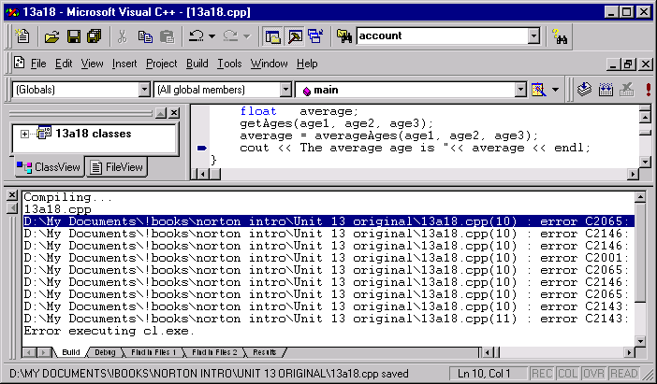
Writing Code in an Editor
Code in C++ along with syntax errors

Slide 12
First Generation Languages
Machine level programming languages
Recall that computers think in binary
Machine code is written in binary
CPU executes the machine code
Different for every CPU
  CPUs have a unique machine code
  language is specific to a particular target machine or family of machines, directly reflecting their characteristics like instruction sets, registers, storage access models, etc., requiring and enabling the programmer to manage their use
no translator was used to compile or assemble the first-generation language
instructions were entered through the front panel switches of the computer system

Slide 13
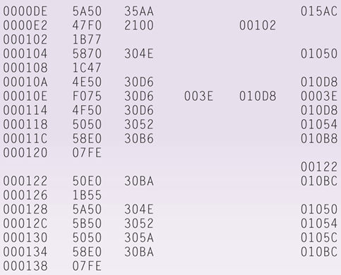
Machine Language
Machine language is the first generation of programming languages and the only language the computer directly recognizes
Machine dependent – runs only on one type of computer
Low-level language
Uses a series of binary digits (1s and 0s) with a combination of numbers and letters that represent binary digits
Notes:
Figure 13-2

Slide 14
Programming Languages
Simplifies the writing of code
  English is used to describe the binary
Original code is called source code
Avoids using machine code
Have strict rules of syntax
  Symbols and punctuation have meaning
  Spelling must be exact
Code is converted into machine language
Several hundred languages exist
Notes:
Insider information
Older languages such as COBOL and Fortran actually required developers to place different coding statements in different columns on the screen.

Slide 15
Second Generation Languages (2GL)
Assembly languages
Statements that represent machine code but written in symbolic codes
Code is then converted into machine language by an assembler
The code can be read and written by a programmer
Second generation of programming languages brought logical structure to software
Sometimes used in kernels and device drivers
Still used to optimize video games

Slide 16
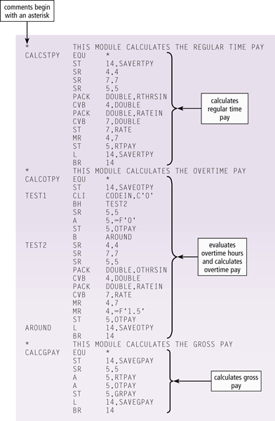
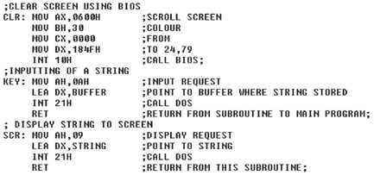
Assembly Language
Language is specific to a particular processor family and environment i.e. machine dependent
Programmer writes instructions using symbolic instruction codes
Notes:
Figure 13-3

Slide 17
Third Generation Languages (3GL)
Brought refinements to make the languages more programmer-friendly
First higher level language
Supports structured and OOP
  Code is reusable
  Code is portable
Typically written in an IDE
C/C++ creates games and applications
Java creates web applets
ActiveX creates Web and Windows applets

Slide 18
Procedural Languages
In a procedural language, the programmer writes instructions that tell the computer what to accomplish and how to do it
  Uses series of English-like words to write instructions
  computer take care of non-essential details, not the programmer
Compilers and interpreters
  Converts source code into binary
    Allows code to execute
  Checks source code for correctness
A compiler translates an entire program before executing it
An interpreter converts and executes one code statement at a time

Slide 19
Compiler
Creates an executable file
  Contents are called object code
  In some languages, object code must then be linked to produce an executable file e.g. C language
  In others, object code itself is executable and can run on its own e.g. Pascal
Once compiled, the program is a stand-alone executable file that no longer needs the compiler to run.
Each language has its own compiler
FORTRAN, COBOL, Pascal, C, C++ and Java are compiled languages

Slide 20
Interpreter
Also converts source code to machine code
Instead of creating an executable object code file, it translates and then executes each line of program , one line at a time
Translate code on the fly so are more flexible than compilers
Interpreted code runs slower than the compiled code because code must be interpreted each time it is run
Interpreter always needed to execute program
LISP, BASIC, Visual Basic and Perl are interpreted languages

Slide 21
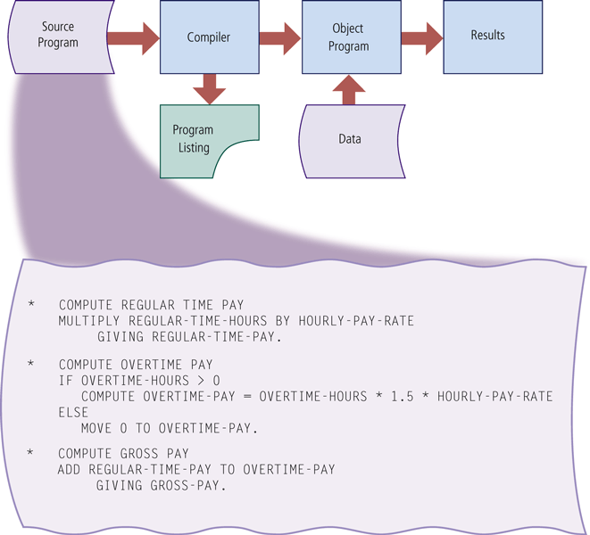
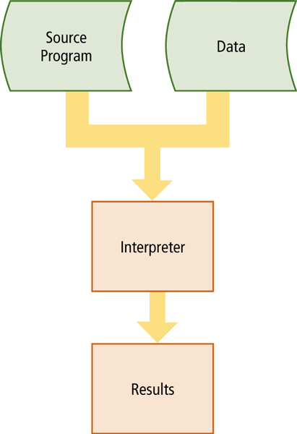
Compiler and Interpreter
Notes:
Figure 13-4 Figure 13-5
Compiler - Program that converts entire source program into machine language before executing it
Interpreter - Program that translates and executes one program code statement at a time. Does not produce object program

Slide 22
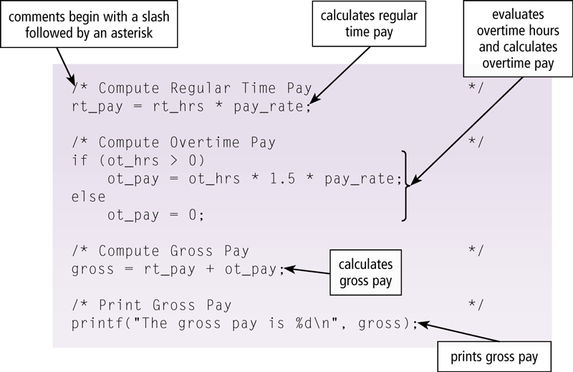
Procedural Languages
The C programming language is used to write many of today’s programs
Powerful language originally designed to write system software
Produces programs with fast and efficient code
Requires professional programming skills
Notes:
Figure 13-6

Slide 23
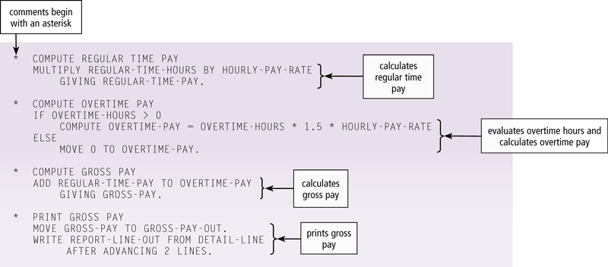
Procedural Languages
COBOL (COmmon Business-Oriented Language) is designed for business applications, but easy to read, maintain and write because of the English-like statements
Notes:
Figure 13-7

Slide 24
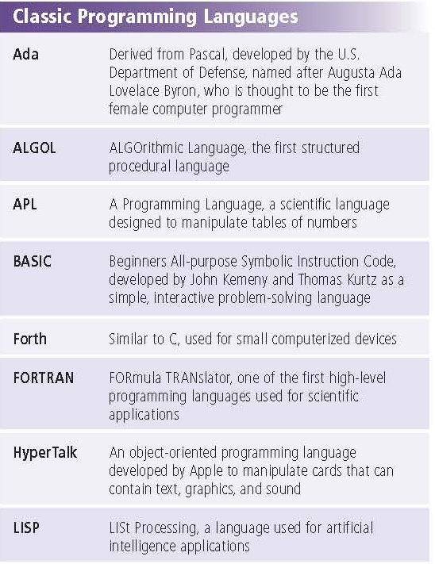
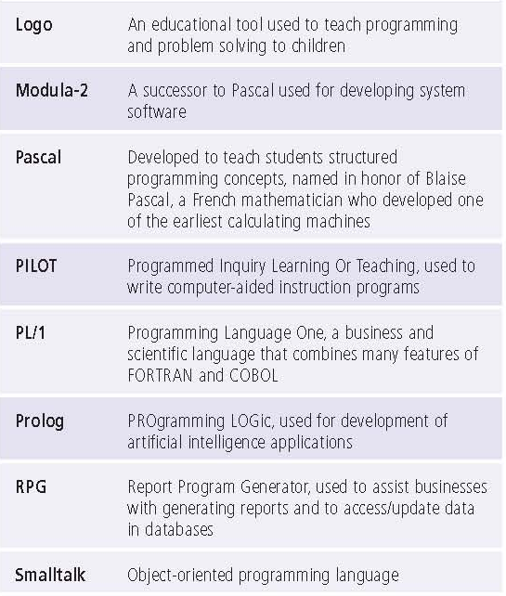
Classic Programming Languages
Notes:
Figure 13-14

Slide 25
OO Programming Languages
An object-oriented programming (OOP) language allows programmers the ability to reuse and modify existing objects
Other advantages include:
Objects can be reused
Programmers create applications faster
Work well in a RAD environment
Most program development tools are IDEs

Slide 26
C++
Developed in the 1980s by Bjarne Sroustrup at Bell Laboratories
Object oriented implementation of C
Extremely powerful and efficient language
C++ includes all the elements of the C language, plus it has additional features for working with objects, classes, events, and other object-oriented concepts
Programmers commonly use C++ to develop database and Web applications
Much application software, such as word processing and spreadsheet programs, also is written in C++
A programmer does not need C programming experience to be a successful C++ programmer

Slide 27
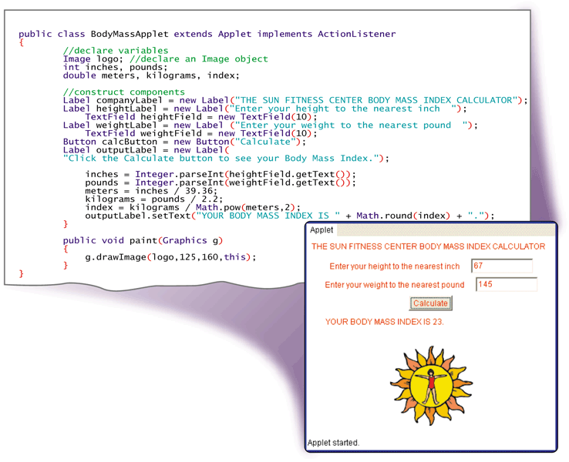
Java
Java is an object-oriented programming language developed by Sun Microsystems
The Just-in-time (JIT) compiler to convert the byte code into machine-dependent code
byte code is machine independent code
Web designers can create interactive and dynamic applications called applets for web pages
Goal of Java EE is to simplify and reduce program development time by developing standard, reusable objects
Notes:
Figure 13-8

Slide 28
.NET
The Microsoft .NET Framework allows almost any type of program to run on the Internet or an internal business network, as well as computers and mobile devices
ASP.NET is a Web application framework that provides the tools necessary for the creation of dynamic Web sites
Features include:
CLR (Common Language Runtime)
Classes

Slide 29
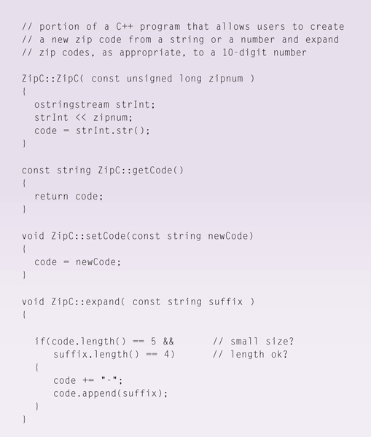
.NET
C++ is an extension of the C programming language
C# is based on C++ and was developed by Microsoft
F# combines the benefits of an object-oriented language with those of a functional language
Notes:
Figure 13-9
C++ Includes all elements of C, plus additional features for working with object-oriented concepts
Used to develop database and Web applications
C# - Object-oriented programming language based on C++
Accepted as a standard for Web applications and XML-based Web services Uses a JIT compiler
Resulting code is called Microsoft Intermediate Language (MSIL)

Slide 30
Visual Studio
Visual Studio is Microsoft’s suite of program development tools
Visual Basic is based on the BASIC programming language
Visual C++ is based on C++
Visual C# combines the programming elements of C++ with an easier, rapid-development environment

Slide 31
Visual Studio
Includes enhanced support for building security and reliability into applications through its
  programming languages
  RAD tools
  Integrated Development Environment (IDE)
  a specialized query language called LINQ (Language Integrated Query), and
  other resources that reduce development time.
.NET is set of technologies that allows program to run on Internet
Comprised of Visual Basic, Visual C++, and Visual C#
Visual Studio Tools for Office (VSTO) is a set of tools integrated in Visual Studio that enables developers to
  create programs that work with Microsoft’s Office suite, including Word, Excel, PowerPoint, Outlook, and Project.

Slide 32
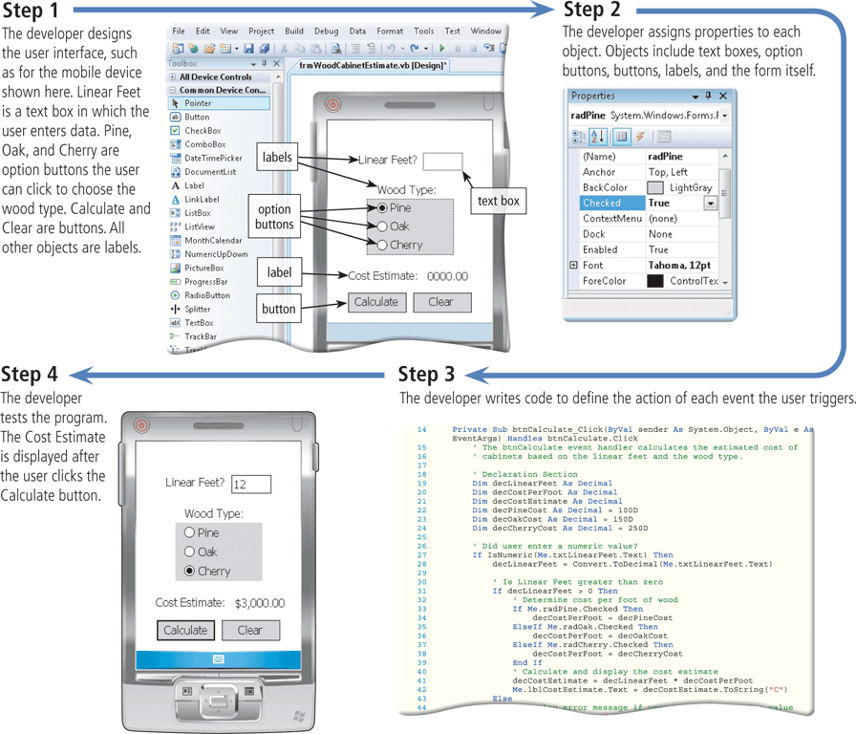
Creating a Visual Basic Program
Notes:
Figure 13-10

Slide 33
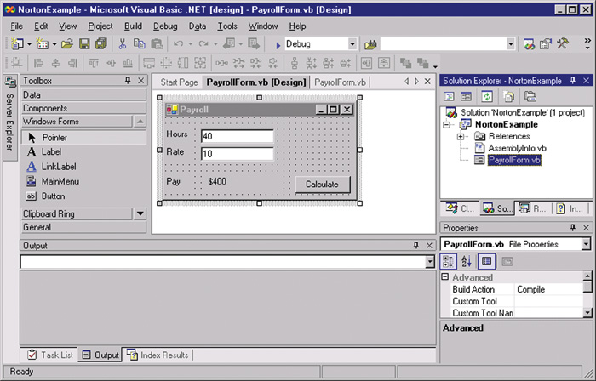
Microsoft.NET

Slide 34
Visual Programming Language
A visual programming language is a language that uses a visual or graphical interface for creating all source code
Borland’s Delphi is a powerful program development tool that is ideal for building large-scale enterprise and Web applications in a RAD environment

Slide 35
Visual Programming Environment
allows developers to drag and drop objects to build program
provides visual and graphical interface for creating source code
Sometimes called fifth generation languages
Often used in RAD (Rapid Application Development) environment
  programmers writes and implements the program in segments

Slide 36
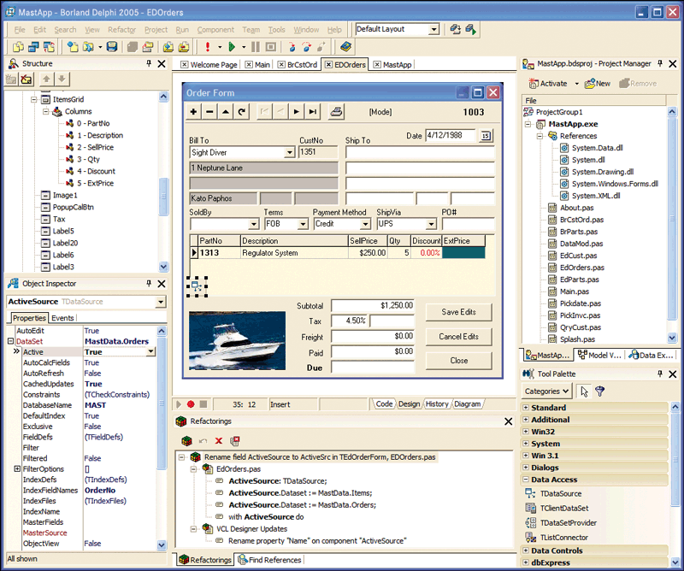
Delphi
Powerful visual programming tool
Ideal for large-scale enterprise and web applications in RAD environment
programmers use Delphi to develop programs quickly for Windows, Linux, and .NET platforms
provides visual modeling tools based on the UML
programmers easily link the UML designs to the working solutions

Slide 37
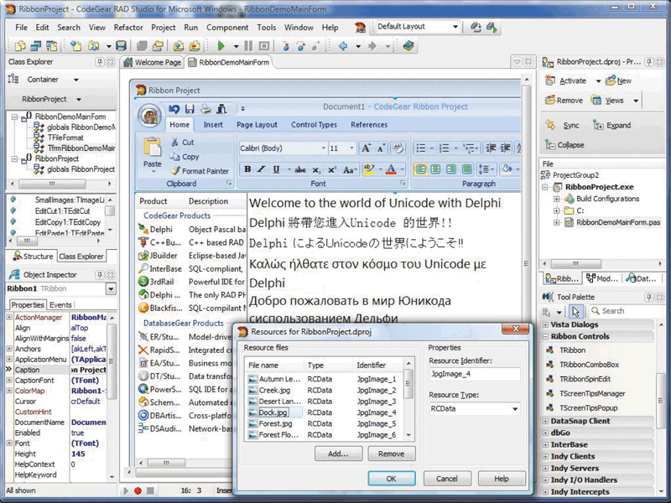
Delphi
Makes Windows development tasks faster, better, and easier by supporting Microsoft’s .NET Framework with both Delphi and C#
Notes:
Figure 13-11

Slide 38
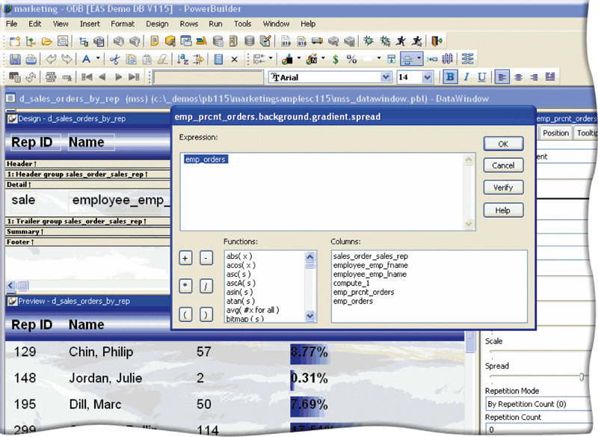
PowerBuilder
PowerBuilder , developed by Sybase, is a powerful program development RAD tool
Best suited for Web-based, .NET, and large-scale enterprise object-oriented applications
Notes:
Figure 13-12

Slide 39
Fourth generation languages (4GL)
Easier to use than 3GL
Coded in a visual IDE
Tools reduce the amount of code
programmer uses a toolbar to drag and drop various items like buttons, labels, and text boxes to create a visual definition of an application
Once the programmer has designed the program’s appearance, he or she can assign various actions to the objects on the screen
Microsoft's Visual Studio and Sun’s Java Studio are two professional IDEs
Many object-oriented program development tools use 4GLs.

Slide 40
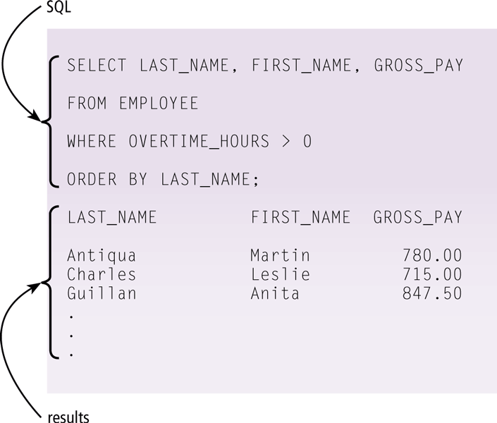
4GL
A 4GL (fourth-generation language) is a nonprocedural language that enables users and programmers to access data in a database
  One popular 4GL is SQL
programmer writes English-like instructions or interacts with a visual environment to retrieve data from files or a database
Program Development Tools
User-friendly programs designed to assist both programmers and users in creating programs
Notes:
Figure 13-13
Why is it necessary for programmers to know SQL?
Programmers often write programs that interact with a database in some fashion. For this reason, programmers must know SQL so that their programs can communicate with the database.

Slide 41
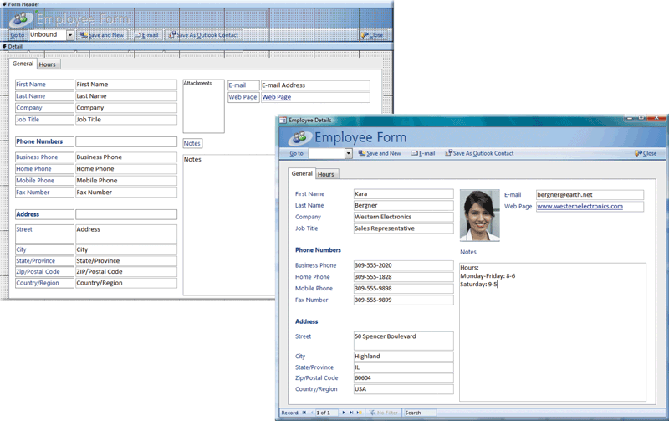
Application Generator
An application generator is a program that creates source code or machine code from a specification of the required functionality
  Consists of report writer, form and menu generator
  Often bundled as part of a DBMS
Notes:
Figure 13-15 from Design in MS Access

Slide 42
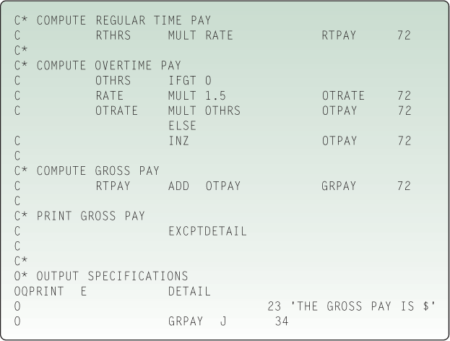
Report Program Generator (RPG)
Nonprocedural language used for generating reports, performing computations, and updating files

Slide 43
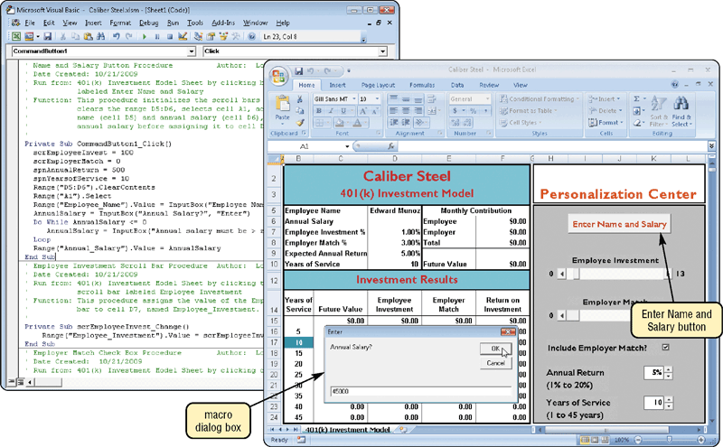
Macro
A macro is a series of statements that instructs an application how to complete a task
allow users to automate routine, repetitive, or difficult tasks
users can create simple programs within the software by writing macros
Create the macro in one of two ways:
  Record the macro with a macro recorder
  Write the macro

Slide 44
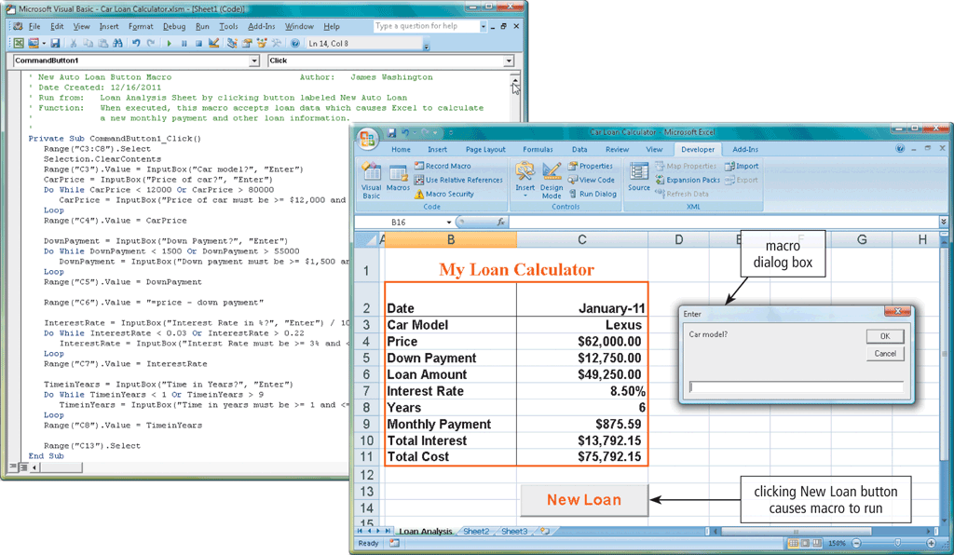
Macro
Notes:
Figure 13-16 VBA Macro

Slide 45
Fifth Generation Languages (5GL)
based on solving problems using constraints given to the program, rather than using an algorithm written by a programmer
Most constraint-based and logic programming languages and some declarative languages are 5Gls
Designed to make the computer solve a given problem without the programmer
Programmer only needs to worry about what problems need to be solved and what conditions need to be met, without worrying about how to implement a routine or algorithm to solve them
Used mainly in artificial intelligence research
Examples include Prolog, OPS5, and Mercury

Slide 46
WWW Development Languages
Internet has evolved from simple text-based messages to complex Web sites that are visual, interactive, and responsive
Likewise, Web related development tools have evolved in power and capabilities
Web developers, use a variety of techniques to create Web pages
Markup languages
  Describe how the text is formatted

Slide 47
Hyper Text Markup Language (HTML)
language used to create documents for the WWW and is the basis of all web pages
Defines web structure using tags and attributes
Tags provide links to
  other points of the document
  other documents on the same site, or
  documents on other sites.
HTML tags also are used to
  format a Web page's look
  position graphics and multimedia elements, and
  incorporate components created in other programming languages such as Java or Flash
Easy to learn and use
Created with a text editor
View a Web page written with HTML in a Web browser such as Internet Explorer, Safari, Firefox, Opera, or Google Chrome

Slide 48
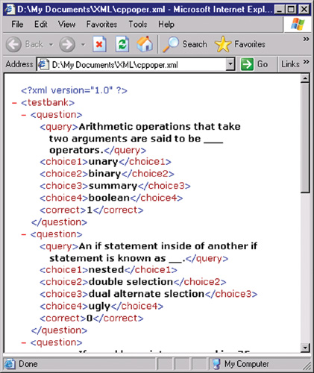
Extensible Markup Language (XML)
next-generation Web content development language
allows developers to describe a page in such a way that one source document can be presented in several different formats such as a Web page, a printable document, and a PDF file
XML separates the Web page content from its format, allowing the Web browser to display the contents of a Web page in a form appropriate for the display device
Stores data in a readable format
Looks like HTML
Allows developers to create tags
Depends on HTML for formatting

Slide 49
WWW Development Languages
Extensible HTML (XHTML)
  Newer version of HTML and have stricter rules
  Based on XML rules
  enables Web sites to be displayed more easily on micro browsers in smart phones and other mobile devices, as well as on desktop and notebook computers
Extensible Style Sheet Language (XSL)
  Format and displays XML documents for HTML browsers
  Composed of rules that dictate formatting
  Using XSL it is relatively simple to have one XML document with several different views
Extensible HTML Mobile Profile (XHTML MP)
  Initially Wireless Markup Language (WML) allows developers to design pages specifically for microbrowsers
  Creates pages viewable on a handheld device PDA or smartphone
Notes:
Teaching tip
Be sure to emphasize that all web technologies at some point need HTML or XHTML to present data in a browser.

Slide 50
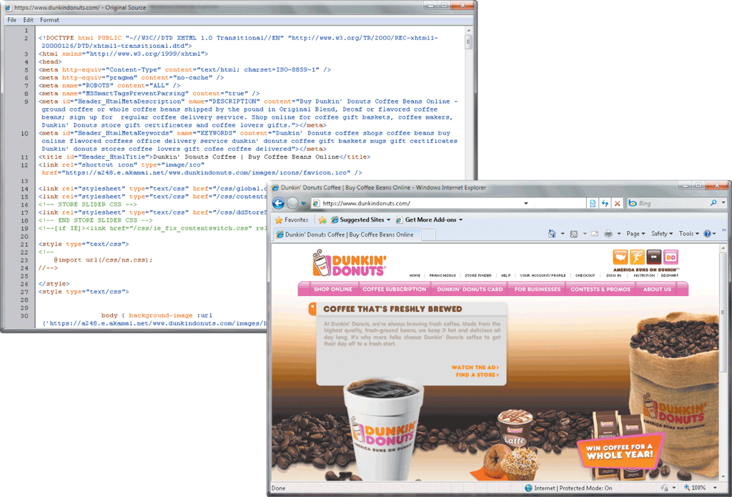
XHTML Code
Notes:
Figure 13-17 The portion of the XHTML code in the top figure generates a portion of a Web page shown in the bottom figure.

Slide 51
Web Page Development
Cascading Style Sheets (CSS)
  Format HTML, XHTML and XSL
  Applies consistent formatting to all pages
Style sheet contains descriptions of a document’s characteristics.
XML works with XSL (Extensible Style sheet Language), a language for creating a style sheet that describes how to present the data described in an XML document on a Web page.
XML, for example, can instruct a Web browser to display data bold and centered.
An extension of XSL, called XSLT (Extensible Style sheet Language Transformations), creates style sheets that describe how to transform XML documents into other types of documents.

Slide 52
Web Page Development
XML allows Web developers to create customized tags and use predefined tags to display content appropriately on various devices
WML is a subset of XML and is used to design pages for microbrowsers
Two applications of XML are RSS 2.0 and ATOM specifications that content aggregators use to distribute content to subscribers
  The online publisher creates an RSS or ATOM document, called a Web feed that is made available to Web sites for publication
News Web sites, blogs, and podcasts often use Web feeds to publish headlines and stories

Slide 53
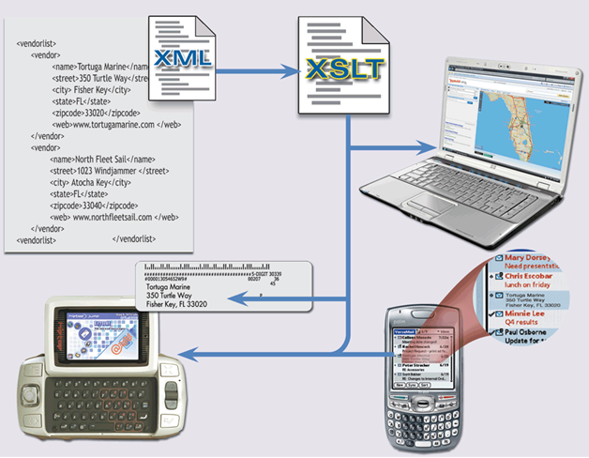
Web Page Development
Notes:
Figure 13-18 Sample XML Document converted by XSLT document

Slide 54
Web Page Development
Web browsers can execute short programs to add interactive elements to Web pages
To send and receive information between your computer and a Web server, these programs use the CGI (common gateway interface)
  Script –interpreted program that runs on client
  Applet – usually runs on client but is compiled
  Servlet – applet that runs on server
  ActiveX control – small program runs on client
  Counter – tracks number of visitor to Web site
  Image Map – graphic image that points to URL
  Processing Form – collect data from visitors to Web site

Slide 55

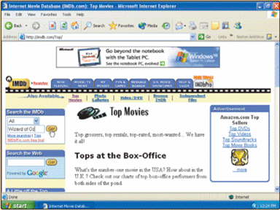
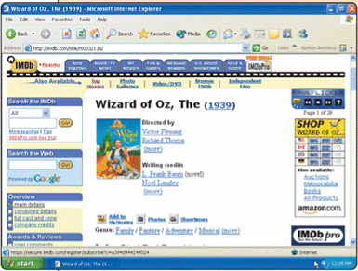
Common Gateway Interface
Communications standard that defines how Web server communicates with outside sources
  CGI script—program that manages sending and receiving across CGI
Step 1. The programmer stores the CGI program in a special folder on the Web server such as /cgi-bin.
Step 2. The Webmaster creates a link between the CGI program and Web page. When a user displays the Web page, the CGI program automatically starts.
Step 4. The CGI program receives information from the database, assembles it in an HTML format, and sends it to the user’s Web browser.
Database
Step 3. When the user submits a request, it is sent to the CGI program. The CGI program contacts the database and requests information for the user. In this case, it looks for a movie titled The Wizard of Oz.

Slide 56
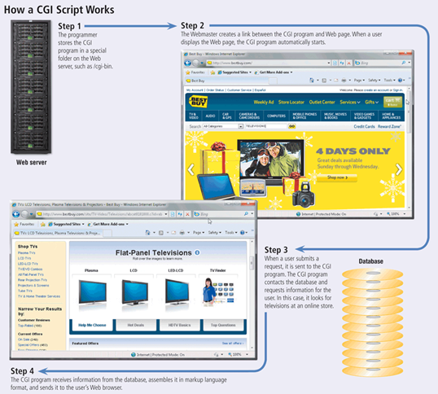
How CGI Works
Notes:
Figure 13-19 how a CGI script works

Slide 57
Web Page Development
Programmers write scripts, applets, servlets, or ActiveX controls using a variety of languages
  Java script —adds dynamic content and interactive elements to Web page
  Perl (Practical Extraction and Report Language)—has powerful text processing capabilities
  VB Script (Visual Basic, Scripting Edition)—adds intelligence and interactivity to Web page
  PHP (Preprocessor Hypertext)
  Rexx
  Tcl

Slide 58
WWW Development Languages
Scripting languages
  Create dynamic web pages
    Change based on user input
  HTML can create static pages
  Page is generated as needed
A script is written that reads from the database
The script then writes the necessary HTML code to display the products

Slide 59
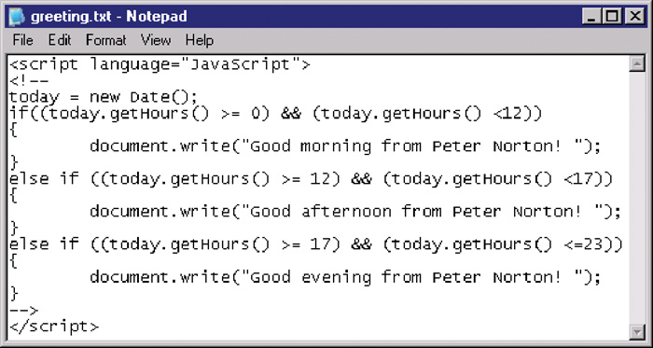
Java Script
Interpreted language that allows a programmer to add dynamic content and interactive elements to a Web page
include alert messages, scrolling text, animations, drop-down menus, data input forms, pop-up windows, interactive quizzes, and mouse rollovers
Works inside of HTML
Page verification and simple animation
Based on Java

Slide 60
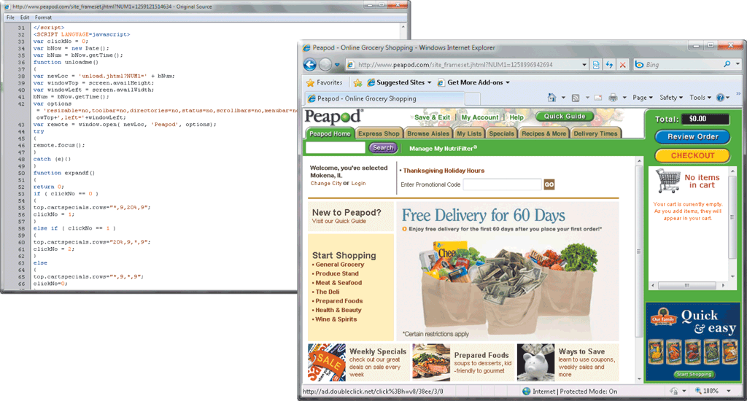
Web Page Development
Java Script Code and its associated web page
Notes:
Figure 13-20

Slide 61
WWW Development Languages
Active Server Pages (ASP)
  Developed by Microsoft
  Based on Visual Basic
  Good at connecting to Microsoft databases
  Runs only on Microsoft servers
Perl
  Old UNIX language
  Found on all Windows and Linux servers
  Excellent web scripting language
Hypertext Pre-Processor (PHP)
  Especially good at connecting to MySQL
  Very popular language
  Runs on UNIX and Windows

Slide 62
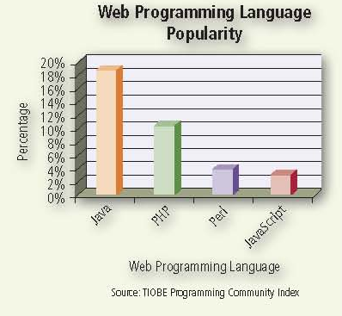
Popular Web Programming Languages

Slide 63
Web Page Development
Dynamic HTML (DHTML) allows Web developers to include more graphical interest and interactivity
Cascading style sheets (CSS) contain the formats for how a particular object should be displayed
Ruby on Rails (RoR) provides technologies for developing object-oriented, database-driven Web sites

Slide 64
Web Page Development
Web 2.0 allows Web sites to provide a means for users to:
Share personal information
Allow users to modify Web site content
Have application software built into the site

Slide 65
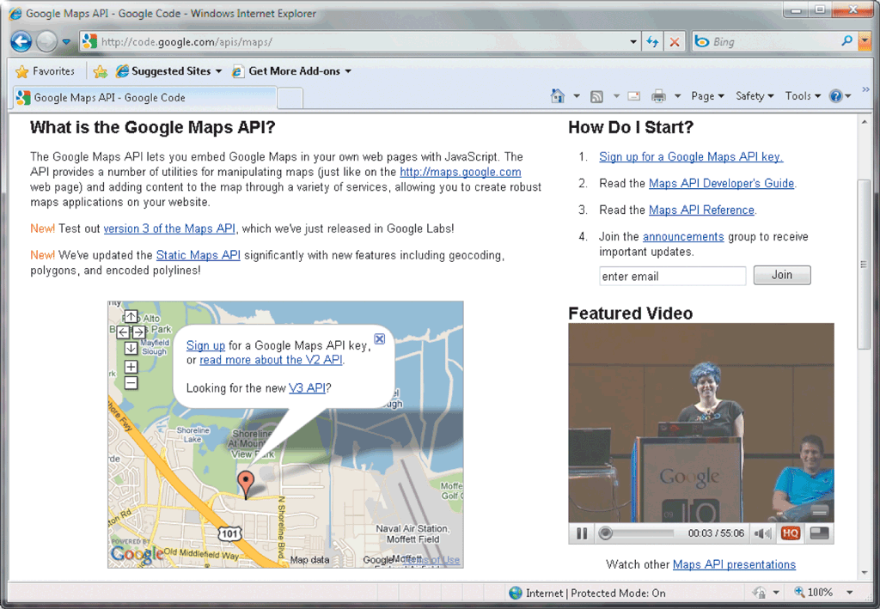
Web Page Development
Most Web 2.0 sites use APIs
  An API enables programmers to interact with an environment such as a Web site or operating system
Notes:
Figure 13-21 Google Maps provide tools for programmers to integrate APIs into their web sites

Slide 66
Web Authoring Environments
Reduces time for creating pages
Tools that simplify web site creation
Macromedia Dream weaver
  Simplifies large sites
  CSS support is exceptional
Microsoft FrontPage simplifies large sites
Macromedia Flash creates web animations
Notes:
Teaching tip
For a fun example of what Flash can do, check out www.homestarrunner.com and watch the exploits of Strong Bad.

Slide 67
Web Page Development
Web page authoring software can create sophisticated Web pages that include images, video, audio, animation, and other effects
Dreamweaver
Expression Web
Flash
SharePoint Designer

Slide 68
Multimedia Authoring Software
Multimedia authoring software allows programmers to combine text, graphics, animation, audio, and video in an interactive presentation
Used for Computer-based Training (CBT) and Web-based Training (WBT)
ToolBook
Director

Slide 69
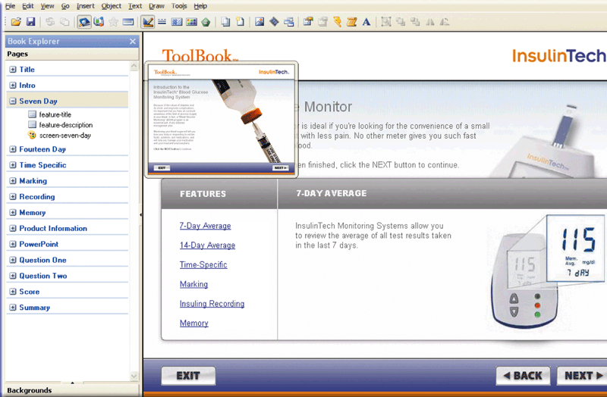
Multimedia Program Development
Sample ToolBook Application
Notes:
Figure 13-22

Slide 70
Summary I
Computer Programs
Generation of Languages
  First Generation, Machine
  Second Generation, Assembly
  Third generation, Procedural
  Fourth Generation
  Fifth Generation
Compiler Interpreters
Visual Programming Environments
70

Slide 71
Summary II
WWW Development Languages
  HTML, XHTML
  XML
  Extensible HTML (XHTML)
  Extensible Style Sheet Language (XSL)
  Extensible HTML Mobile Profile (XHTML MP)
  CSS
CGI and Scripting Languages
Web Page Development
Web Authoring Environments
71

