Slide 1
CSC 101
Introduction to Computing
Lecture 26
Dr. Iftikhar Azim Niaz
ianiaz@comsats.edu.pk
1

Slide 2
Last Lecture Summary I
Business Software
  Project management, Accounting, Document Management
Enterprise Computing Software
Graphic File Formats and Software
Graphics and Multimedia Software
  Computer Aided Design (CAD)
  Desk Top Publishing (DTP)
  Image /Photo Editing
  Video and Audio Editing
  Multimedia Authoring and Web Authoring
  Computer generated Imaging (CGI)
2

Slide 3
Last Lecture Summary II
Software Home, Personal and Educational Use
  Personal finance, Legal, Tax Preparation
  Personal DTP, Personal Paint, Personal Photo
  Clip art, Video & Audio, Home/Landscaping
  Travel, Reference, Educational, Entertainment
Web Application
Communication Software
Learning Tools
  Online Help, Web Help
  Web based Training, Distance Learning
3

Slide 4
Objectives Overview
Define the term, database, and explain how a database interacts with data and information
Define the term, data integrity, and describe the qualities of valuable information
Discuss the terms character, field, record, and file
Describe file maintenance techniques and validation techniques
Differentiate between a file processing approach and the database approach
4

Slide 5
Databases, Data, and Information
Database
Collection of data organized in a manner that allows access, retrieval, and use of that data
Data
Collection of unprocessed items
Text
Numbers
Images
Audio
Video
Information
Processed data
Documents
Audio
Images
Video

Slide 6
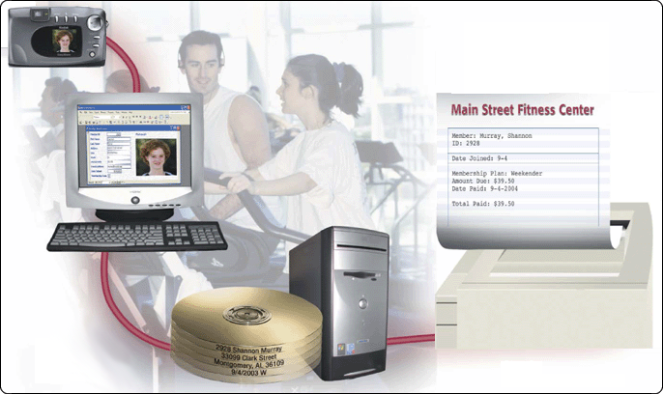
Data and Information
Data is raw facts
Information is data that is organized and meaningful
Computers process data into information

Slide 7
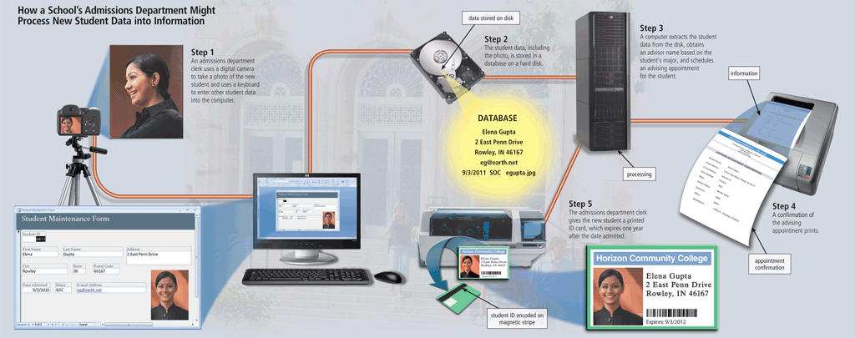
Databases, Data, and Information
A database at a school, for example, contains data about its students and classes.
When a student is admitted to a school, an admissions department clerk enters several data items into a computer. The clerk also uses a digital camera to photograph the new student.
This photo, along with the other entered data, is stored in a database on a server’s hard disk.
A computer at the school then processes the new student data and sends advising appointment information to a laser printer and student ID card information to an ID card printer
The student ID is encoded on a magnetic stripe on the back of the ID card.

Slide 8
The Database
Stores a collection of related items
Store large collections of data
Organize the data
Becomes a data storage system
Collection is arranged in a structure
  Organizes and describes the data
Often includes helper documents
  Forms, Reports

Slide 9
Database Management Systems DBMS
Database is a collection of related data or facts arranged in a specific structure
DBMS is a software tool that allow people to store, access and process data or facts into useful information

Slide 10
Database Management Systems (DBMS)
Database software, often called a database management system (DBMS), allows users to:
Create a computerized database
Add, modify, and delete data
Sort and retrieve data
Create forms and reports from the data

Slide 11
Data Integrity
Data integrity identifies the quality of the data
Garbage in, garbage out (GIGO) points out the accuracy of a computer’s output depends on the accuracy of the input
Garbage in
Garbage out
Data integrity
is lost

Slide 12
Quality of Valuable Information
Valuable information should have the following characteristics:
Accurate
Verifiable
Timely
Organized
Accessible
Useful
Cost-effective

Slide 13
Quality of Valuable Information
Accurate information is error free. Inaccurate information can lead to incorrect decisions.
Verifiable information can be proven as correct or incorrect.
Timely information has an age suited to its use.
Organized information is arranged to suit the needs and requirements of the decision maker.
Accessible information is available when the decision maker needs it. Having to wait for information may delay an important decision
Useful information has meaning to the person who receives it. Most information is important only to certain people or groups of people
Cost-effective information should give more value than it costs to produce.

Slide 14
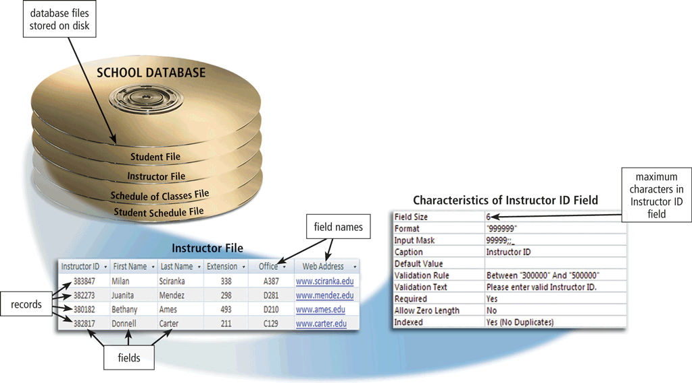
The Hierarchy of Data
Data is organized in layers
  Files, records, fields, characters

Slide 15
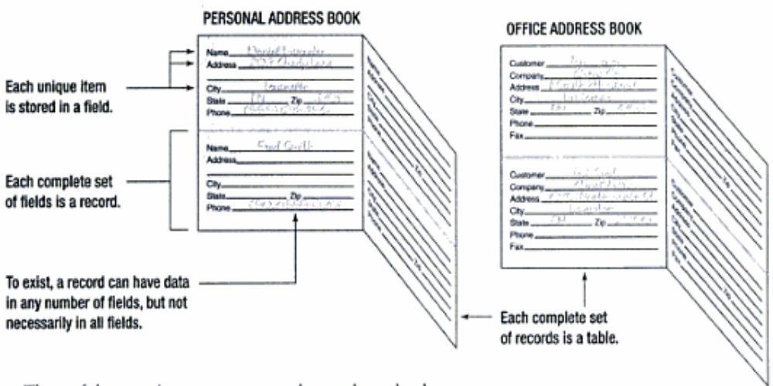
Table, Record and Field

Slide 16
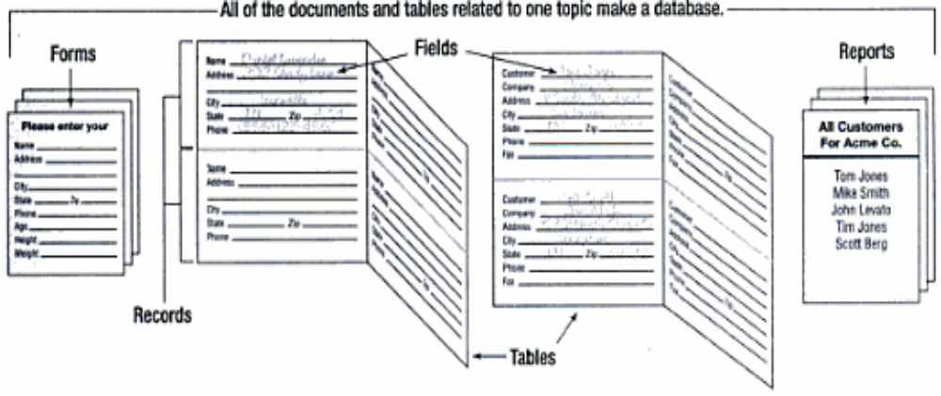
Database and Tables

Slide 17
Fields and Records
Fields
  Hold an individual piece of data
  Are named descriptively, Often called a column
  Phone book examples
    Name, address, e-mail, phone number
  Fields may contain no data
Records
  One full set of fields Often called a row
  Phone book example
    Smith, Joe, 123 Some Street, 412-555-7777
  Databases may have unlimited rows
Tables
  One complete collection of records
  Databases may have thousands of tables

Slide 18
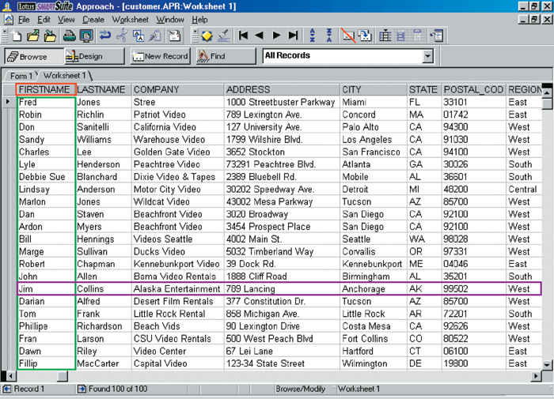
Database Structure
Field Name
Field
Record

Slide 19
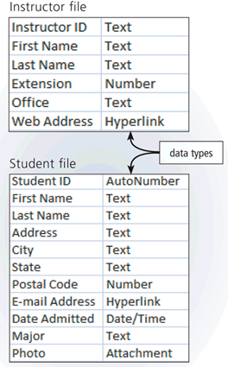
The Hierarchy of Data
A character is one byte
  Numbers, letters, space, punctuation marks, or other symbols
A field is a combination of one or more related characters and smallest unit of data user accesses
  Field name uniquely identifies each field
  Field size defines maximum number of characters a field can contain
  Data type specifies kind of data field contains

Slide 20
The Hierarchy of Data
Common data types include:
Text
Numeric
AutoNumber
Currency
Date
Memo
Yes/No
Hyperlink
Object
Attachment

Slide 21
Field type
Describes the type of data stored
Most DBMS use the same types
  Text fields store letters and numbers
  Numeric field store numbers
  Date and time field
  Logical field stores yes or no
  Binary field stores images or sounds
  Counter field generates sequential numbers
  Memo fields store large amounts of data
Notes:
Teaching tip
Dates are stored sequentially in a database. 0 is January 1, 1970 at midnight. 1 is one millisecond after midnight on January 1, 1970. Each date represents the number of milliseconds from January 1, 1970.

Slide 22
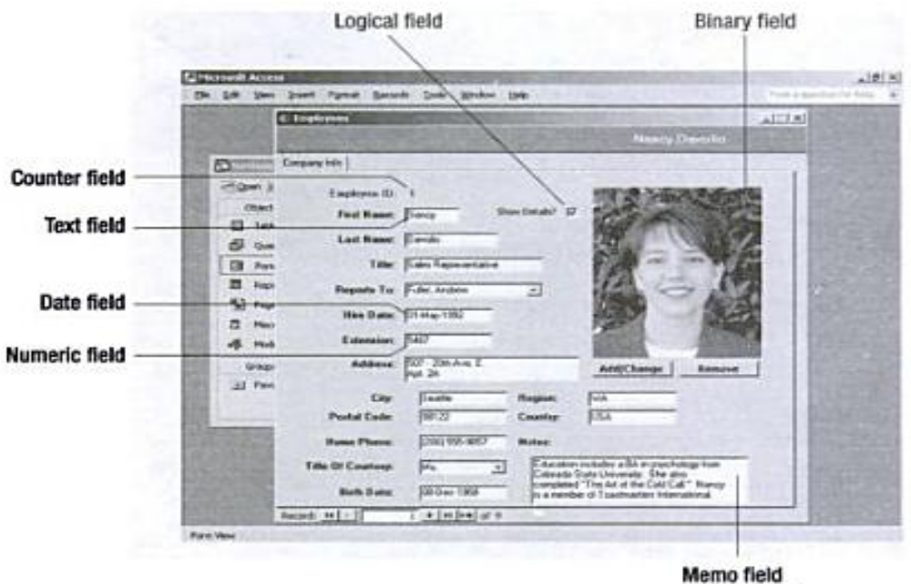
Field Types

Slide 23
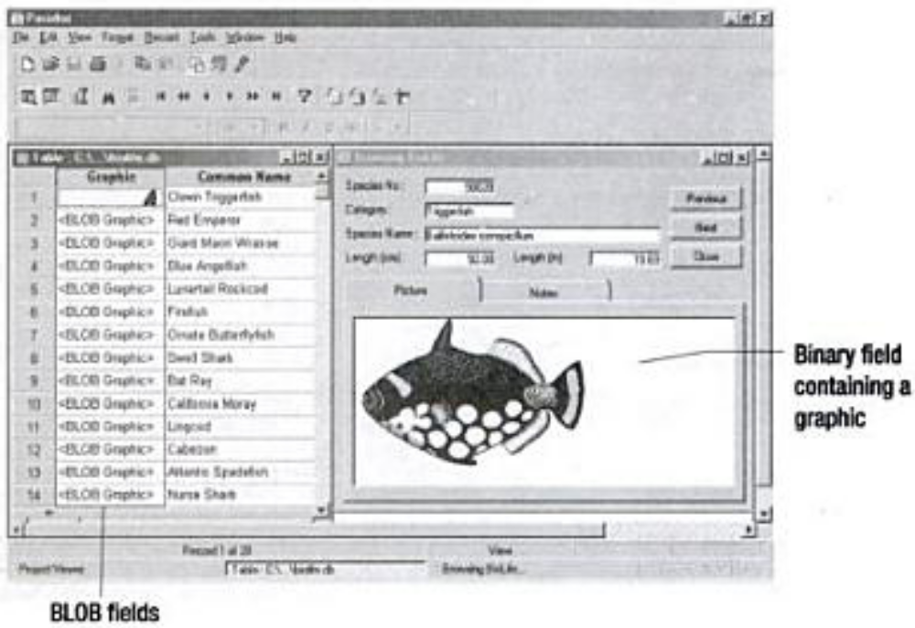
Binary Field

Slide 24
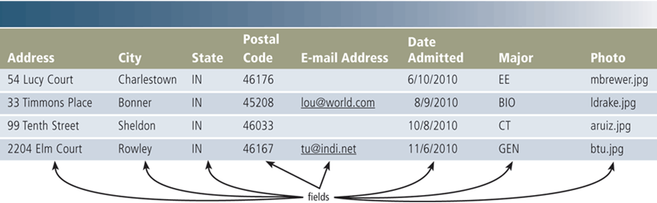
The Hierarchy of Data
A record is a group of related fields
  A primary key uniquely identifies each record
A data file is a collection of related records

Slide 25
Maintaining Data
File maintenance refers to the procedures that keep data current
Adding records
Modifying records
Deleting records

Slide 26
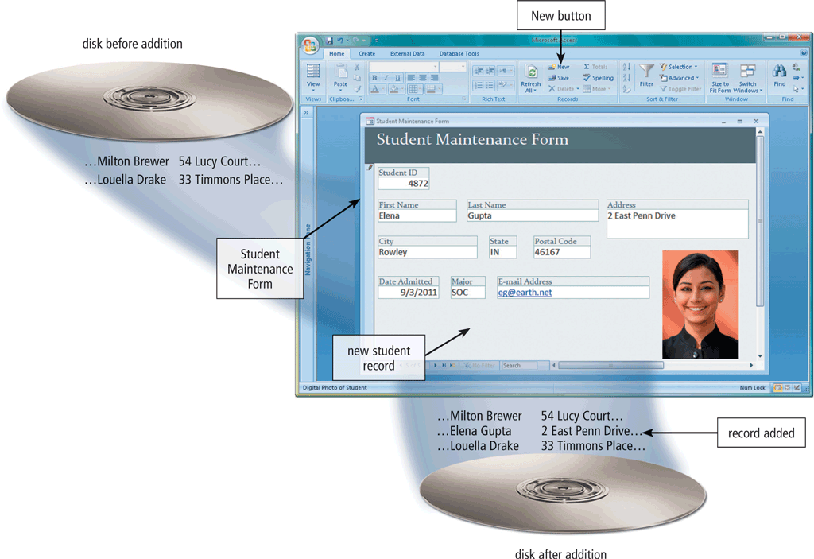
Adding Records
Users add new records to a file when they obtain new data

Slide 27
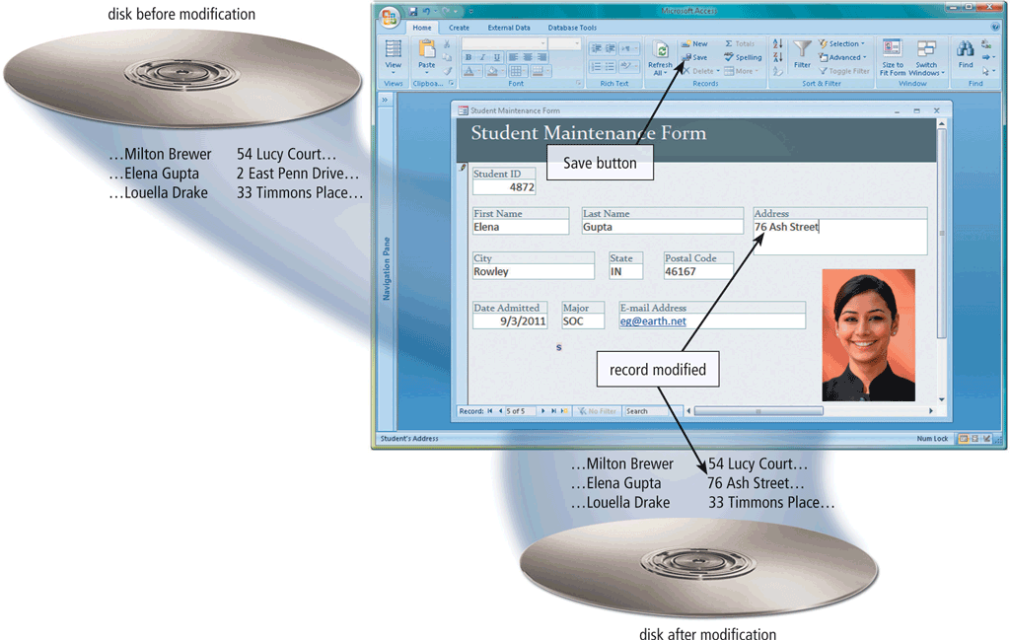
Modifying Records
Users modify a record to correct inaccurate data or update old data

Slide 28
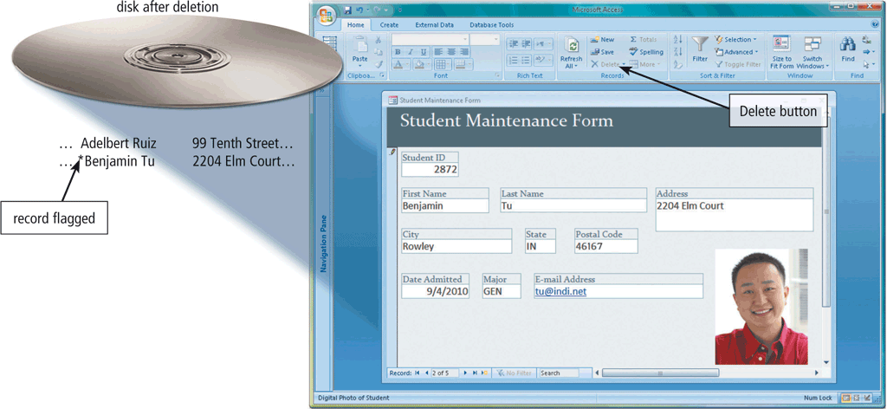
Deleting a Record
When a record no longer is needed, a user deletes it from a file

Slide 29
Validation
Validation compares data with a set of rules or values to find out if the data is correct
Alphabetic/Numeric check
Range check
Consistency check
Completeness check
Check digit
Other checks

Slide 30
Validation
    Check Digit
    number(s) or character(s) appended to or inserted into a primary key value to confirm accuracy of primary key value
    Alphabetic/
    Numeric Check ensures correct type of data entered
    Completeness Check
    verifies that a required field contains data
    Range Check determines whether number is within specified range
    Consistency Check
    tests for logical relationship between two or more fields

Slide 31
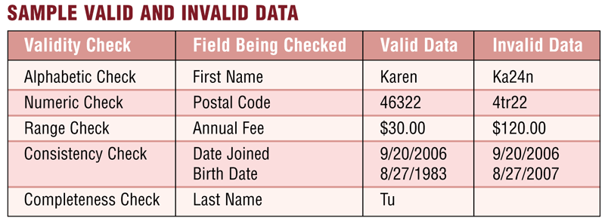
Validation
  Reduce data entry errors and enhance data integrity before program writes data on disk

Slide 32
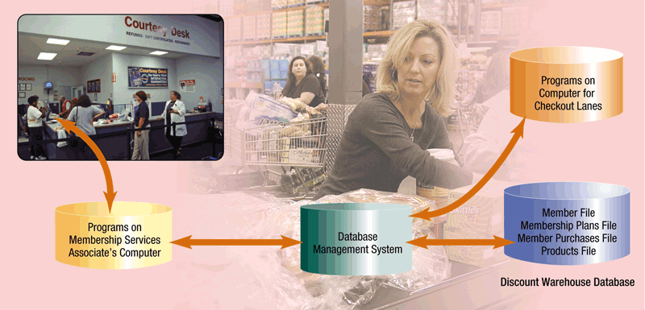
Database Approach
Many programs and users can share data in database
Secures data so only authorized users can access certain data

Slide 33
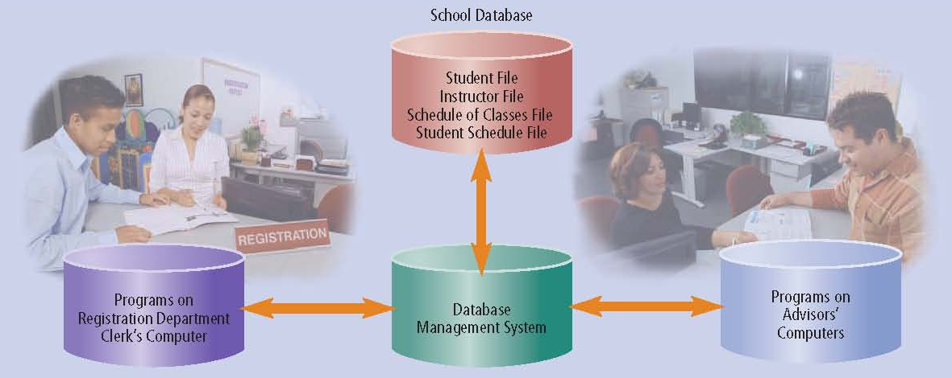
Database Approach
Almost all application programs use the file processing approach, the database approach, or a combination of both approaches to store and manage data.

Slide 34
File Processing Versus Databases
File processing system
Database approach
Each department has its own set of files
Used for many years
Have data redundancy, same field stored in multiple files
Isolate data as data is stored in separate files so it is difficult to access
Programs and users share data
Reduce data redundancy
Improve data integrity
Share data
Allows easier access
Reduces development time

Slide 35
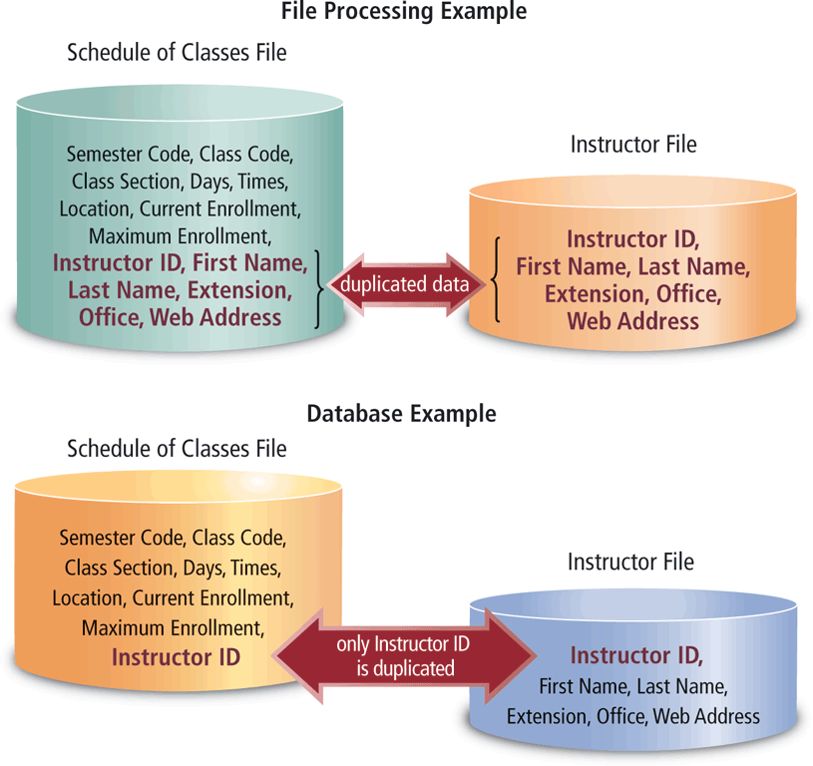
File Processing Versus Databases

Slide 36
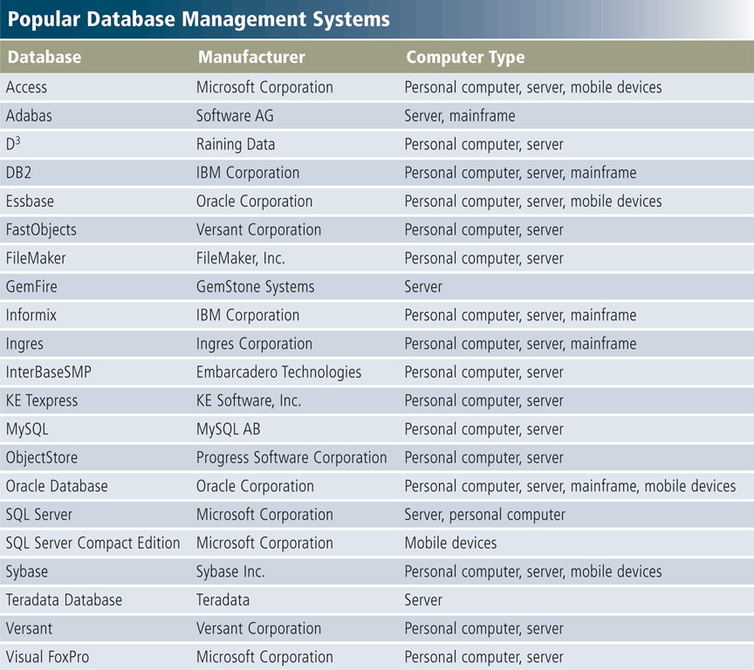
Database Management Systems

Slide 37
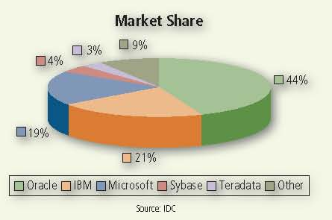
Market Share of Database Vendors
Oracle has the largest market share in terms of revenue, followed by IBM and Microsoft

Slide 38
Flat-file Databases
Typically has only one table
  If multiple, each has a separate file
Useful for simple data storage needs
Hard to manage large data needs
Can waste disk space
Can be difficult to maintain and are limited in their power
When numerous files exist (one for each table or related document), there is often a lot of data redundancy, which increases the chance for errors, wastes time, and uses excess storage space.
Adding, deleting, or editing any field requires that you make the same changes in every file that contains the same field.
Notes:
Teaching tip
Start your students thinking about real databases, with millions of records. Using PA instead of Pennsylvania saves 10 bytes per record. In a database with 1 million records, this saves 10,000,000 bytes. This is roughly equal to a stack of 10 floppy disks

Slide 39
Relational Databases
Made of two or more tables
Tables are related by a common field
  Called a relationship or join
  Can help organize data
Most common form of database
Maintaining data is easier than flat-file
No wasted disk space

Slide 40
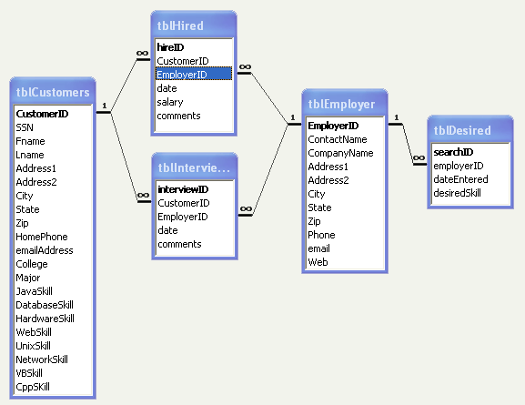
ER Diagram

Slide 41
Summary
Database, Data and Information
Database and DBMS
Data Integrity
Quality of Valuable Information
Hierarchy of Data
  File, Record, field and Character
  Data Type of Fields
File Maintenance Procedures
  Adding, Modifying, Deleting Records
Validation
File Processing vs Database Processing
41

