Slide 1
CSC 101
Introduction to Computing
Lecture 25
Dr. Iftikhar Azim Niaz
ianiaz@comsats.edu.pk
1

Slide 2
Last Lecture Summary I
Application software
Categories of Application Software
  Business
  Graphics and Multimedia
  Home / Personal / Entertainment
  Communications
Forms of Application Software
  Packaged, Custom, Web Application
  Open Source, Shareware, Freeware,
  Public domain, Software Suites
  System software
2

Slide 3
Last Lecture Summary II
Business Software
Word Processing Software
  Features, Interface, Editing and Formatting Text
Spreadsheet Software
  Features, Formula and function, Charting
Presentation Software
  Features, Creating Presentation, Slide Show
Database Software
Note Taking Software
Personal Information Manager (PIM)
Mobile versions
3

Slide 4
Objectives Overview
Identify the key features of widely used graphics and multimedia programs
Identify the key features of widely used home, personal, and educational programs
Discuss the advantages of and ways to access Web applications
Identify the types of application software used in communications
Describe the learning aids available for application software
Identify the key features of widely used business programs
4

Slide 5
Project Management Software
Allows a user to plan, schedule, track, and analyze the events, resources, and costs of a project.
Helps users manage project variables, allowing them to complete a project on time and within budget.
An engineer, might use project management software to manage new product development to schedule timing of market analysis, product design, marketing, and public relations activities.
A customer service manager might use this software to schedule the process of administering customer surveys, evaluating responses, and presenting recommendations

Slide 6
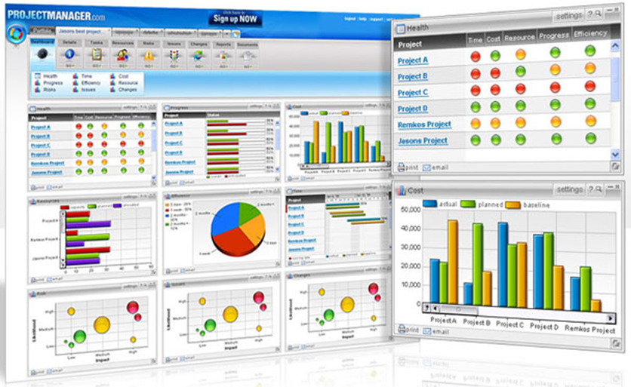
Project Management Software

Slide 7
Accounting Software
Helps companies record and report their financial transactions
Business users perform accounting activities related to the
  general ledger, accounts receivable,
  accounts payable, purchasing, invoicing, and
  payroll functions
Enables business users to
  write and print checks,
  track checking account activity, and
  update and reconcile balances on demand.

Slide 8
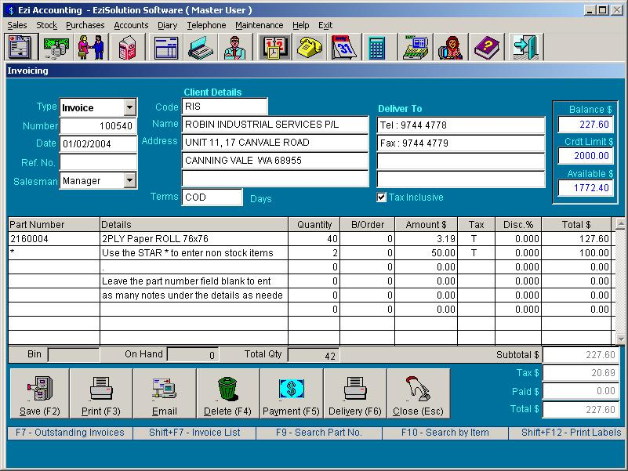
Accounting Software

Slide 9
Document Management Software
Provides a means for sharing, distributing, and searching through documents by converting them into a format that can be viewed by any user
The converted document, which mirrors the original document’s appearance, can be viewed and printed without the software that created the original document
Some allows users to edit and add comments to the converted document
A popular file format is PDF (Portable Document Format) developed by Adobe

Slide 10
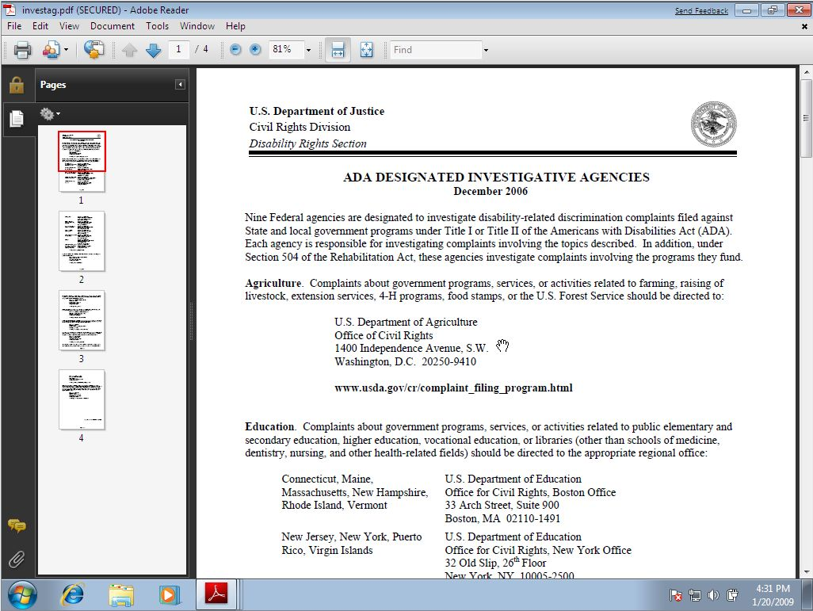
Adobe Reader

Slide 11
Document Management Software
Many businesses use document management software to share and distribute company brochures, literature, and other documents electronically to the public
Home users distribute flyers, announcements, and graphics electronically.
Larger enterprises use more sophisticated one that enables users to check in and out documents or sections of documents from a central library, which stores all documents
  Depending on their needs, users are granted access to certain parts of documents in the library

Slide 12
Enterprise Computing Software
Enterprises typically require special computing solutions for various functional units
Human resources
Accounting
Engineering
Marketing
Sales
Distribution
Customer service
Information Technology
Manufacturing

Slide 13
Graphics Software
From postage stamps to magazine illustrations, from billboards to television programs, all kinds of graphics are created and edited using computers and graphics software
allows artists to do with a computer what they once did with brushes, pencils, and darkroom equipment
architects and engineers now do most of their design and rendering work on computers
Graphics software has advanced a great deal in a short time
offers advanced drawing and painting tools and almost unlimited color control

Slide 14

Graphic File Formats Bitmap
  Most common image type
  Also called raster images
  Image is drawn using a pixel grid
  called a bitmap, whose cells are filled with one or more colors
  Each grid contains a color
  Color depth
    Number of usable colors
  Used to store drawings or photographs
  Resizing image can reduce quality
This image was drawn as a straight line.
Notes:
Teaching tip
Describe bitmapped image as drawing on graph paper. Fill in the blocks to create the image. I use a graph paper circle to illustrate.

Slide 15
Vector Images
Drawn using mathematical formulas
Vectors are lines drawn from one point to another
Use mathematical equations to define the thickness and color of a line, its pattern or fill, and other attributes
Resizing image will not reduce quality and sharpness
CAD and animation software
Notes:
Teaching tip
Remind your students of the algebra classes they took in high school. The functions they plotted on the Cartesian plane are similar to vector equations.

Slide 16
File Formats and Compatibility
Method for storing an image
Each method has pros and cons
Some formats are proprietary
Graphic software can handle all formats
Common bitmapped file formats
  BMP, EMF, GIF, JPG, PICT, PNG, TIFF
Vector file formats, Most vector formats are proprietary, Two universal formats exist
  DXF and IGES
  Either incompatible with other programs or not supported by other programs
Notes:
Teaching tip
Table 8B.1 on page 325 lists several image types.

Slide 17
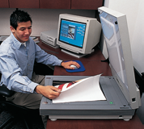
Acquiring Images
Scanners
  Like a photocopier
  Image is saved onto disk
  usually a bitmap file, bur software tools are available for translating images into vector format
  Scanners import a variety of formats
Digital cameras
  Stores digitized images
  Uses long term storage
  Image is usually a JPG file
Digital video cameras
  Stores full motion video
  Uses long term storage
  Movie can be transferred to DVD

Slide 18
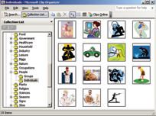
Acquiring Images
Clip art
  Originally a book filled with professionally created drawings and graphics images
  Provides easy way to enhance digital documents
  Most office suites include a selection
  Now a CD with images
  Additional clip art is online
  either bitmap or vector format
Notes:
Teaching tip
Free or inexpensive clip art is often of too poor quality to use in graphic production. They are best suited for interoffice or personal communication.

Slide 19
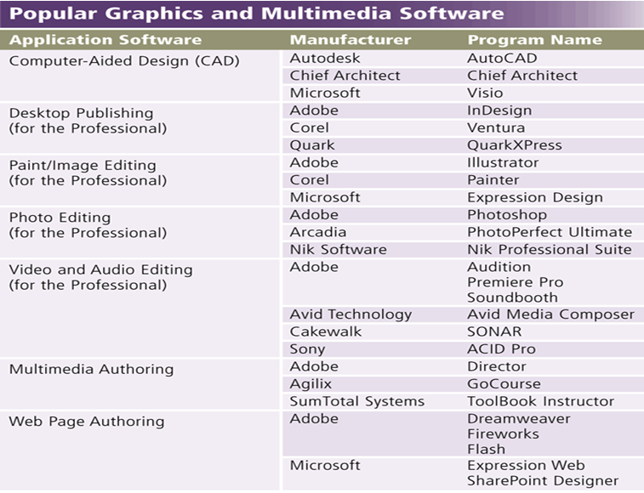
Graphics and Multimedia Software

Slide 20


Computer Aided Design (CAD)
Generates vector files
assists a professional user in creating engineering, architectural, and scientific designs
eliminates the laborious manual drafting that design processes can require
Drawings accurate to the millimeter
AutoCAD

Slide 21
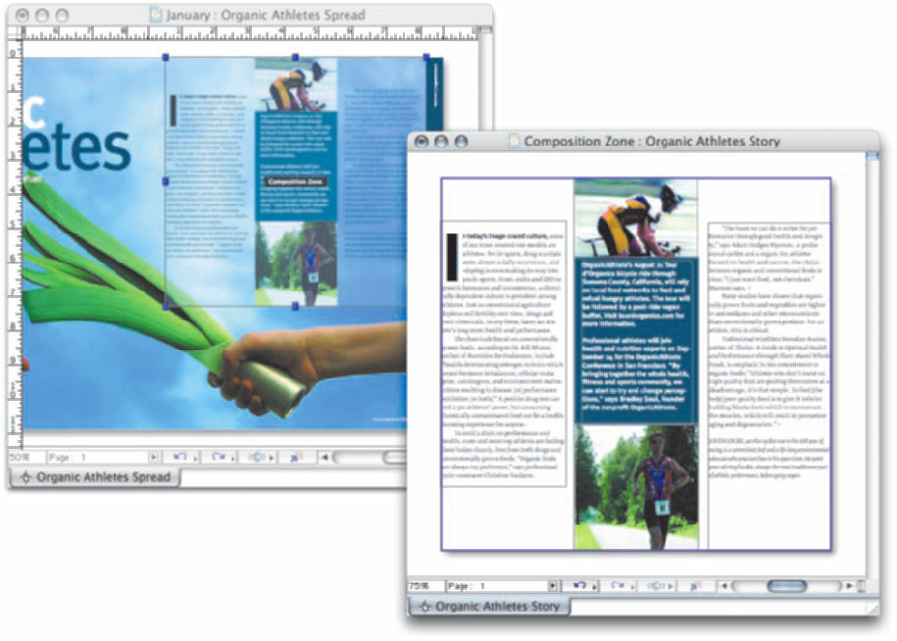
Desk Top Publishing (DTP) Software
enables professional designers to create sophisticated documents that contain text, graphics, and many colors
ideal for the production of high-quality color documents such as textbooks, corporate newsletters, marketing literature, product catalogs, and annual reports.
DTP software supports page layout.

Slide 22
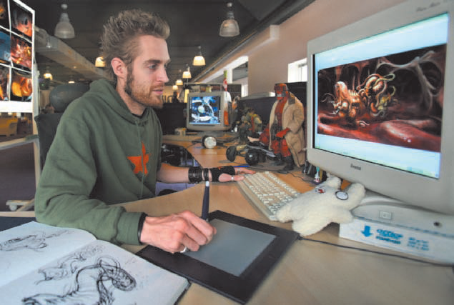
Image Editing Software
Modify and manipulate digital images
Work at the pixel level
Images can be enhanced
Picture flaws can be repaired
Pictures can be completely changed
used to edit non photographic images and to create images from scratch
Photoshop and GIMP
used most often for simple jobs such as sharpening focus, adjusting contrast, or removing flaws from digitized images

Slide 23
Paint Program
Create bitmap images
Includes sophisticated tools
Artists draw with several brushes
Objects drawn become permanent
Includes the capability to enhance and modify existing images and pictures
Modifications can include adjusting or enhancing image colors, adding special effects such as shadows and glows and
Image Stitching, process of combining multiple images into a larger image.
Windows Paint

Slide 24
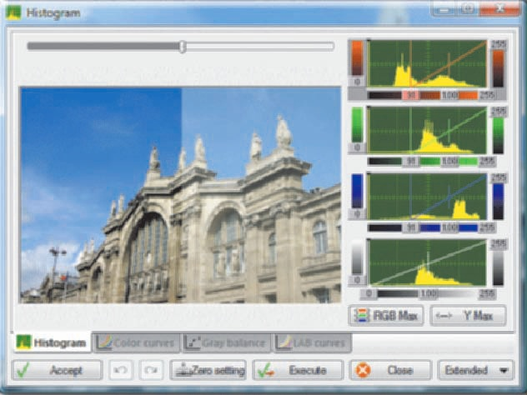
Professional Photo Editing Software
allows photographers, videographers, engineers, scientists, and other high-volume digital photo users to edit and customize digital photos
users can retouch photos, crop images, remove red-eye, change image shapes, color-correct images, straighten images, remove or rearrange objects in a photo, and apply filters
allows users to save images in a wide variety of file formats
users can edit and customize digital photos, such as by adjusting lighting

Slide 25
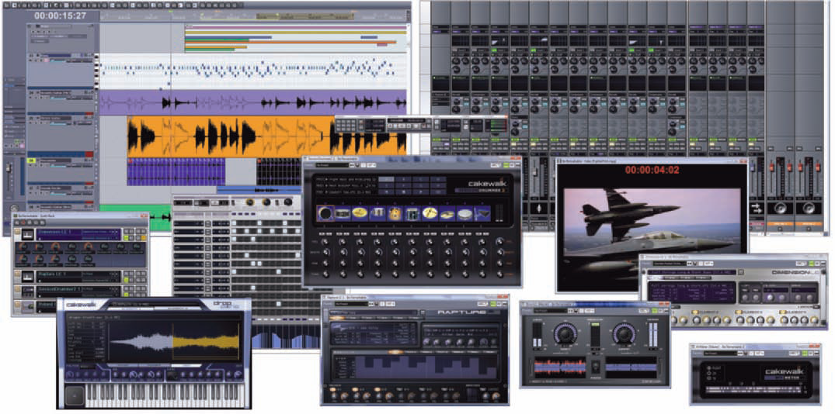
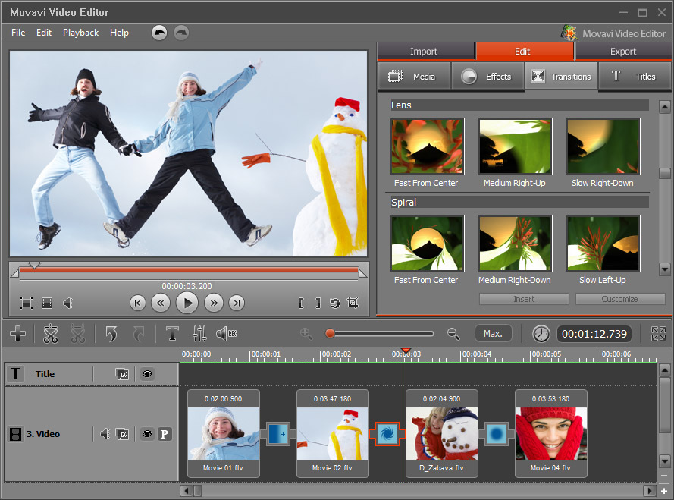
Video and Audio Editing Software
allows professionals to modify a segment of a video, called a clip
users can reduce the length of a video clip, reorder a series of clips, or add special effects such as words that move horizontally across the screen

Slide 26
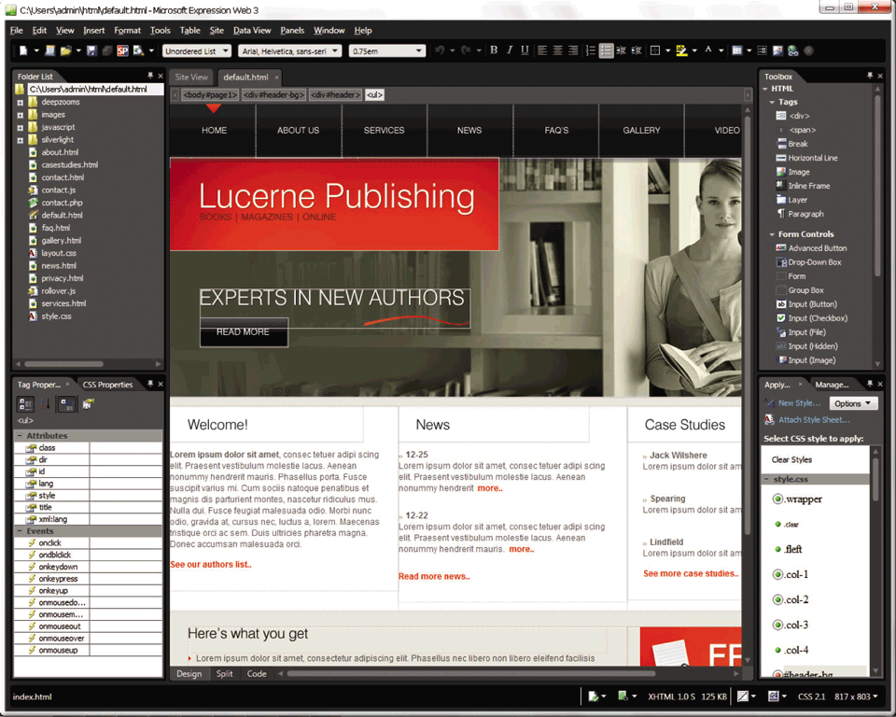
Multimedia Authoring Software
allows users to combine text, graphics, audio, video, and animation in an interactive application
users control the placement of text and images and the duration of sounds, video, and animation
Once created, multimedia presentations often take the form of interactive computer-based presentations or Web-based presentations designed to facilitate learning, demonstrate product functionality, and elicit direct-user participation
Training centers, educational institutions, and online magazine publishers all use multimedia authoring software to develop interactive applications

Slide 27
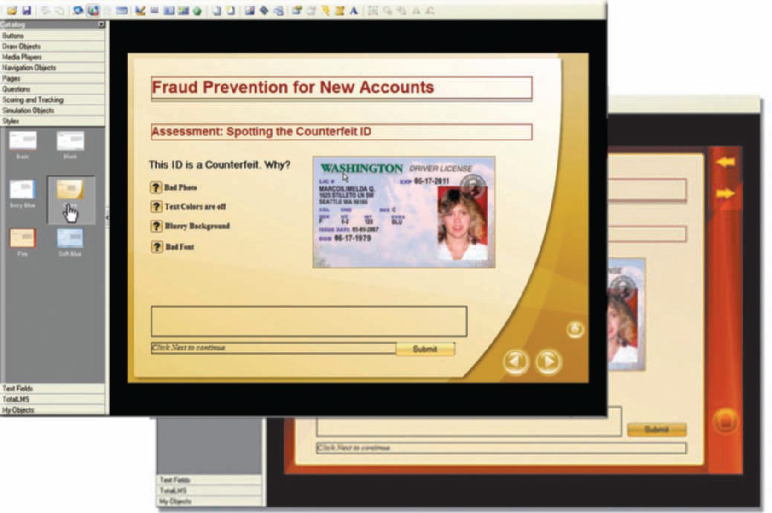
Web Page Authoring Software
helps users of all skill levels create Web pages that include multimedia and interactive content
allow users to organize, manage, and maintain Web sites
Application software, such as Word and Excel, often includes Web page authoring features
Many Web page developers also use multimedia authoring software along with, or instead of, Web page authoring software for Web page development

Slide 28
Draw Programs
Create vector based images
Used when accuracy is critical
Well suited for work when accuracy and flexibility are as important as coloring and special effects
sometimes referred to as OO because each item drawn is treated as a separate and distinct object from all the others
Objects have an outline and fill
  Both have line style and color
  Can fill using pictures
Adobe Illustrator
Notes:
Teaching tip
Figure 8B.7 on page 327 demonstrates two images created with a paint program.

Slide 29

3D Modeling Software
Generates three dimensional images
Image can be shaped on screen
Image is animated frame by frame
3D objects also can be given realistic textures and patterns or they can be animated or made to fly through space
An outgrowth of the 3-D explosion is computer-based animation

Slide 30

Computer Generated Imaging (CGI)
computer animation works on the same principles as traditional animation
  sequence of still images displayed in rapid succession
Generates photo realistic images
  looks so realistic that it could be mistaken for a photograph of a real-life object
Used for movies and television
Gollum of the Lords of the Rings, the Matrix series
Software eliminates tedious parts
Notes:
Teaching tip
Have fun with this one. Remind the students of the Jurassic Park movies. Sarcastically say that the dinosaurs were not real. But they sure looked good.

Slide 31
Multimedia Basics
Medium
  Way of sharing information
  Voice, pictures, text
  More effective with multiple mediums
  Multimedia presents information with one medium
Interactivity
  Users and program respond to one another
  Users can control the content
  Main difference between TV and computer

Slide 32
Software Home, Personal and Educational Use
Personal finance software
Legal software
Tax preparation software

Slide 33
Software Home, Personal and Educational Use
Personal DTP software
Personal paint/image editing software
Personal photo editing software

Slide 34
Software Home, Personal and Educational Use
Clip art/image gallery
Video and audio editing software
Home design/landscaping software

Slide 35
Software Home, Personal and Educational Use
Travel and mapping software
Reference software
Educational software
Entertainment software

Slide 36
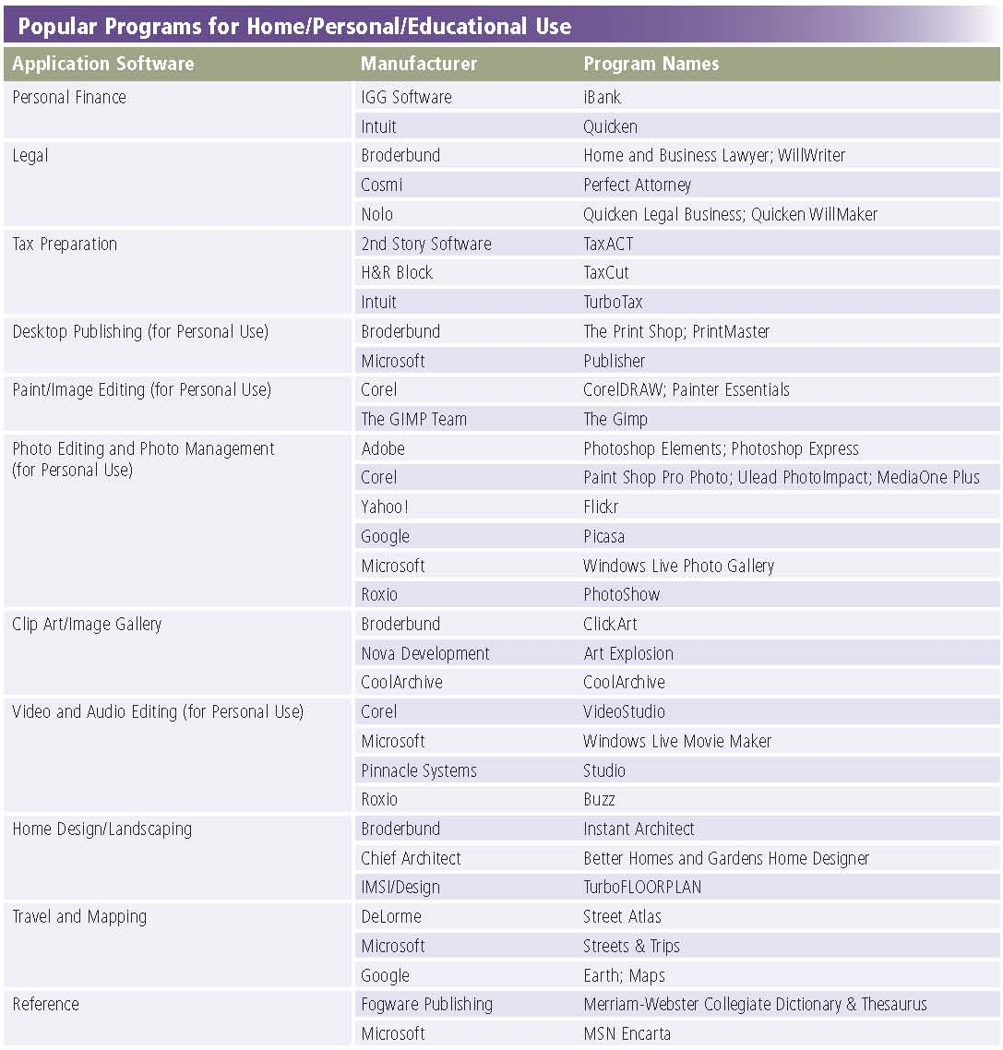
Popular Programs

Slide 37
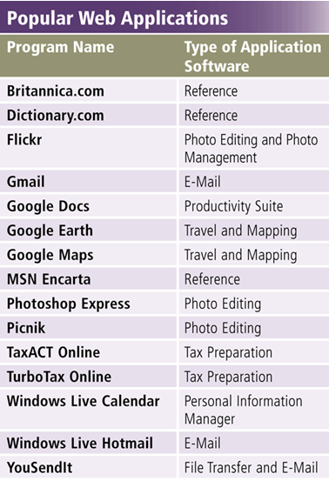
Web Application
A Web application is a Web site that allows users to access and interact with software from any computer or device that is connected to the Internet

Slide 38
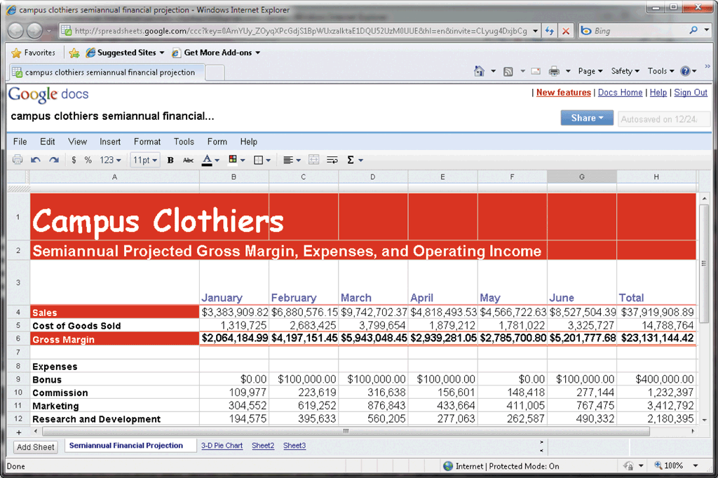
Web Application

Slide 39
Application Software for Communication
Web Browser
E-Mail
Instant Messaging
Chat Room
Text, Picture, Video Messaging
RSS Aggregator
Blogging
Newsgroup/Message Board
FTP
Video Conferencing
VoIP

Slide 40
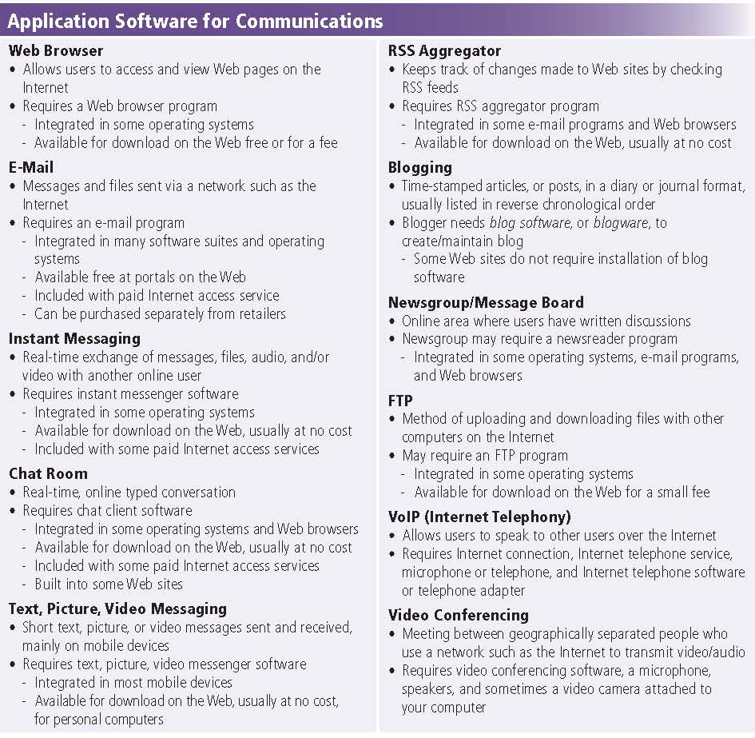
Application Software for Communication

Slide 41
Application Service Provider (ASP)
Third-party organization that manages and distributes software and services on the Web
Allows companies to outsource information technology (IT) needs

Slide 42
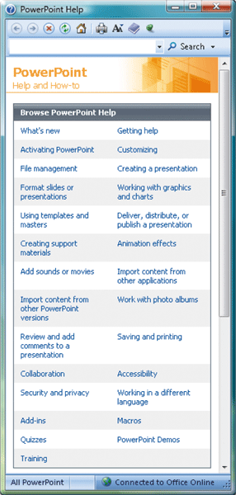
Learning Tools for Application Software
Online Help is the electronic equivalent of a user manual
You can ask a question or access the Help topics in subject or alphabetical order

Slide 43
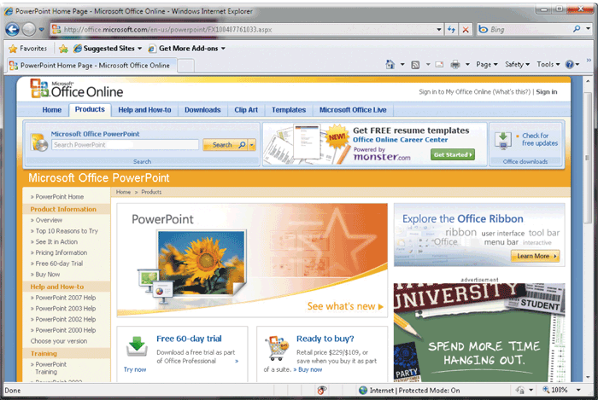
Learning Tools for Application Software
Web-based Help provides updates and more comprehensive resources to respond to technical issues about software
Some Web sites contain chat rooms where a user can talk directly with a technical support person

Slide 44
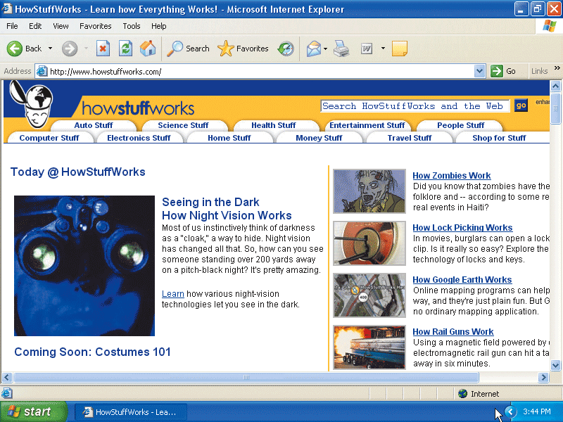
Learning Tools for Application Software
Web-based training is a type of CBT that uses Internet technology and consists of application software on the Web

Slide 45
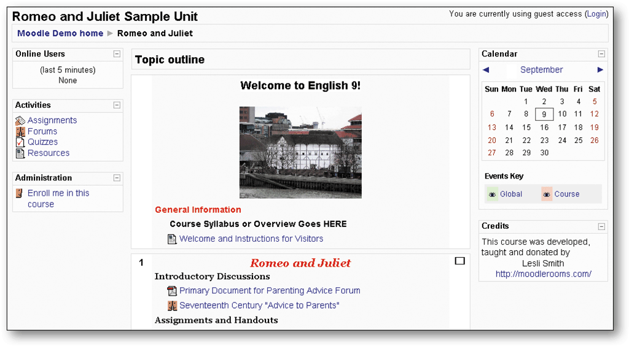
Learning Tools for Application Software
Distance learning (DL) is the delivery of education at one location while the learning takes place at other locations

Slide 46
Summary
Business Software
  Project management, Accounting, Document Management
Enterprise Computing Software
Graphic File formats and Software
Graphics and Multimedia Software
  CAD, DTP, Image Editing, Video and Audio Editing
  Multimedia Authoring and Web Authoring
Software Home, Personal and Educational Use
Web Application
Communication Software
46

