Slide 1
CSC 101
Introduction to Computing
Lecture 24
Dr. Iftikhar Azim Niaz
ianiaz@comsats.edu.pk
1

Slide 2
Last Lecture Summary I
WWW and Multimedia
  Graphics Animation
  Audio Video
  Virtual Reality Plug-In
Web Publishing
E-Commerce
  Business to Consumer
  Business to Business
  Intranets and Extranets
  Security and Secure Web Pages
2

Slide 3
Last Lecture Summary II
Other Internet Services
  E-mail
  Instant Messaging
  Chat and Chat rooms
  News and Newsgroups
  VoIP
  FTP
  P2P
API and Network Drivers
Rules of Netiquettes
3

Slide 4
Objectives Overview
Identify the four categories of application software
Differentiate among the seven forms through which software is available
Explain how the operating system and utility programs work with application software
Describe characteristics of a user interface
Identify the key features of widely used business programs
4

Slide 5
Application Software
Application software consists of programs designed to make users more productive and/or assist with personal tasks
To make business activities more efficient
To assist with graphics and multimedia projects
To support home, personal, and educational tasks
To facilitate communications

Slide 6
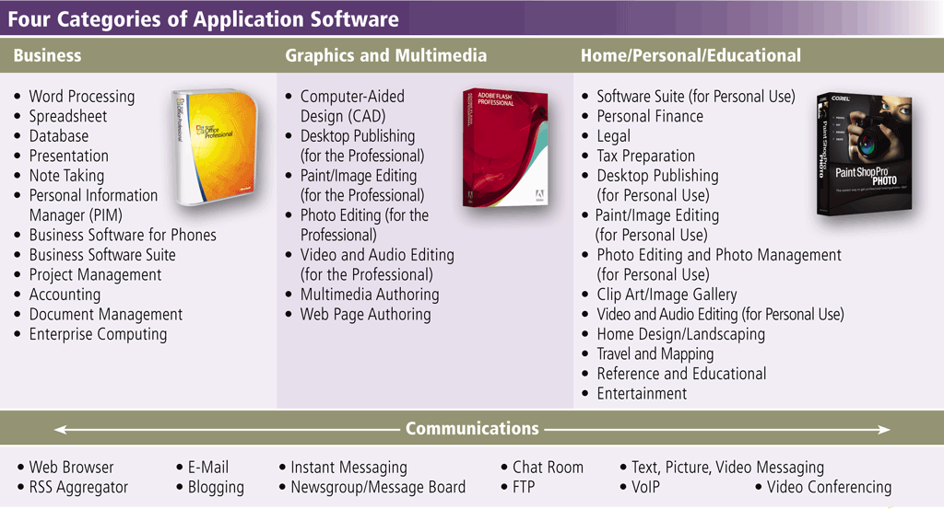
Categories of Application Software

Slide 7
Application Software
Available in a variety of forms:
Packaged software
Custom software
Web application
Open source software
Shareware
Freeware
Public-domain software

Slide 8
Packaged Software
Also called commercial software
Software that must be purchased
Copyrighted retail software that meets the needs of a wide variety of users, not just a single user or company
is an application that performs only one type of task, such as a word processing program, a graphics program, or an e-mail program
might have many tools and features, but it basically focuses on one type of task or a range of related tasks.
Packaged software is available in retail stores or on the Web.

Slide 9
Custom Software
Also called stand alone software
Performs functions specific to a business or industry
Solves one type of problem
Sometimes a company cannot find packaged software that meets its unique requirements
In this case, the company may use programmers to develop tailor-made custom software
Usually costs more than packaged software.

Slide 10
Web Application
A Web site that allows users to access and interact with software from any computer or device that is connected to the Internet
Many Web sites provide free access to their programs
Some charge a fee
Types of Web applications include e-mail, word processing, tax preparation, and game programs.

Slide 11
Open Source
Programs distributed for use with source code
Allows users to modify the software and redistribution
Software has no restrictions from the copyright holder regarding modification of the software’s internal instructions and its redistribution.
Source code is available in editable formats, as are the many development libraries that are used to create applications
Modifications and comments are welcome
Linux and OpenOffice
Notes:
Discussion point
A student once told me that Windows and Linux cost the same – they are free. Use this statement as a springboard to discuss the problems of piracy with your students. Demonstrate the loss of revenue a company faces due to piracy. Demonstrate the security risks the students take when pirating software.

Slide 12
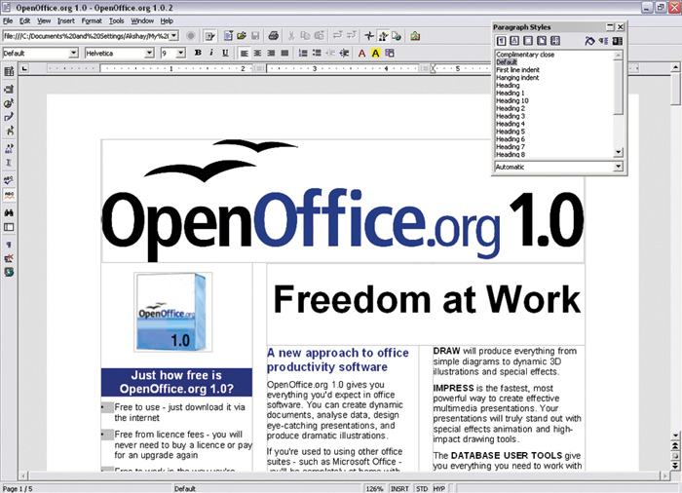
Open Office
OpenOftce.org is an open-source application suite that runs on many different platforms. It is available for free and used by about 16 million people worldwide.

Slide 13
Shareware
Gets its name from the fact that its developers encourage users to share it with one another and to try out the software before purchasing it
Distributed free for trial period
Try before you buy
Typically, the user is allowed a certain number of days to work with the software before registering and/or paying for it
May deactivate if not purchased
In some cases, a scaled-down version of the software is distributed free, and payment entitles the user to the fully functional product.

Slide 14
Freeware
Close cousin to shareware
Copyrighted software provided at no cost by an individual or a company that retains all rights to the software.
No obligation to purchase
  Donations often accepted
Software may be distributed freely
If you use shareware or freeware programs, you must abide by the terms of a license that prohibits you from making changes to the software or selling it to someone else.
Notes:
Teaching tip
The best piece of freeware on the market is spy-bot. Spy-bot is an excellent tool for stopping and removing spyware products on your computer. Get a copy at http://www.safer-networking.org/en/index.html. Patrick Kolla, the author, asks for an optional donation to cover costs.

Slide 15
Public Domain
Freeware with no copyright restrictions
Donated for public use and has no copyright restrictions. Anyone can copy or distribute public-domain software to others at no cost
No compensation is usually expected and the source code is free for anyone to use for any purpose whatever.

Slide 16
Software Suite
A software suite is a collection of individual programs available together as a unit
  Integrated tools that work together
  Solve many problems
  Lower cost and ease of use
Software programs that are very commonly used—such as word processing software, spreadsheets, Web-authoring tools, and e-mail programs—are often packaged together and sold as software suites.
A software suite is a set of carefully integrated tools that are designed to work together seamlessly
Examples include the popular Microsoft Office family of products—Word, Excel, Outlook, PowerPoint, Access—as well as more special-purpose suites, like the Corel family of graphics software
Notes:
Teaching tip
An excellent example is to create a letter in Word. Then in Excel, create a simple spreadsheet. Link the spreadsheet into the letter. Arrange both products on the screen. Change the spreadsheet and the letter should update automatically.

Slide 17
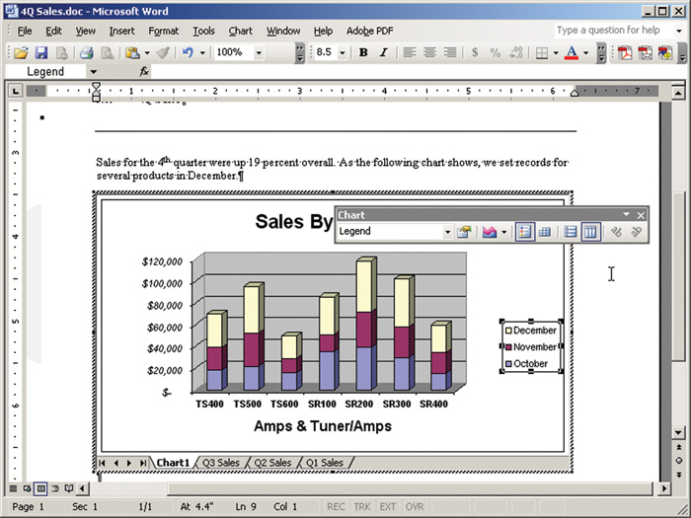
Software Suite
An excellent example is to create a letter in Word. Then in Excel, create a simple spreadsheet.
Link the spreadsheet into the letter. Arrange both products on the screen. Change the spreadsheet and the letter should update automatically.

Slide 18
Installation, Registration and Activation
After you purchase or download software, you install it.
During installation, the program may ask you to register and/or activate the software
Registering the software is optional and usually involves submitting your name and other personal information to the software manufacturer or developer
Registering the software often entitles you to product support.
Product activation is a technique that some software manufacturers use to ensure the software is not installed on more computers than legally licensed
Registering and/or activating the software also usually entitles you to free program updates for a specified time period, such as a year

Slide 19
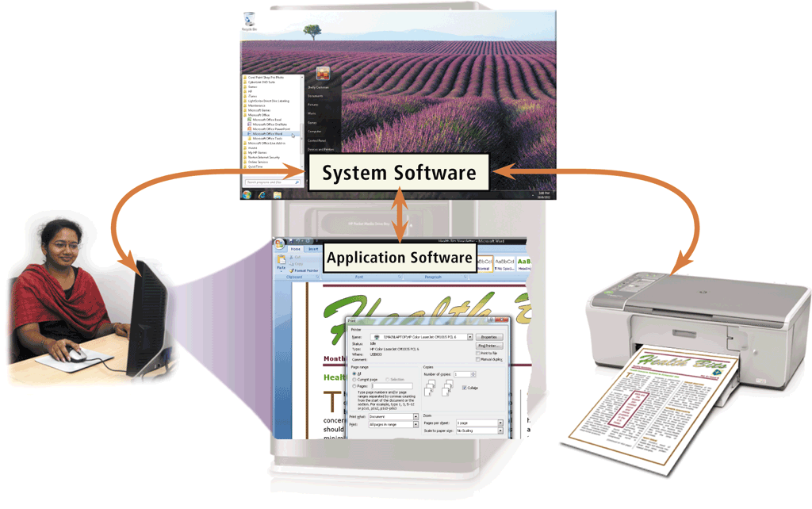
System Software
System software serves as the interface between the user, the application software, and the computer’s hardware
  Programs that control the operations of the computer
  Utility programs

Slide 20
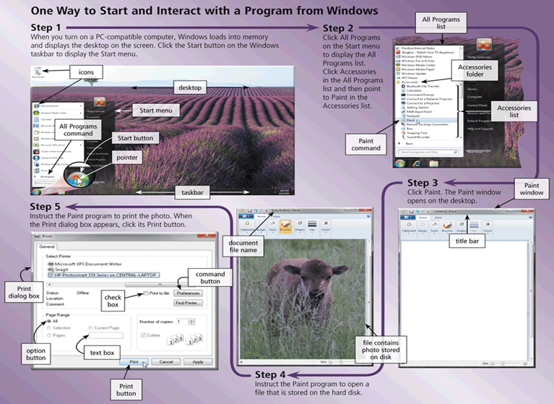
Application Software

Slide 21
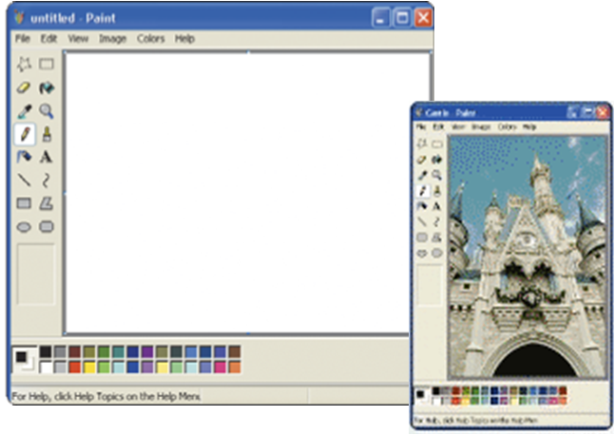
Window
A rectangular area of the screen that displays a program, data, and/or information
Title Bar, Status bar, Menu, Icon, Scroll Bar

Slide 22
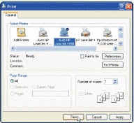
Dialog box
A special window that provides information, presents available options, or requests a response
Dialog boxes, often contain option buttons, text boxes, check boxes, and command buttons
Clicking the Print button in the dialog box instructs the computer to print the photo

Slide 23
Business Software
Business software is application software that assists people in becoming more effective and efficient while performing business activities
Word Processing
Spreadsheet
Database
Presentation
Note taking
Personal information manager
Business software for phones
Business software suites
Project management
Accounting
Document management
Enterprise computing software

Slide 24
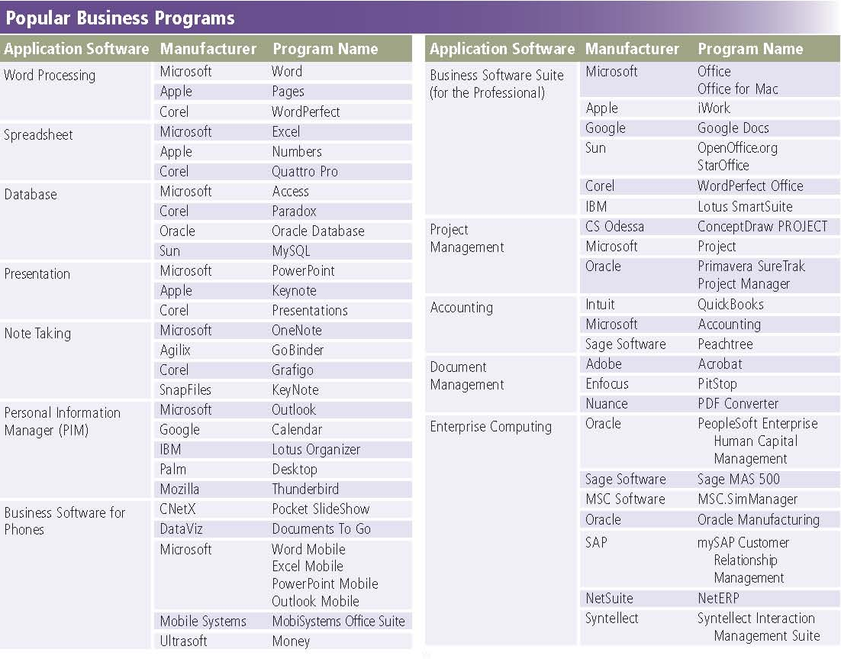
Popular Business Programs

Slide 25
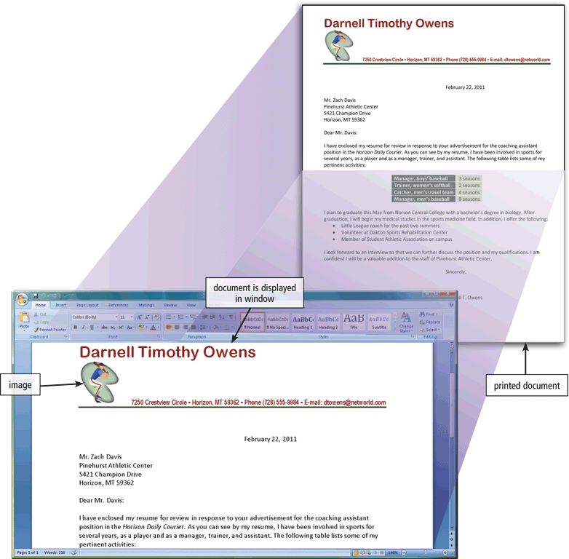
Word Processing Software
provides tools for creating all kinds of text-based documents
allows users to create and manipulate documents
Clip art is a collection of electronic drawings, photos, and other images that you can insert in documents

Slide 26
Developing a Text Document
A major advantage of using word processing software is that users easily can change what they have written
Create a document
Enter text and numbers
Edit a document
Make changes to existing content
Format a document
Change appearance
Insert images
Perform other tasks
Inserting, deleting, cutting, copying, and pasting
Font
Font size

Slide 27
Word Processor Features
Creates text documents
Graphics and other objects are supported
Professional quality can be achieved
Can enhance documents in other ways by embedding sounds, video dips, and animations into them
Can link different documents together—e.g. link a chart from a spreadsheet into a word processing report
To create complex documents that update themselves automatically
Simple web pages may be created

Slide 28
Word Processor Interface
Document area
  or document window, which is where you view the document
Menu bar
  displays titles of menus (lists of commands and options)
Toolbars
  display buttons that represent frequently, used commands
Rulers
  show you the positions of text, tabs, margins, indents, and other elements on the page
Scroll bars
  let you scroll through a document that is too large to fit inside the document area
Status bars
  displays information related to your position in the document, the page count, and the status of keyboard keys

Slide 29
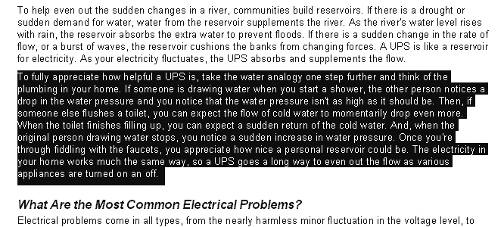
Entering and Editing Text
Text is entered by typing
Cursor indicates position
Blocks of text can be manipulated
Most other programs include text tools
Notes:
Teaching tip
To select a paragraph using the mouse, triple click any word in the paragraph. Double clicking selects the word.

Slide 30
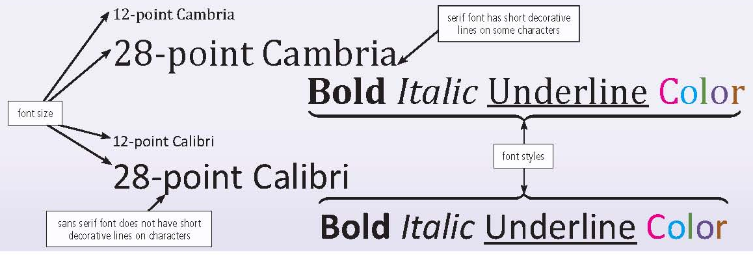
Font
A name assigned to a specific design of characters
Font size indicates the size of the characters in a particular font in points (a single point is about 1/72 of an inch in height)
Font style adds emphasis to a font such as bold, italic, and underline

Slide 31
Formatting Text
Controls the document’s appearance
Character formatting tools
  Fonts
  Type style
Paragraph formatting tools
  Line and paragraph spacing
  Indents, alignment, tabs, borders or shading
Document formatting tools
  Page Margins, Orientation, Page size
  Headers and footers, Breaks, Hyphenation
  Columns
Notes:
Teaching tip
Point out to your students that the simple word processor is the most often used application in most offices.

Slide 32
Additional Word Processing Features
Additional word processing features include
AutoCorrect
AutoFormat
Collaboration
Columns
Grammar Checker
Ink Input
Macros
Mail Merge
Reading Layout
Research
Search and Replace
Smart Tags
Tables
Templates
Thesaurus
Tracking Changes
Voice Recognition
Web Page Development

Slide 33
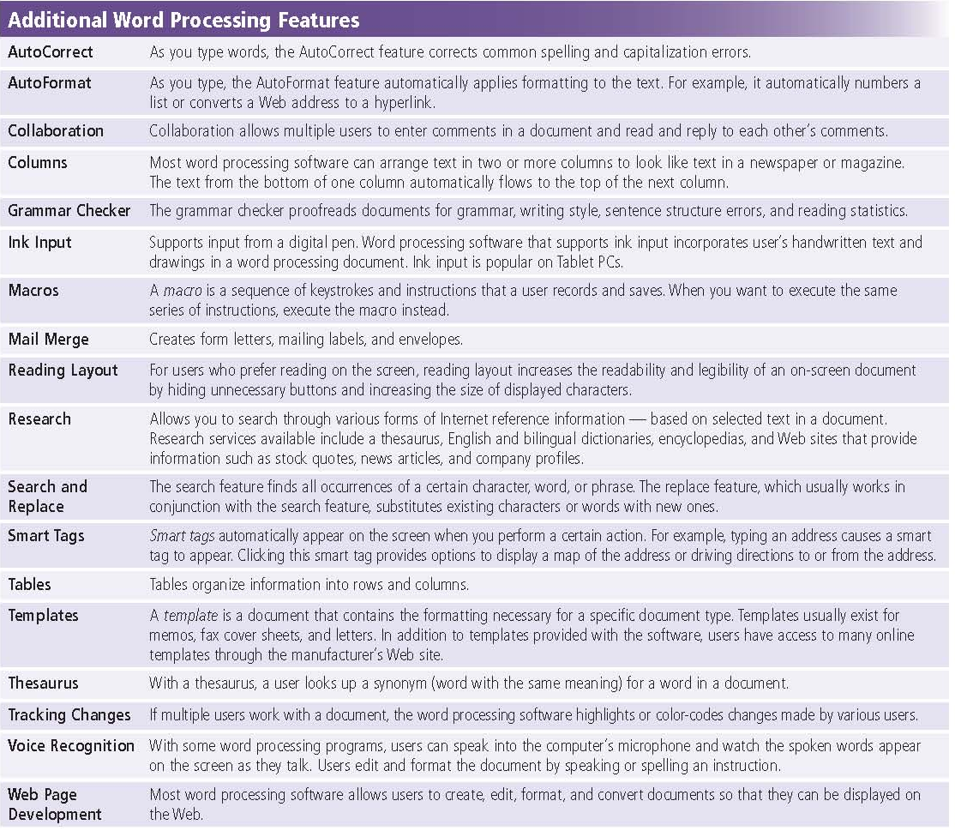
Additional Word Processing Features

Slide 34
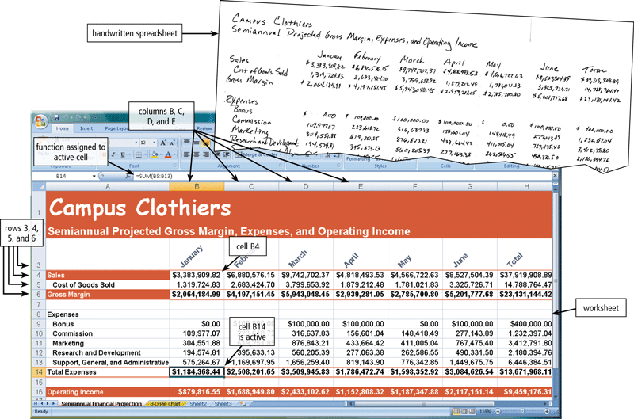
Spreadsheet Software
Allows users to organize data in rows and columns and perform calculations and recalculates when data changes
Columns identified by letters
Rows identified by numbers
A cell is the intersection of a column and row

Slide 35
Spreadsheet Programs Interface
Rows and columns collectively are called a worksheet
Cells can contain four types of data:
  labels, values, dates and formulas.
Calculates numbers and finances
Data viewable in many ways
  Tables
  Graphs
Complex calculations can be automated
Cells also can hold graphics, audio files, and video or animation files.

Slide 36
Spreadsheet Formula and Function
A function is a predefined formula that performs common calculations
    =C4+C5+C6+C7+C8
    =SUM(C4:C8)
FV
NPV
PMT
PV
RATE
DATE
NOW
TIME
ABS
INT
LN
LOG
ROUND
SQRT
SUM
AVERAGE
COUNT
MAX
MIN
STDEV
IF

Slide 37
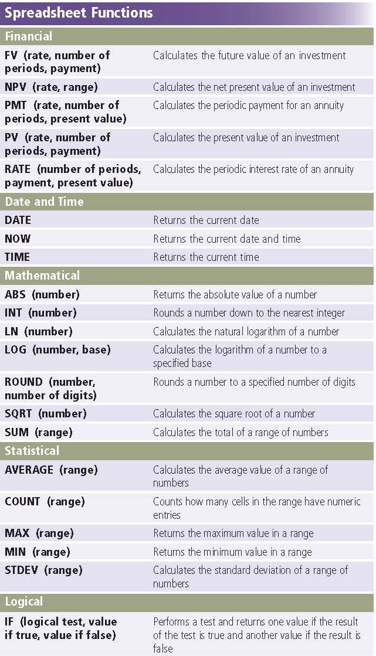
Formula and Functions
= A1+B2 (*C12)
= D1+E2 (*F12)
= SUM (C12:Y12)

Slide 38
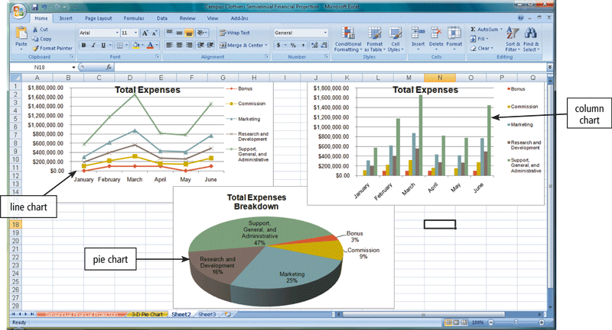
Charting
Depicts data in a spreadsheet in graphical form
A visual representation of data through charts often makes it easier for users to see at a glance the relationship among the numbers

Slide 39
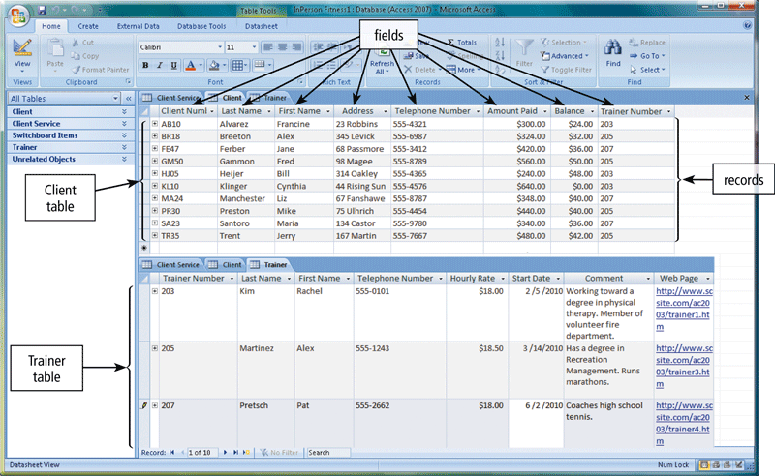
Database Software
A database is a collection of data organized in a manner that allows access, retrieval, and use of that data
  Database software allows users to create, access, and manage a database

Slide 40
Database
A table contains records
A record is a row in a table that contains information about a given person, product, or event
A field is a column in a table that contains a specific piece of information within a record
Extraction of information from a database
  Run queries to retrieve data
    query is a request for specific data from the database
  Can be sent as a report to the printer or present it in a window on the screen

Slide 41
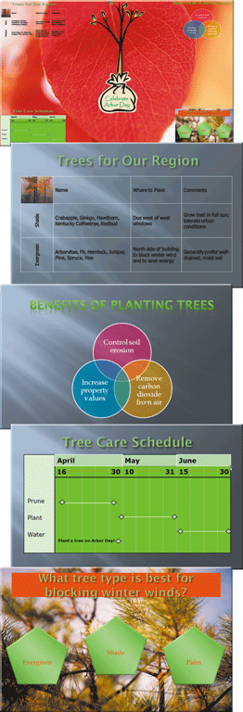
Presentation Software
Allows users to create visual aids for presentations to communicate ideas, messages, and other information to a group
Sometimes called a slide show
Creates slides or transparencies
Complete set is a presentation
Enhances a speech or lecture
Color and animation enhance the slides

Slide 42
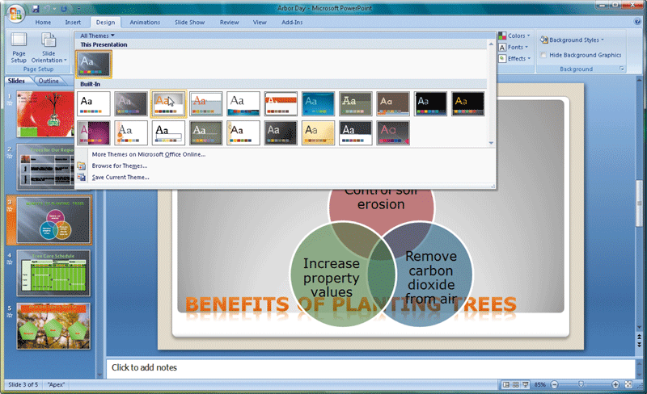
Presentation Software Example

Slide 43
Presentation Programs Interface
Similar to a word processor
Displays a slide in a large document window (Slide window) and provides tools for designing and editing slides
Can add elements to the slide simply by typing, making menu or toolbar choices, and dragging
presentation can contain a single slide or hundreds
Outline window
Speaker notes
Slide shows

Slide 44
Creating a Presentation
Templates can simplify the process
Build the slides
  Pick a layout
  Enter the desired text
  Apply special formatting
Continue adding slides in order
Apply slide transitions if desired
can view or print a finished presentation in a variety of formats, including an outline of text from each slide, audience handouts that show completed slides, and speaker notes for each slide
Notes:
Teaching tip
Point out to the students that templates can be found in nearly all office products.

Slide 45
Presenting Slide Shows
Use to enhance a speech
Mouse click advances to next slide
Physical transparencies on an overhead
Computer screen delivery
Large monitor delivery
Data projector

Slide 46

Using a Large Monitor
Portable, high-resolution data projectors are expensive, but they can display slides to a large audience

Slide 47
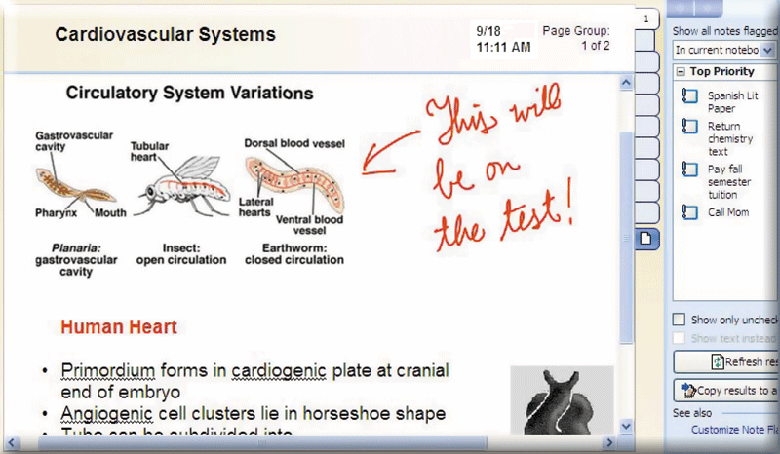
Note Taking Software
Application software that enables users to enter typed text, handwritten comments, drawings, or sketches anywhere on a page
Notes are organized like a notebook

Slide 48
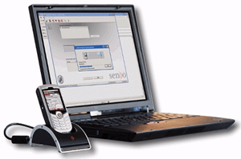
Personal Information Manager (PIM)
application software that includes appointment calendar, contacts, notes facilities
  can take information previously tracked in a weekly or daily calendar, and organize and store it on your computer
  Most PDAs and many smart phones include PIM Functionality, synchronizes with PC
Appointment calendar
Address book
Notepad

Slide 49
Personal Information Managers
Keep track of contact information
Track upcoming events and times
PIMs make contact management easy, because they provide special placeholders for all kinds of contact information
  everything from phone numbers and e-mail addresses to Web pages and regular mail addresses.
MS Outlook is popular
  lets you manage contact lists, your schedule. and other important information it is also a powerful email program

Slide 50
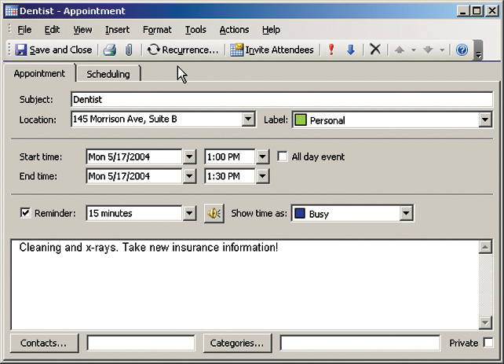
Data Organization
Contact information organized by last name
Users may search for data
Appointment reminders can be set

Slide 51
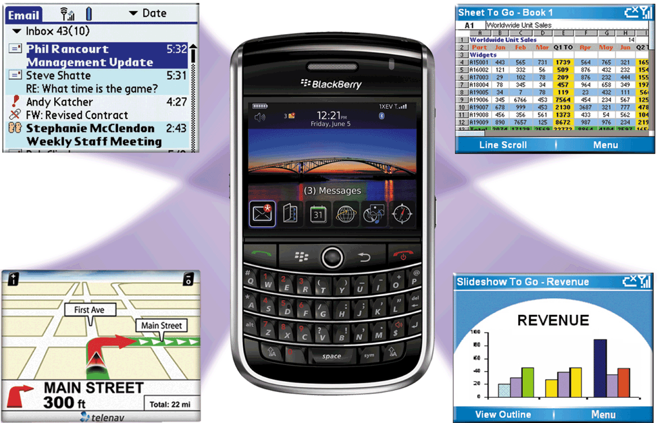
Mobile Versions
Scaled down versions of software are available to work with smart phones and other mobile devices

Slide 52
Summary
Application software and its categories
Forms of Application Software
  Packaged, Custom, web Application, Open Source
  Shareware, Freeware, Public domain, S/W suites
  System software
Business Software
Word Processing Software
  Features, Interface, Formatting text and others
Spreadsheet Software
  Interface, formula and function, charting
Presentation Software
52

