Slide 1
CSC 101
Introduction to Computing
Lecture 23
Dr. Iftikhar Azim Niaz
ianiaz@comsats.edu.pk
1

Slide 2
Last Lecture Summary
Browser and the WWW
  URL, Links, Recognizing Links, Home Page
  Navigating the Web
  Downloading and Uploading MicroBrowsers
  History and Help, Ipv4 and IPv6 addresses
  Tabbed Browsing, Market share
Searching the Web
  Subject Directory
  Search Engine, How to Use, Search engine Items
  Search Text Words Length, Site searches
  Search Techniques Search Operators
2

Slide 3
Last Lecture Summary
Types of Websites
  Portal, News, Information
  Business / Marketing, Blog, Wiki
  Online Social, Educational, Entertainment
  Advocacy, Web Application, Content Aggregator
  Personal Website
Criteria for Evaluating Web site
  Affiliation, Audience
  Authority, Content
  Currency, Design
  Objectivity
3

Slide 4
Objectives Overview
Explain how Web pages use graphics, animation, audio, video, virtual reality, and plug-ins
Identify and briefly describe the steps required for Web publishing
Describe the types of e-commerce
Explain how e-mail, mailing lists, instant messaging, chat rooms, VoIP, newsgroups and message boards, and FTP work
Identify the rules of netiquette
4

Slide 5
WWW and Multimedia
Multimedia refers to any application that combines text with:
Graphics
Animation
Audio
Video
Virtual Reality

Slide 6
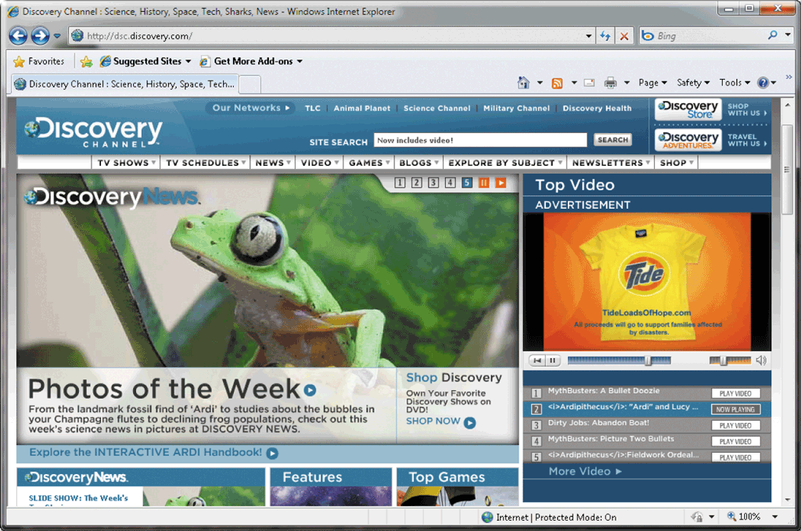
Graphic
A graphic is a digital representation of nontext information
Graphic formats include BMP, GIF, JPEG, PNG, and TIFF
Many Web pages use colorful graphical designs and images to convey messages

Slide 7
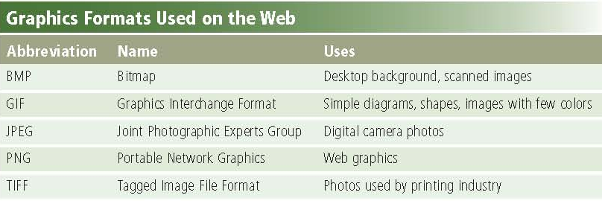
Graphic Format Used on Web

Slide 8
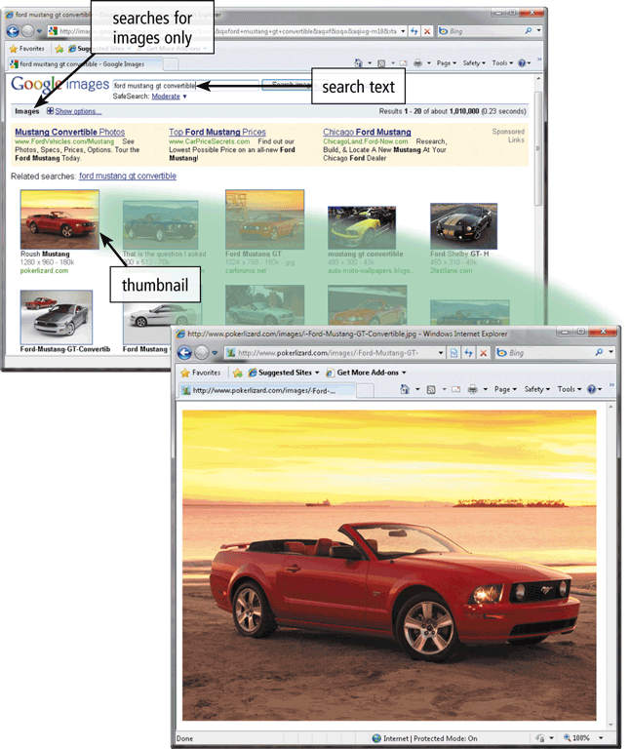
Thumbnail
  A thumbnail is a small version of a larger graphic graphics —used to improve Web page display time
  Usually click on thumbnail to display larger graphic

Slide 9
Animation
Animation is the appearance of motion created by displaying a series of still images in sequence
Animation can make Web pages more visually interesting or draw attention to important information or links

Slide 10
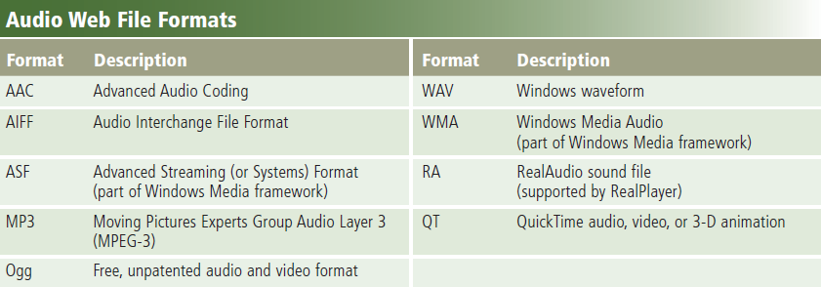
Audio
Audio includes music, speech, or any other sound
  Compressed to reduce file size
You listen to audio on your computer using a player
Streaming is the process of transferring data in a continuous and even flow

Slide 11
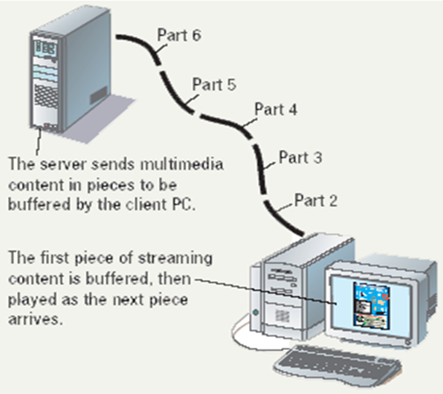
Streaming Audio
The process of
transferring audio
in a continuous
and even flow
Enables you to
listen to music
as it downloads
to your computer

Slide 12
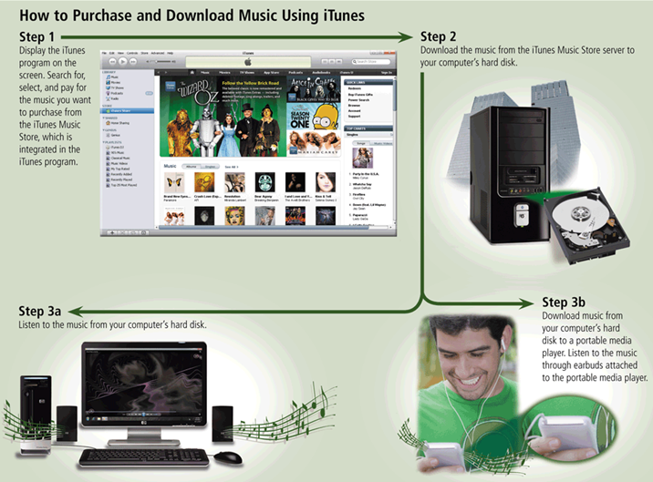
Downloading Music with iTunes

Slide 13
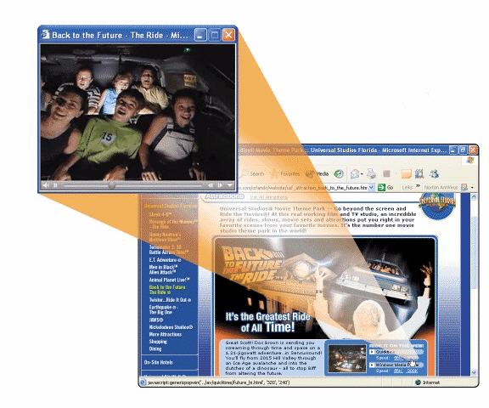
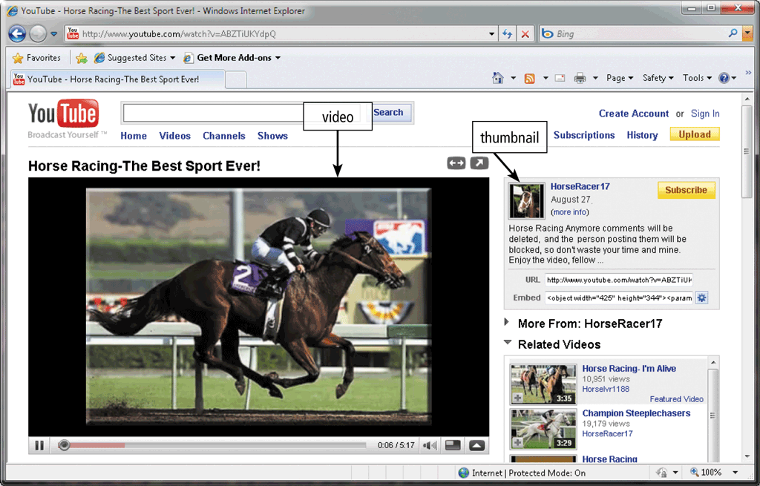
Video
Video consists of full-motion images that are played back at various speeds
MPEG (Moving Picture Experts Group) is a popular video compression standard

Slide 14
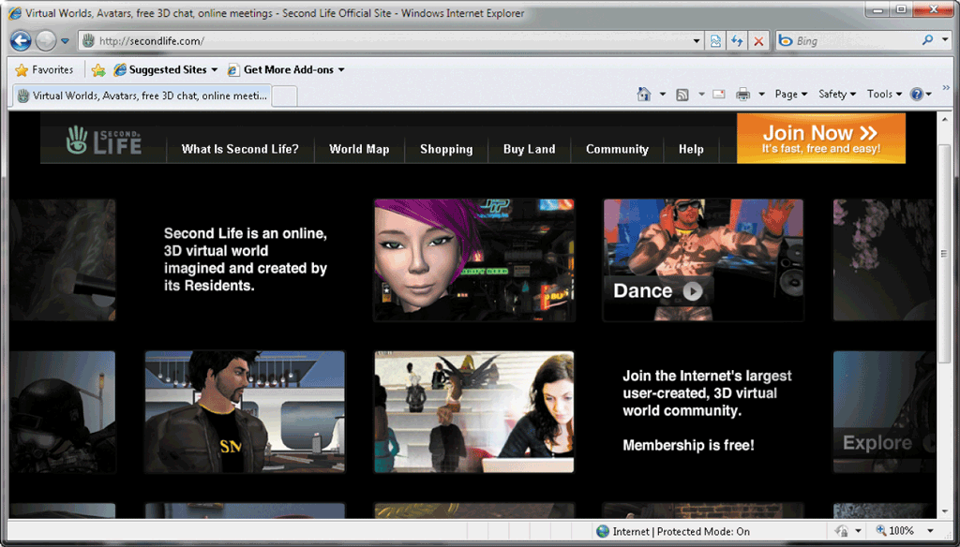
Virtual Reality
Virtual reality (VR) is the use of computers to simulate a real or imagined environment that appears as a three-dimensional space

Slide 15
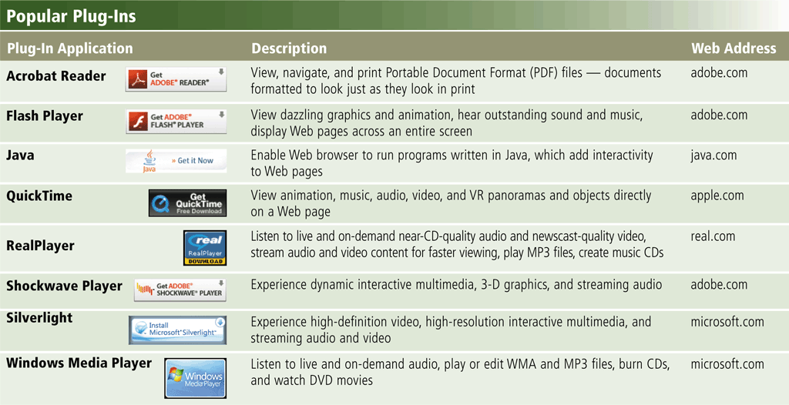
Plug-In
A plug-in is a program that extends the capability of a Web browser

Slide 16
Web Publishing
Web publishing is the development and maintenance of Web pages
Plan a Web site
Analyze and design a Web site
Create a Web site
Deploy a Web site
Maintain a Web site

Slide 17


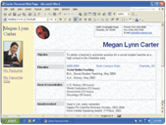
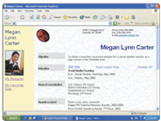
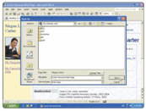
Web Publishing
Development and maintenance of Web pages
Step 2.
Analyze and design the Web site
Step 1.
Plan the Web site
Step 3.
Create the Web site
Step 5.
Maintain
the Web site
Step 4.
Deploy the Web site

Slide 18
E-Commerce
E-commerce is a business transaction that occurs over an electronic network
  M-commerce identifies e-commerce that takes place using mobile devices
Consumer-to-consumer (C2C)
Business-to-business (B2B)
Business-to-consumer (B2C)
E-commerce

Slide 19
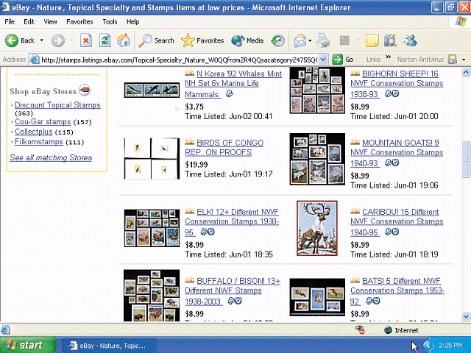
E-Commerce
Popular uses of e-commerce by consumers include retail, finance, travel, entertainment, and health.
Business to consumer (B2C)
Sale of goods to general public
Consumer to consumer (C2C)
One consumer sells directly to another
Business to business (B2B)
Business providing goods and
services to other businesses

Slide 20
Business to Consumer E-Commerce
Online shopping
  Purchasing through a web site
  List of products is nearly endless
  Features
    Searchable catalog
    Secure checkout
    Customer support page

Slide 21
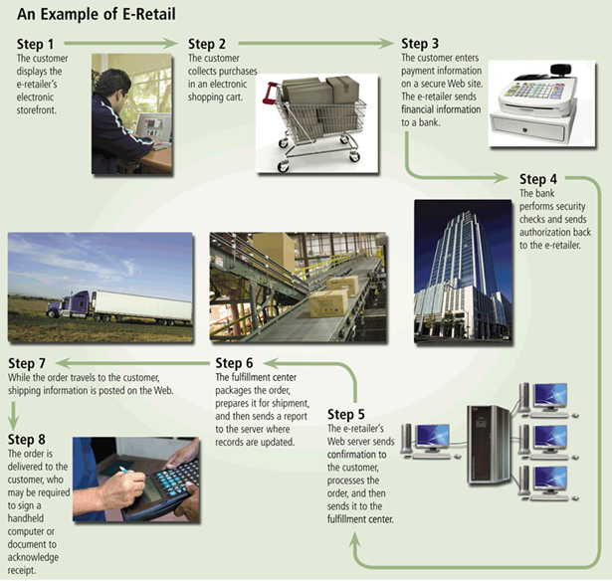
E-Commerce E-Retail

Slide 22
Online Stores Vs Brick and Mortar
Brick and mortar implies a physical store
Brick and mortar properties
  Limited hours
  Salespeople can offer assistance
  Customers can handle the merchandise
Online store properties
  Store is open 24 x 7
  Salespeople usually not available
  Can only view the merchandise

Slide 23
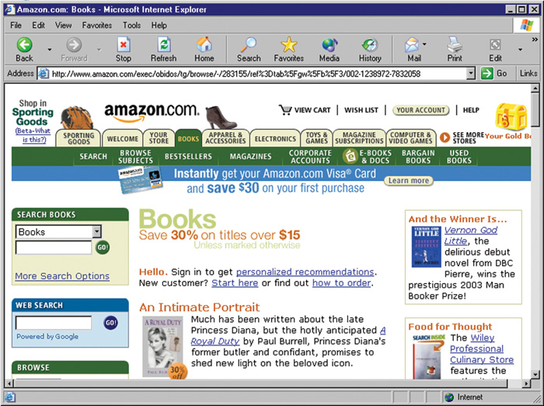
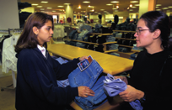
Online vs. Brick and Mortar
Online store catalog
Brick and mortar store experience

Slide 24
Using Online catalogs
Good online stores have a catalog
Products are often arranged by category
Products can be found by keyword
need to be maintained and updated on a continuing basis, so that prices and descriptions are always correct
If you are shopping for an MP3 player at the Web site of an electronics vendor;
  for example, you might click the Electronics category first,
  then the Personal Electronics subcategory, then Personal Audio,
  then Handheld Devices, and then MP3 Players.
Notes:
Teaching tip
Open an online store in class and demonstrate exactly how the catalog works.

Slide 25
Paying for Purchases
Vendors accept several payment methods
  Credit cards
  Paypal
  Electronic Fund Transfer
May need to create an account
  Simplifies shipping
  Encourages repeat shopping
  Does not reveal your financial information
Notes:
Insider information
Suggest to your students that they use the same account name and password for every online vendor they visit. This will simplify their lives when the revisit the site in the future.

Slide 26
Getting Customer Services
Needed to resolve problems
Understand the policies before ordering
Contact information
  How you contact the vendor
Return policies
  Availability and fee for returning items
Shipping policies
  Mostly use least expensive means of shipping
Charges and fees
  Convenience fees
  Hidden fees

Slide 27
Consumer E-Commerce
Online banking
  Most teller services handled online
  Balances can be obtained
  Bills can be paid
  Access is typically very secure
  Not available at all banks
Online finance
  Broker and investment services
  Costs less than a traditional broker
  Stocks and bonds can be traded
  Loans can be procured
  Tax returns can be filed

Slide 28
Consumer-to-Consumer (C2C)
Consumer-to-consumer (C2C) e-commerce occurs when one consumer sells directly to another, such as in an online auction.
With an online auction, users bid on an item being sold by someone else.
The highest bidder at the end of the bidding period purchases the item.
eBay is one of the more popular online auction Web sites.

Slide 29
Business E-Commerce
Business to Business (B2B)
  Business transaction between companies
  Accounts for the majority of e-commerce
  Initially private networks were used
  Common transactions
    Reorder inventory
    Purchase stocks
    Credit checks

Slide 30
Intranets and Extranets
Business partners must work together
  Networks must work together
Intranet uses Internet technologies
  Only internal workers can access resources
  Use a standard browser to access resources
Extranets open the Intranet to clients
  Clients have password level access
  Allows the same abilities as employees
Very simple to use and setup
Notes:
Insider information
Very large businesses may force smaller clients to conform to their network. Two examples are Ford and Highmark Insurance. In Highmark’s case, they require doctors accepting their insurance to process bills using Highmark’s software.

Slide 31

Telecommuters
Employee working outside of the office
Connects to the office through technology
rely on computers and Internet connections to do their jobs
Several technologies are used
  Home computer and the Internet
  Key card changes passwords often
  Encryption is used to protect data
Notes:
Discussion point
Have students list the pros of telecommuting. Expect answers like: “working in my underwear” and “no need to commute”. Once several pros have been listed, switch to cons. Introduce the problems of promotions, employee isolation, and extremely long work days. Finish with the problem of outsourcing to different countries.

Slide 32
Security
Improved security measures
  Before 1998, Web security was nonexistent and consumers were reluctant to give personal and credit card information
  Now safer than restaurant purchases
  All reputable sites protect their customers by using sophisticated measures to ensure that customer information cannot fall into hands of criminal
  Online merchants typically protects customers by providing Secure Web Pages

Slide 33
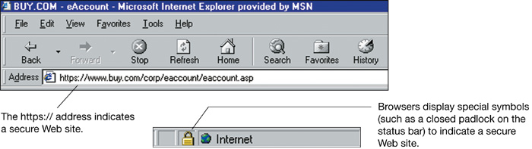
Secure Web Pages
Allows safe transmission of credit card
Use the secure socket layer (SSL)
  Encrypts data transmission to the server
Secure pages are easily identified
  URL uses https://
  Browser status bar shows a closed lock
Notes:
Teaching tip
Explain to your students that Internet security is a very tough concept. The information presented in the chapter is simply a brief introduction. An excellent tutorial on web security can be found on www.pdweb101.com/.

Slide 34
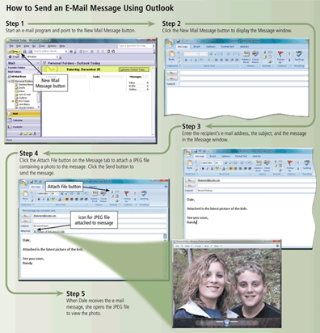
Other Internet Services
E-mail is the transmission of messages and files via a computer network
An e-mail program allows you to create, send, receive, forward, store, print, and delete e-mail messages

Slide 35
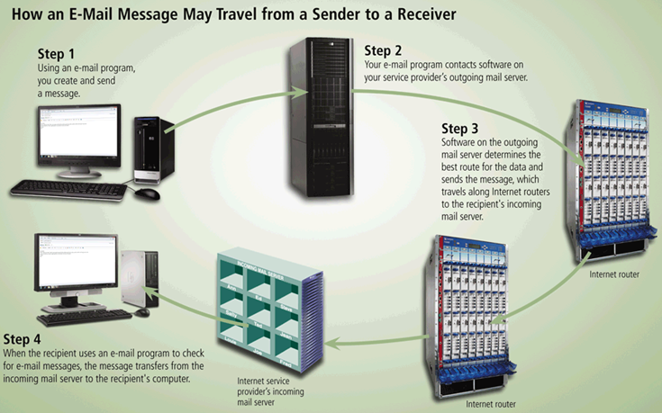
Other Internet Services

Slide 36
Using E-mail
Exchanges messages with other users
  Messages reach destination in seconds
  Mail waits in mailbox until opened
  Text, audio, pictures and video messages
E-mail addresses
  Unique address
  Allows sending and receiving
  Username@isp.com
Listserv
  Lists of e-mail addresses
  Each address gets the e-mail
Notes:
Teaching tip
Have a student define spam. While most people hate spam and wish it would stop, explore the implications of anti-spam laws in a free trade society.

Slide 37
Configure E-mail
e-mail clients read and send e-mail
Outlook and Eudora are common
  Need name of mail server
  Need username and password
Hotmail and Yahoo are online clients
  No configuration needed
Notes:
Teaching Tip
Suggest to your students to acquire a professional e-mail address from Hotmail or other online service. These free services usually outlast university or employer e-mail.

Slide 38
E-mail Actions
Create a new message
Send an attachment
Reply to e-mail
Open attachments
Forward an e-mail
Notes:
Teaching tip
Although not covered in the text, CC refers to Carbon Copy and sends a copy of the e-mail to everyone on the list. Blind carbon copy (BCC) does the same, except the recipients do not know who else got the message.

Slide 39
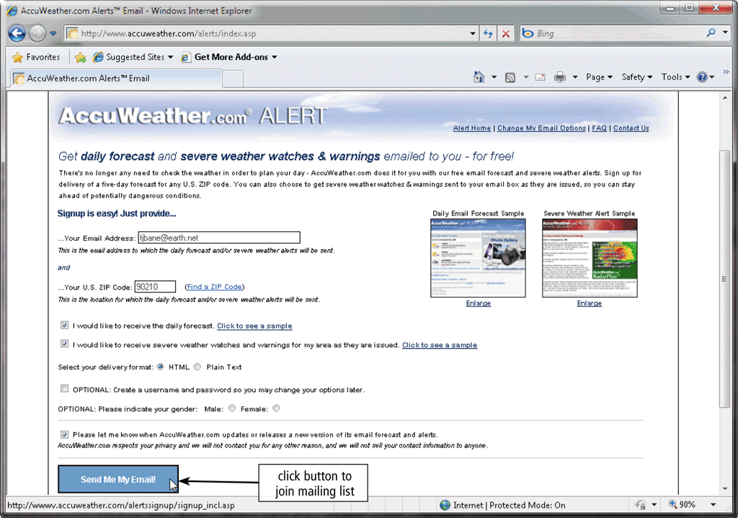
Mailing List
A mailing list is a group of e-mail names and addresses given a single name
  Subscribing adds your e-mail name and address
  Unsubscribing removes your name

Slide 40
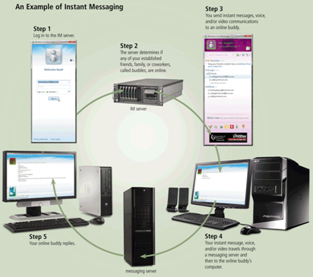
Instant Messaging
real-time Internet communications service
Private, real-time communication
Message sent only to listed users
Buddy lists contain IM names

Slide 41

Chat and Chat Rooms
A chat is a real-time typed conversation that takes place on a computer
A chat room is a location on an Internet server that permits users to chat with each other

Slide 42
Internet Relay Chat (IRC)
Real time communication system
Multi-users with many channels (rooms)
Channels are dedicated to a topic
All users can read the comments
Notes:
Discussion point
Have students discuss methods to be safe and secure in a chat room.

Slide 43
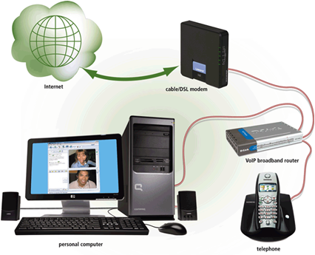
VoIP
VoIP (Voice over IP) enables users to speak to other users over the Internet
  Also called Internet telephony

Slide 44
News
Public board devoted to a topic
Thousands of topics available
Messages are called threads
Users can create threads
Users can comment on threads
Need a news reader program
Notes:
Teaching tip
When you show a newsgroup in class, watch out for non-moderated groups. Off topic messages can appear. Stick to moderated groups like Microsoft sponsored groups. Table 2B.1 lists common news domains.

Slide 45
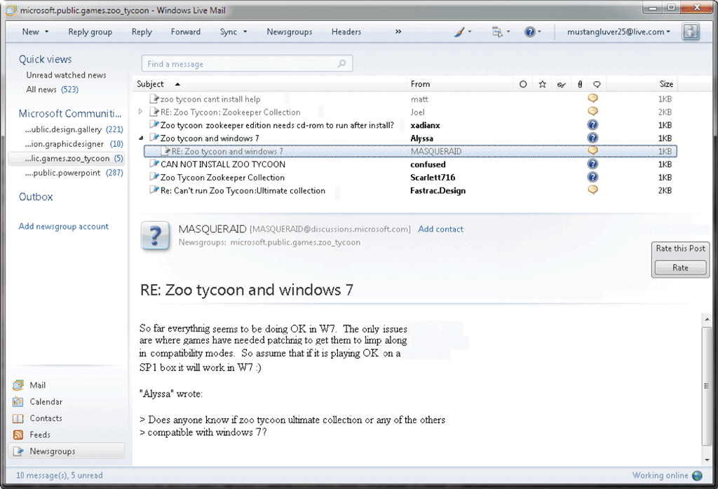
Newsgroup
A newsgroup is an online area in which users have written discussions about a particular subject
  Typically requires a newsreader
A message board is a Web-based type of discussion group

Slide 46
File Transfer Protocol (FTP)
FTP (File Transfer Protocol) is an Internet standard that permits file uploading and downloading with other computers on the Internet
Many operating systems include FTP capabilities
An FTP server is a computer that allows users to upload and/or download files using FTP

Slide 47
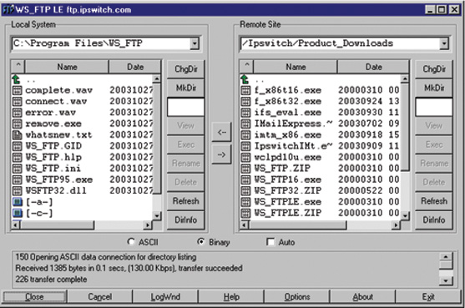
File Transfer Protocol (FTP)
Copies files from a remote computer
FTP client is needed
Some sites require a password
Notes:
Teaching tip
Page 83 of the text has good pictures of ftp in action. This is a service students have most likely not encountered. Be sure to demonstrate in class.

Slide 48
P2P Services
Peer-to-peer (P2P) services
  User computers are connected together
  No centralized organization
  Users can communicate directly
  Users can share files

Slide 49
Online Services
Company that offers access by subscription
Banks, games and research
America Online offers content and Internet

Slide 50
Software Accessing The Internet
Application programming interface (API)
  Simplifies connection to network devices
  Allows any application to access Internet
  UNIX API uses sockets
  Windows API uses winsock
Notes:
Insider information
A socket (UNIX or Windows) is a combination of an IP address and a port. For example, connecting to the HTTPS port on machine 192.168.110.15. The socket is 192.168.110.15:443.

Slide 51
Software Accessing The Internet
Network drivers
  Control access to the hardware
  Ethernet and dial-up require a driver
  API connects to the driver
Notes:
Teaching tip
Figure 10A.4 on page 387 describes this interaction very well.

Slide 52
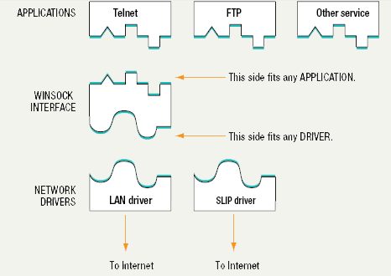
API and Network Drivers

Slide 53
Web 3.0
The Web has evolved through versions 1.0 and 2.0, and work is underway to develop Web 3.0, also known as the Semantic Web.
Some researchers predict that this next generation of the Web will perform practically any task imaginable.
In essence, the Web will become one huge searchable database, and automated agents of every type will retrieve the data we need to live productive lives.
Notes:
For example, your computer will be able to scan a Web page much as you do to look for specific useful information. If you need the location of the nearest eye doctor and the time when your brother’s flight from Chicago actually will land, Web 3.0 first will provide those and then search your calendar, checking to see if your schedule allows time for the doctor’s appointment before picking up your brother at the airport.

Slide 54
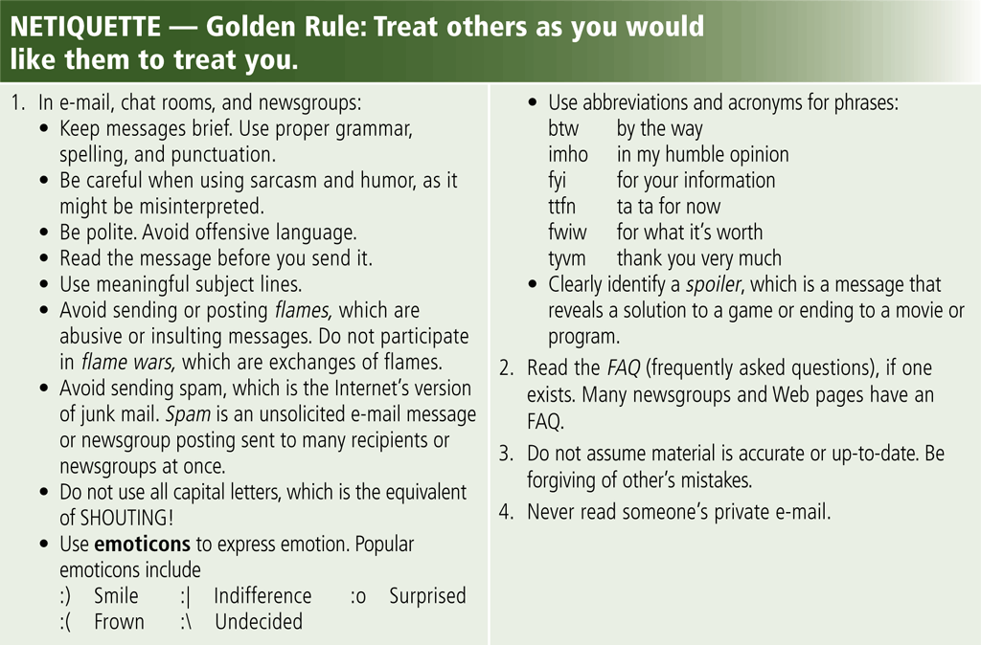
Netiquette
Netiquette is the code of acceptable Internet behavior

Slide 55
Summary I
WWW and Multimedia
  Graphics Animation
  Audio Video
  Virtual Reality Plug-In
Web Publishing
E-Commerce
  Business to Consumer
  Business to Business
  Intranets and Extranets
  Security and Secure Web Pages
55

Slide 56
Summary II
Other Internet Services
  E-mail
  Instant Messaging
  Chat and Chat rooms
  News and Newsgroups
  VoIP
  FTP
API and Network Drivers
Rules of Netiquettes
56

Slide 57
Recommended Websites
d
57

