Slide 1
CSC 101
Introduction to Computing
Lecture 22
Dr. Iftikhar Azim Niaz
ianiaz@comsats.edu.pk
1

Slide 2
Last Lecture Summary I
Internet
Evolution and history of Internet
  ARPANET
  NSFNet
  Internet2
Internet connection service
  Cable internet service
  DSL
  FTTP
  Fixed wireless
  Cellular Radio Network, Wi-Fi, Satellite internet
2

Slide 3
Last Lecture Summary II
Internet Major Services
  Web
  E-mail, mailing list
  News, newsgroup, message board
  FTP
  Instant Messaging, Chat
  VoIP
  Peer-to-peer services
WWW and Browsers
IP Address
Streaming Audio and Video
3

Slide 4
Objectives Overview
Describe how to use a search engine to search for information on the Web
Differentiate between a search engine and a subject directory
Describe the types of Web sites
Using a Browser and WWW
4

Slide 5
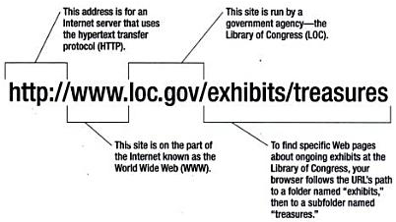
URL
Uniform Resource Locator
Type://Address/path
Type – type of server (protocol, http://)
Address – address of the server
Path – location within the file structure of server

Slide 6
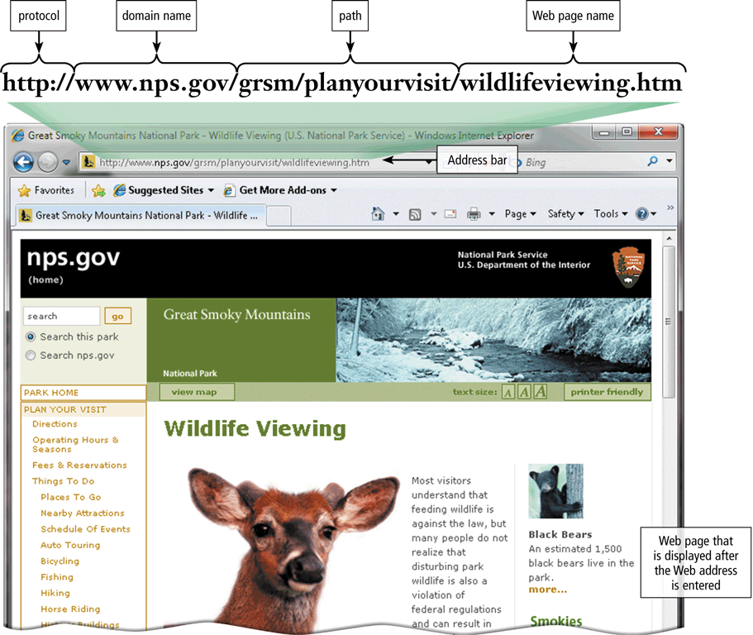
URL and Web Server
A Web page has a unique address called a URL or Web address
A web server delivers the Web page to your computer

Slide 7
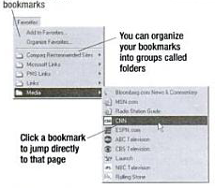
Using a Browser And The WWW
Web pages and Web site
Browser starts on the home page
Navigating the web
  Enter a URL in the browser
  Click a hyperlink
    Links are typically blue underlined words
  Image maps are picture links
  Store the URL in the browser’s Favorites / Bookmarks list
When finished, close the browser

Slide 8
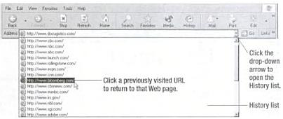
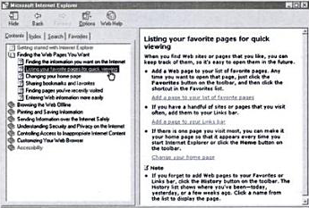
History and Help

Slide 9
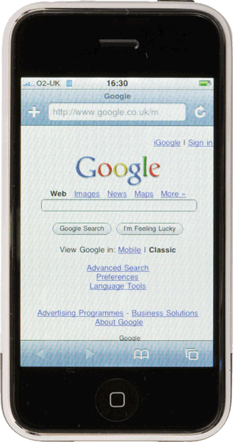
Home Page and Downloading
A home page is the first page that a Web site displays
Web pages provide links to other related Web pages
  Surfing the Web
Downloading is the process of receiving information
Some Web pages are designed specifically for microbrowsers

Slide 10
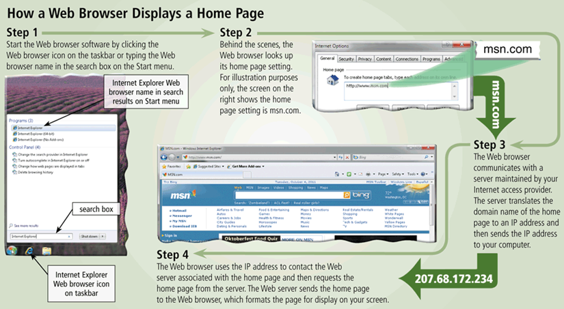
Displaying Home Page

Slide 11
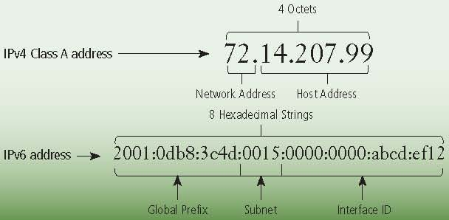
Components of IPv4 and IPv6 addresses

Slide 12
Link
Built-in connection to another related
Web page location
  Item found elsewhere
  on same Web page
  Different Web page
  at same Web site
  Web page at a different
  Web site

Slide 13
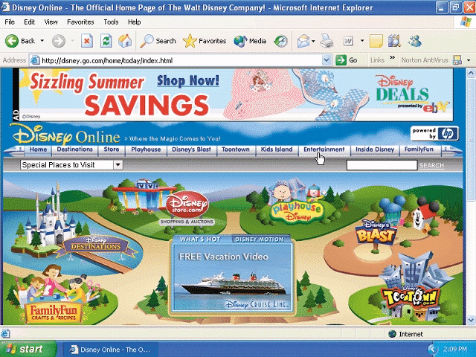
Recognizing Links
Pointer changes to a small hand when you point to a link
A link can be text or an image
Text links are usually underlined and in a different color

Slide 14
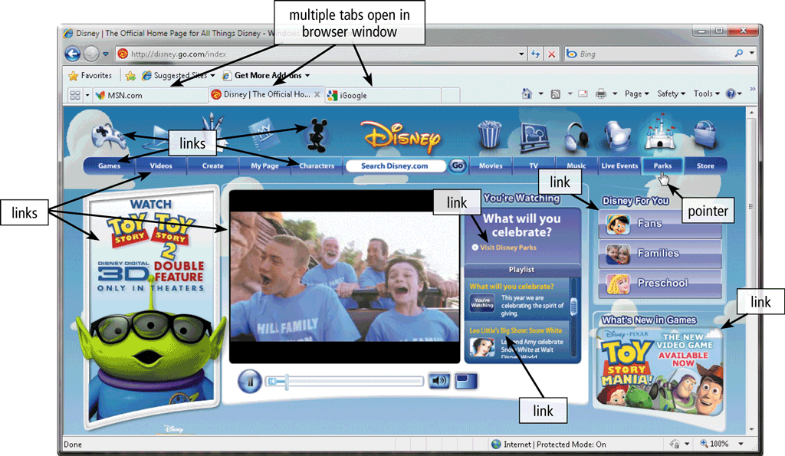
Tabbed Browsing
allows you to open and view multiple Web pages in a single Web browser window

Slide 15
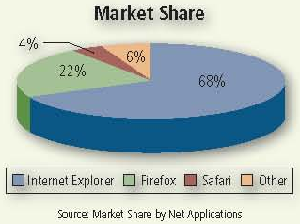
Web Browser Market share
Windows Internet Explorer (IE) currently is the most popular browser, with approximately 68 percent of the market share

Slide 16
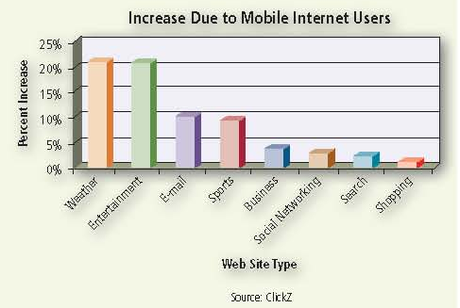
Websites that Mobile Internet User visit
More than 87 million individuals subscribe to a wireless Internet service provider

Slide 17
Search Tools
Two types of search tools are search engines and subject directories
Search engine
Finds information related to a specific topic
Subject directory
Classifies Web pages in an organized set of categories

Slide 18
Subject Directory
A subject directory provides categorized lists of links
Search tool with organized set of topics and subtopics
Lets you find information by clicking links rather than entering keywords
specializes in linking to other web sites and categorizing those links
not a search engine and does not display lists of web pages based on keywords; instead, it lists web sites by category and subcategory.

Slide 19
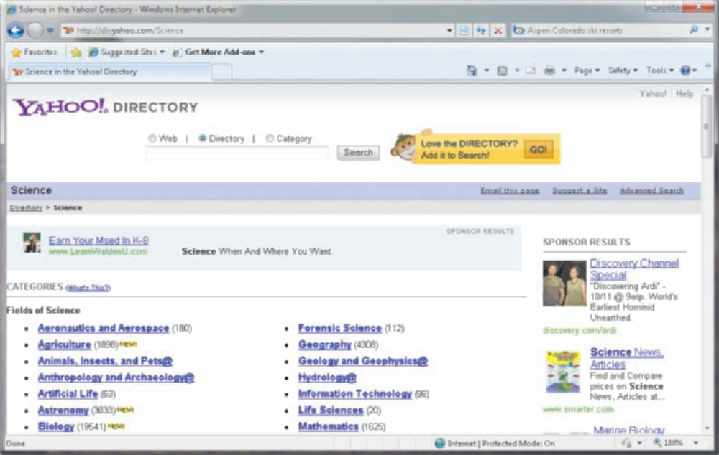
Subject Directory

Slide 20
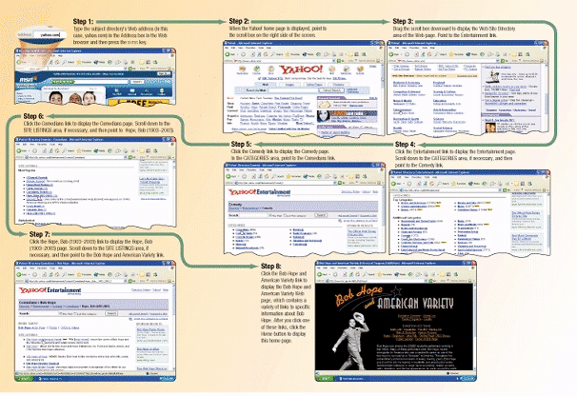
Subject Directory

Slide 21
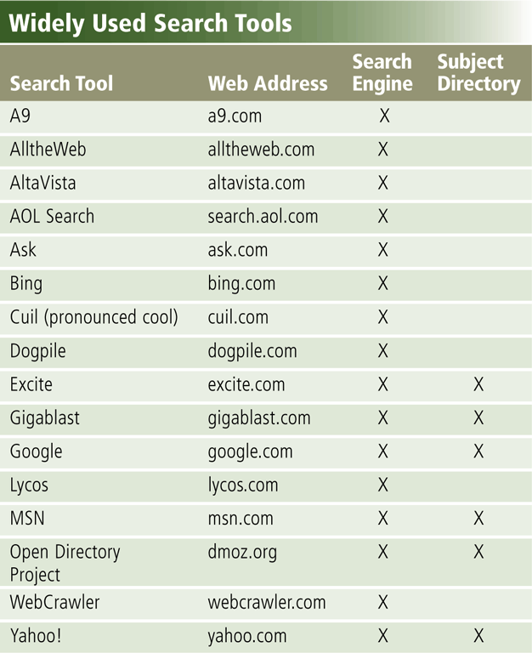
Search Engine
Program used to find
Web sites and Web pages by entering
words or phrases
called search text
Also called a keyword
Some search engines also mine data available in databases or open directories
search engines also maintain real-time information by running an algorithm on a web crawler

Slide 22
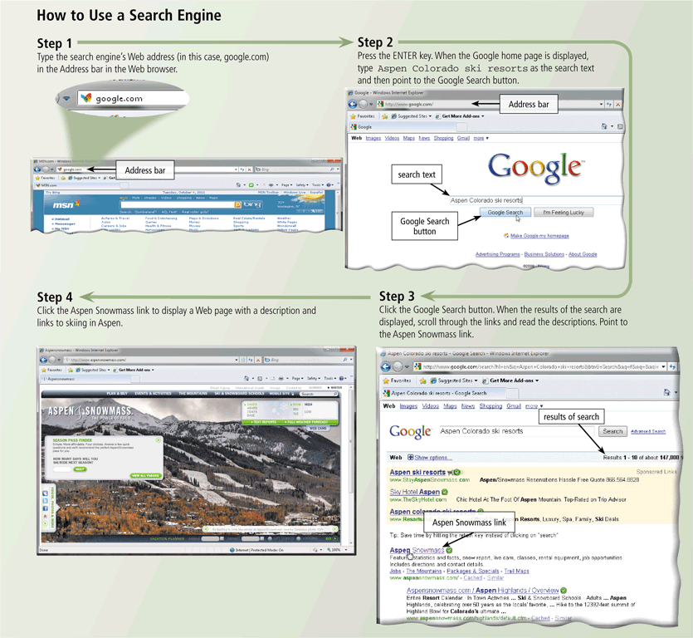
Using a Search Engine

Slide 23
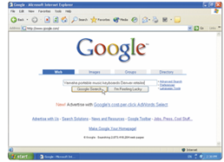
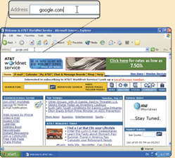
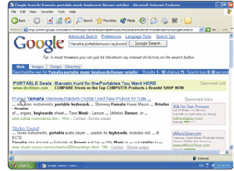
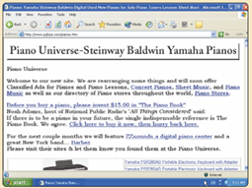
Search Hit
Any Web site name that is listed as the result of a search
Step 2.
Select type of search you want
to run
Step 1. Go to search engine
Step 3. View hits
Step 4.
Click
link to view
Web site

Slide 24
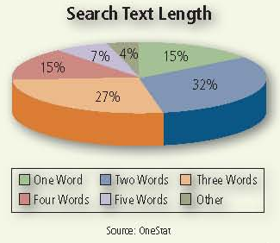
Search Text Word Length
Internet users most often use only two words in their search text.

Slide 25
Search Engine Items
A search engine is helpful in locating items such as:
Images
Videos
Audio
News
Maps
People or Businesses
Blogs

Slide 26
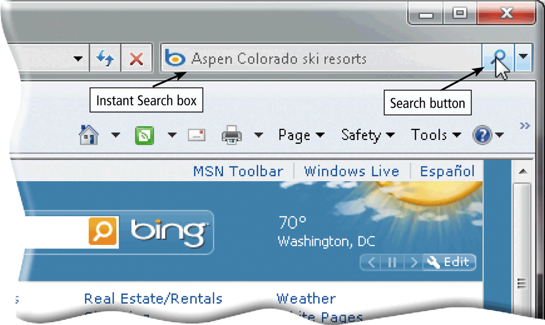
The World Wide Web
Some Web browsers contain an Instant Search box to eliminate the steps of displaying the search engine’s Web page prior to entering the search text

Slide 27
Searching the Web
Site searches
  Large sites have an internal search
Metasearch sites
  Search several web sites at once
Sponsored links
  Sites pay for better search results
Notes:
Insider information
The search engine www.google.com has become one of the hottest search engines on the planet. It is so popular, it’s name has become a verb. For example, “I googled the answer last night” is a phrase uttered on college campuses the world over.

Slide 28
Search Techniques
Quote the exact phrase
Use the keyword AND
Use the keyword NEAR
Avoid common words
Use the site’s advanced tools
Use specific nouns.
Put the most important terms first in the search text.
List all possible spellings, for example, email, e-mail.
Before using a search engine, read its Help information.
If the search is unsuccessful with one search engine, try another

Slide 29
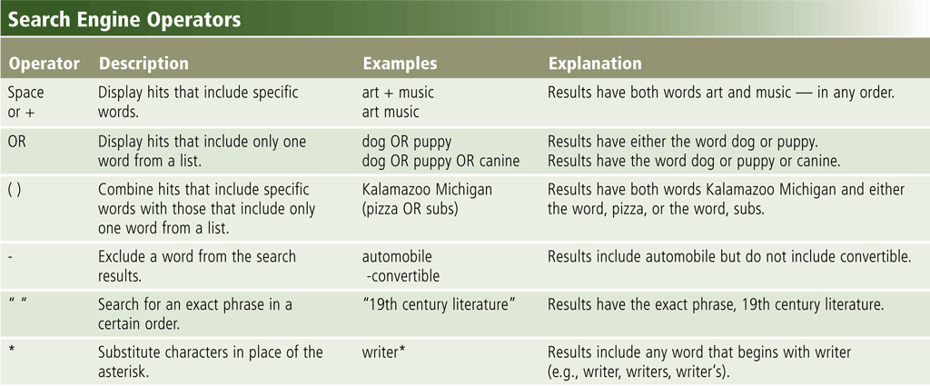
The World Wide Web
Search operators can help to refine your search

Slide 30
The World Wide Web
There are thirteen types of Web sites
Portal
News
Informational
Business/Marketing
Blog
Online Social Network
Educational
Wiki

Slide 31
The World Wide Web
Entertainment
Advocacy
Web Application
Content Aggregator
Personal

Slide 32
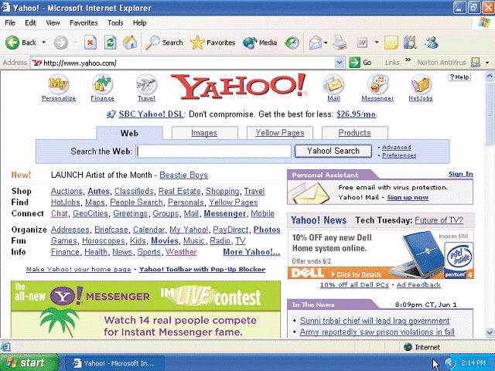
Portal
A Web site that offers a variety of services from one, convenient location, usually for free
  Searching, sports, e-mail, news, weather, auctions,
  Web communities (Web sites that join people with similar interests)

Slide 33
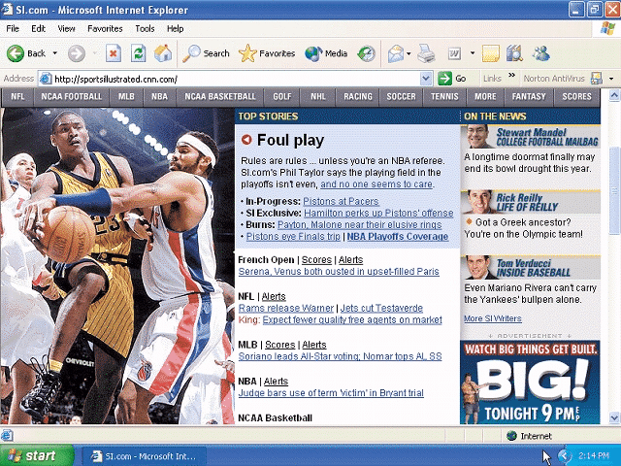
News Web Site
Contains newsworthy material
Stories and articles relating to current events, life, money, sports, and the weather

Slide 34
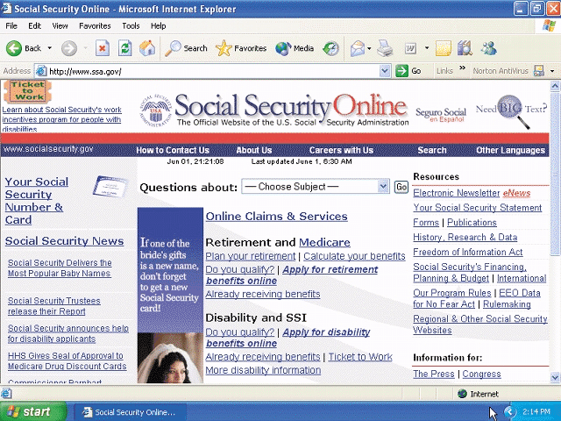
Informational Web site
Contains factual information
Created by organizations and government agencies

Slide 35
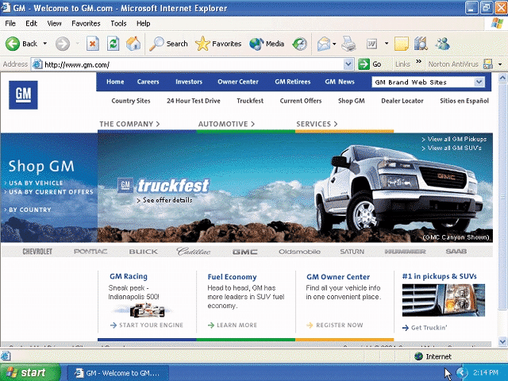
Business / Marketing Website
Contains content that promotes products or services
Allows you to purchase products or services online

Slide 36
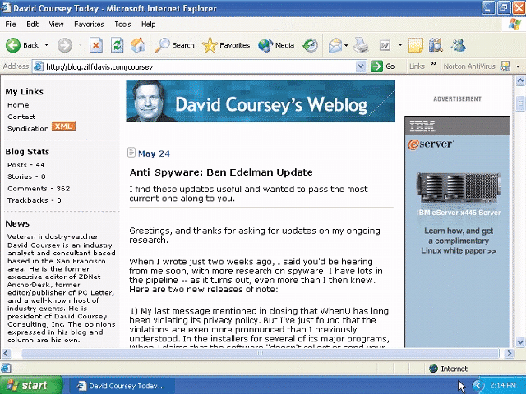
Blog
Uses a regularly updated journal format to reflect the interests, opinions, and personalities of the author and sometimes site visitors

Slide 37
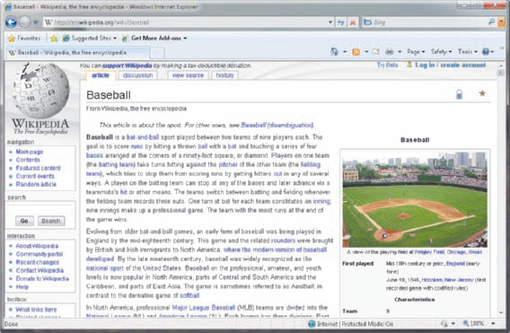
Wiki
A wiki is a collaborative Web site that allows users to create, add to, modify, or delete the Web site content via their Web browser.
37
Notes:
Insider Information
Plug and play was introduced by Apple Computers.

Slide 38
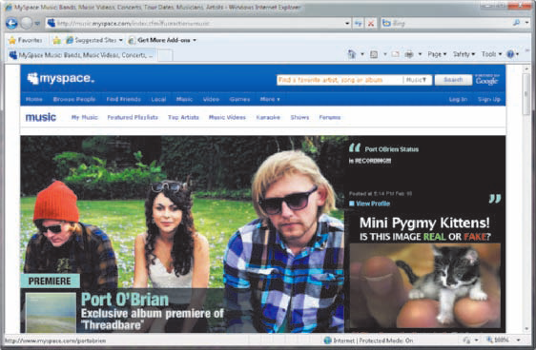
Online Social Network
A Web site that encourages members in its online community to share their interests, ideas, stories, photos, music, and videos with other registered users

Slide 39
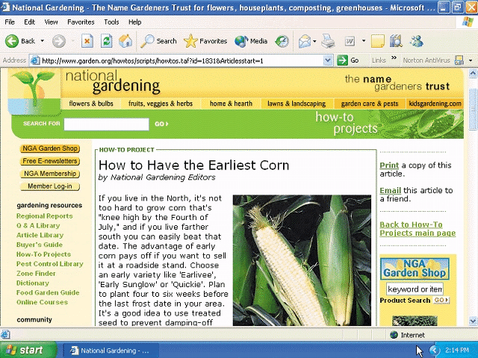
Educational Web Site
Offers avenues for formal and informal teaching and learning
  Some companies
  offer online training
  for employees
  Some colleges offer
  online classes and
  degrees

Slide 40
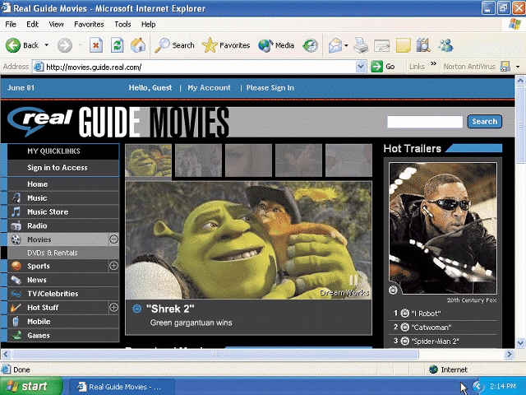
Entertainment Web site
Offers an interactive and engaging environment featuring music, video, sports, games, and more

Slide 41
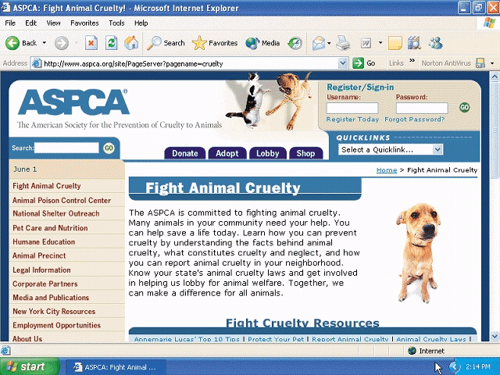
Advocacy Web Site
Contains content that describes a cause, opinion, or idea

Slide 42
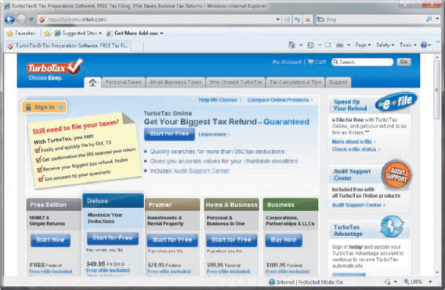
Web Application
A Web application, or Web app, is a Web site that allows users to access and interact with software through a Web browser on any computer or device that is connected to the Internet.

Slide 43
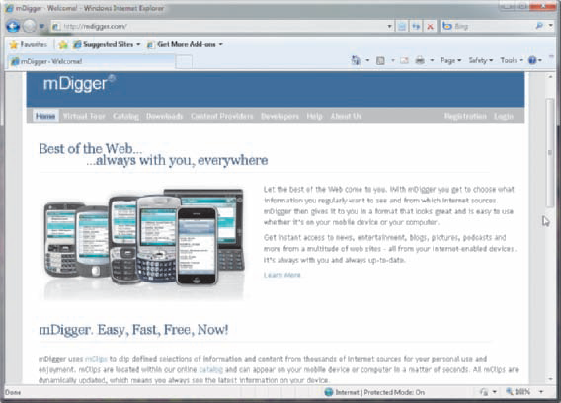
Content Aggregator
A business that gathers and organizes Web content and then distributes, or feeds, the content to subscribers for free or a fee
RSS 2.0 and Atom

Slide 44
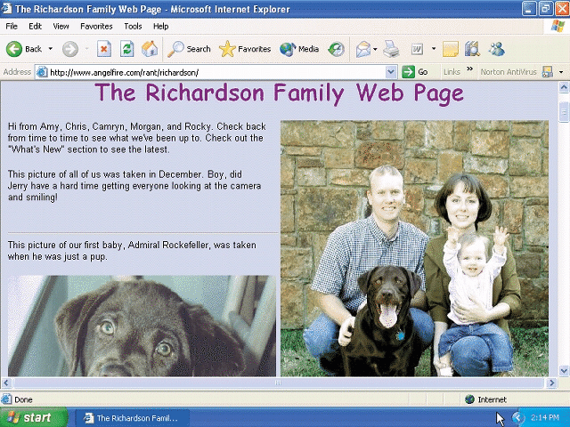
Personal Website
Web page maintained by private individual
Reasons: sharing life experience with the world
or job hunting

Slide 45
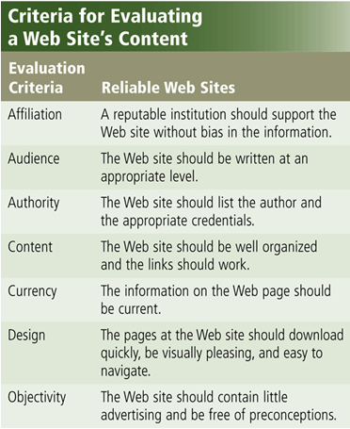
Evaluating a Web Site Content
Information presented on the Web must be evaluated for accuracy
No one oversees the content of Web pages

Slide 46
Summary
Browser and the WWW
Searching the Web
  Search Engine
  Subject Directory
Types of Websites
  Portal, News, Information
  Business / Marketing, Blog, Wiki
  Online Social, Educational, Entertainment
  Advocacy, Web Application, Content Aggregator
  Personal Website
Criteria for Evaluating Web site
46

