Slide 1
CSC 101
Introduction to Computing
Lecture 21
Dr. Iftikhar Azim Niaz
ianiaz@comsats.edu.pk
1

Slide 2
Last Lecture Summary I
Network Media
  Twisted Pair
  Coaxial Cable
  Fiber-optics
  Wireless Transmission Media
Network Linking Devices
  Network Interface Cards
  Hubs, Switches
  Bridge, Routers, Gateways
2

Slide 3
Last Lecture Summary II
Network Communication Standards
  Ethernet
  Token ring
  TCP/IP
  Wi-Fi, Blue tooth, WiMAX
  IrDA, RFID, WAP
Communications Over Telephone Lines
  Modem, Dialup, ISDN
  DSL, ADSL, Cable Modem
  T lines, ATM
3

Slide 4
Objectives Overview
Discuss the history and evolution of the Internet
Identify and briefly describe various broadband Internet connections and state differences between broadband Internet connections and dial-up connections
Describe the types of Internet access providers
Describe the purpose of an IP address and its relationship to a domain name
Explain the purpose of a Web browser and identify the components of a Web address
4

Slide 5
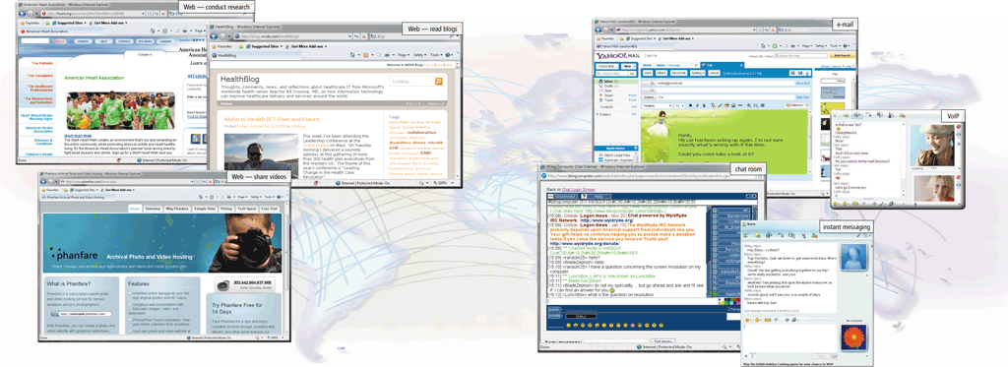
The Internet
The Internet or Net is a worldwide collection of networks that links millions of businesses, government agencies, educational institutions, and individuals

Slide 6
The Internet
Simply put, the Internet is a network of networks— a global communications system that links together thousands of individual networks.
As a result, virtually any computer on any network can communicate with any other computer on any other network.
These connections allow users to exchange messages, to communicate in real time (seeing messages and responses immediately), to share data and programs, and to access limitless stores of information.

Slide 7
Evolution of the Internet
The Internet originated as ARPANET in September 1969 and had two main goals:
Allow scientists at different physical locations to share information and work together
Function even if part of the network were disabled or destroyed by a disaster

Slide 8
The Internet’s History
1969 – ARPANET
  Developed by the Department of Defense
  Connected universities and defense bases
  At first 4 computers one each located at
    University of California at Los Angeles
    University of California at Santa Barbara
    Stanford Research Institute, and
    University of Utah
  Each of these computers served as a host on the network.
  A host, more commonly known today as a server, is any computer that provides services and connections to other computers on a network.
  Hosts often use high-speed communications to transfer data and messages over a network.

Slide 9
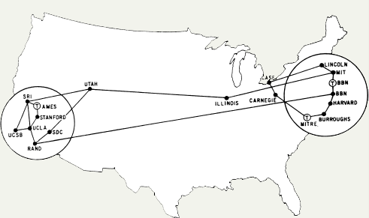
ARPANET 1973
1973 – ARPANET connects to Europe

Slide 10
Evolution of the Internet
1969 ARPANET becomes functional
1984 ARPANET has more than 1,000 individual computers linked as hosts
1986 NSF connects NSFnet to ARPANET and becomes known as the Internet
1995 NSFNet terminates its network on the Internet and resumes status as research network
Today More than 550 million hosts connect to the Internet
1996 Internet2 is founded

Slide 11
The Internet’s History
Mid-1980s – NSFNet
  Network between supercomputers
  Internet was the link to ARPANET
  No commercial traffic allowed
1990s
  ARPANET shut down
  NSFNet abandoned
  Commercial networks take over
  Interest in the Internet began to expand dramatically.
  The system that had been created as a tool for surviving a nuclear war found its way into businesses and homes
Notes:
Discussion point
Have students discuss the pros and cons of no central control for the Internet. Some discussion points can include copyright issues, free speech, advertisements and information access to all.

Slide 12
Today and the Future
Internet connects thousands of networks and hundreds of millions of users around the world
100,000 new web sites per month
More than 50% of U.S. households online
Access is available throughout the world
huge, cooperative community with no central ownership
Internet consists of many local, regional, national, and international networks.
Numerous corporations, commercial firms, and other companies such as IBM provide networks to handle Internet traffic.
Both public and private organizations own networks on the Internet

Slide 13
World Wide Web Consortium
Oversees research and sets standards and guidelines for many areas of the Internet
Mission of the W3C is to contribute to the growth of the Web
More than 350 organizations from around the world are members of the W3C, advising, defining standards, and addressing other issues
These organizations almost universally support the Internet’s openness and lack of centralized control.

Slide 14
Internet2
Connects more than 200 universities and 115 companies via a high-speed private network
Founded in 1996, the goal of Internet2 is to develop and test advanced network technologies that will benefit Internet users in the short-term future.
These technologies require an extremely high-speed network that exceeds the capabilities of today’s Internet and networks.
Examples of previous Internet2 projects that are now mainstream include telemedicine, digital libraries (online books, magazines, music, movies, speeches, etc.), and faster Internet services.
Current Internet2 projects include interactive high-definition video and enhanced detection and resolution of network problems.

Slide 15
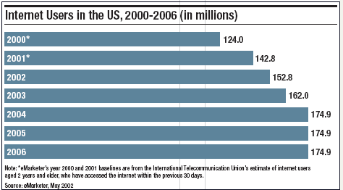
U.S. Internet Growth

Slide 16
Evolution of the Internet
Many home and small business users connect to the Internet via high-speed broadband Internet service
Cable Internet service
DSL
Fiber to the Premises (FTTP)
Fixed wireless
Cellular Radio Network
Wi-Fi
Satellite Internet Service

Slide 17
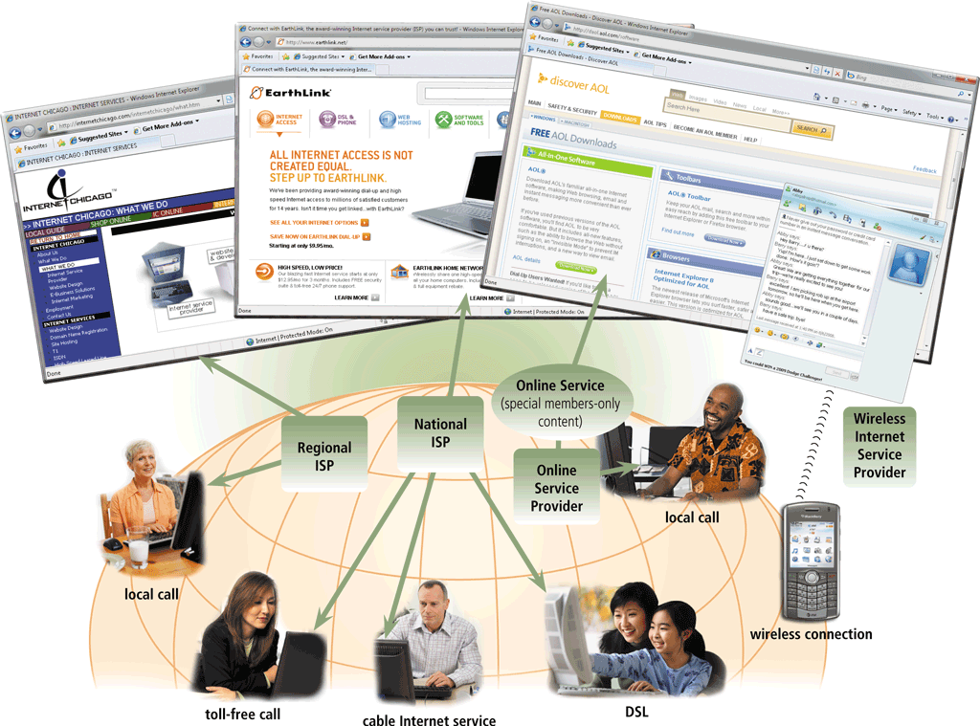
Evolution of the Internet
An access provider is a business that provides individuals and organizations access to the Internet free or for a fee

Slide 18
Evolution of the Internet
ISP (Internet service provider)
Online service provider (OSP)
Wireless Internet service provider (WISP)
Regional ISPs provide Internet access to a specific geographical area
National ISPs provide Internet access in cities and towns nationwide
Has many members-only features
Popular OSPs include AOL (America Online) and MSN (Microsoft Network)
Provides wireless Internet access to computers and mobile devices
May require a wireless modem

Slide 19
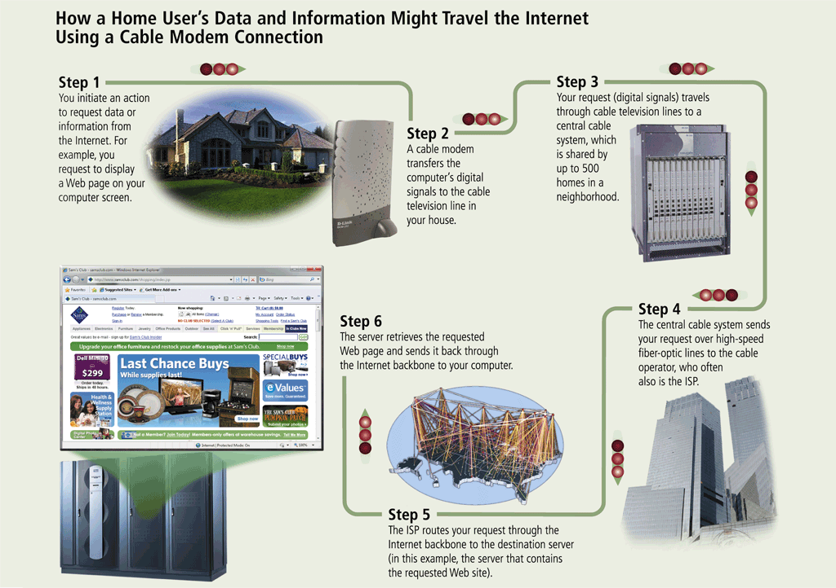
Evolution of the Internet

Slide 20
The Internet’s Major Services
The World Wide Web (WWW)
  Developed in 1993 by Tim-Berners Lee
  Allowed connection of documents
  Required a browser to read documents
Electronic mail (e-mail)
  Instantaneous transmission of documents
News
  Often called newsgroups
  Electronic discussions on several topics
File Transfer Protocol (FTP)
  Sends and receives files

Slide 21
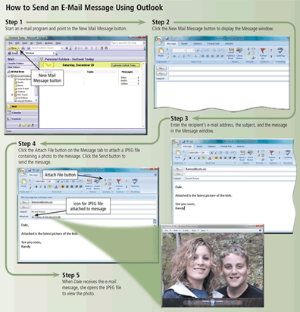
Other Internet Services
E-mail is the transmission of messages and files via a computer network
An e-mail program allows you to create, send, receive, forward, store, print, and delete e-mail messages

Slide 22
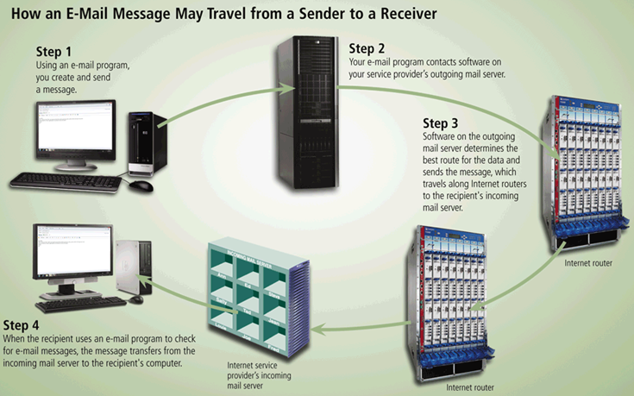
Other Internet Services

Slide 23
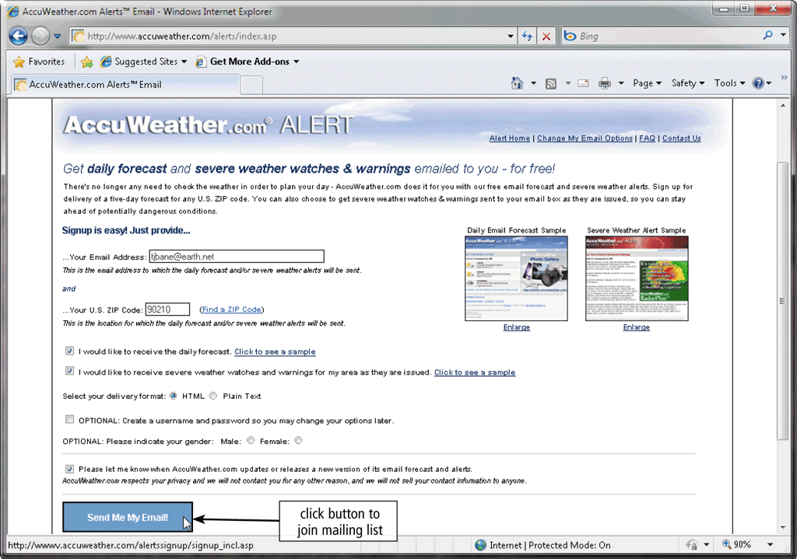
Other Internet Services
A mailing list is a group of e-mail names and addresses given a single name
  Subscribing adds your e-mail name and address
  Unsubscribing removes your name

Slide 24
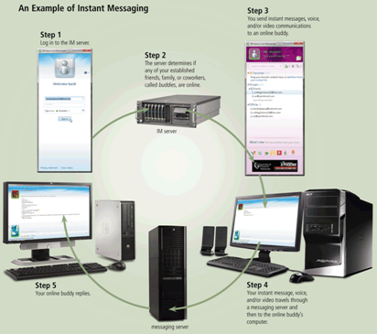
Other Internet Services
Instant messaging (IM) is a real-time Internet communications service

Slide 25
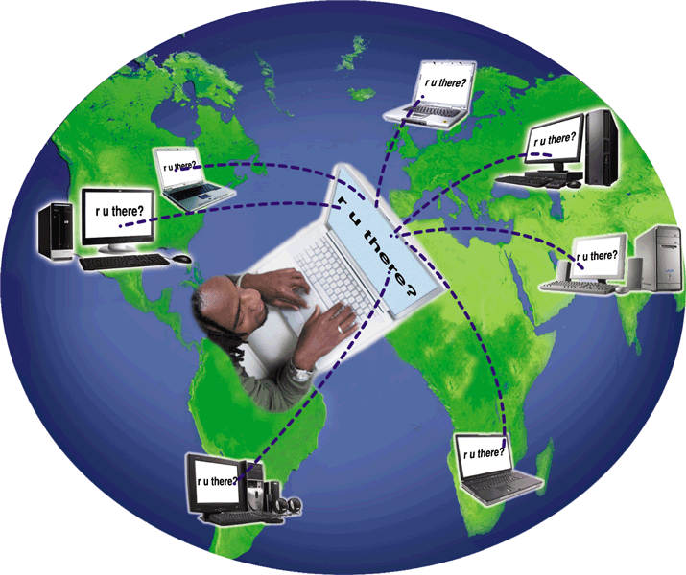
Other Internet Services
A chat is a real-time typed conversation that takes place on a computer
A chat room is a location on an Internet server that permits users to chat with each other

Slide 26
The Internet’s Major Services
Chat
  Public real time conversation
Instant messaging
  Private real time conversation
Peer-to-peer services
  Allows sharing of files among users
  Napster and Kazaa are examples
  Illegal to share copyrighted material
Notes:
Discussion point
Recently the pop artist Madonna posted several copies of her songs on Kazaa and other file sharing services. Instead of music, she talked at length about copyright infringement through music sharing. In retaliation, hackers hit her website and temporarily made her songs free to purchase. Who is right?

Slide 27
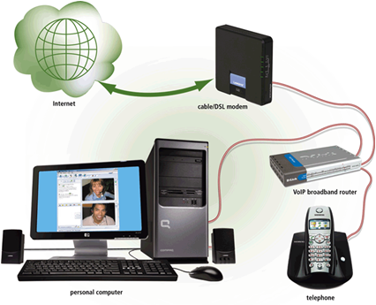
Other Internet Services
VoIP (Voice over IP) enables users to speak to other users over the Internet
  Also called Internet telephony

Slide 28
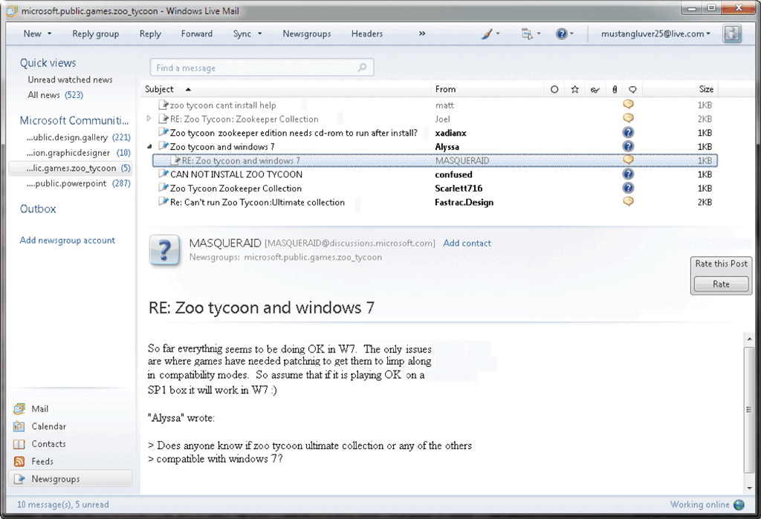
Other Internet Services
A newsgroup is an online area in which users have written discussions about a particular subject
  Typically requires a newsreader
A message board is a Web-based type of discussion group

Slide 29
Other Internet Services
FTP (File Transfer Protocol) is an Internet standard that permits file uploading and downloading with other computers on the Internet
Many operating systems include FTP capabilities
An FTP server is a computer that allows users to upload and/or download files using FTP

Slide 30
Understanding the Internet
The Internet allows accessing resources
Many people believe that the Web and the Internet are the same thing, but this is not correct. In fact, they are two different things
Web is a service (a system for accessing documents) that is supported by the Internet (a gigantic network).
The Web simplifies the Internet
The Web connects documents
  Hypertext creates links between documents
  Documents are stored on a web server
  HTTP delivers documents
Notes:
Teaching tip
Find out who has a web presence. If the site is appropriate, display it in class. Have the student discuss what is needed to establish and maintain a web presence.

Slide 31
Understanding the Internet
Web site is a collection of documents
  Document is a web page
  Pages are published to the web
Hypertext Markup Language (HTML)
  Creates web pages
  Describes how pages should look
  Content enclosed in tags
  <tag>content</tag>
Notes:
Teaching tip
Show your students how to access the HTML of an appropriate web site.

Slide 32
Understanding The Internet
Browsers
  a software application designed to find hypertext documents on the Web and then open the documents on the user’s computer
  Read and translate the HTML
  Display web content
Uniform Resource Locator (URL)
  Address of a web page
Notes:
Teaching Tip
Dissect the URL provided.

Slide 33

Evolution of the Internet
An IP address is a number that uniquely identifies each computer or device connected to the Internet
A domain name is the text version of an IP address
  Top-level domain (TLD)
A DNS server translates the domain name into its associated IP address

Slide 34
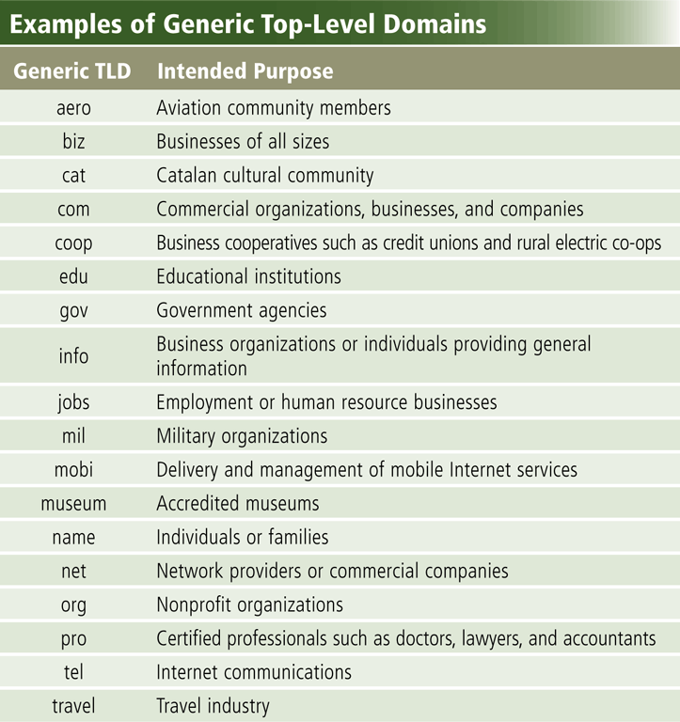
World Wide Web

Slide 35
The World Wide Web
The World Wide Web, or Web, consists of a worldwide collection of electronic documents (Web pages)
A Web site is a collection of related Web pages and associated items
A Web server is a computer that delivers requested Web pages to your computer
Web 2.0 refers to Web sites that provide a means for users to interact

Slide 36
The World Wide Web
A Web browser, or browser, allows users to access Web pages and Web 2.0 programs
Internet Explorer
Firefox
Opera
Safari
Google Chrome

Slide 37
Understanding The Internet
Helper applications
  Plug-ins
  Enhance a browser’s functionality
Streaming audio and video
  Sends the file in small chunks
  Chunks downloaded while others play
Notes:
Teaching point
Direct the students to several different streaming video sites. Www.launch.com and www.apple.com/QuickTime are two excellent examples. Be sure your classroom browsers have the appropriate plug-ins.

Slide 38
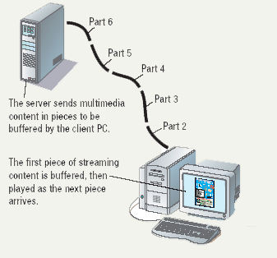
Streaming Audio

Slide 39
Using a Browser And The WWW
Browser starts on the home page
Navigating the web
  Enter a URL in the browser
  Click a link
  Links are typically blue underlined words
  Image maps are picture links
When finished, close the browser

Slide 40
Summary
What is Internet
History and evolution of Internet
WWW Consortium
Internet 2
WWW Services
40

