Slide 1
CSC 101
Introduction to Computing
Lecture 20
Dr. Iftikhar Azim Niaz
ianiaz@comsats.edu.pk
1

Slide 2
Last Lecture Summary I
Computer Communications and Network
Uses of Computer Networks
  Internet
  E-mail
  Instant Messaging, SMS, MMS
  Newsgroup, RSS
  Tele, Audio, Video and Data Conferencing
  VoIP
  Hot Spot, CyberCafe
  GPS
  Groupware, Voice Mail, Web Services
2

Slide 3
Last Lecture Summary II
Types of Networks
  LAN
  WAN
  MAN
  Client Server
  Peer-to-Peer
Network Topologies
  Bus
  Star
  Ring
  Mesh
3

Slide 4
Objectives Overview
Explain the purpose of communications software
Describe various types of lines for communications over the telephone network
Describe various physical and wireless transmission media
Describe commonly used communications devices
Discuss different ways to set up a home network

Slide 5
Network Media
Media refers to the means used to link a network's nodes together
communications channel is the transmission media on which data, instructions, or information travel in a communications system.
Choice impacts
  Speed
  Security
  Size

Slide 6
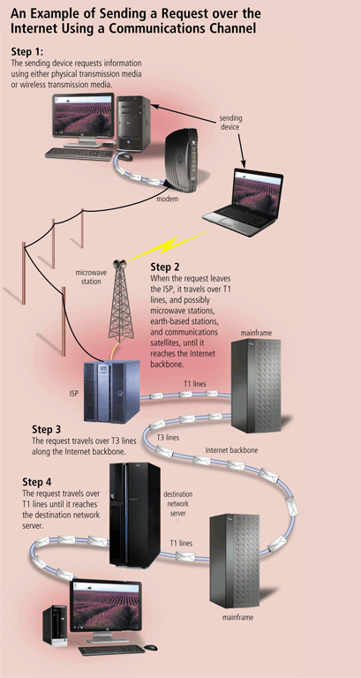
Communication Channel
The amount of data that can travel over a communications channel sometimes is called the bandwidth
Latency is the time it takes a signal to travel from one location to another on a network
Transmission media are materials capable of carrying one or more signals
Broadband media transmit multiple signals simultaneously

Slide 7
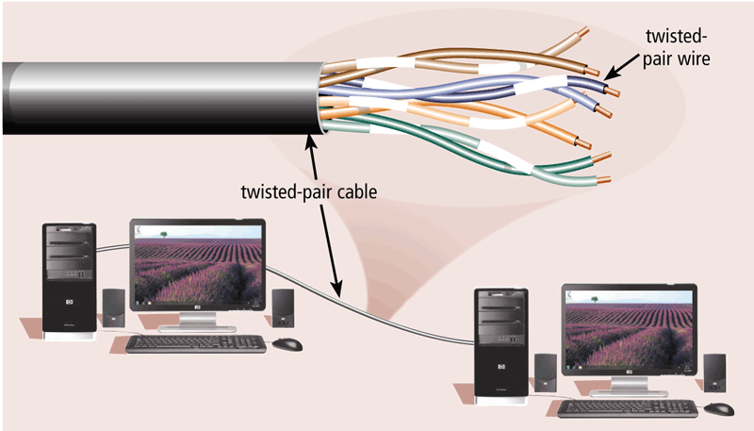
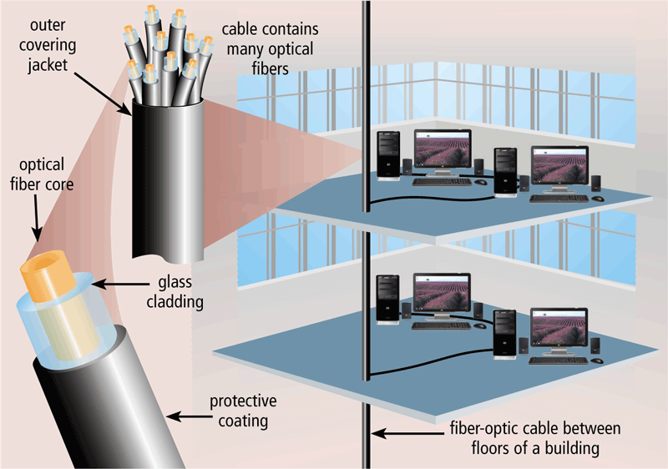
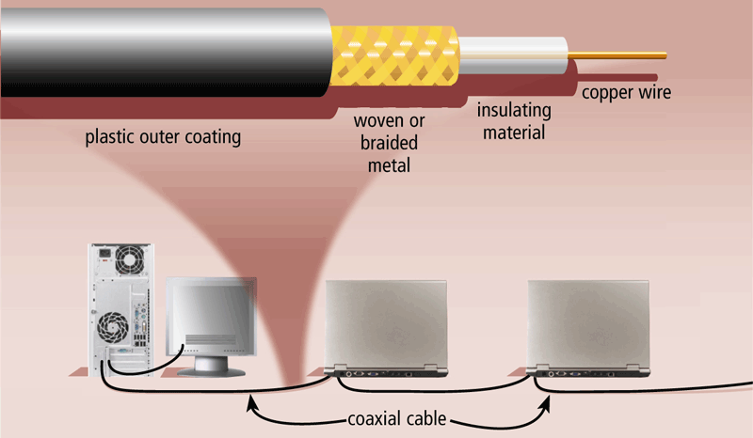
Physical Transmission Media
Twisted-pair cable
Fiber-optic cable
Coaxial cable

Slide 8
Physical Transmission Media
Twisted Pair is used for telephone systems and network cabling
Coaxial cable is often used for cable television wiring
Fiber optic cable is capable of carrying significantly more data at faster speeds than wire cables.
Less susceptible of interference (noise) and therefore more secure
Smaller size (thinner and lighter)

Slide 9
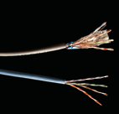
Twisted Pair Cable
Most common LAN cable
Called Cat5 or 100BaseT
Four pairs of copper cable twisted
May be shielded from interference
Speeds range from
1 Mbps to 1,000 Mbps
Notes:
Insider information
Interference is usually electrical. Magnets, solar flares or electronic devices generate interference.

Slide 10
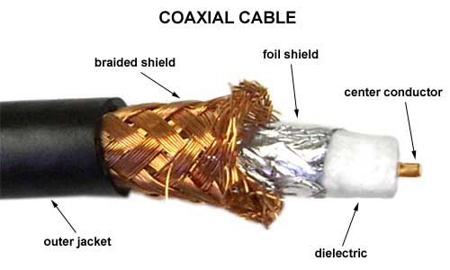
Coaxial Cable
Similar to cable TV wire
One wire runs through cable
Shielded from interference
Speeds up to 10 Mbps

Slide 11
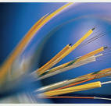
Fiber-optic Cable
Data is transmitted with light pulses
Glass strand instead of cable
Immune to interference
Very secure
Hard to work with
Speeds up to
100 Gbps
Notes:
Teaching tip
Remind students that bps is bits per second. Gbps then is billion bits per second.

Slide 12
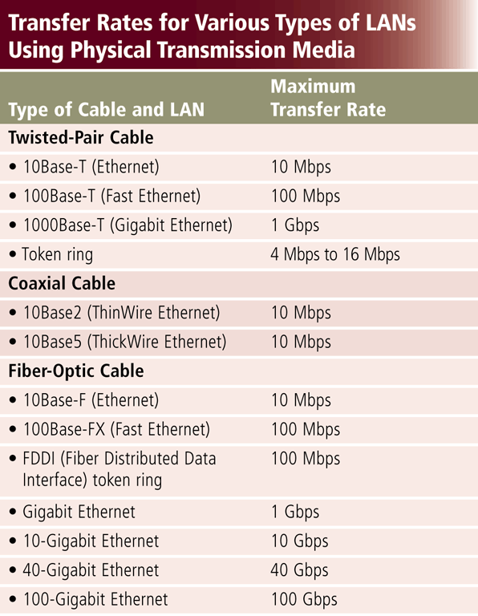
Physical Transmission Media
Wire, cable,
and other tangible materials used
to send communications signals

Slide 13
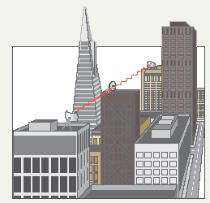
Wireless Media
Data transmitted through the air
LANs use radio waves
WANs use microwave signals
Easy to setup
Difficult to secure
Notes:
Teaching tip
Now is the time to briefly discuss 802.11 standards. A full discussion of 802.11 is covered in the next section.

Slide 14
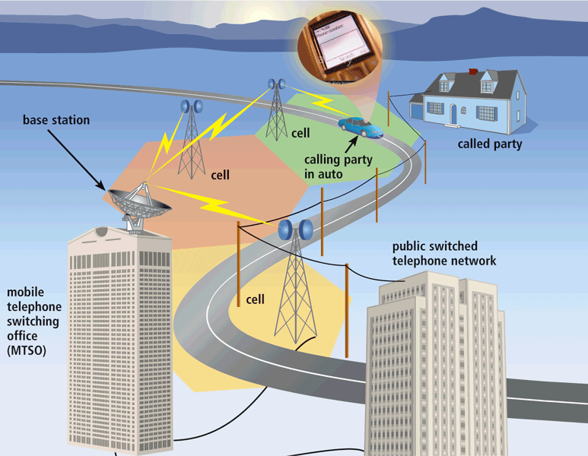
Wireless Transmission Media
Broadcast Radio distributes radio signals over long and short distances
Cellular radio is a form of broadcast radio that is used widely for mobile communications

Slide 15
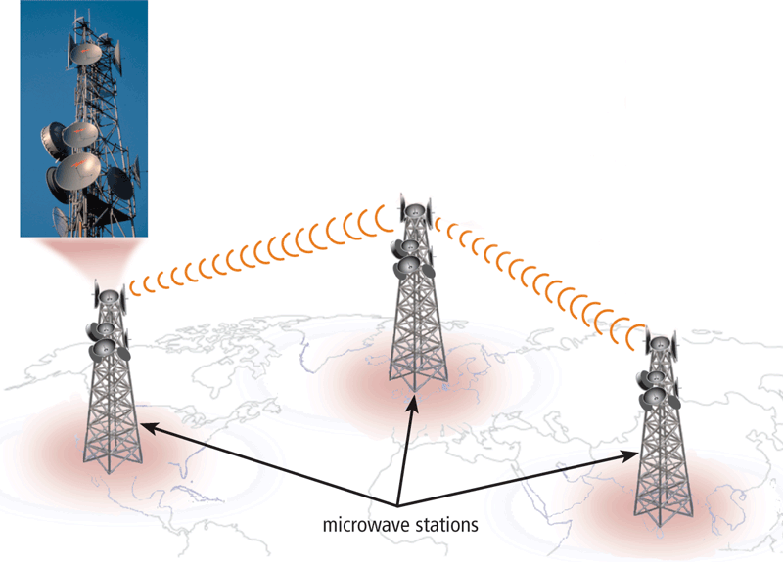
Wireless Transmission Media
Microwaves are radio waves that provide a high-speed signal transmission
A microwave station is an earth-based reflective disk used for microwave communications.
  It must transmit in straight line with no obstructions

Slide 16
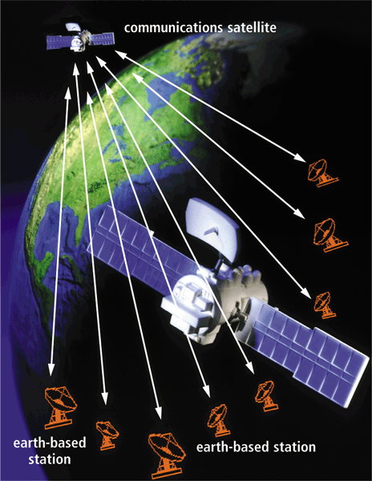
Wireless Transmission Media
A communications satellite is a space station that receives microwave signals from an earth-based station, amplifies it, and broadcasts the signal over a wide area

Slide 17
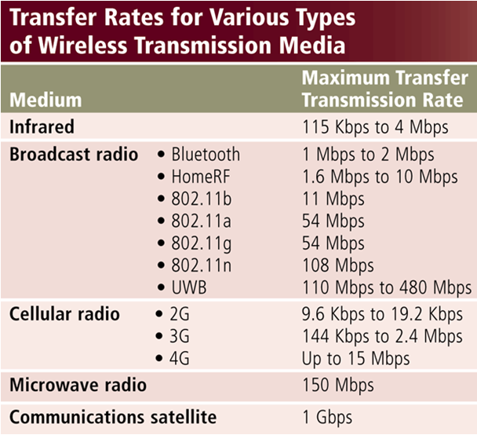
WirelessTransmission Media
Used when inconvenient, impractical, or impossible to install cables
Includes Bluetooth and IrDA

Slide 18
Network Linking Devices
Connect nodes in the network
Cable runs from node to device
Crossover cable connects two computers

Slide 19

Network Interface Cards
Network adapter
Connects node to the media
Unique Machine Access Code (MAC)
Notes:
Insider Information
The Xerox Corporation controls the assignment of Ethernet addresses to NIC manufacturers.

Slide 20
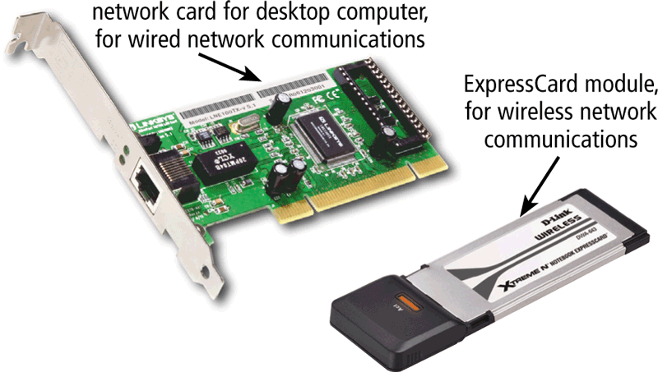
Communication Devices
A network card (NIC) enables a computer or device to access a network
Available in a variety of styles
Wireless network cards often have an antenna

Slide 21
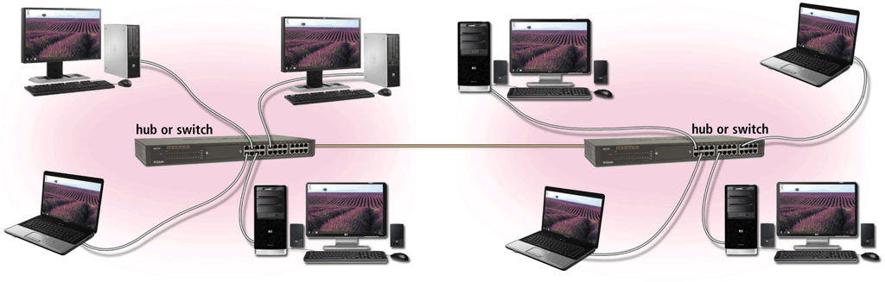
Communication Devices
A hub or switch connects several devices in a network together
Device that provides central point for cables in network

Slide 22
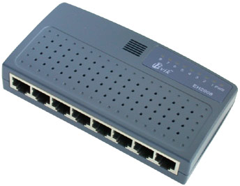
Hubs
Center of a star network
All nodes receive transmitted packets
Slow and insecure

Slide 23
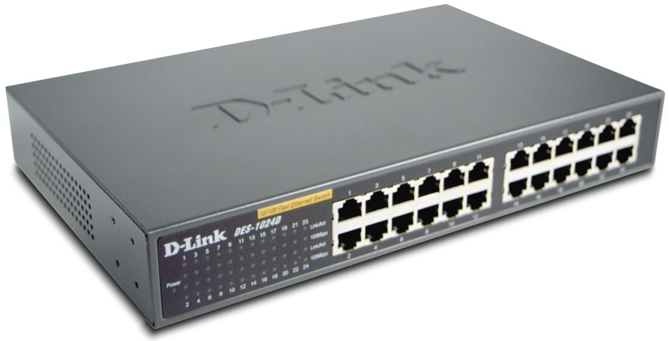
Switches
Replacement for hubs
Only intended node receives transmission
Fast and secure
Notes:
Insider information
Twisted pair networks cannot achieve higher than 10 Mbps using a hub. Switches are necessary to achieve 100 Mbps or higher.

Slide 24
Bridge
Connects two or more LANs together
Packets sent to remote LAN cross
  Other packets do not cross
Segments the network on MAC addresses

Slide 25

Router
Connects two or more LANs together
Packets sent to remote LAN cross
Network is segmented by IP address
Connect internal networks to the Internet
Need configured before installation
Notes:
Discussion point
Ask who in the class has high speed Internet. Then determine if anyone is sharing this to the rest of the house or dorm. If they are, see if they can describe the setup. Most likely, the sharing is done with a router.

Slide 26
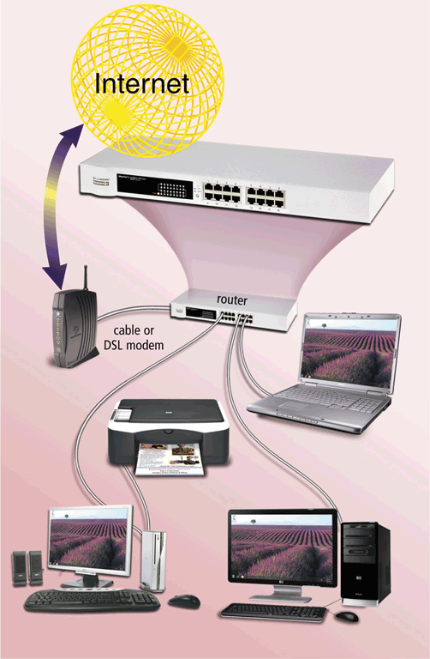
Communication Devices
A router connects multiple computers or other routers together and transmits data to its correct destination on a network
Routers forward data on Internet using fastest available path
Many are protected by a hardware firewall

Slide 27
Gateway
Connects two dissimilar networks
Connects coax to twisted pair
Most gateways contained in other devices

Slide 28
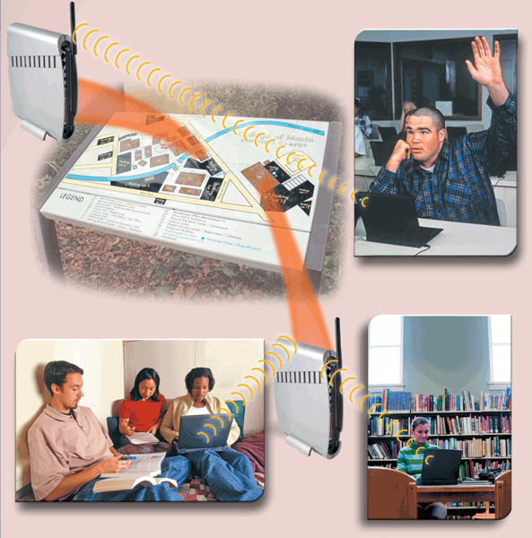
Communication Devices
A wireless access point is a central communications device that allows computers and devices to transfer data wirelessly among themselves or to a wired network

Slide 29
Network Cabling
Cabling specifications
  Bandwidth measures cable speed
    Typically measured in Mbps
  Maximum cable length
  Connector describes the type of plug

Slide 30
Network Protocols
Language of the network
  Rules of communication
  Error resolution
  Defines collision and collision recovery
  Size of packet
  Naming rules for computers

Slide 31
Network Communication Standards
Ethernet
Token ring
TCP/IP
Wi-Fi
Bluetooth
UWB
IrDA
RFID
WiMAX
WAP

Slide 32
Network Communication Standards
Ethernet is a network standard that specifies no computer controls when data can be transmitted
The token ring standard specifies that computers and devices on the network share or pass a special signal (token)
TCP/IP is a network standard that defines how messages are routed from one end of a network to another

Slide 33

Ethernet
Very popular cabling technology
10 Base T, 10Base2, 10Base5
Maximum bandwidth 10 Mbps
Maximum distances100 to 500 meters

Slide 34
Fast Ethernet
Newer version of Ethernet
Bandwidth is 100 Mbps
Uses Cat5 or greater cable
  Sometimes called 100Base T
Requires a switch
Notes:
Teaching tip
Point out that the speed of the cable is the number before the word Base.

Slide 35
Gigabit Ethernet
High bandwidth version of Ethernet
1 to 10 Gbps
Cat 5 or fiber optic cable
Video applications

Slide 36
Token Ring
Uses shielded twisted pair cabling
Bandwidth between 10 and 25 Mbps
Uses a multiple access unit (MAU)
Nodes communicate when they have the token
Popular in manufacturing and finance

Slide 37
IPX/SPX
Internet Packet Exchange/Sequenced Packet Exchange
Older protocol
Associated with Novell Netware
Replaced by TCP/IP

Slide 38
NetBEUI
Network BIOS Extended User Interface
Used by Windows to name computers
Transmission details handled by TCP/IP
Notes:
Discussion Point
Have students tell you what BIOS stands for.

Slide 39
TCP/IP
Transmission Control Protocol/Internet Protocol
Most popular protocol
Machines assigned a name of 4 numbers
  IP address
  209.8.166.179 is the White House’s web site
Dynamic Host Configuration Protocol
  Simplifies assignment of IP addresses
Required for Internet access
Notes:
Teaching tip
Have students determine IP addresses for the computer. On 2000/XP enter ipconfig /all. Windows 98 and back enter winipcfg.

Slide 40
Communication Software
Communication software consists of programs that
  Help user establish a connection to Internet, other network and another computer
  Help users manage the transmission of data, instructions and information
  Provide an interface for users to communicate with one another

Slide 41
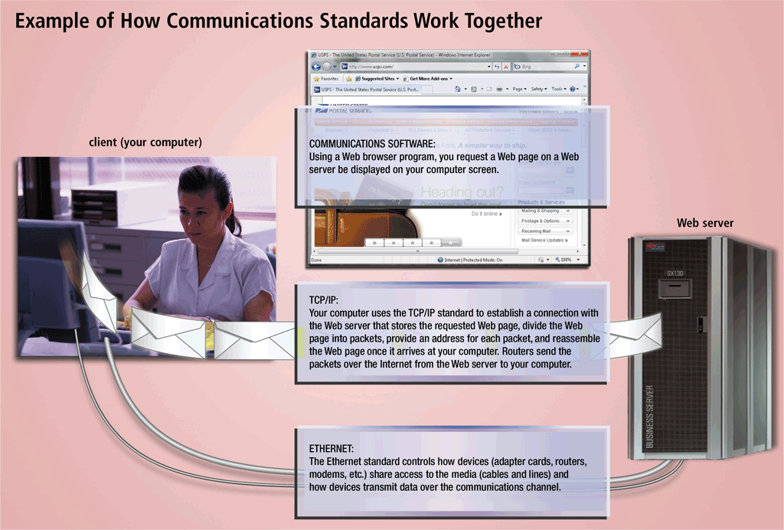
Network Communication Standards

Slide 42
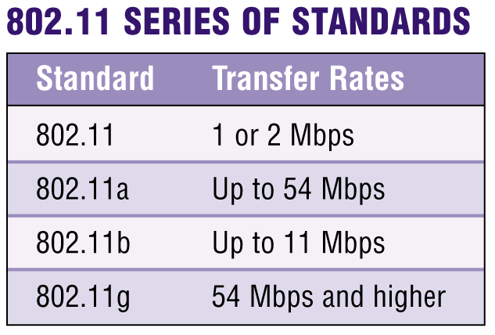
Network Communications Standards
What are TCP/IP and 802.11?
  TCP/IP (Transmission Control Protocol/Internet Protocol) technology transmits data by breaking it up into small pieces, or packets
    Commonly used for Internet transmissions
  802.11 is family of standards for wireless LANs

Slide 43
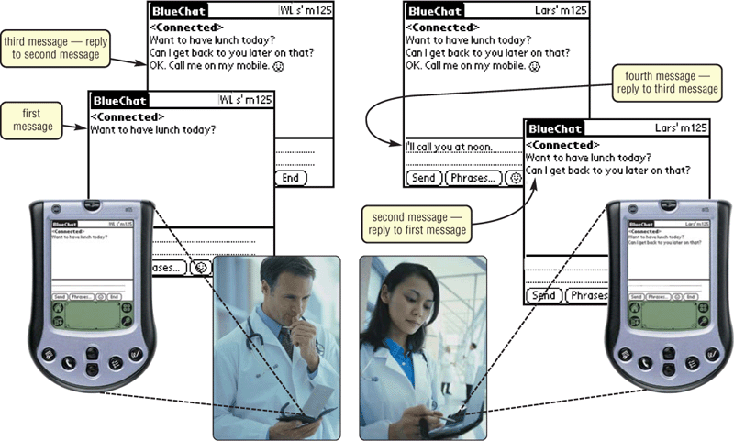
Network Communications Standards
What is Bluetooth?
  Short-range radio waves transmit
  data
  between
  Bluetooth
  devices

Slide 44
Network Communications Standards
What are IrDA, RFID, and Wireless Applications Protocol (WAP)?
Radio Frequency
Identification (RFID)
uses radio signals to communicate
with a tag placed in an object
IrDA
specification allows
data to be transferred
wirelessly via infrared
light waves
Wireless Applications
Protocol (WAP)
allow wireless mobile devices
to access Internet

Slide 45
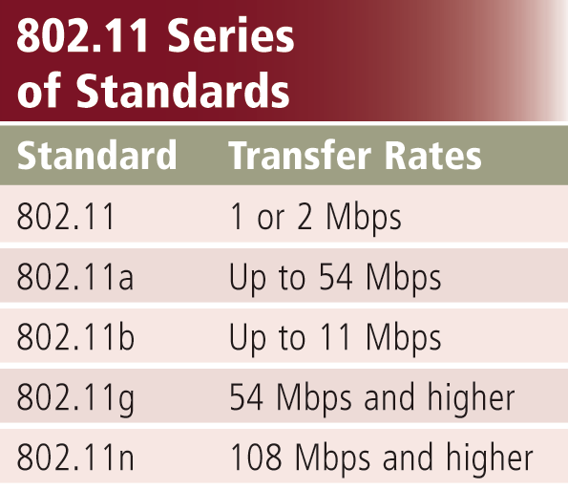
Network Communication Standards
Wi-Fi identifies any network based on the 802.11 standard that facilitates wireless communication
Sometimes referred to as wireless Ethernet

Slide 46
Network Communication Standards
Bluetooth defines how two Bluetooth devices use short-range radio waves to transmit data
UWB (ultra-wideband) specifies how two UWB devices use short-range radio waves to communicate at high speeds
IrDA transmits data wirelessly via infrared (IR) light waves
RFID uses radio signals to communicate with a tag placed in or attached to an object, animal, or person

Slide 47
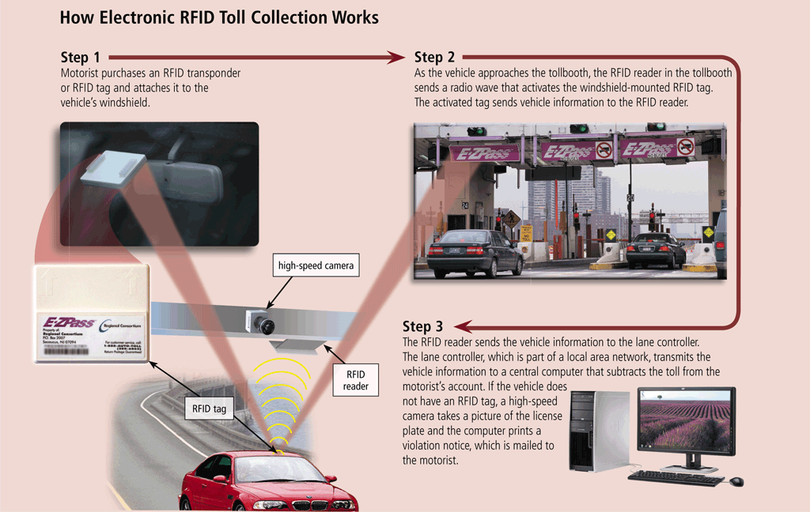
Network Communication Standards

Slide 48
Network Communication Standards
WiMAX (802.16)
Developed by IEEE
Towers can cover a 30-mile radius
Two types are fixed wireless and mobile wireless
Provides wireless broadband Internet access
Wireless Application Protocol (WAP)
Specifies how some mobile devices can display the content of Internet services
Web
E-mail
Chat rooms
Uses a client/server network

Slide 49
Communication Over the Telephone Lines
Dial-up lines
Dedicated line
ISDN line
DSL
FTTP
T-carrier line
ATM

Slide 50
Plain Old Telephone System (POTS)
Standard phone line
Two-way voice communication
Uses analog transmission techniques
Data communication is slow
Notes:
Insider Information
The actual name used by phone technicians is Public Switched Telephone Network (PSTN). Mention POTS to the wrong technician and you will get an earful!

Slide 51
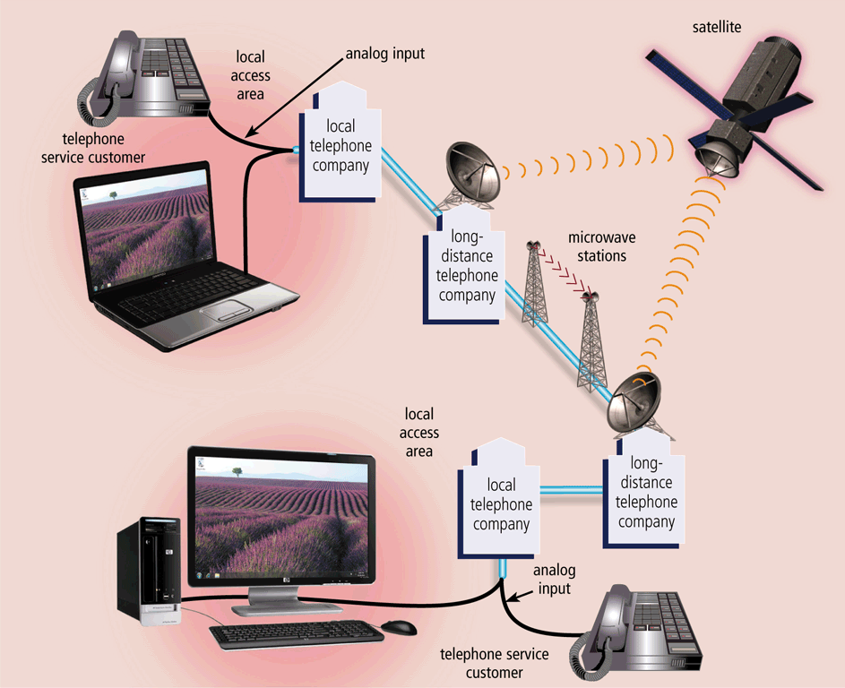
Communication Over the Telephone Lines
The public switched telephone network (PSTN) is the worldwide telephone system that handles voice-oriented telephone calls

Slide 52
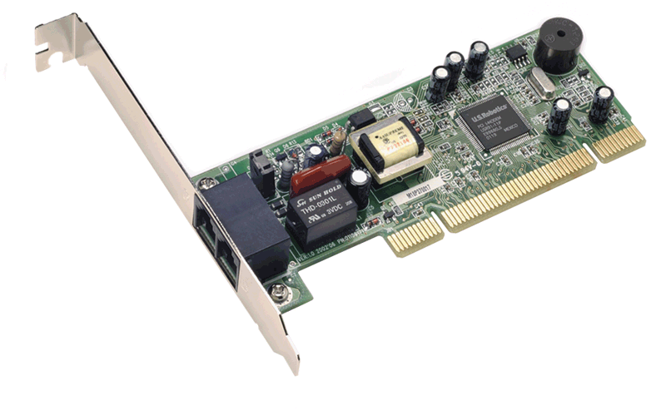
Communication Devices
A communications device is any type of hardware capable of transmitting data, instructions, and information between a sending device and a receiving device
A dial-up modem converts signals between analog and digital
Notebook computers often use PC Card modem

Slide 53
Modem
Modulator/Demodulator
  Modulator converts digital to analog
Speed measured in bits per second (bps)
  Current fastest speed is 56 Kbps
  Quality of phone lines dictates speed
V.92 is the current modem standard
Several modem types
  Internal
  External
  Voice
  Fax
Notes:
Insider information
The Federal Communications Commission (FCC) limits modem speed over an analog line to 53Kbps.
Teaching tip
Determine what your local ISPs support. If your ISPs do not support V.92, suggest to your students to purchase a V.90 modem. They will likely save $10 on the purchase and see no performance difference.

Slide 54

Modem Uses
Connection to the Internet
File transfer
  Uploading
  Downloading
Notes:
Teaching tip
Draw a diagram showing the Internet ‘above’ the client computer to illustrate where the names come from.

Slide 55
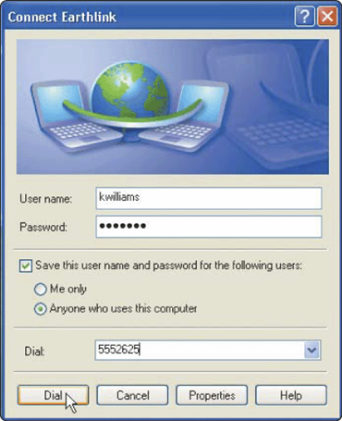
Communication Over the Telephone Lines
Dial-up line is a temporary connection using telephone lines for communications
  Costs no more than making regular call
  Computers at any two locations can establish a connection using modems and telephone network

Slide 56
Digital Data Connections
Digital phone lines
  Local telephone companies are upgrading
  Service will faster and more reliable
  New phones will be needed
  Modems will need to be upgraded

Slide 57
Digital Data Connections
ISDN lines
  Integrated Services Digital Network
  Basic rate uses three channels
    Two data channels each support 64 Kbps
    Error correction channel
  Primary rate uses 24 data channels

Slide 58
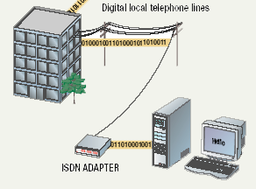
ISDN Connection

Slide 59
Digital Data Connections
Cable modem connections
  Popular with home and office users
  Speeds between 1 and 3 Mbps
  Requires a cable modem

Slide 60
Communication Devices
A digital modem sends and receives data and information to and from a digital line
A DSL Modem is an external device in which one end connects to a telephone line and the other end connects to a port on the system unit
DSL modem
Cable modem

Slide 61
Digital Data Connections
Broadband connection
  Any data connection faster than 56 Kbps
  Common in business
  Becoming popular in home installations

Slide 62
Digital Data Connections
T lines
  High-capacity voice/data lines
  Used to control phone and data
  Several variants
  T1 transmits at 1.544 Mbps
  T3 transmits at 44.736 Mbps
Notes:
Teaching tip
More information on T lines can be found at ckp.made-it.com/t1234.html.

Slide 63
Digital Data Connections
DSL technologies
  Digital Subscriber Line
  Popular with home users
  Speeds range from 100 Kbps to 30 Mbps
  Asymmetrical DSL (ADSL)
    Upload speed slower than download speed
  Symmetrical DSL (SDSL)
  Requires a DSL modem
Notes:
Teaching tip
The website www.dslreports.com provides unbiased information regarding DSL providers.

Slide 64
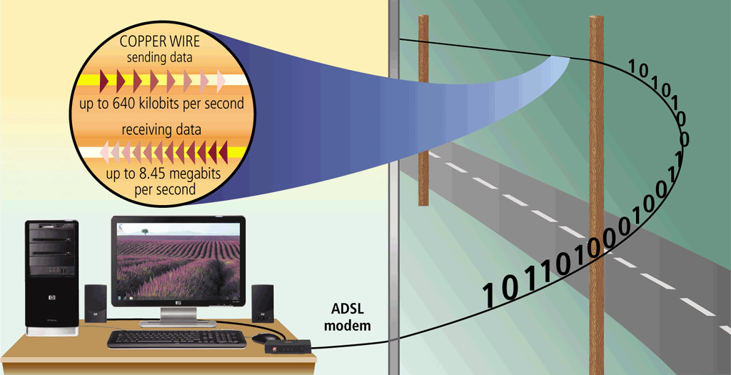
Communication Over the Telephone Lines
ADSL connections transmit data downstream at a much faster rate than upstream

Slide 65
Digital Data Connections
ATM
  Asynchronous Transfer Mode
  Efficient transfer of video and sound
  Requires a special NIC and hardware

Slide 66
Wireless Networks
Benefits
  No cable to pull
  Mobile devices access network resources
  Mobility and flexibility for office workers
Notes:
Discussion point
Wireless networks have drawbacks. Direct your students to discover some of these drawbacks including security, speed and complexity.

Slide 67
Wireless Networks
Wireless 802.11
  Also called Wi-Fi
  IEEE standard
    Institute of Electronic and Electrical Engineers
  Several versions
    802.11b connects up to 11Mbps
    802.11g connects up to 56Mbps
  Use the same type of devices

Slide 68

Wireless Networks
Wireless Access Point
  Center of a wireless network
  WAPS combined cover a larger area
  Distance to WAP determines bandwidth
  Range is 50 to 150 meters
  Extension points can extend range

Slide 69
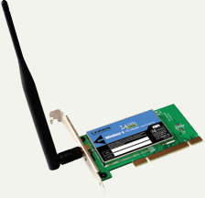
Wireless Networks
Wireless Adapters
  Used by devices to connect
  Includes signal strength software
Notes:
Teaching tip
Spend a little time here describing a home solution to share a broadband connection using a wireless solution. Describe products, security concerns and WAP placement.

Slide 70
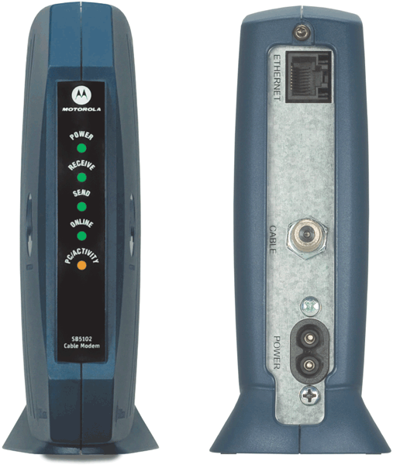
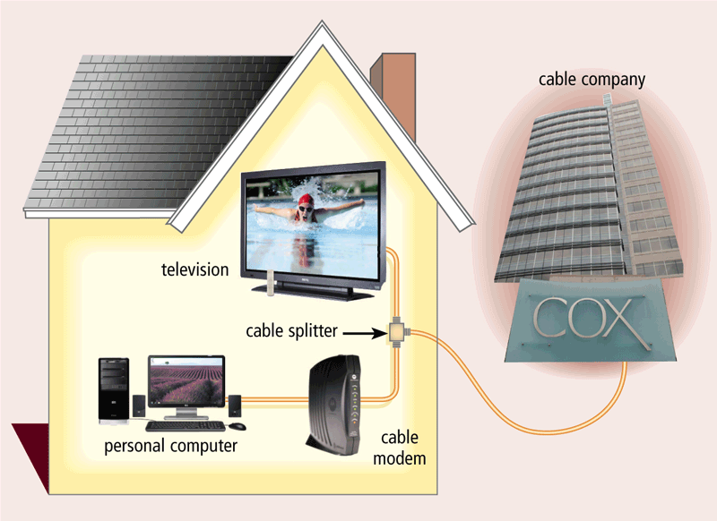
Communication Devices
Cable Modem
  Sends and receives data over cable television network
  Much faster than dial-up modem or ISDN
  Sometimes called a broadband modem

Slide 71
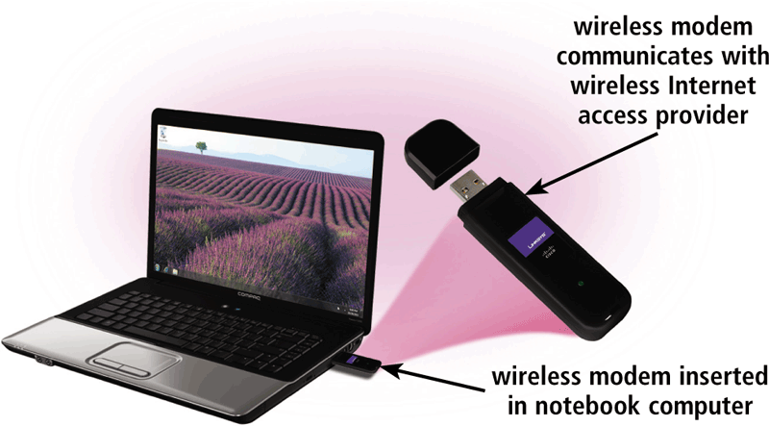
Communication Devices
A wireless modem uses the cell phone network to connect to the Internet wirelessly from a notebook computer, a smart phone, or other mobile device
Typically use the same waves used by cellular telephones

Slide 72
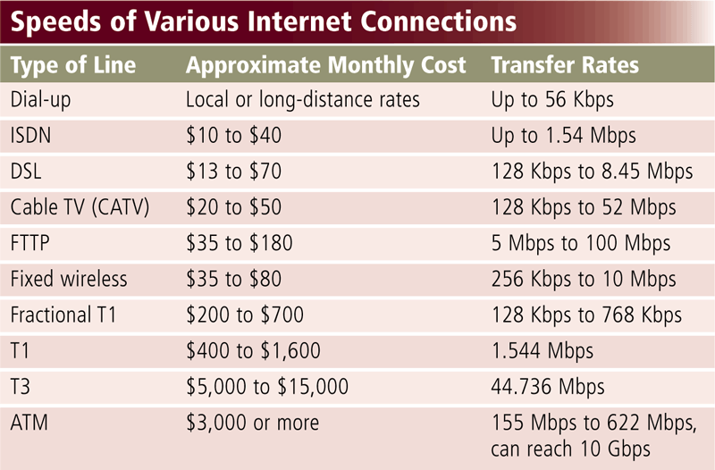
Communication Over the Telephone Lines

Slide 73
Home Networks
Home networks provide computers with the following capabilities:
Connect to the Internet at the same time
Share a single high-speed Internet connection
Access files and programs on other computers
Share peripherals
Play multiplayer games
Connect game consoles to the Internet
Subscribe to and use VoIP

Slide 74
Home Networks
Type of Wired home Network
Ethernet
  Connect computers via cable
Powerline
  Use electrical lines in house
Phoneline
  Use telephone lines
HomeRF (Radio Frequency)
  wireless
Ethernet
Powerline cable
Phoneline
Home RF

Slide 75
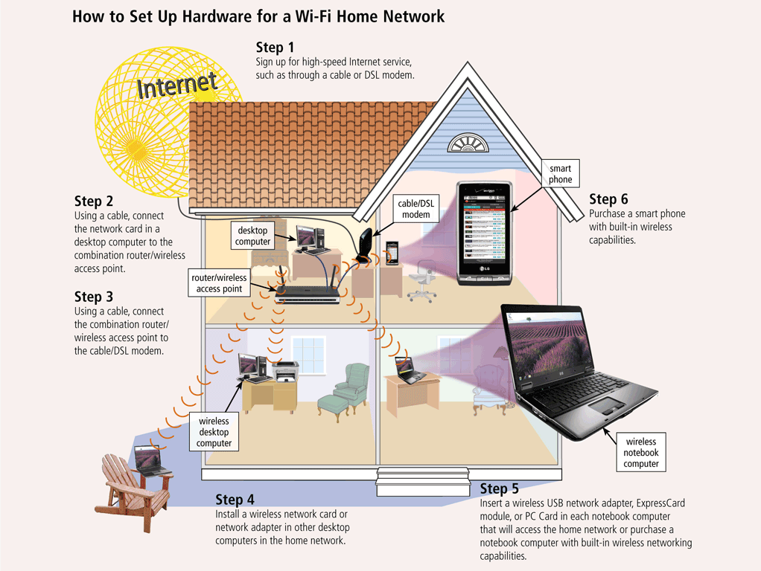
Home Networks

Slide 76
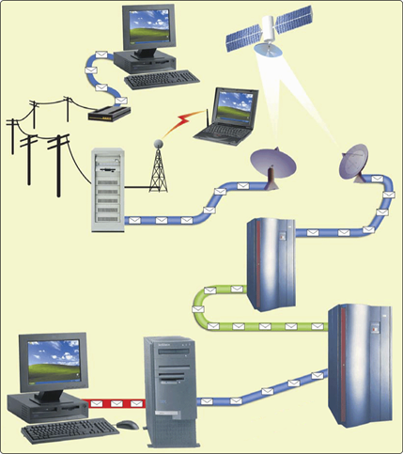
Communications Channel
How is a request sent over the Internet using a communications channel?
Step 1. The sending device requests information using either
a physical transmission media
or a wireless transmission media.
Step 2. When the request leaves
the ISP, it travels over T1 lines, microwave stations, earth-based stations, and communications satellites until it reaches the Internet backbone.
Step 3. The request travels over T3 lines along the Internet backbone.
Step 4. The Request travels over T1 lines until it reaches the destination network server.

Slide 77
Summary
Network Media
  Twisted Pair
  Coaxial Cable
  Fiber-optics
  Wireless Transmission Media
Network Linking Devices
  Network Interface Cards
  Hubs, Switches
  Bridge, Routers, Gateways

Slide 78
Summary
Network Communication Standards
  Ethernet
  Token ring
  TCP/IP
  Wi-Fi, Blue tooth, WiMAX
  IrDA, RFID, WAP
Communications Over Telephone Lines
  Modem, Dialup, ISDN
  DSL, ADSL, Cable Modem
  T lines, ATM
78

