Slide 1
CSC 101
Introduction to Computing
Lecture 19
Dr. Iftikhar Azim Niaz
ianiaz@comsats.edu.pk
1

Slide 2
Last Lecture Summary I
Embedded Operating Systems
  Windows XP Embedded, Windows CE Embedded CE, Windows Mobile
  Pocket PC
  Palm OS
  iPhone OS / iOS
  BlackBerry OS
  Google Andriod
  Embedded Linux
  Symbian OS
2

Slide 3
Last Lecture Summary II
Managing files
Searching for files
Viewing images
Uninstalling programs
Cleaning up Disks
Defragmenting Disks
Backing up files and disks
Disk Compression
Intrusion detection
Screen savers
Antivirus
Removing spyware and adware
Filtering Internet content
Playing media files
Burning optical discs and
Maintaining a PC
3

Slide 4
Objectives Overview
Discuss the purpose of the components required for successful communications and identify various sending and receiving devices
Describe the uses of computer communications
Differentiate between client/server and peer-to-peer networks, and describe how a P2P network works
Differentiate among a star network, bus network, and ring network
List advantages of using a network, and differentiate among LANs, MANs, and WANs

Slide 5
Network Definition
Many organizations quickly learned the importance of connecting PCs
Data communications—the electronic transfer of information between computers—became a major focus of the computer industry.
Set of technologies that connects computers
Allows communication and collaboration between users
information they share can be much more than text documents
Internet is one big Example

Slide 6
Networks
A network is a collection of computers and devices connected together via communications devices and transmission media
Advantages of a network include:
Facilitating communications
Sharing hardware
Sharing data and information
Sharing software
Transferring funds

Slide 7
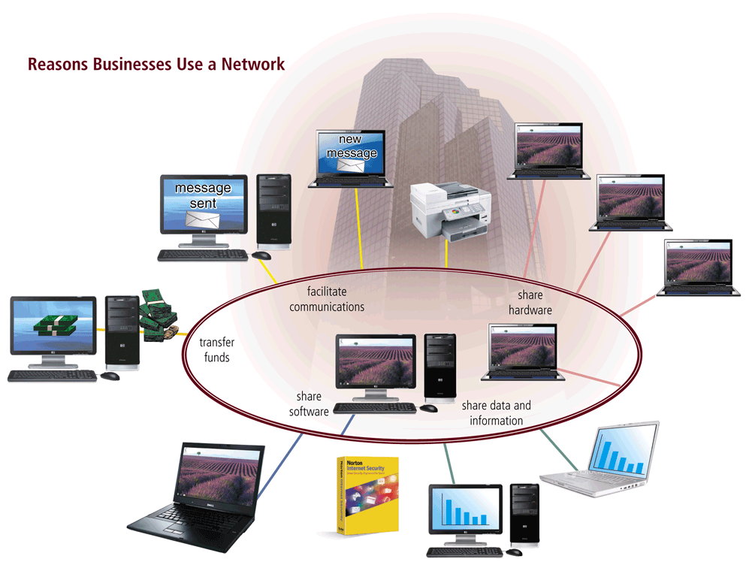
Network

Slide 8
Communications
Computer communications describes a process in which two or more computers or devices transfer data, instructions, and information
Sending
device — initiates instruction to
transmit data, instructions, or information
Communications
device — connects
the sending device to
the communications channel
Communications channel — media
on which data, instructions, or information travel
Communications
device — connects
the communications channel to the
receiving device
Receiving
device — accepts transmission of data, instructions, or information

Slide 9
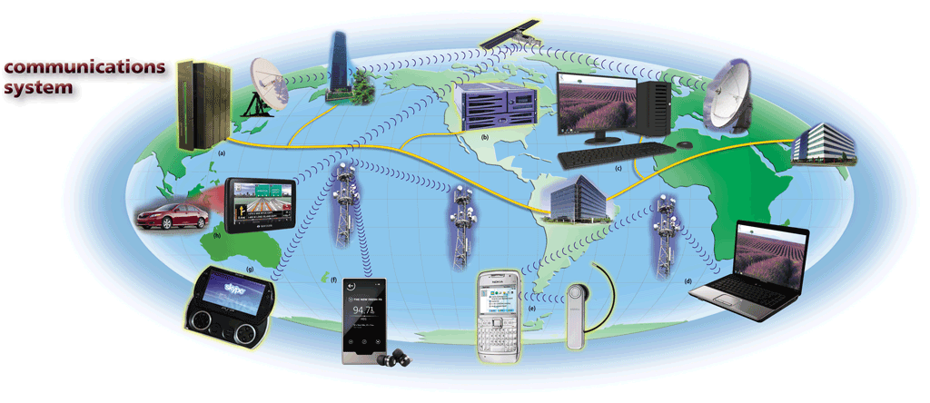
Communications Systems
(a) mainframe computers, (b) servers, (c) desktop computers, (d) notebook computers, (e) smart phones
(f) Internet-enabled portable media players
(g) handheld game consoles, and (h) GPS receivers

Slide 10
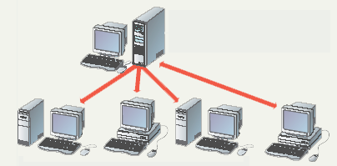
Uses of Commuter Communications
Simultaneous access to data
  Data files are shared
    Shared files stored on a server
    Access can be limited
  Software can be shared
    Site licenses Network versions Application servers
File server contains documents used by other computers.
Notes:
Teaching Tip
Figure 9A.2 on page 342 visually describes the sharing process. It can be helpful to have students open a shared file that you control. Make a change then have the students open it again. Alternatively, share a document and allow your students to write in it. Then demonstrate how the shared document changes.
Spend time discussing why application servers need to be so powerful.

Slide 11
Uses of Commuter Communications
Shared peripheral device
  Printers and faxes are common shares
  Reduces the cost per user
  Devices can be connected to the network
  Print servers control network printing
    Manage the print queue
Easier data backup
  Backup copies data to removable media
  Server data backed up in one step
Notes:
Teaching tip
Figure 9A.4 on page 344 shows a print queue. It can be helpful to demonstrate your classroom queue.

Slide 12
Uses of Computer Communications
Personal Communications
Blogs
Chat rooms
E-mail
Fax
FTP
Instant messaging
Internet
Newsgroups
RSS
Video conferencing
VoIP
Web
Web 2.0
Web folders
Wikis

Slide 13
Uses of Computer Communications
Text messaging (SMS) allows users to send and receive short text messages on a phone or other mobile device or computer
Picture messaging (MMS) allows users to send pictures and sound files
Video messaging allows users to send short video clips
Wireless instant messaging (IM) allows wireless users to exchange real-time messages with one or more other users

Slide 14
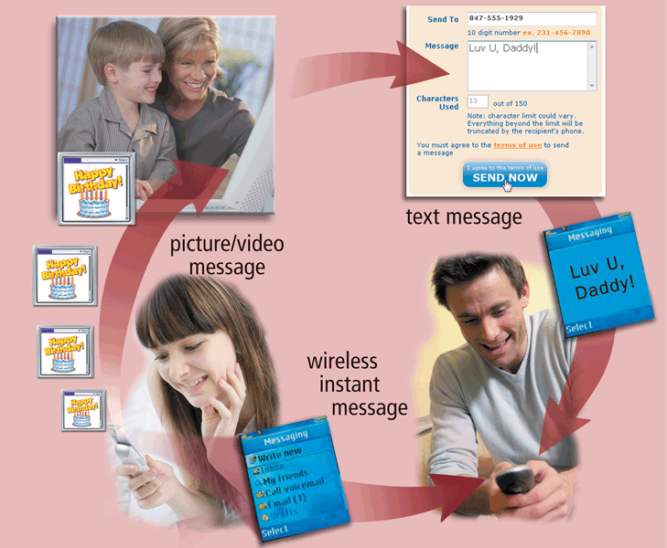
Uses of Computer Communications
Users can send and receive wireless messages using wireless messaging services

Slide 15
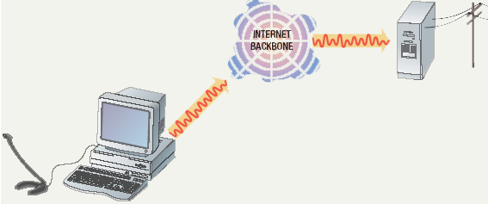
Uses of Commuter Communications
Personal communication
  Email
    Instantaneous communication
  Conferencing
    Tele conferencing
    Videoconferencing
    Audio-conferencing
    Data-conferencing
  Voice over IP
    Phone communication over network wires
    Pure VoIP
    VoIP to POTS (plain old telephone service
Notes:
Teaching tip
It is fun if you can setup a teleconference in your classroom. Students get to learn how to join or create the conference. Additionally, they learn how to participate. Finally, students have fun, especially with shared whiteboards.

Slide 16
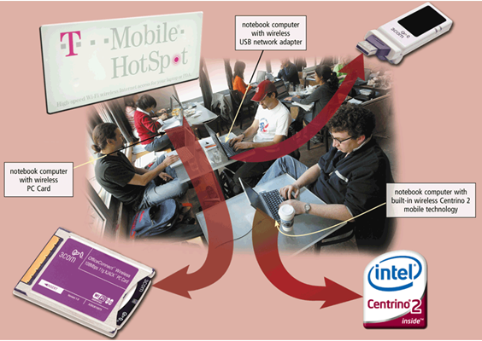
Uses of Computer Communications
Wireless Internet access points allow people to connect wirelessly to the Internet from home, work, school, and in many public locations using notebook computers, smart phones, handheld game consoles, or other devices
Hot Spot and
Mobile Wireless Networks

Slide 17
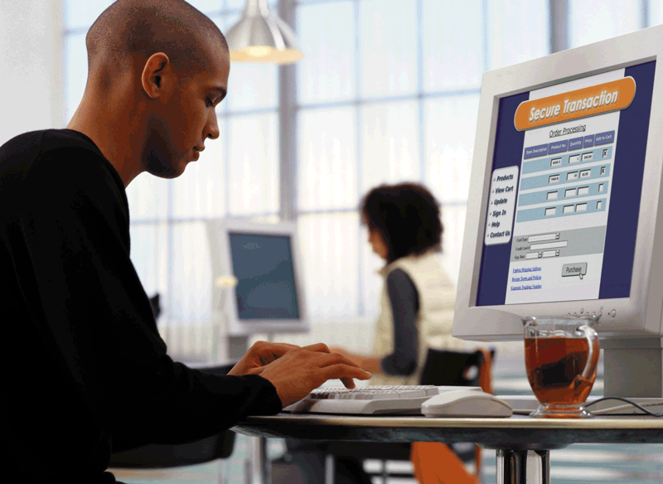
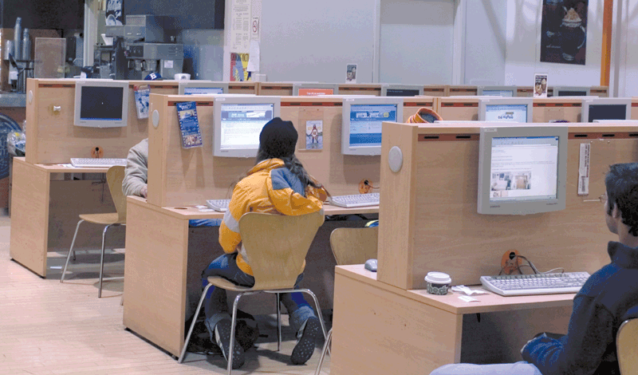
Uses of Computer Communications
A cybercafé is a coffeehouse, restaurant, or other location that provides personal computers with Internet access to its customers
Some are free and some take charges

Slide 18
Uses of Computer Communications
A Global Positioning System (GPS) is a navigation system that consists of one or more earth-based receivers that accept and analyze signals sent by satellites in order to determine the GPS receiver’s geographic location
GPS receivers are:
Built into many mobile devices
Available as a handheld device
Available with new vehicles

Slide 19
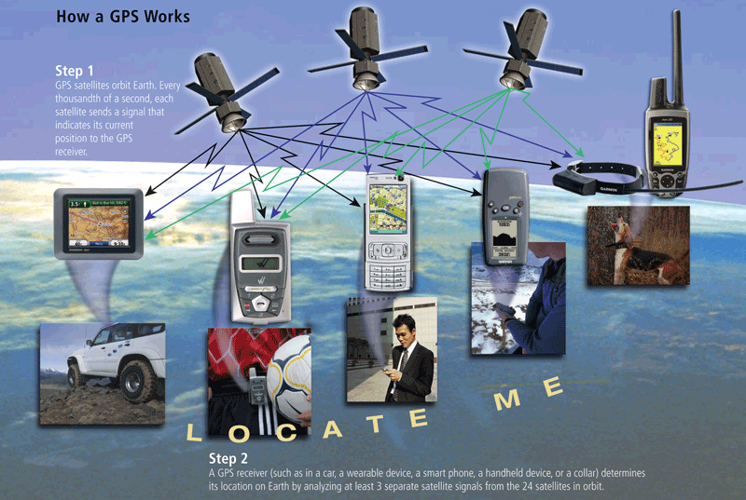
Uses of Computer Communications

Slide 20
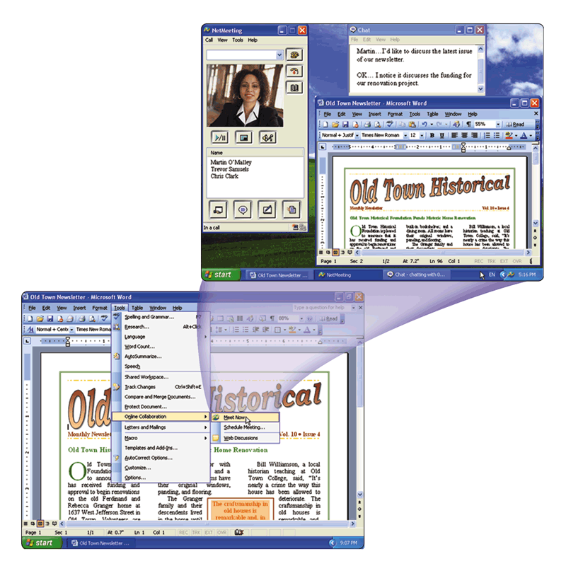
Uses of Computer Communications
Groupware
Helps groups of people work together on projects and share information over a network
Component of workgroup computing
Major feature is group scheduling
  in which a group calendar can track the schedules of multiple users and help coordinate appointments and meeting times

Slide 21
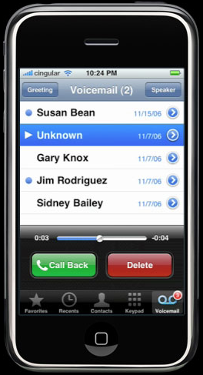
Uses of Computer Communications
Voice Mail
Allows someone to leave a voice message for one or more people
Computer in voice mail system converts an analog voice message into digital form
A voice mailbox is a storage location on a hard disk in the voice mail system

Slide 22
Uses of Computer Communications
Collaboration software includes tools that enable users to share documents via online meetings and communicate with other connected users
Online meetings
Web conferences
Document management systems

Slide 23
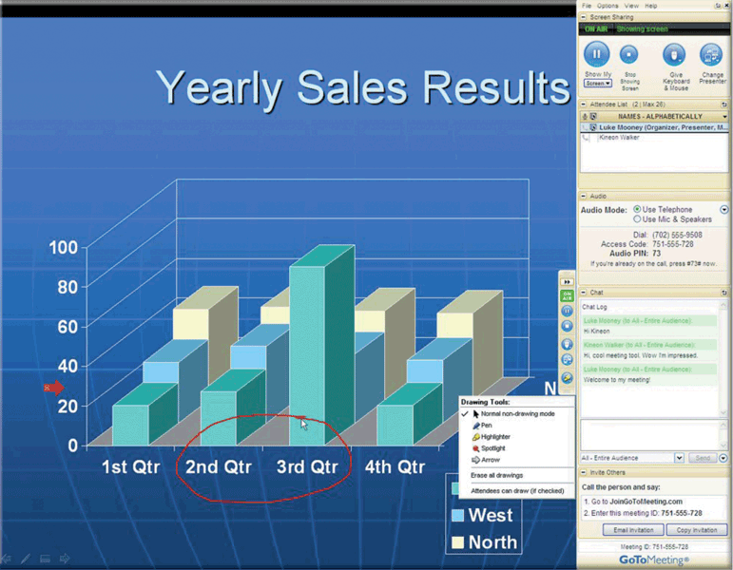
Uses of Computer Communications

Slide 24
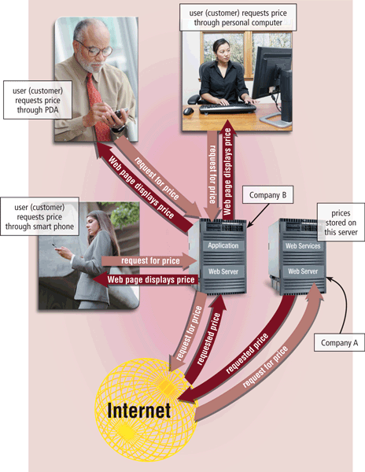
Uses of Computer Communications
Web services enable programmers to create applications that communicate with other remote computers over the Internet or on an internal business network
A mashup is a Web application that combines services from two or more sources

Slide 25
Common Network Types
Local Area Network (LAN)
Wide Area Network (WAN)
Metropolitan Area Network (MAN)
Home Area Network (HAN)
Campus Area Network (CAN)
Client-Server Network
Peer-to-Peer Network
Notes:
Teaching tip
Use a real world example to describe an organization with interconnected LANs.

Slide 26
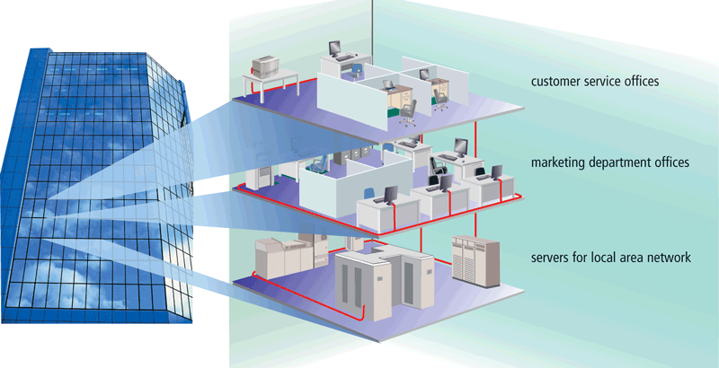
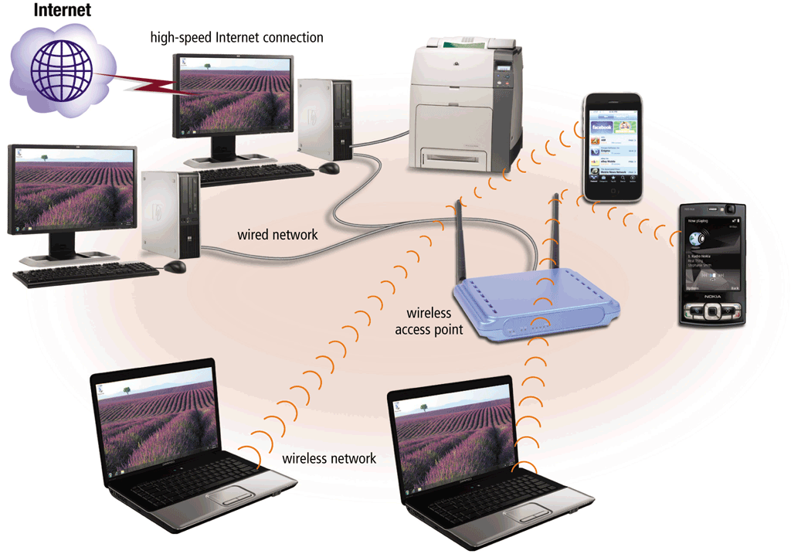
Network
A Local Area Network (LAN) is a network that connects computers and devices in a limited geographical area
A wireless LAN(WLAN) is a LAN that uses no physical wires

Slide 27
Local Area Network (LAN)
Each computer or device on the network is called a node
  nodes are connected via cables, infrared links, or wireless media
Contains printers, servers and computers
Systems are close to each other
Contained in one office or building
not a system that connects to the public environment (such as the Internet) using phone or data lines.
Organizations often have several LANS
Notes:
Teaching tip
Use a real world example to describe an organization with interconnected LANs.

Slide 28
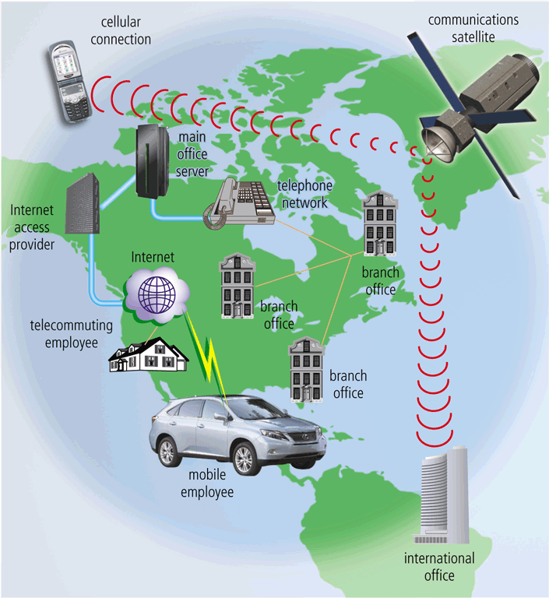
Network
A Wide Area Network (WAN)
is a network that covers a
large geographical area
  Two or more LANs connected
  Typically use public or leased lines
    Phone lines
    Cables
    Radio Waves
    Communication satellite
  The Internet is a WAN

Slide 29
Metropolitan Area Network (MAN)
A high-speed network that connects LANs in a metropolitan area such as a city or town and handles the bulk of communications activity across that region.
Typically includes one or more LANs, but covers a smaller geographic area than a WAN.
A MAN usually is managed by a consortium of users or by a single network provider that sells the service to the users.
Local and state governments, for example, regulate some MANs.
Telephone companies, cable television operators, and other organizations provide users with connections to the MAN

Slide 30
Home Area Network (HAN)
Small scale network
Found mainly in the home
Connects computers and entertainment appliances
  connects a person’s digital devices, from multiple computers and their peripheral devices, such as a printer to telephones, VCRs, DVDs, televisions, video games, home security systems, “ smart” appliances, fax machines, and other digital devices that are wired into the network

Slide 31
Campus Area Network (CAN)
Follows the same principles as a LAN only on a larger and more diversified scale
A LAN in one large geographic area
Resources related to the same organization
Each department shares the LAN
With a CAN, different campus offices and organizations can be linked together
Some university departments or organizations might be linked to the CAN even though they already have their own separate LANs.

Slide 32
Personal Area Network (PAN)
Very small scale network
Range is less than 2 meters
Cell phones, PDAs, MP3 players
PANs can be used for communication among the personal devices themselves (intrapersonal communication), or for connecting to a higher level network and the Internet (an uplink)
A PAN may also be carried over wired computer buses such as USB and FireWire
Notes:
Insider information
PAN is very new. Few devices support PAN. High end cell phones include Bluetooth technology. Once the technology matures, Bluetooth will allow the creation of a PAN.

Slide 33
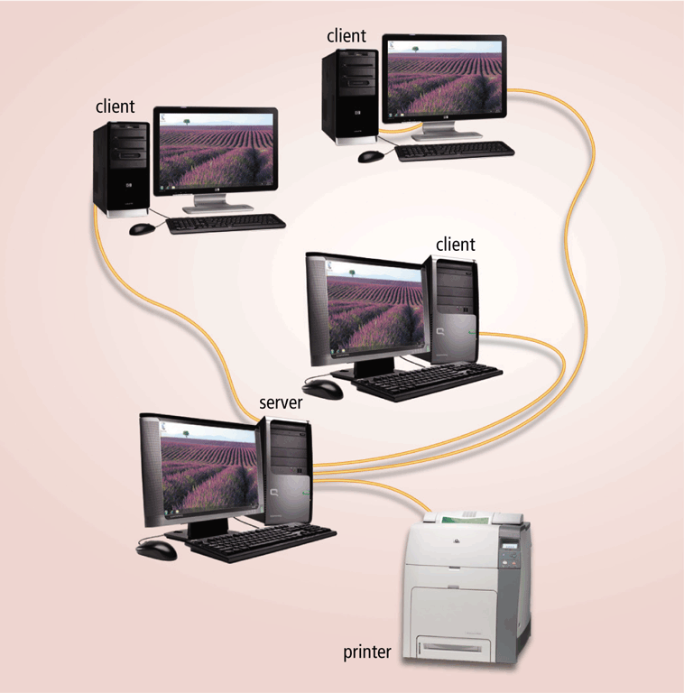
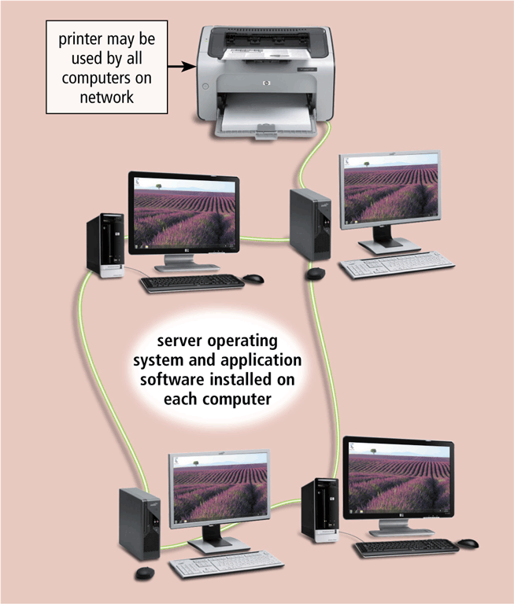
Network Architecture
The design of computers, devices, and media on a network is sometimes called the network architecture
In client/server network one or more computers act as server and others computers or clients access server for some services
Client/server network
Peer-to-peer network

Slide 34
Server Based Network
A node is a processing location that can be a PC or some other device such as a networked printer
Usually, server-based networks include many nodes and one or more servers
  server control nodes access to the network's resources
Users gain access by logging in
Server is the most important computer
Notes:
Teaching tip
Spend a few minutes here discussing password policies. Describe why it is important not to give out a password. Also describe why longer, more complicated passwords are important.

Slide 35
Client-Server Network
Nodes and servers share data roles
Nodes are called clients
Servers are used to control access
requires special software for the nodes and the server
Database software
  Access to data controlled by server
Server is the most important computer
Require a person to serve as a network administrator because of the large size of the network

Slide 36
Client-Server Network
Some servers, called dedicated servers, perform a specific task and can be placed with other dedicated servers to perform multiple tasks.
  For example, a file server stores and manages files.
  A print server manages printers and documents being printed.
  A database server stores and provides access to a database.
  A network server manages network traffic (activity).
  A Web server is a computer that delivers requested Web pages to your computer

Slide 37
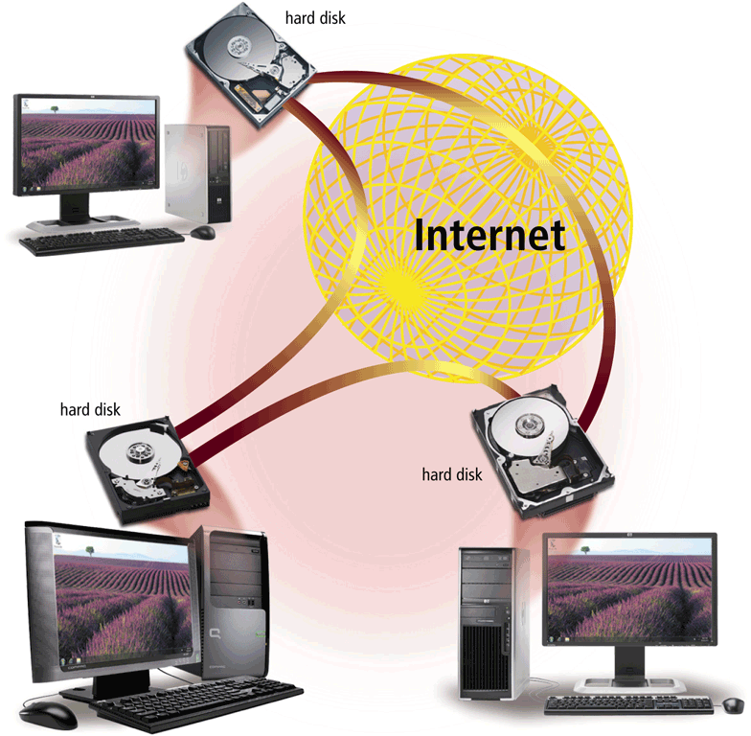
Network
P2P describes an Internet network on which users access each other’s hard disks and exchange files directly over the Internet
Each computer, or peer, has equal capabilities

Slide 38
Peer-to-Peer Network
All nodes are equal
Nodes access resources on other nodes
Each node controls its own resources
Most modern OS allow P2PN
Distributing computing is a form
Kazaa, Bit Torrent,
Notes:
Teaching tip
Discuss how users managing their own security settings can be bad.

Slide 39
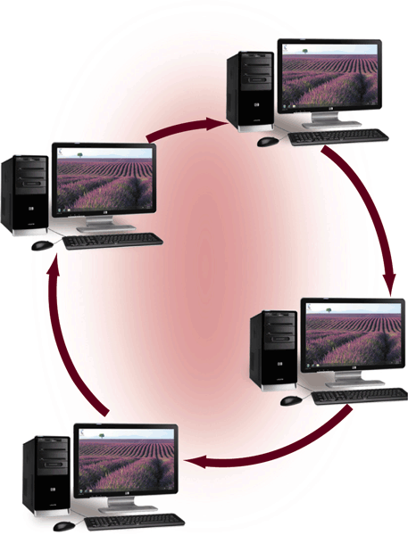
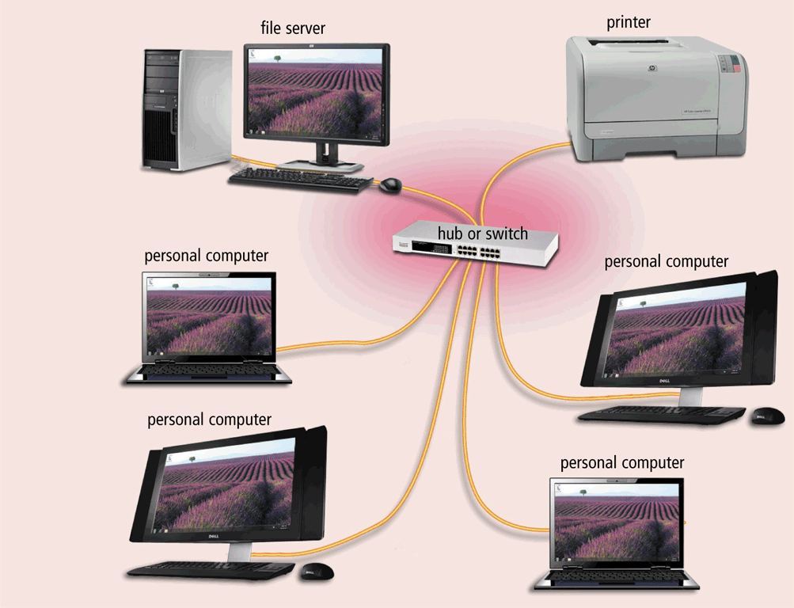
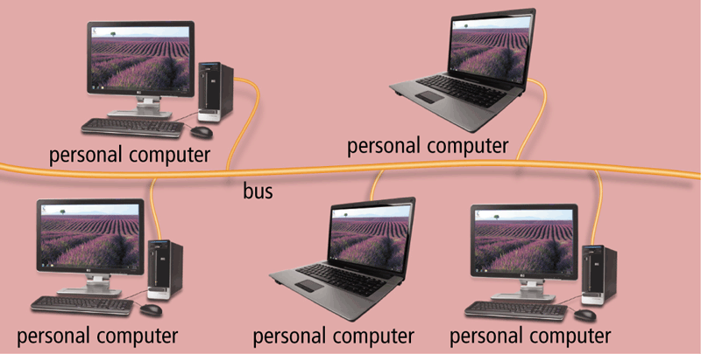
Network
A network topology refers to the layout of the computers and devices in a communications network
  Choice affects
    Network performance
    Network size
    Network collision detection
Ring network
Star network
Bus network

Slide 40
Network Topologies
Packets
  Pieces of data transmitted over a network
    Packets are created by sending node
    Data is reassembled by receiving node
  Packet header
    Sending and receiving address
  Packet payload
    Number and size of data
    Actual data
  Packet error control
Notes:
Teaching tip
For technical students take the time to draw the packet structure on the board. The typical structure is destination address | sending address | packet number | total packets | data size | payload | error control.

Slide 41
Bus Topology
Also called linear bus
One wire connects all nodes
Terminator ends the wires
Advantages
  Easy to setup
  Small amount of wire
Disadvantages
  Slow
  Easy to crash
Notes:
Teaching tip
Pages 352 and 353 have diagrams of each network topology

Slide 42
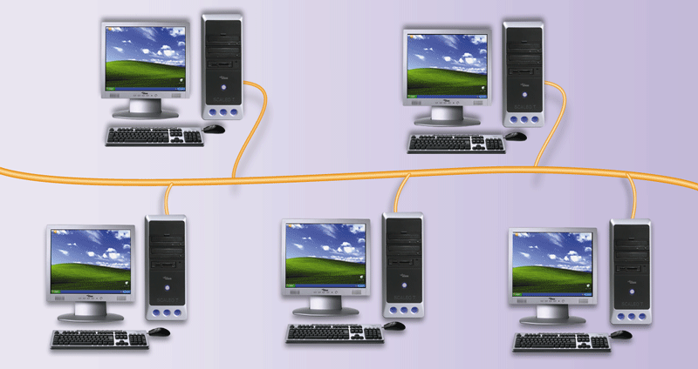
Bus Networks
  All computers and devices connect to central cable, or bus

Slide 43
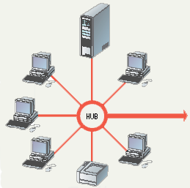
Star Topology
All nodes connect to a hub
  Packets sent to hub
  Hub sends packet to destination
Advantages
  Easy to setup
  One cable can not crash network
Disadvantages
  One hub crashing downs entire network
  Uses lots of cable
Most common topology

Slide 44
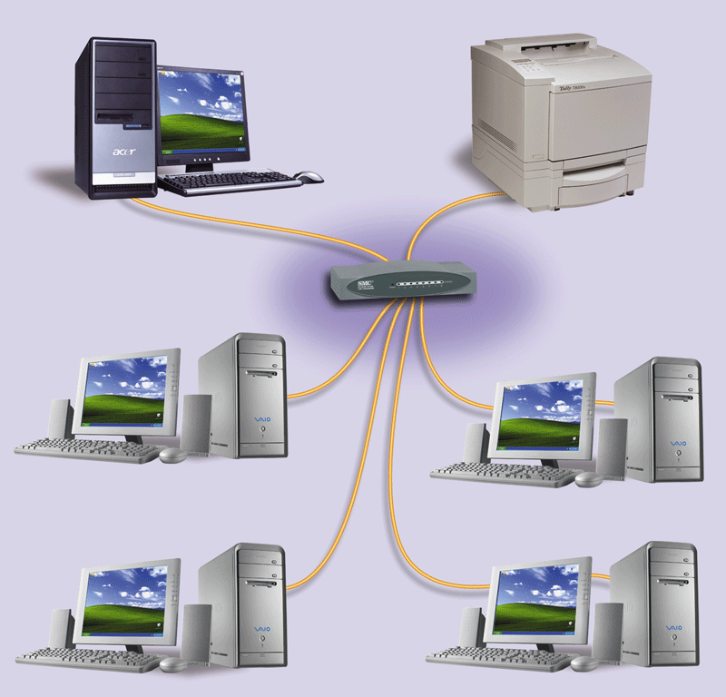
Star Network
  All devices connect to a central device, called hub
  All data transferred from one computer to another passes through hub

Slide 45
Ring Topology
Nodes connected in a circle
Tokens used to transmit data
  Nodes must wait for token to send
Advantages
  Time to send data is known
  No data collisions
Disadvantages
  Slow
  Lots of cable

Slide 46
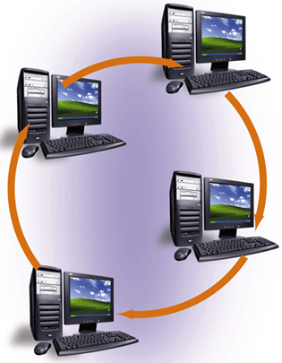
Ring Network
  Cable forms closed ring, or loop, with all computers and devices arranged along ring
  Data travels from device to device around entire ring, in one direction

Slide 47
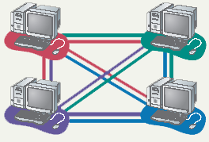
Mesh Topology
All computers connected together
Internet is a mesh network
Advantage
  Data will always be delivered
Disadvantages
  Lots of cable
  Hard to setup

Slide 48
Intranet and Extranet
Intranet makes information accessible to employees
Typically includes connection to Internet
An intranet is an internal network that uses Internet technologies
An extranet allows customers or suppliers to access part of its intranet

Slide 49
Summary
Computer Communications and Network
Uses of Computer Networks
  Internet
  E-mail
  Instant Messaging, SMS, MMS
  Newsgroup, RSS
  Tele, Audio, Video and Data Conferencing
  VoIP
  Hot Spot, CyberCafe
  GPS
  Groupware, Voice Mail, Web Services
49
Notes:
Insider Information
Plug and play was introduced by Apple Computers.

Slide 50
Summary
Types of Networks
  LAN
  WAN
  MAN
  Client Server
  Peer-to-Peer
Network Topologies
  Bus
  Star
  Ring
  Mesh
50

