Slide 1
CSC 101
Introduction to Computing
Lecture 18
Dr. Iftikhar Azim Niaz
ianiaz@comsats.edu.pk
1

Slide 2
Last Lecture Summary I
Operating System Evolution
Types of Operating Systems
Stand alone Operating Systems
  DOS
  Windows NT
  Windows 9x (Windows 95, 98 ME)
  Windows 2000
  Windows XP, Windows Vista, Windows 7
  Mac OS X
  Unix
  Linux
2

Slide 3
Last Lecture Summary II
Network Operating Systems
  Features
  Windows NT Server
  Windows 2000 Server
  Windows 2003 Server
  Windows 2008 Server
  Unix for Servers
  Linux for Servers
  Solaris
  Novell Netware
3

Slide 4
Embedded Operating Systems
built into the circuitry of an electronic device
  unlike a PC's operating system, which resides on a magnetic disk
Stable and fast
Found in wide variety of devices
  Appliances
  Automobiles
  Bar-code scanners
  Cell phones,
  Medical equipment and
  Personal Digital Assistants (PDAs

Slide 5
Embedded Operating Systems
An embedded operating system resides on a ROM chip on a mobile device or consumer electronic device
Windows Embedded CE
Windows Mobile
Palm OS
iPhone OS
BlackBerry
Embedded Linux
Symbian OS
Google Android
5

Slide 6
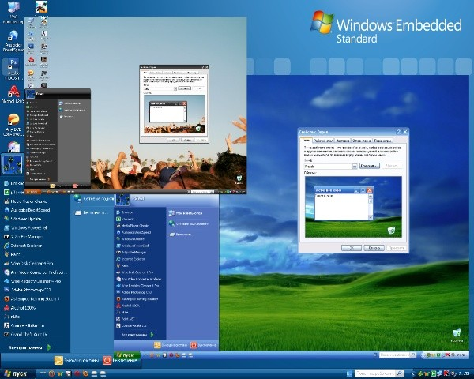
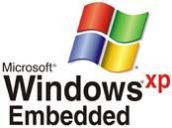
Windows XP Embedded
Based on Windows XP Professional
Not an off-the-shelf OS so much as it is a do-it-yourself kit for device manufacturers
  who wish to pick and choose the parts of the Windows XP Professional OS their products need
Customized for each device

Slide 7
Windows CE
Scaled-down Windows OS designed for use on communications, entertainment, and computing devices with limited functionality
Although a small OS, it supports wireless communications, multimedia and Web browsing
Windows CE is a GUI that supports color, sound, multitasking, multimedia, e-mail, Internet access, and Web browsing
A built-in file viewer allows users to view files created in popular programs such as Word, Excel, and PowerPoint
Devices equipped with Windows CE can communicate wirelessly with computers and other devices using Bluetooth or other wireless technologies,
  as long as the device is equipped with the necessary communications hardware
Notes:
Teaching tip
Have a little fun with this one. Windows CE has the unfortunate and unofficial shortcut name of WinCE.

Slide 8
Windows CE
Allows for the use of smaller versions of Microsoft Word, Excel, Internet Explorer and Outlook.
  Microsoft is positioning a version of Windows CE for the automotive market, calling it Windows Automotive.
Examples of devices that use Windows CE include
  VoIP telephones, industrial control devices
  digital cameras, point-of-sale terminals
  automated teller machines, digital photo frames
  fuel pumps, security robots, handheld navigation devices
  portable media players, ticket machines, and
  computerized sewing machines.

Slide 9
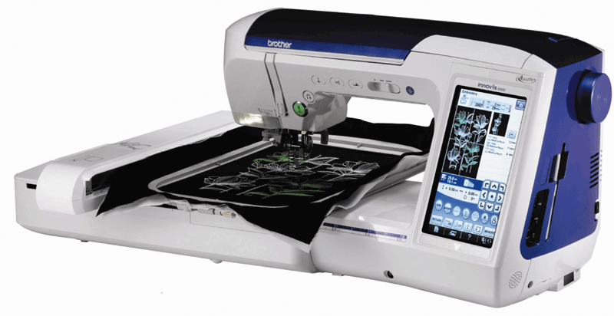
Windows CE
Also provided as a kit to manufacturers
  Customized for each device
Not based on a desktop OS
  Latest version is designed specially for embedded devices requiring a real-time OS
This sewing machine uses Windows Embedded CE to assist with stitching quilts, garments, crafts, decorations, and embroidery
Notes:
Teaching tip
Have a little fun with this one. Windows CE has the unfortunate and unofficial shortcut name of WinCE.

Slide 10
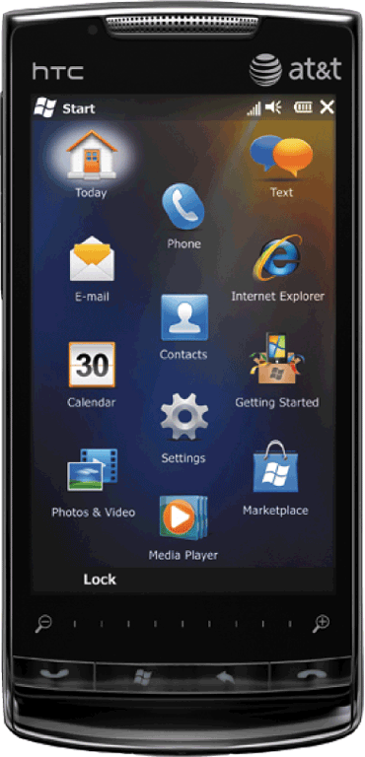
Windows Mobile
based on Windows Embedded CE, includes functionality, programs, and a user interface designed for specific types of smart phones and PDAs
Devices with a touch screen use
  Windows Mobile Professional, and
Devices without touch screens use
  Windows Mobile Standard
Allows for the use of smaller versions of Microsoft Word, Excel, Internet Explorer and Outlook
Smart phone with Windows Mobile OS

Slide 11
Windows Mobile
Users have access to all the basic PIM (personal information manager) functions such as
  contact lists, schedules, tasks, calendars, and notes
  Information on the mobile device easily synchronizes with a personal computer or prints on a printer using a cable or a wireless technology.
Additional features that allow users to
  check e-mail, browse the Web, listen to music,
  take pictures or record video, watch a video,
  send and receive text messages and instant messages
  record a voice message, manage finances, view a map
  read an e-book, or play a game.
Some devices also support handwriting and voice input.

Slide 12
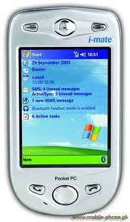
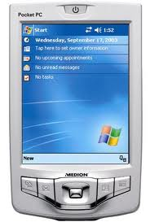
Pocket PC
A custom version of Windows CE developed by Microsoft
Developed to compete with Palm OS
Not customizable
Interacts securely with business networks
Run on ARM version 4 compatible CPUs
application components, such as
  Microsoft® Pocket Internet Explorer
  Microsoft® Pocket Word
  Microsoft® Pocket Excel, and
  Microsoft® Pocket Outlook.

Slide 13
Pocket PC
includes an optimized kernel, which allows the OS to operate with great efficiency
These devices are targeted at the business and corporate market rather than consumers.
The latest version gives users the ability to securely access data from a business network via a handheld device, and
It gives system administrators the ability to manage and control a PC or server via a wireless network connection.

Slide 14
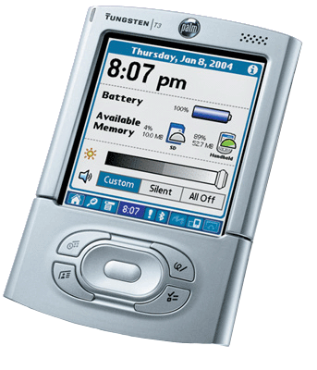
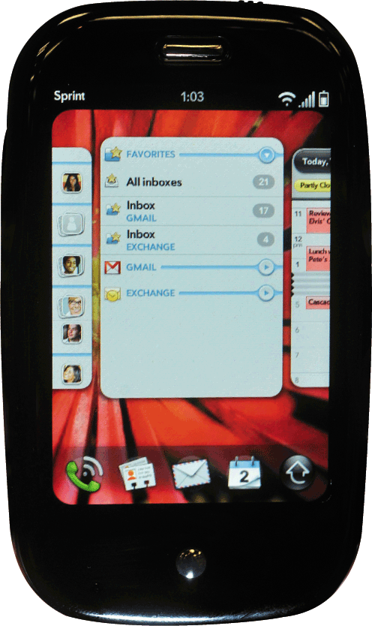
Palm OS
Proprietary mobile OS
Standard OS on Palm PDA
First PDA OS for consumers
Can be found on smart phones
Designed for ease of use with a touch screen-based GUI
provided with a suite of basic applications for Personal Information Management (PIM)
Run on ARM architecture-based processors

Slide 15
Palm OS Features
Simple, single-tasking environment to allow launching of full screen applications with a basic, common GUI set
Monochrome or color screens with resolutions up to 480x320 pixel
Handwriting recognition input system called Graffiti 2
HotSync technology for data synchronization with desktop computers
Sound playback and record capabilities
Simple security model: Device can be locked by password, arbitrary application records can be made private
TCP/IP network access
Serial port/USB, infrared, Bluetooth and Wi-Fi connections
Expansion memory card support

Slide 16
Palm OS
With Palm OS devices, users manage schedules and contacts, phone messages, notes, task and address lists, and appointments.
Information on the mobile device easily prints on a printer using a cable or a wireless technology.
Many Palm OS devices allow users to connect wirelessly to the Internet; browse the Web; send and receive e-mail messages, text messages, and instant messages; listen to music; record voice messages; and view digital photos.
The latest version of Palm OS allows for biometric identification and supports the use of smart cards

Slide 17
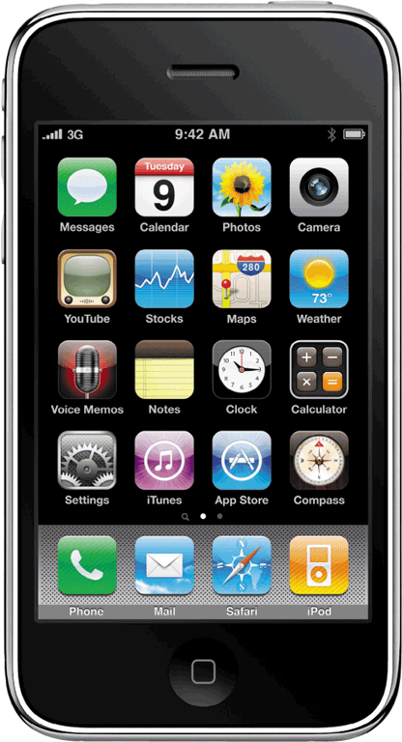
iPhone OS (iOS)
Developed by Apple, is an OS for the iPhone, iPad, Apple TV and iPod Touch
These devices are multi-touch, meaning they recognize multiple points of contact
Interface control elements consist of sliders, switches, and buttons.
provides Wi-Fi access to the iTunes Music Store
iOS is derived from OS X, with which it shares the Darwin foundation, and is therefore a Unix operating system
iPhone OS runs on Apple iPhone

Slide 18
iOS
User interface of iOS is based on the concept of direct manipulation, using multi-touch gestures
enables users to interact with iPhone OS devices using finger motions such as
  tapping a button on the screen,
  sliding your finger to drag an object, and
  pinching or unpinching your fingers to zoom in or out
response to user input is immediate and provides a fluid interface
Interaction with the OS includes gestures such as
  swipe, tap, pinch, and reverse pinch,
  all of which have specific definitions within the context of the iOS and its multi-touch interface

Slide 19
iOS
Internal accelerometers are used by some applications to respond to shaking the device
  one common result is the undo command
or rotating it in three dimensions
  one common result is switching from portrait to landscape mode
users can manage contacts and notes,
send and receive e-mail and text messages
take pictures, record videos, record voice messages,
view a compass, connect to the Internet wirelessly and browse the Web,
check stocks, access maps and obtain directions
listen to music, watch movies and videos, and display photos.

Slide 20
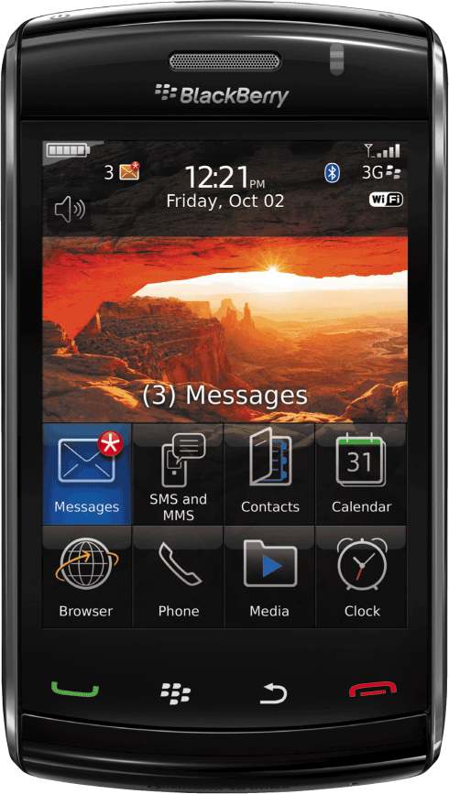
BlackBerry OS
Proprietary OS for BlackBerry line of smartphone handheld devices
Runs on handheld devices supplied by RIM (Research In Motion)
provide PIM capabilities such as managing schedules, contacts, and appointments
provides multitasking and supports specialized input particularly the trackwheel, trackball, trackpad and touchscreen
Smart phone using Blackberry OS

Slide 21
BlackBerry OS
Many BlackBerry devices include a mini keyboard;
Some have touch screens
provide wireless functionality that includes
  sending e-mail messages, text messages, and instant messages; connecting to the Internet and browsing the Web; and accessing Bluetooth devices
Information on the device easily synchronizes wirelessly with a computer or other BlackBerry device
Some devices allow users to take pictures, play music, and access maps and directions

Slide 22
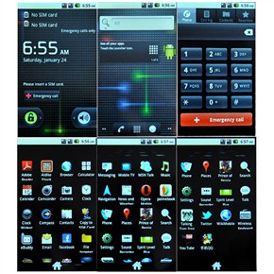
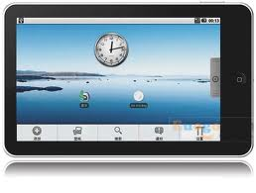
Google Andriod
Open source, Linux-based OS designed by Google for mobile devices such as smart phones and Tablet PCs
Allows programmers to design programs specifically for devices supporting this OS
Contains features such as
  access to e-mail accounts
  an alarm clock, video capture
  access to Google Apps, Wi-Fi access
  easy Web browsing
Used on more than 20 different types of mobile devices

Slide 23
Google Andriod
consists of a kernel based on the Linux kernel, with middleware, libraries and APIs written in C and application software running on an application framework which includes Java-compatible libraries
main hardware platform for Android is the ARM architecture
SQLite, a lightweight relational database, is used for data storage purposes
native support for multi-touch
supports multiple languages

Slide 24
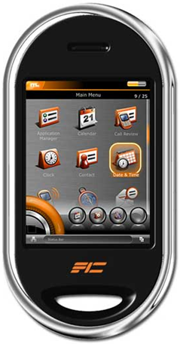
Embedded Linux
Scaled-down Linux OS system designed for smart phones, PDAs, portable media players and Internet telephones
Provide calendar and address book and other PIM functions
Support for touch screens and handwriting recognition
Devices synchronize with Pc with a variety of technologies including Bluetooth
Smart phone using Embedded Linux

Slide 25
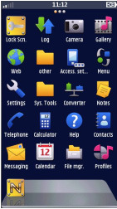
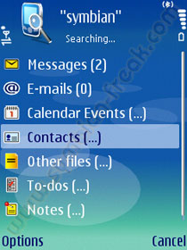
Symbian OS
Open-source, multitasking operating system designed for smart phones
Provide support for Touch screens, Voice, Games, multimedia functions and Internet connectivity
Full color display
Make telephone calls, save appointments, browse Web, send
and receive e-mail and faxes etc.

Slide 26
Symbian OS
Created with three systems design principles in mind:
  integrity and security of user data is paramount
  user time must not be wasted
  all resources are scarce
Features pre-emptive multitasking and memory protection
allows users to communicate wirelessly
Strong localization support enabling manufacturers and 3rd party application developers to localize their products in order to support global distribution.
Currently 48 languages are supported

Slide 27
Utilities Software
System software designed to help analyze, configure, optimize or maintain a computer
A single piece of utility software is usually called a utility or tool
Utility software usually focuses on how the computer infrastructure operates including
  computer hardware
  operating system
  application software and
  data storage
Utilities enhances or extends OS capabilities
Some offer features not included with OS
Notes:
Discussion point
With Windows XP and SP2, Microsoft has included a firewall and pop-up blocker both typically considered utility software. In the near future, the core services provided by an OS may include security features.

Slide 28
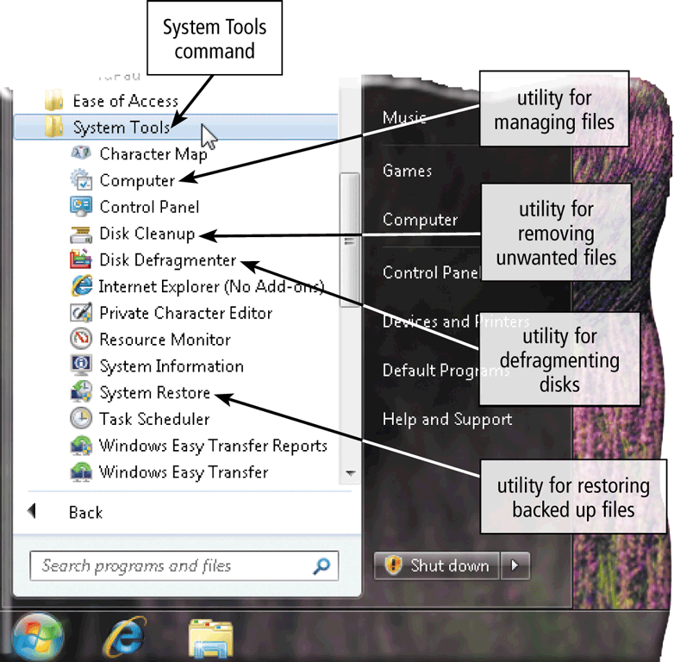
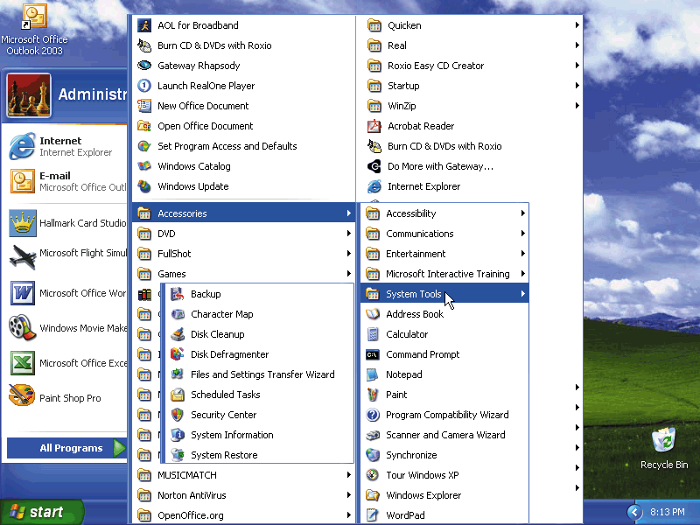
Utility Program
A type of system software that allows a user to perform maintenance-type tasks usually related to managing a computer, its devices, or its programs
28

Slide 29
Utility Software
As an OS is improved and updated, the functionality of popular utilities is included with subsequent releases of the OS
Most OS include several built-in utility software
Users often buy stand-alone utilities because they offer improvements over those included with the OS
Thousands of different utility software and many of them are available on Internet
Some are free and some are priced from very inexpensive to hundreds of dollars

Slide 30
Functions Provided by Utility Software
Managing files
Searching for files
Viewing images
Uninstalling programs
Cleaning up Disks
Defragmenting Disks
Backing up files and disks
Disk Compression
Disk Partitions
Disk space analyzers
Cryptographic
Network utilities
Securing a computer from unauthorized access
Setting up screen savers
Protecting against viruses
Removing spyware and adware
Filtering Internet content
Compressing files
Playing media files
Burning optical discs and
Maintaining a PC
Registry cleaners

Slide 31
File Manager
A utility that performs functions related to file management
  Displaying a list of files
  Organizing files in folders
  Copying, renaming, deleting, moving, and sorting files and folders
    folder is a specific named location on a storage medium that contains related documents
  Creating shortcuts
    shortcut is an icon on the desktop or in a folder that provides a user with immediate access to a program or file
OS typically include a file manager

Slide 32
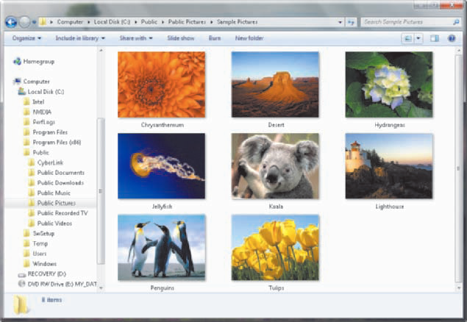
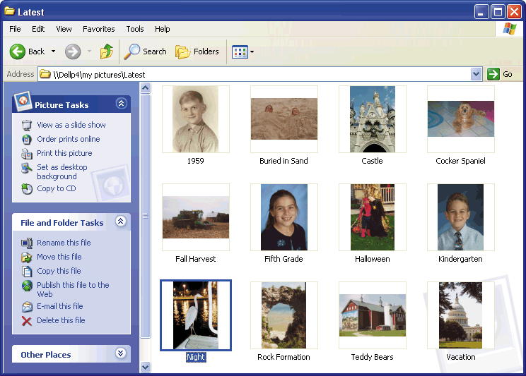
Windows Explorer
displays links to files and folders, as well as previews of folder contents and certain types of files
Long file names
Folders can be created and nested
All storage devices work consistently
thumbnail

Slide 33
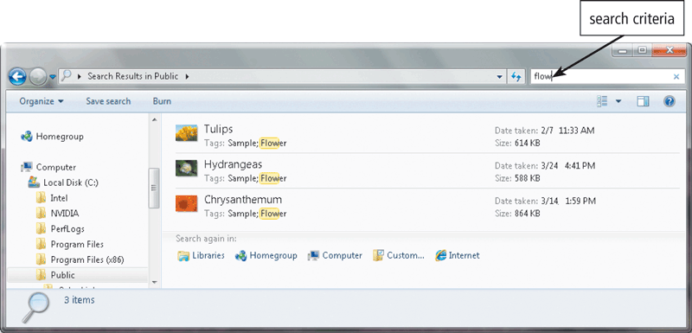
Search Utility
a program that attempts to locate a file on your computer based on criteria you specifies
can look through documents, photos, music, and other files on your computer and/or on the Internet, combining search results in a single location
criteria could be a word or words contained in a file, date the file was created or modified, size of the file, location of the file, file name, author/ artist, and other similar properties

Slide 34
Search Utility - Index
typically use an index to assist with locating files quickly.
An index stores a variety of information about a file, including its name, date created, date modified, author name, and so on.
When you enter search criteria, instead of looking through every file and folder on the storage medium, the search utility looks through the index first to find a match.
Each entry in the index contains a link to the actual file on the disk for easy retrieval
OS typically include a built-in search utility.
In Windows, all the Explorer windows, as well as the Start menu, contain a Search box where you enter the search criteria.

Slide 35
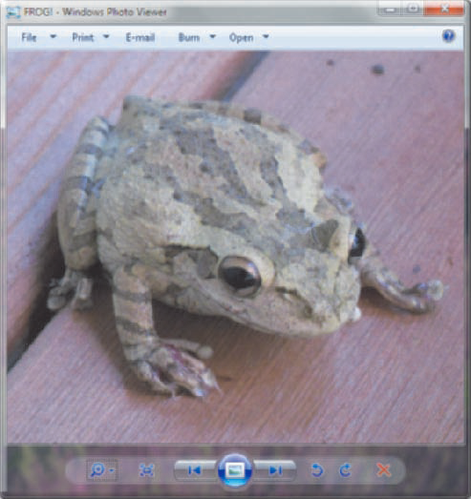
Image Viewer / Image Browser
a utility that allows users to display, copy, and print the contents of a graphics file, such as a photo
users can see images without having to open them in a paint or image editing program
Most OS has an image viewer
Windows Photo Viewer, which also allows you to print and e-mail photos
Windows Photo Viewer allows user to see the contents of a photo file

Slide 36
Image Viewer
it can often handle various graphics file formats.
Such software usually renders the image according to properties of the display such as color depth, display resolution, and color profile
Typical features of image viewers are:
  basic viewing operations such as zooming and rotation
  fullscreen display, Slideshow, thumbnail display
  Printing, screen capture
Common Image viewer include
  Windows Picture Viewer, ACDSee, IrfanView, XnView, MediaPro1, Eye of GNOME, Gwenview

Slide 37
Uninstaller
A utility that removes a program, as well as any associated entries in the system files
When a program is installed, OS records the information it uses to run the software in the system files
Uninstaller deletes files and folders from the hard disk, as well as removes program entries from the system files
OS usually provide an uninstaller
Removes a
program and
all associated files
In Windows XP,
uninstaller is in Add/Remove
Programs in Control Panel

Slide 38
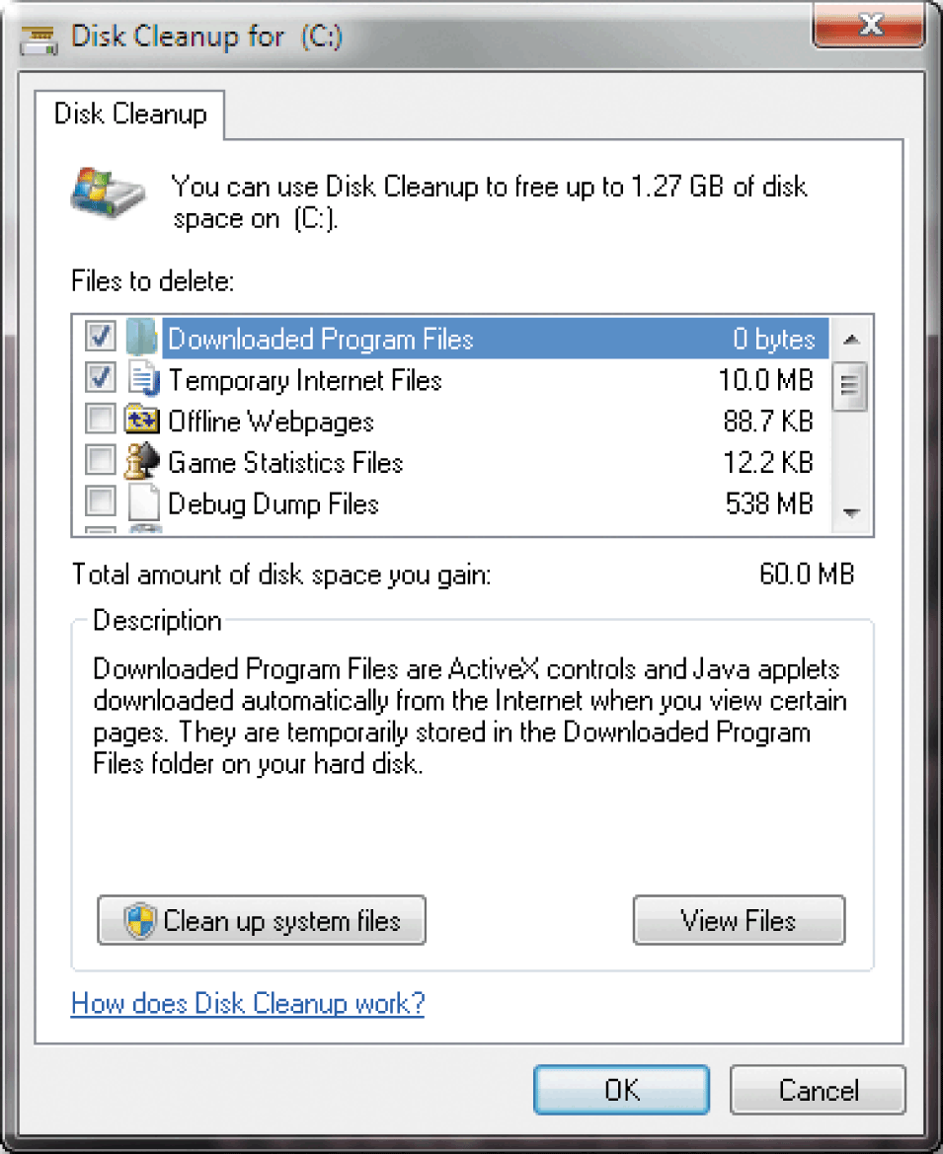
Disk Cleanup
A disk cleanup utility searches for and removes unnecessary files
  Downloaded program files
  Temporary Internet files
  Unused program files
  Delete temp files
  Uninstall unused programs
  Delete obsolete data files
OS such as Windows, include a disk cleanup utility
38
Notes:
Detects and corrects problems on hard disk or floppy disk

Slide 39
Scan a disk for Errors
Bad spots on the media
Find and fix the error
  Move data to a good spot
  Mark the spot as bad
Scanning a disk can be a time-consuming process, but if the disk has errors, scanning may be able to fix problems and improve performance
Several (but not all) versions of Windows have a built-in disk-scanning utility
Disks should be scanned monthly

Slide 40
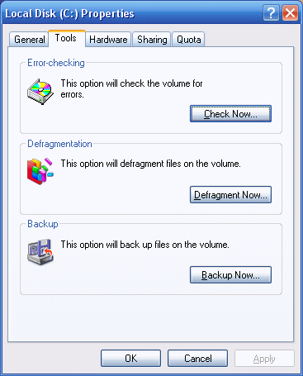
Checking Disk Errors
To do a complete scan of the disk and correct any errors that are found
Place a checkmark in the ‘Scan for and attempt recovery of bad sectors’ check box, and
then click the Start button.

Slide 41
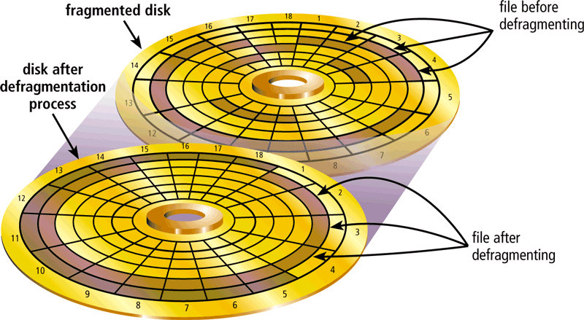
Disk Defragmenter
reorganizes the files and unused space on a computer’s hard disk so that the operating system accesses data more quickly and programs run faster
A fragmented disk has many files stored in noncontiguous sectors. Defragmenting reorganizes the files so that they are located in contiguous sectors, which speeds access time
41

Slide 42
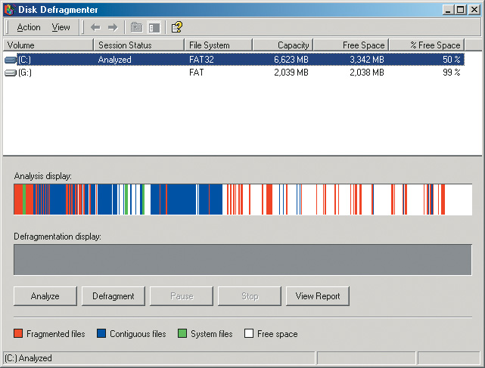
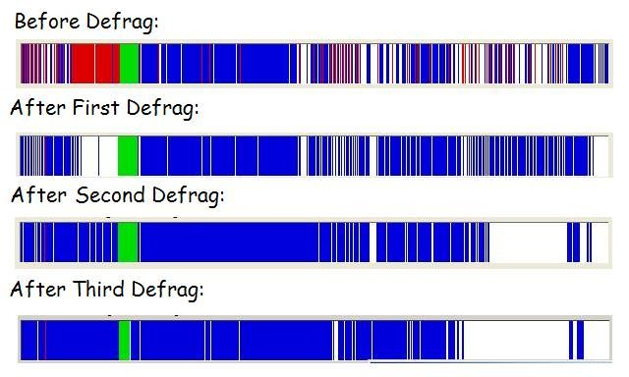
Disk Defragmentation
Which combines all files so that no files are stored in a noncontiguous manner
The defragmentation process can consume more than one hour in some cases.
You can cancel the operation at any time by clicking the Stop operation button in the Disk Defragmenter window

Slide 43
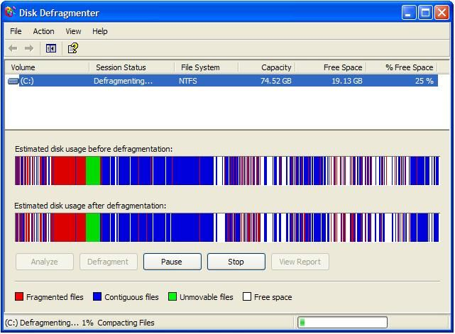
Disk Defragmenter

Slide 44
File Compression
Shrinks the size of a file
Takes up less space on disk
Will increase disk capacity
Compressing files frees up space on the storage media and improves system performance
Uploading and downloading compressed files to and from the Internet reduces the file transmission time
Compressed files, sometimes called zipped files, usually have a .zip extension
Lossy and Lossless compression
PKZip, WinZip and WinRAR
Notes:
Teaching tip
MP3s are created using compression. If a audio song is recorded on a hard drive, the required storage is about 1 MB per second. When the MP3 compression is applied, the size is reduced to about 1 MB per minute.
Windows XP provides several compression routines. It provides for .zip file compression and archive creation. Zip archives can be accessed like normal folders. Folders can be compressed to shrink the contents. Finally, the entire disk can be compressed .

Slide 45
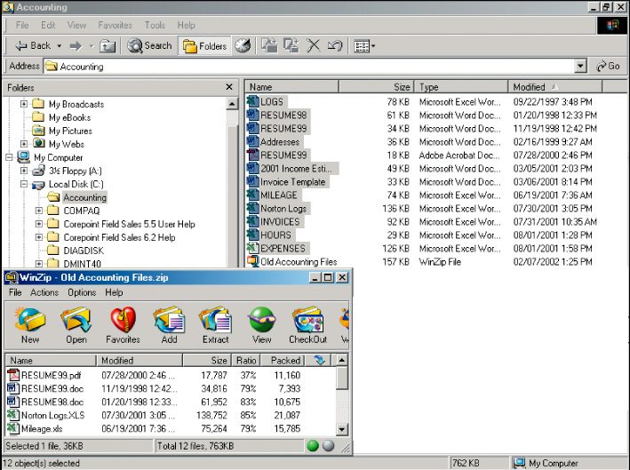
File Compression
763 KB
on disk
Compressed
157 KB

Slide 46
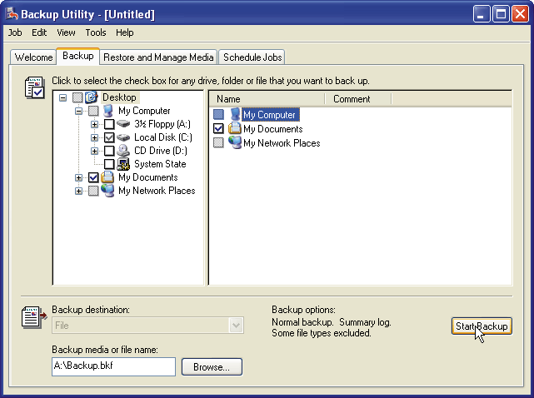
Backup and Restore Utility
A backup utility allows users to copy files to another storage medium such as another hard disk, optical disc, USB flash drive, or tape
  During the back up process, the utility monitors progress and alerts you if it needs additional media, such as another disc
  Most compress files during backup to require less storage space
By compressing the files, the backup program requires less storage space for the backup files than for the original files.
Because they are compressed, you usually cannot use backup files in their backed up form
46

Slide 47
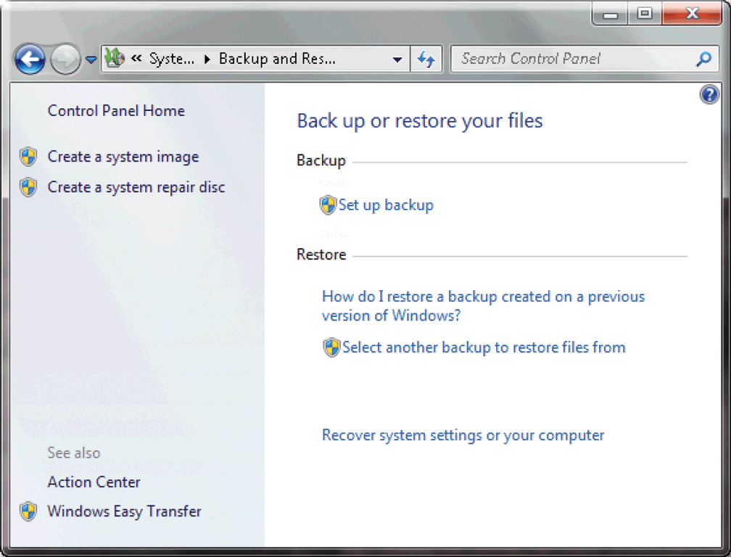
Backup and Restore Utility
A restore utility reverses the process and returns backed up files to their original form
Backup utilities work with a restore utility
Most backup and restore utilities include a scheduler, which instructs the computer to perform a backup automatically on a regularly scheduled basis.
OS, such as Windows, include a backup and restore utility
When you purchase an external hard disk, it also usually includes a backup and restore utility
47

Slide 48
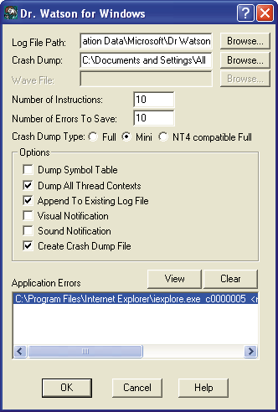
Diagnostic Utility
Compiles technical information about hardware and some software
Prepares report outlining problems

Slide 49
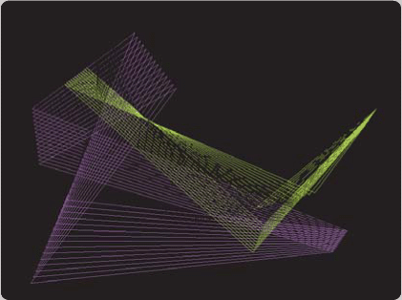
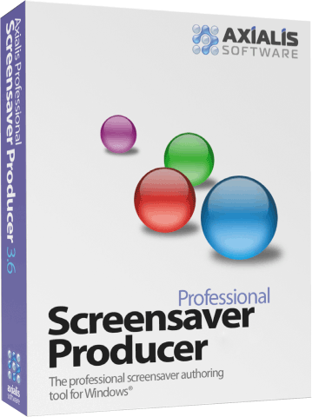
Screen Saver
A screen saver causes a display device’s screen to show a moving image or blank screen if no activity occurs for a specified time
  To secure computer, user configures screen saver to require password to
  deactivate
49

Slide 50
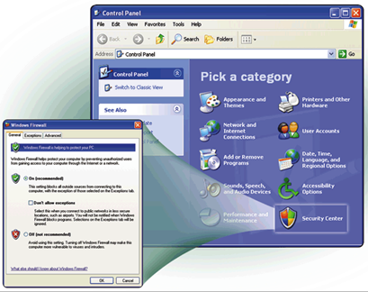
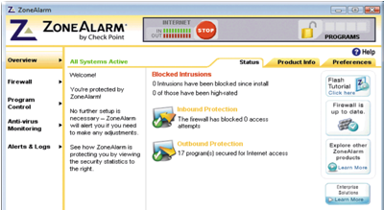
Firewall
  Crucial utility
  Detects and protects your computer from unauthorized intruders
  Makes computer invisible to hackers
  Zone Alarm is a home firewall
  Cisco sells hardware firewalls
  Windows XP automatically enables the built-in personal firewall upon installation
Notes:
Teaching tip
Windows XP includes a firewall. Service pack 2 will turn this firewall on by default. To test your computer’s security visit www.grc.com and run the various Shields Up! tests

Slide 51
Intrusion Detection
monitors network or system activities for malicious activities or policy violations and produces reports to a Management Station
primarily focused on identifying possible incidents, logging information about them, and reporting attempts
differs from a firewall in that a firewall looks outwardly for intrusions in order to stop them from happening.
Firewalls limit access between networks to prevent intrusion and do not signal an attack from inside the network
Often part of a firewall package
Announces attempts to breach security
Snort is a Linux based package

Slide 52
Virus, Worm and Trojans
A virus describes a potentially damaging computer program that affects a computer negatively
A worm copies itself repeatedly in memory or over a network
A Trojan horse hides within or looks like a legitimate program
An antivirus program protects a computer against viruses
52

Slide 53
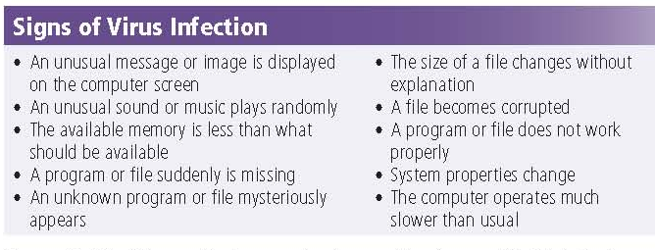
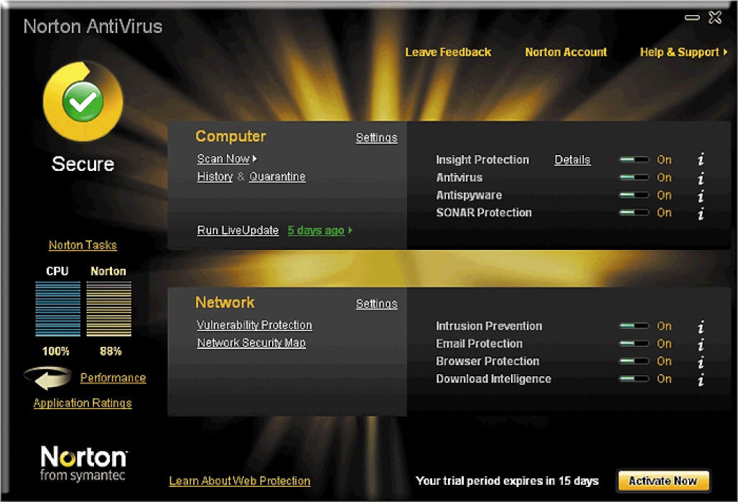
Signs of Virus Infection
Effective antivirus products not only detect and remove viruses; they also help you recover data that has been lost because of a virus
53

Slide 54
Anti-Virus Software
Crucial utility
Identifies and removes viruses in memory, storage media and incoming files
Most antivirus programs also protect against worms and Trojan horses
Must be updated regularly
Popular Antivirus Programs
  McAfee, Norton Anti-Virus, Microsoft Security Essential, Kaspersky
McAfee and Norton offer Web-based antivirus programs

Slide 55
Spyware and Adware
Spyware is a program placed on a computer without the user’s knowledge that secretly collects information about the user
Adware displays an online advertisement in a banner or pop-up window
A spyware remover detects and deletes spyware and other similar programs
An adware remover is a program that detects and deletes adware
Some OS and antivirus programs include spyware and adware removers
Popular stand-alone spyware and adware removers include
  Ad-Aware, Spy Sweeper, Spybot – Search and Destroy, and Windows Defender.
55

Slide 56
Internet Filters
Filters are programs that remove or block certain items from being displayed
  Web filters
    restricts access to certain material on the Web. Some restrict access to specific Web sites
  Anti-spam programs
    a filtering program that attempts to remove spam before it reaches your inbox
  Phishing filters
    a program that warns or blocks you from potentially fraudulent or suspicious Web sites. Some Web browsers include phishing filters
  Pop-up blockers
    a filtering program that stops pop-up ads from displaying on Web pages. Many web browsers include a pop up blocker.
56

Slide 57
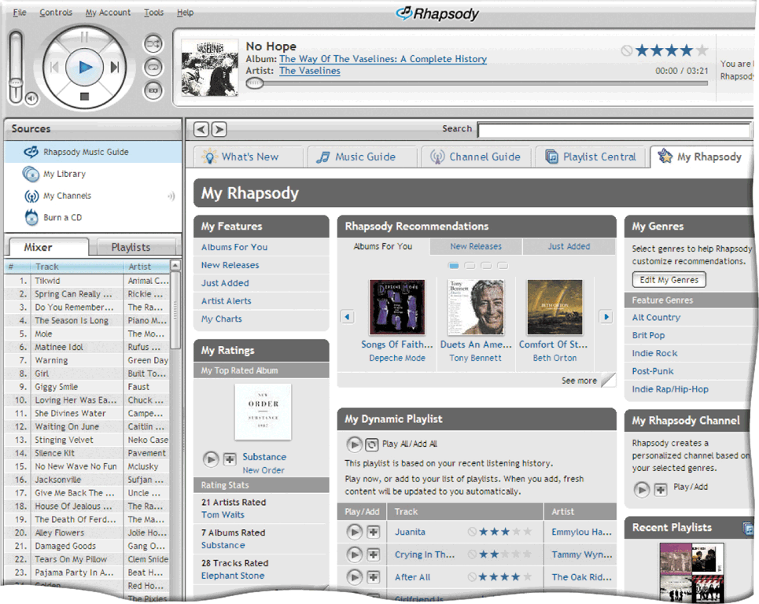
Media Player
allows you to view images and animation, listen to audio, and watch video files on your computer
Windows includes Windows Media Player.
Other popular media players are
  iTunes, Vlc Media Player, RealPlayer, and Rhapsody
57

Slide 58
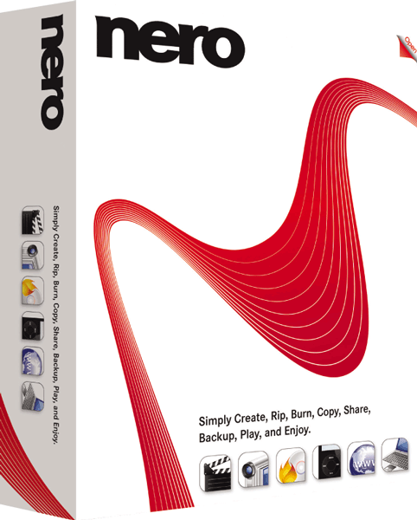
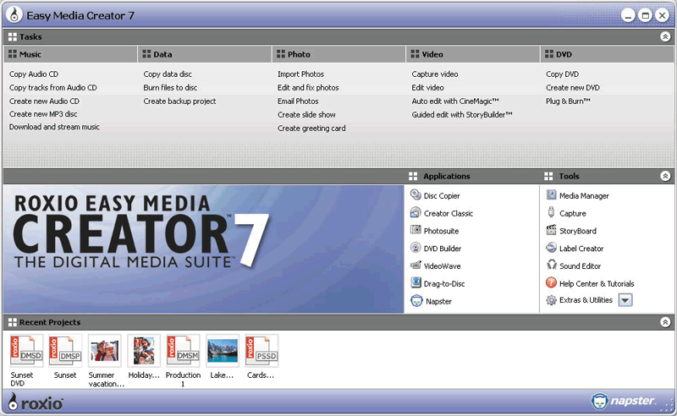
Disk Burning Software
Disc burning software writes text, graphics, audio, and video files on a recordable or rewritable optical disc, CD, DVD, Blu-Ray
58

Slide 59
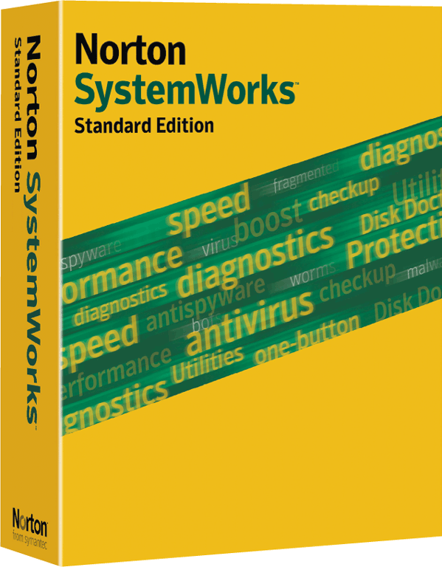

PC Maintenance Utility
A personal computer maintenance utility identifies and fixes operating system problems, detects and repairs disk problems, and includes the capability of improving a computer’s performance
some utilities continuously monitor a computer while you use it to identify and repair problems before they occur.
59

Slide 60
Summary
Embedded Operating Systems
  Windows XP Embedded, Windows CE Embedded CE, Windows Mobile
  Pocket PC
  Palm OS
  iPhone OS / iOS
  BlackBerry OS
  Google Andriod
  Embedded Linux
  Symbian OS
60

Slide 61
Summary
Managing files
Searching for files
Viewing images
Uninstalling programs
Cleaning up Disks
Defragmenting Disks
Backing up files and disks
Disk Compression
Intrusion detection
Screen savers
Antivirus
Removing spyware and adware
Filtering Internet content
Playing media files
Burning optical discs and
Maintaining a PC
61

Slide 62
Recommended Websites
https://en.wikipedia.org/wiki/Mobile_operating_system
https://en.wikipedia.org/wiki/Palm_OS
https://en.wikipedia.org/wiki/BlackBerry_OS
https://en.wikipedia.org/wiki/IOS_(Apple)
https://en.wikipedia.org/wiki/Symbian_OS
https://en.wikipedia.org/wiki/Pocket_PC
https://en.wikipedia.org/wiki/Utility_software
62

