Slide 1
CSC 101
Introduction to Computing
Lecture 17
Dr. Iftikhar Azim Niaz
ianiaz@comsats.edu.pk
1

Slide 2
Last Lecture Summary
System software
Operating systems
Functions of Operating System
  Start and Shut down
  Providing a User Interface
  Managing programs
  Managing memory
  Coordinated tasks and Configure devices
  Internet connections, Monitor Performance
  Providing Utilities and automatic Update
  Control a network and Administrator Security
2

Slide 3
Operating System Evolution
Over past 30 years, the evolution in OS has made PCs
  easier to use and understand
  more flexible and more reliable
Many of the first operating systems were device dependent and proprietary
A device-dependent program is one that runs only on a specific type or make of computer
Proprietary software is privately owned and limited to a specific vendor or computer model
  Some OS still are device dependent

Slide 4
Operating System Evolution
A device-independent OS is one that run on computers provided by a variety of manufacturers
  Advantage is you can retain existing application soft ware and data files even if you change computer models or vendors
As new versions of the OS are released, users upgrade their existing computers and mobile devices to incorporate features of the new version
Purchasing an OS upgrade usually costs less than purchasing the entire operating system
  New versions of OS usually are backward compatible
  Application software, by contrast, may or may not be upward compatible, meaning it may or may not run on new versions of the operating system

Slide 5
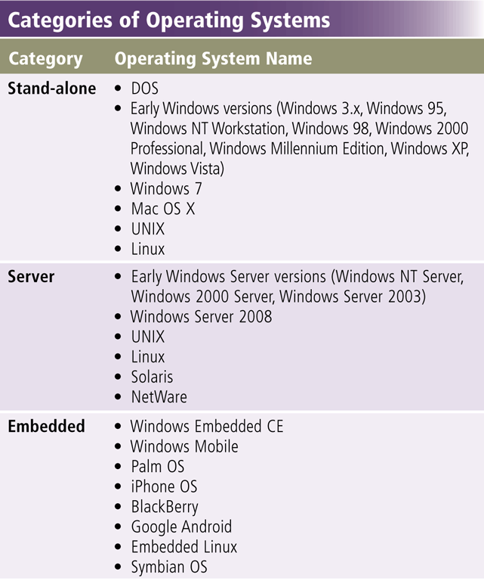
Types of Operating Systems
Windows Version Year Released
Windows 3.x 1990
Windows NT 3.1 1993
Windows 95 1995
Windows NT Workstation 4.0 1996
Windows 98 1998
Windows Millennium Edition 2000
Windows 2000 Professional 2000
Windows XP 2001
Windows XP SP2 2004

Slide 6
Stand Alone Operating Systems
Stand-alone OS is a complete OS that works on a desktop computer, notebook computer, or mobile computing device.
Some stand-alone OS are called Client OS because they also work in conjunction with a server operating system.
  Client OS can operate with or without a network
DOS, Windows 3.x, Windows 95, Windows 98, windows 2000, Windows Vista, Windows XP, Windows 7, Mac OS X, Unix, Linux

Slide 7
Disk Operating System (DOS)
Single user single-tasking OS
Two popular version
  PC DOS, which IBM released with its computers
  MS DOS, which was used on millions of “IBM-compatible” PCs
Command line interface and completely text oriented
16-bit OS, Functions include
  monitor support, disk input and output, keyboard control and internal functions related to program execution and file maintenance
Notes:
Teaching tip
Students often fail to see the value in older OS or applications. As an example, a metal fabrication plant in Pittsburgh PA is still using a program written in the early 70’s that calculates metal temperatures.

Slide 8
Disk Operating System (DOS)
Advantages
  Requires small memory as it is small in size
  Fast and powerful
  Easy to use
  Supports legacy applications
Weaknesses
  Single user single task
  No built-in support for networking
  Manual Installation of device-drivers
  Supports only 16 Bit programs
  Address limited amount of Memory and storage
  Command Line interface
Notes:
Teaching tip
Students often fail to see the value in older OS or applications. As an example, a metal fabrication plant in Pittsburgh PA is still using a program written in the early 70’s that calculates metal temperatures.

Slide 9
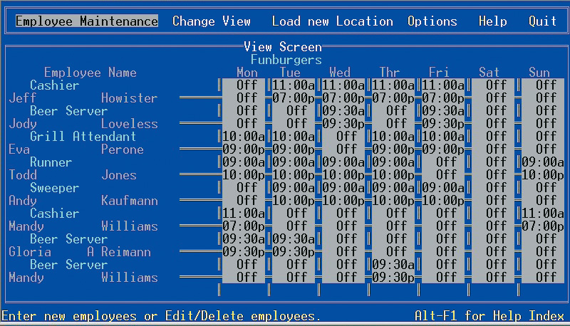
DOS Application

Slide 10
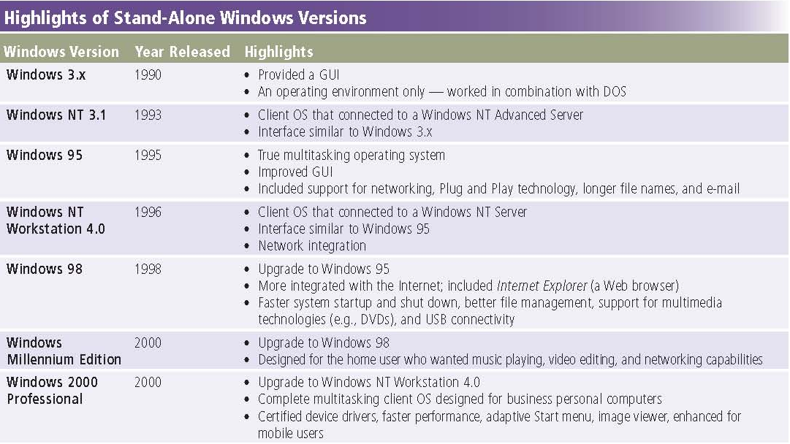
Microsoft Windows 1990 - 2000

Slide 11
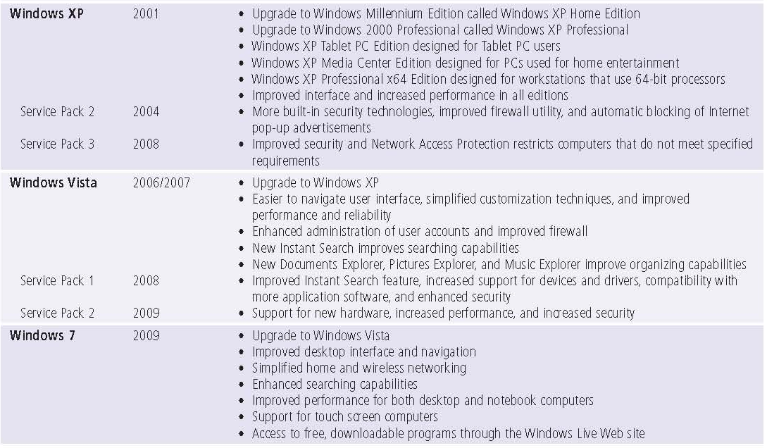
Microsoft Windows 2000 - 2009

Slide 12
Windows NT (New Technology)
32-bit OS released in 1993
Very stable
  Powerful high-level-language-based
  processor-independent,
  Multiprocessing and multiuser operating system with features comparable to Unix
almost completely devoid of MS-DOS code
Windows NT Workstation
  supports networking and can be used as a server in peer-to-peer networks, it generally is not used on network servers

Slide 13
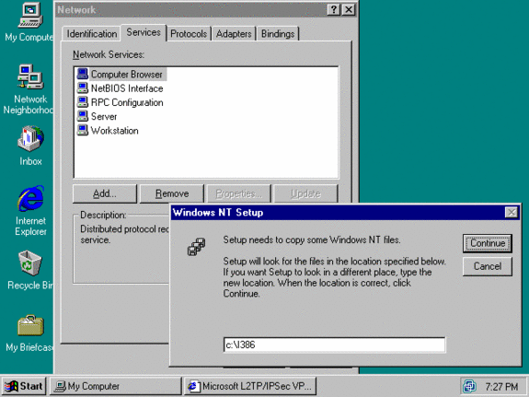
Windows NT Workstation

Slide 14
Windows 9x (Windows 95)
95, 98, and Millennium Edition (Me)
Pre-emptive multitasking 32-bit OS
  Supported 16-bit programs well
Does not require MS-DOS to be installed separately
first version of Windows to support the Plug and Play standard for connecting new hardware.
With integrated networking support
Improvements to the GUI, introduced the Start button and Task Bar
Very pretty not stable OS

Slide 15
Windows 98
Upgrade from Windows 95
Inclusion of the Internet Explorer Web browser
98 introduced Active desktop that lets users browse the Internet and local computer in a similar manner
  enables users to integrate Internet resources directly on the Windows desktop
First OS to use the Windows Driver Model
More robust USB support
Number of improvements are made to various other system tools and accessories

Slide 16
Windows ME
last operating system released in the Windows 9x series.
offers several notable enhancements
  Improved multimedia capabilities,
  built-in support for digital video editing, and
  enhanced Internet features
  Updated GUI
  Optimized for office and developers
Heavily criticized by users for its instability and unreliability, due to frequent freezes and crashes. Entertainment software ran very poorly
Notes:
Discussion point
There are many computer professionals that say that Windows 2000 was the first stable Microsoft product. Engage your class in a discussion regarding a software developer’s obligation to create stable products.

Slide 17
Windows 2000
Look of 9x with file system, networking, power, and stability of Windows NT
designed primarily for PCs in offices and small businesses
Provides support for
  Symmetric Multiprocessing (SMP) with up to two processors
  People with disabilities has been improved
  Different languages and locale information
  Windows NT file system, NTFS 3.0, the Encrypting File System and basic and dynamic disk storage.
Notes:
Discussion point
There are many computer professionals that say that Windows 2000 was the first stable Microsoft product. Engage your class in a discussion regarding a software developer’s obligation to create stable products.

Slide 18
Windows XP
Microsoft’s newest desktop product
Different look from 2000
  desktop has a more three-dimensional look, with rounded corners and more shading.
  It also offers some brighter color choices
Many different versions
  Professional, Home, Media Center Edition
Digital multimedia support was enhanced
Advanced networking and Communications was enhanced
  makes use of Internet Connection Sharing
Mobile computing became a priority
Notes:
Teaching tip
At press time, the 64 bit version of XP was still in the late beta stage. More information can be found at www.microsoft.com/presspass/press/2003/sep03/09-23athlon64betapr.asp.

Slide 19
Windows Vista
Released in 2006 and is available in multiple editions:
  Windows Vista Home Basic
  Windows Vista Home Premium
  Windows Vista Ultimate
  Windows Vista Business
Offered enhancements in reliability, security, easy deployment and performance
Windows Vista Provides Programs such as
  Windows Firewall, Windows Messenger, Windows Media Player, Windows Side Bar

Slide 20
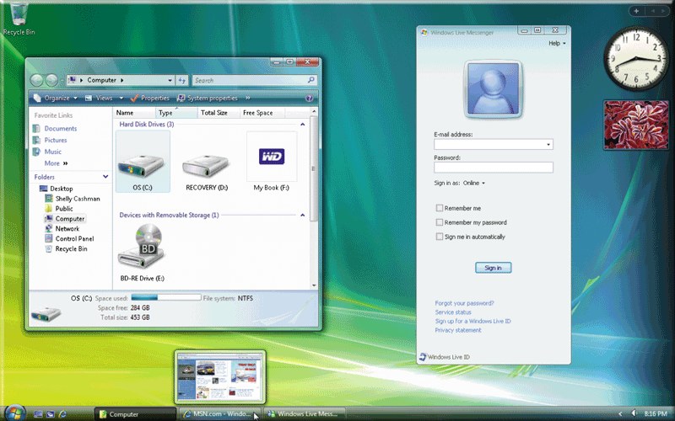
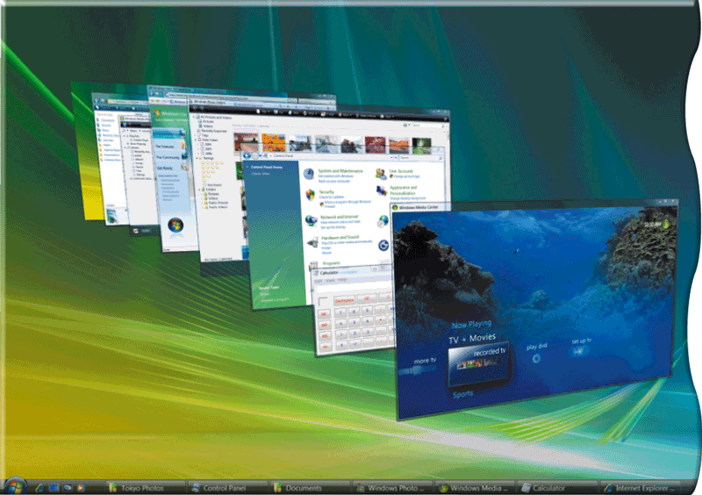
Windows Vista - Desktop
Updated GUI
  Simplified and centralized desktop configuration management.
Visual Style called Aero introduces support for 3D graphics (Windows Flip 3D), translucency effects (Glass), live thumbnails, window animations, and other visual effects

Slide 21
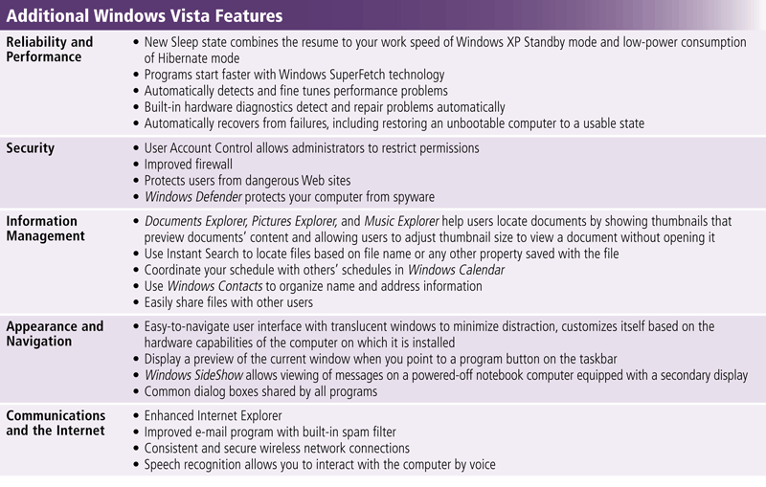
Windows Vista Features

Slide 22
Windows 7
Microsoft’s fastest, most efficient operating system to date and is available in multiple editions:
  Windows 7 Starter
  Windows 7 Home Premium
  Windows 7 Ultimate
  Windows 7 Professional
Windows 7 Provides Programs such as
  Windows Firewall, Windows DVD Maker, Windows Media Player, Desktop Gadget Gallery

Slide 23
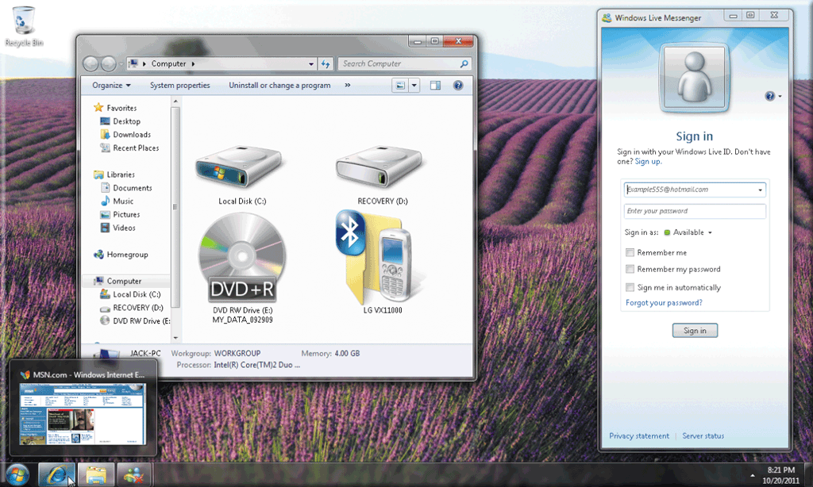
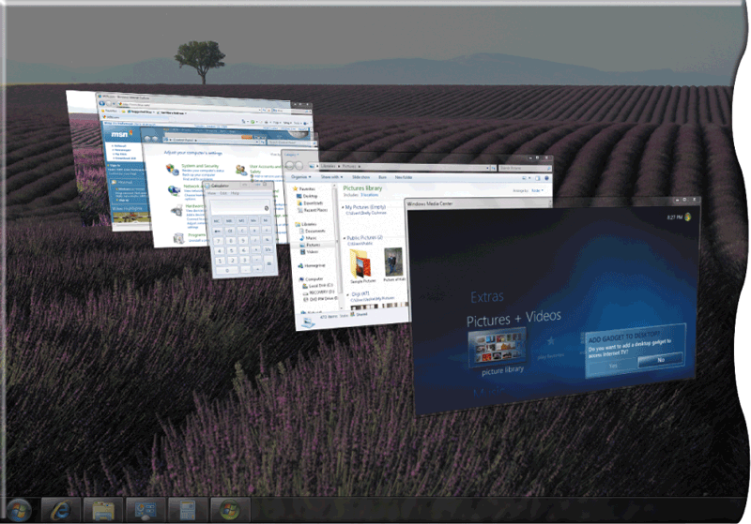
Windows 7 Desktop
Windows 7 has a new interface, easier navigation and searching techniques, and improved security
With Windows 7 Aero Flip 3D, users
flip through windows by rolling the wheel on their mouse.
To run Windows 7 Home Premium requires at least 1 GB of RAM
On a 64-bit computer, 2 GB of RAM is required.
Windows 7 adapts to the hardware configuration on which it is installed

Slide 24
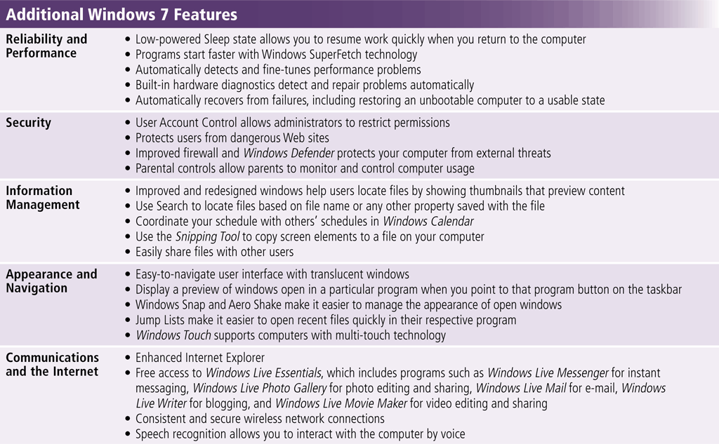
Windows 7 Additional Features

Slide 25
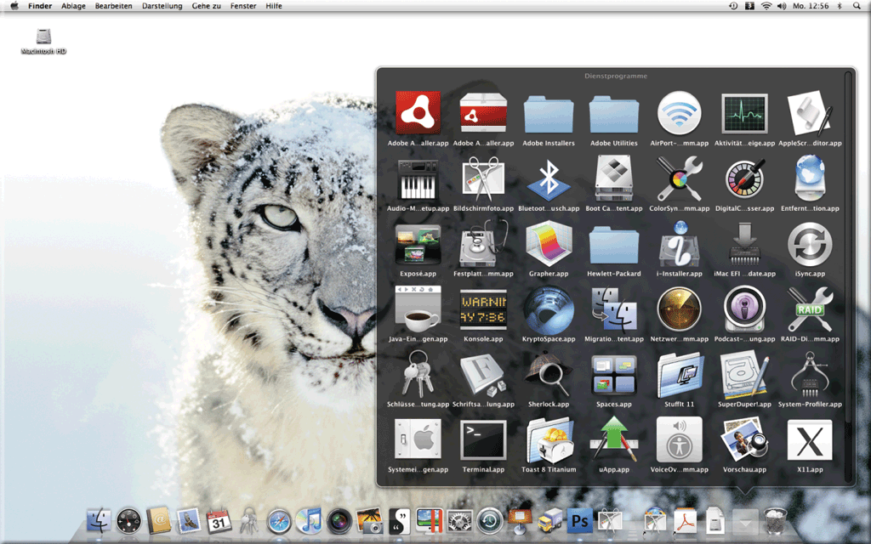
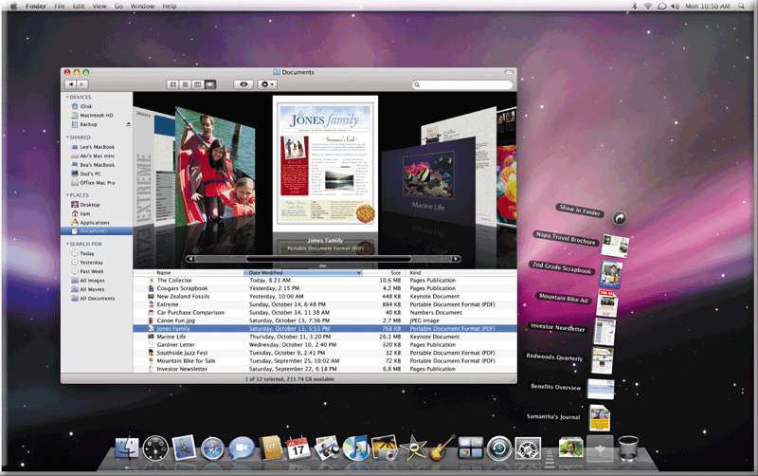
Macintosh OS X
The Macintosh OS has set the standard for operating system ease of use since 1984
Mac OS works only on Macintosh computers
Based on FreeBSD Linux
Small market share
Latest version is Mac OS X

Slide 26
Macintosh OS X
Very stable and easy to configure
Mac OS X includes these features:
  New desktop search technology
  Dashboard, a desktop area for mini-programs called widgets
  Built-in, fast Web browser
  Parental controls
  Improved backup utility, called Time Machine
  Accessibility interface reads e-mail messages
  3-D personal video and audio conferencing
  Filter to eliminate junk e-mail messages
  Contact lists synchronized with Bluetooth enabled smart phone or other mobile device
  Latest version of QuickTime to listen to music and view videos on the Internet
  Easy networking of computers and devices
  Windows network connection and shared Windows documents
Notes:
Teaching tip
OS X versions change often. Keep track of the most current and present this to the class. Visit www.apple.com/macosx/ to keep up to date. At press time the latest version was 10.4 Tiger.

Slide 27
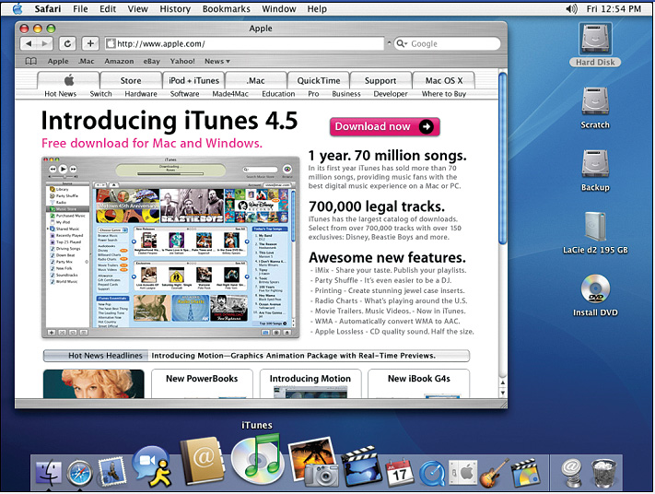
OS X Desktop

Slide 28
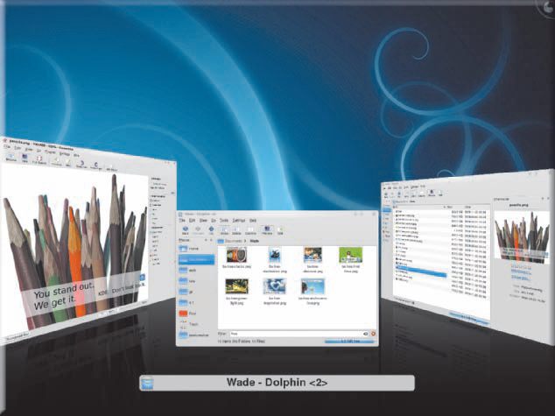
Unix
Runs on all computer types
32- or 64-bit
Very powerful, stable and fast
Command-line interface
Can cost thousands of dollars
Power users often work with UNIX because of its flexibility and power
Unix is a multitasking operating system developed in the early 1970s
Many versions of UNIX have a GUI

Slide 29
Unix
Composed of three parts Kernel, shell and the programs
Kernel is the hub of the Unix OS
  Functions of kernel is to allocate memory and time to the programs.
  handles system calls in response to storage of files and communication.
Shell acts as an interface between user and kernel.
  done through small process which takes place when a user logs in
Program which has a control over the login checks for the correct user name and password of every user who tries to login.
In Unix OS, everything is either a process or a file.
  A file can be considered as a collection of data which are created by the user by making use of text editors, running compilers etc.
  A process can be considered as a program which is under execution and is identified by a unique processor identifier (PID).

Slide 30
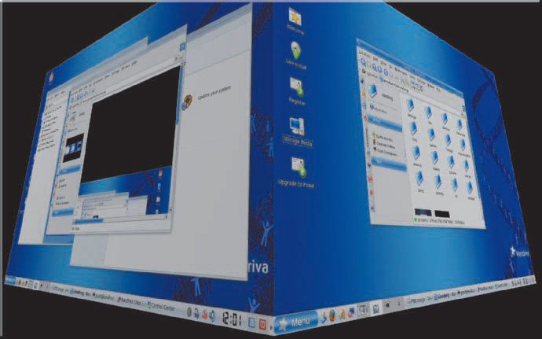
Linux
Open-source, popular, multitasking UNIX-type operating system
Free or inexpensive version of UNIX
32-bit OS
Very stable and fast
Most flavors are open source
X Windows GUI
  Command line interface is available
Some versions of Linux have a GUI
Supports multiple users and multiple processors
Can run on nearly any computer and can support almost any type of application

Slide 31
Linux
Includes many free programming languages and utility programs.
Promoters of open source software state two main advantages:
  users who modify the software share their improvements with others, and
  customers can personalize the software to meet their needs.
Two most popular GUIs available for Linux are GNOME and KDE.
Some companies such as Red Hat market software that runs on their own distribution of Linux.
Many application programs, utilities, and plug-ins have Linux distributions, including OpenOffice.org, StarOffice, Mozilla, Yahoo! Messenger, RealPlayer, QuickTime, and Acrobat Reader

Slide 32
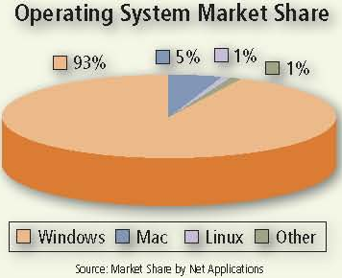
Market Share

Slide 33
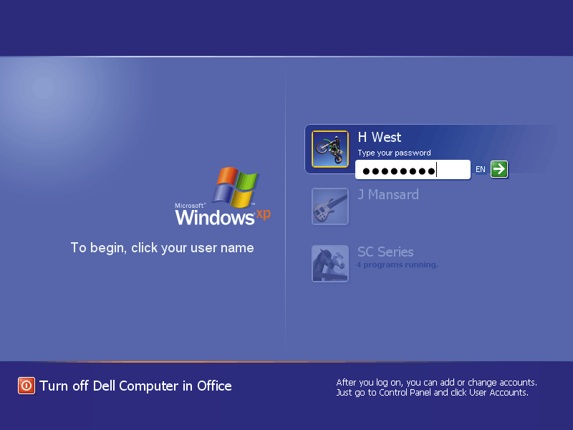
Network Operating System
Allows users to share printer, Internet access, files and programs on a network
Administrator security by establishing user name and password for each user
The “ other" computers are called client computers, and each computer that connects to a network server must be running client software designed to request a specific service

Slide 34
Network Operating Systems (NOS)
Fast and stable
Runs on servers
Multi-user and multitasking OS
32- or 64-bit
File and print sharing
  Users access the same files
  Hundreds of users use a printer
  Different OS can interact
Windows Server 2000, 2003, 2008, Unix, Linux, Solaris, Novell Netware
34
Notes:
Insider Information
Plug and play was introduced by Apple Computers.

Slide 35
NOS Features
Data integrity
  Backups copies data onto tape
  RAID copies data onto other drives
    Redundant Array of Inexpensive Disks
    Relies on two or more hard drives
    May speed access to data
Data security
  Access to data can be restricted
  Access to server resources is controlled
  Audits can be kept

Slide 36
Networking OS – NT Server
Same core as NT Workstation
Security features for grouping and authenticating users and controlling their access to network resources
Multi user capability added
supports the use of many hard disks, working together to store huge amounts of data
RAID support included
  can be configured to provide redundancy of data, writing the same data to multiple disks, so it is preserved in case one disk fails.
  All these features make it possible for Windows NT Server to ensure disk and data security even in the event of a catastrophic failure of a hard disk

Slide 37
Windows 2000 Server
Same technology as 2000 workstation
Active Directory (AD)
  Central database of server resources
  Simplifies network management
Distributed programs supported
Server Standard Edition
Advanced Server Edition
Data Center Edition
It includes the Advanced Server features, plus support for SMP with up to 32 processors.
Notes:
Teaching tip
Spend some time describing how distributed applications can reduce network needs.

Slide 38
Windows 2003 Server
Designed to compete with UNIX
XP like interface
Better support for XP computers
MS .NET framework supported
Distributed programs are supported
  Designed to support Web-based applications, large databases, ecommerce servers, and distributed applications, which are applications with parts that run on different computers, distributing the work and data across the network
Server Standard Edition
Data Center Edition

Slide 39
Windows 2008 Server
server operating system is based on the kernel (i.e. the core) of Windows Vista
offers increased reliability and flexibility in the server environment
Main features of Windows Server 2008
  PowerShell new command line
  User Interface like Windows Server 2003
  “Bitlocker” for the complete encoding of the hard disk
  Windows SharePoint services 3.0
  Network Access Protection (NAP) to isolate unsafe clients
  Windows Deployment Services (WDS)
  Windows System Resource Manager (WSRM)
  Windows Server Backup
  Include Hyper-V, a virtualization technology

Slide 40
Windows 2008 Server
Windows Server 2008 Standard
  capability of supporting up to a maximum of 4 GB RAM in its 32 bit version and 32 GB RAM in its 64 bit version.
  supports up to 4 processors and a maximum of 12 server roles.
Windows Server 2008 Enterprise
  capability of supporting up to a maximum of 64 GB RAM in its 32 bit version and 2 TB RAM in its 64 bit version.
  Supports up to 8 processors and a maximum of 17 server roles.
Windows Server 2008 DataCenter
  capability of supporting up to a maximum of 64 GB RAM in its 32 bit version and 2 TB RAM in its 64 bit version.
  Depending upon hardware, it is capable of supporting up to 64 processors and a maximum of 17 server roles. It is used in computer Centers and Clusters.
Windows Web Server 2008
  Capability of supporting up to a maximum of 4 GB RAM in its 32 bit version and 32 GB RAM in its 64 bit version.
  Support only the Web Server role.
Windows Server 2008 for Itanium-Based Systems for computers with 64-bit processors that function as a Web server

Slide 41
Unix for Servers
Oldest NOS in widespread use
Stable secure and fast
Main OS for Internet and Web
Large organizations depend on UNIX for managing large databases shared by hundreds or thousands of users
capable of handling a high volume of transactions in a multiuser environment and working with multiple processors using multiprocessing
Many Web servers use UNIX as their operating system

Slide 42
Linux for Servers
Popular in small businesses
Cost-effective alternative to other operating systems for sharing files, applications, printers, modems, and Internet services
Stable, fast and inexpensive
large number of Linux servers hosting Web sites and performing other roles on the Internet
Some network servers use Linux as their operating system
  Clients on the network can run Linux, UNIX, or Windows
Notes:
Insider information
The email service hotmail was originally hosted on Linux servers. Microsoft purchased Hotmail and moved it to Windows servers. It took Microsoft nearly a year to make Hotmail work as well on Windows as it did on Linux.

Slide 43
Solaris
a version of UNIX developed by Sun Microsystems, is a server OS designed specifically for e-commerce applications.
Manages high-traffic accounts and incorporates security necessary for Web transactions
Client computers often use a desktop program, such as GNOME desktop, that communicates with the Solaris OS

Slide 44
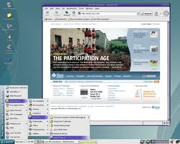
Solaris

Slide 45
Novell NetWare
Server OS designed for client/server networks.
  Server portion that resides on the network server and
  Client portion that resides on each client computer connected to the network
Supports open source software and runs on all types of computers from mainframes to personal computers.
Client computers also can have their own stand-alone OS such as a Windows, Mac OS, or Linux
Benefit is the long-term reliability of the product

Slide 46
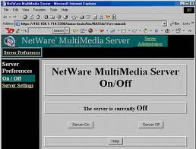
Novell Netware Desktop

Slide 47
Summary I
Operating System Evolution
Types of Operating Systems
Stand alone Operating Systems
  DOS
  Windows NT
  Windows 9x (Windows 95, 98 ME)
  Windows 2000
  Windows XP, Windows Vista, Windows 7
  Mac OS X
  Unix
  Linux
47

Slide 48
Summary II
Network Operating Systems
  Features
  Windows NT Server
  Windows 2000 Server
  Windows 2003 Server
  Windows 2008 Server
  Unix for Servers
  Linux for Servers
  Solaris
  Novell Netware
48

Slide 49
Recommended Websites
https://en.wikipedia.org/wiki/Operating_system
https://en.wikipedia.org/wiki/Microsoft_Windows
https://en.wikipedia.org/wiki/Unix
https://en.wikipedia.org/wiki/Mac_OS_X
https://en.wikipedia.org/wiki/Linux
https://en.wikipedia.org/wiki/List_of_operating_systems
https://en.wikipedia.org/wiki/IOS
https://en.wikipedia.org/wiki/NetWare
https://en.wikipedia.org/wiki/Mobile_operating_system
49

