Slide 1
CSC 101
Introduction to Computing
Lecture 15
Dr. Iftikhar Azim Niaz
ianiaz@comsats.edu.pk
1

Slide 2
Last Lecture Summary I
Hard Disk Controllers
  SATA
  EIDE
  SCSI and
  SAS
External and Removable Hard disks
RAID and Online Storage
Zip Disk
Tape Drive
2

Slide 3
Last Lecture Summary II
Optical Discs
How a Laser Reads Data
CD-ROM, CD-R, CD-RW,
PhotoCD, Archive CD
DVD ROM, DVR+/-R, DVD-RW, DVD-RAM
Drive speed and Writing time
Care of Optical Discs
3

Slide 4
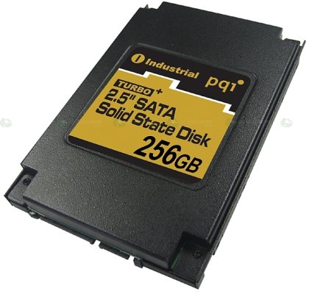
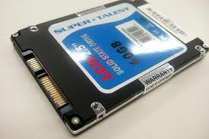
Solid State Storage Devices
Data is stored physically using switches
uses integrated circuit assemblies as memory to store data persistently.
No magnets or laser
Very fast data transfer
4

Slide 5
Solid State Storage Devices
Byte for byte, standard magnetic or optical storage is less expensive and more reliable than solid-state storage
Memory devices can move data in much less time than any mechanical storage device
  solid-state devices have no moving parts and
  store data electronically (the way it is used by the CPU).
Unlike standard devices, solid-state devices do not need to move ahead or sensor to find data or to convert it from magnetic or optical form into electronic form.
5

Slide 6
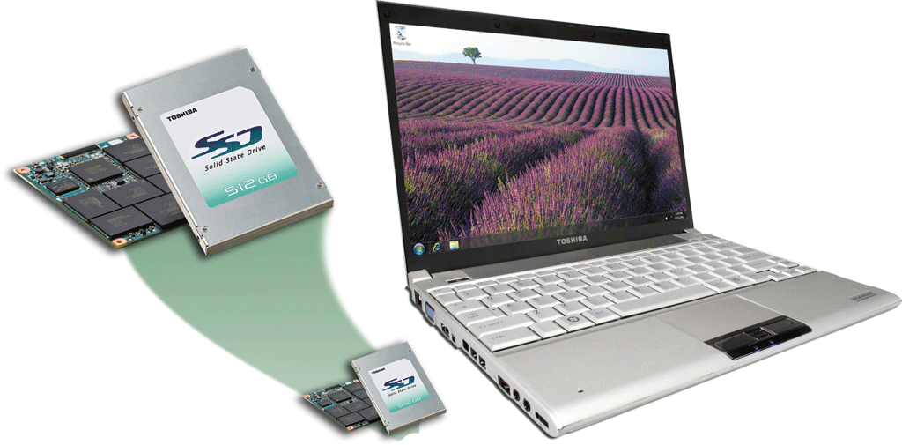
Solid State Drive
A storage device that typically uses flash memory to store data, instructions, and information
Available form factors of 3.5”in, 2.5 in, and 1.8 in
Used in all types of computers including
  servers, desktop computers, and mobile computers
  portable media players and digital video cameras
Storage capacities range from 16 GB to 256 GB and more

Slide 7
Solid State Drives
Solid State Drives (SSDs) have several advantages over magnetic hard disks:
Faster access time
Faster transfer rates
Generate less heat and consume less power
Last longer

Slide 8
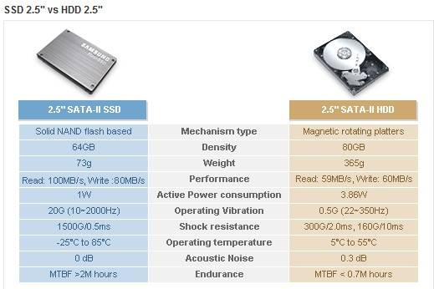
SSD vs HDD

Slide 9
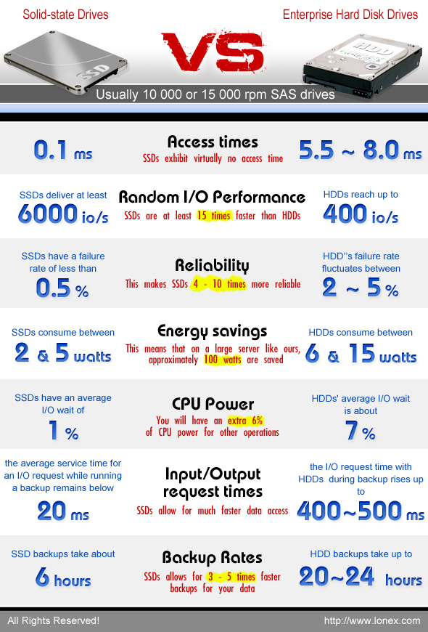

Slide 10
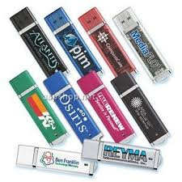
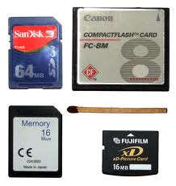
Flash Memory Storage
Type of nonvolatile memory that can be erased electronically and rewritten.
Long term updateable storage
Contains no moving parts makes them
  more durable and shock resistant
  than magnetic hard disks or optical discs.
Found in cameras and USB drives
Combination of RAM and ROM
10

Slide 11
Flash Memory Storage
A memory card is a removable flash memory device that you insert and remove from a slot in a computer, mobile device, or card reader/writer
CompactFlash (CF)
Secure Digital (SD)
Secure Digital High Capacity (SDHC)
microSD
microSDHC
xD Picture Card
Memory Stick
Memory Stick Micro (M2)

Slide 12
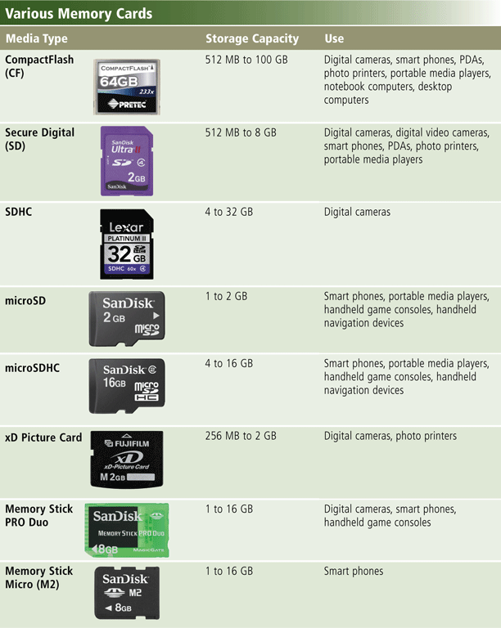
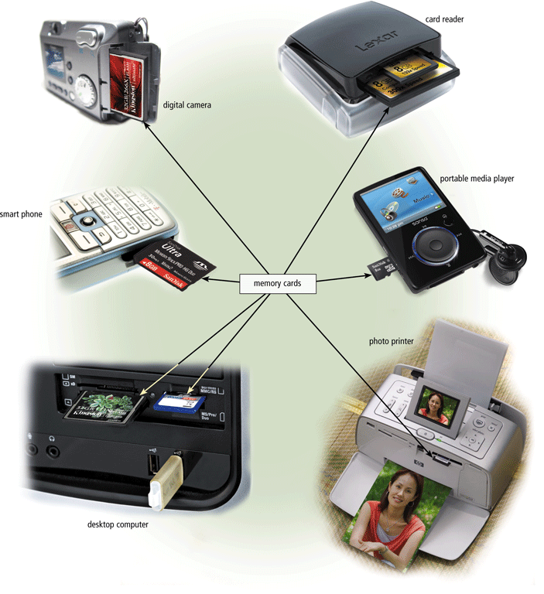
Flash Memory Storage

Slide 13
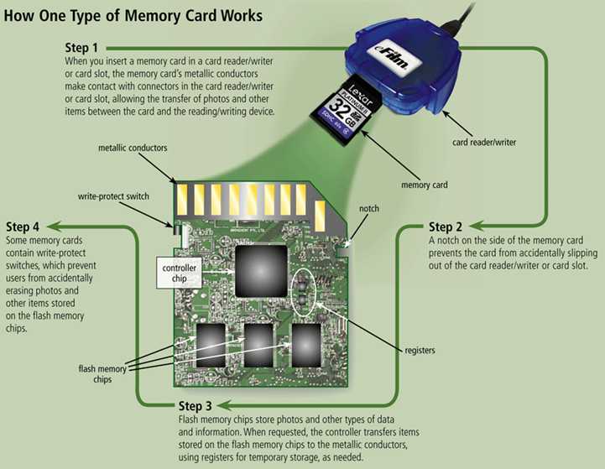
Flash Memory Storage

Slide 14
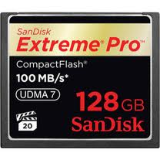
Compact Flash
used in portable electronic devices
Type I (3.3 mm thick) and the thicker Type II (CF2) cards (5 mm thick)
2 MB to 128 GB
Compact Flash IDE (ATA) speed is usually specified in "x" ratings, e.g. 8x, 20x, 133x
  133x rating means transfer speed of:
  133 * 150 KByte/s = 19,950 KByte/s
  ~ 20 MBps

Slide 15
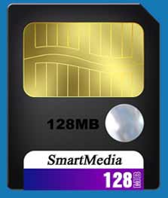
Smart Media
a flash memory card standard owned by Toshiba
capacities ranging from 2 MB to 128 MB.
Data transfer rate: 2MB/s
1,000,000 write cycles
10 year storage time without power
No longer manufactured.

Slide 16
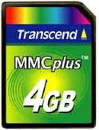
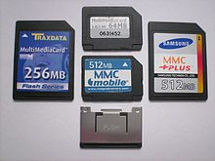
Multi Media Card (MMC)
About the size of a postage stamp
used mostly for a portable device
Sizes up to and including 128 GB
MMC, RS-MMC, MMCplus, MMCmobile
Data transfer
  MMC 20Mbps
  RS-MMC 20Mbps
  MMC mobile 20 Mbps
  MMC Plus 416Mbps
more or less superseded by SD (Secure Digital) card,

Slide 17
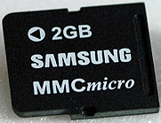
MMC Micro
micro-size version of MMC
even smaller and thinner than RS-MMC
backward compatible with MMC, and
can be used in full-size MMC and SD slots with a mechanical adapter
Storage capacity 16 MB - 2 GB
Data transfer speed
  Read Upto 10MBps – 66X
  Write upto 7 MBps – 4X

Slide 18
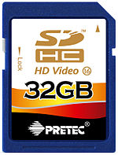
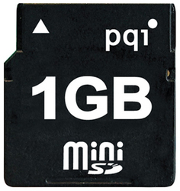
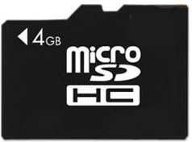
SD Cards
Capacity
  SDSC (SD): 1 MB to 2 GB,
  SDHC: 4 GB to 32 GB
  SDXC: ≥32 GB to 2 TB
Dimension
  Standard: 32×24×2.1 mm
  Mini: 21.5×20×1.4 mm
  Micro: 15×11×1.0 mm
Speed Class Rating
  2 – 10 MBps

Slide 19
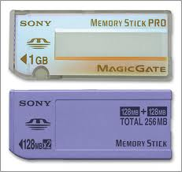
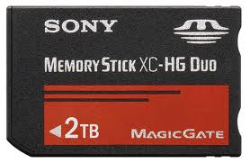

Memory Stick
Flash Memory Card
Capacity 4 MB to 256 GB (Maximum theoretical size: 2TB)
Different Variants
  Memory Stick Select
  Memory Stick PRO andDuo
  Memory Stick PRO-HG Duo
  Memory Stick Micro (M2)
Data Transfer Speed
  upto 60 MBps

Slide 20
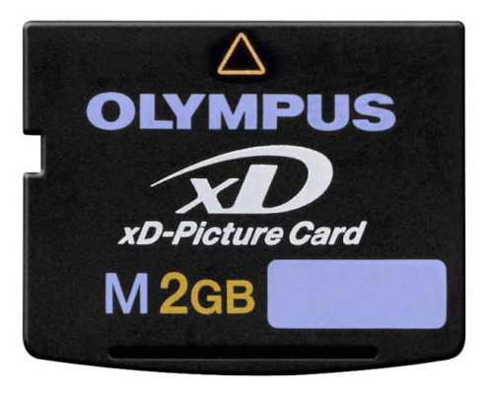
xD Picture Card
xD stands for Extreme Digital
used mainly in older digital cameras
Capacity
  Maximum 512 MiB (original)
  maximum 2 GiB (Type M/M+, Type H)
Dimensions 20 mm × 25 mm × 1.78 mm
Data Transfer Rate
  Read up to 6 MBps
  Write up to 4 MBps

Slide 21
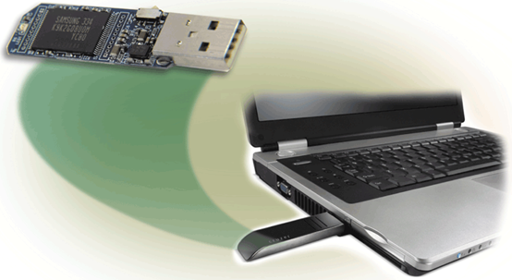
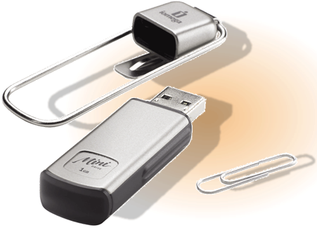
USB Flash Drive
Plug into a USB port on a computer or mobile device
Storage capacities up to 100 GB
Data transfer rates of about 12 MBps
Some USB flash drives include fingerprint readers, restricting access to authenticated users

Slide 22
Flash Drive Advantages
Use little power
Have no fragile moving parts, and
For most capacities are small and light
Data stored on flash drives is impervious to
  mechanical shock, magnetic fields,
  scratches and dust
Store data densely compared to many removable media

Slide 23
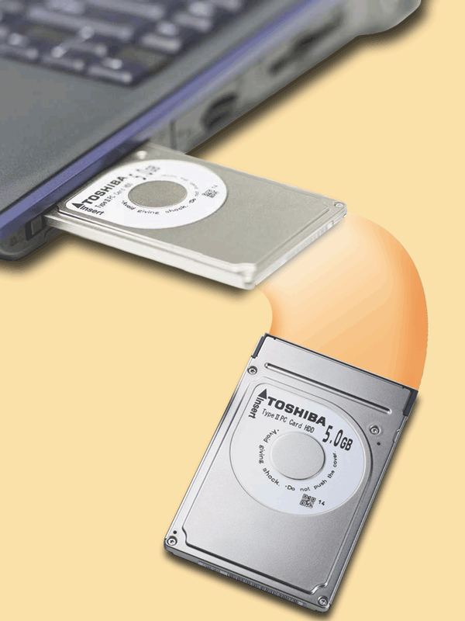
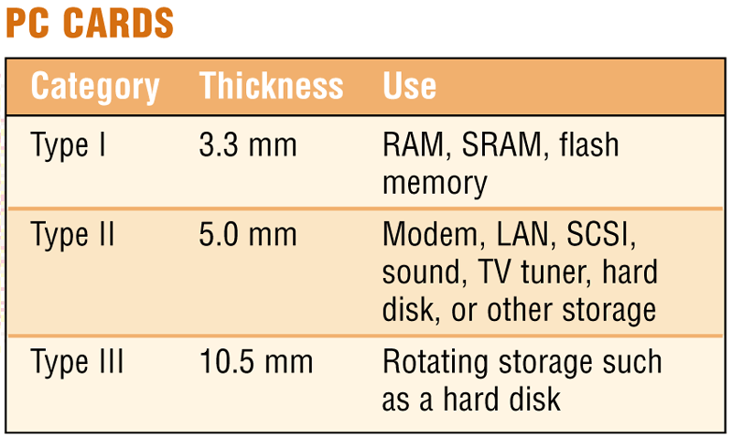
PC Cards
Adds capabilities to computer
Credit-card sized device commonly used in notebook computers
Replaced by Express card

Slide 24
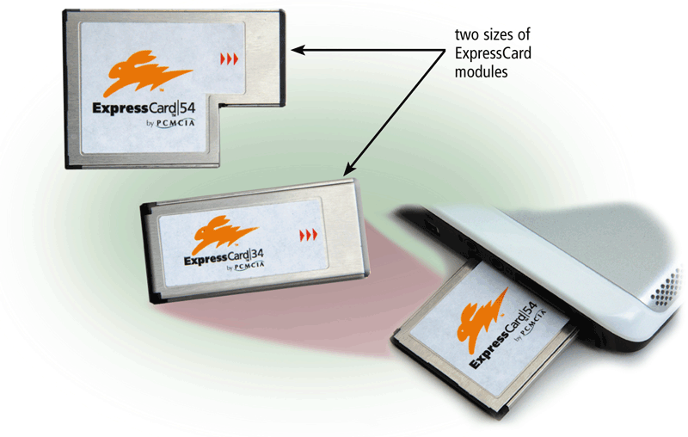
ExpressCard Module
Removable device that fits in an Express Card slot
About 75 mm long and 34 mm wide or L-shaped with a width of 54 mm
Developed by the PCMCIA
Commonly used in notebook computers

Slide 25
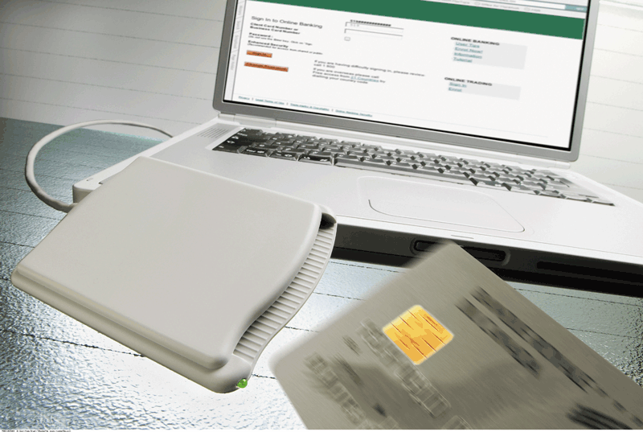
Smart Cards
Stores data on microprocessor embedded in small card
Input, process, output and storage capabilities
Communicates with external services via card-reading devices, such as ticket readers, ATMs

Slide 26
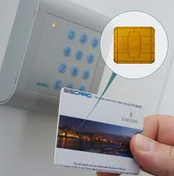
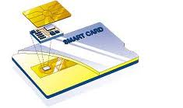
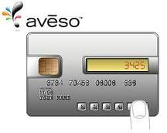
Smart Cards
Credit cards with a chip
Chip stores data
Eventually may be used for cash
Hotels use for electronic keys
26

Slide 27
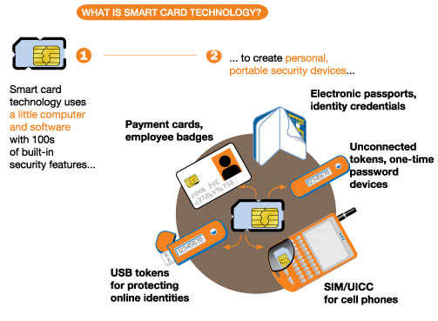
Smart Card Technology
27

Slide 28
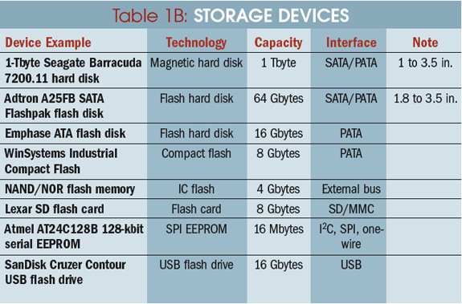
Storage Devices Comparison
28

Slide 29
Other Type of Storage
PC Card
Magnetic stripe cards and smart cards
Microfilm and microfiche
Enterprise storage

Slide 30
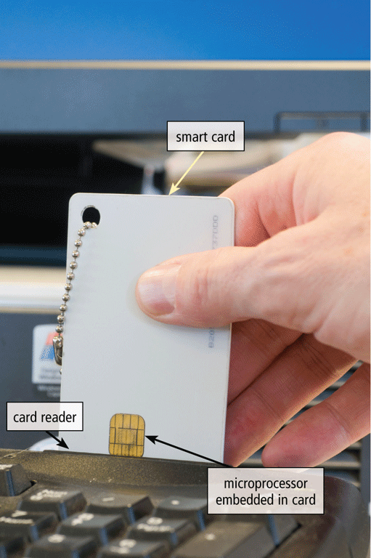
Magnetic Strip
A magnetic stripe card contains a magnetic stripe that stores information
A smart card stores data on a thin microprocessor embedded in the card

Slide 31
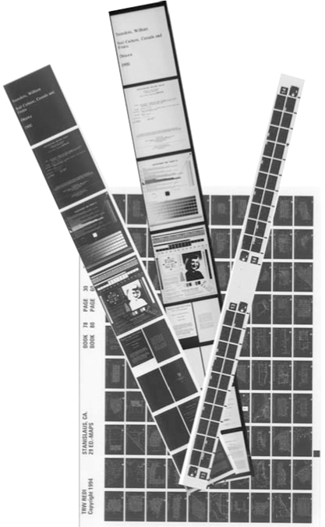
Microfilm and Microfiche
Store microscopic images of
documents on roll or sheet of film
Images recorded using
computer output microfilm recorder
Microfilm — 100- to
215-foot roll of film
Microfiche — small sheet of film, usually 4” × 6”

Slide 32
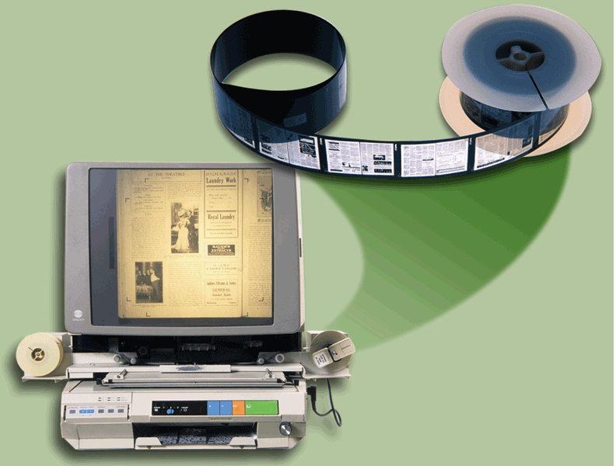
Microfilm Advantages
greatly reduce the amount of paper firms must handle
longest life of any storage media and
inexpensive

Slide 33
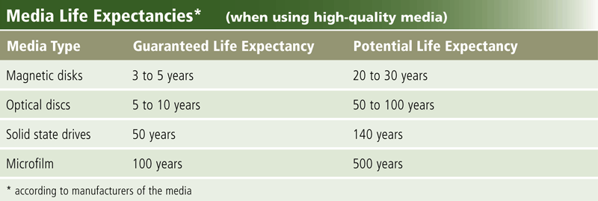
Media Life Expectancies

Slide 34
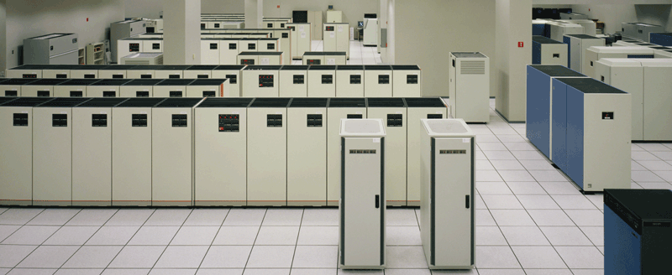
Enterprise Storage Devices
Enterprise storage stores huge volumes of data and information for large businesses
  Uses special hardware for heavy use, maximum availability, and maximum efficiency

Slide 35
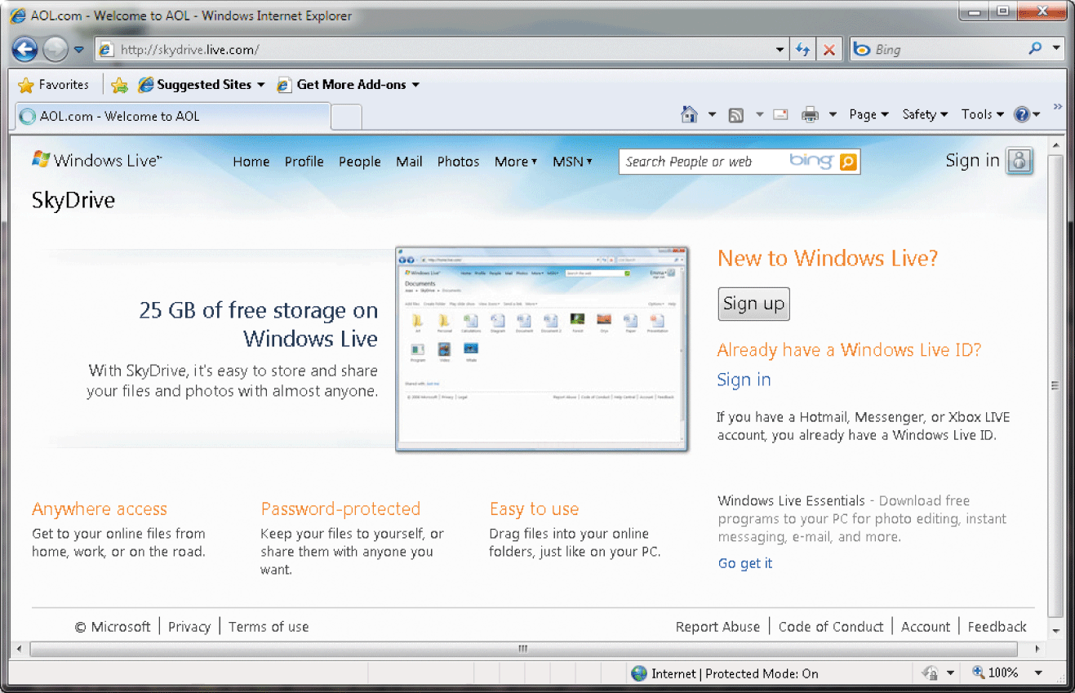
Cloud Storage
Cloud storage is an Internet service that provides storage to computer users

Slide 36
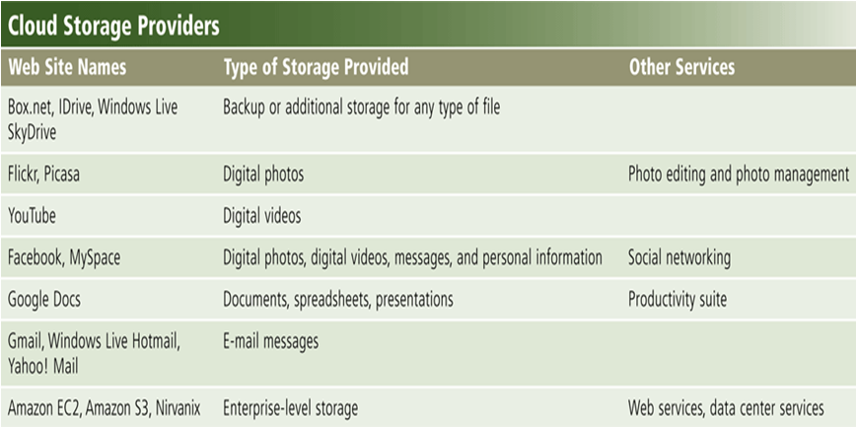
Cloud Storage

Slide 37
Cloud Storage
Users subscribe to cloud storage for a variety of reasons:
Access files from any computer
Store large files instantaneously
Allow others to access their files
View time-critical data and images immediately
Store offsite backups
Provide data center functions
37
Notes:
Teaching tip
Bit size tends to confuse students. A simple example clarifies the importance of bit size. Consider two equal computers, one has a 32-bit processor, the other a 64 bit processor. With all other items equal, the 64-bit processor will handle twice the data the 32 bit processor handles. This is like driving a car at 55 Mph then doubling it to 110 Mph.

Slide 38
Drive Performance
Average Access Time
Data Transfer Rate

Slide 39
Average Access Time
Also known as seek time
Time to find desired data
Measured in milliseconds
Depends on two factors
  RPM
  Time to access a track
Hard drive between 6 and 12 ms
CD between 80 and 800 ms
Notes:
Teaching tip
To provide contrast, present the speed of memory as measured in the nanoseconds, or billionth of a second. Then discuss virtual RAM as defined earlier in the text. More RAM, less virtual RAM makes a faster machine.

Slide 40
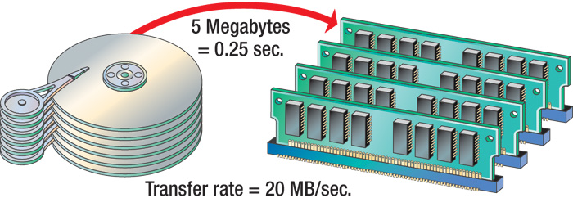
Data Transfer Rate
How fast data can be read
Measured in Bps or bps
Hard drive ranges from 15 to 160 MBps
CD ROMS depend on X factor
  24x CD transfers 24 x 150 KBps
  Floppy disks transfer at 45 KBps
Notes:
Insider information
Most hard disks do not list the time to access a track. This is a good topic to tread lightly with.

Slide 41
Optimizing Performance
PCs performance can slow down
Disk optimization
  Handled by operating system tool
  Routine disk maintenance
  Optimization should be run monthly

Slide 42
Maintaining Hard Disks
Manufacturer give guarantee for 3-5 years
regularly should perform preventive maintenance such as defragmenting or scanning the disk for errors
Disk Clean up removes unused files from a hard disk so that the computer does not have to spend time searching through and accessing unneeded files, and
Disk Defragmenter reorganizes the data on a hard disk so that the data can be accessed more quickly

Slide 43
Disk Clean Up
Clean up unnecessary files
  Delete temp files
  Uninstall unused programs
  Delete obsolete data files
  Files should be cleaned weekly
Notes:
Teaching tip
Figure 6B.3 on page 249 shows the disk cleanup utility for Windows XP.

Slide 44
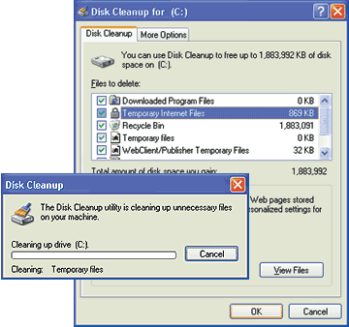
Disk Cleanup
by removing any programs and data that are not required
for the computer.

Slide 45
Scan a disk for Errors
Bad spots on the media
Find and fix the error
  Move data to a good spot
  Mark the spot as bad
Disks should be scanned monthly

Slide 46
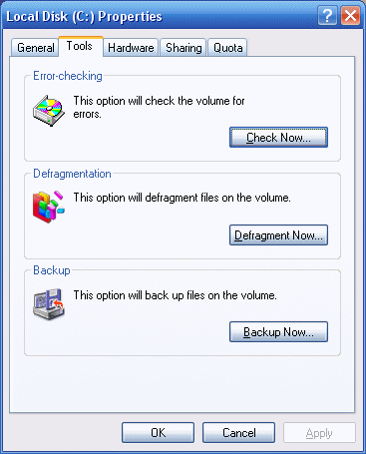
Checking Disk Errors
To do a complete scan of the disk and correct any errors that are found
Place a checkmark in the ‘Scan for and attempt recovery of bad sectors’ check box, and
then click the Start button.

Slide 47
Defragmentation
Defragment a disk
  Files fragment when resaved
  Fragmented files load slower
  Defragment puts the fragments together
  Disks should be defragged monthly
Notes:
Insider information
Windows 9x required the screen saver to be disabled before running scan or defrag. Failing to disable the screen saver could lead to catastrophic data loss!

Slide 48
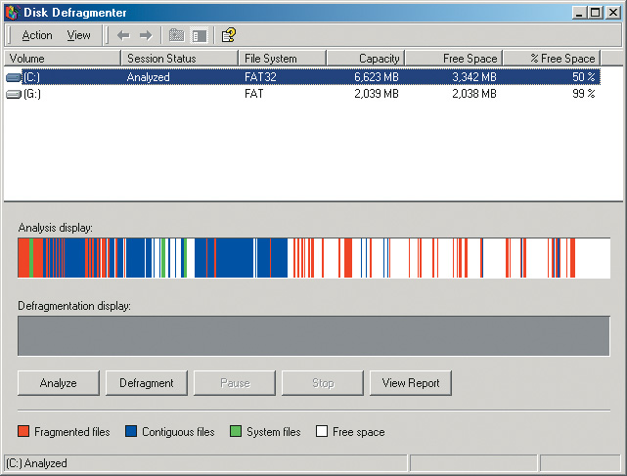
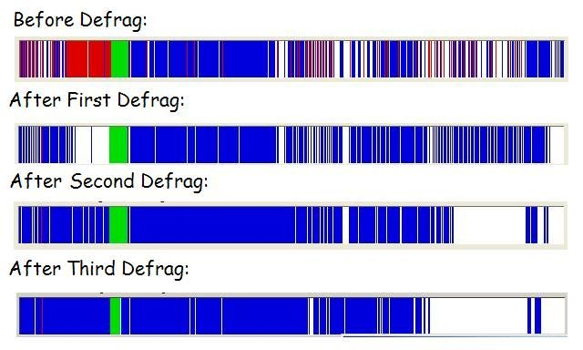
Defragmentation
Which combines all files so that no files are stored in a noncontiguous manner
The defragmentation process can consume more than one hour in some cases.
You can cancel the operation at any time by clicking the Stop operation button in the Disk Defragmenter window

Slide 49
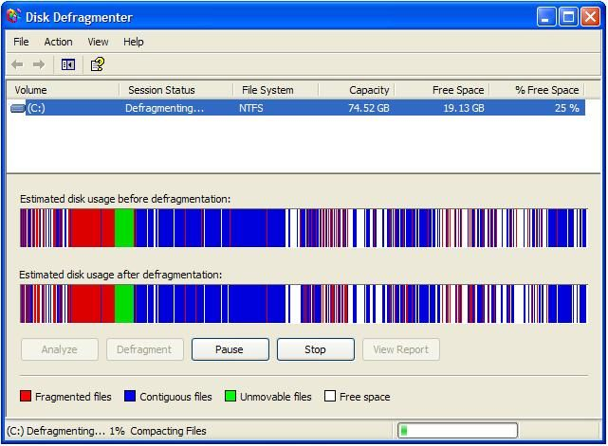
Defragment

Slide 50
File Compression
Shrinks the size of a file
Takes up less space on disk
Reduce a disks performance
Will increase disk capacity
PKZip, WinZip and WinRAR
Notes:
Teaching tip
MP3s are created using compression. If a audio song is recorded on a hard drive, the required storage is about 1 MB per second. When the MP3 compression is applied, the size is reduced to about 1 MB per minute.
Windows XP provides several compression routines. It provides for .zip file compression and archive creation. Zip archives can be accessed like normal folders. Folders can be compressed to shrink the contents. Finally, the entire disk can be compressed .

Slide 51
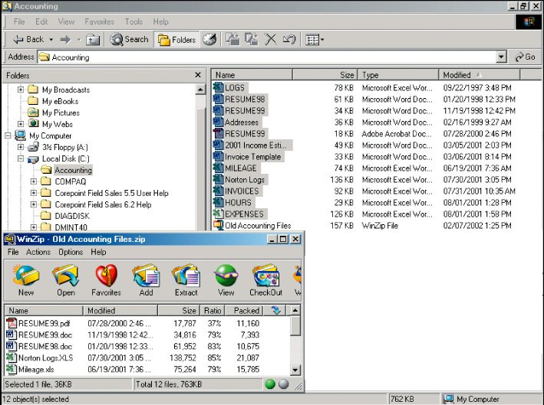
File Compression
763 KB
on disk
Compressed
157 KB

Slide 52
Putting it All Together
w
Home user
• 500 GB hard disk
• Cloud storage
• Optical disc drive
• Card reader/writer
• USB flash drive
Small Office/Home Office user
• 1 TB hard disk
• Cloud storage
• Optical disc drive
• External hard disk for backup
• USB flash drive
Mobile
• 250 GB hard disk
• Cloud storage
• Optical disc drive
• Card reader/writer
• Portable hard disk for backup
• USB flash drive

Slide 53
Putting it All Together
Power User
• 2.5 TB hard disk
• Cloud storage
• Optical disc drive
• Portable hard disk for backup
• USB flash drive
Enterprise User
(desktop computer)
• 1 TB hard disk
• Optical disc drive
• Smart card reader
• Tape drive
• USB flash drive
Enterprise User
(server or mainframe)
• Network storage server
• 40 TB hard disk system
• Optical disc server
• Microfilm or microfiche
w

Slide 54
Summary I
Solid State Devices
Flash Memory Storage
  Compact Flash (CF)
  Secure Digital (SD) MicroSD
  Secure Digital High Capacity (SDHC) MicroSDHC
  xD Picture Card
  Memory Stick Memory Stick Micro (M2)
  PC Card Express Card
  Smart Card
  Magnetic Strip and Microfilm
54

Slide 55
Summary II
Enterprise Storage Devices
Cloud Storage
Drive Performance
  Average Access time
  Data Transfer Rate
Optimizing Performance
  Disk Clean UP
  Check Disk for Errors
  Defragmentation
  File Compression
55

Slide 56
Recommended Websites
https://en.wikipedia.org/wiki/Solid_state_drives
https://en.wikipedia.org/wiki/Memory_card
https://en.wikipedia.org/wiki/Comparison_of_memory_cards
https://en.wikipedia.org/wiki/Cloud_storage
https://en.wikipedia.org/wiki/Defragmentation
https://en.wikipedia.org/wiki/Disk_cleanup
https://en.wikipedia.org/wiki/CHKDSK
56

