Slide 1
CSC 101
Introduction to Computing
Lecture 14
Dr. Iftikhar Azim Niaz
ianiaz@comsats.edu.pk
1

Slide 2
Last Lecture Summary
Describing Storage Devices
  Operations, Votality
Storage Capacity and Access Time
Magnetic Storage Devices
  Formatting, Track, Sector, Cylinder
  FAT 16, FAT 32, NTFS
Floppy disk
  Characteristics, Parts, Capacity, Operation
Hard disk
  Characteristics, parts, operations, formatting
2

Slide 3
Hard Disk Controller
A disk controller consists of a special-purpose chip and electronic circuits that control the transfer of data, instructions, and information from a disk to and from the system bus and other components of the computer
SATA
EIDE
SCSI
SAS

Slide 4
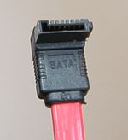
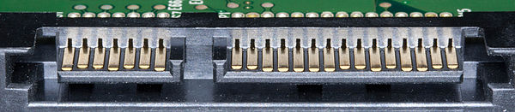
Hard Disk Controllers
SATA (Serial AT Attachment)
  Bus interface for connecting host bus adapters to mass storage devices
communicate via a high-speed serial cable over two pairs of conductors
SATA rev 3.0 (released in 2009_
  Raw bandwidth 6000 Mbps
  Transfer Speed 600MBps

Slide 5
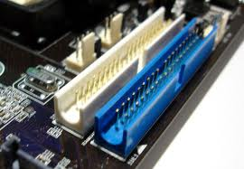
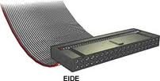
EIDE
Enhanced Integrated Drive Electronics
uses parallel signals to transfer data, instructions, and information.
can support up to four hard disks at 137 GB per disk.
data transfer rates up to 133 MBps.
provide connections for optical disc drives and tape drives

Slide 6
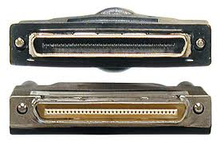
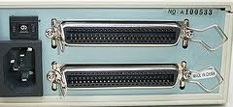
SCSI
Small Computer System Interface
an intelligent, peripheral, buffered, peer to peer interface
use parallel signals, can support up to eight or fifteen peripheral devices
provide up to 640 MBps data transfer rates

Slide 7
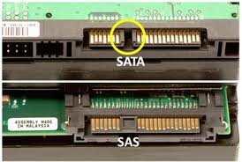
SAS
Serial Attached SCSI
uses serial signals to transfer data
allows up to 65,535 devices through the use of expanders
data transfer rates of 750 MBps and higher
Advantages
  thinner, longer cables
  reduced interference
  less expensive
  Faster speed and
  support for many more connected devices at once

Slide 8
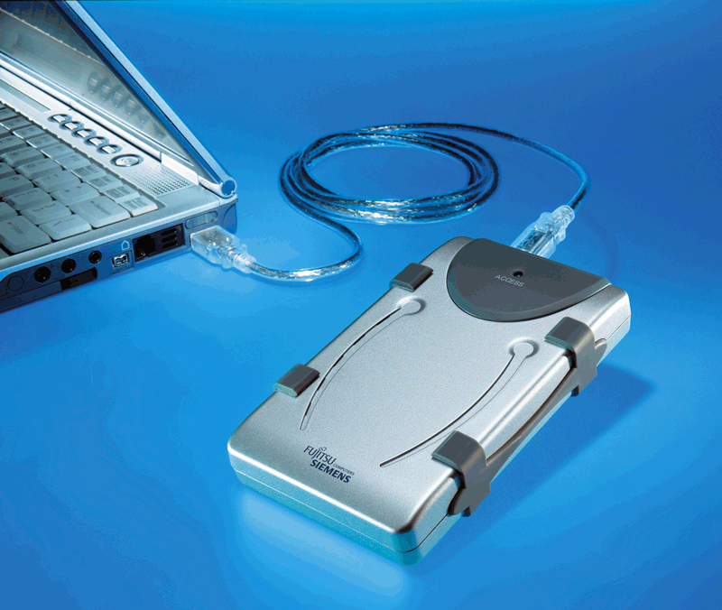
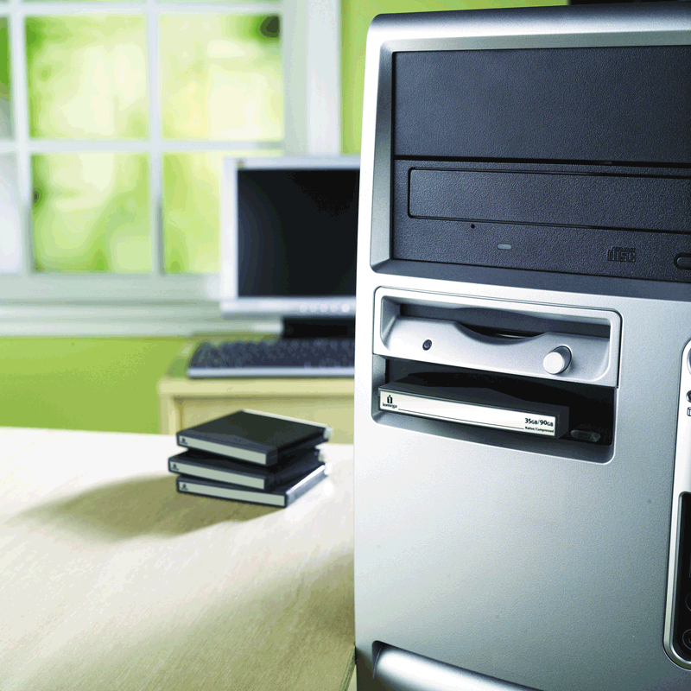
External and Removable Hard Disks
Used to back up or transfer files
Storage capacities > 1TB
Slower transfer rate than internal Hard disks
External hard disk—freestanding
hard disk that connects to system unit thru USB or Firewire port
Removable hard disk—hard disk that you insert and remove from hard disk drive

Slide 9
External Hard disks
An external hard disk is a separate free-standing hard disk that connects to your computer with a cable or wirelessly
A removable hard disk is a hard disk that you insert and remove from a drive
Internal and external hard disks are available in miniature sizes (miniature hard disks)

Slide 10
External Hard Disks - Advantages
Transport a large number of files
Back up important files or an entire internal hard disk (several external hard disk models allow you to back up simply by pushing a button on the disk)
Easily store large audio and video files
Secure your data; for example, at the end of a work session, remove the hard disk and lock it up, leaving no data in the computer
Add storage space to a notebook computer, including notebooks and Tablet PCs
Add storage space to a desktop computer without having to open the system unit or
connect to a network

Slide 11
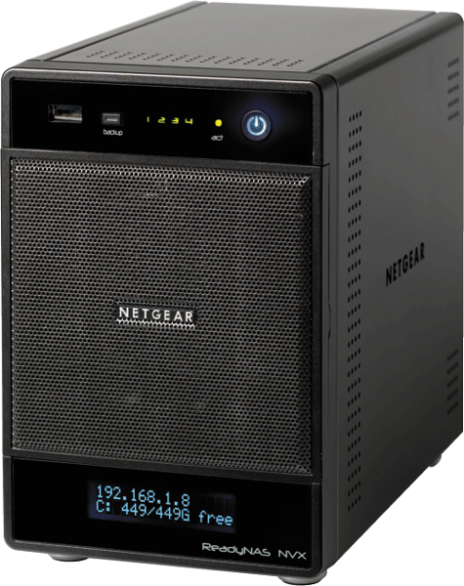
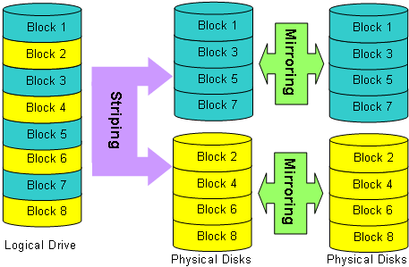
RAID
RAID (redundant array of independent disks) is a group of two or more integrated hard disks
A network attached storage (NAS) device is a server connected to a network with the sole purpose of providing storage

Slide 12
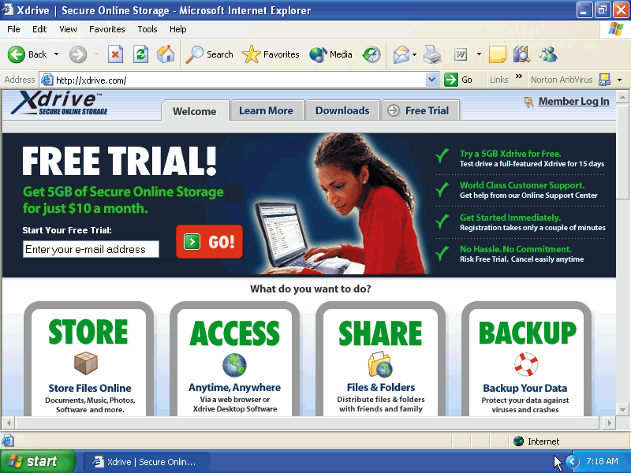
Online Storage
Services on web that provides storage for minimal monthly fee
Files can be accessed from any computer with Web access
Large files can be downloaded instantaneously
Others can be authorized to access your data

Slide 13
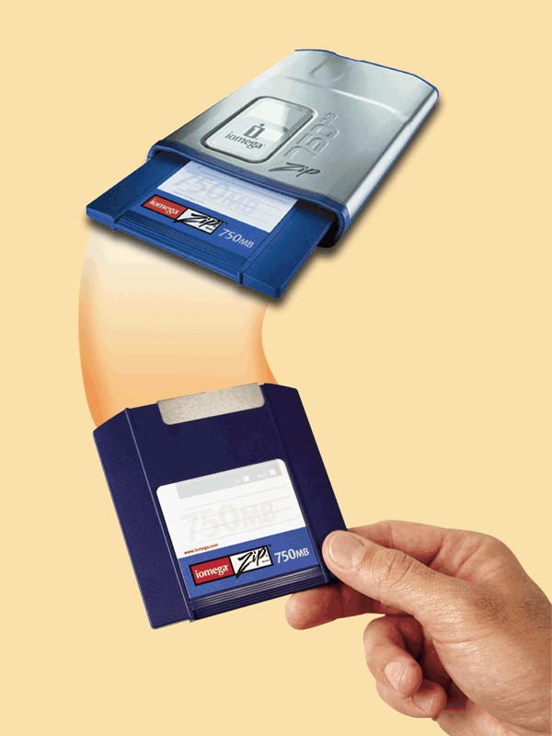
Zip Disk
Magnetic medium that stores 100 MB to 750 MB of data
Used to back up and to transfer files
  Backup is duplicate of file, program, or disk in case original is lost
Zip disks require a Zip drive —high capacity drive that reads from and writes on a Zip disk
c

Slide 14
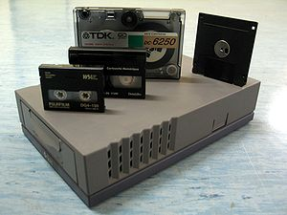
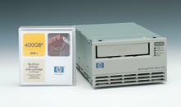
Tape Drives
Tape is a magnetically coated ribbon of plastic capable of storing large amounts of data and information at low costs
A tape drive reads and writes data and information on a tape
Best used for
  Infrequently accessed data
  Back-up solutions
14
Notes:
Teaching tip
Students often do not understand why random access hard drives and floppy drives are faster than sequential drives. To illustrate, compare the modern audio CD to the antiquated 8-track. On a CD if you wish to hear song 1 over and over, you simply press repeat. In an 8-track, you often must play the entire tape before the song can be repeated.

Slide 15
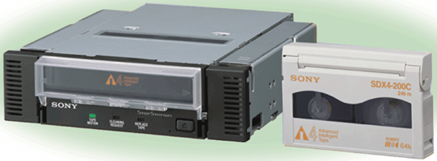
Data Storage on Tape
Slow Sequential Access
  Reads and writes data consecutively, like music tapes
  Unlike direct access – used on floppy disks, Zip disks, Hard Disk, CDs and DVDs – which can locate particular item immediately
Capacity exceeds 200 GB

Slide 16
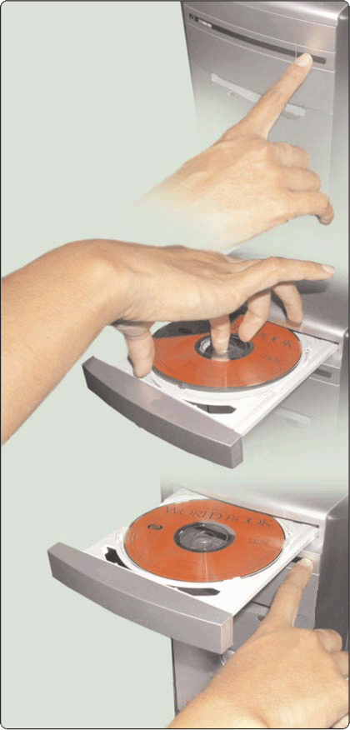
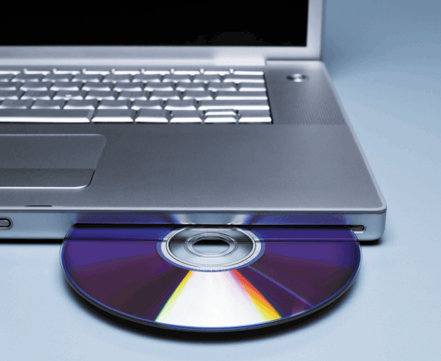
Optical Disks
An optical disc consists of a flat, round, portable disc made of metal, plastic, and lacquer that is written and read by a laser
Typically store software, data, digital photos, movies, and music
Read only vs. rewritable
Push the button to
slide out the tray.
Insert the disc,
label side up.
Push the same button to close the tray.

Slide 17
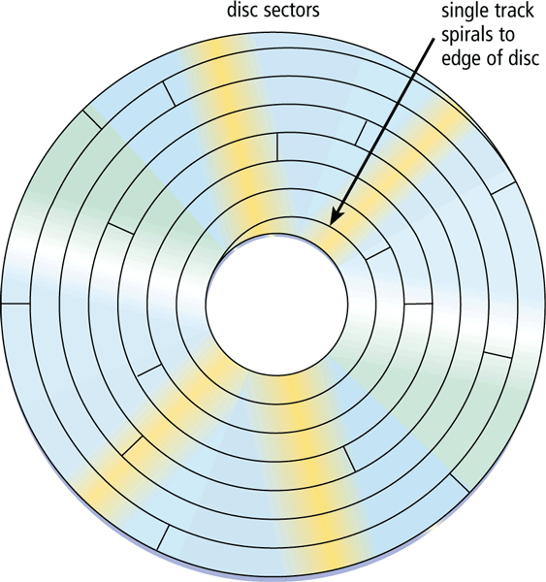
Optical Disks
Optical discs commonly store items in a single track that spirals from the center of the disc to the edge
Track is divided into evenly sized sectors

Slide 18
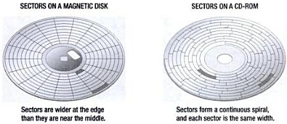
Arrangement of Sectors

Slide 19
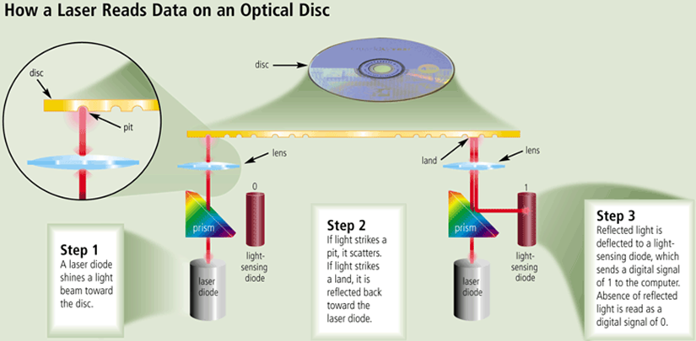
How a Laser Reads Data
w

Slide 20
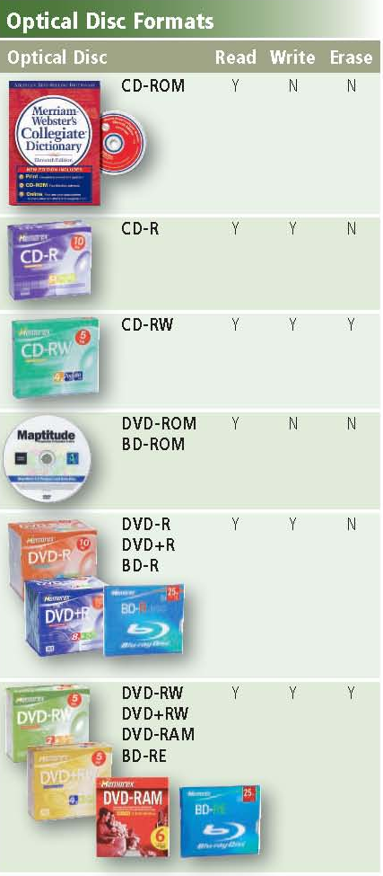
Disc formats

Slide 21
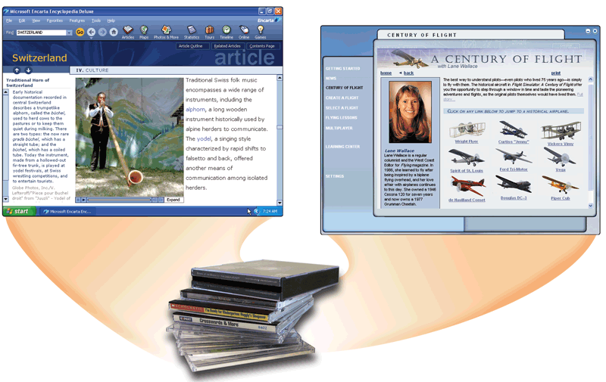
CD-ROM
Compact Disc Read-Only Memory
Cannot erase or modify contents
Commonly used to distribute multimedia and complex software

Slide 22
CD-ROM
Most software ships on a CD
Read using a laser
  Lands, binary 1, reflect data
  Pits scatter data
Written from the inside out
CD speed is based on the original
  Original CD read 150 Kbps
  A 10 X will read 1,500 Kbps
Standard CD holds 650 MB or 700 MB of data
  74 or 80 minutes of Audio
22

Slide 23

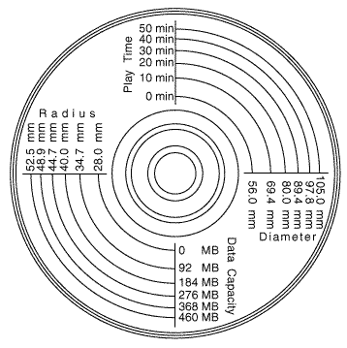
CD ROM Size and Capacity
A CD-ROM can be read from but not written to
  Read from a CD-ROM drive or CD-ROM player
23

Slide 24

CD Recordable (CD-R)
A CD-R is a multisession optical disc on which users can write, but not erase
Create a data or audio CD
Data cannot be changed
Can continue adding until full
Most CD-Rs on the market have an 80 minute capacity. There are also 90 minute/790 MB and 99 minute/870 MB discs, although they are less common
24

Slide 25

CD Rewritable (CD-RW)
A CD-RW is an erasable multisession disc
  Must have a CD-RW drive
Create a reusable CD
Require a more sensitive laser optics
CD-RW discs need to be blanked before reuse
Cannot be read in all CD players
Can reuse about 100 times
25
Notes:
Insider Information
When a CD-R or RW is ‘burned’, the laser modifies the reflectivity of a dye that is sandwiched between the bottom clear layer and a top reflective layer. The lands are transparent sections while the pits are non-reflective.

Slide 26
Photo CD
Developed by Kodak
Provides for photo storage
Photos added to CD until full
Original pictures cannot be changed
Discs were designed to hold nearly 100 high quality images, scanned prints and slides using special proprietary encoding
Single-session CD-ROM that stores digital versions of film
Typically uses a 1024 x 1536 resolution
26

Slide 27
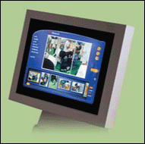
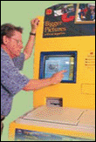
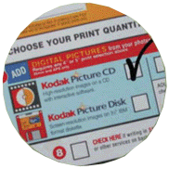

Picture CD
Stores digital
versions of
roll of film
Film developers
offer
Picture CD
service
Can be
modified
using photo
editing software
Step 1.
Drop off film to be developed. Mark the Picture CD box on the film-processing envelope.
Step 3.
At home, print images
from Picture CD on
your ink-jet photo printer.
Step 2.
When you pick up prints and negatives, a Picture CD contains digital images of each photograph.
At a store, print images to Picture CD at kiosk.

Slide 28
Archive Disc
Archive disc
Stores photos from an online photo center
Resolution usually is 7200 pixels per photo
Cost is determined by the number of photos being stored

Slide 29
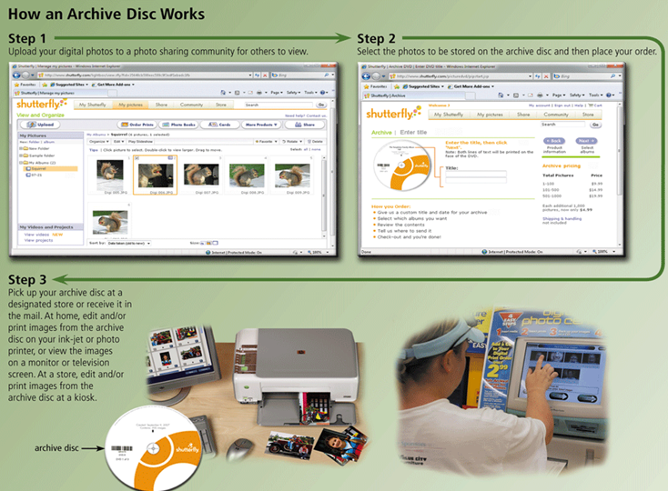
How an Archive Disc Works
w

Slide 30
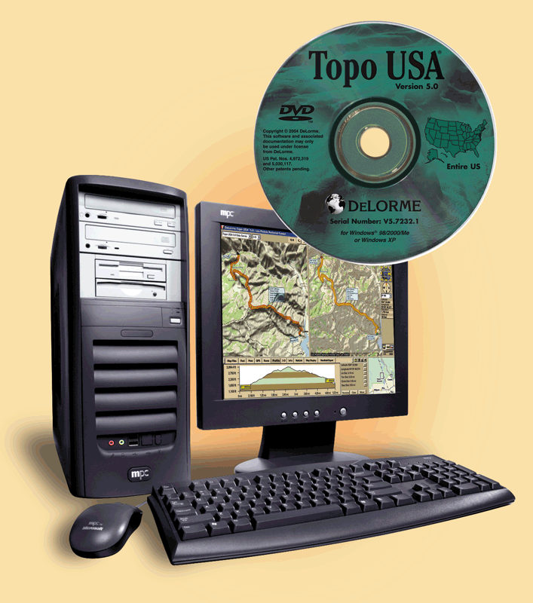
DVD-ROM
Digital versatile disc-ROM or digital video disc-ROM)?
High Capacity disc capable of storage 4.7 GB to 17 GB
Must have DVD-ROM drive or DVD Player to read DVD-ROM
Stores databases, music, videos, movies, complex software

Slide 31
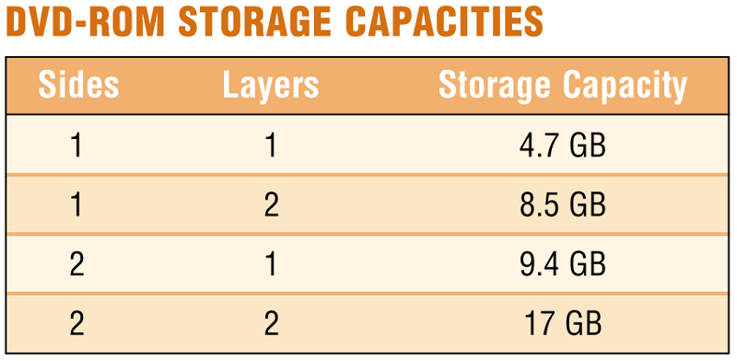
How DVD-ROM Stores Data
Two layers of pits are used, lower layer is semi transparent so laser can read through
Some are double sided

Slide 32
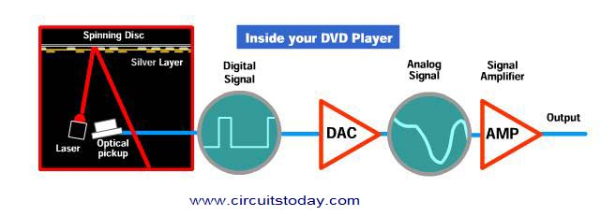
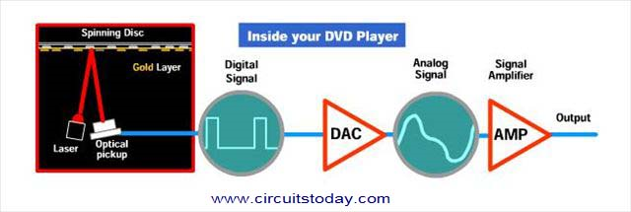
DVD working
http://www.circuitstoday.com/working-of-dvd-player
32

Slide 33
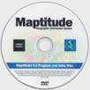
DVD-ROM
A DVD-ROM is a high-capacity optical disc on which users can read but not write or erase
  Requires a DVD-ROM drive
Create a data or audio CD
Data cannot be changed because data can only be read and not written nor erased.
Can continue adding until full i.e. multisessions
33

Slide 34

DVD-RW
DVD-RW, DVD+RW, and DVD+RAM are high-capacity rewritable DVD formats
Create a reusable DVD
Cannot be read in all DVD players
Can reuse about 1000 times
34
Notes:
Insider Information
When a CD-R or RW is ‘burned’, the laser modifies the reflectivity of a dye that is sandwiched between the bottom clear layer and a top reflective layer. The lands are transparent sections while the pits are non-reflective.

Slide 35
DVD-R
Several different formats exist
None are standardized
Allows home users to create DVDs
Cannot be read in all players
Disk Type | Data sectors (2,048 each) | Capacity
 |  | bytes | GB
DVD-R (SL) | 2,298,496 | 4,707,319,808 | 4.7
DVD+R (SL) | 2,295,104 | 4,700,372,992 | 4.7
DVD-R DL | 4,171,712 | 8,543,666,176 | 8.5
DVD+R DL | 4,173,824 | 8,547,991,552 | 8.5
SL / DL – Single/Dual layer
35

Slide 36
DVD RAM
Allow reusing of DVD media
Long life - can be rewritten 100,000 times
Reliable writing of discs
Very fast access of small files on disc
Finalization not necessary
Disadvantages
  Not standardized
  Higher Media Cost
  Cannot be read in all players
  Less compatibility than DVD+RW and DVD-RW
36

Slide 37
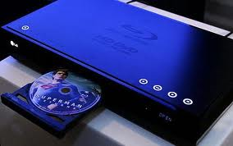

Blu-ray Disc
Optical disc storage medium
Standard physical media 12 cm
Single layer discs 25 GB capacity
Dual layer discs 50 GB capacity
A Blu-ray Disc-ROM (BD-ROM) has a storage capacity of XL 4 L 100 GB
37

Slide 38
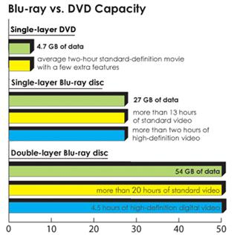
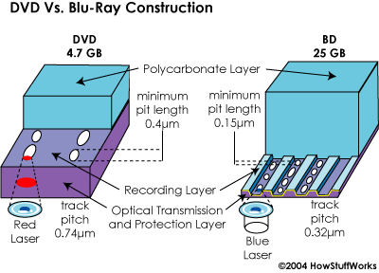

Slide 39
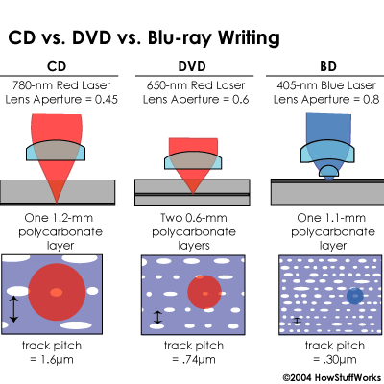
39

Slide 40
Data Transfer Rate
Generation | Base 1x | Max
 | (Mbit/s) | (Mbit/s) | X
1st CD | 1.17 | 65.62 | 56x
2nd DVD | 10.55 | 210.94 | 20x
3rd Blu Ray | 36.00 | 432.00 | 12x
Notes:
A 1× speed CD drive reads 75 consecutive sectors per second.

Slide 41
Drive Speed and Writing Time
Drive speed | Data rate (MB/s) | Data rate (Mbit/s) | Write time for single-layer DVD-R
1X | 1.32 MB/s | 10.56 Mbit/s | 60 minute
2X | 2.64 MB/s | 21.12 Mbit/s | 30 minutes (CLV)
4X | 5.28 MB/s | 42.24 Mbit/s | 15 minutes (CLV)
8X | 10.56 MB/s | 84.48 Mbit/s | 8 minutes (Z-CLV)
16X | 21.12 MB/s | 168.96 Mbit/s | 5.75 minutes (CAV)
18X | 23.76 MB/s | 190.08 Mbit/s | 5.5 minutes (CAV)
20X | 26.40 MB/s | 211.20 Mbit/s | 5 minutes (CAV)
22X | 29.04 MB/s | 232.32 Mbit/s | 4.5 minutes (CAV)
24x | 31.68 MB/s | 253.44 Mbit/s | ~4.0 minutes (CAV)
CLV – Constant Linear Velocity
CAV – Constant Angular Velocity
41

Slide 42
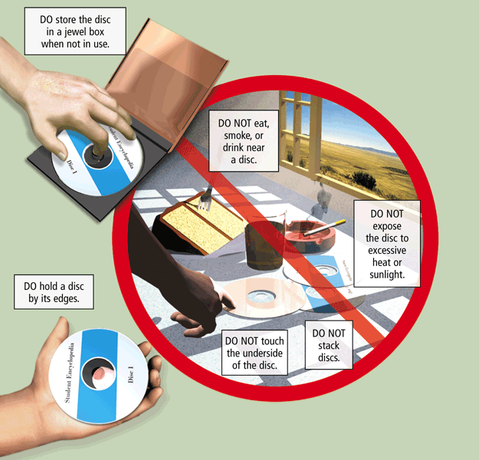
Care of Optical Discs

Slide 43
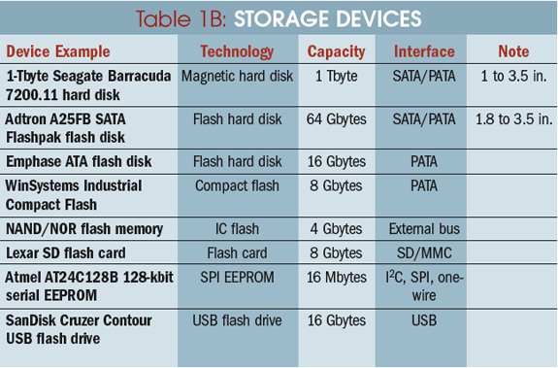
Storage Devices Comparison
43

Slide 44
Summary
Hard Disk Controllers
  SATA, EIDE, SCSI and SAS
External and Removable Hard disks
RAID and Online Storage
Zip Disk
Tape Drive
Optical Discs
  How a Laser Reads Data
  CD-ROM, CD-R, CD-RW, PhotoCD, Archive CD
  DVD ROM, DVR+/-R, DVD-RW, DVD-RAM
  Drive speed and Writing time
  Care of Optical Discs
44

Slide 45
Recommended Websites
https://en.wikipedia.org/wiki/SATA
https://en.wikipedia.org/wiki/Parallel_ATA
https://en.wikipedia.org/wiki/Serial_attached_SCSI
https://en.wikipedia.org/wiki/SCSI
https://en.wikipedia.org/wiki/RAID
https://en.wikipedia.org/wiki/Zip_disk
https://en.wikipedia.org/wiki/Tape_Drive
https://en.wikipedia.org/wiki/Optical_disc
https://en.wikipedia.org/wiki/Blu-ray_Disc
45

