Slide 1
CSC 101
Introduction to Computing
Lecture 13
Dr. Iftikhar Azim Niaz
ianiaz@comsats.edu.pk
1

Slide 2
Last Lecture Summary I
Processor architecture
  Intel Processors
  AMD Processors
  Motorola Processors
  IBM Processors
Comparing Processors
  Speed, Cache size, Registers, Word Size, FSB
RISC and CISC Processors
Parallel Processing
2

Slide 3
Last Lecture Summary II
External Bus
Ports and Connectors
Standard Computer Ports
  Serial, Parallel, VGA, Component Port, DVI
Expansion Slots and Adapter Cards
External Bus Standards
  ISA, PCI, AGP, USB,
  IEEE 1394 (Firewire), PC card, HDMI
  Bluetooth and IrDA
  Plug and Play
3

Slide 4
Describing Storage Devices
Every computer stores system software and application software.
A Storage device holds data, instructions, and information for future use
  OS, User data
A storage medium also called secondary storage, is the physical material on which a computer keeps data, instructions, and information
Storage devices manage the media
4

Slide 5
Storage Device
A storage device is the computer hardware that records and/or retrieves items to and from storage media
Reading is the process of transferring items from a storage medium into memory
Writing is the process of transferring items from memory to a storage medium

Slide 6
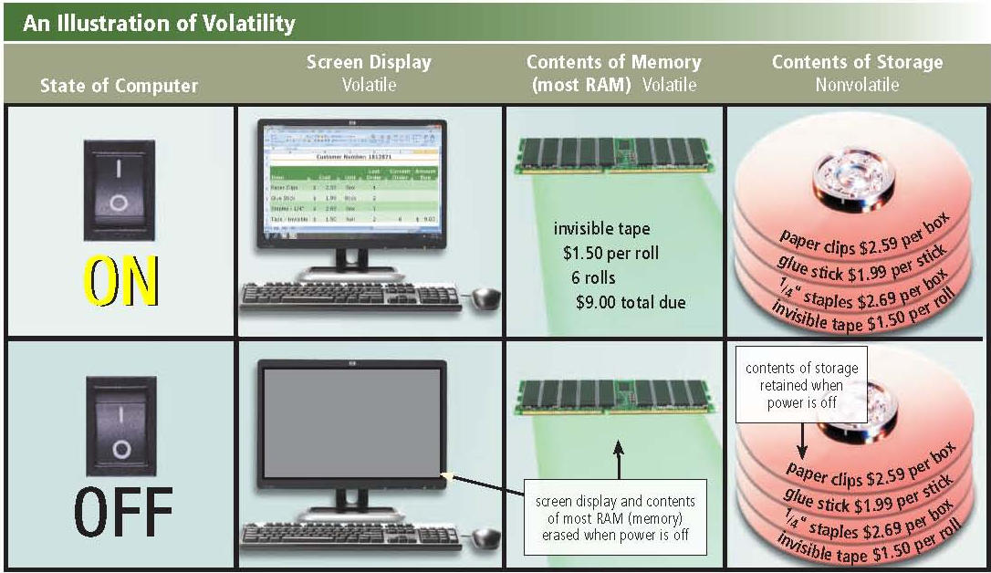
Illustration of Volatility
Store data permanently when computer is off

Slide 7
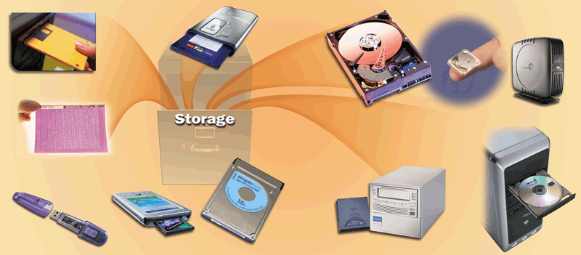
Storage Devices 10 years ago
C

Slide 8
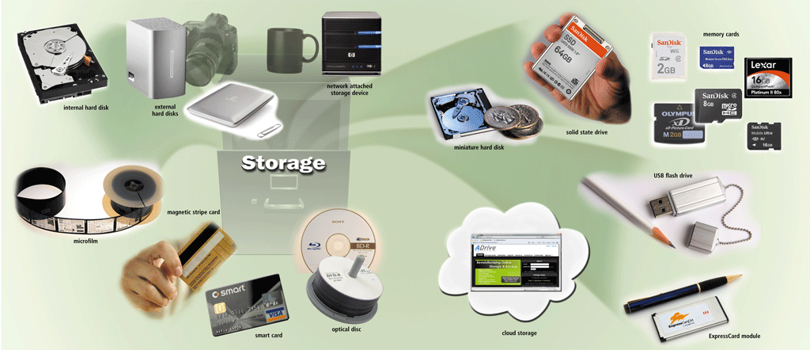
Storage Devices Nowadays

Slide 9
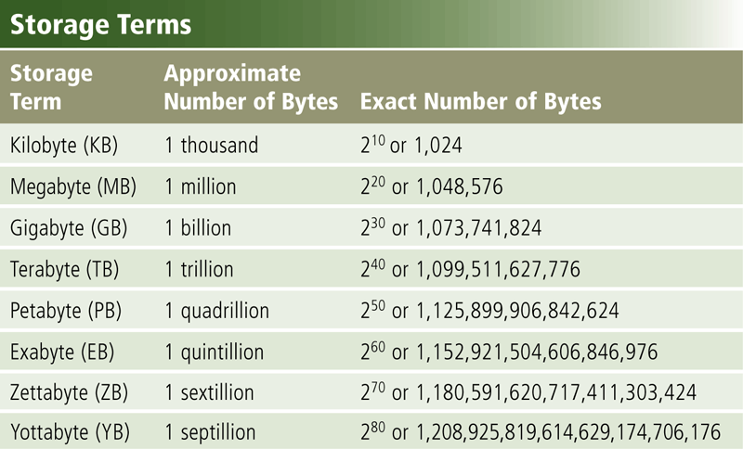
Storage Capacity

Slide 10
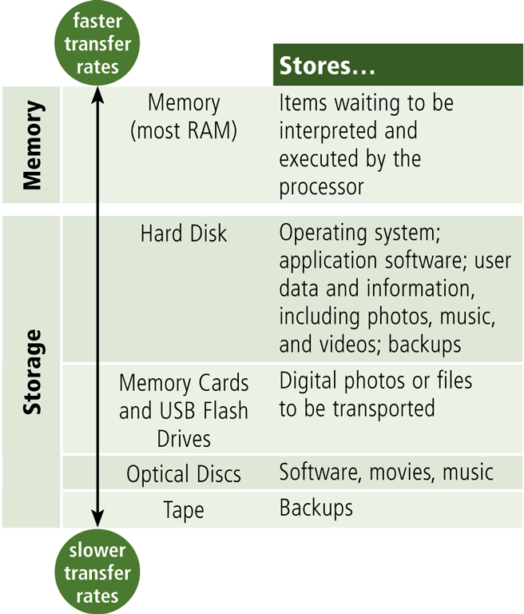
Storage Access Time
Access time measures:
  The amount of time it takes a storage device to locate an item on a storage medium
  The time required to deliver an item from memory to the processor

Slide 11
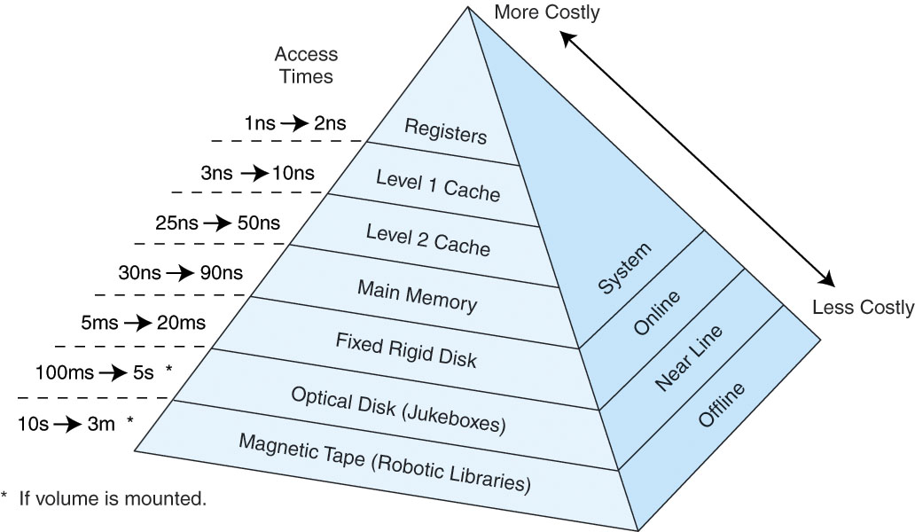
Access Time

Slide 12
Storage Technology
Two main categories of storage technology
  Magnetic storage
    use a magnet
  Optical storage
    uses laser
  A third category of storage—solid-state storage—is increasingly being used in computer systems
    uses physical switches
    But is more commonly found in devices such as digital cameras and media players.

Slide 13
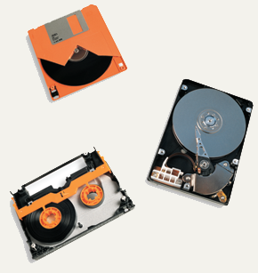
Magnetic Storage Devices
Most common form of storage
Hard drives, floppy drives, tape
All magnetic drives work the same
Floppy Disk
Tape
Hard Disk
13
Notes:
Teaching tip
Figure 5A.2 and 5A.3 on page 227 provide illustrations of devices and the read/write process.

Slide 14
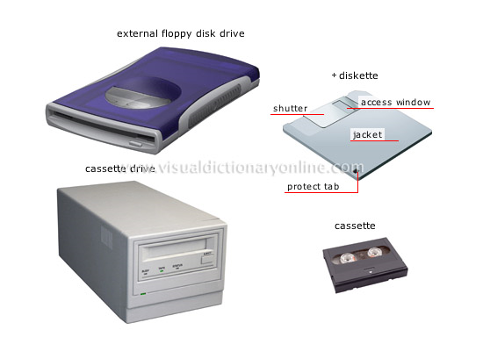
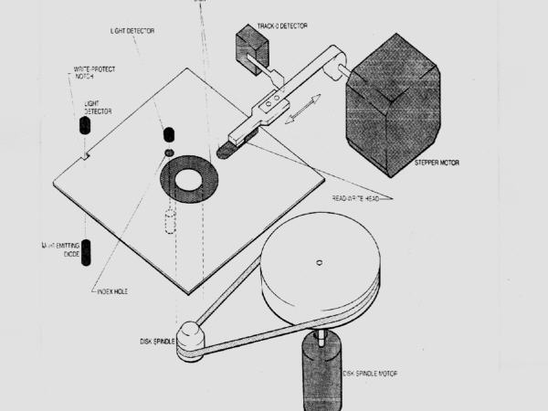
Magnetic Storage Devices
14

Slide 15
Floppy Diskettes
Also known as floppy disks
Read with a disk drive
Mylar disk
Spin at 300 RPM
Takes .2 second to find data
3 ½ floppy disk holds 1.44 MB
15
Notes:
Teaching tip
The formula for the disk capacity is listed on page 232 of the text.

Slide 16
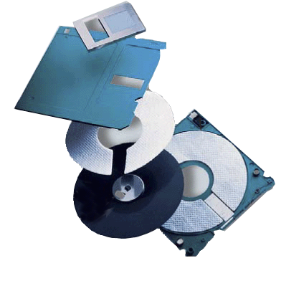
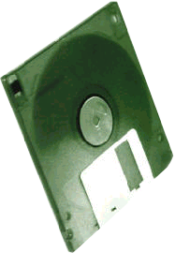
Floppy Disk
What is a floppy disk?
shutter
  Portable, inexpensive storage medium (also called diskette)
shell
liner
magnetic
coating
  Thin, circular, flexible film enclosed
  in 3.5” wide plastic shell
metal hub
flexible thin film

Slide 17
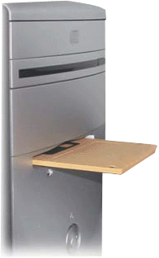
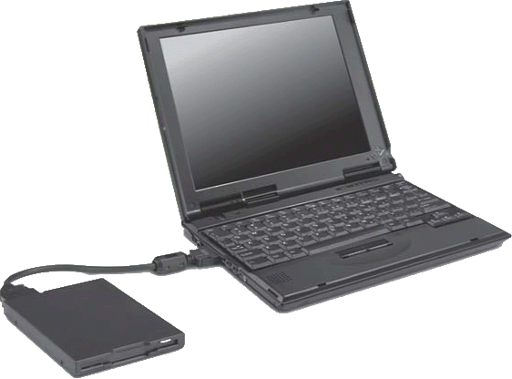
Floppy Disks
What is a floppy disk drive?
  Device that reads from and
  writes to floppy disk
Floppy disk drive built into
a desktop computer
    One floppy drive, named drive A
  Also called secondary storage
External floppy disk drive attaches to
a computer with a cable

Slide 18
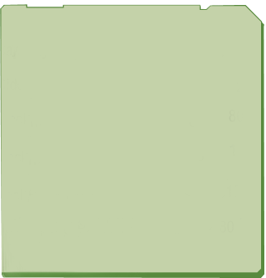
Floppy Disks
How do you compute a disk’s storage capacity?
  Multiply number of sides, number of tracks, number of sectors per track, and number of bytes per sector
    For high-density disk: 2 sides × 80 tracks × 18 sectors per track × 512 bytes per sector = 1,474,560 bytes
Capacity: 1.44 MB
Sides: 2
Tracks: 80
Sectors per track: 18
Bytes per sector: 512
Sectors per disk: 2880
Characteristics of a
3.5-inch High-Density
Floppy Disk
p. 359
Next

Slide 19
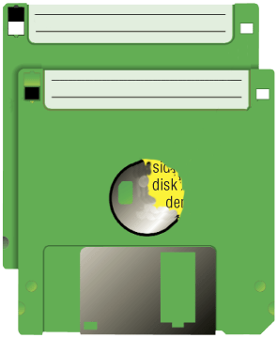
Floppy Disks
What is a write-protect notch?
  Small opening with a cover that you slide
  Protects floppy disk from being erased accidentally
write-protected
notch open
means you
cannot write
on the disk
not write-protected
notch closed
means you
can write on
the disk
hole on this
side means
disk is high
density
Next

Slide 20
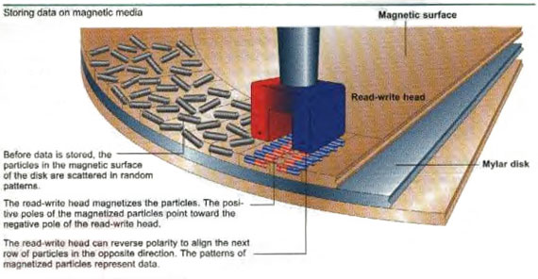
Storing Data on Magnetic Media
20

Slide 21
Magnetic Storage Data Organization
Disks must be formatted before use
Format draws tracks on the disk
Tracks is divided into sectors
  Amount of data a drive can read
21
Notes:
Discussion point
Discuss the sector size limitation. Discuss what can happen when writing a 1-byte file or a 513-byte file. After the waste issue is brought up, then discuss the problem from the hardware issue. How can a manufacturer make a 1-byte head?

Slide 22
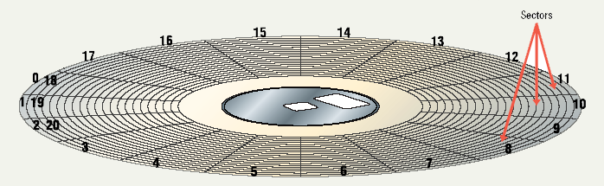
Tracks and Sectors
22

Slide 23
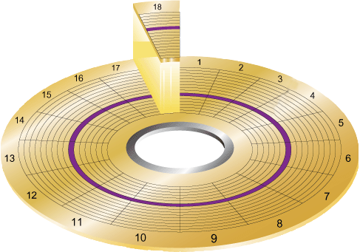
Track and Sectors
Track
is narrow recording band
that forms full
circle on disk
  Sector stores up to
  512 bytes
  of data
    Formatting prepares disk for use and marks bad sectors as unusable

Slide 24
Magnetic Storage Devices
Finding data on disk
  Each track and sector is labeled
    Some are reserved
  Listing of where files are stored
    File Allocation Table (FAT)
    FAT32
    NTFS
  Data is organized in clusters
    Size of data the OS handles
24
Notes:
Teaching tip
Draw clustering on the board. Discuss why it can improve the performance of a system.

Slide 25
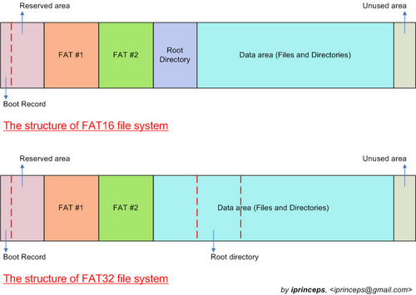
FAT File System
25

Slide 26
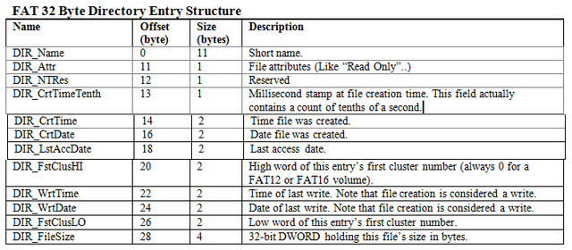
FAT 32 Byte Directory Entry Structure
26

Slide 27
Hard Disks
Primary storage device in a computer
2 or more aluminum platters
Each platter has 2 sides
Spin between 5,400 to 15,000 RPM
Data found in 9.5 ms or less
Drive capacity greater than 40 GB
27
Notes:
Teaching tip
Students often have a hard time grasping the speed of a hard drive. Use an analogy: The circumference of a hard drive platter is nearly 1 foot. A drive spinning 5,400 RPM can travel 5,400 feet in one minute, or a little over 1 mile in a minute!

Slide 28
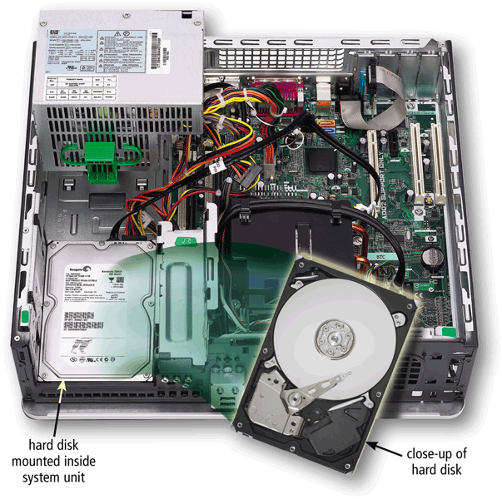
Hard Disk
A hard disk contains one or more inflexible, circular platters that use magnetic particles to store data, instructions, and information

Slide 29
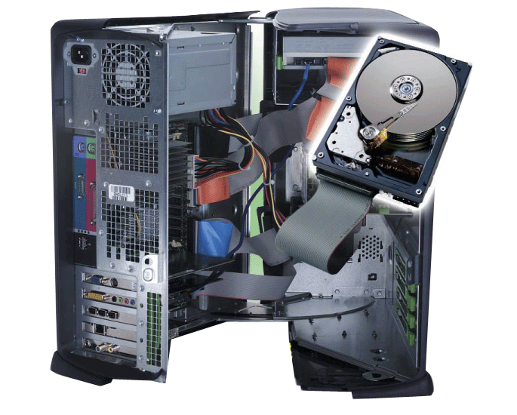
Magnetic Disks
What is a hard disk?
hard disk installed
in system unit
  High-capacity storage
  Consists of several inflexible, circular platters that store items electronically
  Components enclosed in airtight, sealed case for protection

Slide 30
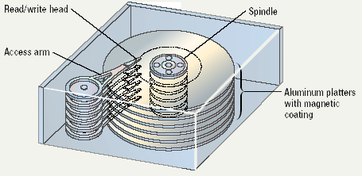
Illustrated Hard Disk
30

Slide 31
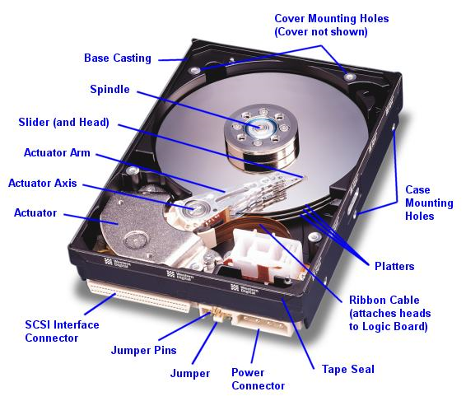
Parts of a Hard Disk
31

Slide 32
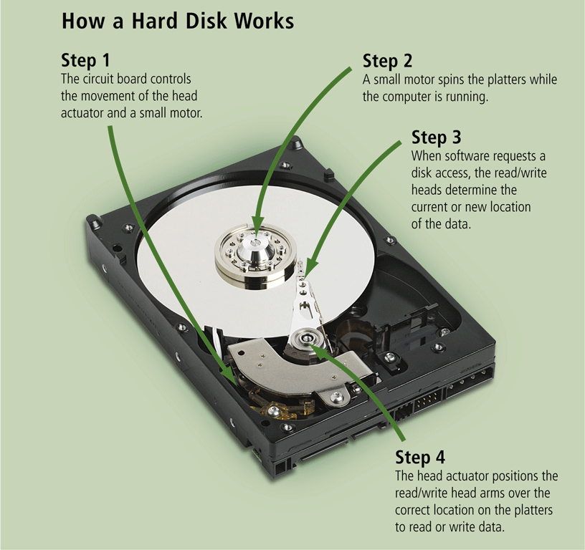
How a Hard Disk Works

Slide 33
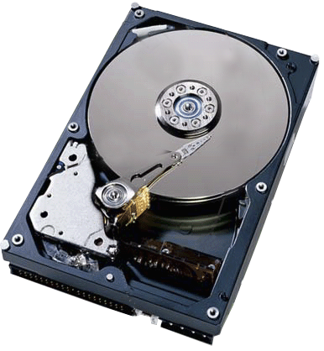
Magnetic Disks
How does a hard disk work?
Step 3.
When software requests a disk access, read/write heads determine current or new location of data.
Step 2.
Small motor spins platters while computer is running.
Step 4.
Head actuator positions read/write head arms over correct location on platters to read or write data.
Step 1.
Circuit board controls movement of head actuator and a small motor.
p. 361 Fig. 7-12
Next

Slide 34
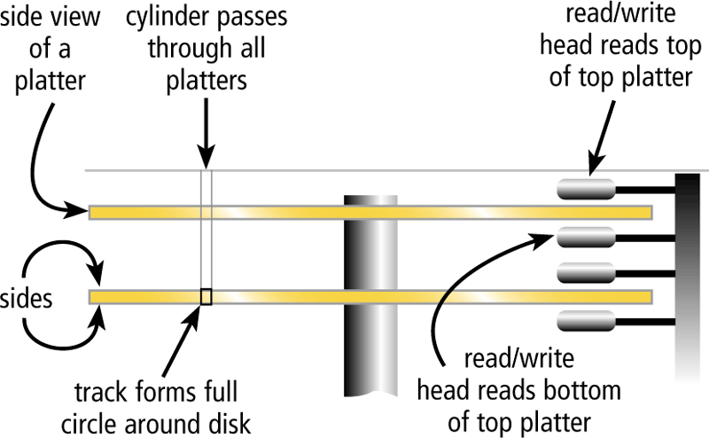
Hard Disk
The hard disk arms move the read/write head, which reads items and writes items in the drive
  Location often is referred to by its cylinder

Slide 35
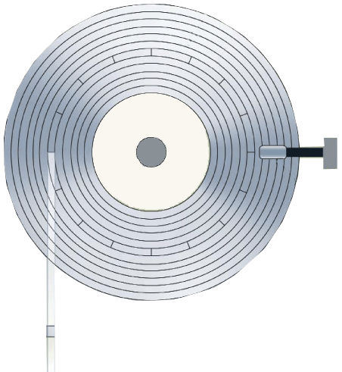
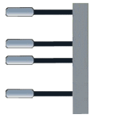
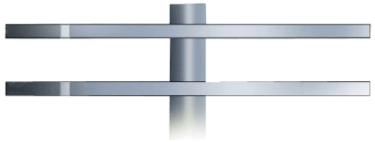
Magnetic Disks
What is a cylinder?
track
  Vertical section of track through all platters
sector
  Single movement of read/write head arms accesses all platters
  in cylinder
read/write
head
platter
platter
sides
cylinder

Slide 36
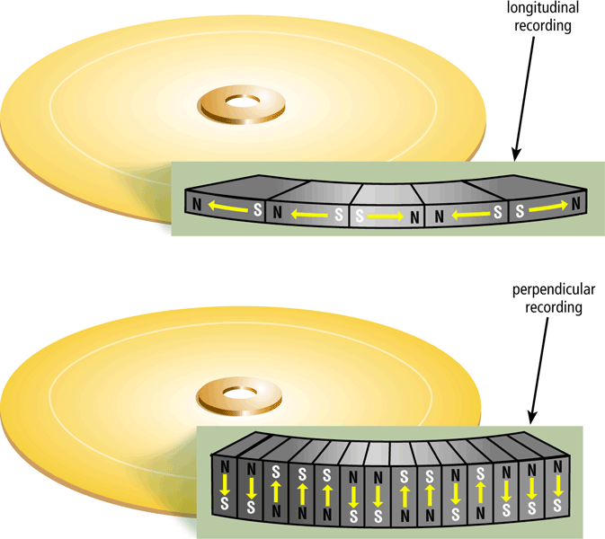
Hard Disks
Hard disks can store data using longitudinal recording or perpendicular recording

Slide 37
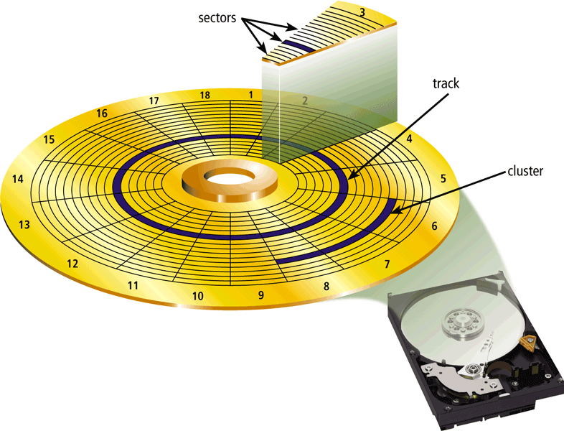
Hard disk Characteristic
Capacity
Platters
Read/Write Heads
Cylinders
Sectors and Tracks
Revolutions per Minute
Transfer Rate
Access Time

Slide 38
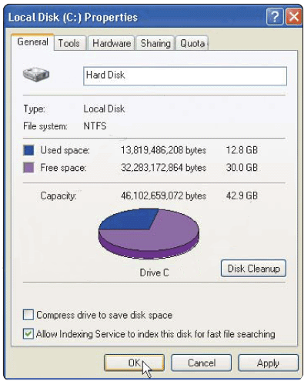


Magnetic Disks
What are characteristics of a hard disk?
Sample Hard Disk Characteristics
Advertised capacity 120 GB
Platters 3
Read/write heads 6
Cylinders 16,383
Bytes per second 512
Sectors per track 63
Sectors per drive 234,441,648
Revolutions per minute 7,200
Transfer rate 133 MB per second
Access time 8.9 ms
actual
disk
capacity

Slide 39
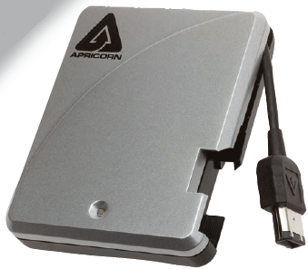
Removable High Capacity Disks
Speed of hard disk
Portability of floppy disk
Several variants have emerged
High capacity floppy disk
  Stores up to 750 MB of data
Hot swappable hard disks
  Provide GB of data
  Connect via USB
39

Slide 40
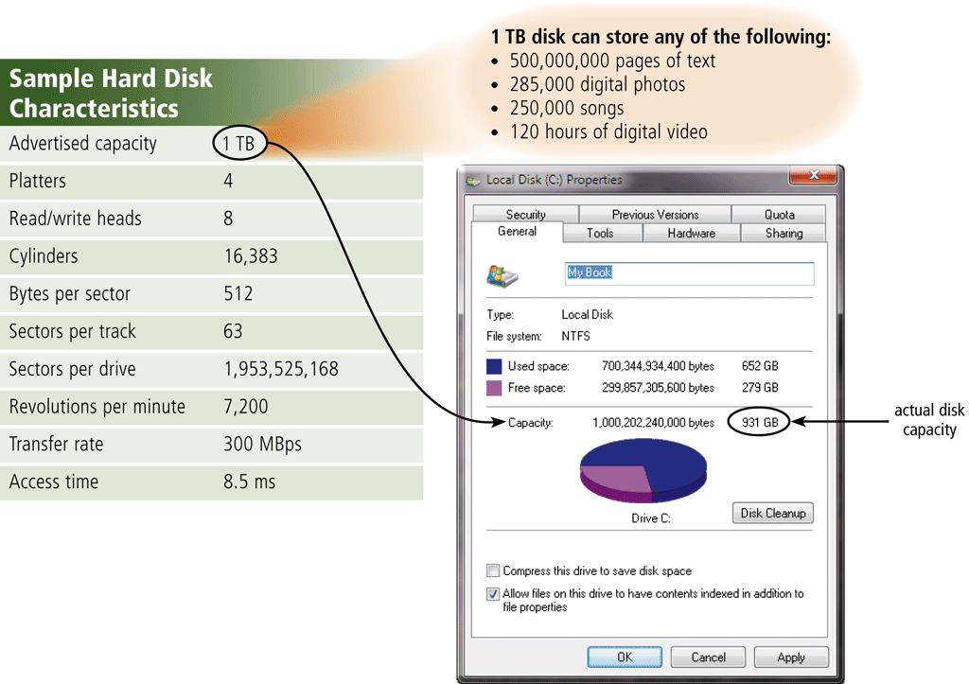
Hard Disk
Formatting is the process of dividing the disk into tracks and sectors so that the operating system can store and locate data and information on the disk

Slide 41
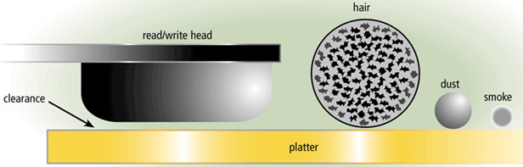
Hard Disk Crash
occurs when a read/write head touches the surface of a platter
Spinning creates cushion of air that floats read/write head above platter
  Clearance between head and platter is approximately two-millionths of an inch
  A smoke particle, dust particle, or human hair could render drive unusable
Always keep a backup of your hard disk

Slide 42
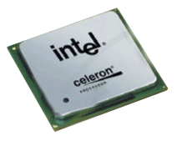

Magnetic Disks
processor
What is a disk cache?
  Portion of memory that processor uses to store frequently accessed items
disk cache
first request
for data—to disk cache
second request
for data—to hard disk
hard disk

Slide 43
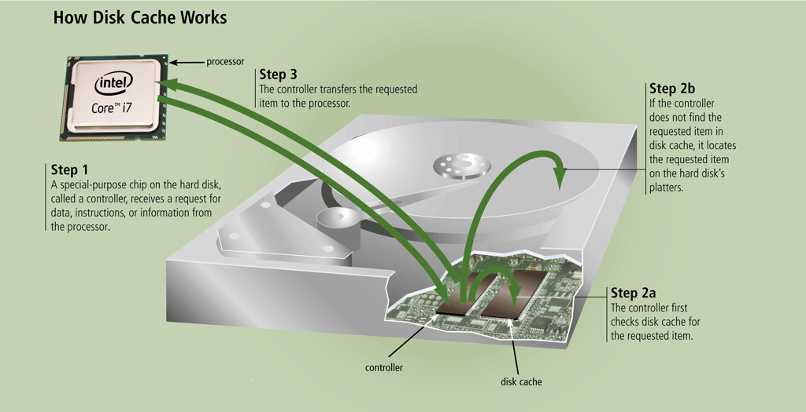
Hard Disk Cache

Slide 44
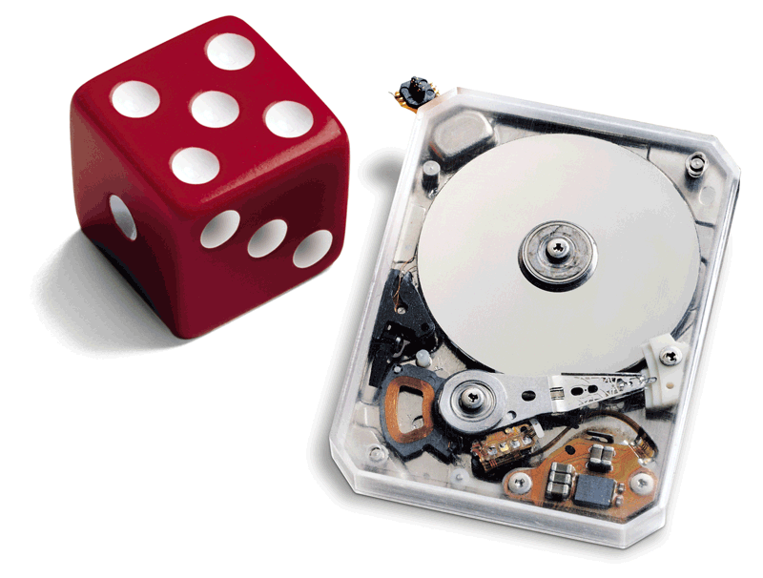
Magnetic Disks
What is a miniature hard disk?
  Provide users with greater storage capacities than flash memory
  Some have a form factor of less than 1 inch
  Storage capacities range from 2 GB to 100 GB

Slide 45
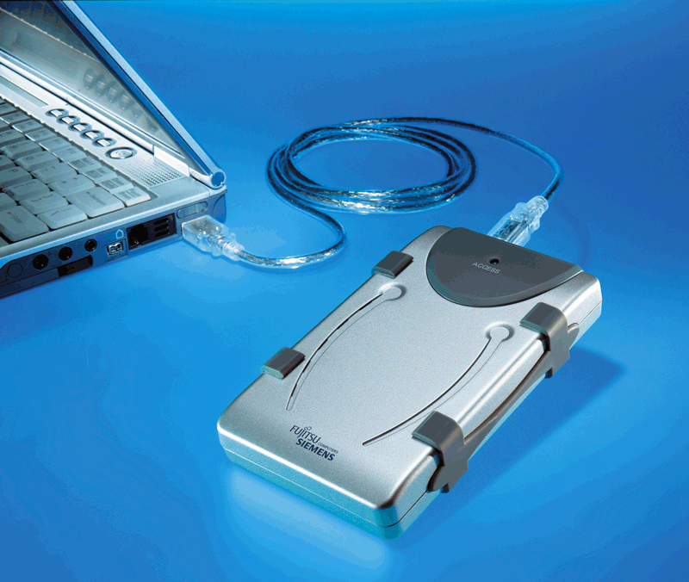
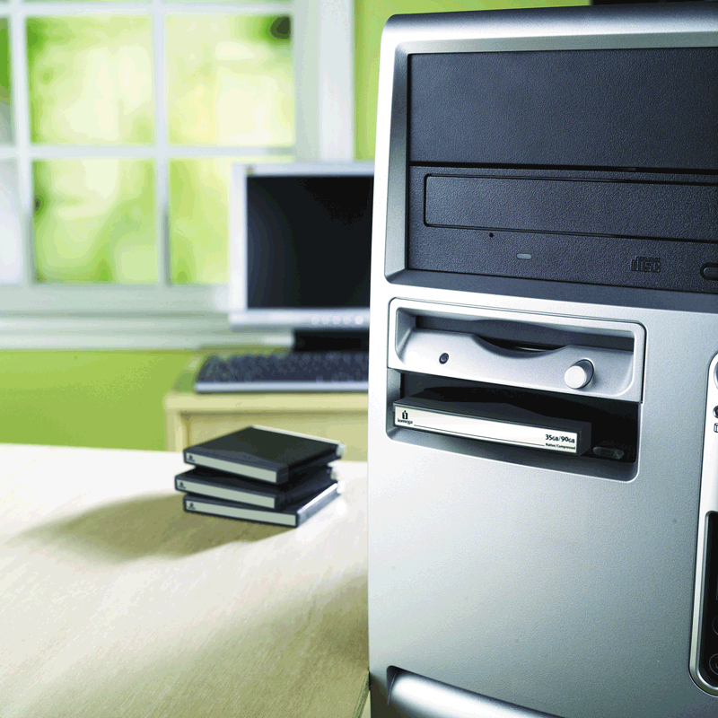
Magnetic Disks
What are external hard disks and removable hard disks?
Used to back up or transfer files
Removable hard disk—hard disk that you insert and remove from hard disk drive
External hard disk—freestanding
hard disk that connects to system unit

Slide 46
External Hard disks
An external hard disk is a separate free-standing hard disk that connects to your computer with a cable or wirelessly
A removable hard disk is a hard disk that you insert and remove from a drive
Internal and external hard disks are available in miniature sizes (miniature hard disks)

Slide 47
Hard Disk Controller
A disk controller consists of a special-purpose chip and electronic circuits that control the transfer of data, instructions, and information from a disk to and from the system bus and other components of the computer
SATA
EIDE
SCSI
SAS

Slide 48
Summary
Describing Storage Devices
  Operations, Votality
Storage Capacity and Access Time
Magnetice storage Devices
Floppy disk
  Characteristics, Parts, operations
Hard disk
  Characteristics, parts, operations, formatting
  Disk Controllers
48

Slide 50
Objectives Overview
Differentiate between storage devices and storage media
Describe the characteristics of an internal hard disk including capacity, platters, read/write heads, cylinders, sectors and tracks, revolutions per minute, transfer rate, and access time
Discuss the purpose of network attached storage devices, external and removable hard disks, and hard disk controllers
Describe the various types of flash memory storage

