Slide 1
CSC 101
Introduction to Computing
Lecture 12
Dr. Iftikhar Azim Niaz
ianiaz@comsats.edu.pk
1

Slide 2
Last Lecture Summary I
Components Affecting Speed
Achieving Increased Processor Speed
Registers
  Functions and Size
  User accessible and other types of Registers
System or Internal Clock
  Clock speed and clock rate
  Underclocking
  Overclocking

Slide 3
Last Lecture Summary II
Cache memory
  Function operation
  Type: Instruction, data and TLB
  Multi Level Cache, L1, L2 and L3
    Intel Cache Evolution
  Memory Hierarchy
Bus
  Bus width and speed
  Bus Interconnection Scheme
    Data, address and control bus

Slide 4
A Look Inside The Processor
Architecture
  Determines
    Location of CPU parts
    Bit size
    Number of registers
    Pipelines
Best Known families of CPU
RISC and CISC
Parallel Processing
4
Notes:
Teaching tip
Bit size tends to confuse students. A simple example clarifies the importance of bit size. Consider two equal computers, one has a 32-bit processor, the other a 64 bit processor. With all other items equal, the 64-bit processor will handle twice the data the 32 bit processor handles. This is like driving a car at 55 Mph then doubling it to 110 Mph.

Slide 5
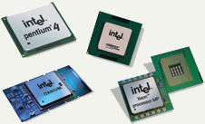
Intel Processors
Leading manufacturer of processors
Intel 4004 was worlds first microprocessor
IBM PC powered by Intel 8086
Current processors
  Centrino
  Itanium
  Pentium IV
  Xeon
  Core 2 Duo
  I3, I5, i7
5

Slide 6
x86 Evolution (1)
8080
  first general purpose microprocessor
  8 bit data path
  Used in first personal computer – Altair
8086 – 5MHz – 29,000 transistors
  much more powerful
  16 bit
  instruction cache, prefetch few instructions
  8088 (8 bit external bus) used in first IBM PC
80286
  16 Mbyte memory addressable
  up from 1Mb
80386
  32 bit
  Support for multitasking
80486
  sophisticated powerful cache and instruction pipelining
  built in maths co-processor

Slide 7
x86 Evolution (2)
Pentium
  Superscalar
  Multiple instructions executed in parallel
Pentium Pro
  Increased superscalar organization
  Aggressive register renaming
  branch prediction
  data flow analysis
  speculative execution
Pentium II
  MMX technology
  graphics, video & audio processing
Pentium III
  Additional floating point instructions for 3D graphics

Slide 8
x86 Evolution (3)
Pentium 4
  Note Arabic rather than Roman numerals
  Further floating point and multimedia enhancements
Core
  First x86 with dual core
Core 2
  64 bit architecture
Core 2 Quad – 3GHz – 820 million transistors
  Four processors on chip
x86 architecture dominant outside embedded systems
Organization and technology changed dramatically
Instruction set architecture evolved with backwards compatibility
~1 instruction per month added
500 instructions available
See Intel web pages for detailed information on processors

Slide 9
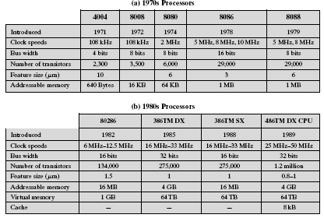
Intel Processors (1970’s and 1980’s)

Slide 10
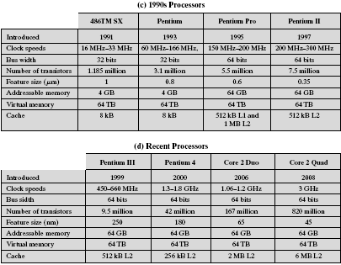
Intel Processors (1990’s and 2000’s)

Slide 11

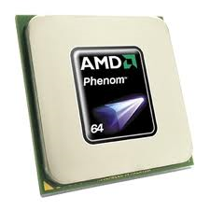
Advanced Micro Devices (AMD) Processors
Main competitor to Intel
Originally produced budget products
Current products outperform Intel
Current processors
  Sempron
  Athlon FX 64
  Athlon XP
  Athlon X2
  Phenom
  Sempron
11

Slide 12
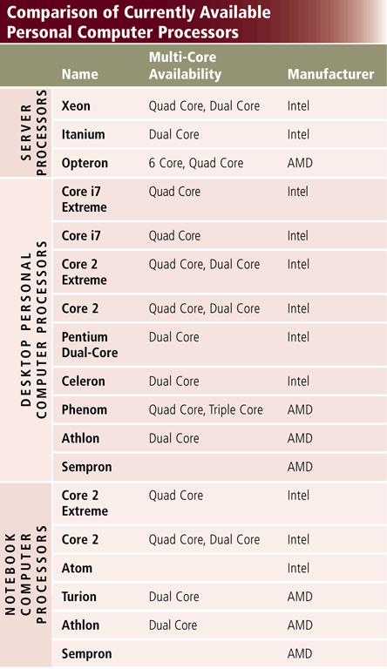
Leading Processor Manufacturer
12

Slide 13
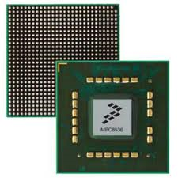
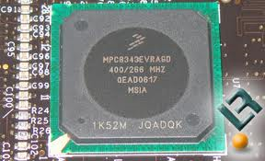
Freescale (Motorola) Processors
A subsidiary of Motorola
Co-developed the Apple G4 PowerPC
Currently focuses on the Linux market
13

Slide 14
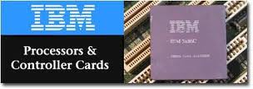
IBM Processors
Historically manufactured mainframes
Partnered with Apple to develop G5
  First consumer 64 bit chip
14

Slide 15
Comparing Processors
Speed of processor
Size of cache
Number of registers
Word size
Speed of Front Side Bus (FSB)
15

Slide 16
CPU’s Performance Specifications
Specification | AMD Athlon 64 FX | Intel Pentium IV | PowerMac G5
Registers | 16 | 16 | 80
Word size | 64 bits | 32 bits | 64bits
System Bus Speed | 1.6 GHz | 800 MHz | 1 GHz
L1 Cache | 128 KB | NA | NA
L2 Cache | 1024 KB | 512 | 512

Slide 17
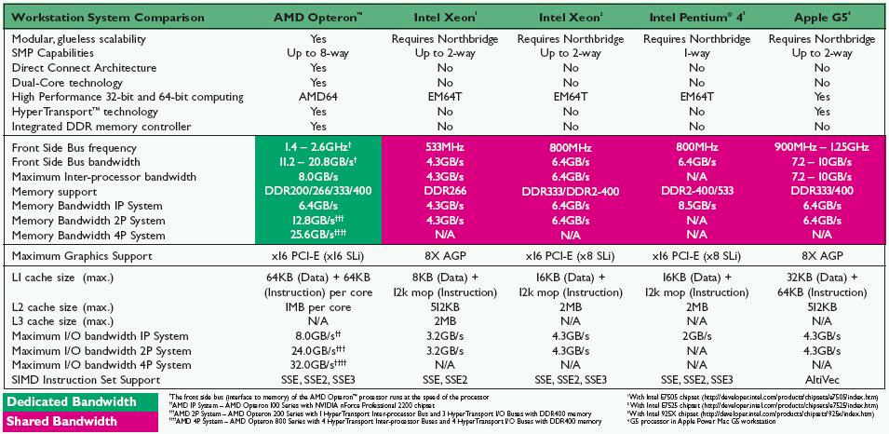
CPU’s Performance Specifications

Slide 18
CISC Processors
Complex Instruction Set Computers
single instructions can execute several low-level operations
  such as a load from memory, an arithmetic operation, and a memory store) and/or
are capable of multi-step operations or addressing modes within single instructions
to design instruction sets that directly supported high-level programming constructs
  such as procedure calls, loop control, and complex addressing modes,
allowing data structure and array accesses to be combined into single instructions
Intel x86, Pentium series
18

Slide 19
Driving force for CISC
Software costs far exceed hardware costs
Increasingly complex high level languages
Semantic gap
Leads to:
  Large instruction sets
  More addressing modes
  Hardware implementations of HLL statements
    e.g. CASE (switch) on VAX

Slide 20
Intention of CISC
Ease compiler writing
Improve execution efficiency
  Complex operations in microcode
Support more complex HLLs

Slide 21
RISC Processors
Reduced Instruction Set Computing
Smaller instruction sets
May process data faster
can provide higher performance if this simplicity enables much faster execution of each instruction
now used across a wide range of platforms, from cellular telephones and tablet computers
ARM, MIPS, PowerPC and G5, Apple iPhone and iPad
21

Slide 22
RISC Key Features
Large number of general purpose registers
or use of compiler technology to optimize register use
Limited and simple instruction set
Emphasis on optimising the instruction pipeline
typically have separate instructions for I/O and data processing
at most a single data memory cycle—compared to the "complex instructions" of CISC CPUs that may require dozens of data memory cycles in order to execute a single instruction.

Slide 23
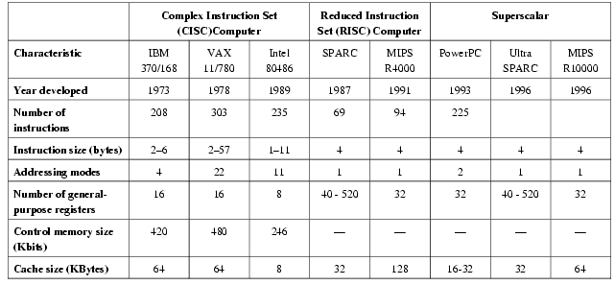
Comparison of RISC and CISC

Slide 24
Parallel Processing
Multiple processors in a system
with multi-core and multi-processor computers having multiple processing elements within a single machine
while Clusters, Massively Parallel Processing (MPPs), and grids use multiple computers to work on the same task.
Specialized parallel computer architectures are sometimes used alongside traditional processors, for accelerating specific tasks.
Symmetric Multiple Processing
  Number of processors is a power of 2
Massively Parallel Processing
  Thousands of processors
  Mainframes and super computers
24
Notes:
Discussion point

Slide 25
Parallel Computer Programs
Parallel computer programs are more difficult to write than sequential ones
  concurrency introduces several new classes of potential software bugs, of which race conditions are the most common.
  Communication and synchronization between the different subtasks are typically some of the greatest obstacles to getting good parallel program performance

Slide 26
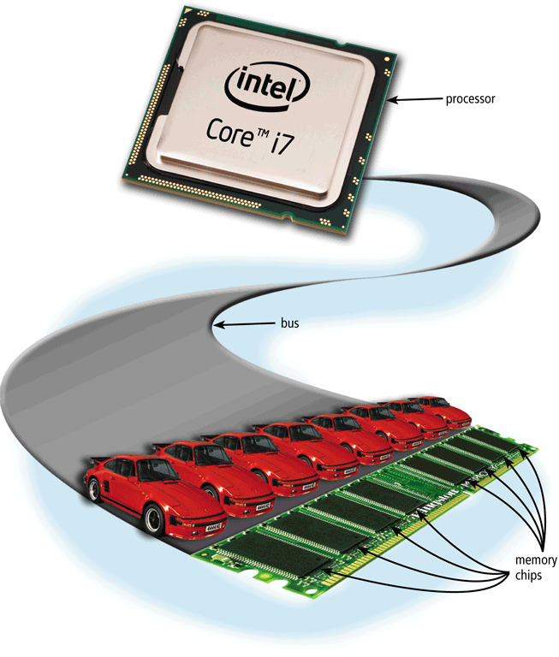
Buses
A bus allows the various devices both inside and attached to the system unit to communicate with each other
  Data bus
  Address bus
Word size is the number of bits the processor can interpret and execute at a given time
26

Slide 27
Ports and Connectors
A port is the point at which a peripheral attaches to or communicates with a system unit (sometimes referred to as a jack)
A connector joins a cable to a port
27

Slide 28
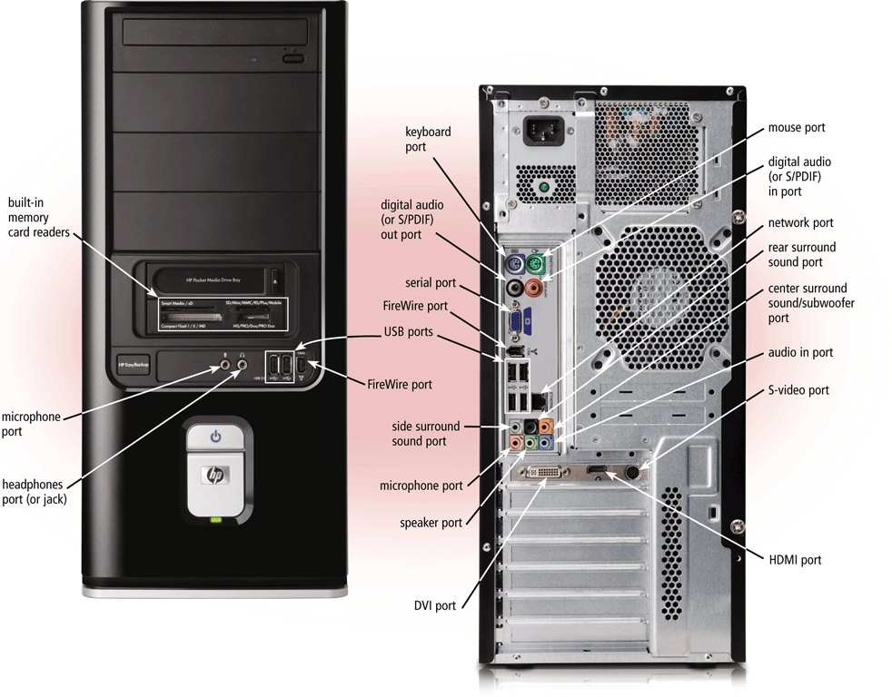
Ports and Connectors
28

Slide 29
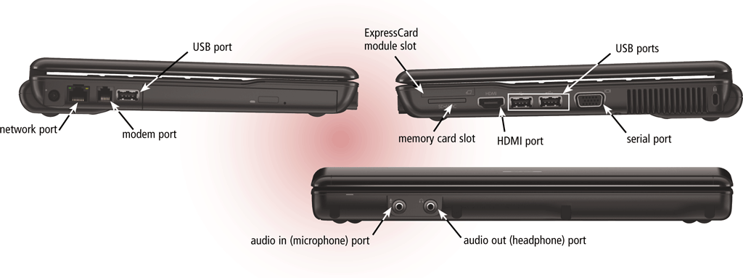
Ports and Connectors
On a notebook computer, the ports are on the back, front, and/or sides
29

Slide 30
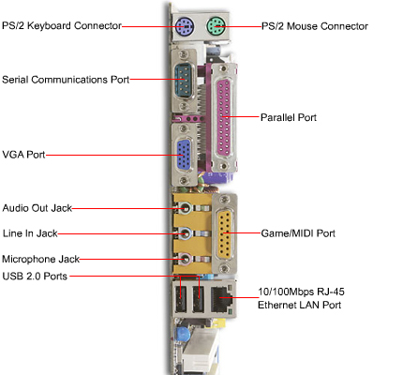
Standard Computer Ports
  Keyboard
  Mouse
  USB ports
  Parallel
  Network
  Modem
  Audio
  Serial
  Video
30

Slide 31
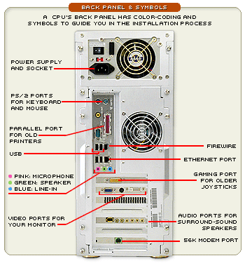
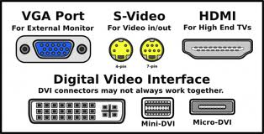
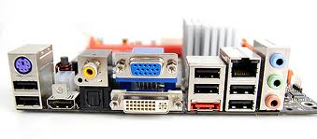
Standard Computer Ports
31

Slide 32
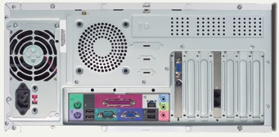
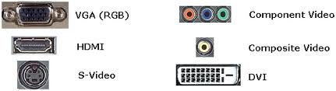
Standard Computer Ports
32

Slide 33
Serial and parallel ports
Extending The Processors Power
Connect to printers or modems
Parallel ports move bits simultaneously
  Made of 8 – 32 wires
  Internal busses are parallel
Serial ports move one bit
  Lower data flow than parallel
  Requires control wires
  UART converts from serial to parallel
33

Slide 34
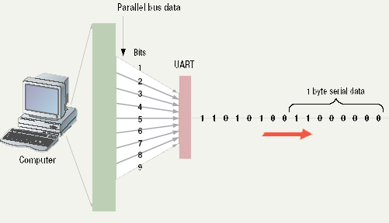
Serial Communications
Universal Asynchronous Receiver/Transmitter (UART) is a type of "asynchronous receiver/transmitter", a piece of computer hardware that translates data between parallel and serial forms.
34

Slide 35
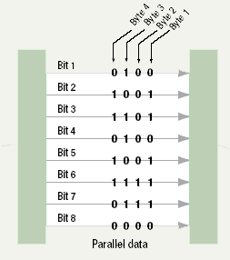
Parallel Communications
a parallel interface can handle a higher volume of data than a serial interface
more than one bit can be transmitted through a parallel interface simultaneously
35

Slide 36
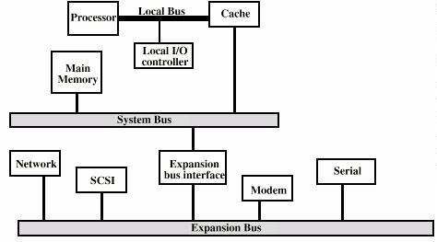
Expansion Bus

Slide 37
Buses
Expansion slots connect to expansion buses
Common types of expansion buses include:
PCI bus
PCI Express bus
Accelerated Graphics Port
USB and FireWire bus
PC Card bus
37

Slide 38
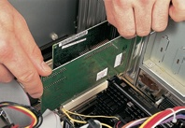
Expansion Slots and Boards
Allows users to configure the machine
Slots allow the addition of new devices
Devices are stored on cards
Computer must be off before inserting
38

Slide 39
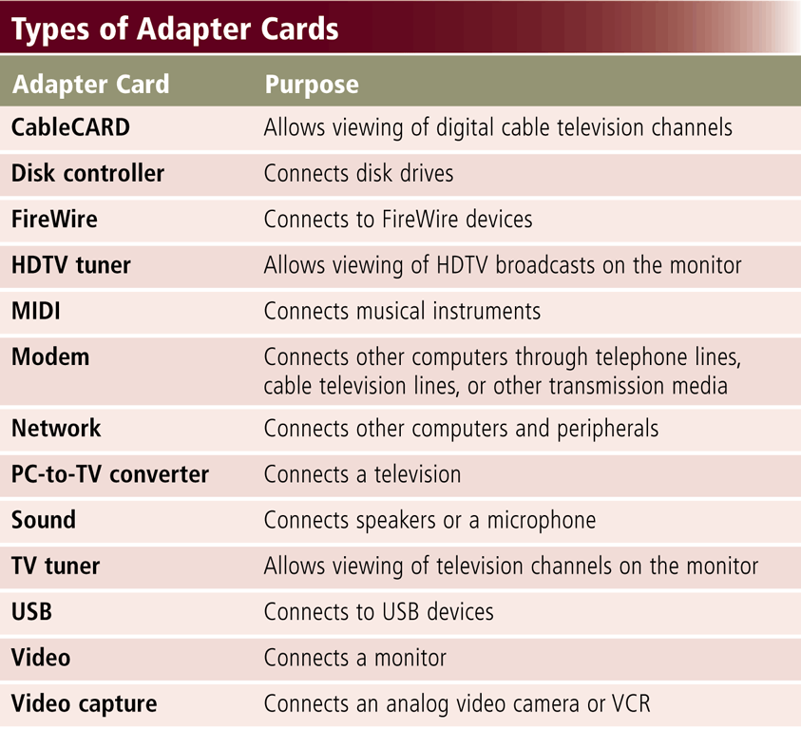
Expansion Slots and Adapter Cards
An expansion slot is a socket on the motherboard that can hold an adapter card
An adapter card enhances functions of a component of the system unit and/or provides connections to peripherals
  Sound card and video card
39

Slide 40
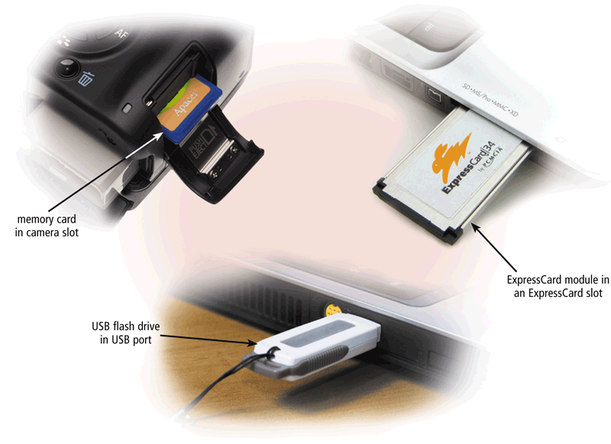
Expansion Slots and Adapter Cards
Removable flash memory includes:
  Memory cards, USB flash drives, and PC Cards/Express Card modules
40

Slide 41
External Bus Standards
Industry Standard Architecture (ISA)
Local bus
Peripheral Control Interface (PCI)
Accelerated Graphics Port (AGP)
Universal Serial Bus (USB)
IEEE 1394 (FireWire)
PC Card
High Definition Multimedia Interface (HDMI)
41

Slide 42
Industry Standard Architecture
bus standard for IBM PC compatible computers introduced with the IBM Personal Computer to support its Intel 8088 microprocessor's 8-bit external data bus and
extended to 16 bits for the IBM Personal Computer/AT's Intel 80286 processor.
further extended for use with 32-bit processors as Extended Industry Standard Architecture (EISA)
the ISA bus was synchronous with the CPU clock, until sophisticated buffering methods were developed and implemented by chipsets to interface ISA to much faster CPUs
42

Slide 43
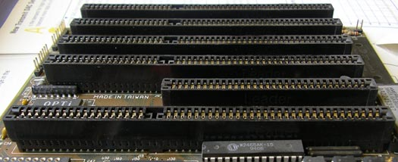
Industry standard Architecture (ISA)

Slide 44
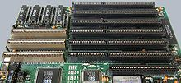
VESA Local Bus
VESA (Video Electronics Standards Association) Local Bus worked alongside the ISA bus;
it acted as a high-speed conduit for memory-mapped I/O and DMA,
while the ISA bus handled interrupts and port-mapped I/O.
44

Slide 45
Peripheral Control Interface (PCI)
Connects modems and sound cards
Found in most modern computers
higher maximum system bus throughput
lower I/O pin count and smaller physical footprint
better performance-scaling for bus devices
more detailed error detection and reporting mechanism (Advanced Error Reporting (AER)
native hot-plug functionality.
More recent revisions of the PCI standard support hardware I/O virtualization.

Slide 46
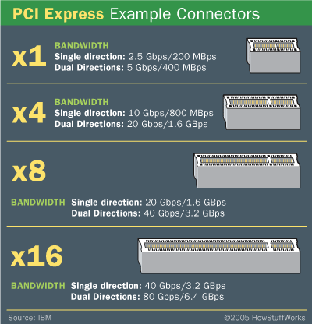
Peripheral Control Interface (PCI)
46

Slide 47
Accelerated Graphics Port (AGP)
Connects video card to motherboard
Extremely fast bus
Found in all modern computers
high-speed point-to-point channel for attaching a video card to a computer's motherboard, primarily to assist in the acceleration of 3D computer graphics. Since 2004 AGP has been progressively phased out in favor of PCI Express (PCIe).
47

Slide 48
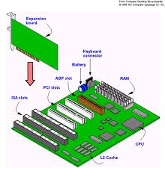
Accelerated Graphics Port (AGP)
primary advantage of AGP over PCI is that it provides a dedicated pathway between the slot and the processor rather than sharing the PCI bus.
Lack of contention for the bus, the direct connection allows for higher clock speeds.

Slide 49
Ports and Connectors
Other types of ports include:
Firewire port
Bluetooth port
SCSI port
eSATA port
IrDA port
Serial port
MIDI port
49

Slide 50
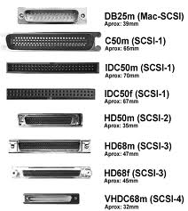
SCSI
Small Computer System Interface
Supports dozens of devices
External devices daisy chain
Fast hard drives and CD-ROMs
50

Slide 51
SCSI
Instead of forcing the user to plug multiple cards into the computer’s expansion slots, a single SCSI adapter ex tends the bus outside the computer by way of a cable. SCSI is like an extension cord for the data bus.
define commands, protocols, and electrical and optical interfaces
intelligent, peripheral, buffered, peer to peer interface.
hides the complexity of physical format
Up to 8 or 16 devices can be attached to a single bus
There can be any number of hosts and peripheral devices but there should be at least one host

Slide 52
Universal Serial Bus (USB)
an industry standard that defines the cables, connectors and communications protocols used in a bus for connection, communication and power supply between computers and electronic devices
USB 1.0 and 1.1
  Specified data rates of 1.5 Mbit/s (Low-Bandwidth) and 12 Mbit/s (Full-Bandwidth).
  Does not allow for extension cables or pass-through monitors (due to timing and power limitations)
USB 2.0:
  Added higher maximum bandwidth of 480 Mbit/s (60 MB/s) (now called "Hi-Speed")
USB 3.0
  Maximum transmission speed of up to 5 Gbit/s (625 MB/s), which is more than 10 times as fast as USB 2.0 (480 Mbit/s, or 60 MB/s)
52

Slide 53
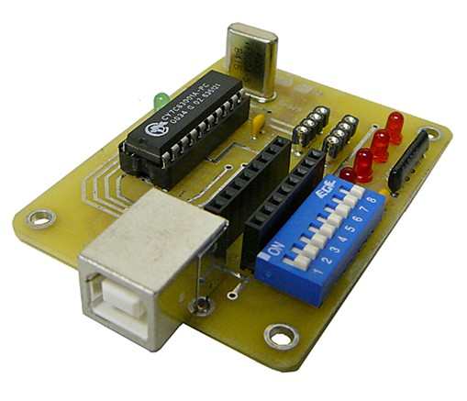
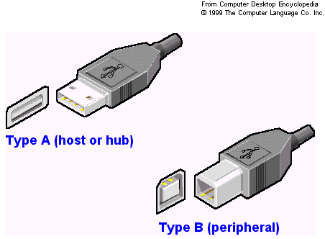
USB
Universal Serial Bus
Most popular external bus
Supports up to 127 devices
Hot swappable
53

Slide 54
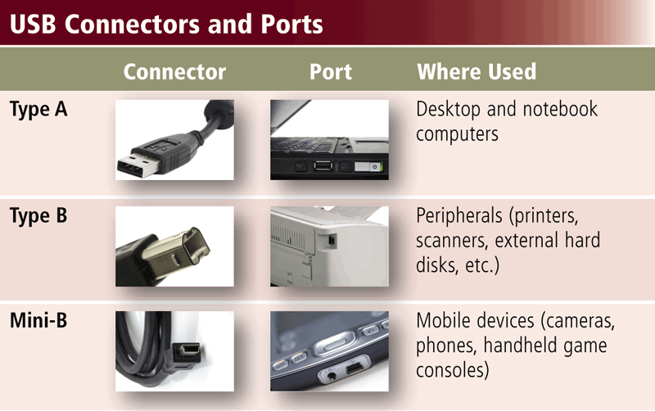
USB
A USB port can connect up to 127 different peripherals together with a single connector
  You can attach multiple peripherals using a single USB port with a USB hub
54

Slide 55
Firewire (IEEE 1394)
FireWire, is a serial bus interface standard for high-speed communications and isochronous real-time data transfer.
The 1394 interface is comparable with USB and often those two technologies are considered together, though USB has more market share
IEEE 1394 replaced parallel SCSI in many applications, because of lower implementation costs and a simplified, more adaptable cabling system
55

Slide 56
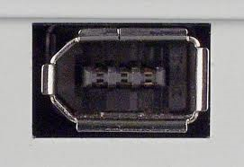
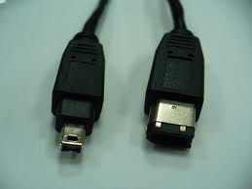
Firewire (IEEE 1394)
Cameras and video equipment
Hot swappable
Port is very expensive so is not very popular
56

Slide 57
PC Cards
PC Card was originally designed for computer storage expansion,
but the existence of a usable general standard for notebook peripherals led to many kinds of devices being made available based on the form factor, including
  network cards,
  modems, and
  hard disks.
The cards were also used in early digital SLR cameras, such as the Kodak DCS 300 series
Their original use as storage expansion is no longer common.
57

Slide 58
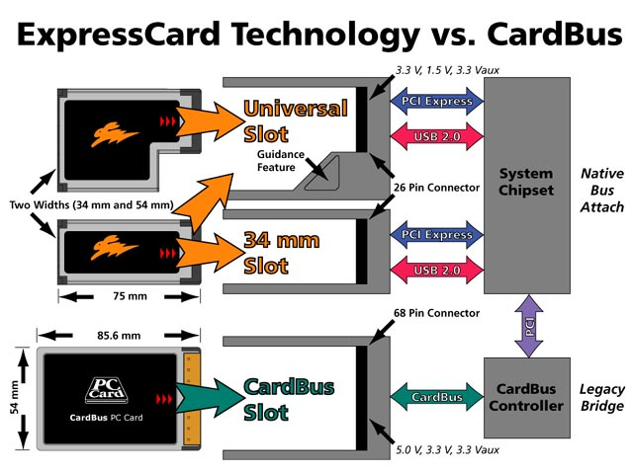
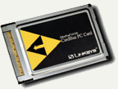
PC Cards
Used on laptops
Hot swappable
Devices are the size of a credit card
58

Slide 59
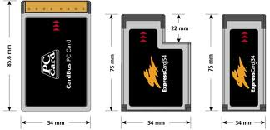
PC Cards
Expansion bus for laptops
PCMCIA
Hot swappable
Small card size
Three types, I, II and III
Type II is most common
59

Slide 60
HDMI
HDMI (High-Definition Multimedia Interface) is a compact audio/video interface for transferring uncompressed digital audio/video data from a HDMI-compliant device ("the source" or "input") to a compatible digital audio device, computer monitor, video projector, and digital television
Type A Nineteen pins, with bandwidth to support all SDTV, EDTV and HDTV modes
Type B has 29 pins and can carry six differential pairs instead of three, for use with very high-resolution future displays such as WQUXGA (3,840×2,400)
Type C intended for portable devices
Type D keeps the standard 19 pins of types A and C but shrinks the connector size to something resembling a micro-USB connector

Slide 61
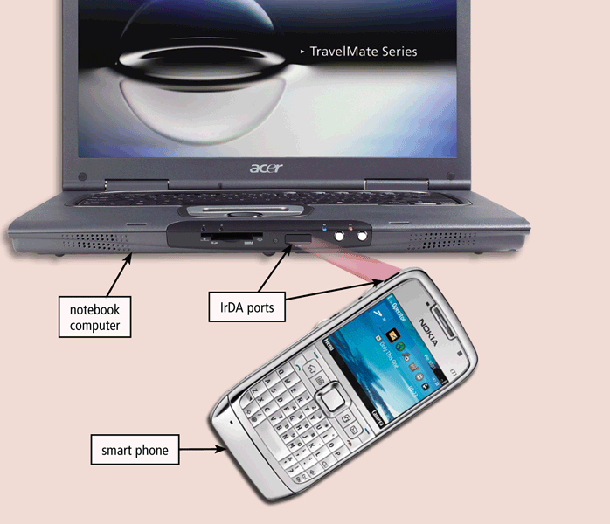
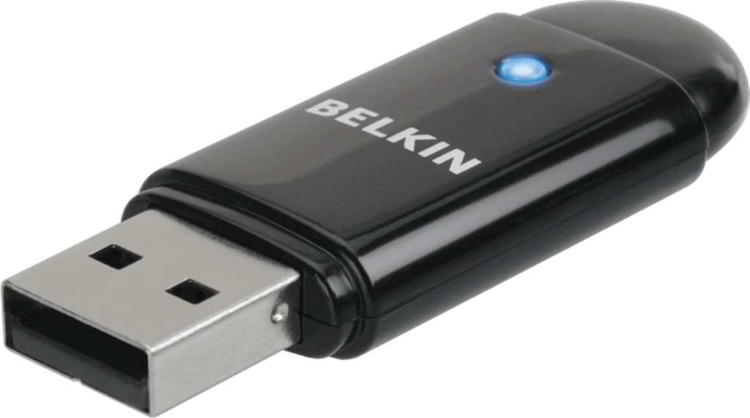
Bluetooth and IrDA
A Bluetooth wireless port adapter converts a USB port into a Bluetooth port
A smart phone might communicate with a notebook computer using an IrDA port
61

Slide 62
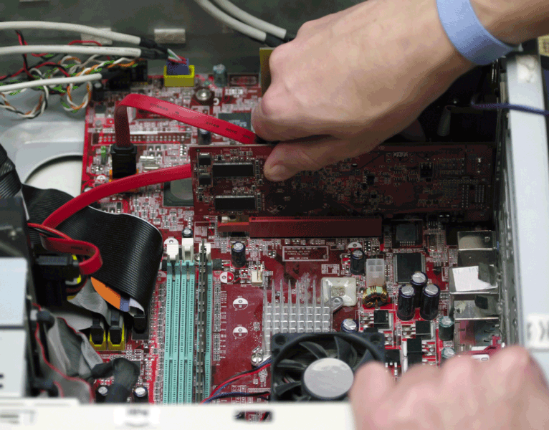
Plug and Play
With Plug and Play, the computer automatically can configure adapter cards and other peripherals as you install them
62

Slide 63
Plug and Play
New hardware detected automatically
Prompts to install drivers
Non-technical users can install devices
63
Notes:
Insider Information
Plug and play was introduced by Apple Computers.

Slide 64
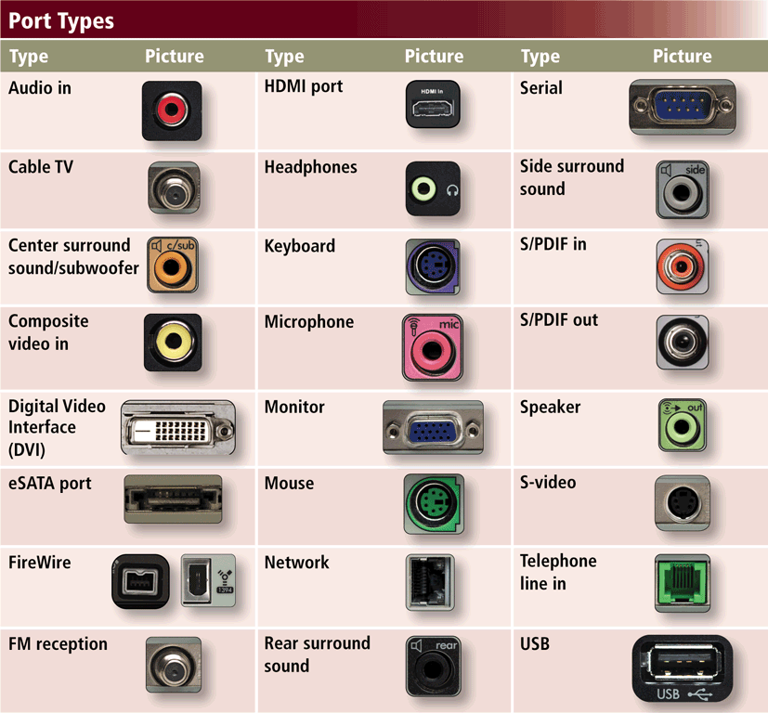
Ports and Connectors
64

Slide 65
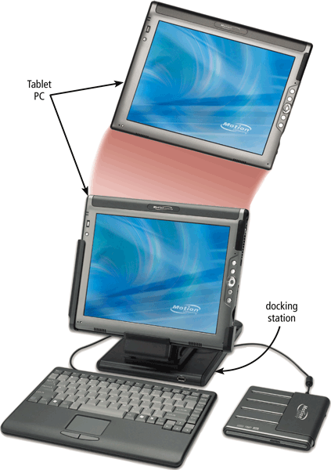
Ports and Connectors
A port replicator is an external device that provides connections to peripherals through ports built into the device
A docking station is an external device that attaches to a mobile computer or device
65

Slide 66
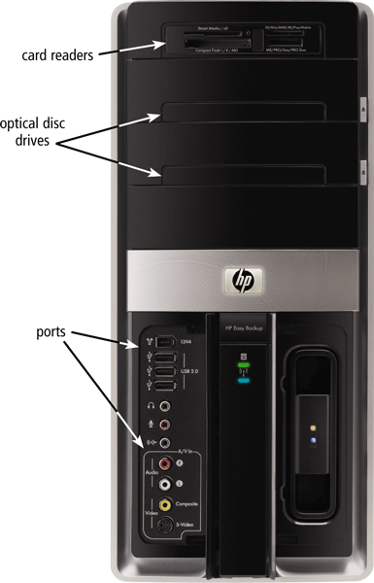
Bays
A bay is an opening inside the system unit in which you can install additional equipment
  A drive bay typically holds disk drives
66

Slide 67
Power Supply
The power supply converts the wall outlet AC power into DC power
Some external peripherals have an AC adapter, which is an external power supply
67

Slide 68
Putting It All Together
Home
Intel Core i5 or
Intel Core 2 i3 or
AMD Athlon II or
AMD Sempron
Minimum RAM: 2 GB
Small Office/
Home Office
Intel Core i7 or
Intel Core i7 Extreme or AMD Phenom II or
AMD Athlon II
Minimum RAM: 4 GB
Mobile
Intel Core i7 Extreme or
Intel Core i7 or
AMD Phenom II or
AMD Turion II
Minimum RAM: 2 GB
68

Slide 69
Putting It All Together
Power
Intel Xeon or
Intel Itanium or
AMD Opteron
Minimum RAM: 8 GB
Enterprise
Intel Core i7 or
Intel Core i7 Extreme or AMD Phenom II or
AMD Athlon II
Minimum RAM: 4 GB
69

Slide 70
Keeping Your Computer or Mobile Device Clean
Clean your computer or mobile device once or twice a year
Turn off and unplug your computer or mobile device before cleaning it
Use compressed air to blow away dust
Use an antistatic wipe to clean the exterior of the case and a cleaning solution and soft cloth to clean the screen
70

Slide 71
Summary
Processor architecture
  Intel Processors
  AMD Processors
  Motorola Processors
  IBM Processors
Comparing Processors
  Speed, Cache size, Registers, Word Size, FSB
RISC and CISC Processors
Parallel Processing
71

Slide 72
Summary II
External Bus
Ports and Connectors
Standard Computer Ports
  Serial, Parallel, VGA, Component Port, DVI
Expansion Slots and Adapter Cards
External Bus Standards
  ISA, PCI, AGP, USB,
  IEEE 1394 (Firewire), PC card, HDMI
  Bluetooth and IrDA
  Plug and Play
72

Slide 73
Recommended Websites
https://en.wikipedia.org/wiki/SCSI
https://en.wikipedia.org/wiki/FireWire
https://en.wikipedia.org/wiki/Universal_Serial_Bus
https://en.wikipedia.org/wiki/RS-232
https://en.wikipedia.org/wiki/AGP
https://en.wikipedia.org/wiki/PC_Card
73

