Slide 1
CSC 101
Introduction to Computing
Lecture 11
Dr. Iftikhar Azim Niaz
ianiaz@comsats.edu.pk
1

Slide 2
Last Lecture Summary
Memory
  Address , size
What memory stores
  OS, Application programs, Data, Instructions
Types of Memory
  Non Volatile and volatile
Non Volatile
  ROM, PROM, EPROM, EEPROM, Flash
RAM – Volatile Memory
  Static RAM, Dynamic RAM, MRAM
SDRAM and its types
2

Slide 3
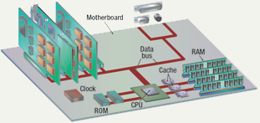
Components affecting Speed
CPU
Memory
Registers
Clock speed
Cache memory
Data bus
3

Slide 4
Achieving Increased Processor Speed
Increase the hardware speed of the processor.
  shrinking the size of the logic gates on the processor chip, so that more gates can be packed together more tightly
Increasing the clock rate
  individual operations are executed more rapidly.
Increase the size and speed of caches
  In particular, by dedicating a portion of the processor chip itself to the cache,
  cache access times drop significantly.
Make changes to the processor organization and architecture that increase the effective speed of instruction execution.
  Typically, this involves using parallelism in one form or another.
4

Slide 5
Registers
processor contains small, high-speed storage locations
temporarily hold data and instructions
part of the processor, not part of memory or a permanent storage device.
Different types of registers, each with a specific storage function including
  storing the location from where an instruction was fetched
  storing an instruction while the control unit decodes it
  storing data while the ALU computes it, and
  storing the results of a calculation.
5

Slide 6
Register Function
Almost all computers load data from a larger memory into registers where it is used for
  arithmetic,
  manipulated, or
  tested, by some machine instruction.
Manipulated data is then often stored back in main memory,
  either by the same instruction or
  a subsequent one.
6

Slide 7
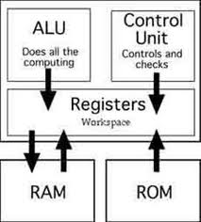
Register Size
Number of bits processor can handle
Word size
  indicates the amount of data with which the computer can work at any given time
Larger indicates more powerful computer
Increase by purchasing new CPU
  16 bit registers
  32 bit registers
  64 bit registers
7

Slide 8
User Accessible Registers
Data registers
  can hold numeric values such as integer and floating-point values, as well as characters, small bit arrays and other data.
  In some older CPUs, a special data register accumulator, is used implicitly for many operations.
Address registers
  hold addresses and are used by instructions that indirectly access main memory i.e. RAM
8

Slide 9
Other types of Registers
Conditional registers
  hold truth values often used to determine whether some instruction should or should not be executed.
General purpose registers (GPRs)
  can store both data and addresses, i.e., they are combined Data/Address registers.
Floating point registers (FPRs)
  store floating point numbers in many architectures.
Constant registers
  hold read-only values such as zero, one, or pi.
Vector registers
  hold data for vector processing done by SIMD instructions (Single Instruction, Multiple Data).
9

Slide 10
Other types of Registers
Control and Status registers hold program state; they usually include
  Program counter (aka instruction pointer) and
  Status register (aka processor status word or Flag register).
  Instruction register store the instruction currently being executed
Registers related to fetching information from RAM,
  Memory Buffer register (MBR)
  Memory Data register (MDR)
  Memory Address register (MAR)
  Memory Type Range Registers (MTRR)
Hardware registers are similar, but occur outside CPUs.
10

Slide 11
System or Internal Clock
Operations performed by a processor, such as
  fetching an instruction,
  decoding the instruction,
  performing an arithmetic operation, and so on,
  are governed by a system clock
Typically, all operations begin with the pulse of the clock
Speed of a processor is dictated by the pulse frequency produced by the clock, measured in cycles per second, or Hertz (Hz)
Clock signals are generated by a quartz crystal, which generates a constant signal wave while power is applied.
  This wave is converted into a digital voltage pulse stream that is provided in a constant flow to the processor circuitry
11
Notes:
Teaching tip
Spend a little time here discussing over clocking. Over clocking causes the computer to run faster than designed. Possibly, you have students that can share stories of over clocking.

Slide 12
System or Internal Clock
The rate of pulses is known as the clock rate, or clock speed.
One increment, or pulse, of the clock is referred to as a clock cycle, or a clock tick or the time it takes to turn a transistor off and back on again.
The time between pulses is the cycle time.
controls the timing of all computer operations
A processor can execute an instruction in a given number of clock cycles.
Pace of the system clock is called the clock speed
  Modern machines use Giga Hertz (GHz)
    One billion clock ticks in one second
12
Notes:
Teaching tip
Spend a little time here discussing over clocking. Over clocking causes the computer to run faster than designed. Possibly, you have students that can share stories of over clocking.

Slide 13
Underclocking and Overclocking
Underclocking
  With any particular CPU, replacing the crystal with another crystal that oscillates half the frequency will generally make the CPU run at half the performance and reduce waste heat produced by the CPU.
Overclocking
  to increase performance of a CPU by replacing the oscillator crystal with a higher frequency crystal
  the amount of overclocking is limited by the time for the CPU to settle after each pulse, and by the extra heat created.
13

Slide 14
Overclocking
process of making a computer or component operate faster than specified by the manufacturer by modifying system parameters.
Most overclocking techniques increase power consumption, generating more heat, which must be carried away.
The purpose of overclocking is to increase the operating speed of given hardware.
Computer components that may be overclocked include
  processors (CPU),
  video cards,
  motherboard chipsets, and
  RAM.
14

Slide 15
Cache Function
The data that is stored within a cache
  might be values that have been computed earlier or
  duplicates of original values that are stored elsewhere
If requested data is contained in the cache (cache hit),
  this request can be served by simply reading the cache, which is comparatively faster.
Otherwise (cache miss),
  the data has to be recomputed or fetched from its original storage location, which is comparatively slower.
Hence, the greater the number of requests that can be served from the cache, the faster the overall system performance becomes.

Slide 16
Cache
Small amount of very fast memory which stores copies of the data from the most frequently used main memory locations
Sits between normal main memory (RAM & ROM) and CPU
May be located on CPU chip or module
Used to reduce the average time to access memory.
As long as most memory accesses are cached memory locations, the average access time of memory accesses will be closer to the cache access time than to the access time of main memory.

Slide 17
Cache Operation – Overview
CPU requests contents of memory location
Check cache for this data
If present, get from cache (fast)
If not present, read required block from main memory to cache
Then deliver from cache to CPU
Cache includes tags to identify which block of main memory is in each cache slot

Slide 18
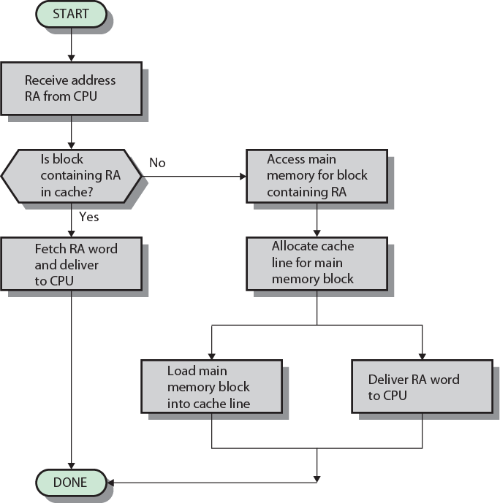
Cache Read Operation - Flowchart

Slide 19
Types of Cache
Most modern desktop and server CPUs have at least three independent caches:
an instruction cache to speed up executable instruction fetch,
a data cache to speed up data fetch and store, and
a translation lookaside buffer (TLB) used to speed up virtual-to-physical address translation for both executable instructions and data.

Slide 20
Multi Level Cache
Another issue is the fundamental tradeoff between cache access time and hit rate
  Larger caches have better hit rates but longer access time
To address this tradeoff, many computers use multiple levels of cache, with small fast caches backed up by larger slower caches.
Multi-level caches generally operate by checking the smallest level 1 (L1) cache first;
  if it hits, the processor proceeds at high speed.
  If the smaller cache misses, the next larger cache (L2) is checked, and
  so on, before external memory is checked.
L1 holds recently used data
L2 holds upcoming data
L3 holds possible upcoming data
20

Slide 21
Multilevel Caches
High logic density enables caches on chip
  Faster than bus access
  Frees bus for other transfers
Common to use both on and off chip cache
  L1 on chip, L2 off chip in static RAM
  L2 access much faster than DRAM or ROM
  L2 often uses separate data path
  L2 may now be on chip
  Resulting in L3 cache
    Bus access or now on chip…

Slide 22
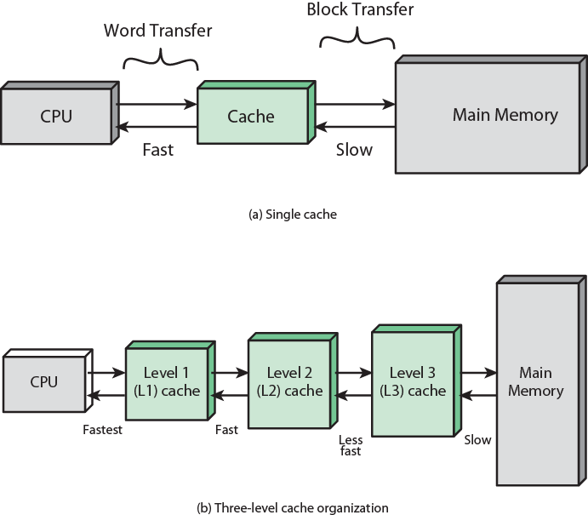
Multilevel Cache

Slide 23
L1 Cache
Built directly in the processor chip.
Usually has a very small capacity, ranging from 8 KB to 128 KB.
The more common sizes for PCs are 32 KB or 64 KB.

Slide 24
L2 Cache
Slightly slower than L1 cache
Has a much larger capacity, ranging from 64 KB to 16 MB
Current processors include Advanced Transfer Cache (ATC), a type of L2 cache built directly on the processor chip
Processors that use ATC perform at much faster rates than those that do not use it
PCs today have from 512 KB to 12 MB of ATC
Servers and workstations have from 12 MB to 16 MB of ATC

Slide 25
L3 Cache
L3 cache is a cache on the motherboard
Separate from the processor chip.
Exists only on computers that use L2 Advanced Transfer Cache.
Personal computers often have up to 8 MB of L3 cache;
Servers and work stations have from 8 MB to 24 MB of L3 cache.

Slide 26
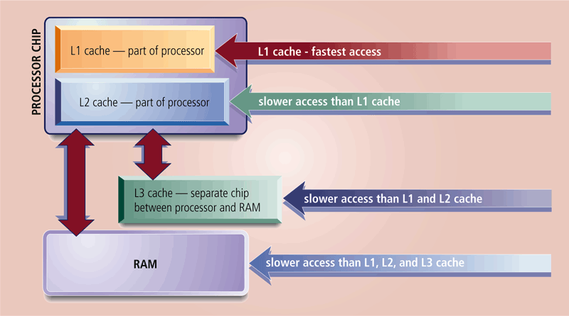
Multi Level Cache
speeds the processes of the computer because it stores frequently used instructions and data
26

Slide 27
Intel Cache Evolution
Problem
Solution
Processor on which feature first appears
External memory slower than the system bus.
Add external cache using faster memory technology.
386
Increased processor speed results in external bus becoming a bottleneck for cache access.
Move external cache on-chip, operating at the same speed as the processor.
486
Internal cache is rather small, due to limited space on chip
Add external L2 cache using faster technology than main memory
486
Contention occurs when both the Instruction Prefetcher and the Execution Unit simultaneously require access to the cache. In that case, the Prefetcher is stalled while the Execution Unit’s data access takes place.
Create separate data and instruction caches.
Pentium
Increased processor speed results in external bus becoming a bottleneck for L2 cache access.
Create separate back-side bus that runs at higher speed than the main (front-side) external bus. The BSB is dedicated to the L2 cache.
Pentium Pro
Move L2 cache on to the processor chip.
Pentium II
Some applications deal with massive databases and must have rapid access to large amounts of data. The on-chip caches are too small.
Add external L3 cache.
Pentium III
Move L3 cache on-chip.
Pentium 4

Slide 28
Memory hierarchy –Design constraints
How much?
  open ended. If the capacity is there, applications will likely be developed to use it
How fast?
  To achieve greatest performance, the memory must be able to keep up with the processor.
    As the processor is executing instructions, it should not have to pause waiting for instructions or operands.
How expensive?
  the cost of memory must be reasonable in relationship to other components

Slide 29
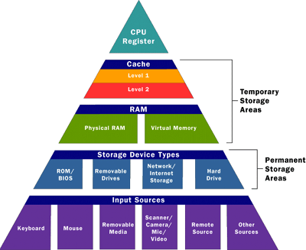
Memory Hierarchy
Faster access time, greater cost per bit
Greater capacity, smaller cost per bit
Greater capacity, slower access time
29

Slide 30
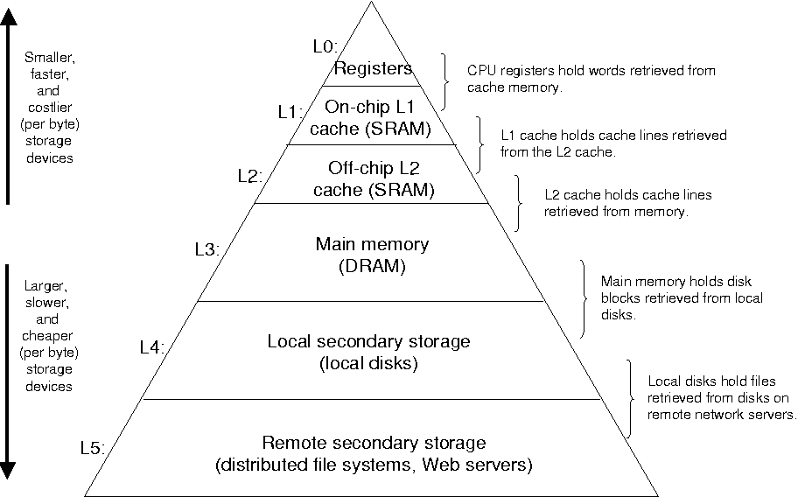
Memory Hierarchy

Slide 31
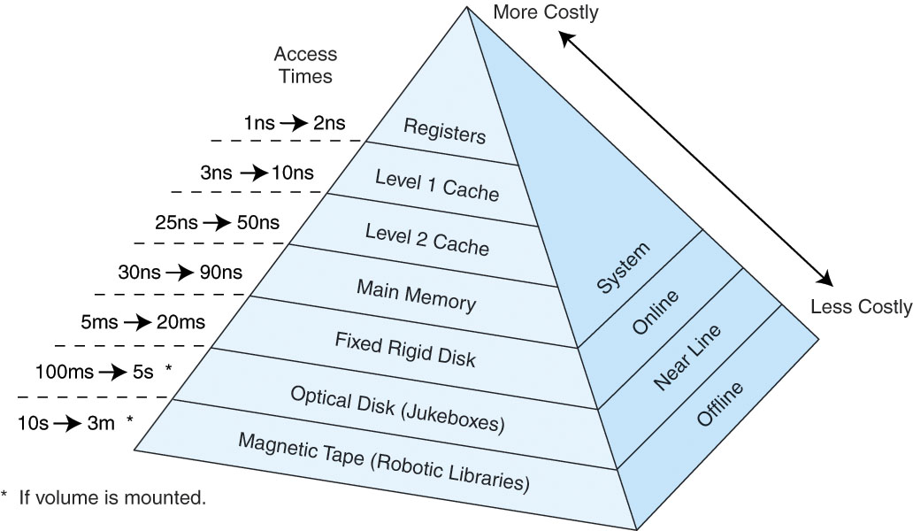
Access Time

Slide 32
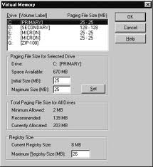
Virtual RAM
Computer is out of actual RAM
File that emulates RAM
Computer swaps data to virtual RAM
  Least recently used data is moved
Techniques
  Paging
  Segmentation or
  Combination of both
32

Slide 33
The Bus
Electronic pathway between components
Two main buses: Internal (or system) bus and External (or expansion) bus.
Internal or System bus
  resides on the motherboard and connects the CPU to other devices that reside on the motherboard
  has three parts: the data bus, address bus and control bus
External or Expansion bus
  connects external devices, such as the keyboard, mouse, modem, printer and so on, to the CPU.
  Cables from disk drives and other internal devices are plugged into the bus.
33

Slide 34
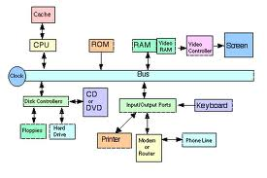
Bus Width and Speed
Bus width is measured in bits
Speed is tied to the clock
34

Slide 35
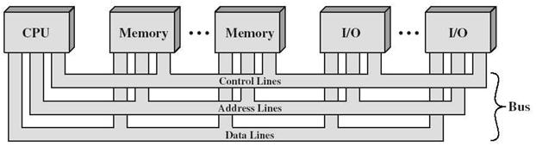
Bus Interconnection Scheme
A system bus consists of a
  A data bus,
  a memory address bus and
  a control bus.

Slide 36
Data Bus
is a computer subsystem that allows for the transferring of data
  from one component to another on a motherboard or system board, or
  between two computers.
This can include transferring data to and from the memory, or from CPU to other components
Each one is designed to handle so many bits of data at a time.
The amount of data a data bus can handle is called bandwidth
A typical data bus is 32-bits wide
Newer computers are making data buses that can handle 64-bit
36

Slide 37
Address Bus
is a series of lines connecting two or more devices that is used to specify a physical address.
When a processor needs to read or write to a memory location,
  it specifies that memory location on the address bus (the value to be read or written is sent on the data bus).
The width of the address bus determines the amount of memory a system can address.
  For example, a system with a 32-bit address bus can address 2³² (4,294,967,296) memory locations.
  If each memory address holds one byte, the addressable memory space is 4 GB.
37

Slide 38
Control Bus
A control bus is (part of) a computer bus, used by CPUs for communicating with other devices within the computer.
  While the address bus carries the information on which device the CPU is communicating with and
  data bus carries the actual data being processed,
Control bus carries commands from the CPU and returns status signals from the devices
  e.g. if the data is being read or written to the device the appropriate line (read or write) will be active
38

Slide 39
Summary I
Components Affecting Speed
Achieving Increased Processor Speed
Registers
  Functions and Size
  User accessible and other types of Registers
System or Internal Clock
  Clock speed and clock rate
  Underclocking
  Overclocking

Slide 40
Summary II
Cache memory
  Function operation
  Type: Instruction, data and TLB
  Multi Level Cache, L1, L2 and L3
    Intel Cache Evolution
  Memory Hierarchy
Bus
  Bus width and speed
  Bus Interconnection Scheme
    Data, address and control bus

Slide 41
Recommended Websites
https://en.wikipedia.org/wiki/Processor_register
https://en.wikipedia.org/wiki/CPU_cache
https://en.wikipedia.org/wiki/Clock_rate
https://en.wikipedia.org/wiki/Bus_(computing)
41

