Slide 1
CSC 101
Introduction to Computing
Lecture 10
Dr. Iftikhar Azim Niaz
ianiaz@comsats.edu.pk
1

Slide 2
Last Lecture Summary
How Computer Stores Data
Text Codes
  EBCDIC, ASCII, Extended ASCII and Unicode
Binary Arithmetic
Boolean Algebra
Central Processing Unit (CPU)
  Control Unit and ALU
Machine Cycle
2

Slide 3
Memory
Consists of electronic components
  store instructions waiting to be executed by the processor
  data needed by those instructions, and
  results of processing the data (information).
Stores both programs and data
  CPU cannot hold permanently
Small chips on the motherboard or on a small circuit board attached with motherboard
  Allows CPU to store and retrieve data quickly
More memory makes a computer faster
3

Slide 4
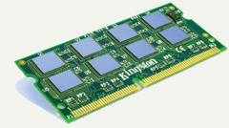
Memory
Von Neumann Architecture
  Concept of stored program
Memory stores three basic categories of items:
  operating system and other system
  application programs and
  data being processed and resulting information.

Slide 5
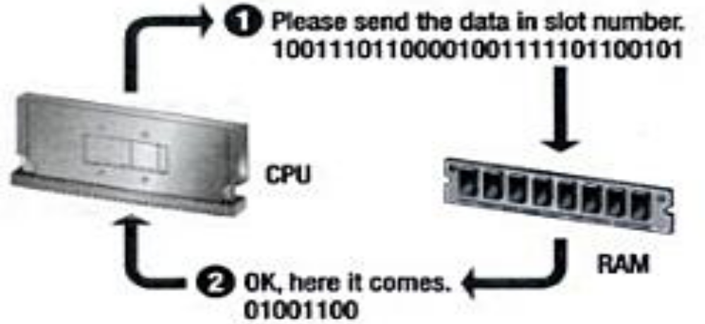
Memory Address
Bit –smallest storage unit
Byte (character)– smallest addressable unit
  Room vs House
Each memory cell has an address
An addresses is a unique number that identifies the location of a byte in memory.
5

Slide 6
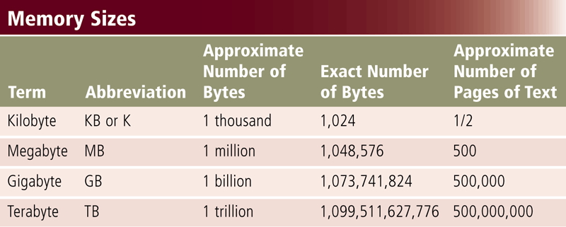
Memory Size
Byte is a basic storage unit in memory
Memory and storage devices size is measured in KB, MB, GB or TB
6

Slide 7
What Memory Stores?
Store Instructions waiting to be executed by the processor
Data needed by those instructions, and
Results of processing the data
Stores three basic categories of items:
The operating system and other system software
Application programs
Data being processed and the resulting information
7

Slide 8
Types of Memory
Volatile memory
Nonvolatile memory
Loses its contents when power is turned off
Does not lose contents when power is removed
Example includes RAM
Examples include ROM, flash memory, and CMOS
8

Slide 9
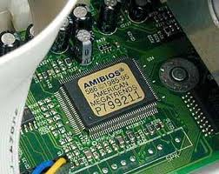
Non Volatile Memory ROM
Read Only Memory (ROM)
Holds data when power is off
Basic Input Output System (BIOS)
Power On Self Test (POST)
9
Notes:
Teaching tip
If you are in a computer lab, spend a few minutes exploring your BIOS. Demonstrate what happens when values are adjusted. Walk through a POST check. Unplug a device and generate POST errors. Be sure to reset everything before moving on with the lecture!

Slide 10
ROM Types
Read-only memory (ROM) refers to memory chips storing permanent data and instructions
Firmware Microcode stored in ROM
A PROM (Programmable Read-Only memory) chip is a blank ROM chip that can be written to permanently only once.
EEPROM can be erased
10

Slide 11
Types of ROM
Written during manufacture
  Very expensive for small runs
Programmable (once)
  PROM
  Needs special equipment to program
Read “mostly” than write operation
  Erasable Programmable (EPROM)
    Optically erased by UV
  Electrically Erasable (EEPROM)
    Takes much longer to write than read
  Flash memory
    Erase whole memory electrically
11

Slide 12

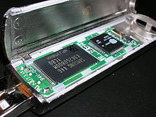
Flash Memory
Data is stored using physical switches
Special form of nonvolatile memory
Camera cards, USB key chains
Microwave, Cars
12

Slide 13
Flash Memory
Can be electrically erased and reprogrammed
  high density NAND type must also be programmed and read in (smaller) blocks, or pages,
  NOR type allows a single machine word (byte) to be written or read independently
Limitations
  Block erasure
  Memory wear
  Read disturb
13

Slide 14
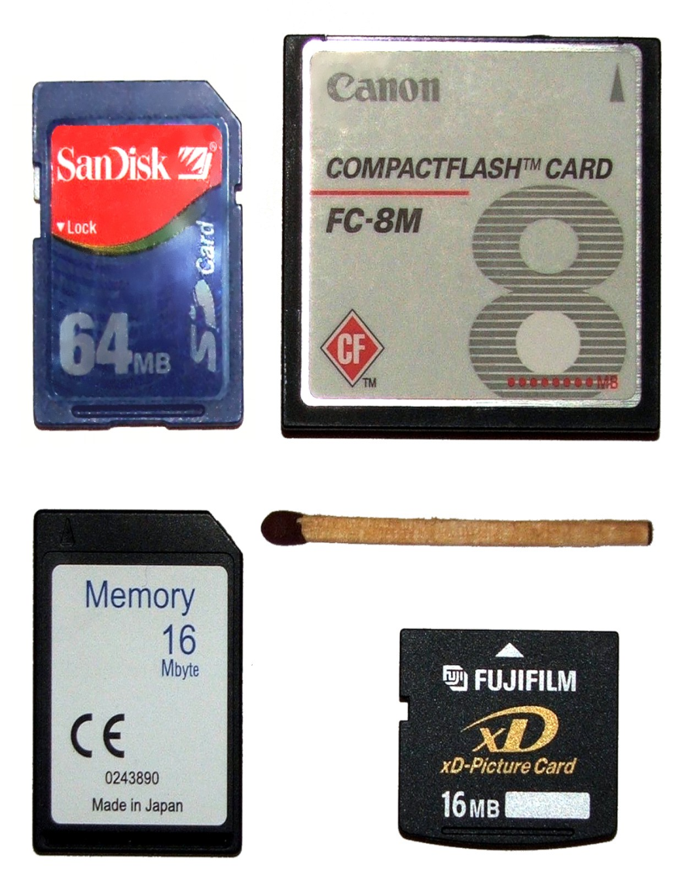
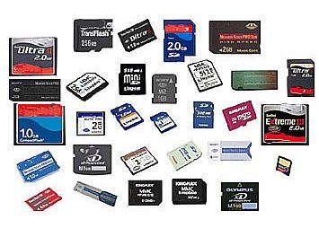
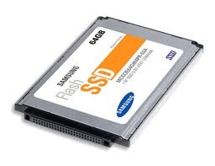
Flash Memory
14

Slide 15
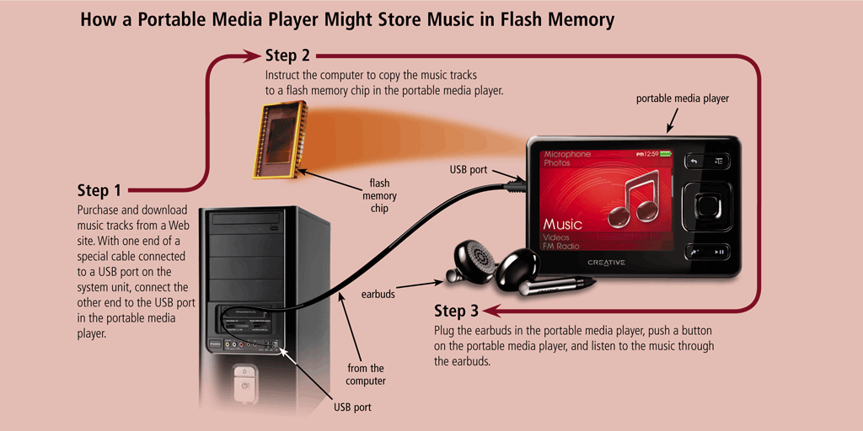
Flash Memory
Flash memory can be erased electronically and rewritten
  CMOS technology provides high speeds and consumes little power
15

Slide 16
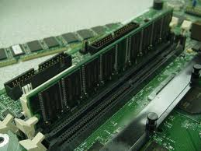
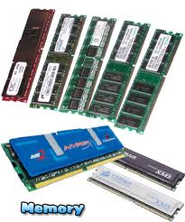
RAM
Requires power to hold data
Random Access Memory (RAM)
Data in RAM has an address
CPU reads data using the address
CPU can read any address
16
Notes:
Teaching tip
One of the most commonly asked questions is “How do I speed up my computer”. The simplest answer is to add RAM. The Productivity Tip on page 200 provides some guidelines when to add RAM.

Slide 17
RAM
Misnamed as all semiconductor memory is random access
  random access means individual words of memory are directly accessed through wired-in addressing logic.
Read/Write
Volatile
  A RAM must be provided with a constant power supply. If the power is interrupted, then the data are lost.
Can only be used as temporary storage
17

Slide 18
Semiconductor Memory
In earlier computers, main memory employed an array of doughnut-shaped ferromagnetic loops referred to as cores
Today, the use of semiconductor chips for main memory is almost universal.
Properties
  exhibit two stable (or semistable) states, which can be used to represent binary 1 and 0.
  capable of being written into (at least once), to set the state.
  capable of being read to sense the state.
18

Slide 19
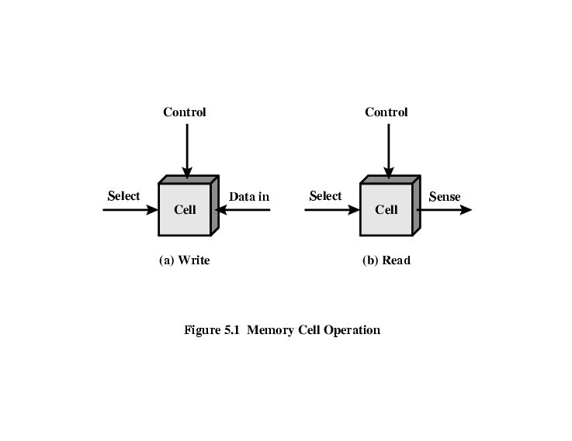
Memory Cell Operation
Select terminal selects a memory cell for a read or write operation.
Control terminal indicates read or write.
For writing, the other terminal provides an electrical signal that sets the state of the cell to 1 or 0.
For reading, that terminal is used for output of the cell’s state.
19

Slide 20
RAM Chip sets
Static RAM
Dynamic RAM (DRAM)
Magnetoresistive RAM (MRAM)
Dynamic RAM (DRAM)
Static RAM (SRAM)
Magnetoresistive RAM (MRAM)
20

Slide 21
Static RAM
Bits stored as on/off switches
No charges to leak
  Digital uses flip-flops
No refreshing needed when powered
More complex construction
Requires larger area per bit
More expensive
Faster and more reliable
Cache uses SRAM chips
21

Slide 22
Dynamic RAM
Bits stored as charge in capacitors
  presence or absence of charge in a capacitor is interpreted as a binary 1 or 0
Capacitors have a natural tendency to discharge.
dynamic refers to this tendency of the stored charge to leak away, even with power continuously applied.
Need refreshing even when powered
22

Slide 23
Dynamic RAM
Simpler construction
Smaller per bit
Less expensive
Need refresh circuits
Slower
Used Main memory
Essentially analogue device although stores binary
  Capacitor can store any charge value within a range
  A threshold value determines whether the charge is interpreted as 1 or 0.
23

Slide 24
SRAM v DRAM
Both volatile
  Power needed to preserve data (bit value)
Dynamic cell
  Simpler to build, smaller
  More dense (smaller cells= more cells per unit area)
  Less expensive
  Needs refresh
  Larger memory units
Static
  Faster
  Cache (both on and off chip)
24

Slide 25
Synchronous DRAM (SDRAM)
Exchange data with processor is synchronized with an external clock
  Address is presented to RAM
  RAM finds data (CPU waits in conventional DRAM)
  Since SDRAM moves data in time with system clock, CPU knows when data will be ready
  CPU does not have to wait, it can do something else
Burst mode allows SDRAM to set up stream of data and fire it out in block
25

Slide 26
SDR SDRAM
SDR (Single Data Rate) can accept one command and transfer one word of data per clock cycle.
Typical clock frequencies are 100 and 133 MHz.
Chips are made with a variety of data bus sizes (most commonly 4, 8 or 16 bits),
  but chips are generally assembled into 168-pin DIMMs that read or write 64 (non-ECC) or 72 (ECC) bits at a time
Typical SDR SDRAM clock rates are 66, 100, and 133 MHz (periods of 15, 10, and 7.5 ns).

Slide 27
DDR1 SDRAM
SDRAM can only send data once per clock
DDR (Double Data Rate) SDRAM can send data twice per clock cycle
  Rising edge and falling edge
DDR SDRAM interface makes higher transfer rates possible by more strict control of the timing of the electrical data and clock signals.
With data being transferred 64 bits at a time, DDR SDRAM gives a transfer rate of
  (memory bus clock rate) × 2 (for dual rate) × 64 (number of bits transferred) / 8 (number of bits/byte).
Thus, with a bus frequency of 100 MHz, DDR SDRAM gives a maximum transfer rate of 1600 MB/s.
27

Slide 28
DDR2 SDRAM
Allows higher bus speed and requires lower power by running the internal clock at half the speed of the data bus
The two factors combine to require a total of four data transfers per internal clock cycle
With data being transferred 64 bits at a time, DDR2 SDRAM gives a transfer rate of
  (memory clock rate) × 2 (for bus clock multiplier) × 2 (for dual rate) × 64 (number of bits transferred) / 8 (number of bits/byte).
Thus with a memory clock frequency of 100 MHz, DDR2 SDRAM gives a maximum transfer rate of 3200MB/s.

Slide 29
DDR3 SDRAM
Double Data Rate type 3 has a high bandwidth interface.
ability to transfer data at twice the rate (eight times the speed of its internal memory arrays), enabling higher bandwidth or peak data rates
With two transfers per cycle of a quadrupled clock, a 64-bit wide DDR3 module may achieve a transfer rate of up to 64 times the memory clock speed in megabytes per second (MB/s).
Thus with a memory clock frequency of 100 MHz, DDR3 SDRAM gives a maximum transfer rate of 6400 MB/s.
In addition, the DDR3 standard permits chip capacities of up to 8 gigabytes.

Slide 30
Forward and Backward Compatibility
DDR3 SDRAM is neither forward nor backward compatible with any earlier type of random access memory (RAM) due to different
  signaling voltages, timings, and other factors.
Similarly DDR2 is neither forward nor backward compatible with either DDR or DDR3.
Similarly DDR is neither forward nor backward compatible with either DDR3 or DDR3 meaning
  meaning that DDR2 or DDR3 memory modules will not work in DDR equipped motherboards, and vice versa

Slide 31
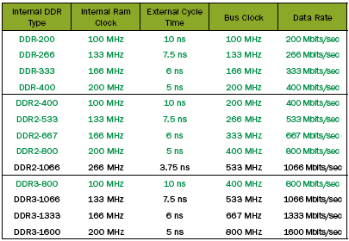
DDR, DDR2 DDR3 Comparison

Slide 32
RDRAM – Rambus DRAM
RDRAM chips are vertical packages, with all pins on one side.
The chip exchanges data with the processor over 28 wires no more than 12 centimeters long.
The bus can address up to 320 RDRAM chips and is rated at 1.6 GBps
Not in use after 2000

Slide 33
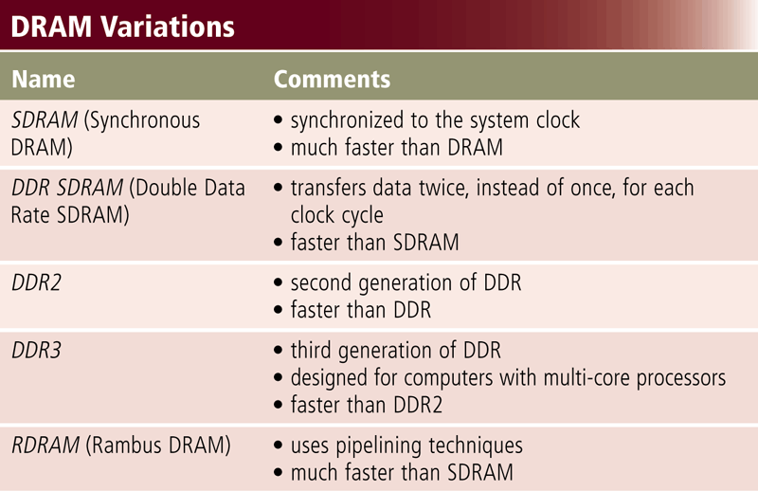
DRAM Chip sets
33

Slide 34
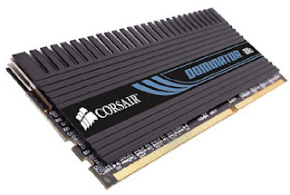
Magnetoresistive RAM
Faster and more energy efficient
MRAM has similar performance to SRAM
Similar density of DRAM but much lower power consumption than DRAM,
Much faster and suffers no degradation over time in comparison to flash memory
34

Slide 35
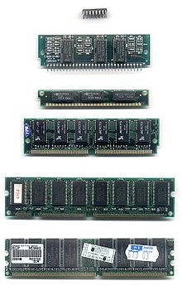
DRAM Variations
DIP 16-pin (DRAM chip, usually pre-fast page mode DRAM (FPRAM))
SIPP 30-pin (usually FPRAM)
SIMM 30-pin (usually FPRAM)
SIMM 72-pin (often extended data out DRAM (EDO DRAM)
DIMM 168-pin (SDRAM)
DIMM 184-pin (DDR SDRAM)
RIMM 184-pin (RDRAM)
DIMM 240-pin (DDR2 SDRAM and DDR3 SDRAM)
35

Slide 36
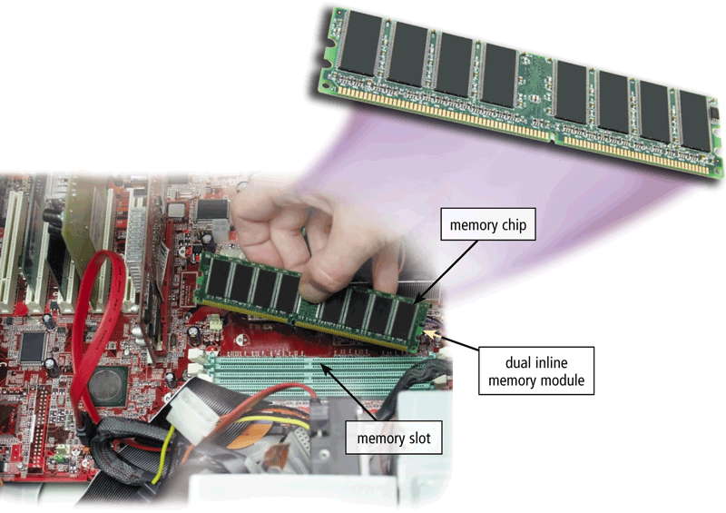
Memory Slots
RAM chips usually reside on a memory module and are inserted into memory slots
36

Slide 37
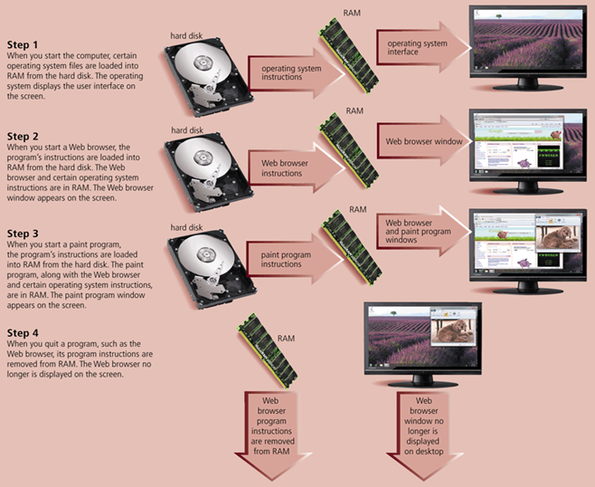
How Instruction Moves In and Out of RAM
37

Slide 38
Multitasking and Multiprogramming
Multitasking
  a method where multiple tasks are performed during the same period of time
  Tasks share common processing resources, such as a CPU and main memory
  One CPU, only one task is said to be running at any point in time
  The act of reassigning a CPU from one task to another one is called a context switch
Multiprogramming
  running task keeps running until it performs an operation that requires waiting for an external event (e.g. reading from a tape) or until the computer's scheduler forcibly swaps the running task out of the CPU

Slide 39
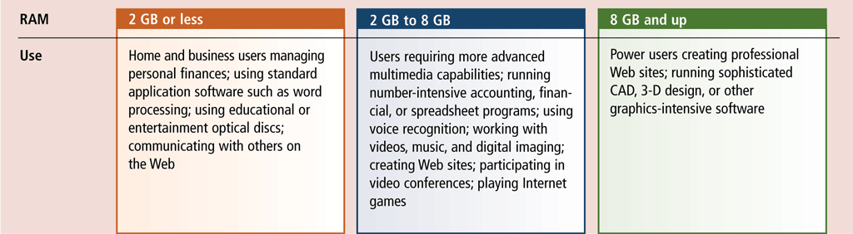
How Much RAM is necessary?
The amount of RAM necessary in a computer often depends on the types of software you plan to use
39

Slide 40
Semiconductor Memory Types
Memory Type | Category | Erasure | Write Mechanism | Volatility
Random-access memory (RAM) | Read-write memory | Electrically, byte-level | Electrically | Volatile
Read-only memory (ROM) | Read-only memory | Not possible | Masks | Nonvolatile
Programmable ROM (PROM) |  |  | Electrically
Erasable PROM (EPROM) | Read-mostly memory | UV light, chip-level
Electrically Erasable PROM (EEPROM) |  | Electrically, byte-level
Flash memory |  | Electrically, block-level
40

Slide 41
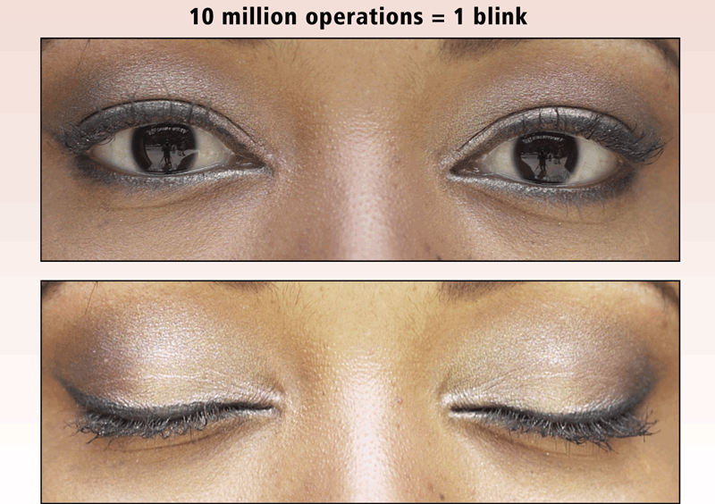
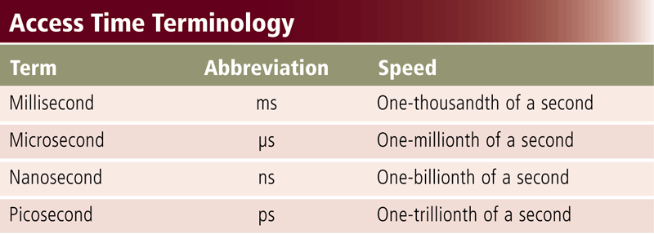
Memory
Access time is the amount of time it takes the processor to read from memory
  Measured in nanoseconds
Accessing memory is much faster than accessing hard drive due to mechanical parts
41

Slide 42
Calculating Access Time
Manufacturer states access time in MHz
Access time = 1 billion ns / MHz number
  e.g. 800 MHz memory
  1,000,000,000 / 800,000,000 = 1.25 ns
Access time of various memories
  Standard SDRAM chips 133 MHz ( about 7.5 ns)
  DDR SDRAM chips reach 266 MHz (about 3.75 ns)
  DDR2 chips reach 800 MHz (1.25 ns), and
  DDR3 chips reach 1600 MHz (about 0. 625 ns)
  RDRAM chips have 1600 MHz (about 0.625 ns).
  ROM access times range from 25 to 250 ns.

Slide 43
Summary
Memory
  Address , size
What memory stores
  OS, Application programs, Data, Instructions
Types of Memory
  Non Volatile and volatile
Non Volatile
  ROM, PROM, EPROM, EEPROM, Flash
RAM – Volatile Memory
  Static RAM, Dynamic RAM, MRAM
SDRAM and its types
43

Slide 44
Recommended Websites
https://en.wikipedia.org/wiki/Computer_multitasking
https://en.wikipedia.org/wiki/SDRAM
https://en.wikipedia.org/wiki/DDR_SDRAM
https://en.wikipedia.org/wiki/DDR2_SDRAM
https://en.wikipedia.org/wiki/DDR3_SDRAM
44

