Slide 1
Summery of Lecture. 8.
LECTURE. 8. Unit. 2 was related to
Islamic Glass work
Medieval Islamic metalwork
Calligraphy
Calligraphy in different Cultures and traditions of the world
Calligraphy in Japan
Calligraphy in China
Calligraphy in Persia
Arabic calligraphy

Slide 2
LECTURE. 9. UNIT. 2
Persian Artists and their Calligraphy
Persian calligraphy : is the calligraphy of the Persian writing system. It is one of the most revered arts throughout Persian history.

Slide 3
HISTORY OF NASTALIQ: After initiation of Islam in the 7th century, Persians adapted the Arabic alphabet to Persian and developed the contemporary Persian alphabet. Arabic alphabet has 28 characters. An additional 4 letters were added by Iranians , which resulted in the 32 letters currently present in the Persian alphabet.

Slide 4
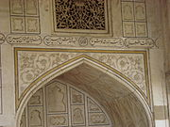
Calligraphy of Persian Poems on large

Slide 5
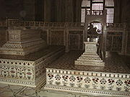
Calligraphy in Persian on Taj Mehal

Slide 6
Around one thousand years ago, Ibn Muqlah (Persian: and his brother created six genres of Iranian calligraphy, namely "Tahqiq", "Reyhan", "Sols", "Naskh", "Toqi" and "Reqa". These genres were common for four centuries in Persia. In the 7th century (Hijri calendar), Hassan Farsi Kateb combined "Naskh" and "Reqah" styles and invented a new genre of Persian calligraphy, named "Ta'liq".

Slide 7
In the 14th century, Mir Ali Tabrizi combined two major scripts of his time i.e. Naskh and Taliq and created the most attractive Persian Calligraphy style, "Nas’taliq". In past 500 years Iranian calligraphy called Nastaʿlīq (also anglicized as Nastaleeq; Persian: (nastaʿlīq) is one of the main script styles used in writing the Perso-Arabic script, and traditionally the predominant style in Persian calligraphy

Slide 8
History of cursive Nas'taliq
Morteza Gholi Khan Shamlou and Mohammad Shafi Heravi created a new genre called cursive Nastaʿlīq Shekasteh Nastaʿlīq in the 17 th century. Almost a century later, a Abdol-Majid Taleqani, who was a prominent artist at the time, brought this genre to its highest level. This calligraphy style is based on the same rules as Nas’taliq.

Slide 9
However, it has a few significant differences: it provides more flexible movements and it is slightly more stretched and curved. Yadollah Kaboli is one of the most prominent contemporary calligraphers within this style.
Contemporary Persian calligraphy
In 1950, the Iran's Association of Calligraphers was founded by Hossein Mirkhani, Ali Akbar Kaveh, Ebrahim Bouzari, Hassan Mirkhani and Mehdi Baiani.

Slide 10
For an overview of persian calligraphy's development within Afghanistan, see "Calligraphy during last two centuries in Afghanistan" (1964), by Azizuddin Vakili.
Modernist movement
Zendeh Roudi, Jalil Rasouli, Parviz Tanavoli, and Masih Zad use Persian calligraphy and Rumi poetry in dress designing

Slide 11
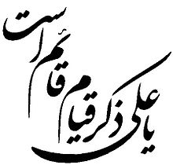

Slide 12
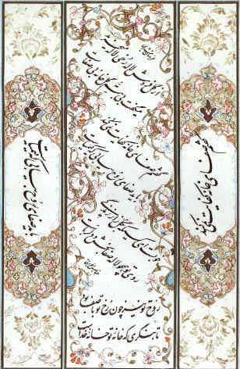
Important Iranian Calligraphers and their work:
Abbas Akhwain, 1936, Place of Birth: Meshed, Iran, Director of Superior Council and Member of The Board of Trustees of Iranian Calligraphers Society

Slide 13
Ghulam Husain Amirkhani, 1939
Place of Birth: Taleqan, Iran
Teachers: Husain Mirkhani, Hasan Mirkhani
Director of Superior Council and Member Of The Board Of Trustees of Iranian Calligraphers Society
Exhibitions: Numerous individual and group exhibitions in Iran
Exhibitions in France, Pakistan, Syria and UK
Some of his works: Anthology Of Sadi (Talat Haq)
Penmanship Models
Educational booklets and albums
In Memory Of Kalhor
Hafiz Sonnets

Slide 14
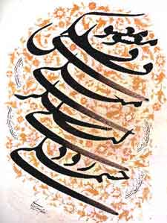
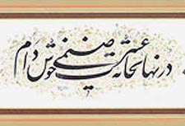

Slide 15
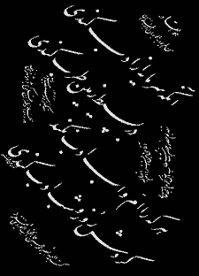
 | Mirza Muhammad Husain Saifi Ammad-ul-Kattab 1866-1936 Place of Birth: Qazwin, Iran. Inspiration: Mirza Muhammad Raza Kalher

Slide 16
 | Rasool Muradi 1954 Teacher(s)/Instructor(s): Mustafa Mehdizada, Ghulam Husain Amirkhani Students: Inspiration: Place of Birth: Mashhad, Iran Awards: 2001, 3rd Prize in Taaliq, International Competition for Calligraphy, Research Centre for Islamic History, Art and Culture, Istanbul, Turkey

Slide 17
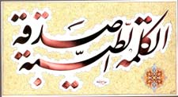
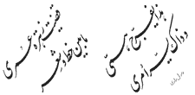

Slide 18
HISTORIC PERSIAN CALLIGRAPHY ARTISTS:
Among all those great names in the history of Persian Calligraphy, four figures are the most famous ones: Mir-Ali Tabrizi, Mir-Emad, Kalhor, and Emad-ol-Kottab.
Mir-Ali Tabrizi: He lived in 14th and 15th century. He is known as father of Nas-Taliq because he invented this beautiful calligraphy style by means of combining two older styles together (Naskh and Taliq) and adding a flavor of nature into it. Therefore, this calligraphy style implemented natural curves rather than Naskh and Taliq styles.

Slide 19
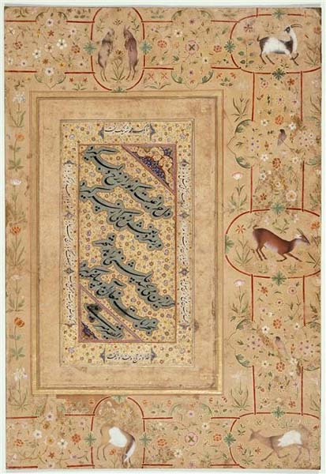
A Sample of Mir-Ali’s Art Pieces (Louvre Museum - Paris)

Slide 20
Mir-Emad: He is probably the most prominent Persian Calligrapher ever! His full name is Mir-Emad Hassani and lived in 16th century. He was originally from city of Qazvin where he started learning calligraphy. Then he moved to the city of Tabriz where he attended Mohammad-Hossein Tabrizi's calligraphy classes. He modified Nas’taliq style and altered its structure.

Slide 21
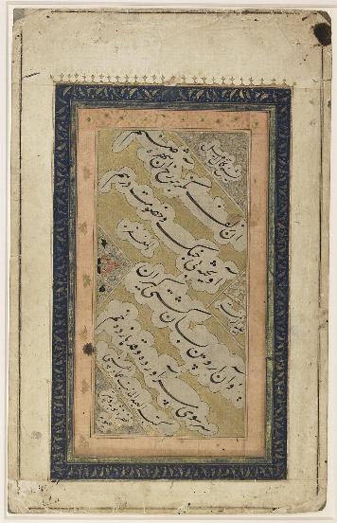
A Sample of Mir-Emad’s Art Pieces

Slide 22
Mierza Mohammad-Reza Kalhor: He was born in1828 in city of Kermanshah, western part of Iran. His first mentor was his own cousin who had a nice hand-writing. As he moved to Tehran - capital of Iran - he worked on his calligraphy skill in Nas’taliq style and after a few years of hard work, his artistic talent impressed every one including his calligraphy teacher. He told Kalhor: "... to control your hand's movements is as if you want to train a wild horse.

Slide 23
Now that you have done so, make it as perfect as possible; create your own style in such a way that without signing your master pieces people can tell that it is your work!...." He did so and became Nasser-eddin Shah's (king of Iran at the time) calligraphy tutor and met Amir-Kabir, his prime minister who promoted and encouraged Iranian scientists and artists and had a noticeable positive

Slide 24
impact on the country's cultural affairs at his time. Kalhor had a special interest in Mir Emad's calligraphy style and followed his rules in calligraphy; but ultimately he had his own flavor in Persian calligraphy that makes his art different.

Slide 25
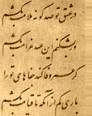
A Sample of Mirza Mohammad Reza Kalhor's Arts

Slide 26
Emad-ol-Kottab (1861-1936): He was born in city of Qazvin. When he was a young man, he had a hard time living in poverty until later on his artistic talent in calligraphy helped him as he became royal calligrapher and he hand-wrote Ferdowsi's -a famous Iranian poet who lived in 11th century- poem book for Mozaffar-eddin Shah, king of Iran at the time. A few years later he became Ahmad Shah's calligraphy tutor. Even after Ahmad Shah's era, when Reza Shah Pahlavi took over, he became his command writer. He also mentored his son who became second Shah (king) in Pahlavi's dynasty.

Slide 27
OTHER HISTORICAL PERSIAN CALLIGRAPHERS:
Soltan-ali Mashadi: He lived in 15th century and mentored a many calligraphy students who later on became prominent calligraphers themselves. He used his artistic calligraphy skills to re-write poem books of a few prominent Persian poets such as Hafez, Jaami, and Khaajeh Abdollah Ansaari.

Slide 28
Yaqoot Mosta'sami: His full name is Jamal-eddin Yaqoot Mosta’sami and he lived in 13th century. It is believed that he hand-wrote 364 full-versions of the holy book of Koran at his life time. Seven of his pupils became great masters of their own time and that is why Yaqoot is called master of the seven masters.
Mirza Qolam-Reza Esfahani : He was one of the most prominent historic figure both in Nas’taliq and Cursive Nas’taliq styles who lived in 19th century.
Darvish Abd-ol-Majid Taleqani: He is the most important historical figure in Cursive Nas’taliq style.

Slide 29
SUMMERY OF TODAYS LECTURE:
At the end I would like to sum up the lecture related to Persian calligraphers and their work. Persian calligraphy is related to Quranic calligraphy, poetry and illuminated manuscripts. In Persian art most of the time script is the part of painting.

