Slide 1
SUMMERY OF LECTURE. 7.
Before starting lecture 8 lets do the summery of our previous lecture.
Islamic Art
Introduction to Islamic Art
History and development of Islamic Art
Islamic art and links across the curriculum
The segments that we have done from Islamic art in lecture 7 are. Islamic calligraphy, Islamic Painting, Islamic Carpets and Rugs.

Slide 2
LECTURE. 8. Unit. 2
Islamic Glass work
Medieval Islamic metalwork
Calligraphy
Calligraphy in different Cultures and traditions of the world
Calligraphy in Japan
Calligraphy in China
Calligraphy in Persia
Arabic calligraphy

Slide 3
ISLAMIC GLASS WORK: For most of the Middle Ages Islamic glass was the most sophisticated in Eurasia, exported to both Europe and China. Islam took over much of the traditional glass-producing territory of Sasanians and Ancient Roman glass, and since figurative decoration played a small part in pre-Islamic glass, the change in style is not abrupt,

Slide 4
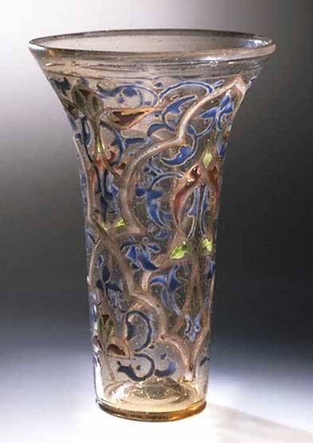

Slide 5
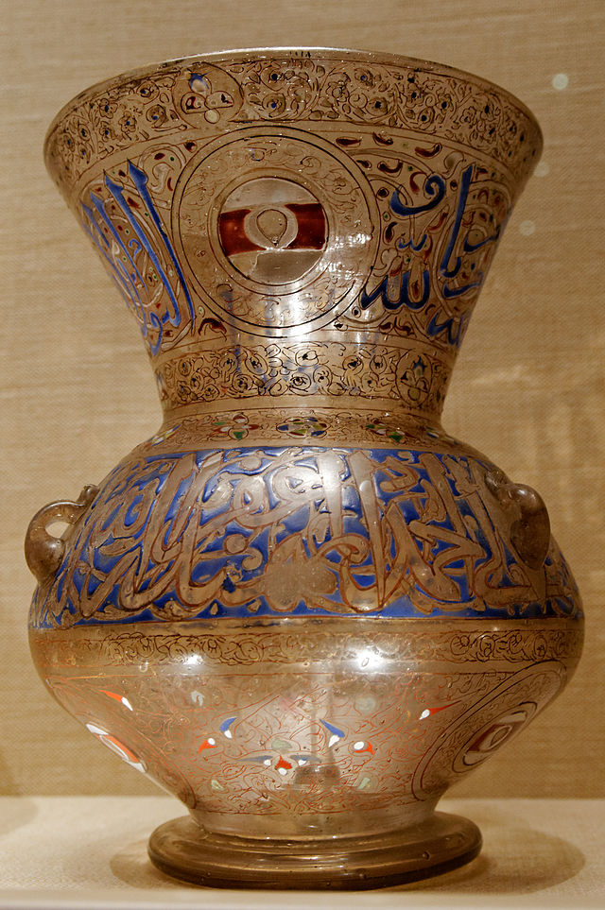

Slide 6
except that the whole area initially formed a political whole, and, for example, Persian innovations were now almost immediately taken up in Egypt. For this reason it is often impossible to distinguish between the various centres of production, of which Egypt, Syria and Persia were the most important,

Slide 7
except by scientific analysis of the material, which itself has difficulties. From various documentary references glassmaking and glass trading seems to have been a specialty of the Jewish minority in several centres between the 8th and early 11th centuries the emphasis in luxury glass is on effects achieved by "manipulating the surface" of the glass, initially by incising into the glass on a wheel,

Slide 8
and later by cutting away the background to leave a design in relief. The very massive Hedwig glasses, only found in Europe, but normally considered Islamic (or possibly from Muslim craftsmen in Norman Sicily), are an example of this, though puzzlingly late in date. These and other glass pieces

Slide 9
probably represented cheaper versions of vessels of carved rock crystal (clear quartz), themselves influenced by earlier glass vessels, and there is some evidence that at this period glass cutting and hard stone carving were regarded as the same craft . From the 12th century the industry in Persia and Mesopotamia appears to decline,

Slide 10
and the main production of luxury glass shifts to Egypt and Syria, and decorative effects of colour on smooth surfaced glass. Throughout the period local centres made simpler wares such as Hebron glass in Palestine. Luster painting, by techniques similar to luster ware in pottery, dates back to the 8th century in Egypt,

Slide 11
and became widespread in the 12th century. Another technique was decoration with threads of glass of a different colour, worked into the main surface, and sometimes manipulated by combing and other effects. Gilded, painted and enamelled glass were added to the repertoire,

Slide 12
and shapes and motifs borrowed from other media, such as pottery and metalwork. Some of the finest work was in mosque lamps donated by a ruler or wealthy man. As decoration grew more elaborate, the quality of the basic glass decreased, and it "often has a brownish-yellow tinge, and is rarely free from bubbles". Aleppo seems to have ceased to be a major centre after the Mongol invasion of 1260,

Slide 13
and Timur appears to have ended the Syrian industry about 1400 by carrying off the skilled workers to Samarkand. By about 1500 the Venetians were receiving large orders for mosque lamps.

Slide 14
Medieval Islamic metalwork: offers a complete contrast to its European equivalent, which is dominated by modelled figures and brightly coloured decoration in enamel, some pieces entirely in precious metals. In contrast surviving Islamic metalwork consists of practical objects mostly in brass, bronze, and steel,

Slide 15
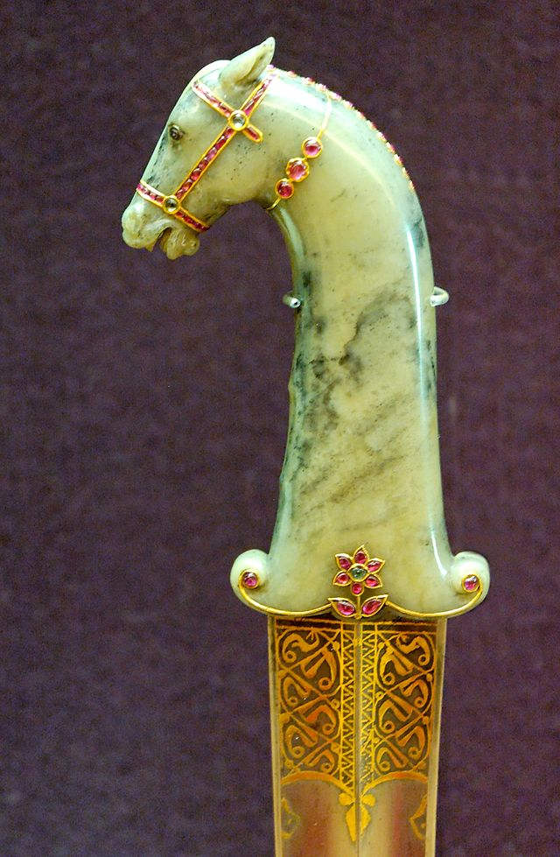

Slide 16
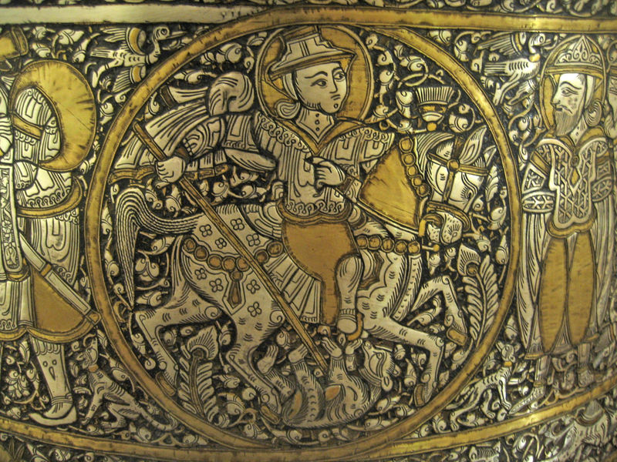

Slide 17
with simple, but often monumental, shapes, and surfaces highly decorated with dense decoration in a variety of techniques, but colour mostly restricted to inlays of gold, silver, copper or black niello. The most abundant survivals from medieval periods are fine brass objects, handsome enough to preserve, but not valuable enough to be melted down. The abundant local sources of zinc compared to tin explains the rarity of bronze.

Slide 18
Household items, such as ewers or water pitchers, were made of one or more pieces of sheet brass soldered together and subsequently worked and inlaid. The use of drinking and eating vessels in gold and silver, the ideal in ancient Rome and Persia as well as medieval Christian societies, is prohibited by the Hadiths, as was the wearing of gold rings. One thing Islamic metalworkers shared with European ones was high social status compared to other artists and craftsmen, and many larger pieces are signed.

Slide 19
The use of drinking and eating vessels in gold and silver, the ideal in ancient Rome and Persia as well as medieval Christian societies, is prohibited by the Hadiths, as was the wearing of gold rings. One thing Islamic metalworkers shared with European ones was high social status compared to other artists and craftsmen, and many larger pieces are signed.

Slide 20
A typical 13th century ewer from Khorasan is decorated with foliage, animals and the Signs of the Zodiac in silver and copper, and carries a blessing. Specialized objects include knives, arms and armours (always of huge interest to the elite) and scientific instruments such as astrolabes, as well as jewellery. Decoration is typically densely packed and very often includes arabesques and calligraphy, sometimes naming an owner and giving a date

Slide 21
Calligraphy is a type of visual art. It is often called the art of fancy lettering. A contemporary definition of calligraphic practice is "the art of giving form to signs in an expressive, harmonious and skillful manner". Modern calligraphy ranges from functional hand-lettered inscriptions and designs to fine-art pieces where the abstract expression of the handwritten mark may or may not compromise the legibility of the letters.

Slide 22
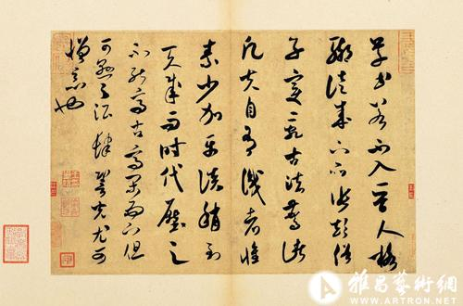
Chinese calligraphy written by Song Dynasty (A.D. 1051-1108) poet Mi Fu. The style Xinshu display there is specific by its fast speed and low pressure of the ink-brush on the paper.

Slide 23
Ancient China
In ancient China, the oldest Chinese characters existing are Jiǎgǔwén characters carved on ox scapula and tortoise plastrons, because the dominators in Shang Dynasty carved pits on such animals bones and then baked them to gain auspice of military affairs ,agricultural harvest, or even procreating and weather etc.

Slide 24
Imperial China
In Imperial China, the graphs on old steles — some dating from 200 BC, and in Xiaozhuan style — are still accessible.
About 220 BC, the emperor Qin Shi Huang, the first to conquer the entire Chinese basin, imposed several reforms, among them Li Si's character unification, which created a set of 3300 standardized Xiǎozhuàn characters. Despite the fact that the main writing implement of the time was already the brush, few papers survive from this period, and the main examples of this style are on steles.

Slide 25
Cursive styles and hand-written styles
Cursive styles such as Xíngshū (semi-cursive or running script) and Cǎoshū (cursive or grass script) are less constrained and faster, where more movements made by the writing implement are visible. These styles' stroke orders vary more, sometimes creating radically different forms.

Slide 26
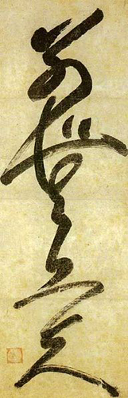
L)Calligraphy by Musô Soseki, 1275 - 1351, Japanese zen master, poem writer, garden designer. It says "別無工夫", meaning "no spiritual meaning".

Slide 27
Japanese calligraphy (書道) is a form of calligraphy, or artistic writing, of the Japanese language. For a long time, the most esteemed calligrapher in Japan had been Wang Xizhi, a Chinese calligrapher in the 4th century but after the invention of Hiragana and Katakana, the Japanese unique syllabaries, the distinctive Japanese writing system developed and calligraphers produced styles intrinsic to Japan.

Slide 28
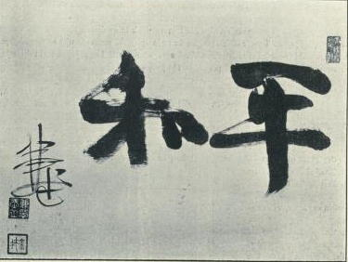
Japanese calligraphy, the word "peace" and the signature of the Meiji period calligrapher Ōura Kanetake, 1910

Slide 29
The Chinese roots of Japanese calligraphy go back to the twenty-eighth century BCE, to a time when pictographs were inscribed on bone for religious purposes. When this writing developed into an instrument of administration for the state, the need for a uniform script was felt and Li Si, prime minister in the Chinese dynasty of Qin, standardized a script and its way of being written.

Slide 30
The oldest existing calligraphic text in Japan is the inscription on the halo of the Bhaisajya guru statue in the Hōryū-ji Temple. This Chinese text was written in Shakeitai (写経体) style, prominent in the Chinese Six Dynasties period.

Slide 31
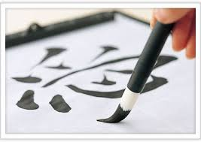
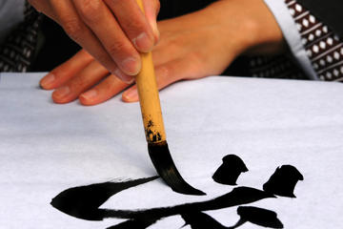

Slide 32
Islamic calligraphy (calligraphy in Arabic is khatt ul-yad خط اليد‎) has evolved alongside Islam and the Arabic language. As it is based on Arabic letters, some call it "Arabic calligraphy". However the term "Islamic calligraphy" is a more appropriate term as it comprises all works of calligraphy by the Muslim calligraphers from Andalusia in modern Spain to China.

Slide 33
Islamic calligraphy is associated with geometric Islamic art (arabesque) on the walls and ceilings of mosques as well as on the page. Contemporary artists in the Islamic world draw on the heritage of calligraphy to use calligraphic inscriptions or abstractions.
Instead of recalling something related to the spoken word, calligraphy for Muslims is a visible expression of the highest art of all, the art of the spiritual world. Calligraphy has arguably become the most venerated form of Islamic art because it provides a link between the languages of the Muslims with the religion of Islam.

Slide 34
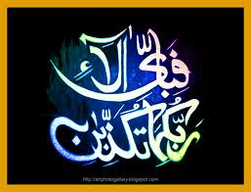

Slide 35
The Qur'an has played an important role in the development and evolution of the Arabic language, and by extension, calligraphy in the Arabic alphabet. Proverbs and passages from the Qur'an are still sources for Islamic calligraphy.
It is generally accepted that Islamic calligraphy excelled during the Ottoman era. Turkish calligraphers still present the most refined and creative works. Istanbul is an open exhibition hall for all kinds and varieties of calligraphy, from inscriptions in mosques to fountains, schools, houses, etc.

Slide 36
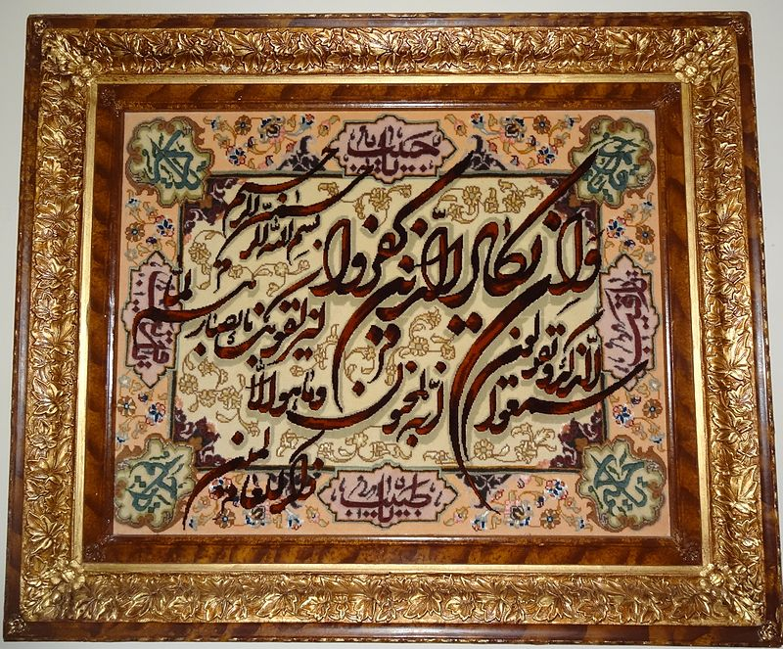
Quran Verses on Pictorial carpet

Slide 37
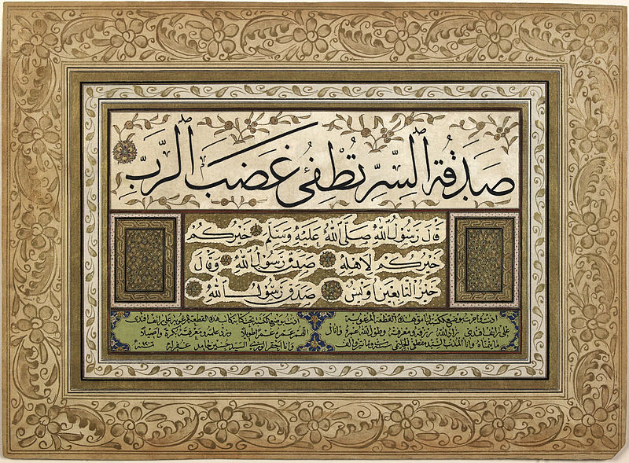
An Ottoman ijazah written in Arabic certifying competence in calligraphy, 1206 AH/1791 AD

Slide 38
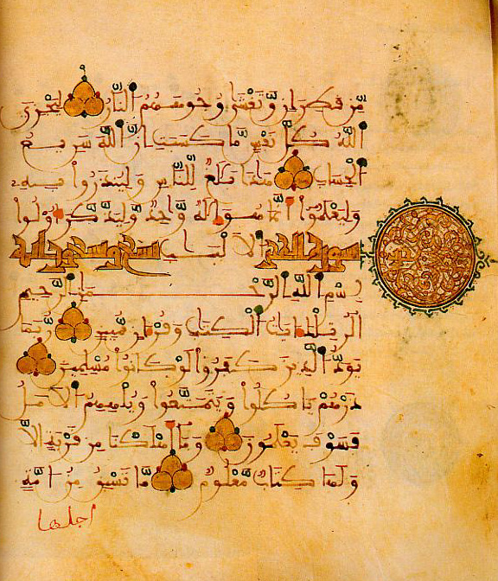

Slide 39
: Persian calligraphy
Example showing Nastaliq's proportional rules
The history of calligraphy in Persia dates back to the pre-Islam era. In Zoroastrianism beautiful and clear writings were always praised.
It is believed that ancient Persian script was invented by about 600–500 BC to provide monument inscriptions for the Achaemenid kings.

Slide 40
These scripts consisted of horizontal, vertical, and diagonal nail-shape letters, which is why it is called "script of nails/cuneiform script" (khat-e-mikhi) in Persian. Centuries later, other scripts such as "Pahlavi" and "Avestan" scripts were used in ancient Persia.
After the expansion of "Persian Empire" around the world, Arabs also adapted the Arabic alphabet to fit their language, which reduced the Arabic alphabet to 28 letters from 32 letters in Persian alphabet.

Slide 41
The hypothesis of such devolution in Arabic language center and therefore the Arabic alphabet, goes back to restricted Arabic literature resources until the development of Islamic influence around the world.

Slide 42
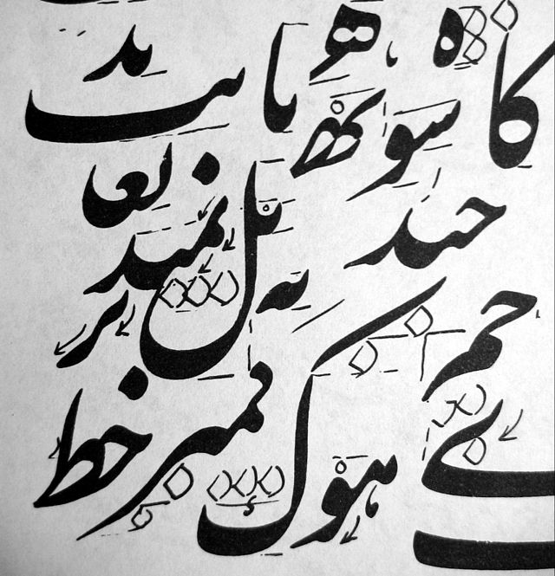

Slide 43
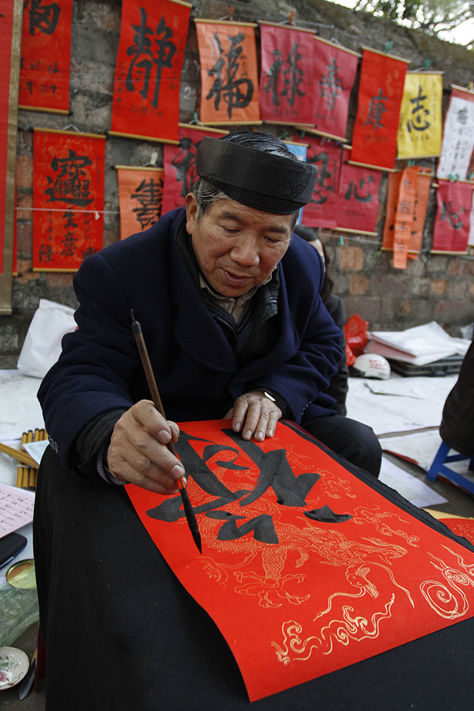
The writer is possibly writing 祿 (Vietnamese: lộc, Chinese lù) with the meaning “blessing, happiness, prosperity”, see also Fu Lu Shou.

Slide 44
Lets sum up this lecture, 8.
Calligraphy in different Cultures and traditions of the world
Islamic Glass work
Islamic metal work
Calligraphy in Japan
Calligraphy in China
Calligraphy in Persia
Arabic calligraphy

