Slide 1
Art, Craft and Calligraphy, A teacher’s training program course.
Course code. AD212.
Since lecture. 6. is practical based this is lecture 7

Slide 2
In lecture 5 unit 2 we have discussed the following topics.
Art and craft (the development of pottery, metal work, printing on cloth and bead making).
Teaching and learning was planed on Indus valley civilization.

Slide 3
LECTURE. 7. Unit. 2
Since lecture 6 was practical based, this is lecture 7
Islamic Art
Introduction to Islamic Art
History and development of Islamic Art
Islamic art and links across the curriculum

Slide 4
Definition of Islamic art:
It comprises the visual arts produced from the 7th century onwards by people who lived within the territory that was inhabited by or ruled by culturally Islamic populations. It is thus a very difficult art to define because it covers many lands and various peoples over some 1400 years.

Slide 5
It is not art specifically of a religion, or of a time, or of a place, or of a single medium like painting. The huge field of Islamic architecture is another subject, leaving fields as varied as calligraphy, painting, glass, ceramics, and textiles, among others. Islamic art is not at all restricted to religious art, but includes all the art of the rich and varied cultures of Islamic societies as well.

Slide 6
It frequently includes secular elements and elements that are frowned upon, if not forbidden, by some Islamic theologians. Apart from the ever-present calligraphic inscriptions, specifically religious art is actually less prominent in Islamic art than in Western medieval art, with the exception of Islamic architecture where mosques and their complexes of surrounding buildings are the most common remains.

Slide 7
Figurative painting may cover religious scenes, but normally in essentially secular contexts such as the walls of palaces or illuminated books of poetry. The calligraphy and decoration of manuscript Qurans is an important aspect, but other religious art such as glass mosque lamps and other mosque fittings such as tiles (e.g. Girih tiles), woodwork and carpets usually have the same style and motifs as contemporary secular art, although with religious inscriptions even more prominent.

Slide 8
INFLUENCES ON ISLAMIC ART: "Islamic art developed from many sources: Roman, Early Christian art, and Byzantine styles were taken over in early Islamic art and architecture; the influence of the Sasanians art of pre-Islamic Persia was of paramount significance; Central Asian styles were brought in with various nomadic incursions; and Chinese influences had a formative effect on Islamic painting, pottery, and textiles."

Slide 9
Though the whole concept of "Islamic art" has been criticized by some modern art historians, calling it a "figment of imagination" or a "mirage", the similarities between art produced at widely different times and places in the Islamic world have been sufficient to keep the term in wide use by scholars.

Slide 10
There are repeating elements in Islamic art, such as the use of geometrical floral or vegetal designs in a repetition known as the arabesque. The arabesque in Islamic art is often used to symbolize the transcendent, indivisible and infinite nature of God. Mistakes in repetitions may be intentionally introduced as a show of humility by artists who believe only God can produce perfection.

Slide 11
Typically, though not entirely, Islamic art has focused on the depiction of patterns and Arabic calligraphy, rather than on figures, because it is feared by many Muslims that the depiction of the human form is idolatry and thereby a sin against God, forbidden in the Qur'an. Human portrayals can be found in all eras of Islamic art, above all in the more private form of miniatures, where their absence is rare. Human representation for the purpose of worship is considered idolatry.

Slide 12
Calligraphy: Calligraphic design is omnipresent in Islamic art, where, as in Europe in the Middle Ages, religious exhortations, including Quranic verses, may be included in secular objects, especially coins, tiles and metalwork, and most painted miniatures include some script, as do many buildings.

Slide 13
. Other inscriptions include verses of poetry, and inscriptions recording ownership or donation. Two of the main scripts involved are the symbolic kufic and naskh scripts, which can be found adorning and enhancing the visual appeal of the walls and domes of buildings, the sides of minbars, and metalwork. Islamic calligraphy in the form of painting or sculptures are sometimes referred to as quranic art.

Slide 14
East Persian pottery from the 9th to 11th centuries decorated only with highly stylised inscriptions, called "epigraphic ware", has been described as "probably the most refined and sensitive of all Persian pottery". Large inscriptions made from tiles, sometimes with the letters raised in relief, or the background cut away, had a higher status than other artists.

Slide 15
are found on the interiors and exteriors of many important buildings. Complex carved calligraphy also decorates buildings. For most of the Islamic period the majority of coins only showed lettering, which are often very elegant despite their small size and nature of production.

Slide 16
The tughra or monogram of an Ottoman sultan was used extensively on official documents, with very elaborate decoration for important ones. Other single sheets of calligraphy, designed for albums, might contain short poems, Quranic verses, or other texts.
The main languages, all using Arabic script, are Arabic, always used for Quranic verses, Persian in the Persianate world, especially for poetry, and Turkish, with Urdu appearing in later centuries.

Slide 17
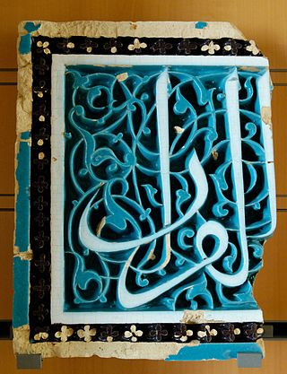

Slide 18
Calligraphers usually Islamic Painting: Although there has been a tradition of wall-paintings, especially in the Persianate world, the best-surviving and highest developed form of painting in the Islamic world is the miniature in illuminated manuscripts, or later as a single page for inclusion in a muraqqa or bound album of miniatures and calligraphy

Slide 19
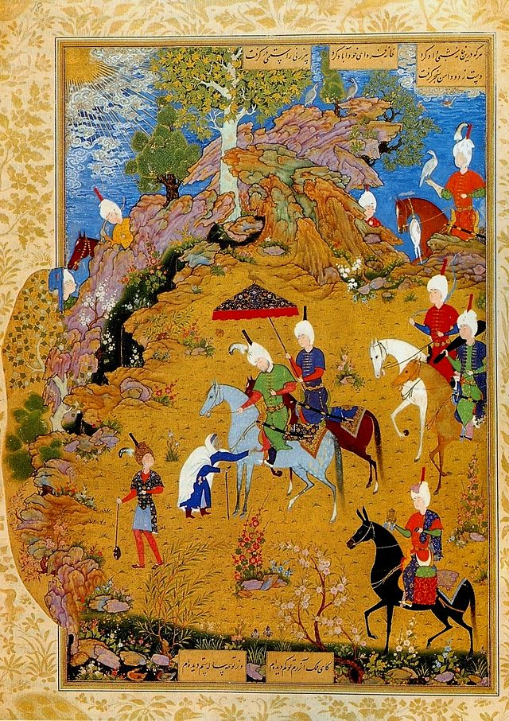

Slide 20
The tradition of the Persian miniature has been dominant since about the 13th century, strongly influencing the Ottoman miniature of Turkey and the Mughal miniature in India. Miniatures were especially an art of the court, and because they were not seen in public, it has been argued that constraints on the depiction of the human figure were much more relaxed, and indeed miniatures often contain great numbers of small figures, and from the 16th century portraits of single ones.

Slide 21
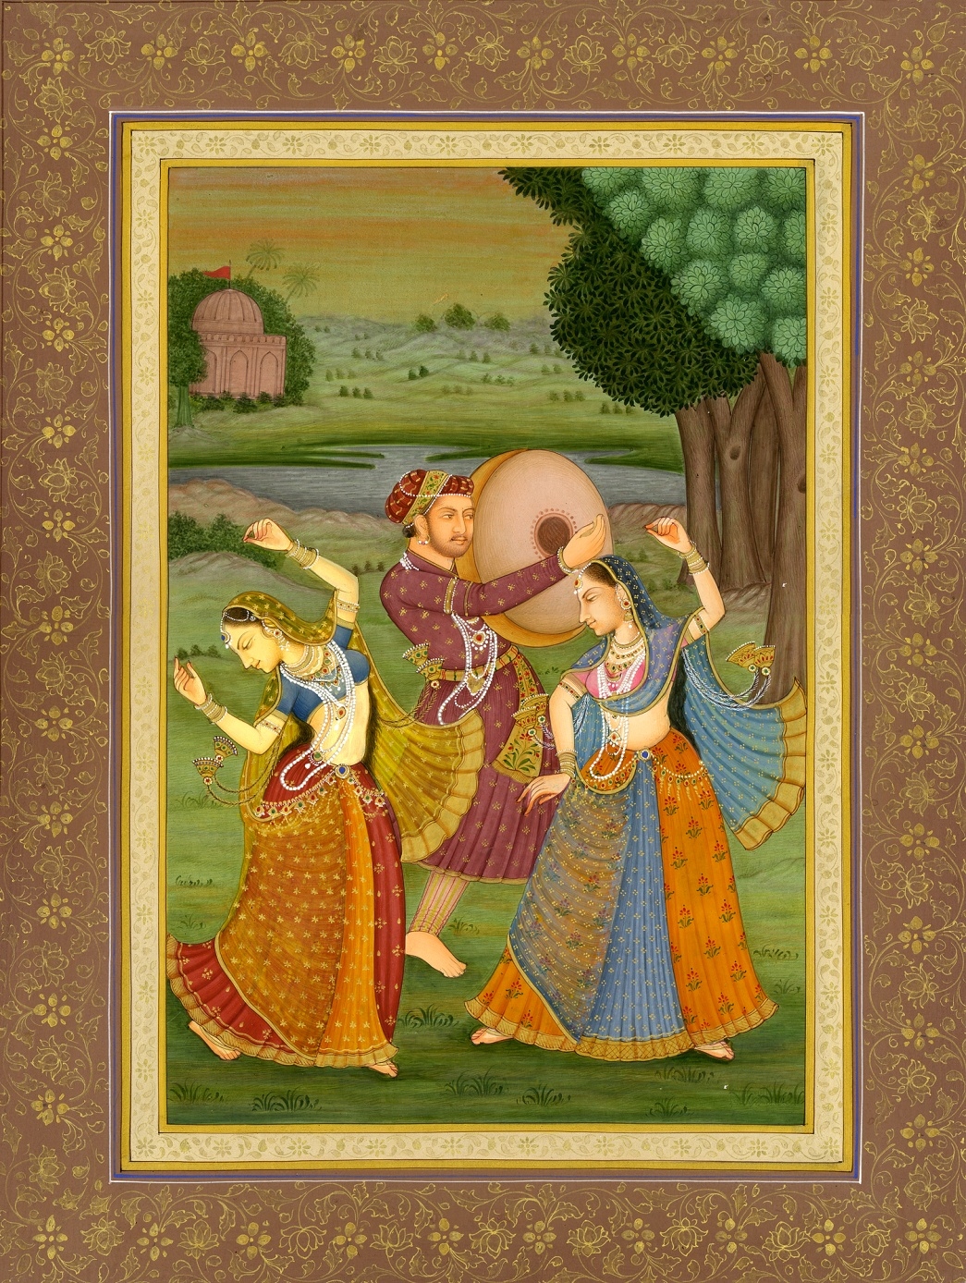

Slide 22
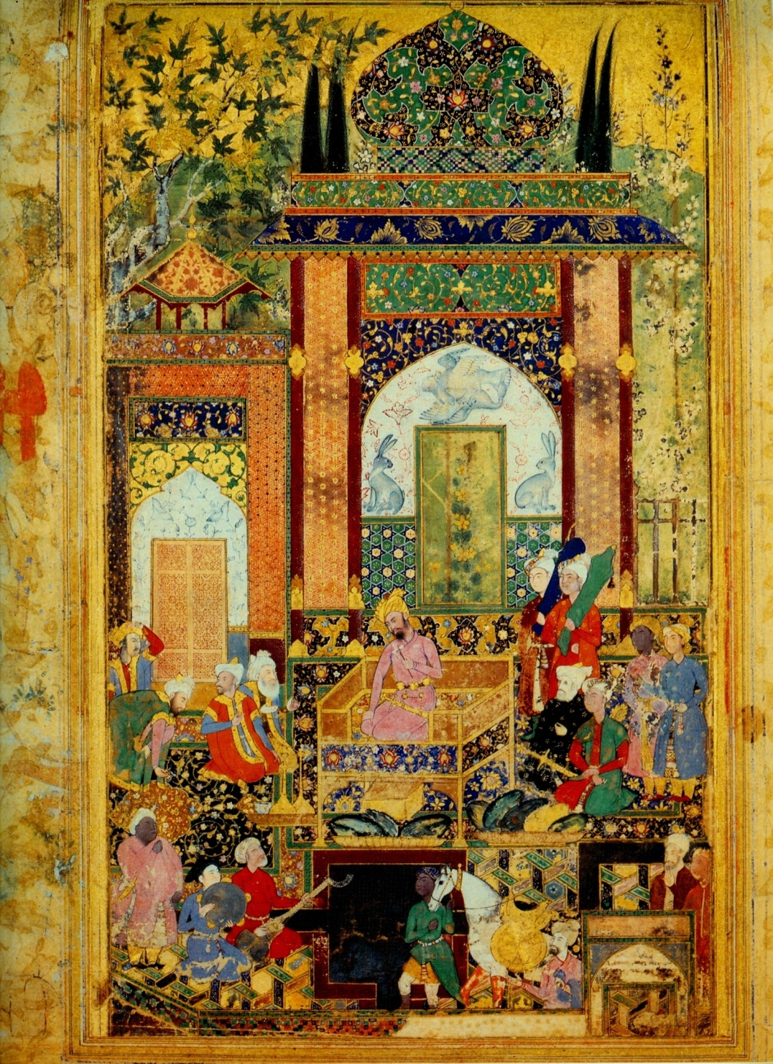

Slide 23
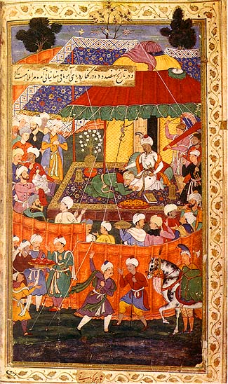

Slide 24
Recent scholarship has noted that, although surviving early examples are now uncommon, human figurative art was a continuous tradition in Islamic lands in secular contexts (such as literature, science, and history); as early as the 9th century, such art flourished during the Abbasid Caliphate (c. 749–1258, across Spain, North Africa, Egypt, Syria, Turkey, Mesopotamia, and Persia). Figurative wall painting in Mesopotamia, Syria, and Egypt from this earlier time period is also mentioned in the sources.

Slide 25
The largest commissions of illustrated books were usually classics of Persian poetry such as the epic Shahnameh, although the Mughals and Ottomans both produced lavish manuscripts of more recent history with the autobiographies of the Mughal emperors, and more purely military chronicles of Turkish conquests. Portraits of rulers developed in the 16th century, and later in Persia, then becoming very popular.

Slide 26
Mughal portraits, normally in profile, are very finely drawn in a realist style, while the best Ottoman ones are vigorously stylized. Album miniatures typically featured picnic scenes, portraits of individuals or (in India especially) animals, or idealized youthful beauties of either sex.

Slide 27
Chinese influences included the early adoption of the vertical format natural to a book, which led to the development of a birds-eye view where a very carefully depicted background of hilly landscape or palace buildings rises up to leave only a small area of sky. The figures are arranged in different planes on the background, with recession

Slide 28
(distance from the viewer) indicated by placing more distant figures higher up in the space, but at essentially the same size. The colours, which are often very well preserved, are strongly contrasting, bright and clear. The tradition reached a climax in the 16th and early 17th centuries, but continued until the early 19th century, and has been revived in the 20th

Slide 29
Rugs and Carpets: No Islamic artistic product has become better known outside the Islamic world than the pile carpet, more commonly referred to as the Oriental carpet (oriental rug). Their versatility is utilized in everyday Islamic and Muslim life, from floor coverings to architectural enrichment, from cushions to bolsters to bags and sacks of all shapes and sizes,

Slide 30
and to religious objects (such as a prayer rug, which would provide a clean place to pray). They have been a major export to other areas since the late Middle Ages, used to cover not only floors but tables, for long a widespread European practice that is now common only in the Netherlands. Carpet weaving is a rich and deeply embedded tradition in Islamic societies, and the practice is seen in large city factories as well as in rural communities and nomadic encampments.

Slide 31
Special establishments and workshops were in existence that functioned directly under court patronage very early Islamic carpets, which means before the 16th century, are extremely rare, indeed more have survived in the West, and oriental carpets in Renaissance painting from Europe are a major source of information on them

Slide 32
as they were valuable imports that were painted accurately. The most natural and easy designs for a carpet weaver to produce consist of straight lines and edges, and the earliest Islamic carpets to survive or be shown in paintings have geometric designs, or centre on very stylized animals, made up in this way.

Slide 33
Since the flowing loops and curves of the arabesque are central to Islamic art, the interaction and tension between these two styles was long a major feature of carpet design.
There are a few survivals of the grand Egyptian 16th century carpets, including one almost as good as new discovered in the attic of the Pitti Palace, in Florence, whose complex patterns of octagon roundels and stars, in just a few colours, shimmer before the viewer

Slide 34
Production of this style of carpet began under the Mamluks but continued after the Ottomans conquered Egypt. The other sophisticated tradition was the Persian carpet which reached its peak in the 16th and early 17th century in works like the Ardabil Carpet and Coronation Carpet; during this century the Ottoman and Mughal courts also began to sponsor the making in their domains of large formal carpets, evidently with the involvement of designers used to the latest court style in the general Persian tradition.

Slide 35
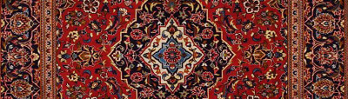

Slide 36
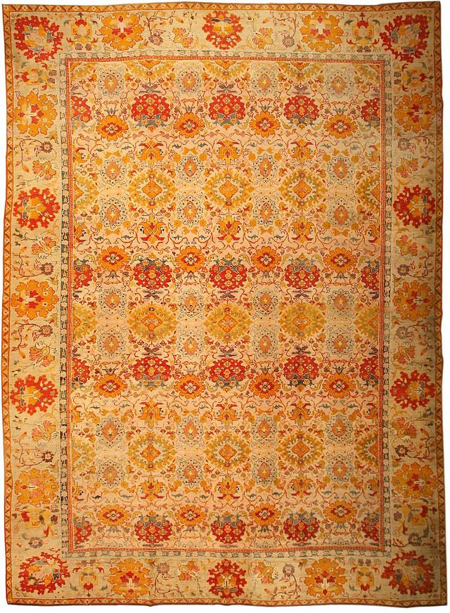

Slide 37
These use a design style shared with non-figurative Islamic illumination and other media, often with a large central gul motif, and always with wide and strongly demarcated borders. The grand designs of the workshops patronized by the court spread out to smaller carpets for the merely wealthy and for export, and designs close to those of the 16th and 17th centuries are still produced in large numbers today.

Slide 38
The description of older carpets has tended to use the names of carpet-making centres as labels, but often derived from the design rather than any actual evidence that they originated from around that centre. Research has clarified that designs were by no means always restricted to the centre they are traditionally associated with,

Slide 39
and the origin of many carpets remains unclear.
As well as the major Persian, Turkish and Arab centres, carpets were also made across Central Asia, in India, and in Spain and the Balkans. Spanish carpets, which sometimes interrupted typical Islamic patterns to include coats of arms, enjoyed high prestige in Europe, being commissioned by royalty and for the Papal Palace, Avignon, and the industry continued after the Reconquista.

Slide 40
Armenian carpet-weaving is mentioned by many early
sources, and may account for a much larger proportion of East Turkish and Caucasian production than traditionally thought. The Berber carpets of North Africa have a distinct design tradition Apart from the products of city workshops, in touch with trading networks that might carry the carpets to markets far away.

Slide 41
CERAMICS
Islamic art has very notable achievements in ceramics, both in pottery and tiles for walls, which in the absence of wall-paintings were taken to heights unmatched by other cultures. Early pottery is often unglazed, but tin-opacified glazing was one of the earliest new technologies developed by the Islamic potters.

Slide 42
a large and widespread village and nomadic industry producing work that stayed closer to traditional local designs. As well as pile carpets, kelims and other types of flat-weave or embroidered textiles were produced, for use on both floors and walls. Figurative designs, sometimes with large human figures, are very popular in Islamic countries but relatively rarely exported to the West, where abstract designs are generally what the market expects.

Slide 43
The first Islamic opaque glazes can be found as blue-painted ware in Basra, dating to around the 8th century. Another significant contribution was the development of stone paste ceramics, originating from 9th century Iraq. The first industrial complex for glass and pottery production was built in Ar- Raqqah, Syria, in the 8th century. Other centers for innovative pottery in the Islamic world included Fustat (from 975 to 1075), Damascus (from 1100 to around 1600) and Tabriz (from 1470 to 1550).

Slide 44
Luster wares with iridescent colours may have continued pre-Islamic Roman and Byzantine techniques, but were either invented or considerably developed on pottery and glass in Persia and Syria from the 9th century onwards Islamic pottery was often influenced by Chinese ceramics, whose achievements were greatly admired and emulated

Slide 45
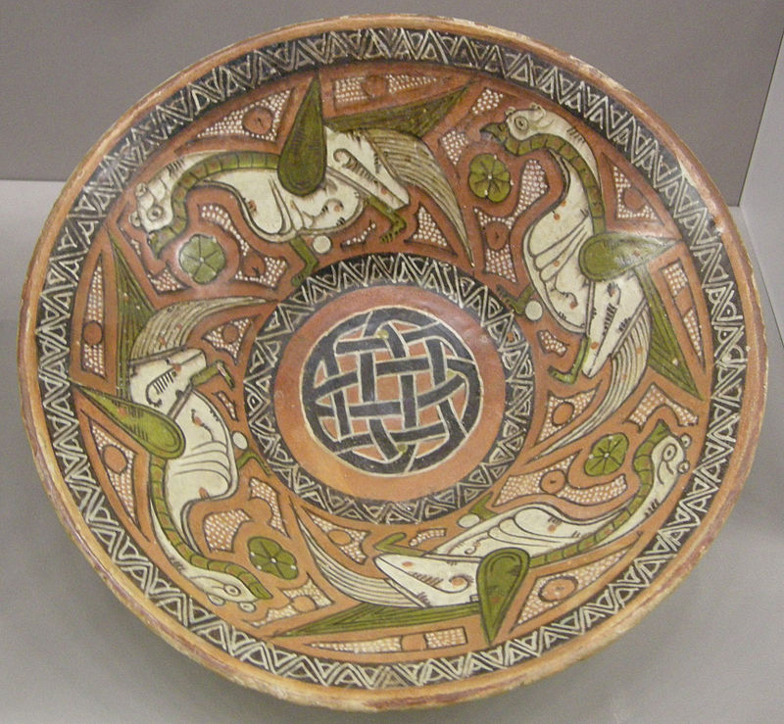

Slide 46
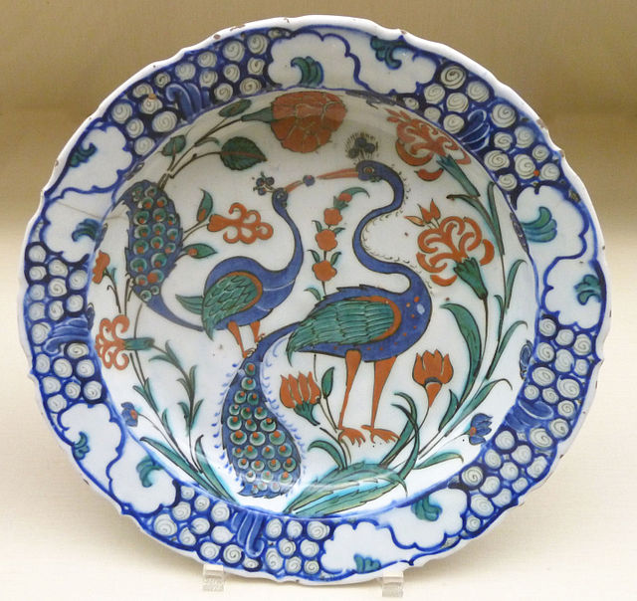

Slide 47
This was especially the case in the periods after the Mongol invasions and those of the Timurids. Techniques, shapes and decorative motifs were all affected. Until the Early Modern period Western ceramics had very little influence, but Islamic pottery was very sought after in Europe, and often copied. An example of this is the albarello,

Slide 48
a type of maiolica earthenware jar originally designed to hold apothecaries' ointments and dry drugs. The development of this type of pharmacy jar had its roots in the Islamic Middle East. Hispano-Moresque examples were exported to Italy, stimulating the earliest Italian examples, from 15th century Florence.

Slide 49
The Hispano-Moresque style emerged in Al-Andaluz or Muslim Spain in the 8th century, under Egyptian influence, but most of the best production was much later, by potters presumed to have been largely Muslim but working in areas re conquered by the Christian kingdoms. It mixed Islamic and European elements in its designs, and much was exported across neighboring European countries.

Slide 50
It had introduced two ceramic techniques to Europe: glazing with an opaque white tin-glaze, and painting in metallic lusters. Ottoman İznik pottery produced most of the best work in the 16th century, in tiles and large vessels boldly decorated with floral motifs influenced, once again, by Chinese Yuan and Ming ceramics. These were still in earthenware;

Slide 51
there was no porcelain made in Islamic countries until modern times, though Chinese porcelain was imported and admired The medieval Islamic world also had pottery with painted animal and human imagery. Examples are found throughout the medieval Islamic world, particularly in Persia and Egypt.

Slide 52
ISLAMIC TILES:
The earliest grand Islamic buildings, like the Dome of the Rock, in Jerusalem had interior walls decorated with mosaics in the Byzantine style, but without human figures. From the 9th century onwards the distinctive Islamic tradition of glazed and brightly coloured tiling for interior and exterior walls and domes developed.

Slide 53
Some earlier schemes create designs using mixtures of tiles each of a
single colour that are either cut to shape or are small and of a few shapes, used to create abstract geometric patterns. Later large painted schemes use tiles painted before firing with a part of the scheme – a technique requiring confidence in the consistent results of firing.

Slide 54
Some elements, especially the letters of inscriptions, may be molded in three-dimensional relief, and in especially in Persia certain tiles in a design may have figurative painting of animals or single human figures. These were often part of designs mostly made up of tiles in plain colours but with larger fully painted tiles at intervals.

Slide 55
The larger tiles are often shaped as eight-pointed stars, and may show animals or a human head or bust, or plant or other motifs. The geometric patterns, such as modern North African work, made of small tiles each of a single colour but different and regular shapes, are often referred to as "mosaic", which is not strictly correct.

Slide 56
The Mughals made much less use of tiling, preferring (and being able to afford) "parchin kari", a type of pietradura decoration from inlaid panels of semi-precious stones, with jewels in some cases. This can be seen at the Taj Mahal, Agra Fort and other imperial commissions. The motifs are usually floral, in a simpler and more realistic style than Persian or Turkish work, relating to plants in Mughal miniatures.

Slide 57
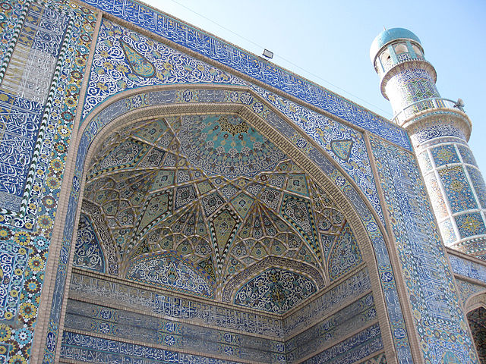

Slide 58
Lets sum up this lecture 7. In this lecture we have done a detailed study of different branches of Islamic Art,
Calligraphy
Painting
Metal Work
Glass work etc
We have also seen some specimen of the final products of Islamic Art.
The purpose was to make the student teacher familiar with the Islamic art and the history of Islamic art.

