Slide 1
Summery of Lecture. 4. UNIT. 2
HISTORY AND CULTURE
INDUS VALLEY ART AND CULTURE
We discussed in our previous lecture
That Indus valley civilization is one of the oldest civilization of the world like Mesopotamian civilization. That is bronze age is 3300 to 1300 BCE. It flourished in the basins of Indus. This civilization is really rich in art and culture.

Slide 2
We also discussed Roots of Indus Valley Civilization and how the two major capital cities Mohenjo Daro and Harappa were discovered? Actually Harappa was discovered by a railway crew during digging. These two cities are 400 miles apart from each other but they culturally resemble a lot to each other.

Slide 3
We also talked about the town planning of Indus Valley civilization, especially Mohenjo daro and Harappa. These two cities Harappa which is in Punjab near Sahiwal and Mohenjo daro which is in Sindh near Larkana are so well planned that it is thought that these two cities might be designed by some development authority by the Government.

Slide 4
We discussed in our previous lecture about the streets and sewerage system of Indus valley Civilization. Most of the streets are paved with covered drains. This system was so advanced as far as the time period is concerned. In India and Pakistan we still find open drains. Streets cross each other at right angles and from east to west a north to south. The purpose was cross ventilation and cleanliness.

Slide 5
We also discussed in detail about the art and craft of Indus valley Civilization.
Sculptures.
Pottery.
Seals.
The making and uses of these art and craft works along there way of living and culture has been discussed in detail.

Slide 6
LECTURE. 5. UNIT. 2.
Art and craft (the development of pottery, metal work, printing on cloth and bead making).
Teaching and learning will be planed on Indus valley civilization.

Slide 7
Development of Pottery in the Indian subcontinent has an ancient history and is one of the most tangible and iconic elements of regional art. Evidence of pottery has been found in the early settlements of Mehrgargh from the Indus Valley Civilization. Today, it is a cultural art that is still practiced extensively in India and Pakistan.

Slide 8
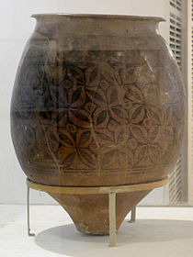
Today, pottery thrives as an art form in India, and it is slowly gaining awareness as a functional items as well. Various platforms, including potters' markets. Storage jar)

Slide 9
HISTORY OF POTTERY
Vedic pottery
Wilhelm Rau (1972) has examined the references to pottery in Vedic texts like the Black Yajur Veda and the Taitriya Samhita. According to his study, Vedic pottery is for example hand-made and unpainted.

Slide 10
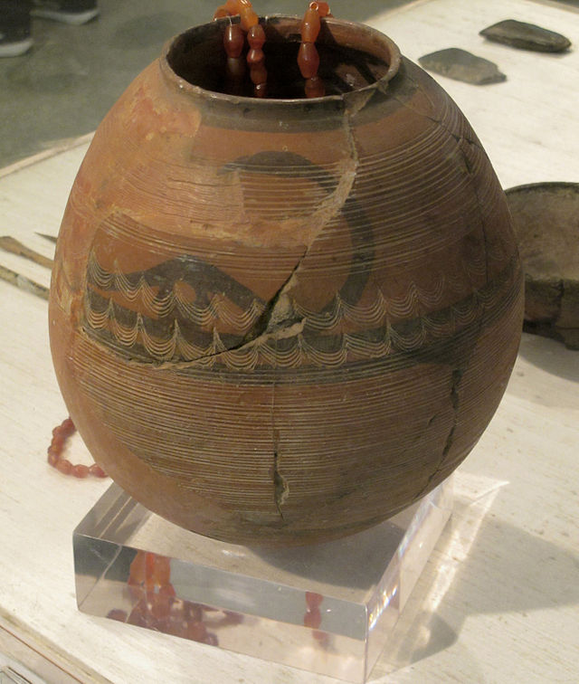
According to Kuzmina (1983), Vedic pottery that matches Willhelm's Rau description cannot be found in Asia Minor and Central Asia, though the pottery of Andronovo is similar in some respects.

Slide 11
Indus Valley Civilization
India has a great and ancient tradition of pottery making. The origin of pottery in India can be traced back to the Neolithic age, with coarse handmade pottery - bowls, jars, vessels - in various colors such as red, orange, brown, black and cream. The real beginning of Indian pottery is with the Indus Valley Civilization.

Slide 12
There is proof of pottery being constructed in two ways, handmade and wheel-made. Harappan and Mohenjo-Daro cultures heralded the age of wheel-made pottery, characterized by well-burnt black painted red wares.

Slide 13
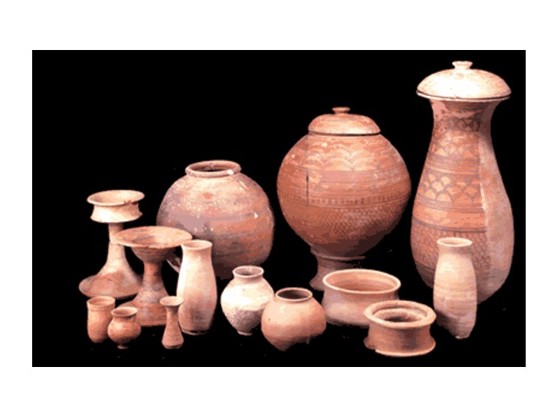

Slide 14
Painted Grey Ware
Painted Grey Ware, Sonkh, Mathura (Uttar Pradesh) - 1000-600 BCE. Mathura Museum.
During first millennium BC, painted grey ware was found in parts of North India and the Gangetic plain. Decorated pottery becomes significant in the Sunga, Kushan and Gupta periods

Slide 15
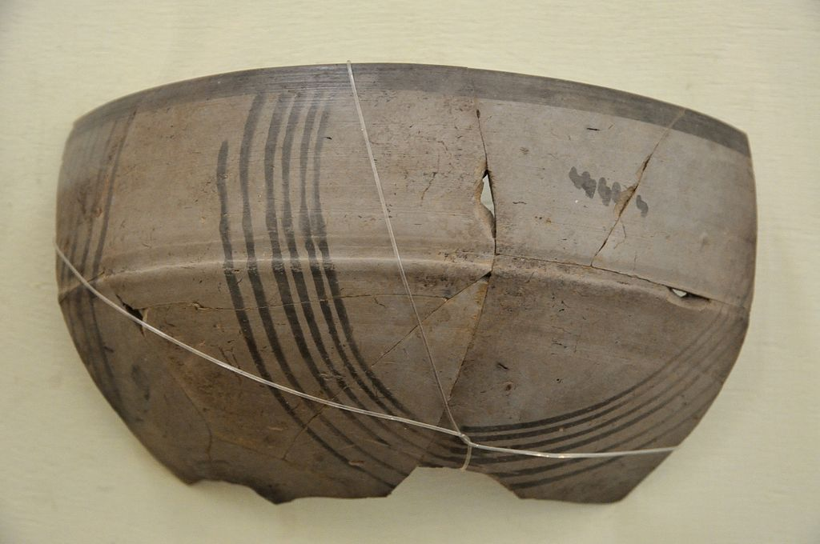

Slide 16
Islamic period
The phase of glazed pottery started in the 12th century AD, when Muslim rulers encouraged potters from Iran and elsewhere to settle in India. Glazed pottery of Persian models with Indian designs, dating back to the Sultanate period, has been found in Gujarat and Maharashtra.

Slide 17
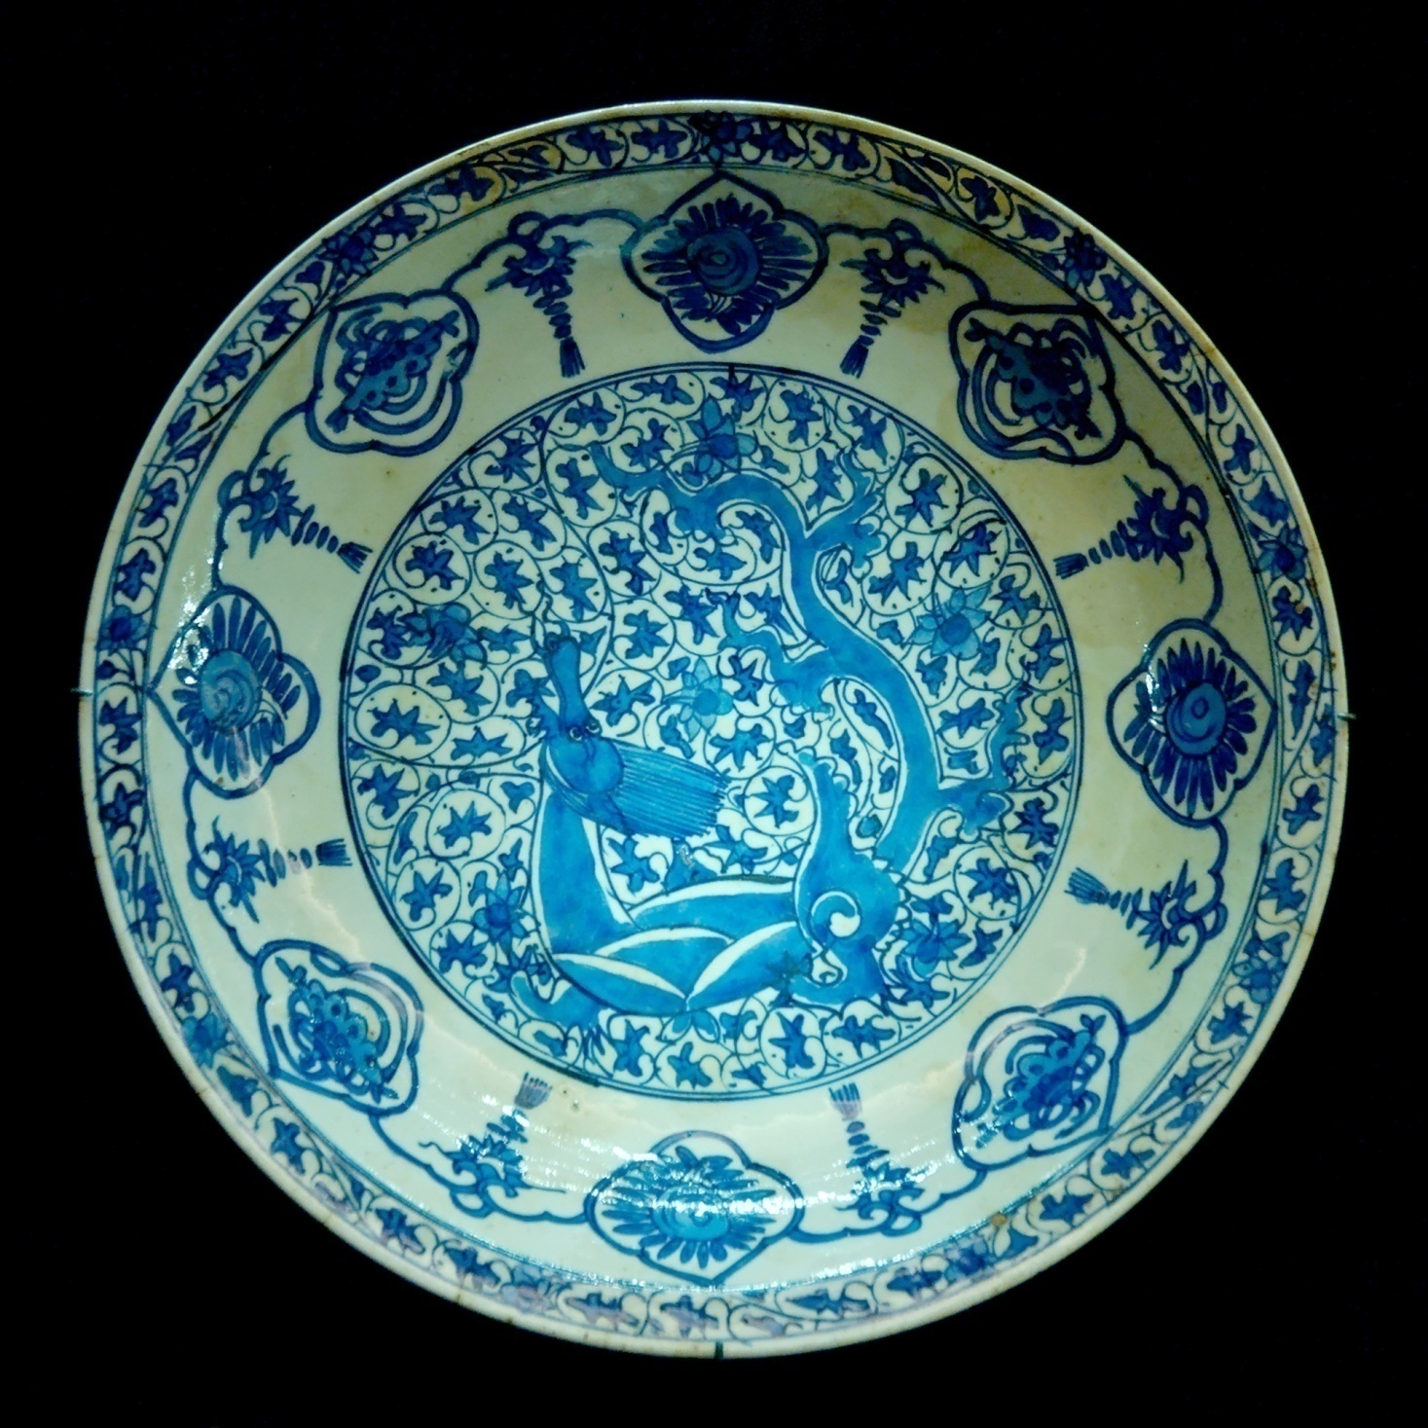

Slide 18
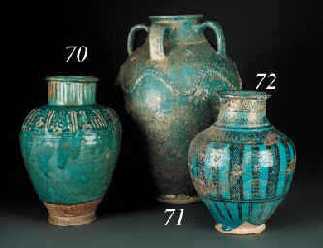

Slide 19
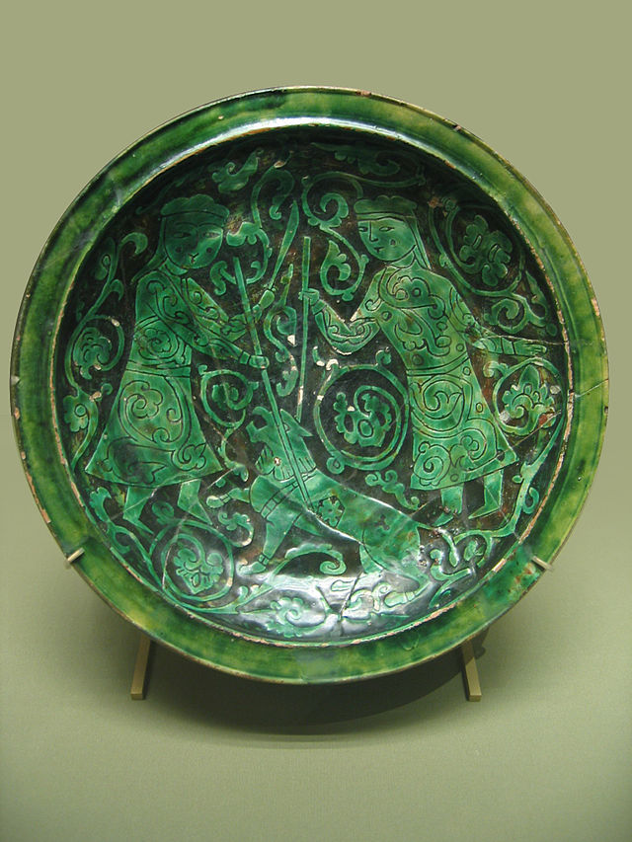

Slide 20
Styles
Clay pots in Punjab, Pakistan
Over time India's simple style of molding clay went into an evolution. A number of distinct styles emerged from this simple style. Some of the most popular forms of pottery include unglazed pottery, glazed pottery, terracotta, and papier-mâché.

Slide 21
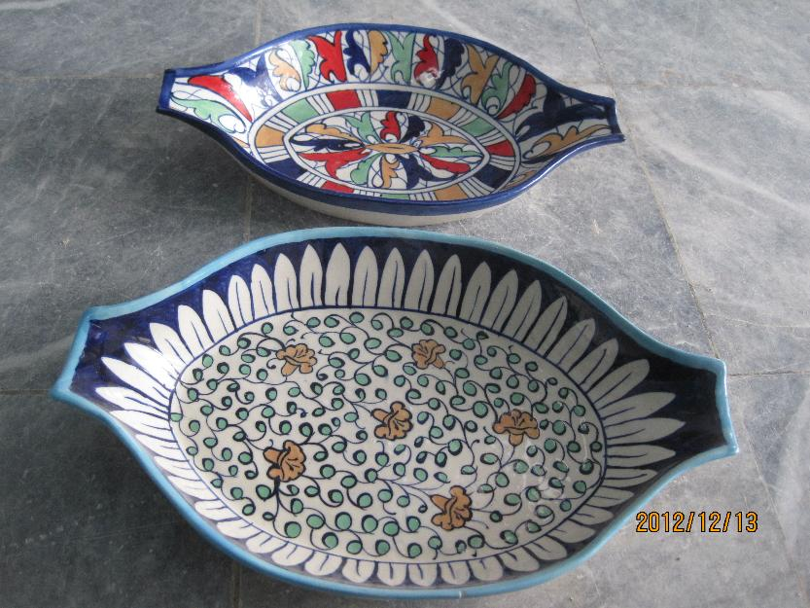

Slide 22
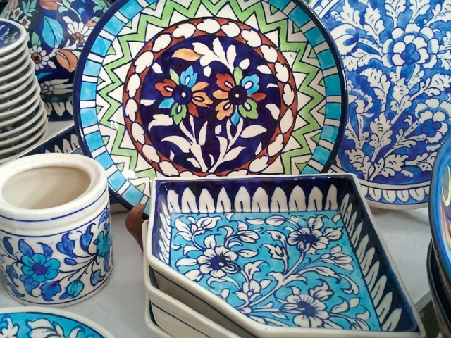

Slide 23
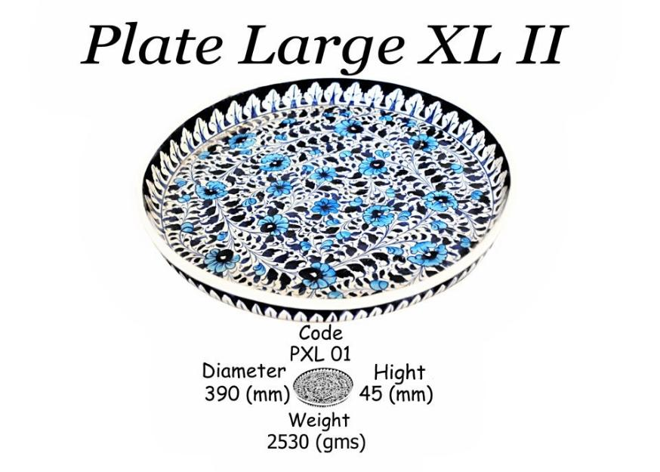

Slide 24
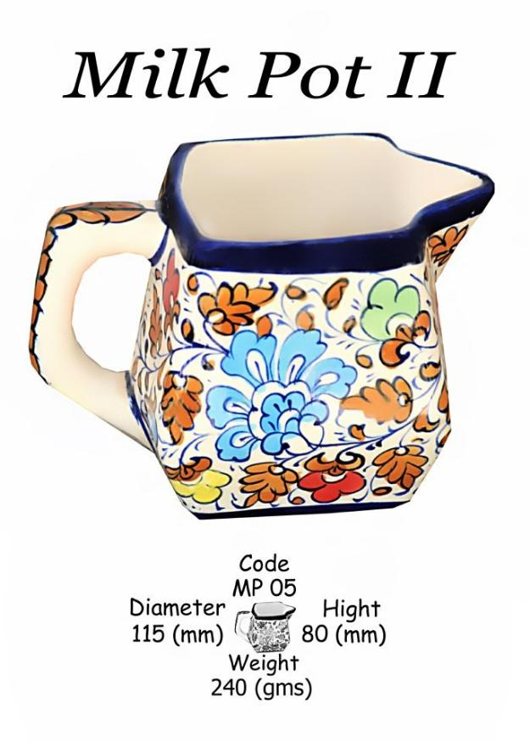

Slide 25
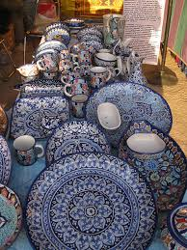

Slide 26
Unglazed pottery
This is the oldest form of pottery practiced in India. There are three types of unglazed pottery. First is paper thin pottery, biscuit-colored pottery decorated with incised patterns. Next is the scrafito technique; the pot is polished and painted with red and white slips along with intricate patterns. The third is polished pottery; this type of pottery is strong and deeply incised, and has stylized patterns of arabesque

Slide 27
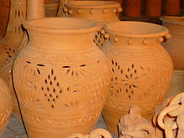

Slide 28
Glazed pottery
This era of pottery began in the 12th century AD. This type of pottery contains a white background and has blue and green patterns. Glazed pottery is only practiced in selected regions of the country

Slide 29
Terracotta
A style of pottery wherein women prepare clay figures to propitiate their gods and goddesses, during festivals. In Moela deities are created with molded clay on a flat surface. They are then fired and painted in bright colors. Other parts of India use this style to make figures like horses with riders, and other votives.

Slide 30
Papier-mache
This type of pottery is made from paper pulp, which is coarsely mashed and mixed with copper sulphate and rice-flour paste. It is then shaped by covering the mould with a thin paper and then applying layers of the mixture. The designers then sketch designs on them and polish the pottery with bright colors. A touch of gold is always found on papier-mache products. The gold represents its roots to the Persian design

Slide 31
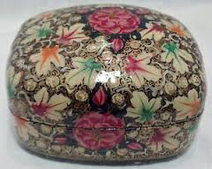

Slide 32
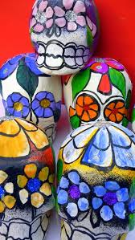

Slide 33
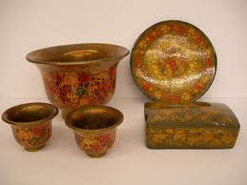

Slide 34
Ajrak, Sindhi: A name given to a unique form of block printed shawls and tiles found in Sindh, Pakistan; Kutch, Gujarat; and Barmer, Rajasthan in India. These shawls display special designs and patterns made using block printing by stamps. Common colours used while making these patterns may include but are not limited to blue, red, black, yellow and green. Over the years, ajraks have become a symbol of the Sindhi culture and traditions.

Slide 35
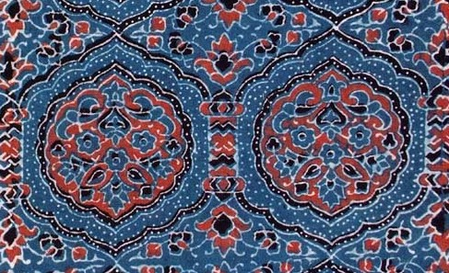

Slide 36
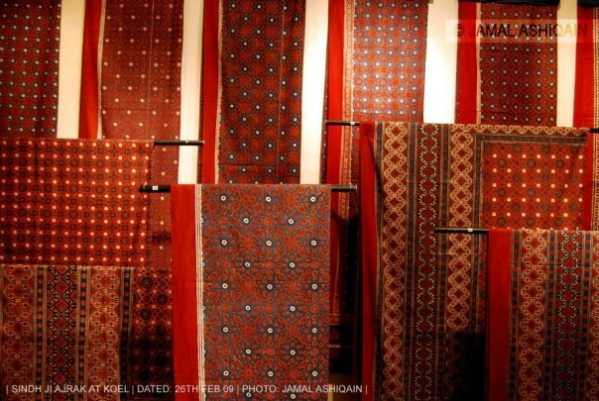

Slide 37
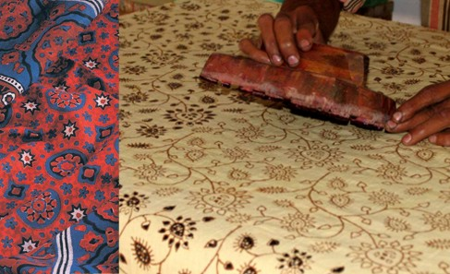

Slide 38
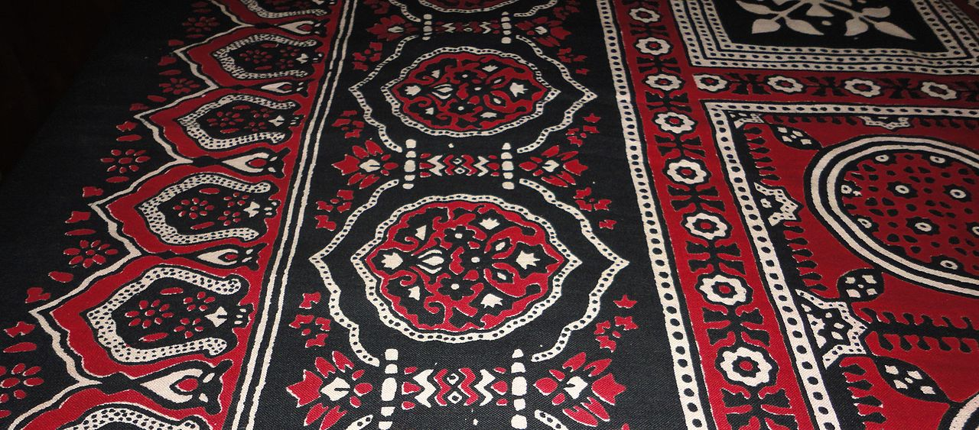

Slide 39
History
Early human settlements in the region which is now the province Sindh in Pakistan along the Indus River had found a way of cultivating and using Gossypium arboreum commonly known as tree cotton to make clothes for themselves. These civilizations are thought to have mastered the art of making cotton fabrics.

Slide 40
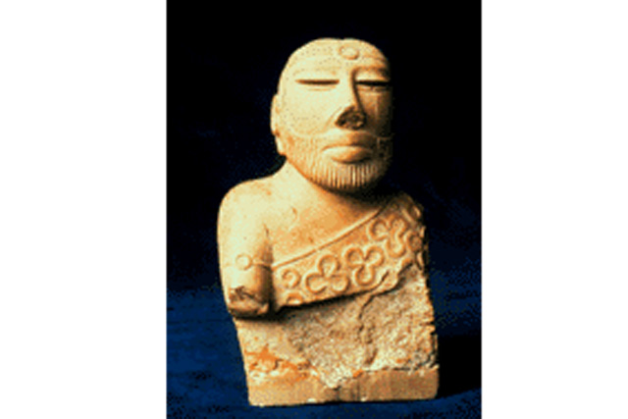

Slide 41
A bust of a priest-king excavated at Mohenjo-daro, currently in the National Museum of Pakistan, shows him draped over one shoulder in a piece of cloth that resembles an ajrak. Of special note are the trefoil pattern etched on the person's garment interspersed with small circles, the interiors of which were filled with a red pigment.

Slide 42
This symbol illustrates what is believed to be an edifice depicting the fusion of the three sun-disks of the gods of the sun, water and the earth. Excavations elsewhere in the Old World around Mesopotamia have yielded similar patterns appearing on various objects, most notably on the royal couch of Tutankhamen. Similar patterns appear in recent ajrak prints

Slide 43
The level of geometry on the garment comes from the usage of a method of printing called woodblock printing in which prints were transferred from geometric shapes etched on the wooden blocks by pressing them hard on the fabric. Block printing is thought to have been first used in ancient China, at least as far as movable type is concerned. On its way through the populous regions of the Indus Valley, this technique of fabric printing was adopted at Mohenjo-daro.

Slide 44
The tradition still prevails centuries later, and people still use the same methods of production that were used in the earlier days to create an ajrak. The garment has become an essential part of the Sindhi culture and apparel of Sindhis. Men use it as a turban, a cummerbund or wind it around their shoulders or simply drape it over one shoulder.

Slide 45
Women use it as a dupatta or a shawl and sometimes as a makeshift swing for children. Ajraks are usually about 2.5 to 3-meters long, patterned in intense colours predominantly rich crimson or a deep indigo with some white and black used sparingly to give definition to the geometric symmetry in design.

Slide 46
Ajraks are made all over Sindh, especially in Matiari, Hala, Bhit Shah, Moro, Sukkur, Kandyaro, Hyderabad, and many cities of Upper Sindh and Lower Sindh.
The ajrak is an integral part of Sindhi culture and Sindhi nationalism. Its usage is evident at all levels of society, and is held in high esteem, with the utmost respect given to it

Slide 47
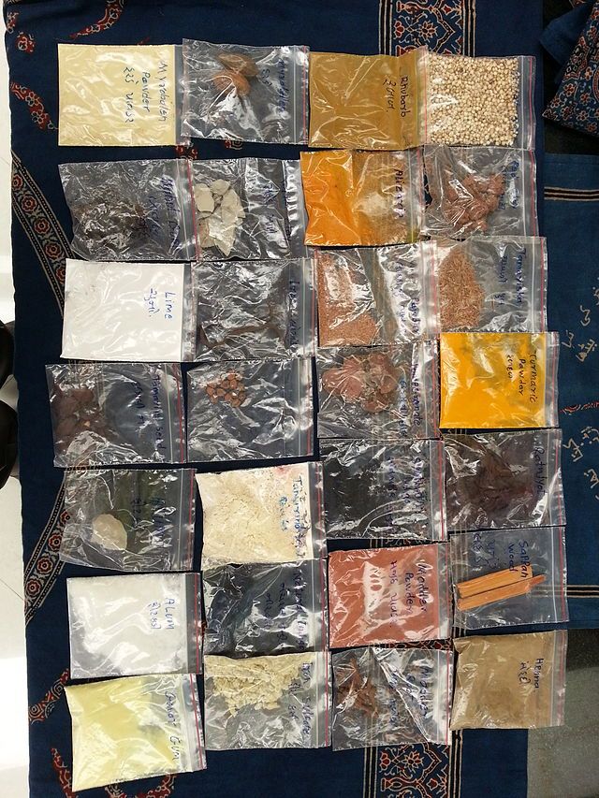
Natural Dyes: Ajrak craft products are made with natural dyes. The entire production of the products include both vegetable dyes and mineral dyes. Indigo is key dye.

Slide 48
Bronze Age and Indus valley Civilization (3300-1200 B.C) The beginning of Indus valley Civilization (3300-1700 B.C) or Harappan Culture coincided with the Bronze Age around 3300 B.C. The Bronze Age literally referred to the times when most advanced metal working used Bronze (an alloy of tin and copper).

Slide 49
The Indus Valley tradition of Pakistan and Western India has been the focus research of Dr Jonathan Mark kenoyer . His one paper provides an over view of none fernous metal technologies in the north western regions of the subcontinent and the role of these technologies during the Harappan phase of the Indus valley traditions (2600- 1900 B.C). As the first such overview since Agarwal’s seminal work in 1971, we will focus on the information available on metal sources, processing and use.

Slide 50
The Indus tradition was centred in the greater Indus plain , which was formerly watered by two major river systems, The Indus and Ghaggar Hakra (now dry). Adjacent regions that were currently integrated at various periods with this vast double river plain include the highlands and plateaus of Baluchistan to the west and , and the mountainous regions of Northern Pakistan, Afghanistan, India to northwest and north.

Slide 51
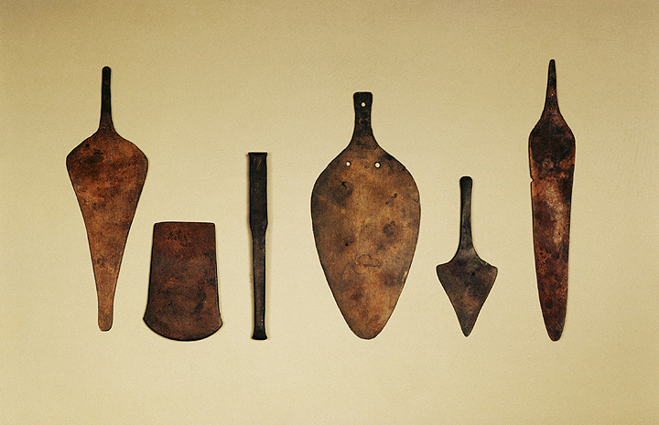
The Thar Desert and the Aravali Hills formed the eastern periphery. The coastal regions from Makran to Kuch and Gujarat formed the southern boundary and pro

Slide 52
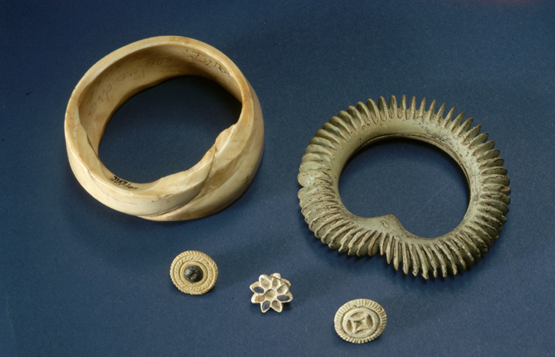

Slide 53
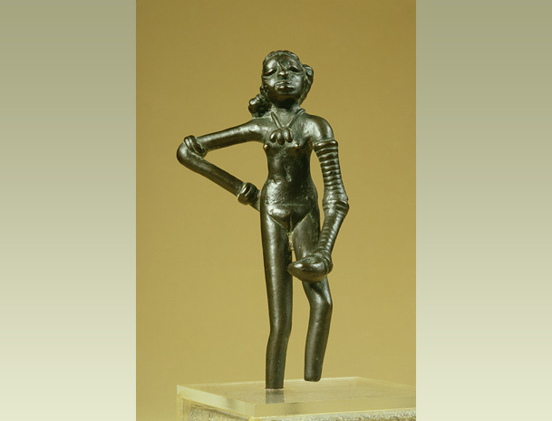

Slide 54
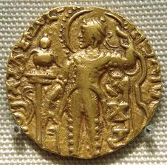

Slide 55
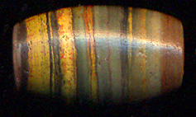
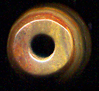
Ancient Bead making
Bead with six different colours, The old craftsman used copper drill to make this fine hole

Slide 56
BANDED AGATE & VARIEGATED JASPER BEADS
From the late Indus Valley Civilization 1900 B.C. to the classical period until 100 A.D.
The most beautiful beads were made around 3000 years ago!
A Golden Age of beads
In what is referred to as the late Harappan period from 1900 to 1000 B.C. expressions of art
reached a climax. Most of the Indus beads displayed on Ancientbead.com are from this late period.

Slide 57
With exceptions, the art of bead making has been in a slow decline since then.
As an example, take a short look on the page with the etched beads from the later Maurian period; most of the beads from this period are made in a much more sloppy way.

Slide 58
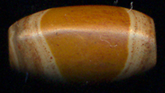

The symmetry and harmony in the colour composition in this bead is awesome.

Slide 59
Hence the most beautiful beads were made more than 3000 years ago! The large holed Indus beads you can see below are like cultural messengers, each of them in the language of stone. Shapes and colors bearing witness to an age where there was ample time to sit with
a single piece of agate and wait for the right bead to emerge.

Slide 60
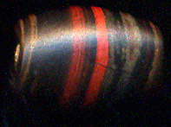

Slide 61
An ideal bead is both ancient and beautiful!
The beads displayed here would be stunning even if they were new!
Each of the beads displayed here are among the most perfect beads.
These beads are composed pieces of art where the beauty of the stone patterns are revealed by their makers.

Slide 62
They are made out of the human intention to create beauty.
Around 3000 years ago they came out of raw stone to let itself be displayed on this page. Believing that the sculpture was waiting inside the stone for the artist to free it, these ancient craftsmen knew the art of letting the different natural motifs of the agate show itself at its finest!

Slide 63
As you can see in most of the beads, symmetry plays an important role in choosing-creating the motives.
Often you can also find the golden angle in the motives. In the magic Eye Beads the eye is almost always placed in the symmetric middle or in the golden angle position.

Slide 64
Beads as currency
In the Indus Valley civilization it is easy to assume that beautiful beads had a symbolic religious
function that reached into the sphere of trade. Beads would fulfill the same function as later coins would.
In the historic periods to follow the Indus culture beads started to loose their importance as currency
because the relatively high and well ordered social organization of Kingdoms made the controlled mass
production of coins possible.

Slide 65
A bead does not posses the same quantifiable quality as a coin produced
by a certain Kingdom. In contrast to a coin the value is of a certain bead can always be argued.
However if the beads lost their importance as currency they
at least in the east never lost their importance as magic totems!

Slide 66
Late Indus Valley to the
beginning of the Classical Period
1000 BC to 100 A.D.
The beads from the area called Rakhigarhi in Haryana, India.
Rakhigarhi is remarkable since this area was continuously populated from the Indus time up to 100. A.D.
As the Indus river civilization died out with the change of rivers in what is now Pakistan around 1900 BC,

Slide 67
this remarkable culture went eastward. It spread into India where it continued to evolve until around 1000 BC.
Rakhigarhi is such a remarkable area.
In this particular area the Indus civilization merged into the early classical time in such a way that the cultural
knowledge of the Indus people did not die out, but could continue to evolve, into an absolute peak!

Slide 68
The hunt for beauty
The late Indus people went to great efforts to obtain exotic stones for
making beads of different colors, shapes and sizes. With increasing bead making skills in
the end of the Indus Valley period it was not enough just to posses a perfect made bead.
In order for the bead and its owner to stand out the hunt for the special stone became more and
more important. The Indus people and the Mesopotamians loved jasper. It was their favroite gem stone.

Slide 69
Especially they liked variegated jasper. Jasper is an opaque cryptocrystalline quartz, typically red to
brown, or in more rare cases green. The strange mineral 'landscapes' you will explore below reflect the strive for
the sublime made bead made out of the sublime material. In these kind of rare beads one will often find what is
called variegated jasper. In this type of jasper there are up to 20 percent non-quartz elements.
These elements account or the wide range of colours and decorative patterns.

Slide 70
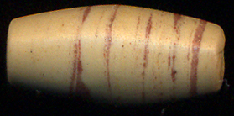
Bead from Indus

Slide 71
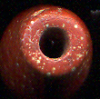
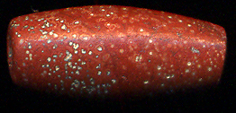

Slide 72
TRANSLUCENT INDUS VALLEY/ EARLY CLASSIC PERIOD BEADS: The beauty of translucent beads is a bit difficult to display in a picture. Unfortunately it is impossible to capture the real shine of a translucent bead. The 3-dimensional lustre can only be experienced when you have the bead in your hand. Still I hope you can get a glimpse of the magic shine emanating from these ancient beads! The translucent shine of the bead TIVB 2 has not diminished in over 3000 years!

Slide 73
A beautiful bead is a messenger transcending time
As you look through the stone you pierce through time. The same shine that has captivated the bead makers in the golden Indus Valley still shines bright even today!
A timeless bond between you and your ancestors living countless generations before you is established in this fascination of translucent bead-beauty.

Slide 74
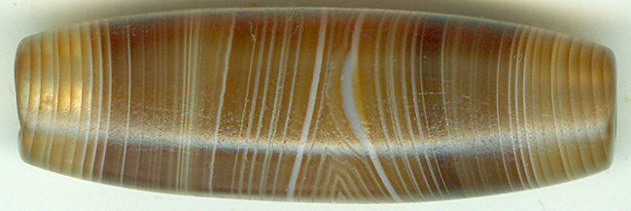
Translucent bead

Slide 75
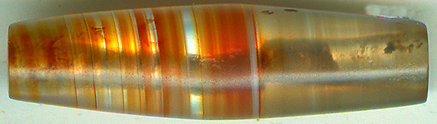
Translucent bead

Slide 76
Lets sum up today’s lecture that took us to the beautiful past known as Indus Valley Civilization.
Art and craft (the development of pottery, metal work, printing on cloth and bead making.
Teaching and learning was planed on Indus valley civilization.
We will be doing practical work based on these lines influences taken from Indus valley.

