Slide 1
SUMMERY OF LECTURE. 3. UNIT. 1
The concepts that were discussed are
Approaches to art teaching
art and child development.
Why teach art and crafts in elementary grades?
The role of teacher in teaching art, craft and calligraphy.

Slide 2
Art and Child development:
Five Stages of development in children’s art.
First stage is the scribble stage deals with the age 2 to 4.
The second stage is pre schematic stage, when child produces his first symbol.
The third stage of development in children’s art is Schematic stage when child learns to repeat the symbols.

Slide 3
The fourth stage is the Transitional stage when a child learns to meat adult standards.
The fifth stage is the Realism stage when child is around 12 years and learns to use different mediums.
In lecture Three we have discussed these five stages in detail with the specimen of the work of children during different stages.

Slide 4
Then in our previous lecture we tried to find the answer to this question, Why teach art and craft to children at elementary levels.
The basic purpose of art education is to boost up the creative abilities of children. And how art education can help develop the learning skills of children and their speaking abilities.
This education also helps in creating hand and body coordination in children.
Decision making, visual learning and innovative abilities can be strengthen in children by art education.

Slide 5
The most important thing that we discussed in our previous lecture is, the role of teacher in teaching art, craft and calligraphy.
They acts like a guide in the life of children and if they are able to make a place in the heart of a child then the child starts believing in him or her blindly.
Art education needs individual attention, by giving art education a teacher can improve the skills of a child.

Slide 6
LESSON. 4. UNIT. 2
HISTORY AND CULTURE
INDUS VALLEY ART AND CULTURE
Indus valley civilization is one of the oldest civilization of the world like Mesopotamian civilization. That is bronze age is 3300 to 1300 BCE. It flourished in the basins of Indus. This civilization is really rich in art and culture.

Slide 7
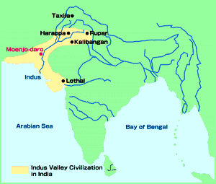
Roots of Indus Valley Civilization
Earliest civilizations in Indus Valley was discovered in 1856 by a railroad crew.
  Harappa
  Mohenjo-Dara or “Mount of the Dead”
  Both cities shared urban design and architectural features.
  3 miles in circumference with populations of 40,000

Slide 8
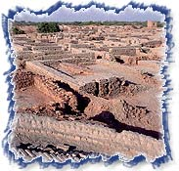
Roots of Indus Valley Civilization
Roots of Indus Valley began as early as 7000 B.C.E.
  Possibly began as herders who moved into the river valley during colder months.
  Over time, they may have decided to farm – river-watered lands of the valley.
  They began trading by boat along the Indus down into the Arabian Sea, into the Persian Gulf, and up the Tigris and Euphrates into Mesopotamia.

Slide 9
Indus Valley History: Sir John marshal discovered Indus valley civilization in1920. The two major cities are Mohenjo-Daro and Harappa. These two cities are 400 miles apart from each other but culturally these two cities are so much alike (UNESCO’s world heritage site). Indus valley people lead a simple life that is why their residential houses are so simple and without any decoration. They preferred simplicity over luxury.

Slide 10
Indus valley houses were built on a simple plan ,It was actually the same as we can find in India and Pakistan even now, courtyard in the middle and rooms around it.
Indus Valley town Planning:
  Originating around 2500 B.C.E. the thriving civilizations survived for around 500 years.
  Both Harappa and Mohenjo-Daro, two of the largest among 500 sites, were three miles in circumference with around 40,000 people.

Slide 11
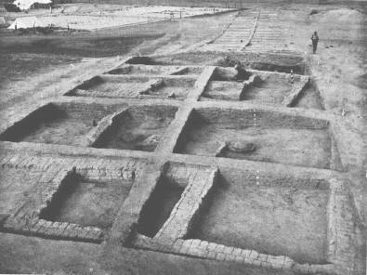
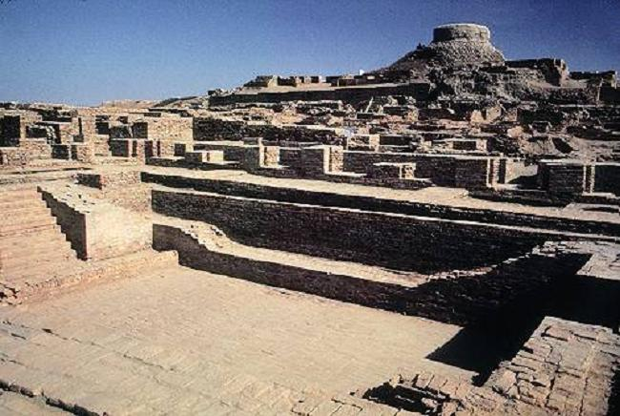
Town Planning

Slide 12
Mohenjo-Daro and Harappa
  To the north is a citadel or raised area.
  In Mohenjo-Daro, the citadel is built on an architectural platform about 45 feet above the plain.
  On the summit was a huge communal bath.
  Next to the large bath was a huge open space—a granary where food was stored from possible floods.
  Fortified walls mark the southeast corner.

Slide 13
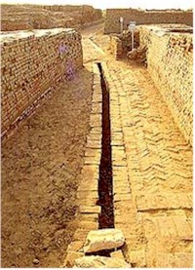
Mohenjo-Daro and Harappa
The lower city was laid out in a gridiron with the main streets about 45 feet wide.
Private houses, almost every one with its own well, bathing space, and toilet consisting of a brick seat over a drainage area.
Brick-lined drains flushed by water carried liquid and solid waste to sumps, where it was carted away, probably to fertilize nearby fields.

Slide 14
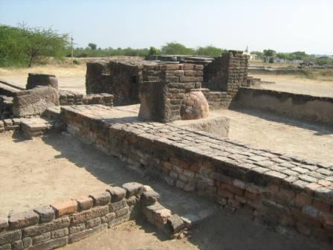
Mohenjo-Daro and Harappa
The town plan was regular.
Even fire-baked bricks were uniform in size and shape.
The regularity of plan and construction suggests a government with organization and bureaucratic capacity.
No monumental architecture clearly marks the presence of a palace or temple.
There is little sign of social stratification in the plan or buildings.

Slide 15
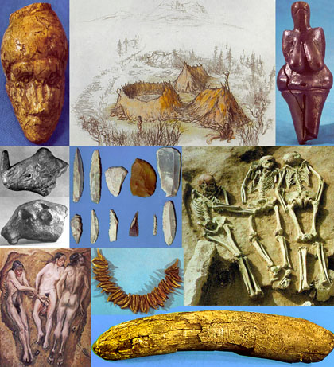
Indus Valley Archaeological Finds
Among the 20,000 artifacts uncovered, the extraordinary extremes of wealth and poverty of Egypt and Mesopotamia do not appear.

Slide 16
Indus Valley Archaeological Finds
Why do you think that is the case?
Questions of Interpretation:
Artifacts stress the apparent classlessness of the society.
Until the Harappan language is deciphered, its civilization will remain mysterious.

Slide 17
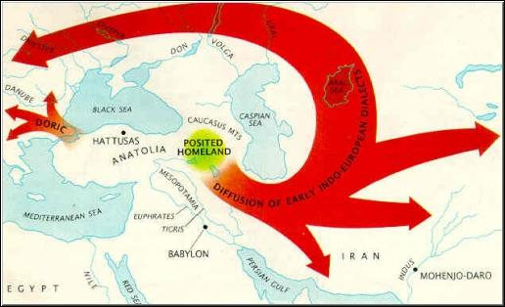
Enter: The Aryans
Approximately 1500 B.C.E. a nomadic and pastoral people who spoke the Indo-European language passed through the Hindu Kush mountains.
They called themselves “Aryans” or “noble people.”
They established small herding and agricultural communities throughout northern India.
Their migrations took place over several centuries.

Slide 18
The Artifacts: Crafts and the Arts
Arts of Indus Valley includes sculptures.
Three types of sculptures have been found.
Terracotta figurines.
Stone sculptures
Bronze sculptures
Crafts of the Indus valley included pottery making, dyeing, metal working in bronze, and bead making.

Slide 19
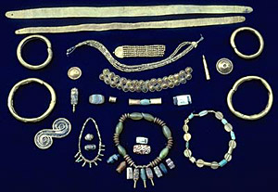
  Bead materials included: jade from the Himalayas, lapis lazuli from Afghanistan, turquoise from Persia, amethyst from Mewar in India, and steatite, which was found locally.

Slide 20
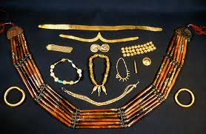
Indus Valley Jewellery

Slide 21
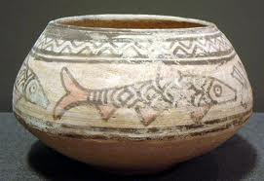
Indus Valley Pottery

Slide 22
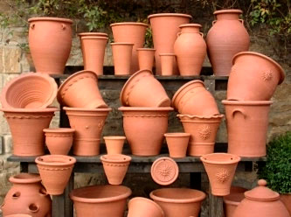
The Harappan pottery is bright or dark red and uniformly sturdy and well baked. It consists chiefly of wheel made wares both plain and painted. The plain pottery is more common than the painted ware. The plain ware is usually of red clay with or without a fine red slip.

Slide 23
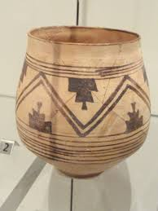
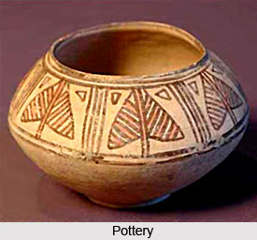
The painted pottery is of red and black colours. Several methods were used by people for the decoration of pottery. Geometrical patterns, circles, squares and triangles and figures of animals, birds, snakes or fish are frequent motifs found in Harappan pottery.

Slide 24
Another favorite motive was tree pattern. Plants, trees and pipal leaves are found on pottery. A hunting scene showing two antelopes with the hunter is noticed on a pot shreds from the cemetery H.A jar found at Lethal depicts a scene in which two birds are seen perched on a tree each holding a fish in its beak. Below it is an animal with a short thick tail which can be a fox according to S R Rao. He also refers to the presence of few fish on the ground. Harappan people used different types of pottery such as glazed, polychrome, incised, perforated and knobbed.

Slide 25
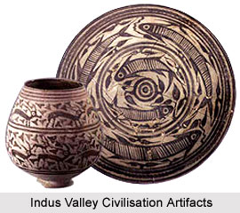
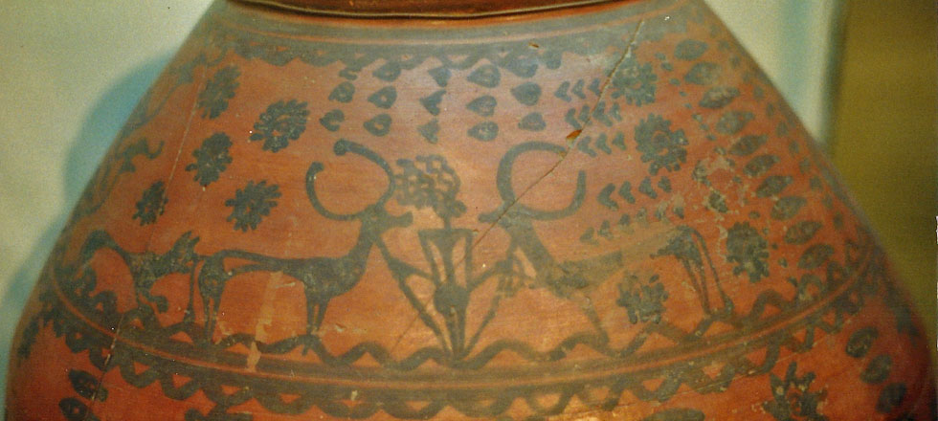
Indus Valley painted Pottery

Slide 26
The glazed Harappan pottery is the earliest example of its kind in the ancient world. Polychrome pottery is rare and mainly comprised small vases decorated with geometric patterns mostly in red, black and green and less frequently in white and yellow. Incised ware is rare and the incised decoration was confined to the bases of the pans.

Slide 27
Perforated pottery has a large hole at the bottom and small holes all over the wall and was probably used for straining liquor. Knobbed pottery was ornamented on the outside with knobs. The Harappan pottery includes goblets, dishes, basins, flasks, narrow necked vases, cylindrical bottles, tumblers, corn measures, spouted vases and a special type of dish on a stand which was a offering stand or incense burner.

Slide 28
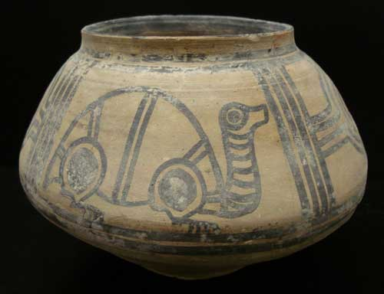
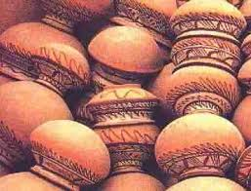
Indus Valley Pots

Slide 29
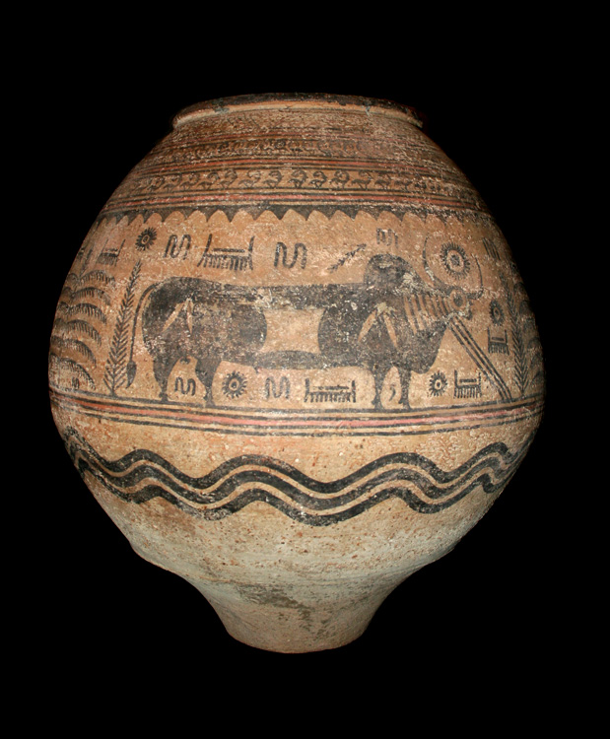

Pottery with animal figure and linear designs

Slide 30
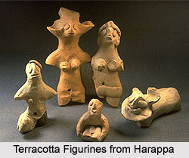
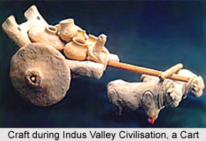
Indus Valley sculptures
Indus valley sculptures have mainly three types 1.Terra cotta Figurines 2. stone sculptures
3. Bronze sculpture.

Slide 31
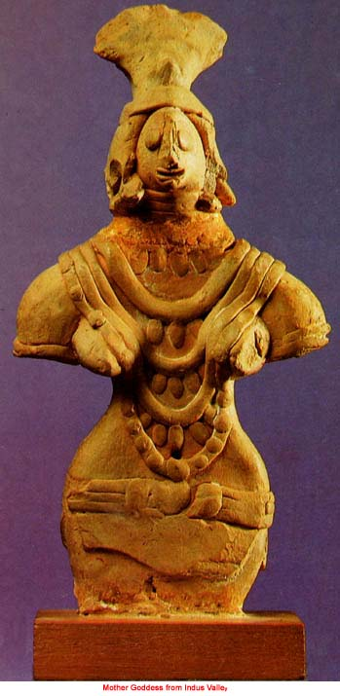
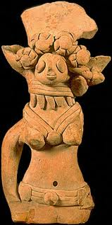
Terra cotta figures of Indus Valley

Slide 32
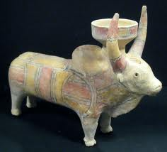
Terra cotta Bull

Slide 33
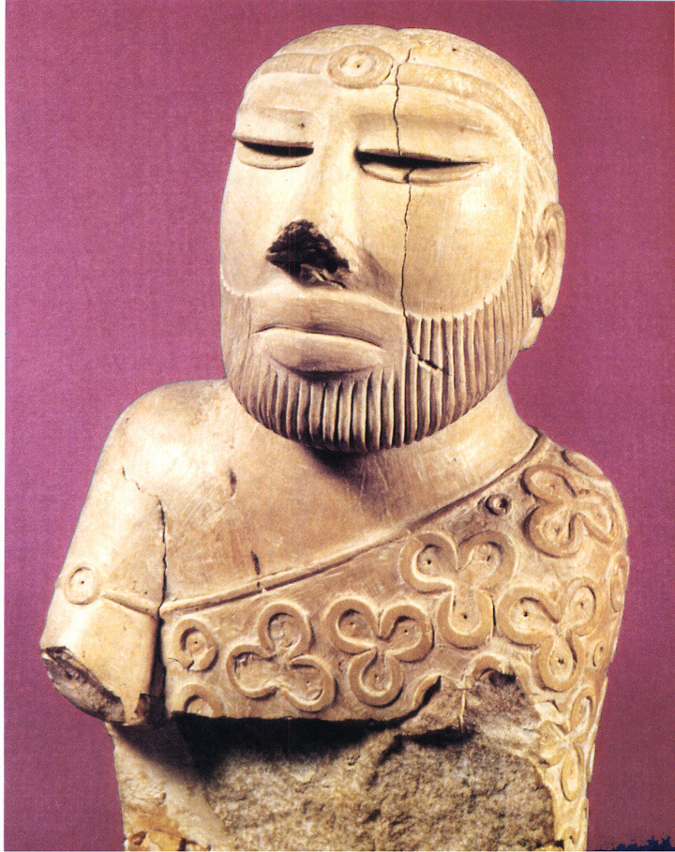
Indus valley stone sculptures

Slide 34
Head of a priest.
This is sculpture in round with typical physical features from Indus, inlaid eyes, upper lip shaved and thick lips, and the nose is broad. The shawl on the shoulder has trefoil design.
The material used is soft stone.
The arm of the sculpture is broken.
Notes:
H

Slide 35
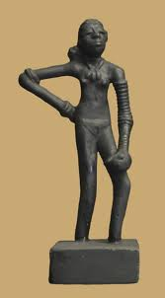
Bronze Sculpture in round of a dancing girl
This is a female sculpture of a dancer with her one arm on her waist and other arm resting on her knee. Both arms are filled with bangles and neck less can also be seen.
Her hair are tied in a fashionable style.

Slide 36
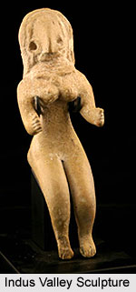
Indus Valley Sculpture
Sculpture in round from Indus valley

Slide 37
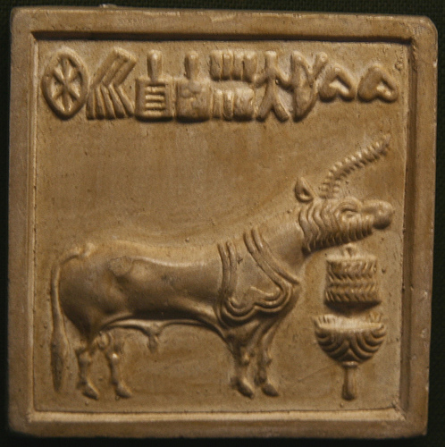
Indus Valley Seals
Indus valley seals seem very important for them only from Mohenjo Daro almost 20000 seals have been found. The shape of these seals generally is rectangular but some circular and square seals have also been found

Slide 38
The stone used for making these seals is Steatite, which is a soft stone. There are knobs or hooks at the back of these seals. It is thought that they might be used for two purposes. One is for the trade purpose to use them as signatures while sending goods to other places and the other might be to wear them as neck less.

Slide 39
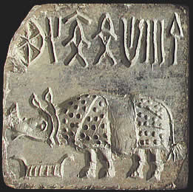
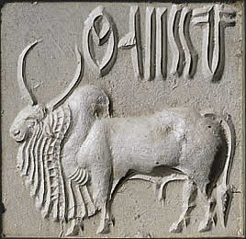
Some Seals are in Intaglio and some are relief

Slide 40
Shapes on seals:
The most common shapes on seals are fish, swastika and some script like design. The most common and important shape on seals is however animals for example, Unicorn, Bull and elephant etc.
However some human shapes can also rarely be seen on seals.

Slide 41
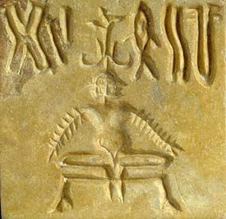
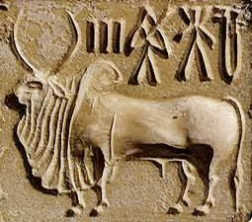
Left is three human head seal with arms like fish bone. Right is again a bull seal with some relief design like text.

Slide 42
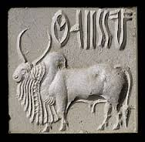
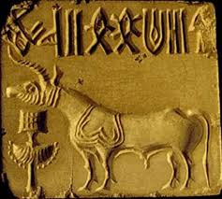
More seals with animals

