Slide 1
LECTURE. 32.
SUMMERY OF LECTURE. 11. TO LECTURE .30.

Slide 2
LECTURE. 11. UNIT. 2. (PRACTICAL)
Making Calligraphies using different tools and mediums. (Practical).
We did calligraphy with different tools in the class with students for the portfolio.
Calligraphy with Kalam on Paper.
Calligraphy with Brush on Paper.
Calligraphy with paint on Canvas.

Slide 3
IN LECTURE. 12. Unit. 2
we discussed Introduction to Cubism and 20th Century art in Pakistan
Introduction to Cubism.
20th Century art in Pakistan
(Pakistani Artists Shakir Ali
and Mansoor Rahi)

Slide 4
WE DID A BRIEF INTRODUCTION TO CUBISM:
Within the first two decades of the 20th century, a new art movement began that was unlike any other—Cubism.
Started by Georges Braque and Pablo Picasso, most Cubist works are immediately recognizable due to their flattened, nearly two-dimensional appearance; an inclusion of geometric angles, lines, and shapes; and a fairly neutral color palette.

Slide 5
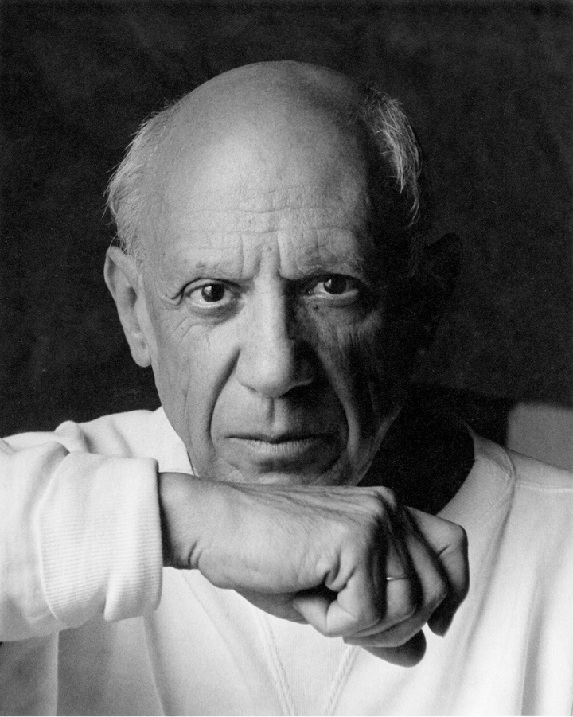
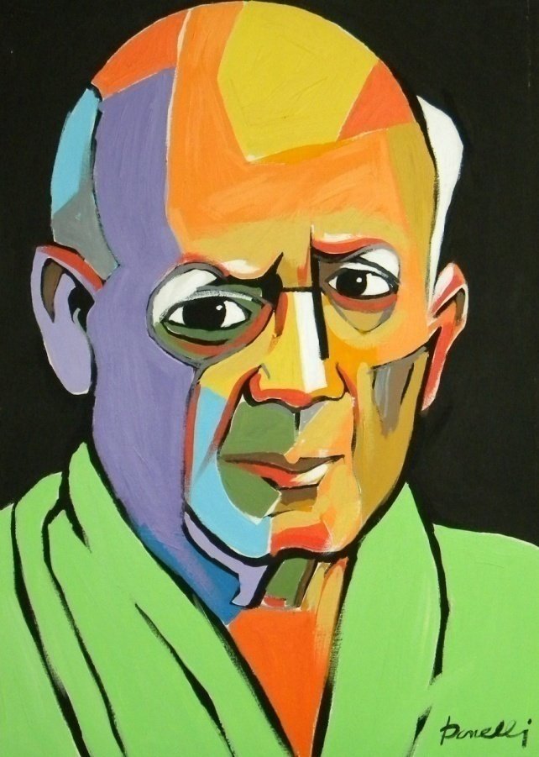

Slide 6
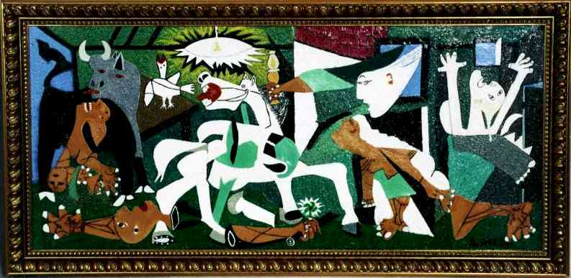

Slide 7
We found the answer to What is Cubism?
Unlike traditional still-lifes, landscapes, or portrait paintings, Cubist paintings aren’t meant to be realistic or life-like in any way. Instead, after looking at the subject from every possibly angle, the artist will piece together fragments from different vantage points into one painting.

Slide 8
We talked about Famous Cubist Artists
The most famous Cubist is probably Picasso, with Braque a distant second. . . even though he was just as instrumental as Picasso was in founding Cubism.
Paul Cézanne: (although not a part of the Cubist movement himself) is often credited with sparking Braque’s first attempts at painting a Cubist landscape. Cézanne’s paintings separated objects into basic shapes—cubes and spheres, mostly—which directly led to Cubism’s use of fractured, geometric planes.

Slide 9
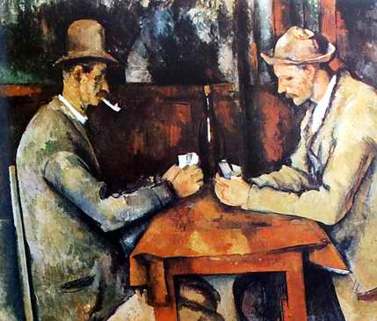

Slide 10
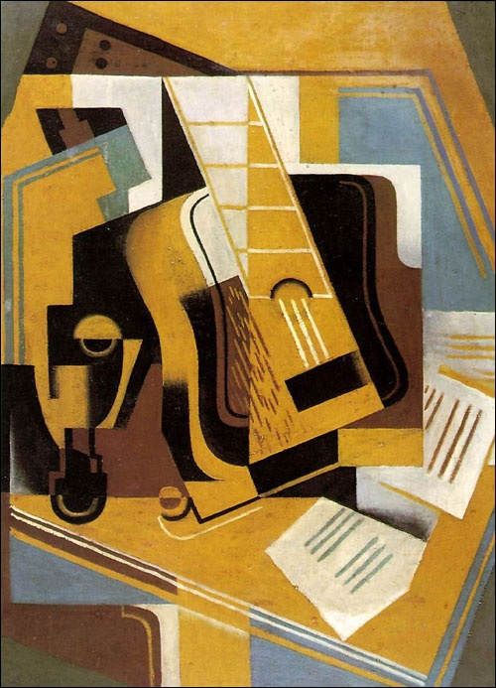

Slide 11
We also talked about 20th Century art in Pakistan. Cubism in Pakistan.
In the early post -1947 decades, the artists in Pakistan adopted Modernism not as perpetuation of the First World hegemony but as a metaphor for change and economic freedom. The society was no longer being viewed in stereotypes or idealised images, but as an evolving nation faced with the challenges of transition.

Slide 12
In 1947 Lahore boasted of two art institutions and an expanding artists’ community. Karachi had very little post-Partition art activity, which expanded and became enriched by the arrival of pioneering talent in the exodus of displaced people from all over the sub-continent.

Slide 13
In the early 1950s The Lahore Group initiated experimentation in the Modern idiom and had a seminal influence on contemporary Pakistani art. Ahmed Parvez, Shemza, Ali Imam, Moyene Najmi, Sheikh Safder and Qutub Sheikh were members of this informal group and like the Progressive group of Artists, were also inspired by the Paris School. These painters looked upon the new aesthetics of Modern Art as a manifestation of a technological and industrial progress leading to economic freedom, as it had brought to the west.

Slide 14
By the 1960s. The art of the East Pakistani [now Bangladesh] painters had a tremendous impact on their counterparts in Lahore, Karachi, Rawalpindi and Peshawar, who had yet to reach that mature understanding of the discipline. Artists such as Zainul Abedin had already bridged the gulf between folk art and contemporary art.

Slide 15
Mansur Rahi, a student of Zainul Abedin, became one of the pioneer teachers at Karachi School of Art where his pedagogic influence on the young watercolorists heralded an aquarelle revival in the 1980s. Rahi became a faithful exponent of analytical cubism and developed his oeuvre under the influence of this style.

Slide 16
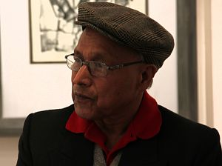
we talked about Cubism in Pakistan there are two big names worth mentioning.
Shakir Ali and
Mansoor Rahi
Profession: Painter
Location: Islamabad
Born: 1938

Slide 17
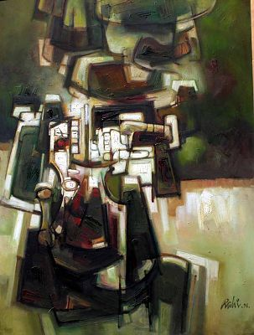

Slide 18
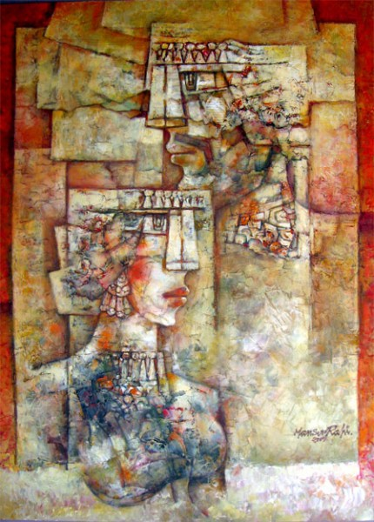
Purely structured with formally bold forms of mainly Human figure. Cubical Expression with rayonistic activity and Psychedelic tension of forms and colors which evolves in new form of illusion.

Slide 19
Mansoor Rahi has played an instrumental role in spreading art for the last four decades. His paintings are unique and take the viewers to a far off land. Mansoor Rahi’s paintings are intricate as they involve a lot of mathematics. It is an established fact that Mansoor Rahi does a lot of calculations before starting any of his paintings. The mastery is evident in his paintings, as he is adopted the cubist genre.

Slide 20
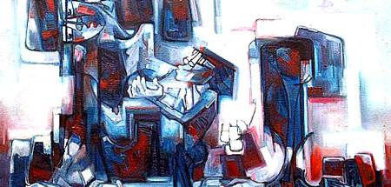
He has taken inspiration from giants like Picasso, Meero, Barque and Paul Klee. Rahi is the only artist who took the charge of introducing regular development in cubism after Picasso, who took noticeable development in cubism. This is statement of a writer about Rahi

Slide 21
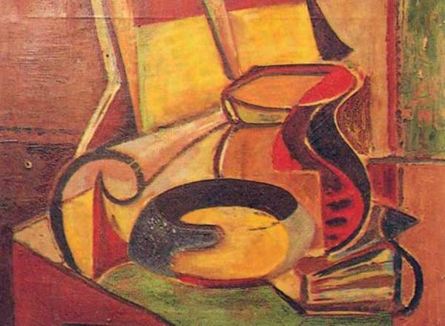
SHAKIR ALI:
Born in 1922, Pakistan
Shakir Ali has spent 12 years, 7 years in Bombay and 5 in London to learn classic and modern art. He came back to Pakistan in 1952.

Slide 22
Art for Shakir is a meant of expressing his own lonely personality. It is devoid of sensuousness and sentimentality, and possesses the distilled quality of brooding in in solitude on subjects from life, which only provide point of departure into the realm of line, tone values and color. His approach to his craft is essentially of virtuoso.

Slide 23
He treats line solely as a matter of Measure, short or long, of angles, obtuse or acute. He uses tone values or chiaroscuro as Weight and color as Quality. He uses these three formal elements in the construction of new order and creates image, which we call the subject.

Slide 24
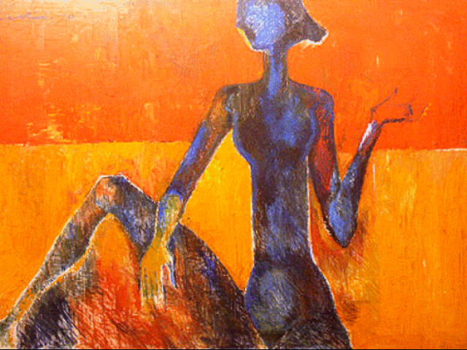

Slide 25
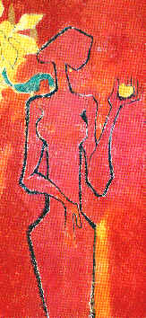
In the work of such artist, the appearance of recognizable object is cause for confusion among the viewers.

Slide 26
The work of these two modern artists reflects the talent that is possessed by this land of South Asia. They not only produced the magnificent miniatures on this land but have the capacity to produce modern art also.

Slide 27
IN LECTURE. 13. UNIT.2.WE DISCUSSED
Introduction to Realism.
(Pakistani artists)
Anna Molka Ahmad
Ali Imam,
Iqbal Hussain,
Khalid Iqbal

Slide 28
Realism, in the arts, the accurate, detailed, unembellished depiction of nature or of contemporary life. Realism rejects imaginative idealization in favour of a close observation of outward appearances. As such, realism in its broad sense has comprised many artistic currents in different civilizations. In the visual arts, for example,

Slide 29
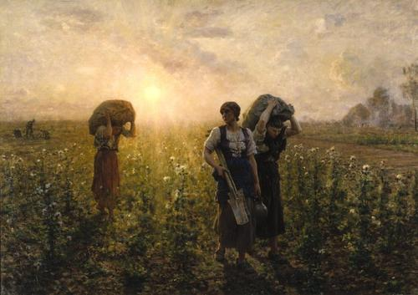
Realism (or naturalism) in the arts is the attempt to represent subject matter truthfully, without artificiality and avoiding artistic conventions, implausible, exotic and supernatural elements. Painting by Julis Brenor

Slide 30
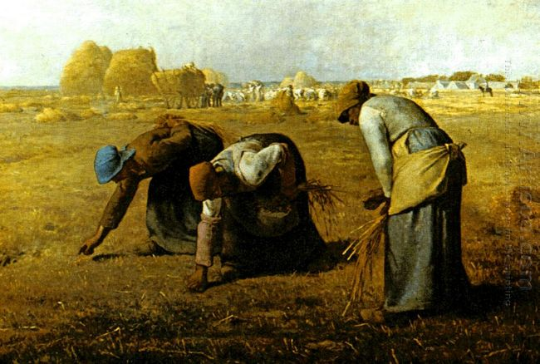
The realist painters rejected Romanticism, which had dominated French literature and art since the late 18th century.
The Gleaner by Millet

Slide 31
Then we talked about famous Pakistani artist Anna Molka Ahmed, was a famous Pakistani artist and pioneer of fine arts in the country after its independence in 1947. She was a professor of fine arts at the University of the Punjab in Lahore. Anna Molka's father, painted in 1950 by Anna Molka.

Slide 32
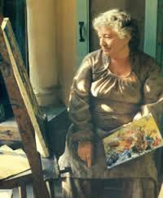

Slide 33
Prof Anna Molka Ahmed was a famous Pakistani artist and pioneer of fine arts in the country after the Partition.
She was a professor of fine arts at the University of the Punjab in Lahore. She was born to Jewish parents in London.
Her mother was Polish and father Russian. She studied painting, sculpture and design at St Martin School of Arts in London.

Slide 34
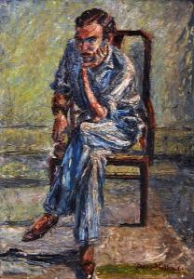

Slide 35
In 1940, Prof Em Anna Molka Ahmed set up the Department of Fine Arts, now the College of Arts and Design, at the University of the Punjab, which has now become a centre of excellence for fine arts in Pakistan.
Her students turned into famous artists at home, whereas many of them are recognized internationally.

Slide 36
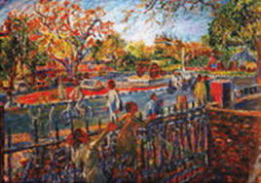

Slide 37
The Imam of Art
By Shamim Akhter
Ali Imam, the Imam of art and artists of Pakistan passed away on May 23, 2002. To pay homage to Imam Saheb, Gallery 6 in Islamabad hosted two of his rare works of art. In Karachi, Shahnaz Imam, now the director/ curator of Indus Gallery paid tribute to her husband by holding a big exhibition of paintings by senior and prominent artists of Pakistan. She also produced a brochure on the occasion sketching the life and works of Imam Saheb by various writers.

Slide 38
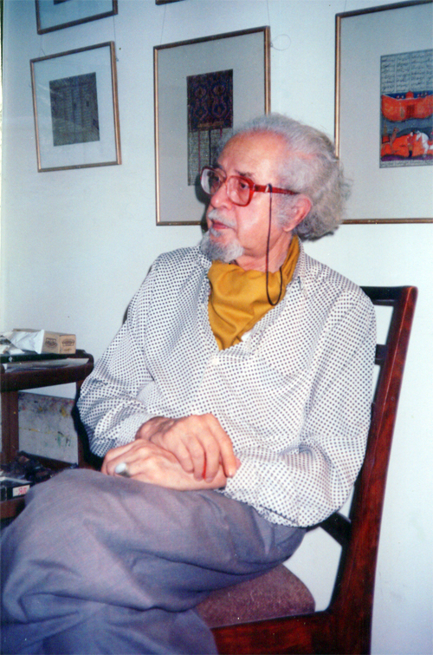

Slide 39
Pakistan Art Review also remembers the Great Guru and gives ample place to the man who dedicated his life to promote art and artists of Pakistan and opened the doors of Indus Gallery for modern art, thus paving the way for a proper art movement in Pakistan. There are many issues include writings on Ali Imam by prominent writers and a personal note by his daughter and wife.

Slide 40
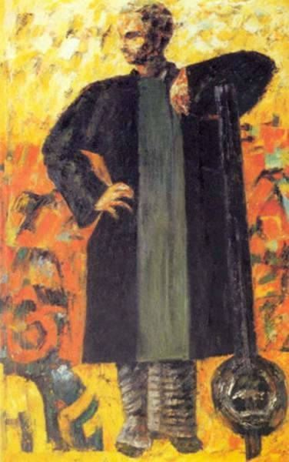

Slide 41
Iqbal Hussain:
After finishing his studies at NCA in 1974, Mr. Hussain dedicated his career to painting women of his abode - the red light district of Lahore. He has continued to live in the district to be close with his people to whome he portrays in his paintings_ the men and mainly women, the denizens of the vicinity. The mostly neutral palette and diffused light source hints at the sadness and less glamorous reality of Heera Mandi - the local name for the district. Mr. Hussain has a sensitive yet unapologetic approach, unwilling to simply gloss over the truth.

Slide 42
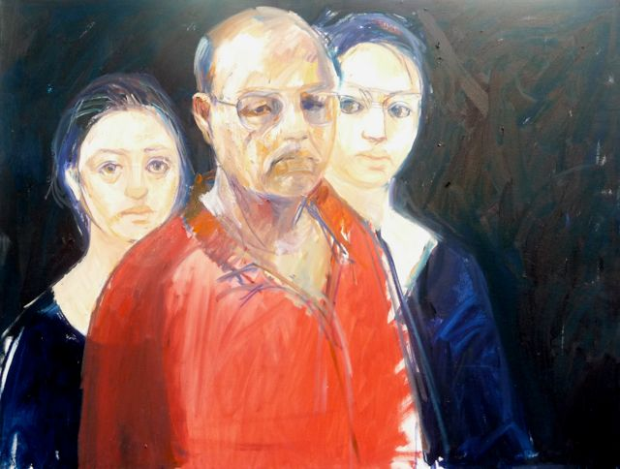

Slide 43
A constant painter of the spirit of old city of Lahore and the Red Light area, Iqbal Hussain was hosted by Ejaz Galleries, Lahore on October 20, 2011. Hussain graduated from National College of Arts, Lahore in 1974 and held his first exhibition in 1981; since then, with a wounded soul, he has been narrating his saga on canvas in morose hues.

Slide 44
His subjective experience has left a lasting impact on his conscious mind which he keeps expressing constantly. He has exposed all the facets of life in the red light area, a matriarchal society. That was a time when even talking about this segment of society was a taboo. Hussain raised his voice at that time; now it has become a household name courtesy the plays run on TV channels.

Slide 45
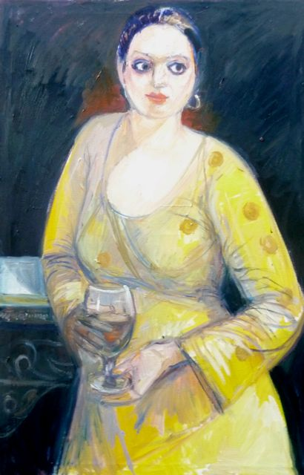

Slide 46
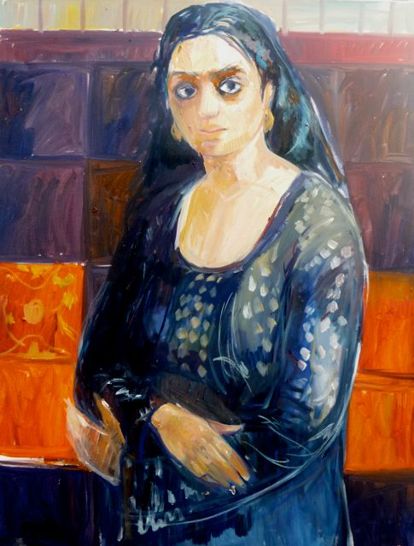
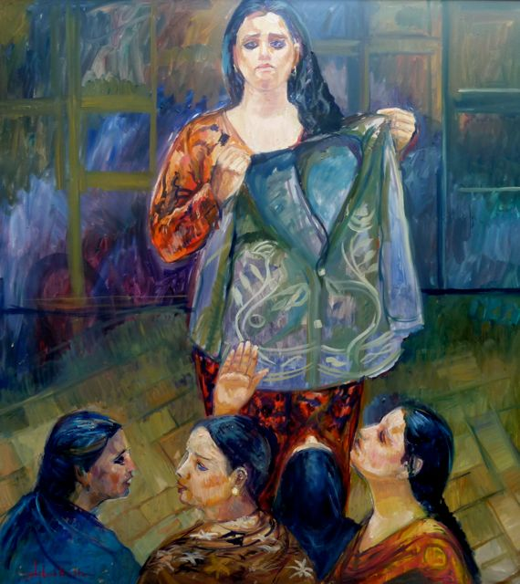
The other segment of his work consists of cityscapes, landscapes related with river Ravi and street scenes from Shahi Mohallah,

Slide 47
His mural size canvas speaks of his vigour and velocity of expression of a living reality. He is the first artist in Pakistan to say through line and colour that these are human too. They are souls related with the profession of singing; dancing and body selling earlier confined in a certain locality popularly known as Heera Mandi- the Red Light area. But now they are scattered allover. Although all his figurative work is a social comment even when he is expressing their agonies, aspirations and way of life, at times Hussain specifically makes a comment on the hypocrisies of the self-acclaimed pious society.

Slide 48
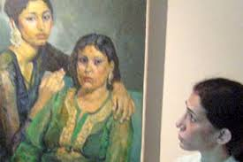

Slide 49
Khalid Iqbal: The father of modern realism in landscape painting in Pakistan
Landscape painting has always been a popular and undisputedly, the most acceptable genre of visual arts among all and sundry in Pakistan. Owing to its natural and gifted beauty, the plains of Punjab have invariably attracted the onlookers, as well as the painters, to pay homage to the enriched colours, captivating light and in-depth perspectives of orange and red horizons of dawn and dusk.

Slide 50
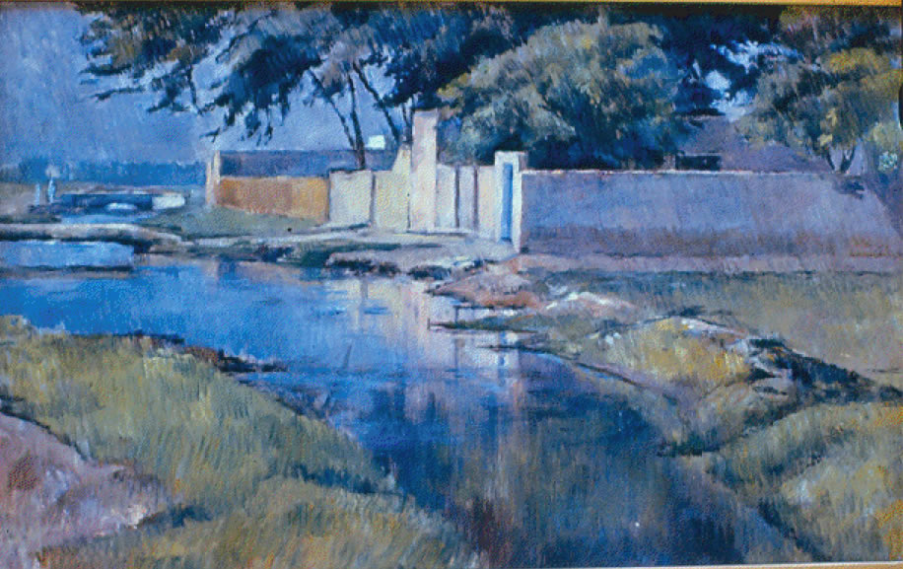

Slide 51
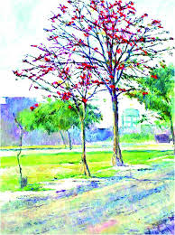

Slide 52
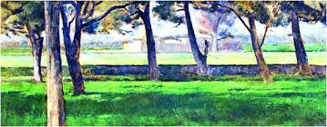

Slide 53
it was the company painters of the colonial era who brought the modern and realistic technique of landscape painting to the subcontinent preferably through the mediums of oil colour and water colour. The realistic style owing to its capacity of imitating the naturalistic rendering of the seen-objects, received popularity and acceptance among the local artists and the genius of Allah Bakhsh responded to the depth and illusions created by the geometrically enhanced perspective, a new approach in for the regional painters and viewers.

Slide 54
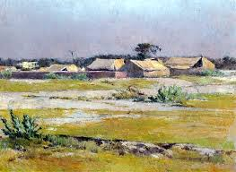

Slide 55
IN LECTURE. 14. UNIT. 2
We discussed about
Introduction to Abstraction.
(Pakistani artist)
Ahmad Pervaiz

Slide 56
INTRODUCTION TO ABSTRACTION:
"Of all the arts, abstract painting is the most difficult. It demands that you know how to draw well, that you have a heightened sensitivity for composition and for colours, and that you be a true poet. This last is essential." -- Wassily Kandinsky is a big name as far as abstract art is concerned. The great Cubists Picasso and Braque we have already discussed

Slide 57
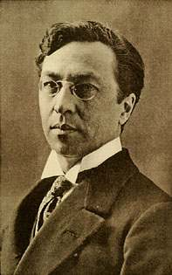
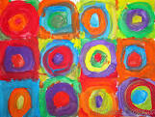
Wassily Kandinsky (1866 – 1944) was a Russian-French painter. His style of painting originally belonged to expressionism.

Slide 58
A further distinction tends to be made between abstract art which is geometric, such as the work of Mondrian, and abstract art that is more fluid (and where the apparent spontaneity often belies careful planning and execution), such as the abstract art of Kandinsky or Pollock.

Slide 59
Also generally classified with abstract art are figurative abstractions and paintings which represent things that aren't visual, such an emotion, sound, or spiritual experience. Figurative abstractions are abstractions or simplifications of reality, where detail is eliminated from recognizable objects leaving only the essence or some degree of recognizable form.

Slide 60
In Western art history, the break from the notion that a painting had to represent something happened in the early 20th century. Impressionism, Fauvism, Cubism and other art movements of the time all contributed by breaking the "rules" of art followed since The Renaissance. Impressionism saw painters not "finishing" their paintings. The Fauvists used colour in a non-realistic way. Cubism introduced the idea of painting an object from more than one view point. From all of these the idea developed that colour, line, form, and texture could be the "subject" of the painting.

Slide 61
Painting the Invisible: Paul Klee (1879-1940)
The art of Paul Klee defies easy categorisation. During his career he experimented relentlessly with creating images in a wide variety of styles, some abstract, some less so. Visionary, subtle, whimsical, sometimes innocent, but always innovative, his prolific output has ensured that he remains one of the favourites of twentieth century abstract artists.

Slide 62
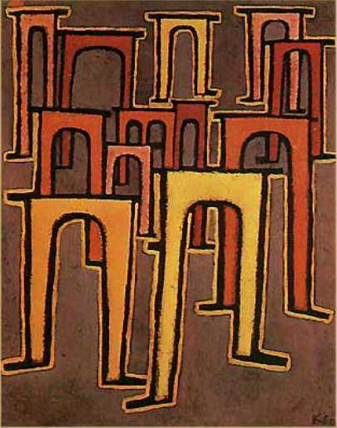

Slide 63
Hans Hofmann (1880-1966)
Artist and teacher, Hans Hofmann, occupied a unique place in the world of 20thcentury art as someone whose career spanned art movements from Cubism and Fauvism, through Surrealism to Abstract Expressionism. Hofmann knew artists such as Matisse, Picasso, Braque and Delaunay as well as Pollock, Krasner and Frankenthaler.

Slide 64
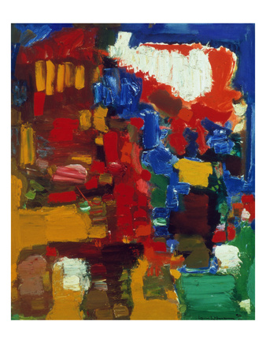

Slide 65
Jackson Pollock Paintings
Jackson Pollock paintings are some of the most recognisable and thrilling images produced in the 20th century. Pollock was dubbed ‘Jack the Dripper’ by Time magazine due to the unusual way he liked to drip and splatter paint onto his canvas. Some of the inspiration for his paintings came from the Native American sand art he saw as a child and his own method of working resembled a form of ritualised dance around the canvas which was laid out flat on the floor.

Slide 66
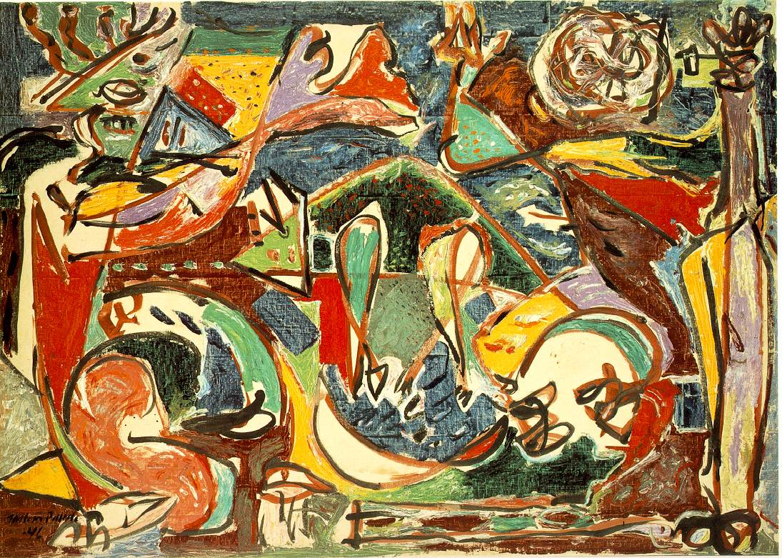

Slide 67
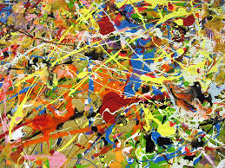

Slide 68
Clyfford Still (1904-1980)
Clyfford Still’s art is electrifying. It’s like a bolt of lightning both visually and in its impact on the viewer. There is a constant sense of revelation running through the work, an ongoing depiction of those powerful intricacies of nature that we inherently understand but can’t find words for.

Slide 69
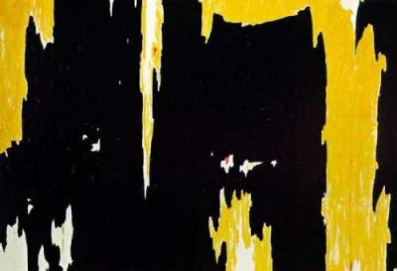

Slide 70
Ahmed Pervez
Ahmed Parvez (1926–1979) was born in Rawalpindi, Pakistan. He was one of the most remarkable artists produced by Pakistan and he received widespread acclaim in Pakistan and abroad. From his first solo exhibition in 1952 to his last in 1979, he passed through many phases as a painter, but his work remained marked with energy.

Slide 71
Before 1972, he spent about 12 years in Britain and exhibited successfully all over Europe; and also two years in USA, where his exhibition in Galerie Internationale, New York, was very well received. He received the President’s Medal for Pride of Performance in 1978.

Slide 72
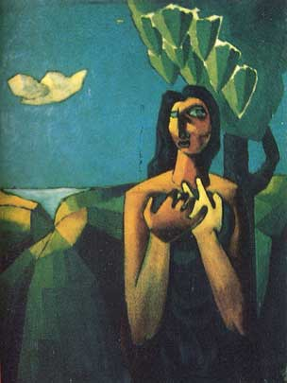

Slide 73
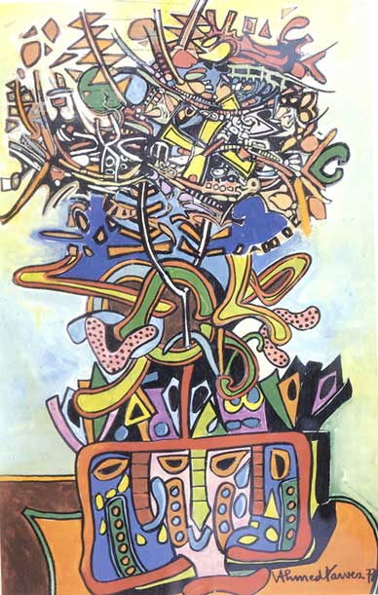

Slide 74
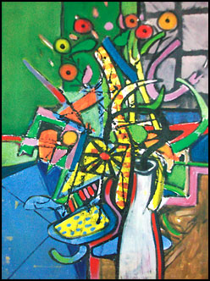
Ahmed Parvez rightly called himself an Van Gogh With A Twist ''organic'' painter, because like the great masters of art such as Bashir Mirza,

Slide 75
LECTURE. 15. Unit. 3
Elements and principals of Design
Elements of Art and their importance. Line, shape, form, space, texture, Value and colour.
Lines and what they do in Art.
Types of lines. Vertical, horizontal, diagonal, zigzag and curved.
line variation, length, width and texture.

Slide 76
Artists have these elements got:
line
shape
form
space
texture
value
Color
Artists manipulate these seven elements, mix them in with principles of design and compose a piece of art. Not every work has every last one of these elements contained within it, but there are always at least two present.

Slide 77
Artists manipulate these seven elements, mix them in with principles of design and compose a piece of art. Not every work has every last one of these elements contained within it, but there are always at least two present.
For example, a sculptor, by default, has to have both form and space in a sculpture, because these elements are three-dimensional.

Slide 78
Art would be sunk without line, sometimes known as "a moving point." While line isn't something found in nature, it is absolutely essential as a concept to depicting objects and symbols, and defining shapes.
Texture is another element, like form or space, that can be real (run your fingers over an Oriental rug, or hold an unglazed pot), created (think of van Gogh's lumpy, impasto-ed canvases) or implied (through clever use of shading).

Slide 79
I will try not to leap up and down and pinwheel my arms in large, excited arcs over color, but, really -- it's often the whole point for us visual types. Show me a red spectrum, regardless of value (lightness or darkness), and my brain yells "Hallelujah!" Then, of course, there are all of those lovely, soothing blues... oh! And green -- he color of nature and the renewal of life. There have got to be at least 84,000 tints and tones of green. And, yellow! My goodness, I do love a sunny yellow. So personal choices are there according to the personality.

Slide 80
Why Are the Elements of Art Important?
Right. The elements of art are important for several reasons. First, and most importantly, a person can't create art without utilizing at least a few of them. No elements, no art. And we wouldn't even be talking about any of this, would we?
Secondly, knowing what the elements of art are enables us to (1) describe what an artist has done, (2) analyze what is going on in a particular piece and (3) communicate our thoughts and findings using

Slide 81
Design is the creation of a plan or convention for the construction of an object or a system (as in architectural blueprints, engineering drawings, business processes, circuit diagrams and sewing patterns). Design has different connotations in different fields. In some cases the direct construction of an object (as in pottery, engineering, management, cowboy coding and graphic design) is also considered to be design.
More formally design has been defined as follows.

Slide 82

The Grammar of Lines
A line is a dot out for a walk.
—Paul Klee
A line connects two points. It’s also the path
made by a moving point.
Lines can be thick or thin. They can be long
or short. The can be vertical, horizontal, or
diagonal. They can be solid or dotted or dashed
. Lines can be
curved or straight of combinations of both.
There’s an endless variety in what we think of as a line.

Slide 83
The Meaning of Different Kinds of Lines
As I mentioned above there are a lot of different ways we can describe a given line and each gives a line unique characteristics. What do these characteristics mean and what do they communicate?

Slide 84
Thin lines are fragile. They appear easy to break or knock over. They suggest frailty and convey an elegant quality. They are delicate and give off an ephemeral air. Thick lines on the other hand appear difficult to break. They suggest strength and give emphasis to nearby elements. Thick lines are bold and make a statement.

Slide 85
Horizontal lines are parallel to the horizon (hence the name). They look like they’re lying down, at rest, asleep. They suggest calm and quiet, a relaxed comfort.
Horizontal lines can’t fall over. They accentuate width. They’re stable and secure. The convey an absence of conflict, a restful peace. Horizontal lines by their connection to the horizon are associated with earth bound things and idea.

Slide 86
Vertical lines are perpendicular to the horizon. They are filled with potential energy that could be released if they were to fall over. Vertical lines are strong and rigid. They can suggest stability, especially when thicker. Vertical lines accentuate height and convey a lack of movement, which is usually seen as horizontal.
They stretch from the earth to the heavens and are often connected with religious feelings. Their tallness and formality may give the impression of dignity.

Slide 87
Diagonal lines are unbalanced. They are filled with restless and uncontrolled energy. They can appear to be either rising or falling and convey action and motion. Their kinetic energy and apparent movement create tension and excitement. Diagonal lines are more dramatic than either horizontal or vertical lines.
Diagonal lines can also appear solid and unmoving if they are holding something up or at rest against a vertical line or plane.

Slide 88
Vertical lines are perpendicular to the horizon. They are filled with potential energy that could be released if they were to fall over. Vertical lines are strong and rigid. They can suggest stability, especially when thicker. Vertical lines accentuate height and convey a lack of movement, which is usually seen as horizontal.
They stretch from the earth to the heavens and are often connected with religious feelings. Their tallness and formality may give the impression of dignity.

Slide 89
Curved lines are softer than straight lines. They sweep and turn gracefully between end points. They are less definite and predictable than straight lines. They bend, they change direction. Curved lines express fluid movement. They can be calm or dynamic depending on how much they curve. The less active the curve the calmer the feeling.

Slide 90
Zigzag lines are a combination of diagonal lines that connect at points. They take on the dynamic and high energy characteristics of diagonal lines. They create excitement and intense movement. They convey confusion and nervousness as they change direction quickly and frequently. They can imply danger and destruction as they break down

Slide 91
IN LECTURE. 16. UNIT. 3 WE STUDIED
. Colour and the colour wheel (primary, secondary and tertiary colours).
Characteristics of Colours. Hue, value, and intensity.

Slide 92
Basic Color Theory
Color theory encompasses a multitude of definitions, concepts and design applications - enough to fill several encyclopedias. However, there are three basic categories of color theory that are logical and useful : The color wheel, color harmony, and the context of how colors are used.
Color theories create a logical structure for color. For example, if we have an assortment of fruits and vegetables, we can organize them by color and place them on a circle that shows the colors in relation to each other.

Slide 93

There are also definitions (or categories) of colors based on the color wheel. We begin with a 3-part color wheel.

Slide 94
Primary Colors: Red, yellow and blue
In traditional color theory (used in paint and pigments), primary colors are the 3 pigment colors that can not be mixed or formed by any combination of other colors. All other colors are derived from these 3 hues.
Secondary Colors: Green, orange and purple
These are the colors formed by mixing the primary colors.
Tertiary Colors: Yellow-orange, red-orange, red-purple, blue-purple, blue-green & yellow-green
These are the colors formed by mixing a primary and a secondary color. That's why the hue is a two word name, such as blue-green, red-violet, and yellow-orange.

Slide 95
Color Harmony
Harmony can be defined as a pleasing arrangement of parts, whether it be music, poetry, color, or even an ice cream sundae.
In visual experiences, harmony is something that is pleasing to the eye. It engages the viewer and it creates an inner sense of order, a balance in the visual experience. When something is not harmonious, it's either boring or chaotic.

Slide 96
Characteristics of Colours. Hue, value, and intensity.
Hue Tint Shade Tone Saturation Lightness Chroma Intensity / Luma Brightness / Luminance Grayscale
In this section we have a look at the terminology of color properties and
their meaning in different contexts. Color properties allow us to distinguish
and define colors. The more we know about color properties, the better w
e can adjust colors to our needs.

Slide 97
LECTURE. 17. UNIT. 3.
Geometric shapes and forms.
Organic shapes and forms.
Texture.

Slide 98
An "organic" or "natural" form is loose and undefined. Often things found in nature are organic forms, like clouds. Clouds have no set form, and no geometric lines or angles.
"Geometric" or "inorganic" forms have hard, defined lines and angles, and don't vary too much. Often man-made things have these kinds of forms, which must be measured to come out "correctly."

Slide 99
Geometry
Geometry is all about shapes and their properties.
If you like playing with objects, or like drawing, then geometry is for you! Geometry can be divided into:
Plane Geometry is about flat shapes like lines, circles and triangles ... shapes that can be drawn on a piece of paper

Slide 100
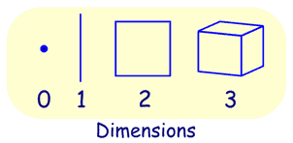
Point, Line, Plane and Solid
A Point has no dimensions, only position
A Line is one-dimensional
A Plane is two dimensional (2D)
A Solid is three-dimensional (3D)

Slide 101
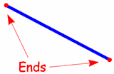
A line has no ends! Line Segment

Slide 102
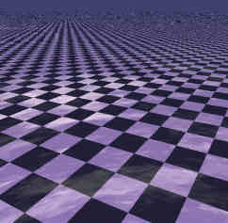
Plane
A plane is a flat surface with no thickness. Our world has three dimensions, but there are only two dimensions on a plane: length and width make a planex and y also make a plane And a plane goes on forever.

Slide 103
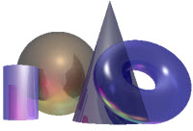
Solid Geometry is the geometry of three-dimensional space, the kind of space we live in .

Slide 104
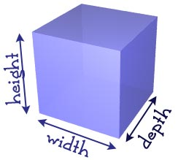
Three Dimensions
It is called three-dimensional, or 3D because there are three dimensions: width, depth and height.

Slide 105
1. Geometric shapes:
Are circles, rectangles, squares, triangles and so on - have the clear edges one achieves when using tools to create them.
Most geometric shapes are made by humans, though crystals are also considered to be geometric despite the fact that they are made in nature.

Slide 106
2. Organic shapes:
Are shapes with a natural look and a flowing and curving appearance.
Organic shapes and forms are typically irregular or asymmetrical.
Organic shapes are associated with things from the natural world, like plants and animals.

Slide 107
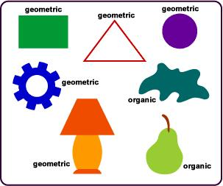

Slide 108
Texture, another element of art, is used to describe either the way a three-dimensional work actually feels when touched, or the visual "feel" of a two-dimensional work.
Take rocks, for example. A real, 3-D rock might feel rough or smooth, and definitely feels hard when touched or picked up. A painter, depicting a rock, would create the illusions of these qualities through use of color, line, shape, etc.

Slide 109
In the visual arts, texture is the perceived surface quality of a work of art. It is an element of two-dimensional and three-dimensional design and is distinguished by its perceived visual and physical properties. Use of texture, along with other elements of design, can convey a variety of messages and emotions.

Slide 110
Physical Texture
A bumpy texture of a sidewalk
Physical texture, also known as actual texture or tactile texture, are the actual variations upon a surface. This can include, but is not limited to, fur, wood grain, sand, smooth surface of canvas or metal, glass, and leather. It differentiates itself from visual texture by having a physical quality that can be felt by touch.

Slide 111
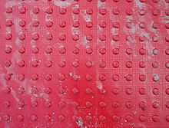

Slide 112
Visual Texture
Visual texture is the illusion of having physical texture. Every material and every support surface has its own visual texture and needs to be taken into consideration before creating a composition. As such, materials such as canvas and water colour paper are considerably rougher than, for example, photo-quality computer paper and may not be best suited to creating a flat, smooth texture. Photography, drawings and paintings use visual texture both to portray their subject matter realistically and with interpretation. Texture in these media are generally created by the repetition of shape and line.

Slide 113
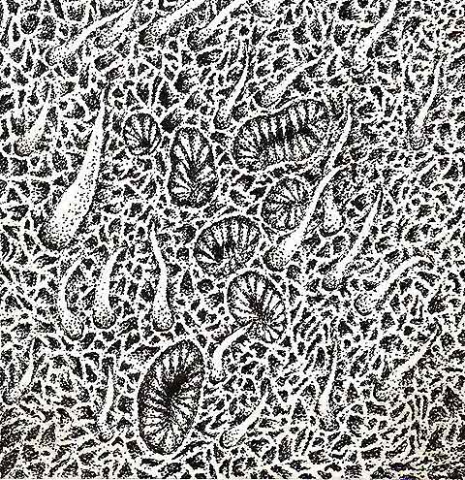

Slide 114
LECTURE. 18. UNIT. 3.
Printing and patterns.
Printing. Vegetable printing, Leaf printing and Block printing
Pattern making. Geometric and organic patterns.

Slide 115
Printing and Pattern
We have already done printing technique specially block printing technique with reference to Indus Valley Civilization.
Vegetable printing, Leaf Printing and Block Printing.

Slide 116
How to Paint With Fruit and Vegetables
Are you fed up of eating the same old vegetables and fruit? Try something new! Instead of eating your vegetables and fruit, try painting with them.
Ingredients
vegetables or fruits that have interesting shapes when cut or sliced (but are not too wet), e.g. ladyfingers/okra; French beans, apples, pears
vegetables or fruits that can easily be cut into interesting shapes, e.g. potatoes, carrots

Slide 117
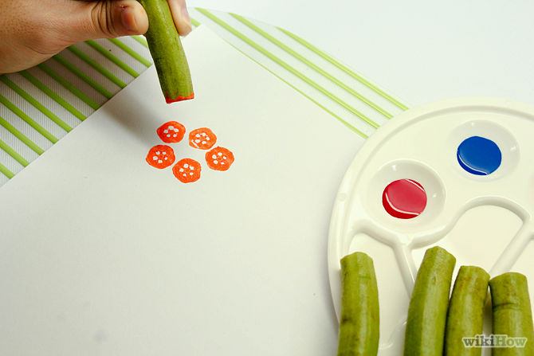
Paint the "flower" section first: Chop off a Ladyfinger's top portion, along the width. Discard the small cut-off end.
Dip the end of the long piece left into your color palette, choosing the color that you like most.

Slide 118
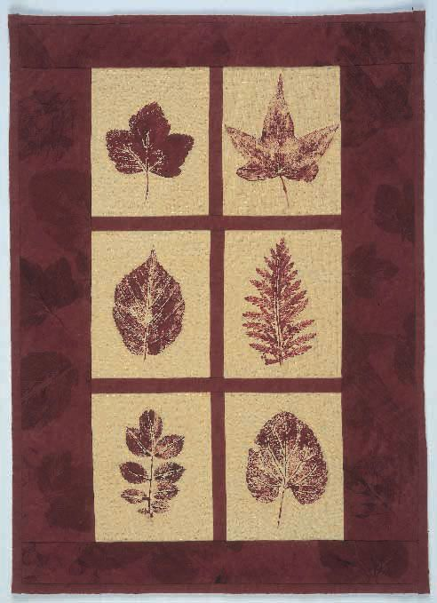
LEAF PRINTING ON FABRIC

Slide 119
What is Block Printing?
Block Printing is one of the oldest types of printmaking, and has been around for thousands of years. There is evidence that it existed as early as the fifth century BC, with actual fragments found from as early as the fifteenth century. It has been done around the world, with roots in India, China and Japan.

Slide 120
Since there is such a long history of block printing, there are many different techniques, but it is essentially using a carved material covered in ink to transfer an image on to paper or fabric. Block printing can be done with wood, linoleum, rubber, or many other materials, but I use linoleum for my work.

Slide 121
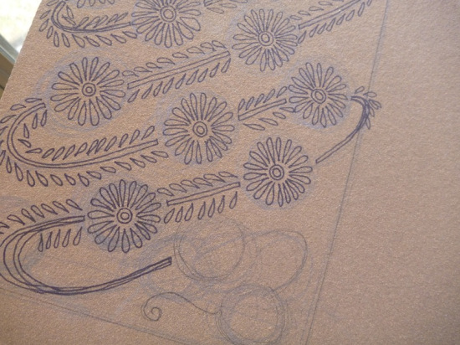

Slide 122
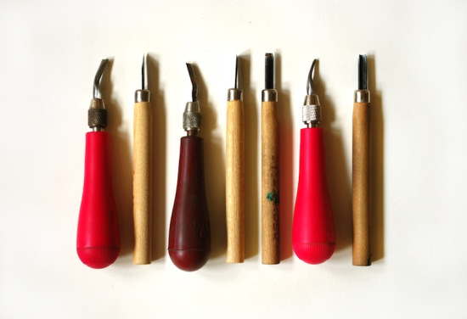

Slide 123


Slide 124
To print, we squeeze a small amount of ink onto a piece of glass or plexiglass, and roll it out with a roller (also called a brayer). we do this to get a thin, even layer, because it’s important to apply the ink evenly to the block

Slide 125


Slide 126


Slide 127


Slide 128
LECTURE.19. UNIT. 3. PRACTICAL
Printing and patterns.
Printing. Vegetable printing, Leaf printing and Block printing
Pattern making. Geometric and organic patterns.
How to draw? Drawing practical

Slide 129
IN LECTURE. 20, Unit. 3
We discussed rules of Drawing
Pencil drawing, graphite drawing, crayons, Pastels, etc.
Shading techniques.

Slide 130
Drawing is a form of visual art that makes use of any number of drawing instruments to mark a two-dimensional medium. Instruments used include graphite pencils, pen and ink, inked brushes, wax color pencils, crayons, charcoal, chalk, pastels, various kinds of erasers, markers, styluses, and various metals (such as silverpoint). An artist who practices or works in drawing may be called a draftsman or draughtsman.

Slide 131


It is one of the simplest and most efficient means of communicating visual ideas. The wide availability of drawing instruments makes drawing one of the most common artistic activities.

Slide 132
Drawing is often exploratory, with considerable emphasis on observation, problem-solving and composition. Drawing is also regularly used in preparation for a painting, further obfuscating their distinction. Drawings created for these purposes are called studies.
There are several categories of drawing, including figure drawing, cartooning, doodling and shading.

Slide 133


Slide 134
Chalk
Chalk is crushed rock mixed with gum and pressed into the form of a stick. It is most commonly seen in its familiar white form used on black boards but you can also use it on paper. If you want the technical details: in white chalk the rock is calcium carbonate; in black chalk it is carbonaceous shale: and in red chalk it is haematite.

Slide 135


Slide 136
Pen and Ink
The metal pen nib was not invented until the 18th century, and was not widely used until the second quarter of the 19th century. The earliest pens were made from reeds, cut with a sharp knife and shaped into a nib. They were effective but not very flexible and produced strong lines with distinctive patterns of broadening and narrowing.

Slide 137


Slide 138
Lead pencil
The familiar lead pencil contains no metallic lead. The writing medium is graphite, which is a form of carbon. The first writing instrument made from a stick of graphite inserted into a wooden tube was introduced in about 1560. In 1795 a French chemist, Nicholas Jacques ContC) patented a new process for making lead pencils by mixing powdered graphite and clay which he hardened in a furnace.

Slide 139


Slide 140


Slide 141
Pastel
A pastel is a stick of colour made from powdered pigment bound with resin or gum. The colours are usually pale and chalky, and the marks are soft and fragile. They can be worked or smudged with the fingers and different colours can be blended together. The softness means that outlines can be made as long flowing lines.

Slide 142


Slide 143


Slide 144
Pencil Shading Techniques: Tips to Bring Your Artwork to Life
The main reason why artists use different shading techniques is to help make their work look more realistic. Through shading techniques you can add hard and soft shadows to your work, make it look as if light is reflecting off of it, and you can even give a solid ground or surface that your work appears on to give it more depth, so it doesn’t just appear as if it’s sitting on a piece of paper.

Slide 145
Crosshatching
Crosshatching is popular amongst artists – you may have even seen it in professionally done pieces. This method requires you to draw alternating sets of lines that cross over each other in a criss-cross pattern. One important thing to remember is that the closer together the lines are, the darker the shading will look. You can create highlights with the work as well by either increasing the space between the lines or by taking out certain lines completely.

Slide 146


Slide 147
Smooth Pencil Shading
Smooth shading involves very soft strokes. It is one of the most difficult types of shading to master, but it can also be one of the most effective, and can help you create the most realistic shapes and pictures. Smooth shading is done in a similar way that you would color using a crayon. You use a consistent amount of pressure and create a single layer of graphite. You apply more pressure as you press down on the pencil, and you can lean the pencil on its side to help create a larger effect. There is a special technique you can use to help blend the graphite. Take a piece of cloth or a piece of tissue and rub it against the graphite. This way you can create a smoother transition between the light and the shadow on your work.

Slide 148


Slide 149
Stippling Pencil Shading
Stippling, which is also known as pointillism, is a very common form of shading that people commonly use with pens. Stippling bears a strong resemblance to crosshatching, but instead of making lines that criss-cross, you create spots that are closer together and further apart. As you space the dots out you can create highlights or, similar to crosshatching, you can just leave out large amounts of dots to give the illusion of highlighting as well.

Slide 150


Slide 151
Slinky Pencil Shading
The slinky form of shading is quick and easy to use, even for beginners. You do this form of shading by using very fast back and forth motions with your pencil. You eventually create a line that looks resembles a slinky. This is an excellent method for creating sketches or if you are making pieces that don’t need a lot of detail to complete.
If you want to create something that is more detailed or advanced, you may want to consider using a different technique that gives you more range.

Slide 152


Slide 153
Circulism Pencil Shading
Circulism is a form of shading where, as the name suggests, you create small circles to shade your work. Imagine creating curly hair on a character you drew; you would apply the same technique when you’re doing circulism. As you create smaller circles the shading will be darker, but as you create larger circles the shading will appear lighter.

Slide 154


Slide 155
Contour Shading
Another form of shading that resembles crosshatching, contour is a shading type that follows the contour of a line, or the lines of the shape of your particular image. This form of shading works best when you are working with various types of circular images, such as an apple or orange.

Slide 156
LECTURE. 21. Unit. 3.
PAINTING:
Painting in different mediums
Water colour painting
Oil Painting
Acrylic Painting

Slide 157
Painting Techniques: Priming and Staining
Both oils and acrylics can be applied to raw canvas, but the canvas will abs orb the first layer of paint, so it is customary to apply a coat of primer. This acts as a barrier between the paint and the canvas. Paper, which can be used for both acrylics and oils, can be primed in the same way.

Slide 158
Painting Tips: Building Up Oil and Acrylic
The process of building up an oil or acrylic painting is largely an individual matter. Some painting artists like to cover the canvas as quickly as possible, starting with an under-painting in thin, diluted paint that dries very quickly. This allows them to establish the main blocks of tone and texture. Apply the skills you can learn from this from your teacher to paint texture in your artwork.

Slide 159
Paint Techniques: Surface Mixing
Unlike paints, pastel colors cannot be mixed in a palette before being applied to paper. Instead the colors are mixed on the paper itself. Even if you have an extensive range of pastel colors, some surface mixing is almost always necessary. Learn how to build up overlays of color to set the tonal key for your next painting. Learn to paint pieces that are lively and full of dynamic color using tips.

Slide 160
Learn to Paint Texture: Brushwork
The marks of the brush have played an important part in paint techniques since first Titian, then Rembrandt, began to exploit them in contrast to the smooth surfaces and subtle blends preferred by earlier painting artists. Brushwork can be very helpful for painting texture and adding detail to objects in your painting. The extent to which brushwork is used in an acrylic painting depends on the painting artist.

Slide 161


Slide 162
Playing with water colour with different techniques.
DRY BRUSH
WET BRUSH
SALT
Different artists have explored different creative ways to bring various forms of textures to their paintings. So we will discuss few techniques of water colour, but as we all know that art is not to restrict to any traditional ways but it is to experiment with different ways and materials.

Slide 163
Dry Brush technique:
Dry brush is a versatile and creative technique that places more pigments and less water onto the surface of paper. The technique works best on water colour paper. That has a nice texture to it, as cold pressure or rough.
How to do dry Brush technique:
First load brush with colour and blot several times onto a paper towel.

Slide 164
Wet to wet Technique
Wet to wet is another versatile and popular technique where water colour, water, is dropped onto a wet surface. This is a great background in your painting.
How to do wet on wet technique:
First apply clean water to the area you will be painting. When the sheen is almost gone, begin painting in your colours. You can also water on top to create more effects.

Slide 165


Slide 166
Salt Technique
The salt technique is both a fun and creative way to add a different type of texture to your painting. You can use table salt to achieve a smaller and tighter appearance, or sea salt which will give you a larger pattern and effect

Slide 167


Slide 168
How to paint in Acrylics;
Painting is one of the most rewarding ways to artistically express yourself, and starting that odyssey by learning how to use acrylic paint is a smart decision because the medium is flexible and durable. Using acrylic paint is considerably more affordable than working with oil a significant boon for the beginning painter.

Slide 169


Slide 170
LECTURE. 24. Unit. 4 we discussed
CRAFTS
Crafts in Pakistan
crafts practiced and made in Pakistan.
Crafts and technology

Slide 171
CRAFTS AND HANDICRAFTS OF PAKISTAN: Pakistan has a rich history of handicrafts. Handicrafts reflects the culture and tradition of Pakistan. These handicrafts spread out quality of beauty and show the inherited skills of people. The actual beauty of a piece of handicrafts surely depends on the simplicity of material, the glimpses of a culture and touch of art.

Slide 172
Wood Crafts
The art of carving on Metal & Wood items are the real beauties of our hard working Craftsmen.
These items are manufactured in small villages by hard-working craftsman, and can easily be purchased in big cities. Such crafts include, mirror frames, decoration pieces etc.

Slide 173


Slide 174
Pottery
Bahawalpur, Rawalpindi, Gujrat and other places produced colorful pottery which reflect the traditional heritage. Mult an is famous for its fabulous blue pottery. Chiniot is also known for carving work on woods. Pakistani potters are responsible for making the tiles that decorate mosques and public buildings.

Slide 175
Carpets & Textile
Pakistan has tradition of carpet-making. The handmade carpets produced in Lahore. Islamic designs in woolen carpets are the cultural part of South Asia and the Middle East. In Pakistan, Karachi and Lahore are important centers for the production of fine carpets. Sindh and Baloch people are famous for their mirror embroidery, where small mirrors are stitched into the fabric to create sparkly masterpieces.

Slide 176


Slide 177
Jewelry & Leather Goods
Important crafts jewelry includes metal work on swords, boxes and dishes. And jewelry with precious stones and pearls is not limited to necklaces, bracelets, rings but also includes hair and forehead decorations and nose stuff. Leatherwork and basketry are also important crafts.

Slide 178


Slide 179


Slide 180
Brass utensils once used to be common in household uses, especially in the villages. Now these have slowly and gradually vanished due to their high cost, but brassware handicrafts can still be found displaying master craft of the artisans. They make decorative plates, vases, bowls and similar other things in exquisite designs reminiscent of the great Mughal period.

Slide 181


Slide 182
Embroidery is one of the most sought out handicrafts of Pakistan the world over. Multan, Bahawalpur and surrounding areas are full of gifted men and women who produce one of the most adorable cross stitch. "Tilla" work, Pearl work and "Salma Sitary" work of NWFP are very famous throughout the country. Swat is well-known due to thread embroidery, whereas, in D.G.Khan mirror work is done on clothes.

Slide 183



Slide 184
Truck Art: With its all colorful floral patterns, depiction of human heroes with creative aspect ratios, calligraphy of poetic verses and driver’s words of wisdom, this form of art is truly a part of Pakistani transport tradition.
These truck bodies are immaculately painted by the street artists who can be found at Truck stands all across the country. e.g. Hawkes Bay/Mauripur Road Road Karachi, Pir Wadhai Rawalpindi, Badami Bagh Lahore, Sariab Road Quetta etc.

Slide 185


Slide 186

Colorful Threads Used in Sindhi Hand Embroidery

Slide 187

Baloch Culture
The people of Balochistan are very loving and leading a very simple life. The formation of villages with having houses made of mud, are a big attraction for the guests and tourists.

Slide 188


Slide 189


Slide 190
IN LECTURE. 25. UNIT. 4we did detailed study of
Doing craftwork and making handicrafts,
(puppets and puppetry, textiles, making beads).

Slide 191
Puppet Crafts for Kids
Puppets are a great tool everyone can use to stretch their imagination. Puppets can be made using any supplies you like. You can experiment with socks, gloves, household packages, and just about anything else. Design your own puppet crafts and then submit it to be included here!

Slide 192
Instructions
  1 Insert your hand into the sock. Make sure your fingers are located in the toe and that the back of your wrist rests at the heel area. Manipulate your hand in the sock like it is a mouth talking. This area is where you will create a mouth with your craft supplies.

Slide 193



Slide 194

How to Make Paper Beads

Slide 195

Step 1: Selecting your paper and materials to make the bead.
Step 2: Measuring and cutting the paper for the bead
Step 3: Rolling the Paper Bead
Step 4: Varnish, leave to dry and finish

Slide 196


Slide 197

How to Make a Paper Mosaic

Slide 198
Lecture. 26. Unit. 4. practical all related to crafts
Doing Art and Crafts with children in the elementary grades
Paper Mosaic
Clay Beads
Picture Frame
Making candle stand with mirror
Making door bell

Slide 199
LECTURE. 27. Unit. 4
Doing Art and Crafts with children in the elementary grades
Doing Art and craftworks and handicrafts
Art and Crafts across the curriculum
Doing art and crafts with children in the elementary grade

Slide 200
The subject arts and crafts has an important position in developing general cultural education. It also prepares pupils for a number of further education, trades and occupations. Aesthetic competence is a source of development on several levels, from personal growth, via influence on one's personal surroundings, to creative innovation in a larger social perspective.

Slide 201
At the end of the Unit students teachers were able to know about crafts of Pakistan and their location, and how these crafts have been manufactured by the skills of Craftsmen, learnt from father to son. How technology has brought a change in producing the crafts.

Slide 202
LECTURE. 28. UNIT. 5
Preparing to teach art, craft and calligraphy
Connecting art craft and calligraphy across the curriculum
Managing art, craft and calligraphy in the classroom.

Slide 203
How to Incorporate the Arts in All Subjects
Art is a valuable tool for students to learn how to express themselves, work through a process, work cooperatively, and gain respect and understanding for others. How can we teach the arts in all subject areas so that students benefit from the learning opportunities that art affords them? For more ways art instruction benefits students, read “Ten reasons why teaching the arts is critical in a 21st century world” by Elliott Seif.

Slide 204
Below are examples of the arts blended with other curriculum areas, helping students to draw out a deeper understanding and appreciation for both familiar and unfamiliar concepts.
Science
See art as a tool to make meaning of our relationship with the natural world in Art Through “The Natural World.”

Slide 205
Mathematics
Mathematicians understand symmetry differently than the rest of us, as a fundamental aspect of group theory. Learn more in Mathematics Illuminated, which includes a symmetry interactive. Students can manipulate a wallpaper design to practice common geometric motions such as rotation and reflection.

Slide 206
Language Arts
Students explore Greek myths using puppets in Connecting With the Arts Library, “Breathing Life into Myths.”
Artifacts & Fiction, how visual art, paired with literature, can be used to enhance students’ understanding of the predominant culture and historical setting of a work of literature.

Slide 207
Foreign Languages
Latin students learn the difference between translating and interpreting the language using music and literary works of Mozart, Vergil, and Cicero.
In Teaching Foreign Languages, some times students discuss “Dos caras” (Two faces) by New Mexico author Sabine Ulibarri. They act out scenes and make comparisons to a painting by a local artist, some times “Interpreting Picasso’s Guernica,” students write and deliver radio newscasts interpreting the scene in the famous painting. -

Slide 208
Social Studies
Fifth graders in The Arts in Every Classroom some times do “Teaching Visual Art,” view portraits, looking beyond the face for historical cues. They continue the lesson by creating new portraits that reveal clues to the lives of their subjects through clothing, expressions, and background.

Slide 209
Art and Socio-Emotional Development
Young children feel a sense of emotional satisfaction when they are involved in making art, whether they are modeling with clay, drawing with crayons, or making a collage from recycled scraps.

Slide 210
Conclusion
Through the art activities described in this lecture, young children will develop abilities and skills that have application in many other areas of the curriculum. Most importantly, however, children will also develop an appreciation for the art of other people and cultures, and the confidence to express their own thoughts and feelings through art. Far from creating individual prodigies, this integration of making and enjoying art in the early childhood classroom will result in the "all-sided development" of the children participating.

Slide 211
LECTURE. 29. UNIT. 5
What is assessment
in art, craft and calligraphy?

Slide 212
What is Art and craft Evaluation?
The task of evaluating a work of art, such as a painting, craft or a sculpture, requires a combination of objective information and subjective opinion. Yes, it's true that art appreciation is highly subjective, but the aim of evaluating a picture is not simply to ascertain whether you like/dislike a picture, but WHY you like/dislike it. And this requires a certain amount of knowledge. After all, your assessment of a drawing produced by a 14-year old child in a school playground, is likely to be quite different from a similar drawing by a 40-year old Michelangelo.

Slide 213
Art Evaluation is Not Simply Liking or Disliking
Before going into detail about how to evaluate art, let us again re-emphasize that the whole point of art appreciation is to explain WHY we like or dislike something, not simply WHETHER we like it or not. For example, you may end up disliking a picture because it is too dark, but you may still like its subject matter, or appreciate its overall message.

Slide 214
How to Evaluate the Context/Background of the Work?
When was the Painting Created?
Is the Painting Abstract or Representational?
What Type of Painting is It?
What Materials were Used in the Creation of the Painting?
How to Appreciate Composition in a Painting?
How to Appreciate Line and Shape in a Painting?
How to Appreciate Colour in a Painting?
How to Appreciate Texture and Brushwork in a Painting?

Slide 215
LESSON. 30. UNIT. 5
Preparing to teach art, craft and calligraphy continued.
Assessing children’s learning during an art activity.
Assessment rubrics
PLANNING FOR ART, CRAFT AND CALLIGRAPHY.
Art and crafts exhibition
Display and assessment of student teacher projects and portfolios.

Slide 216
How to Evaluate the Work of Art Itself
How to Appreciate Paintings.
Famous Paintings Analyzed.
Once we have investigated or researched the context of the painting, we can begin to appreciate the work itself. Knowing how to appreciate a painting is itself an art rather than a science.
The perimeters that we are supposed to have in mind are the following:

Slide 217
painting technique
Material used in the work
Composition
Line and shape
Colour
Form
Texture and brush work
Over all aesthetic quality of the work

Slide 218
Rubrics (set of Instructions) for the Art Teacher
Because art teachers measure student skills using independent judgment, they need another method to grade student work. Performance-based assessment has been shown to be much more effective in evaluating student performance. Art teachers have always been ahead of the game with performance-based assessments by using portfolios.

Slide 219
STUDENT ASSESSMENT
Evaluation of a student is done through a portfolio assessment. They provide insight into how a student has grown creatively and which media and techniques have been explored in school.

Slide 220
Portfolios will also include many other items that yield pieces of information concerning student development and learning. In addition to finished works of art, students' portfolios may include:
1. Sketches, studies, and preliminary works.
2. Samples (a collection of images that have influenced the student artist).
3. Reproductions of works by the student's favorite artists.

Slide 221
4. Written notes and thoughts concerning the creative process.
5. Comments about the problem solving that accompanies going from preliminary ideas to the finished product.

Slide 222
Lecture. 31.
We did a Summery of Lecture 1 to Lecture 10.
Lecture. 32.
We did a summery of Lecture 11 to Lecture 30.

