Slide 1
LECTURE. 31.
SUMMERY OF FIRST TEN LECTURES

Slide 2
SUMMERY OF LECTURE 1. Unit 1.
Introduction to the Art, Craft and Calligraphy
Introduction to art education
Overview of the course.

Slide 3
COURSE DESCRIPTION
Teachers Education course
Knowledge on Art, Craft and Calligraphy with relation to Pakistani artist and Craftsman
Practice of making their own Art works
Roll of Art in child development
Importance of Art and craft in Curriculum and relationship with other subjects
Class room planning and Evaluation of Art works

Slide 4
COURSE GOALS
Student teacher learnt to enhance the importance of art education in child development.
They also recognize and make their students recognize and appreciate the artists, art styles and work.
Origin and development of art and crafts in Pakistan.

Slide 5
Student teacher learnt a variety of making art.
Principles and elements of design and its application.
Discussed links between art, craft and calligraphy and other subjects.
Evaluation and appreciation of art works by students.
presentation of portfolio related to their knowledge gathered after this course.

Slide 6
LEARNING AND TEACHING APPROACH
Student teacher in this practical oriented course will communicate the knowledge in an interactive way according to their learning abilities.
Personal interest will be inculcated in Art, Craft and Calligraphy, so that they could communicate with elementary class room.
Elementary students visits to the Museums art galleries and crafts man will be planed irrespective of place.
Portfolio making and portfolio assessment at the end of the course.

Slide 7
LECTURE 2. Unit 1.
Introduction to the Art, Craft and Calligraphy
Introduction to art education
Overview of the course.

Slide 8
Definition of art Education.
What is Art?
What is Craft?
What is Calligraphy?
Art and craft are related to each other like glass and jug or cup and saucer.
Creativity is essential for both.

Slide 9
Different definitions of art.
Art education is the area of learning that is based upon the visual, tangible arts—drawing, painting, sculpture, and design in jewelry, pottery, weaving, fabrics, etc. and design applied to more practical fields such as commercial graphics and home furnishings.

Slide 10
Meaning of art is debatable, and somewhat ambiguous.
Art is not a thing it’s a way.
Art is something less directed it is more creative.
Art has less defined goals.
Art enables us to find ourselves and as well as to loose ourselves.

Slide 11
There is actually no such definition that is convincing enough for all.
The expression or application of human creative skill and imagination, typically in a visual form such as painting, or sculpture, producing works to be appreciated primarily for their beauty or emotional power.

Slide 12
An other definition of art is
the various branches of creative activity, such as painting, music, literature, and dance.
Human effort to imitate, supplement, alter, or counteract the work of nature.

Slide 13
a. The conscious production or arrangement of sounds, colors, forms, movements, or other elements in a manner that affects the sense of beauty, specifically the production of the beautiful in a graphic or plastic medium.
b. The study of these activities.
c. The product of these activities; human works of beauty considered as a group.

Slide 14
Definition and conclusion of art is equally difficult, but can be concluded that art is some thing that is creative, related to beauty or sometimes not related to beauty, but deals with the inner feeling as well as knowledge and concepts of art. Art also deals with skills and learning of the tools of art. The broader spectrum of art deals with the branches of art. Art is produced with lesser defined goals in the mind of the artist.

Slide 15
Now the second question related to this course is, What is craft?
Craft is an activity that uses specific materials with a certain goal in mind. Usually a craft has a set of directions and skills to make to a finished product. The creator of craft learns to follow directions and solve problems while working towards a goal.

Slide 16
To have a convincing answer to what is craft? Lets discuss some more definitions of Craft.
Craft as a verb means, exercise skill in making (an object), typically by hand.
an activity that involves making something in a skillful way by using your hands

Slide 17
CONCLUSION OF DIFFERENT DEFINITIONS OF CRAFT.
Craft is a tangible object produced by the craftsman manually with a well defined goal using his creative abilities.
an art, trade, or occupation requiring special skill, especially manual skill, that can be reproduced, in a skillful way at a mass scale.

Slide 18
DIFFERENCES AND SIMILARITIES IN ART AND CRAFT
The difference between art and craft is that in art, object made are for beauty and decorative purposes while objects produced in crafts are mostly functional though also decorative. Crafts include ceramic pottery, glass and basketry while art includes painted portraits and sculptures. The distinction between the two terms increasingly becomes unclear as others consider them one and the same thing.

Slide 19
What is Calligraphy:
decorative handwriting or handwritten lettering.
the art of producing decorative handwriting or lettering with a pen or brush.
fancy penmanship, especially highly decorative handwriting, as with a great many flourishes.

Slide 20
Few definitions of Calligraphy:
A script, usually cursive, although sometimes angular, produced chiefly by brush, especially Chinese, Japanese, or Arabic writing of high aesthetic value.
Fine Arts. line or a group of lines either derived from or resembling letter forms and characterized by qualities usually associated with cursive writing, especially that produced with a brush or pen.

Slide 21
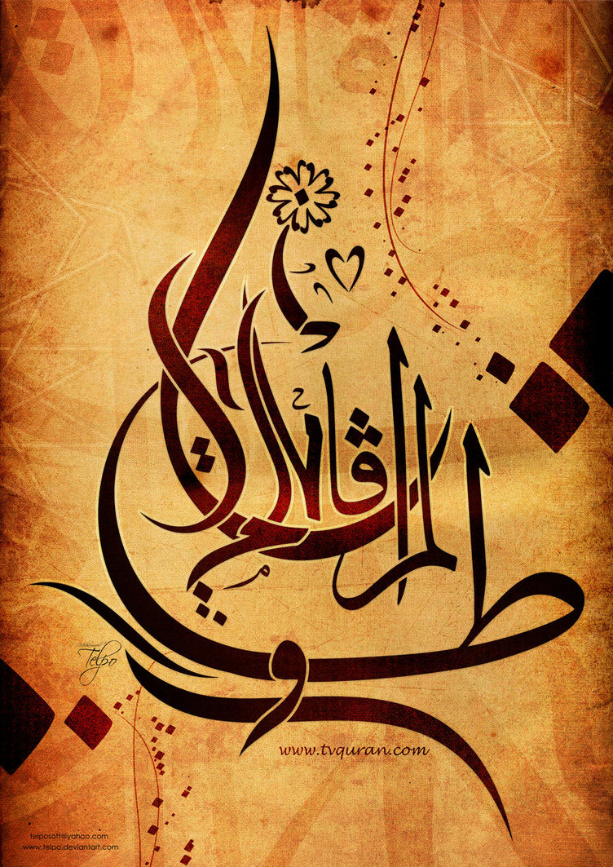
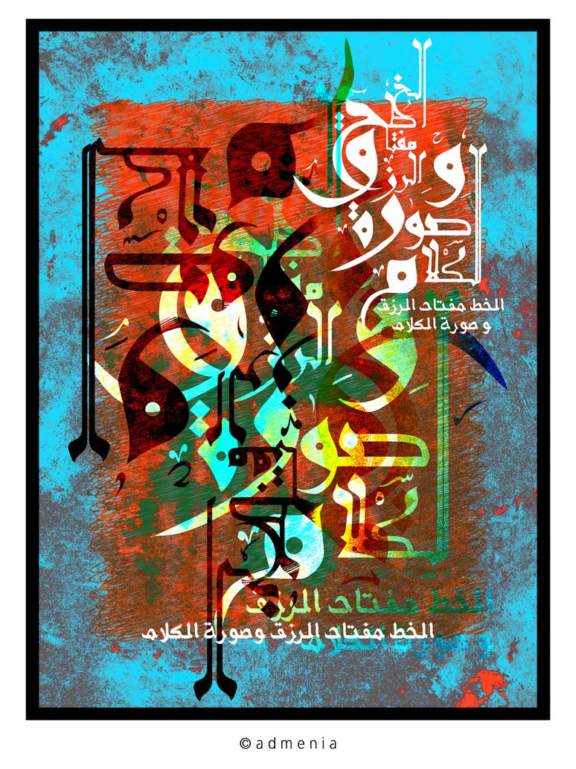
Arabic Calligraphy

Slide 22
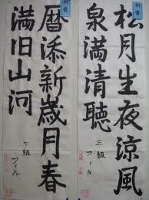
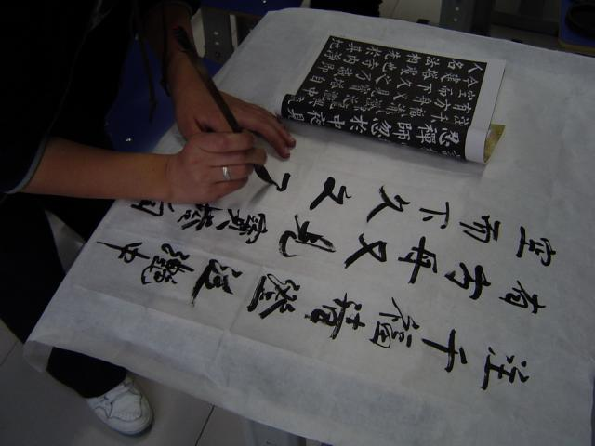
Japanese and Chinese calligraphy

Slide 23
THE COURSE PORTFOLIO
Since this course is basically divided in two areas. One area deals with theory and the other deals with practical.
Portfolio deals with the practical area. Portfolio will comprise of the end products practically produced by the student.

Slide 24
LECTURE 3. UNIT. 1 (CONTINUATION)
APPROACHES TO ART TEACHINGS
Approaches to art teaching
Art and child development.
Why teach art and crafts in elementary grades?
The role of teacher in teaching art, craft and calligraphy.

Slide 25
ART AND CHILD DEVELOPMENT
Five Stages of development in children’s art.
Each of these stages refers to a combination of visual characteristics found in the art work of children. “Developmental-Stage” theory assumes that the stages occur in a sequential order.

Slide 26
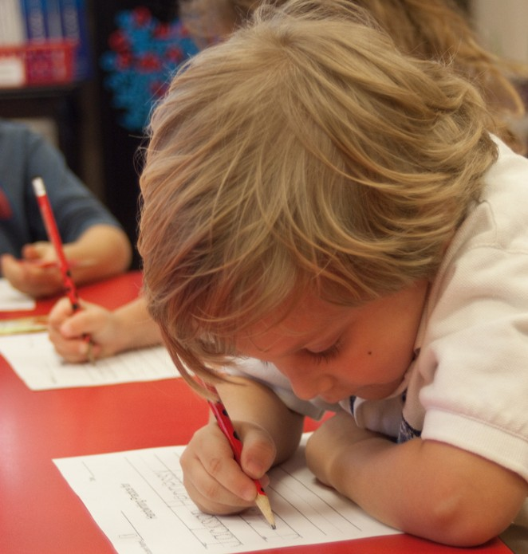
Little attempt has been made to relate these stages of growth in art directly to chronological age because so many factors contribute to the child’s development in art.

Slide 27
FIVE STAGES OF DEVELOPMENT OF Children art
1. The Scribble Stage
There are three discernible stages during this stage:
random scribbling
controlled scribbling
naming of scribbling
By definition, a child in the scribbling stage, usually 2 - 4 years of age, is not drawing symbols for objects.

Slide 28
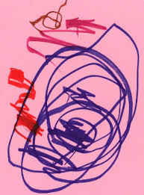
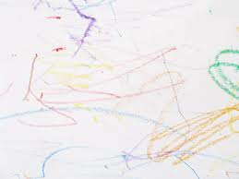

Slide 29
2. The Pre-Schematic Stage
The second, or pre-schematic stage, is entered when the child produces his first representative symbols for objects in his environment. These symbols are formed with circles, squares, and lines. The symbols change frequently. The pictures have a “floating organization and the paper may be turned many times while drawing.

Slide 30
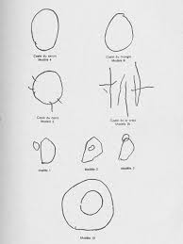

Slide 31
3. The Schematic Stage
The main characteristics of this stage are the repetition of symbols for familiar objects, and the use of the base-line. The term “schema” refers to the habitually repeated symbol for an object. Examples of such schema are the lollipop tree, the stiff scarecrow-type drawings of people, or a series of houses which are all drawn the same.

Slide 32
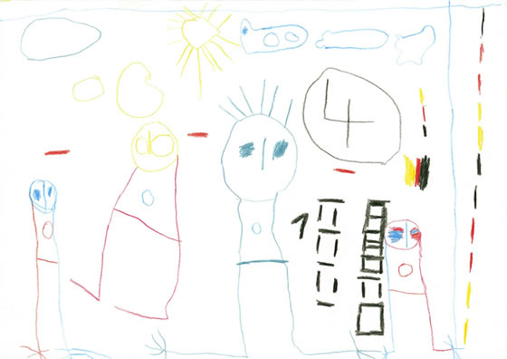
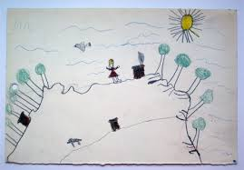

Slide 33
4. The Transitional Stage
This is the stage in which the maturing child, usually 9 years or older, attempts to produce art work that meets adult standards; yet he still produces works which unintentionally contain many characteristics of the schematic stage. For instance, a picture may include a natural looking ground plane with trees of diminishing size going off into the distance.

Slide 34
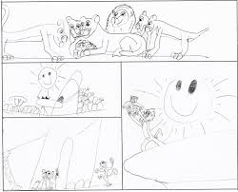
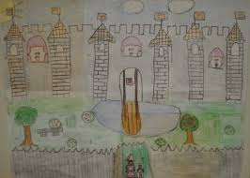

Slide 35
5. The Realism Stage
The stage of realism is entered when the child is producing art work in the manner of adult artists. In general, the child is 12 or older. Considerable control over the medium, content, and organization is evident. The figures become natural in appearance, or are intentionally stylized.

Slide 36
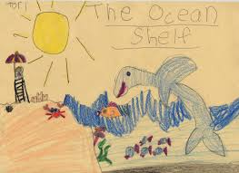

Slide 37
Why teach Art and Craft in elementary grade?
Art and craft teaching is required at elementary grades to boost the creative ability of the students and to make them familiar with the art materials and the prevailing art, Craft and calligraphy styles in the country.

Slide 38
Developmental Benefits of Art
Motor Skills: Many of the motions involved in making art, such as holding a paintbrush or scribbling with a crayon, are essential to the growth of fine motor skills in young children.
Language Development: For very young children, making art—or just talking about it—provides opportunities to learn words for colors, shapes and actions.

Slide 39
Decision Making: According to a report by Americans for the Arts, art education strengthens problem-solving and critical-thinking skills. The experience of making decisions and choices in the course of creating art carries over into other parts of life.
Visual Learning: Drawing, sculpting with clay and threading beads on a string all develop visual-spatial skills, which are more important than ever

Slide 40
Inventiveness: When kids are encouraged to express themselves and take risks in creating art, they develop a sense of innovation that will be important in their adult lives.
Cultural Awareness: As we live in an increasingly diverse society, the images of different groups in the media may also present mixed messages. “If a child is playing with a toy that suggests a risk of child distraction towards unwanted paths,

Slide 41
Improved Academic Performance: Studies show that there is a correlation between art and other achievement.
How important is the study of Art and craft in enhancing the teaching skills:
It is highly important to study arts and crafts to enhance teaching skills and abilities because smaller children learn through visualization. If a child is put to recreate the different types of forest and other environments they will clearly be able to keep this in their minds. Imagine I still remember different forest! So it's strongly advised to really have students be able to express themselves, especially when some students enjoy arts and crafts and will encourage them for their future.

Slide 42
THE ROLE OF TEACHER IN TEACHING ART, CRAFT AND CALLIGRAPHY
Art teacher is the best tool for enhancing creative abilities of the child.
Art teacher can help the child to create hand and brain coordination.
At early stage child can recognize basic shapes in nature.
A teacher can produce dexterity in child for using his hand for cutting and pasting.

Slide 43
LESSON.4.UNIT.2
HISTORY AND CULTURE
INDUS VALLEY ART AND CULTURE
Indus valley civilization is one of the oldest civilization of the world like Mesopotamian civilization. That is bronze age is 3300 to 1300 BCE. It flourished in the basins of Indus. This civilization is really rich in art and culture.

Slide 44
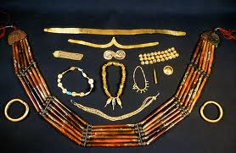

Slide 45
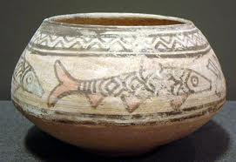

Slide 46
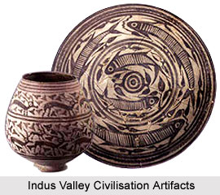
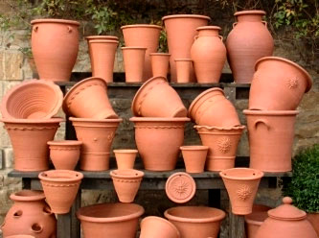

Slide 47
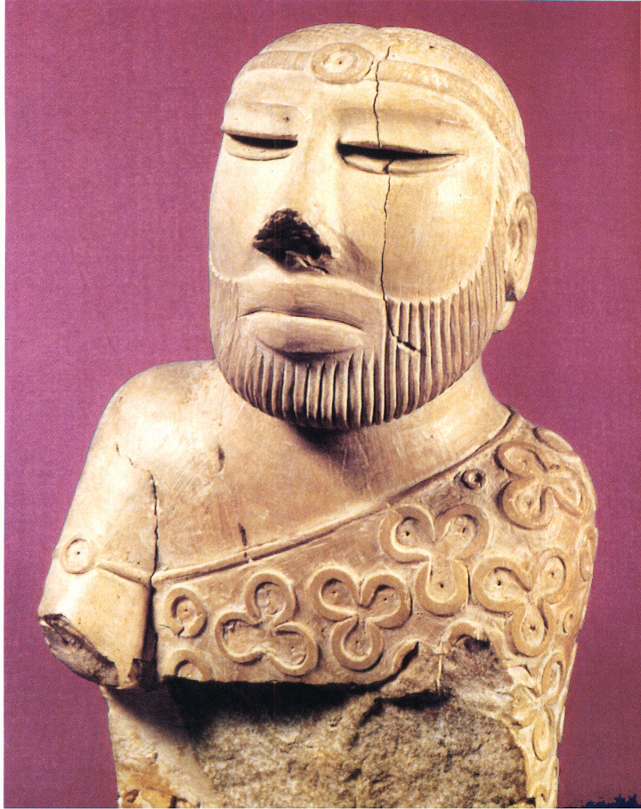
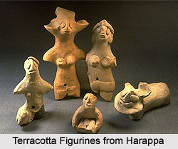

Slide 48
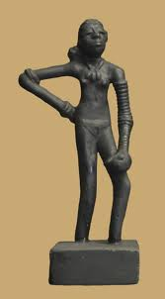
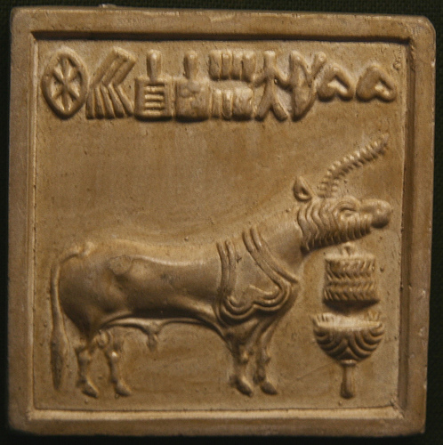

Slide 49
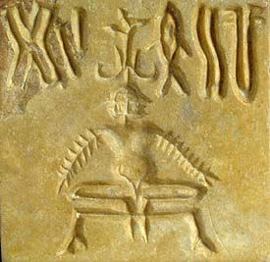
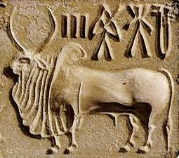

Slide 50
LECTURE. 5. UNIT. 2.
Art and craft (the development of pottery, metal work, printing on cloth and bead making).
Teaching and learning will be planed on Indus valley civilization.

Slide 51
Development of Pottery in the Indian subcontinent has an ancient history and is one of the most tangible and iconic elements of regional art. Evidence of pottery has been found in the early settlements of Mehrgargh from the Indus Valley Civilization. Today, it is a cultural art that is still practiced extensively in India and Pakistan.

Slide 52
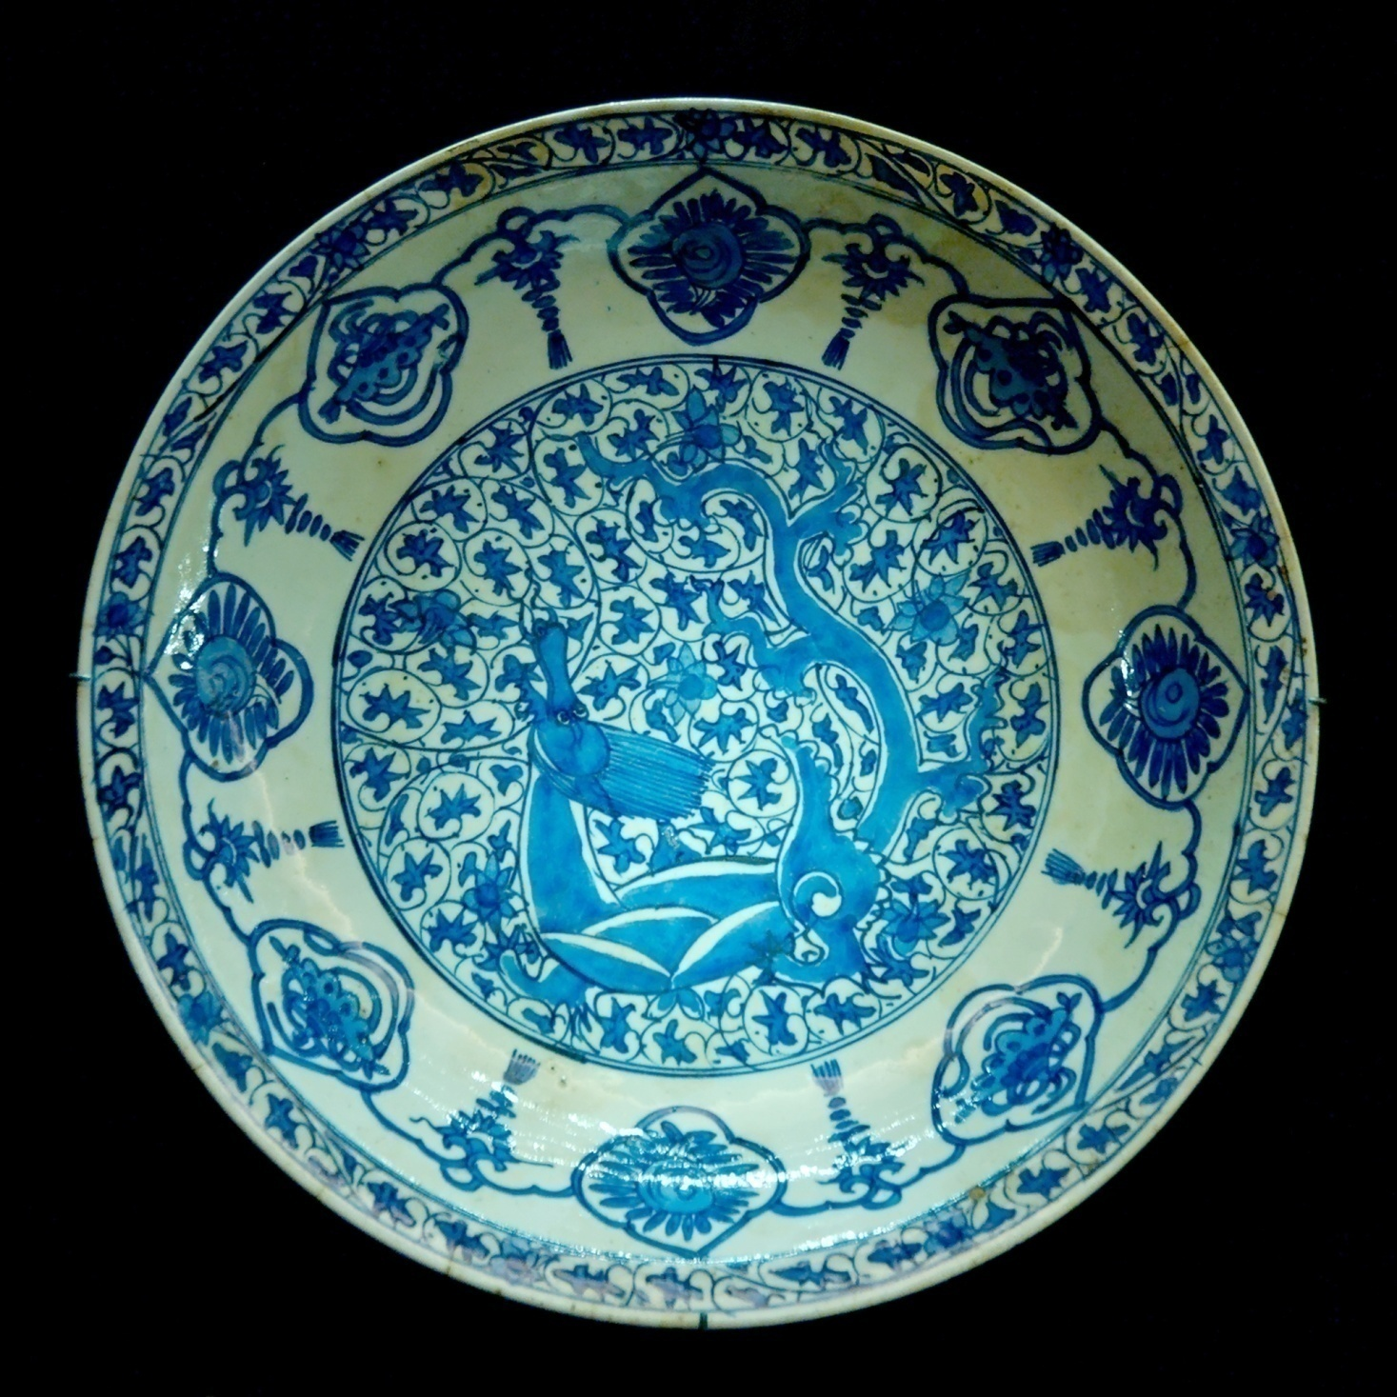

Slide 53
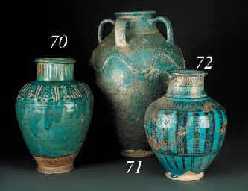

Slide 54
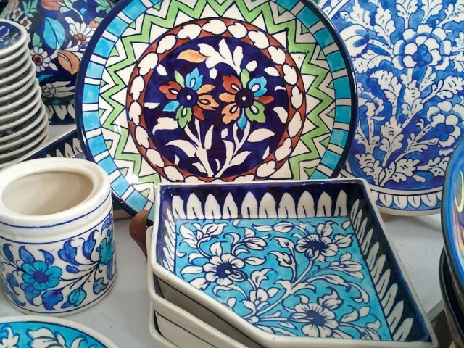

Slide 55
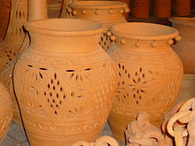

Slide 56
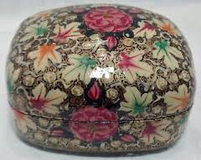
Papier-mache
This type of pottery is made from paper pulp, which is coarsely mashed and mixed with copper sulphate and rice-flour paste. It is then shaped by covering the mould with a thin paper and then applying layers of the mixture.

Slide 57
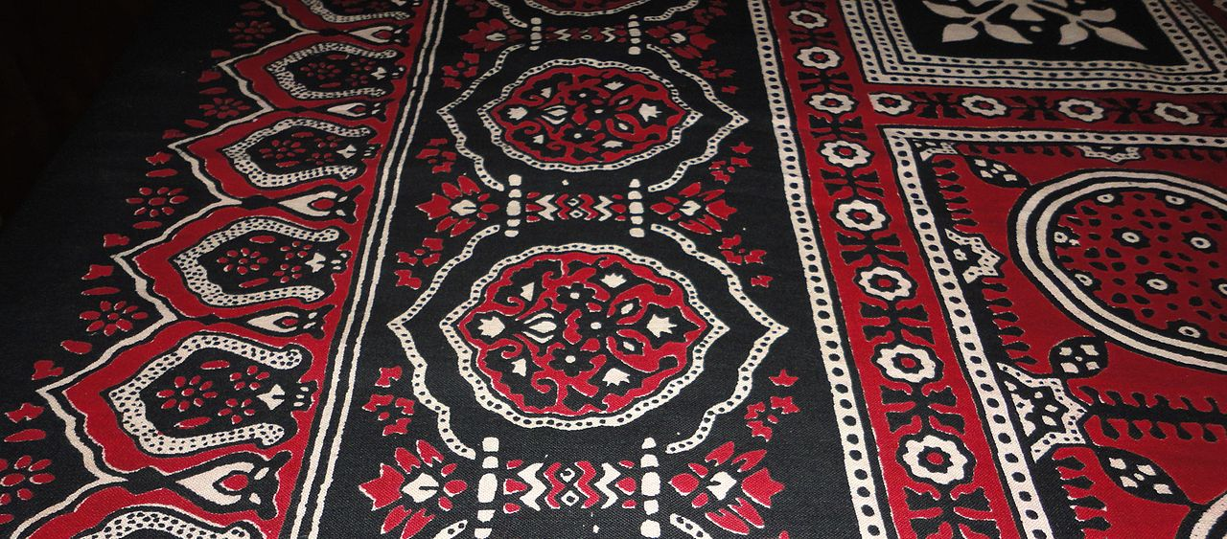
Ajrak, Sindhi: A name given to a unique form of block printed shawls and tiles found in Sindh, Pakistan; Kutch, Gujarat; and Barmer, Rajasthan in India. These shawls display special designs and patterns made using block printing by stamps.

Slide 58
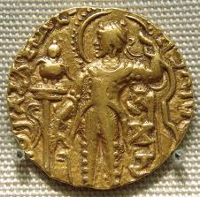
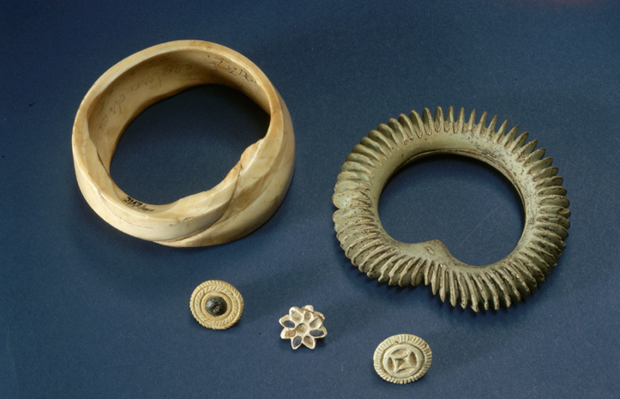
Bronze Age and Indus valley Civilization (3300-1200 B.C) The beginning of Indus valley Civilization (3300-1700 B.C) or Harappan Culture coincided with the Bronze Age around 3300 B.C.

Slide 59
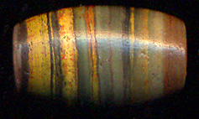
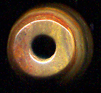
Ancient Bead making
Bead with six different colours, The old craftsman used copper drill to make this fine hole. The stone was carefully selected and bronze tools were used for carving.

Slide 60
Lecture. 6. practical
In this lecture we did practical work with taking influences from Indus Valley Civilization.
We did some pottery painting with Indus valley Motives.
We also made some Indus Valley Seals with modeling clay with the same designs. We also tried to copy some Sculptures from Indus Valley.

Slide 61
LECTURE. 7. Unit. 2
Islamic Art
Introduction to Islamic Art
History and development of Islamic Art
Islamic art and links across the curriculum

Slide 62
Definition of Islamic art:
It comprises the visual arts produced from the 7th century onwards by people who lived within the territory that was inhabited by or ruled by culturally Islamic populations. It is thus a very difficult art to define because it covers many lands and various peoples over some 1400 years.

Slide 63
It is not art specifically of a religion, or of a time, or of a place, or of a single medium like painting. The huge field of Islamic architecture is another subject, leaving fields as varied as calligraphy, painting, glass, ceramics, and textiles, among others. Islamic art is not at all restricted to religious art, but includes all the art of the rich and varied cultures of Islamic societies as well.

Slide 64
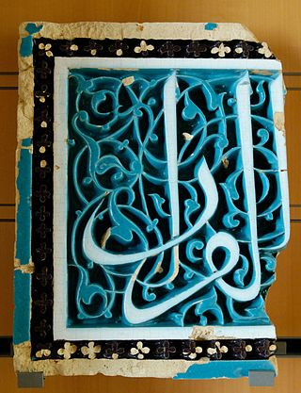

Slide 65
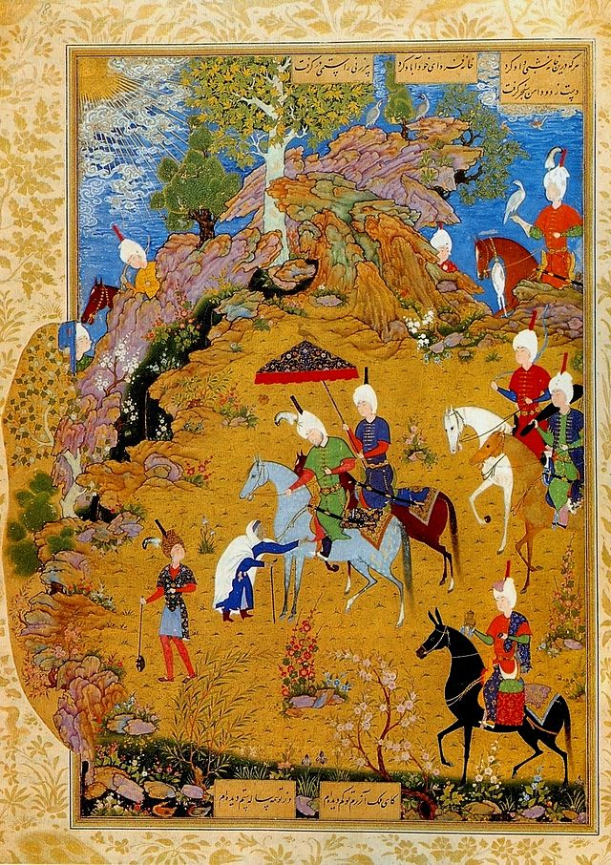

Slide 66
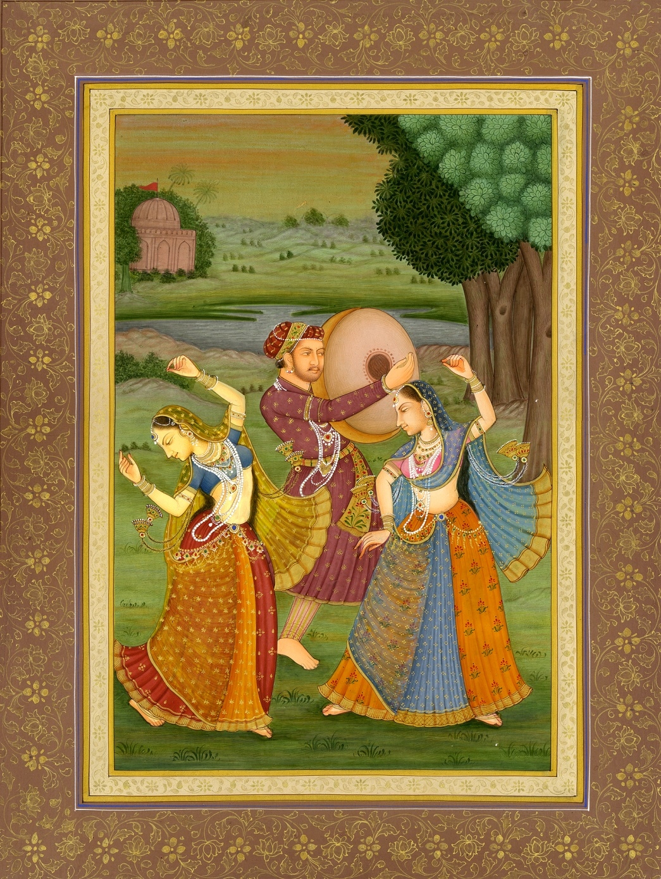

Slide 67
Rugs and Carpets: No Islamic artistic product has become better known outside the Islamic world than the pile carpet, more commonly referred to as the Oriental carpet (oriental rug). Their versatility is utilized in everyday Islamic and Muslim life, from floor coverings to architectural enrichment, from cushions to bolsters to bags and sacks of all shapes and sizes,

Slide 68
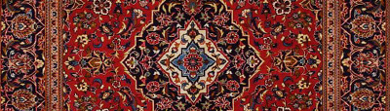

Slide 69
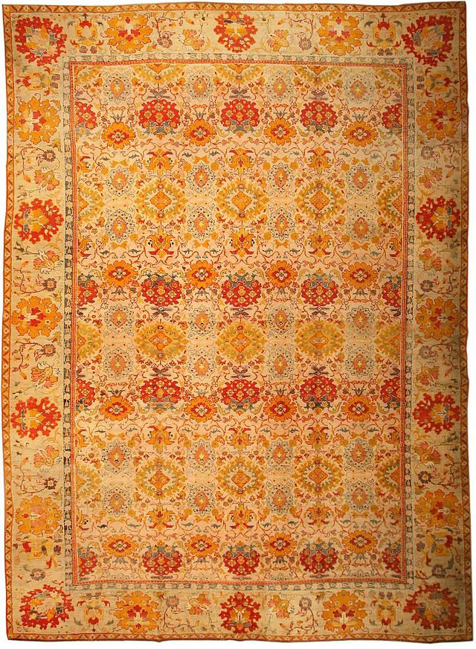

Slide 70
Islamic Ceramics:
Islamic art has very notable achievements in ceramics, both in pottery and tiles for walls, which in the absence of wall-paintings were taken to heights unmatched by other cultures. Early pottery is often unglazed, but tin-opacified glazing was one of the earliest new technologies developed by the Islamic potters

Slide 71
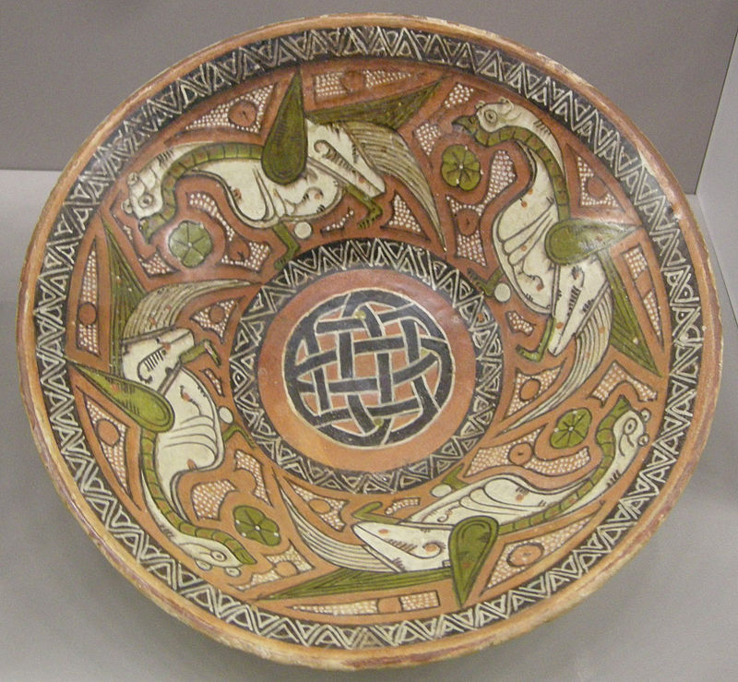
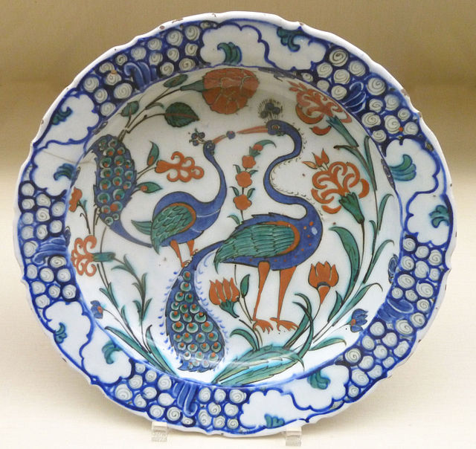

Slide 72
ISLAMIC TILES:
The earliest grand Islamic buildings, like the Dome of the Rock, in Jerusalem had interior walls decorated with mosaics in the Byzantine style, but without human figures. From the 9th century onwards the distinctive Islamic tradition of glazed and brightly coloured tiling for interior and exterior walls and domes developed.

Slide 73
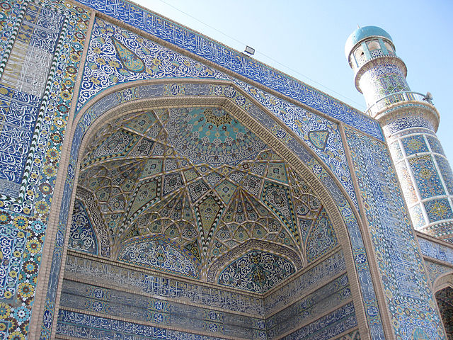

Slide 74
LECTURE. 8. Unit. 2
Islamic Glass work
Medieval Islamic metalwork
Calligraphy
Calligraphy in different Cultures and traditions of the world
Calligraphy in Japan
Calligraphy in China
Calligraphy in Persia
Arabic calligraphy

Slide 75
ISLAMIC GLASS WORK: For most of the Middle Ages Islamic glass was the most sophisticated in Eurasia, exported to both Europe and China. Islam took over much of the traditional glass-producing territory of Sasanians and Ancient Roman glass, and since figurative decoration played a small part in pre-Islamic glass, the change in style is not abrupt,

Slide 76
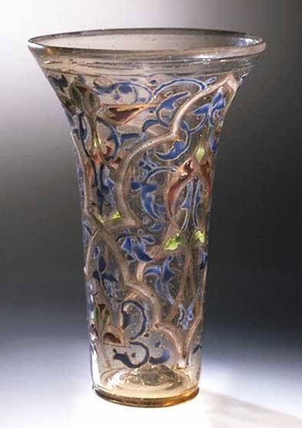

Slide 77
Medieval Islamic metalwork: offers a complete contrast to its European equivalent, which is dominated by modeled figures and brightly coloured decoration in enamel, some pieces entirely in precious metals. In contrast surviving Islamic metalwork consists of practical objects mostly in brass, bronze, and steel,

Slide 78
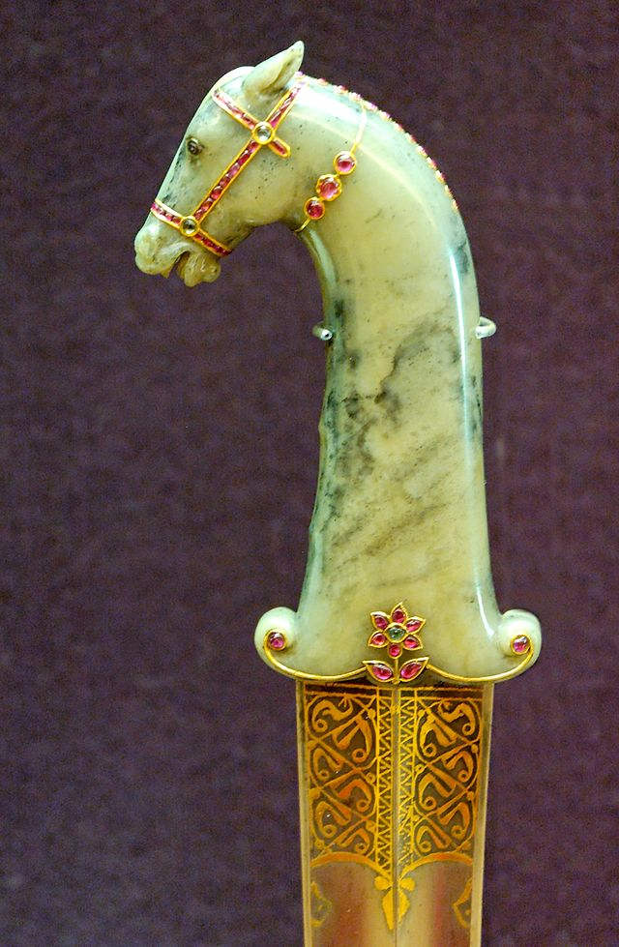

Slide 79
Calligraphy is a type of visual art. It is often called the art of fancy lettering. A contemporary definition of calligraphic practice is "the art of giving form to signs in an expressive, harmonious and skillful manner". Modern calligraphy ranges from functional hand-lettered inscriptions and designs to fine-art pieces where the abstract expression of the handwritten mark may or may not compromise the legibility of the letters.

Slide 80
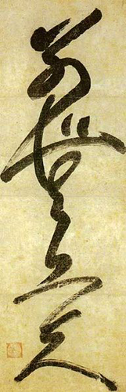
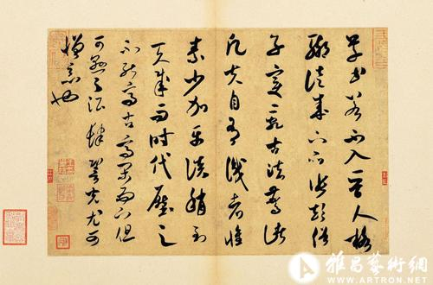

Slide 81
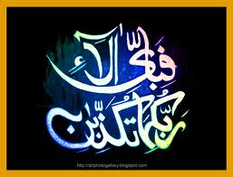
Islamic calligraphy is associated with geometric Islamic art (arabesque) on the walls and ceilings of mosques as well as on the page. Contemporary artists in the Islamic world draw on the heritage of calligraphy to use calligraphic inscriptions or abstractions.

Slide 82
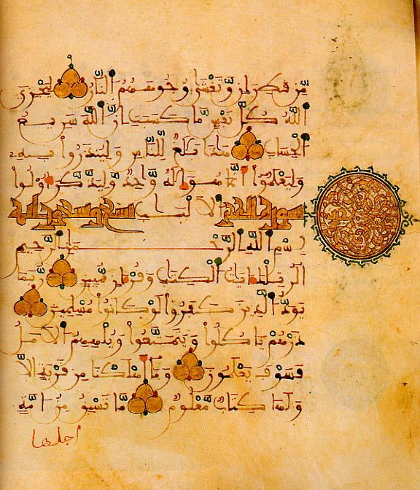

Slide 83
Persian calligraphy
Example showing Nastaliq's proportional rules
The history of calligraphy in Persia dates back to the pre-Islam era. In Zoroastrianism beautiful and clear writings were always praised.
It is believed that ancient Persian script was invented by about 600–500 BC to provide monument inscriptions for the Achaemenid kings.

Slide 84
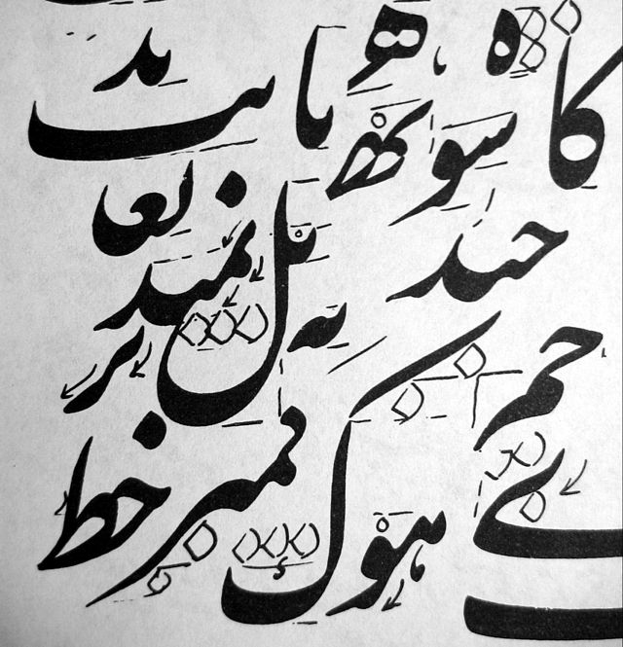

Slide 85
LECTURE. 9. UNIT. 2
Persian Artists and their Calligraphy
Persian calligraphy : is the calligraphy of the Persian writing system. It is one of the most revered arts throughout Persian history.

Slide 86
HISTORY OF NASTALIQ: After initiation of Islam in the 7th century, Persians adapted the Arabic alphabet to Persian and developed the contemporary Persian alphabet. Arabic alphabet has 28 characters. An additional 4 letters were added by Iranians , which resulted in the 32 letters currently present in the Persian alphabet.

Slide 87
Around one thousand years ago, Ibn Muqlah (Persian: and his brother created six genres of Iranian calligraphy, namely "Tahqiq", "Reyhan", "Sols", "Naskh", "Toqi" and "Reqa". These genres were common for four centuries in Persia. In the 7th century (Hijri calendar), Hassan Farsi Kateb combined "Naskh" and "Reqah" styles and invented a new genre of Persian calligraphy, named "Ta'liq".

Slide 88
In the 14th century, Mir Ali Tabrizi combined two major scripts of his time i.e. Naskh and Taliq and created the most attractive Persian Calligraphy style, "Nas’taliq". In past 500 years Iranian calligraphy called Nastaʿlīq (also anglicized as Nastaleeq; Persian: (nastaʿlīq) is one of the main script styles used in writing the Perso-Arabic script, and traditionally the predominant style in Persian calligraphy

Slide 89
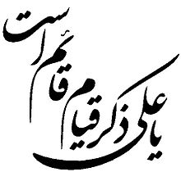

Slide 90
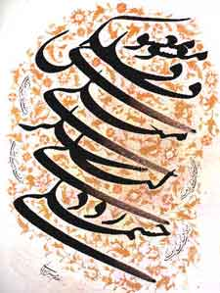

Slide 91
Important Iranian Calligraphers and their work:
Abbas Akhwain, 1936, Place of Birth: Meshed, Iran.
Ghulam Husain Amirkhani, 1939
Place of Birth: Taleqan, Iran
Teachers: Husain Mirkhani, Hasan Mirkhani
HISTORIC PERSIAN CALLIGRAPHY ARTISTS:
Among all those great names in the history of Persian Calligraphy, four figures are the most famous ones: Mir-Ali Tabrizi, Mir-Emad, Kalhor, and Emad-ol-Kottab.

Slide 92
Mir-Ali Tabrizi: He lived in 14th and 15th century. He is known as father of Nas-Taliq because he invented this beautiful calligraphy style by means of combining two older styles together (Naskh and Taliq) and adding a flavor of nature into it. Therefore, this calligraphy style implemented natural curves rather than Naskh and Taliq styles.

Slide 93
LECTURE. 10. Unit. 2.
PAKISTANI CALLIGRAPHERS
PAKISTANI CALLIGRAPHERS:
The Quran is written in Arabic, and the language’s flowing script is not just a way of writing, but also a form of art. Calligraphy grew in part because of religious restrictions on representational art and Muslim’s love of arabesque, the flowing repetition of multiplying and interlaced patterns, which represents the infinite. When created in calligraphy, a simple word or proverb can become an intricate, abstract design so complex as to be almost unreadable.

Slide 94
The traditional instrument of the Arabic calligrapher is a reed pen called the qalam, which is used by dipping into a variety of colored inks. Some calligraphers weave together letterforms or separate words using different colors; in some cases, gold or silver leaf is applied.

Slide 95
Calligraphy In Pakistan
Islam and, through it, calligraphy came to the sub-continent through the conquest of Sindh by Mohammad Bin Qasim in 712 AD, and reached its peak during the reign of the Mughal emperors. The Taj Mahal, an Indian icon built by Mughal king Shah Jehan, is one testament to the beauty of Islamic art.

Slide 96
In Pakistani calligraphy, the names of Allah or Muhammad (PBUH), the Kalima, “La Ilah Ha Illalah, Muhammadar Rasullulah” (I Swear That There Is No God But Allah And Mohammad Is His Messenger), and “Bis Millah Ar-Rahman Ar Raheem” (I Start With The Name Of Allah, The Beneficial & The Merciful)

Slide 97


Slide 98

Anwar Jalal Shemza (14 July 1928 - 18 January 1985) was an artist and writer active in Pakistan and later the United Kingdom. Despite being better known as an artist, Shemza published several Urdu novels and books of poetry

Slide 99

This is globally famous Pakistani artist. Ismail Gul Gee (1926-2007). Ismail Gulgee was yet another award winning

Slide 100


Slide 101


Slide 102
Syed Sadequain Ahmed Naqvi (Urdu:Tamgha-e-Imtiaz, Pride of Performance, Sitara-e-Imtiaz, also often referred to as Sadequain Naqqash, was a world-renowned Pakistani artist, best known for his skills as a calligrapher and a painter. He is considered as one of the finest painters and calligraphers Pakistan has ever produced.

Slide 103


Slide 104


Slide 105
Shakir Ali
Shakir Ali (1916 – 1975) held sway over the Pakistani modernists for two decades, both with his work and his disposition. He was among the privileged few of his generation of painters who had firsthand experience of Modern Art in Paris. After studying art at J.J. School of Art, he attended Slade School in London, then worked in Paris with Andre L’Hote before he went to Prague.

Slide 106


Slide 107


Slide 108
Summery of today's Lecture
We have discussed here three major calligraphers of Pakistan. Although there are many more who’s work is well known Internationally.
We have discussed in this lecture in detail the status of Calligraphy and its importance.

Slide 109
We have also discussed in detail the three famous artists who are internationally well known not only for their calligraphic work but are also famous for their interest in Modern art and production of work at a mass scale.
In our next Lecture 11 we will do some practical work related to calligraphy and produce some works for the final portfolio.
Thank You.

