Slide 1
Summery of the lecture 2 of art craft and Calligraphy.
In the previous lecture we have discussed or tried to reply four questions.
What is art?
What is Craft?
What is Calligraphy?
How to make portfolio?

Slide 2
What is art?
Briefly speaking art is a creative activity dealing with the inner feelings and imaginative approach with having lesser defined goals in mind.

Slide 3
Definition and conclusion of art is equally difficult, but can be concluded that art is some thing that is creative, related to beauty or sometimes not related to beauty, but deals with the inner feeling as well as knowledge and concepts of art. Art also deals with skills and learning of the tools of art. The broader spectrum of art deals with the branches of art. Art is produced with lesser defined goals in the mind of the artist.

Slide 4
What is craft.
Craft is a creative activity with set goals in mind of the crafts man. Creating an end product which can be produced at a mass scale.

Slide 5
Craft is a job or activity that requires special skill.
crafts : objects made by skillful use of the hands.
A craft is an activity such as weaving, carving, or pottery that involves making things skillfully by hand, often in a traditional way. When craft has this meaning, its plural form is crafts.

Slide 6
What is Calligraphy:
decorative handwriting or handwritten lettering.
the art of producing decorative handwriting or lettering with a pen or brush.
fancy penmanship, especially highly decorative handwriting, as with a great many flourishes.

Slide 7
THE COURSE PORTFOLIO
Since this course is basically divided in two areas. One area deals with theory and the other deals with practical.
Portfolio deals with the practical area. Portfolio will comprise of the end products practically produced by the student.

Slide 8
LECTURE 3. UNIT. 1 (CONTINUATION)
APPROACHES TO ART TEACHINGS
Approaches to art teaching
Art and child development.
Why teach art and crafts in elementary grades?
The role of teacher in teaching art, craft and calligraphy.

Slide 9
ART AND CHILD DEVELOPMENT
Five Stages of development in children’s art.
Each of these stages refers to a combination of visual characteristics found in the art work of children. “Developmental-Stage” theory assumes that the stages occur in a sequential order.

Slide 10
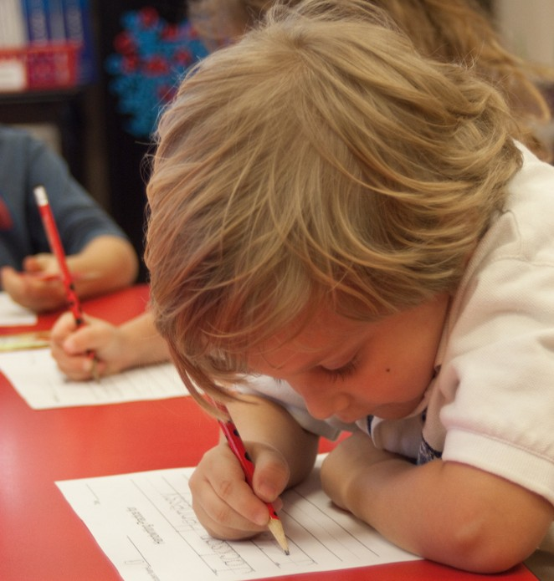
Little attempt has been made to relate these stages of growth in art directly to chronological age because so many factors contribute to the child’s development in art.

Slide 11
Many individuals never continue beyond the schematic or transitional mode of representation in the graphic arts. Just as children don’t grow physically and at the same time as their peers, the same can be said for their creative and mental growth. It happens at different rates, which is normal.

Slide 12
FIVE STAGES OF DEVELOPMENT OF Children art
1. The Scribble Stage
The first stage occurs when the child manipulates a drawing tool and makes random marks, dots, and lines on the drawing surface. He will scribble and manipulate the drawing tool with little or no concern for the appearance of the marks he makes.

Slide 13
There are three discernible stages during this stage:
random scribbling
controlled scribbling
naming of scribbling
By definition, a child in the scribbling stage, usually 2 - 4 years of age, is not drawing symbols for objects.

Slide 14
Children like to scribble because it gives them a chance to move their arms around freely. The act of scribbling is purely kinesthetic and imaginative. Don’t waste money on coloring books, they can actually inhibit children’s creativity. They are much better off with a large sheet of paper and a fat, dark crayon.

Slide 15
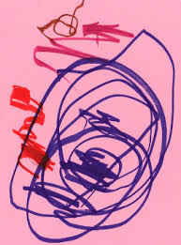
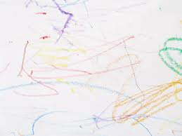
1st stage of development of children’s art

Slide 16
2. The Pre-Schematic Stage
The second, or pre-schematic stage, is entered when the child produces his first representative symbols for objects in his environment. These symbols are formed with circles, squares, and lines. The symbols change frequently. The pictures have a “floating organization and the paper may be turned many times while drawing.

Slide 17
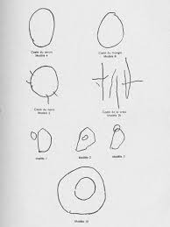
2nd stage of development in children’s art

Slide 18
Later, the symbols may be organized horizontally. The pre-schematic stage refers to that stage when the child is drawing his first symbols, but has not yet developed “schema”. Generally from 3 to 7 years of age.

Slide 19
3. The Schematic Stage
The main characteristics of this stage are the repetition of symbols for familiar objects, and the use of the base-line. The term “schema” refers to the habitually repeated symbol for an object. Examples of such schema are the lollipop tree, the stiff scarecrow-type drawings of people, or a series of houses which are all drawn the same.

Slide 20
The figures appear flat and stiff, and are changed only when there is strong motivation to do so. Later, multiple base-lines are the major organizational devices used by the child in this stage. X-ray or transparent views, top views, side views, or raised base-lines are used in increasing frequency as the subject depicted demands variation from the single base-line.

Slide 21
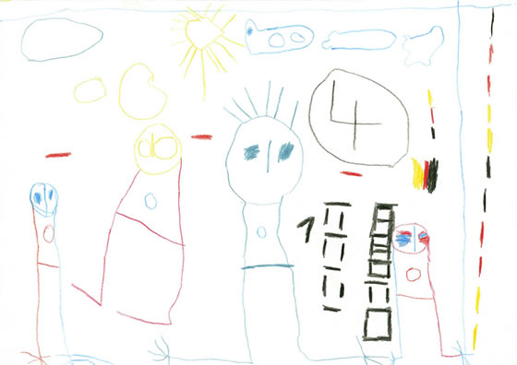
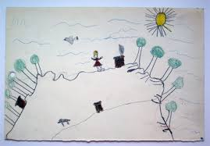
3rd stage of the development of children’s art

Slide 22
The pictures become more complex; yet they still use schema. Single base-lines, multiple base-lines, and fold-up views are used. The fused or continuous contour line is also used to further define figures. In general, children reach this stage between 6 and 11 years of age. Without further instruction and practice a few children will reach a plateau during the latter part of this stage.

Slide 23
4. The Transitional Stage
This is the stage in which the maturing child, usually 9 years or older, attempts to produce art work that meets adult standards; yet he still produces works which unintentionally contain many characteristics of the schematic stage. For instance, a picture may include a natural looking ground plane with trees of diminishing size going off into the distance.

Slide 24
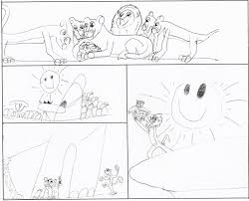
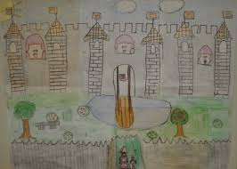
Transitional Stage examples

Slide 25
However, the child may include the top view of a swimming pool and place several stiff figures on the edge of the paper. The art work has visual contradictions. The base-line is replaced by a receding ground plane, and there is frequent use of intentional overlapping. Much attention is given to details, sex roles, and clothing differences. Some linear perspective may be used during this stage. A few children who enter this stage will reach a plateau and not enter the stage of realism.

Slide 26
5. The Realism Stage
The stage of realism is entered when the child is producing art work in the manner of adult artists. In general, the child is 12 or older. Considerable control over the medium, content, and organization is evident. The figures become natural in appearance, or are intentionally stylized.

Slide 27
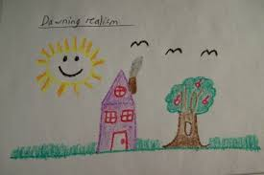
Realism Stage

Slide 28
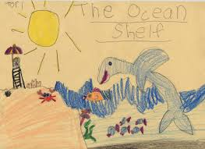
Realism Stage

Slide 29
The consistent use of many organizational devices is also quite evident in the art work produced during this stage, such as overlapping, diminishing size, placement on the picture plane, and linear and aerial perspective. It is at this stage that the child becomes most critical and self conscious about their ability to produce realistic artwork.

Slide 30
Why teach Art and Craft in elementary grade?
Art and craft teaching is required at elementary grades to boost the creative ability of the students and to make them familiar with the art materials and the prevailing art, Craft and calligraphy styles in the country.

Slide 31
Although some may regard art education as a luxury, simple creative activities are some of the building blocks of child development. Learning to create and appreciate visual aesthetics may be more important than ever to the development of the next generation of children as they grow up.

Slide 32
Developmental Benefits of Art
Motor Skills: Many of the motions involved in making art, such as holding a paintbrush or scribbling with a crayon, are essential to the growth of fine motor skills in young children. According to the National Institutes of Health, developmental milestones around age three should include drawing a circle and beginning to use safety scissors.

Slide 33
Around age four, children may be able to draw a square and begin cutting straight lines with scissors. Many preschool programs emphasize the use of scissors because it develops the dexterity children will need for writing.

Slide 34
Language Development: For very young children, making art—or just talking about it—provides opportunities to learn words for colors, shapes and actions. When toddlers are as young as a year old, parents can do simple activities such as crumpling up paper and calling it a “ball.” By elementary school, students can use descriptive words to discuss their own creations or to talk about what feelings are elicited when they see different styles of artwork.

Slide 35
Decision Making: According to a report by Americans for the Arts, art education strengthens problem-solving and critical-thinking skills. The experience of making decisions and choices in the course of creating art carries over into other parts of life. “If they are exploring and thinking and experimenting and trying new ideas, then creativity has a chance to blossom,” says MaryAnn Kohl, an arts educator and author of numerous books about children’s art education.

Slide 36
Visual Learning: Drawing, sculpting with clay and threading beads on a string all develop visual-spatial skills, which are more important than ever. Even toddlers know how to operate a smart phone or tablet, which means that even before they can read, kids are taking in visual information. This information consists of cues that we get from pictures or three-dimensional objects from digital media, books and television.

Slide 37
“Parents need to be aware that children learn a lot more from graphic sources now than in the past,” says Dr. Kerry Freedman, Head of Art and Design Education at Northern Illinois University. “Children need to know more about the world than just what they can learn through text and numbers.

Slide 38
Art education teaches students how to interpret, criticize, and use visual information, and how to make choices based on it.” Knowledge about the visual arts, such as graphic symbolism, is especially important in helping kids become smart consumers and navigate a world filled with marketing logos.

Slide 39
Inventiveness: When kids are encouraged to express themselves and take risks in creating art, they develop a sense of innovation that will be important in their adult lives. “The kind of people society needs to make it move forward are thinking, inventive people who seek new ways and improvements, not people who can only follow directions,” says Kohl. “Art is a way to encourage the process and the experience of thinking and making things better!”

Slide 40
Cultural Awareness: As we live in an increasingly diverse society, the images of different groups in the media may also present mixed messages. “If a child is playing with a toy that suggests a risk of child distraction towards unwanted paths, part of that meaning develops because of the aesthetics of the toy—the color, shape, texture of the hair,” says Freedman. Teaching children to recognize the choices an artist or designer makes in portraying a subject helps kids understand the concept that what they see may be someone’s interpretation of reality.

Slide 41
Improved Academic Performance: Studies show that there is a correlation between art and other achievement. A report by Americans for the Arts states that young people who participate regularly in the arts (three hours a day on three days each week through one full year) are four times more likely to be recognized for academic achievement, to participate in a math and science fair or to win an award for writing an essay or poem than children who do not participate.

Slide 42
How important is the study of Art and craft in enhancing the teaching skills:
It is highly important to study arts and crafts to enhance teaching skills and abilities because smaller children learn through visualization. If a child is put to recreate the different types of forest and other environments they will clearly be able to keep this in their minds. Imagine I still remember different forest! So it's strongly advised to really have students be able to express themselves, especially when some students enjoy arts and crafts and will encourage them for their future.

Slide 43
TEHE ROLE OF TEACHER IN TEACHING ART, CRAFT AND CALLIGRAPHY
Art teacher is the best tool for enhancing creative abilities of the child.
Art teacher can help the child to create hand and brain coordination.
At early stage child can recognize basic shapes in nature.
A teacher can produce dexterity in child for using his hand for cutting and pasting.

Slide 44
A Teacher can create language skills through art and craft teachings.
A teacher can ask the students to give names to their creations from their every day life. For example they can draw a boll and they can be asked that the boll is round etc.
Notes:
A

Slide 45
An Art teacher can develop the thinking ability and power of decision making in a child. When a child is doing some creative work, teacher can make him think freely for decided for his creation.
Child will willingly be deciding his on creation.

Slide 46
An Art teacher can enhance visual learning abilities in a child. In a way a teacher can make a child more observant in life.

