Slide 1
LECTURE. 29. UNIT. 5
What is assessment
in art, craft and calligraphy?

Slide 2
Summery of LECTURE. 28. UNIT. 5
Preparing to teach art, craft and calligraphy
Connecting art craft and calligraphy across the curriculum
Managing art, craft and calligraphy in the classroom.

Slide 3
We discussed, Art is a valuable tool for students to learn how to express themselves, work through a process, work cooperatively, and gain respect and understanding for others. How can we teach the arts in all subject areas so that students benefit from the learning opportunities that art affords them? For more ways art instruction benefits students.

Slide 4
How are arts blended with other curriculum areas, helping students to draw out a deeper understanding and appreciation for both familiar and unfamiliar concepts. Arts integration is an important way to enhance student learning and comprehension. Studies in neuroscience have found strong links between arts education and cognitive development (e.g. thinking, problem solving, concept understanding, information processing, and overall intelligence).

Slide 5
What is Art and craft Evaluation?
The task of evaluating a work of art, such as a painting, craft or a sculpture, requires a combination of objective information and subjective opinion. Yes, it's true that art appreciation is highly subjective, but the aim of evaluating a picture is not simply to ascertain whether you like/dislike a picture, but WHY you like/dislike it. And this requires a certain amount of knowledge. After all, your assessment of a drawing produced by a 14-year old child in a school playground, is likely to be quite different from a similar drawing by a 40-year old Michelangelo.

Slide 6
Similarly, one cannot use the same standards when evaluating the true-to-life qualities of a realist portrait compared with an expressionist portrait. This is because the expressionist painter is not trying to capture the same degree of visual objectivity as his realist counterpart. To put it simply, art evaluers need to generate facts upon which to base their opinions: namely, facts about (1) the context of the artwork; and (2) the artwork itself. Once we have the facts, we can then make our assessment. The more information we can glean about the context, and the work of art itself, the more reasoned our assessment will be.

Slide 7
the terms "art evaluation", "art assessment" and "art appreciation" are used interchangeably.
Art Evaluation is Not Simply Liking or Disliking
Before going into detail about how to evaluate art, let us again re-emphasize that the whole point of art appreciation is to explain WHY we like or dislike something, not simply WHETHER we like it or not. For example, you may end up disliking a picture because it is too dark, but you may still like its subject matter, or appreciate its overall message. To put it simply, saying "I don't like this painting" is insufficient. We need to know the reasons behind your opinion, and also whether you think the work has any positive qualities.

Slide 8
How to Appreciate a Work of Art
The easiest way to get to understand and therefore appreciate a work of art is to investigate its context, or background. This is because it helps us to understand what was (or might have been) in the mind of the artist at the time he created the work in question. Think of it as basic detective work. Start with these questions.

Slide 9
How to Evaluate the Context/Background of the Work?
When was the Painting Created?
Knowing the date of the work helps us to gauge how it was made, and the degree of difficulty involved. For instance, landscapes produced before the popularity of photography (c.1860), or the appearance of collapsible tin paint tubes (1841), had a greater level of difficulty. Oil painting produced before the Renaissance, or after the Renaissance by artists of modest means, will not contain the fabulous but astronomically expensive natural blue pigment Ultramarine, made from ground up mineral Lapis Lazuli.

Slide 10
Is the Painting Abstract or Representational?
A painting can be wholly abstract (meaning, it has no resemblance to any natural shapes: a form known as non-objective art), or organically abstract (some resemblance to natural organic forms), or semi-abstract (figures and other objects are discernible to an extent), or representational (its figurative and other content is instantly recognizable). Obviously an abstract work has quite different aims to that of a representational work, and must be judged according to different criteria. For example, a wholly abstract picture makes no attempt to divert the viewer with any naturalism and thus depends entirely for its effect on its formal qualities (line, shape, colour and so on).

Slide 11
What Type of Painting is It?
Paintings come in different types or categories (known as painting genres). The established genres are: Landscape, Portraiture, Genre-Paintings (everyday scenes), History, and Still Life. During the 17th century, the great European Academies, such as the Academy of Art in Rome, the Academy of Art in Florence, the Parisian Academie des Beaux-Arts, and the Royal Academy in London followed the rule laid down in 1669, by Professor Andre Felibien, Secretary to the French Academy, who ranked the genres as follows: (1) History Painting; (2) Portraiture; (3) Genre Painting; (4) Landscape Painting; (5) Still Life. This hierarchy reflected the moral impact of each genre. Experts believed that a moral message could be conveyed much more clearly through a history picture, a portrait or a genre painting, rather than a landscape or still life.

Slide 12
Other types of painting, in addition to the above five, include: cityscapes, marine paintings, religious paintings, icons, altarpieces, miniatures, murals, illuminations, illustrations, caricatures, cartoons, poster art, graffiti, animal pictures, and so on.
A number of these painting-types have traditional rules concerning composition, subject matter and so on. This applies especially to religious art.

Slide 13
Christian themes, for instance, which appear many times in Renaissance and Baroque paintings, are obliged to contain certain Holy figures, and must conform to certain compositional rules. In addition, painters often hark back to earlier pictures within the same genre (Francis Bacon's Screaming Pope was modelled on the Portrait of Innocent 10 by Velazquez). Because of all this, paintings are best evaluated against other works of the same type.

Slide 14
How to Evaluate the Work of Art Itself
How to Appreciate Paintings.
Famous Paintings Analyzed.
Once we have investigated or researched the context of the painting, we can begin to appreciate the work itself. Knowing how to appreciate a painting is itself an art rather than a science. And perhaps the most difficult aspect of art evaluation is judging the painting method itself: that is, how the actual painting has been done? It is with great humility therefore that we offer these suggestions for how to evaluate the actual painting technique used.

Slide 15
What Materials were Used in the Creation of the Painting?
What sort of paint was used? What type of ground or support did the painter employ? The answers to these questions can furnish interesting information about the intentions of the artist. The standard materials are oil paint on canvas. Oil because of its richness of colour, canvas because of its adaptability. However, acrylics or water colours are used instead of oils when thin glazes are required, and acrylics are also better when large flat areas of colour are called for. The American abstract expressionists Mark Rothko and Barnett Newman, both famous for their monumental coloured canvases, experimented in the 1950s with a mixture of oil and acrylics.

Slide 16
Water colour and acrylic paints also dry much faster than oils, and are therefore ideally suited for rapidly worked paintings. Wooden panel paintings are sometimes used as an alternative to canvas when very precise paintwork is intended (miniatures were/are still painted on wood, copper or even slate panels, or Wasli a special paper), or in conjunction with tempera or acrylics when the artist wants to build up the paint in very thin layers.

Slide 17
How to Appreciate Composition in a Painting?
Composition means the overall design the general layout. And how a painting is laid out is vital since it largely determines its visual impact. Why? Because a well composed painting will attract and guide the viewer's eye around the picture. Painters who excelled at composition were invariably classically trained in the great academies, where composition was a highly regarded element in the painting process. Three supreme examples are Nicolas Poussin (1594-1665), J.A.D Ingres (1780–1867) and Edgar Degas (1834-1917). Lack of space prevents us from going into detail here.

Slide 18
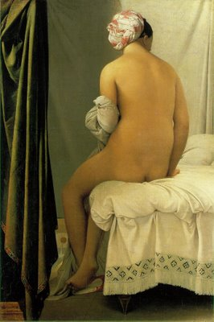
A painting by Ingre

Slide 19
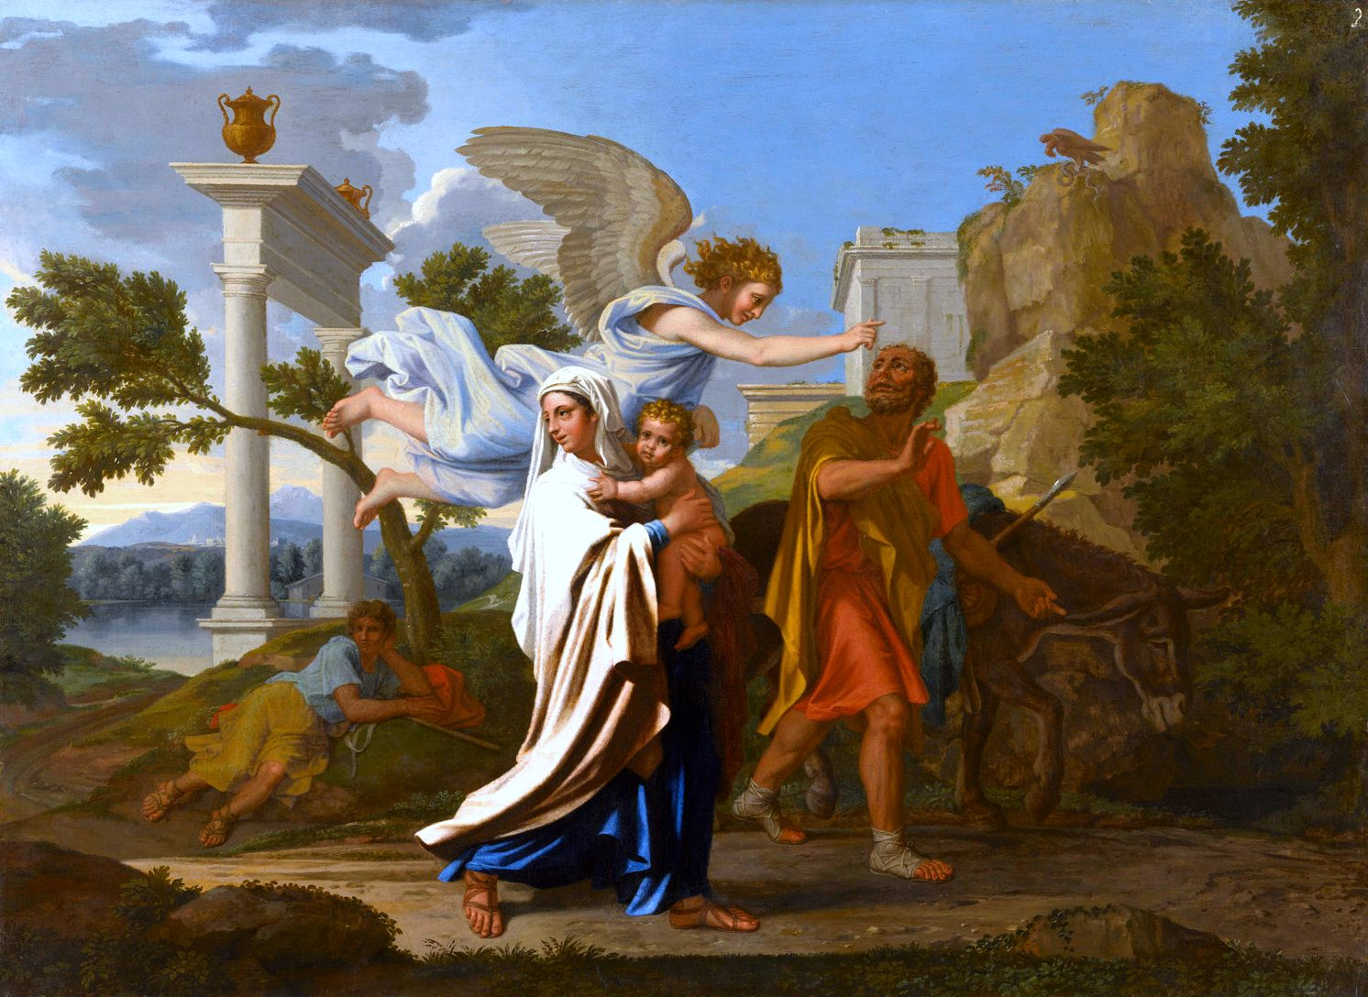
Flight to Egypt by Nicola Possein

Slide 20
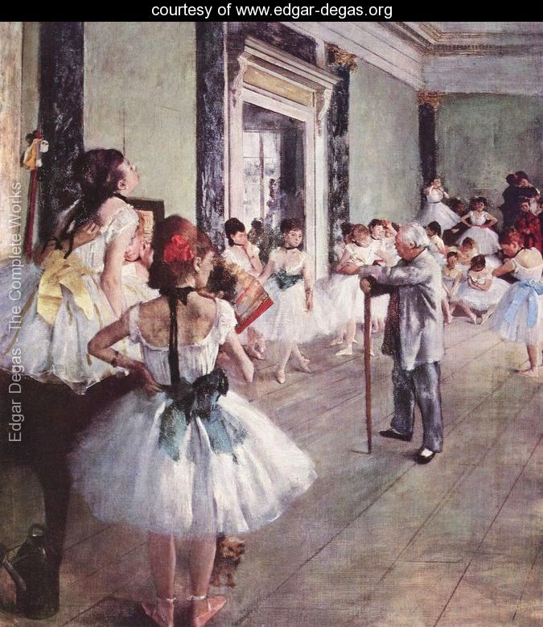
Dance class by Degas

Slide 21
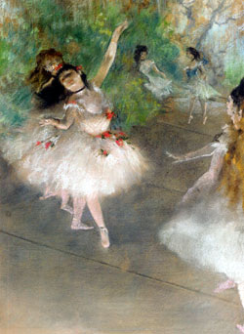

Slide 22
How to Appreciate Line and Shape in a Painting?
The skill of a painter is often revealed in the strength and confidence of his line (outline), creating and delineating the various shapes in his picture. In a famous story, an important patron sends a messenger to Giotto, the great pre-Renaissance painter. The messenger asks Giotto for proof of identity, whereupon the artist produces a paintbrush and a piece of linen, on which he paints a perfect circle. He then hands it to the messenger, saying: "your Master will know exactly who painted this." Line is a crucial element in the structure of a painting, and explains why drawing was regarded by all Renaissance experts as the greatest attribute of an artist. In fact, when the great European Academies of Fine Arts first opened, students were not taught painting (colorito) at all -

Slide 23
just drawing. Some of the finest draftsmen were portrait painters, whose line could be almost faultless: a modern example is the classically trained portraitist John Singer Sargent (1856–1925) who was a master of the "au premier coup" technique - one exact stroke of the brush, with no re-working. Among modern artists with no classical training, the paintings of Van Gogh and Gauguin stand out as having exceptionally strong and confident lines.
In figurative painting: (1) examine how the artist uses chiaroscuro to optimize the 3-D quality of his figures;
(2) see whether he uses tenebrism as part of his plan of illumination in order to put the spotlight on certain parts of the picture; (3) look if the painter is using the technique of sfumato in the blending of colour.

Slide 24
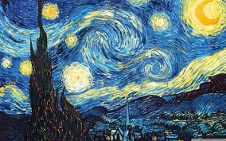

Slide 25
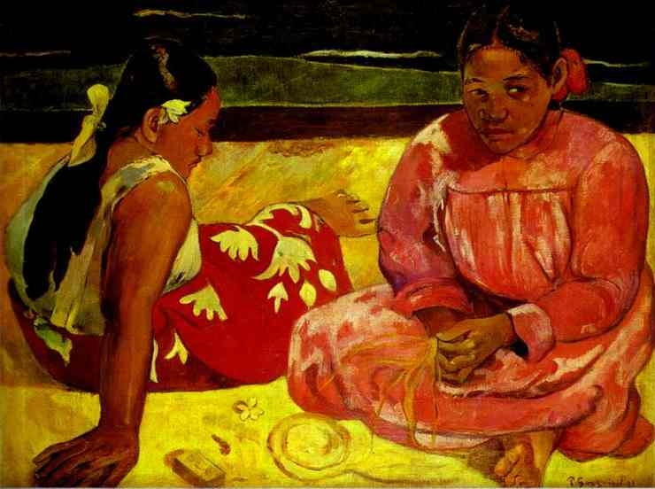
On the beach by Gauguin

Slide 26
How to Appreciate Colour in a Painting?
Colour in painting is a major influence on our emotions, and therefore plays a huge part in how we appreciate art. Curiously, although we can identify up to 10 million variants of colour, there are only 11 basic colour terms in the English language - black, white, red, orange, yellow, green, blue, purple, pink, brown and grey. So talking precisely about colour is not easy. Incidentally, as regards terms: a "hue" is a synonym for colour; a "tint" is a lighter version (eg. pink) of a particular colour (red); a "shade" is a darker version (eg. magenta); "tone" is the lightness, intensity or brilliance of a colour. Incidentally, many works by Old Masters are beginning to darken with age, which makes them look less attractive. It can also make even the best art museums look extra gloomy!

Slide 27
How to Appreciate Texture and Brushwork in a Painting?
When it comes to learning how to evaluate texture and brushwork in painting, there is no substitute for visiting a gallery or museum and seeing some canvases for yourself. Even the best art books are incapable of replicating texture to any extent. Once again, it tends to be classically trained painters who excel at differing textures, and use of impasto. Ingres would even choose certain subjects (eg. La Grande Odalisque) in order to show off his skill in capturing the texture of materials like nacre, mother-of-pearl and silk. At any rate, how well a painter handles texture is a good guide to the strength of his/her painting technique.
Brushwork can be tight (slower, precise, controlled) or loose (more rapid, more casual, more expressionistic).

Slide 28
It is largely determined by the style and mood of the painting, rather than (say) the temperament of the artist. Caravaggio had a violent hot temperament, yet his paintings were models of controlled brushwork. Cezanne had a slow temperament: he painted so slowly that all the fruit in his still lifes rotted away weeks before he finished. Yet the brushwork in many of his works is exceptionally loose.

Slide 30
Generalising wildly, we might say that the brushstrokes of realist painters tend to be more deliberate, and more controlled than expressionists. When the Impressionists held their first exhibition in Paris, in 1874, critics and spectators were horrified at what they called the "sloppiness" of the brushstrokes. They had to stand much further away from the paintings before the exact image took shape. Nowadays we are quite at ease with Impressionism, but in the beginning its super-loose brushwork caused a scandal.
When it comes to evaluating a picture, the question to ask is: Does the brushwork add or detract from the painting?

Slide 31
How to Appreciate Beauty in a Painting?
Aesthetics is an intensely personal subject. We all see things differently, including "art", and especially "beauty". In addition, painting is first and foremost a visual art - something we see, rather than think about. So if we are asked whether we think a painting is beautiful, we are likely to give a fairly instant response. However, if we are then asked to evaluate the beauty (or lack thereof) of a painting - meaning, explain and give reasons - well, its a different story. So to help you analyze the situation, here are some questions to ask yourself about the painting. Most are concerned with the harmony, regularity and balance that is visible.

Slide 32
What Proportions are Evident in the Picture?
Greek art and Renaissance art was often based on certain rules of proportion, which accorded with classical views on optical harmony. So maybe the beauty you see (or not) can be partly explained by reference to the proportions (of objects and figures) in the work.
Are Certain Shapes or Patterns Repeated in the Painting?
According to psychologists, repetition of pleasing shapes, especially in symmetrical patterns, can relax the eye and the brain, causing us to feel pleasure.

Slide 33
Do the Colours Used in the Painting Complement Each Other?
Colour schemes with complementary hues or tonal variations are known for their appealing effect on the senses.
Does the Picture Draw You in? Does it Maintain Your Attention?
The greatest paintings are the easiest to look at. They attract our attention, and then "signposts" guide our eye around the work.

Slide 34
How Does the Painting Compare With Others?
Everything is relative. So how does the painting in front of you compare with similar types of painting by the same artist? If it's a mature work, you may find it improves on earlier ones, and vice versa. If you can't find others by the same artist, try looking at similar works by other artists. Ideally, start with works painted in the same decade, and then gradually move forward in time. You can't look at too many paintings!

Slide 35
Art Evaluation: Judging Your Own Painting
Art Shows
What do judges at look for art shows? It depends on the level of entry, regulations and individual preferences of the panel members, but the qualities usually sought are:
1. Integrity: a sense that the work comes from within and is the authentic expression of the author's spirit.
2. Completeness: a coherent and integrated statement, with all aspects closely worked in.

Slide 36
3. Depth: a subtlety that can survive repeated viewing.
4. Originality: no clones of other artist's work or previous entries/winners.
5. Vitality: emotion-laden, taking risks that come off.
6. Quality: design and execution show panache and authority.
7. Intriguing: work leaves something unsaid or to be further imagined.
8. Innovative: extends the usual characteristics of the genre.
9. Significance: work makes some statement that enlarges our visual understanding of the world.

Slide 37
General Check List
In an analysis of still life, or of any other genre, how realistically can you judge your own work? The short answer is that you have to. Just as good writing is essentially rewriting, so good painting means continually appraising your efforts, appreciating its strengths and weaknesses, and learning to do better.
The real difficulty is seeing your work as others see it, and that's where painting clubs, local art shows and galleries are so useful. The standing of your work is much more evident when hung with others, particularly in a large exhibition with a common theme or genre.

Slide 38
The above — the overall qualities and the showing against the competition — are the overriding concerns, but you may find the following criteria useful for a point by point evaluation of a particular work. The listing is incomplete, needs some painting experience to understand, and will remain only words until applied. You will probably make your own checklist in time, but this may serve as a starting point with which to compare your painting against a recognized masterwork.

Slide 39
Line
Articulation: do the lines clearly articulate the forms? Entirely so?
Economy of Statement: sense of a powerfully organizing mind that has weighed up and placed the lines exactly?
Sureness of touch: more than deftness or facility: a sense that the brush was always and fully under the artist's intelligent control.
Rhythmic Quality: considered in the abstract, do the lines evoke a powerful and integrating rhythm?
Sensitivity: with what sensitively and variation are the qualities of the lines depicted?
Line Design: do the lines themselves create a pleasing design?

Slide 40
Form
Solidity: do the objects depicted look solid, individually and in relation to other objects?
Organic Character: are the density, texture and individual characteristics of each object properly captured (e.g. a silk dress looks like silk and not linen)?
Coherence: considered as a design, do the forms create a pleasing and coherent design in the third dimension?
Articulation of Planes: is the 3-D position of every point in the picture entirely clear?

Slide 41
Tone
Range: a pleasing range of light and dark within the painting?
Correctly judged: does the tone of everything depicted seem correct given the implied lighting conditions?
Mood: if tone is being used to create mood, is that mood believable and acceptably varied?

Slide 42
Color
Harmony: a good sense of color harmony — by hue, purity and tone?
Scheme: what color harmony scheme is being adopted? Is it appropriate?
Discord: are the departures from color harmony sensible — i.e. create their own dynamic, have expressive qualities and/or further the subject/mood/statement of the painting?

Slide 43
Composition
Appropriate: considered purely as composition, are the elements of the painting appropriate — measured, restful, dynamic, energetic, etc.?
Consistency: is the composition consistent, as a design and as an expression of content?
Integration: are all compositional elements closely and pleasingly integrated?
Richness of Formal Relationships: relationships between compositional elements are varied, original and expressive?

Slide 44
Some Maxims
1. Talent is no more than persistence in recognizing and solving problems. Practice.
2. The crucial question is not how to paint but what. First decide what you want to paint and then how you'll do it.
3. Start with an image in your mind and paint that.
4. Ensure you put in every stroke as best you can, even in under painting. Each stroke should follow naturally from the previous and lead on the next.
5. Work the whole picture at once.
6. Depict smaller than life-size.
7. Take nothing on trust but experiment continually.

Slide 45
8. Work from large to small.
9. Do everything as simply and economically as possible. If you can bring an element to completion quickly, do so.
10. The good painter grasps the importance and significance of what he sees. To develop that is more important than technique.

Slide 46
ASSESSMENT OR EVALUATION OF ART AND CRAFT
Evaluation is necessary and vital, and should be regarded as an important and essential diagnostic procedure to improve what is taught and learned. Procedures in this area will be primarily concerned with determining the following:- the degree to which the learning objective has been fulfilled. level of Individual response· level of Class Group response.

Slide 47
Emphasis should be placed on evaluating the learner in the process of learning and evaluating the students work as a whole.
The primary purpose is to secure and record information that will enable the teacher to improve the educational process and therefore evaluation should be perceived as an educational device through which the teachers professional expertise can be exercised on behalf of the students whom the syllabus is designed to serve.

Slide 48
In this lecture Student Teachers will focus on assessment of art,
crafts, and calligraphy in elementary grades. The most important aim of assessment
in these subjects in elementary grades is to enhance children’s learning. Assessment
is, therefore, at the heart of teaching and learning arts, crafts, and calligraphy.

Slide 49
The Evolution of Fine Arts
After primitive forms of cave painting, figurine sculptures and other types of ancient art, there occured the golden era of Greek art and other schools of Classical Antiquity. The sacking of Rome (c.400-450) introduced the dead period of the Dark Ages (c.450-1000), brightened only by Celtic art and Ultimate La Tene Celtic designs, after which the history of art in the West is studded with a wide variety of artistic 'styles' or 'movements' - such as: Gothic (c.1100-1300), Renaissance (c.1300-1600), Baroque (17th century), Neo-Classicism (18th century), Romanticism (18th-19th century), Realism and Impressionism (19th century), Cubism, Expressionism, Surrealism, Abstract Expressionism and Pop-Art (20th century).

Slide 50
For a brief review of modernism (c.1860-1965), see Modern art movements; for a guide to postmodernism, (c.1965-present) see our list of the main Contemporary art movements.
The Tradition
Fine art was the traditional type of Academic art taught at the great schools, such as the the Accademia dell'Arte del Disegno in Florence, the Accademia di San Luca in Rome, the Académie des Beaux-Arts in Paris, and the Royal Academy in London. One of the key legacies of the academies was their theory of linear perspective and their ranking of the painting genres, which classified all works into 5 types: history, portrait, genre-scenes, landscape or still life.
Patrons

Slide 51
ESSMENT OBJECTIVES
On completion of the course,
students should be able to:
(i) give a personal response to an
idea, experience or other stimulus
(ii) work from imagination, memory and direct observation
(iii) use drawing for observation, recordin
g and analysis, as a means of thinking
and for communication and expression

Slide 52
(iv) use the core two-dimensional
processes in making, manipulating and
developing images, using lettering and
combining lettering with image, in
expressive and communicative modes
(v) use the three-dimensional processes of additive, subtractive and
constructional form-making in expressive and functional modes

Slide 53
(vi) use and understand th
e art and design elements
(vii) use a variety of material
s, media, tools and equipment
(viii) use an appropriate working vocabulary
(ix) understand relevant scientific, mathematical and technological aspects of
art, craft and design

Slide 54
(x) sustain projects from
conception to realisation
(xi) appraise and evaluate his/her
own work in progress and on completion
(xii) develop an awareness of the historical, social and economic role" and value
of art, craft and design and aspects of
contemporary culture and mass media.
To evaluate a craft one must keep in mind that how the crafts man has used his material with the best use of his skill. What is the purpose of making this craft.

Slide 55
What were the set goals that the crafts man had in his mind.
Was he interested in keeping the same tradition of craft making of the region or there was some creativity introduced by him with the tradition.
Is the craft communicating some moral lesson trough the craft or it is just representational. If the evaluator has answers to these questions in his mind then he can judge and mark the craft.

Slide 56
Summery of the lecture
I hope that after this lecture student teacher will be able to assess and evaluate art and craft piece with the abilities of an expert.

