Slide 1
LESSON. 25. UNIT. 4
Doing craftwork and making handicrafts, (puppets and puppetry, textiles, making beads).

Slide 2
SUMMERY OF LECTURE. 24. Unit. 4
CRAFTS
Crafts in Pakistan
crafts practiced and made in Pakistan.
Crafts and technology

Slide 3
Puppet Crafts for Kids
Puppets are a great tool everyone can use to stretch their imagination. Puppets can be made using any supplies you like. You can experiment with socks, gloves, household packages, and just about anything else. Design your own puppet crafts and then submit it to be included here!

Slide 4
and learn how you can create a large variety of puppets using little more that empty toilet paper rolls and some basic craft supplies.
Age Guideline: 3 Years and Up
Time Required: 30 minutes (Does not include drying time)

Slide 5
The above age and time guidelines are estimates. This project can be modified to suit other ages and may take more or less time depending on your circumstances. Materials Needed:
Toilet Tissue and/or Paper Towel Rolls
Craft Sticks
Glue
Scissors
Construction Paper
Misc. Craft Supplies (felt, moving eyes, yarn, etc.)

Slide 6
Instructions:
This is a very simple craft. Use a variety of craft supplies and your imagination to decorate cardboard toilet paper rolls to make different people or animals. You can even cut them to different heights. Use miscellaneous craft supplies to make hair, clothes, mouths, etc. Be creative, Glue the craft sticks inside the bottom edge of the cardboard roll for handle

Slide 7
How to Build a Sock Puppet
Depending on the embellishments used and individual creativity, an ordinary sock can morph into an entirely new identity as a sock puppet. Building sock puppets is a fun craft project for a rainy day, or simply as a new project anytime. The great thing about sock puppets is you can make them all your own--each one is different based upon how you design it. There is no wrong way to make a sock puppet.

Slide 8
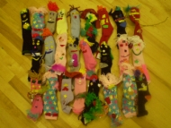

Slide 9


Slide 10
Things You'll Need
Thick white sock
2 clothespins
Pink felt
Poster board
Glue-on wiggly eyes
Glue gun
Glue sticks
Elmer's glue
Scissors
Yarn
Thin ribbon
Needle
Pink thread
Miscellaneous craft decoration

Slide 11
Instructions
  1 Insert your hand into the sock. Make sure your fingers are located in the toe and that the back of your wrist rests at the heel area. Manipulate your hand in the sock like it is a mouth talking. This area is where you will create a mouth with your craft supplies.

Slide 12
2
Create the mouth by tucking the sock in between your thumb and fingers, to make the mouthpiece. Use clothespins to keep sock in that position. Secure the position by stitching sock with needle and thread. Remove sock from your hand.
Sponsored Links
Big Book Of Knitting
Read more : http://www.ehow.com/how_6557545_build-sock-puppet.html?ref=Track2&utm_source=ask
2
Create the mouth by tucking the sock in between your thumb and fingers, to make the mouthpiece. Use clothespins to keep sock in that position. Secure the position by stitching sock with needle and thread. Remove sock from your hand.
Sponsored Links
Big Book Of Knitting
Read more : http://www.ehow.com/how_6557545_build-sock-puppet.html?ref=Track2&utm_source=ask
2 Create the mouth by tucking the sock in between your thumb and fingers, to make the mouthpiece. Use clothespins to keep sock in that position. Secure the position by stitching sock with needle and thread. Remove sock from your hand.

Slide 13



Slide 14
3
Cut a piece of poster board that is 2.5 inches wide by 5 inches long, and cut the same size from a piece of felt. Glue the pieces of felt and poster board together with Elmer's glue. Once dry, fold it in half, and sew onto your sock, positioning it as the mouth. Remove the clothespins.
4
Position the eyes. Use your hot glue gun to attach wiggly eyes. Ap
Read more : http://www.ehow.com/how_6557545_build-sock-puppet.html?ref=Track2&utm_source=ask
3 Cut a piece of poster board that is 2.5 inches wide by 5 inches long, and cut the same size from a piece of felt. Glue the pieces of felt and poster board together with Elmer's glue. Once dry, fold it in half, and sew onto your sock, positioning it as the mouth. Remove the clothespins.

Slide 15
4 Position the eyes. Use your hot glue gun to attach wiggly eyes. Apply a few dots of glue to the back of each eye. Affix the wiggly eyes to the face of your sock puppet. Hold each eye firmly until the glue has set.

Slide 16
5 Cut yarn for hair that is 8 inches long. Attach it with the hot glue gun beginning at top of puppet's forehead, positioning all the way down to nape of its neck. Make ponytails for the puppet. Tie the yarn off into two section at the nape of neck with ribbon. If the yarn is too long once it is attached, trim it to an appropriate length.

Slide 17
6 Customize your sock puppet with your leftover craft supplies. Sock puppets are a craft tradition that will never go out of style, and they are an enjoyable project for everyone.

Slide 18
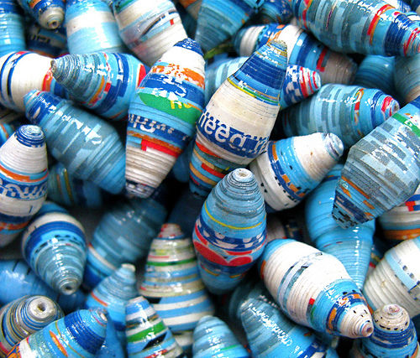
How to Make Paper Beads

Slide 19
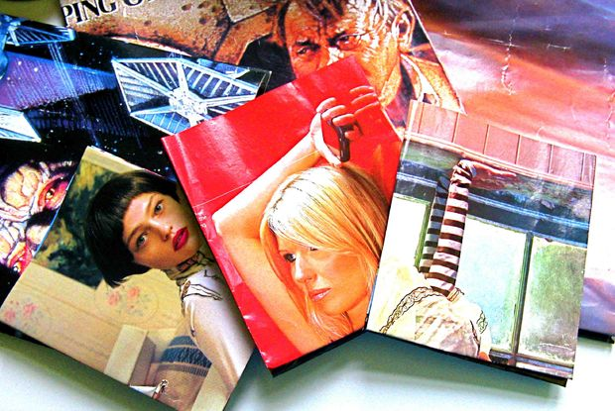
Step 1: Selecting your paper and materials to make the bead

Slide 20
First collect the following. A colourful page from a used magazine or an old colourful poster. If you want to make beads of a full colour, you must find a full colour page of poster. For example to get ALL blue beads, pick up a page with photo of the ocean! Vogue and House and Home, or some old teenage music posters are my favorite. The thicker the paper the fatter the bead!
Scissors
Pen
Ruler
Needle or toothpick
Clear varnish - most clear varnishes from local store will do or nail varnish.
Fishing wire/plastic wire or some sort of thread similar width as your needle or toothpick.

Slide 21

Step 2: Measuring and cutting the paper for the bead

Slide 22
This is the part where put your paper down on a flat surface and equip yourself with a pen and a long ruler.
Please refer to the RED triangle in the illustration on the vogue page for these instructions:
Use a normal thin ballpoint pen, not a thick marker!
Mark a 2cm point long from the a top corner at (C), and a 1cm point along from the bottom corner at (B). Take your ruler and draw a line from point A to B and C respectively, and you will have drawn a perfect triangle.

Slide 23
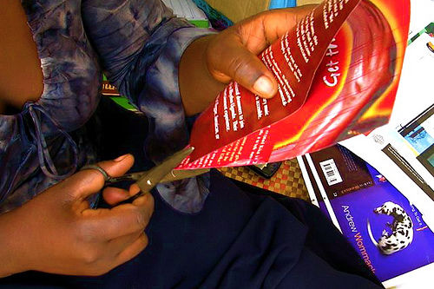
Continue this routine, until you end up with a zigzaging block of triangles throughout the page.
Cut your triangles neatly out, and discard the uneven one marked blue in the illustration.

Slide 24
PLEASE NOTE:
Measuring your marks on the paper will determine the shape and size of the bead.
Measuring along at 2cm on a page inside a magazine like Vogue will give you an oval, slim type paper bead like this, If you would like a similar shape of bead but longer or shorter, simply increase or decrease the length to 1.5cm or up to 3.5 or 4cm. Simply half the length of A to C to determine point B.

Slide 25
If you would like a round, fat bead like this you will have to find paper as thick as a poster or front cover of a magazine, and keep the width of the bead to 1.5 - 2cm ONLY. Alternatively you can attempt to double or triple up your paper strips, but this takes time and skill.

Slide 26
If you would like to leave some text of image on your bead, simply cut off the end of the triangle at the point you wish you keep. But, all these special effects will come to you once you get into it, and start experimenting with different types of paper.
If you would like to make tube type beads, simply replace the triangles with simple rectangular strips, easy!

Slide 27
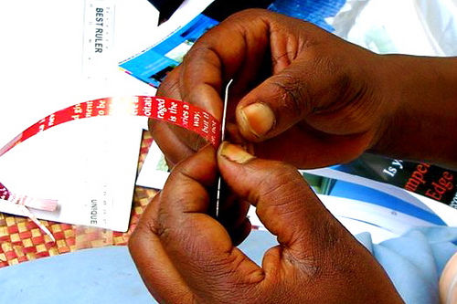
Step 3: Rolling the Paper Bead

Slide 28
Take your needle, or toothpick. I recommend needle, as the string or thread you string them on (for varnishing) must be equal in width. Starting at the thickest end of the strip, start rolling it tightly around the needle. Using your nails to catch it in at first, ensuring to keep the paper central. Put a dab of glue at the end and press down on it for a few seconds to hold the bead in place. (liquid paper glue works best).

Slide 29
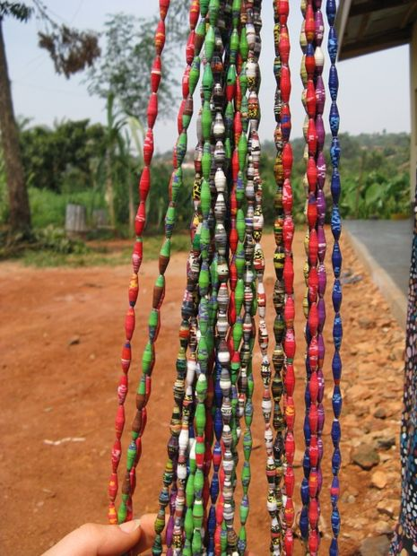
Step 4: Varnish, leave to dry and finish

Slide 30
hread all your beads on plastic wire or string. I recommend a thickish plastic, fishing type thread as the beads will slide off easily once dry. Whatever you chose to use, ensure it does not allow for the varnish to seep in and bock the holes. Once fully strung, start varnishing, we use a brush and give them at least 2 coats of varnish. Leave to dry for 2-3 days, and your beads are ready to use!

Slide 31
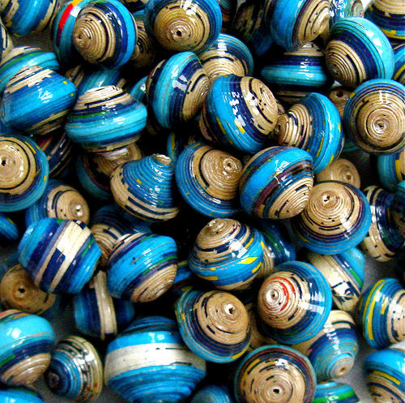

Slide 32
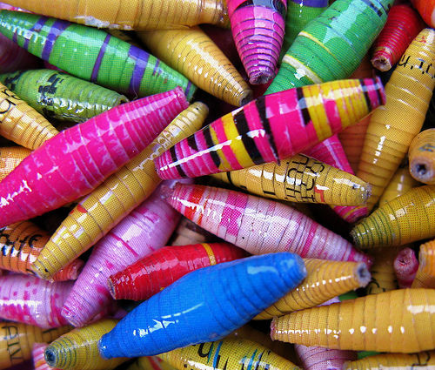

Slide 33
How to Make a Mosaic from Broken Tiles
1
Get an idea in your head of what kind of mosaic you would like to make. Sketch a basic drawing of what you would like it to look like when it finishes. This can be as detailed as you want, but it just has to give you a guide

Slide 34
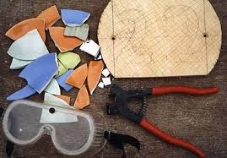

Slide 35
2. Head over to your local hardware or floor store and select and buy the tiles you would like to use. This includes color and texture, or anything that you like. You could also go dumpster diving to find old tiles. These should be ceramic. (If your mosaic will be used where it may be subjected to freezing temperatures, the tiles should be porcelain that is frost resistant.) You may want to purchase a tile cutter if you are looking for a dramatic, organized mosaic with square pieces. You should also buy some tile adhesive and cement.

Slide 36
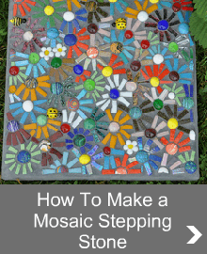

Slide 37
3
With your safety glasses and protective gloves on, throw your tiles at any hard object, or simply drop them. In order to avoid major scratches, lay a thin comforter over the ground. Or score and cut with the tile cutter. These are great stress relievers and they don't hurt anyone.

Slide 38
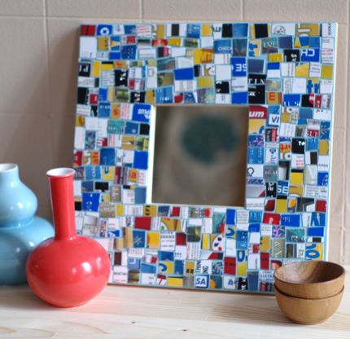

Slide 39
4. your broken tiles into color categories. This will help you when it comes time to actually put them into place.
5. Now it comes time to make the mosaic. When you have all of your broken tile pieces, lay them onto the surface that you will decorate. Again, this can be anything at all.

Slide 40
6. Take your pieces and slide them into the wooden frame (if not already there). They might scatter a little, but if you are careful, it should not be too bad. Slide the attempted escapees back into place.

Slide 41
7. Now, individually glue each piece into place with the tile adhesive.
8. Once the tiles have set, mix up the cement with water until it is of the consistency described on the cement bag (liquid but not runny). Now put the cement/water mix over all the tiles.

Slide 42
9. Using a soft cloth, rub off the excess cement that covers the tile pieces.
10. You now have a beautiful Mosaic!

Slide 43
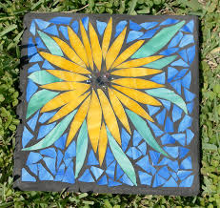

Slide 44

How to Make a Paper Mosaic

Slide 45
Mosaics were traditionally made with bits of tile or glass, but a paper mosaic is a great project for art classes and for parents to do with their kids. The only rule is to have fun.At the same time,it also increases one's ability to develop his/her sense about beautification and sublimity

Slide 46

1. Lightly Draw a picture on a piece of paper but do not shade it or put a lot of details in it. The objective is simply to create an outline for the image you will be creating.

Slide 47
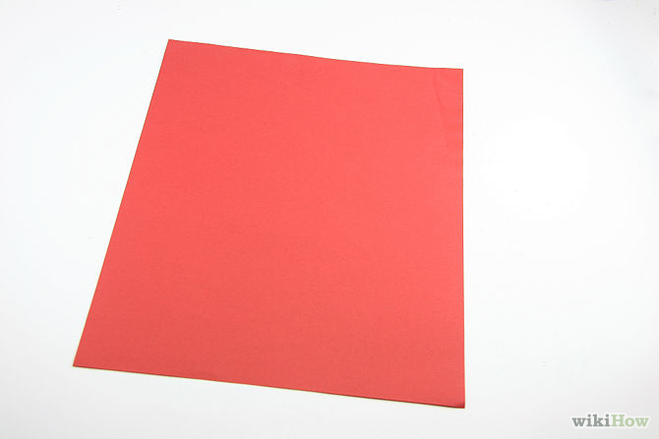
2. Get some colored paper. You can use construction paper, or you can look in your junk mail for glossy catalogs with brightly colored photos.

Slide 48
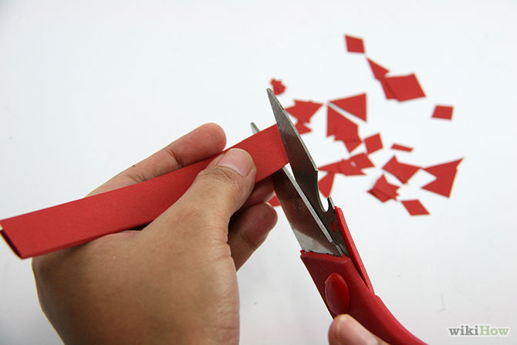
3. Cut or shred the paper into small pieces. You can make regular pieces, like squares or triangles, or let the shapes be irregular for a different effect.

Slide 49
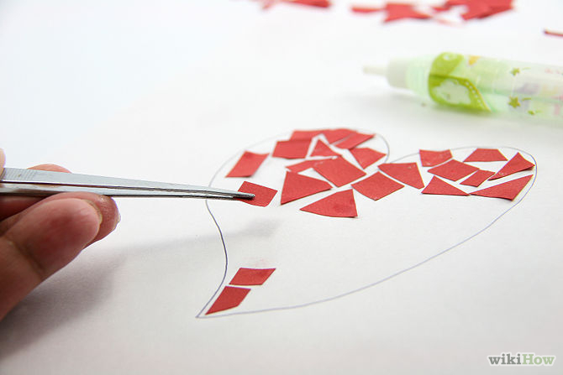
4. Glue your pieces of paper over the sketch you just made. Leave a small gap between each piece for a tiled effect, or place them close together or overlapping for a different look.

Slide 50

5. Let it dry. If you'd like to keep it sturdy and able to hang on walls, glue onto a thick piece of cardboard.

