Slide 1
LESSON. 24. Unit. 4
CRAFTS
Crafts in Pakistan
crafts practiced and made in Pakistan.
Crafts and technology

Slide 2
SUMMERY OF LECTURE 21. UNIT. 3
PAINTING:
Painting in different mediums
Water colour painting
Oil Painting
Acrylic Painting

Slide 3
Unit learning goals and essential questions.
Student teachers will learn to use elements of art and design in communicate ideas and feelings and use art vocabulary in daily life.
Experience using different mediums for expression
Questions?
What are the elements and principals of design.
How these elements can be used in production of art works?

Slide 4
CRAFTS AND HANDICRAFTS OF PAKISTAN
Pakistan has a rich history of handicrafts. Handicrafts reflects the culture and tradition of Pakistan. These handicrafts spread out quality of beauty and show the inherited skills of people. The actual beauty of a piece of handicrafts surely depends on the simplicity of material, the glimpses of a culture and touch of art.

Slide 5
The Kashmiri Shawls, the Balochi and Sindhi embroidery work, the Peshawari chapels and carpets, camel skin lamps of Multan, Gujrati pottery and the wood and brass work done in different parts of Pakistan. Handicrafts are the most outstanding expressions of the individuality of Pakistan’s regional identities. The color, the shape or style of a craft item will represent the specialty of region.

Slide 6
Wood Crafts
The art of carving on Metal & Wood items are the real beauties of our hard working Craftsmen.
These items are manufactured in small villages by hard-working craftsman, and can easily be purchased in big cities. Such crafts include, mirror frames, decoration pieces etc.

Slide 7
Chiniot and areas adjacent to Kashmir are famous for the exquisite carving in wood and woodcrafts inlaid with ivory, which are highly prized by tourists. Carving in ivory is a very specialized art requiring a high degree of skill and patient work on the part of the artisan. Caskets with delicate lace work ale highly prized. The present artisans have inherited the skill from gene-rations going far back into the past. The carved wooden furniture in wide range is exported in huge quantities because of its richness in design and high quality wood.

Slide 8
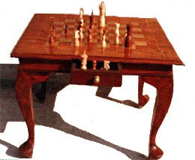
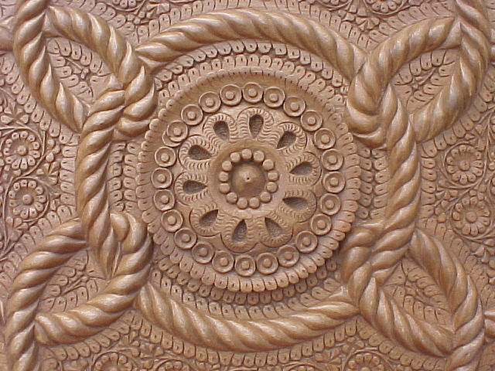

Slide 9
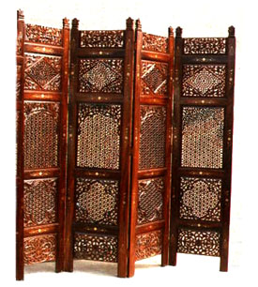
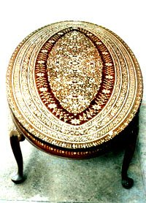

Slide 10
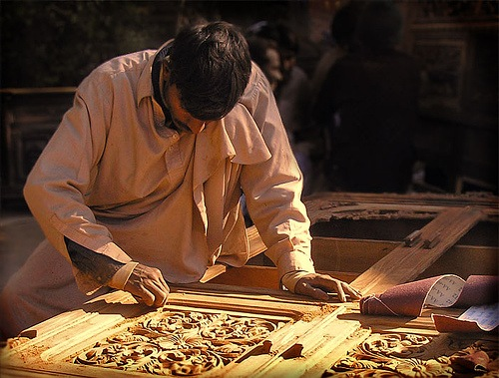

Slide 11
Pottery
Bahawalpur, Rawalpindi, Gujrat and other places produced colorful pottery which reflect the traditional heritage. Mult an is famous for its fabulous blue pottery. Chiniot is also known for carving work on woods. Pakistani potters are responsible for making the tiles that decorate mosques and public buildings.

Slide 12
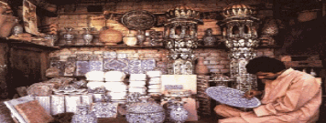

Slide 13
Carpets & Textile
Pakistan has tradition of carpet-making. The handmade carpets produced in Lahore. Islamic designs in woolen carpets are the cultural part of South Asia and the Middle East. In Pakistan, Karachi and Lahore are important centers for the production of fine carpets. Sindh and Baloch people are famous for their mirror embroidery, where small mirrors are stitched into the fabric to create sparkly masterpieces.

Slide 14
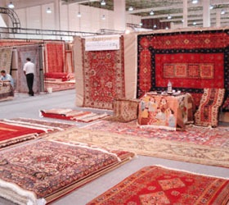

Slide 15
Furniture
Pakistani furniture is known all over the world for its beautiful and complicated designs. The wood is available in crowded jungles in northern areas of Pakistan. In local language people knew it ”SHESHAM”. Such furniture is famous all over the world for its uniqueness and beauty.

Slide 16
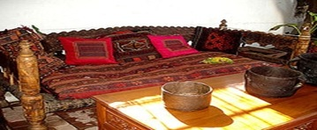

Slide 17
Jewelry & Leather Goods
Important crafts jewelry includes metal work on swords, boxes and dishes. And jewelry with precious stones and pearls is not limited to necklaces, bracelets, rings but also includes hair and forehead decorations and nose stuff. Leatherwork and basketry are also important crafts.

Slide 18
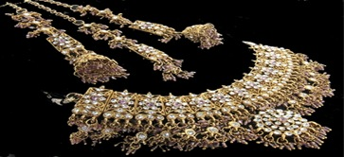

Slide 19
Handicrafts of Pakistan
Pakistan has inherited a rich cultural heritage from its history which is as old as 7000-9000 years old. The imprints left by successive civilizations have left a rich heritage of handicrafts. The different regions with wide variety of tradition and culture, dialects, folklore, music, dresses and costumes have much to offer to any connoisseur of handicrafts.

Slide 20
The Kashmiri Shawls, the Balochi and Sindhi embroidery work, the Peshawari chappals (an indigenous shoe ware) and carpets, camel skin lamps of Multan, Gujrati pottery and the wood and brass work done in different parts of Pakistan have charm of their very own. The handicraft shops in major cities and hotels abound in the handicrafts of Pakistan, which are taken as souvenirs by the tourists from the world over. These specially include the handicrafts made of marble, camel skin, wood and ivory work and cane-basket work. In fact the handicrafts are the most striking expressions of the individuality of Pakistan’s regional identities. The color, the shape or style of a craft item instantly evokes its region.

Slide 21
Multan, Bahawalpur and Hala are famous for the blue pottery made of special clay found in these areas. These are wrought by the inherited skill of artisans into paper-thin pottery noted for its elegance, delicacy of design and decorative patterns painted thereon.

Slide 22
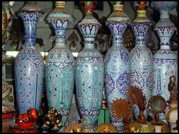

Slide 23
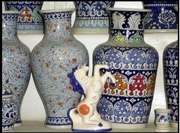

Slide 24
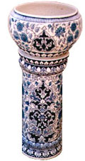
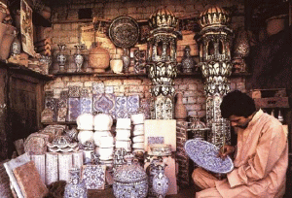

Slide 25
Brass utensils once used to be common in household uses, especially in the villages. Now these have slowly and gradually vanished due to their high cost, but brassware handicrafts can still be found displaying master craft of the artisans. They make decorative plates, vases, bowls and similar other things in exquisite designs reminiscent of the great Mughal period. Products of polished brass have their own appeal but it is the engraved work in colorful and artistic patterns that is most prized. In Peshawar, brass work is done on many things like household utensils of daily use to decoration pieces.

Slide 26
In Hindko (one of the much spoken languages in NWFP), brass is called as “Mis,” and the individuals who work on this metal are called “Misgar.” In Peshawar a big market is allocated for this handicraft, known as, “Misgaran Bazaar,” that means, bazaar of brass workers. People of NWFP give household utensils to their daughters in “Dowry,” that are made of brass and are beautifully carved. These include water storage and cooking utensils.

Slide 27
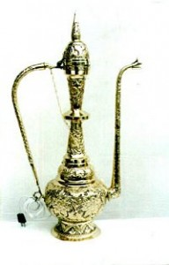

Slide 28
Embroidery is one of the most sought out handicrafts of Pakistan the world over. Multan, Bahawalpur and surrounding areas are full of gifted men and women who produce one of the most adorable cross stitch. "Tilla" work, Pearl work and "Salma Sitary" work of NWFP are very famous throughout the country. Swat is well-known due to thread embroidery, whereas, in D.G.Khan mirror work is done on clothes. Works of these types are called "Kadhai." Chitrali "Patti," that is woven on hand looms and Kadhai done on Chitrali Chugha is very famous.

Slide 29
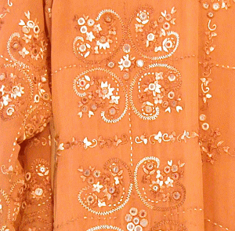
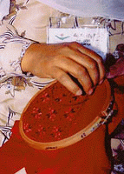

Slide 30
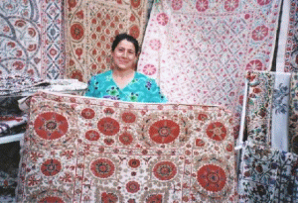

Slide 31
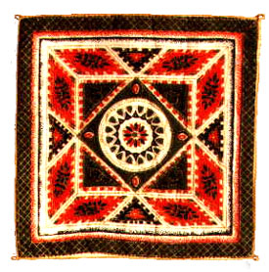
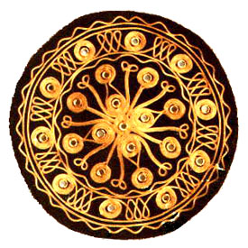

Slide 32
Pakistan is also world famous for its hand knotted carpets. Lahore and surrendering areas abound in small weavers who make “Chand Chauthai” carpets. These carpets have a density is 200 knots per square inch and are made of locally spun carpet wool - yarn and dyed fast with chrome dyes.

Slide 33
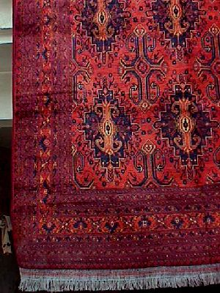
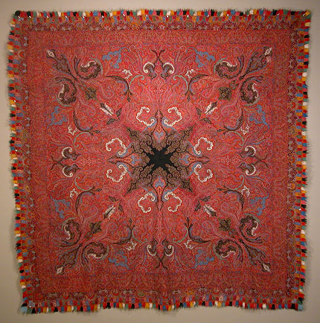

Slide 34
Marble Carving generally come from Balochistan and NWFP. The utility articles of Balochistan include marble carved in decorative patterns, which represent a rare craftsmanship of the area; the skill having been passed on from generations to generations over a period in the past which would perhaps go back to the Palaeolithic age. The onyx made show pieces are really eye catching.

Slide 35
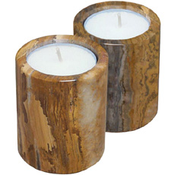
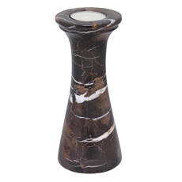

Slide 36
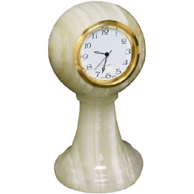
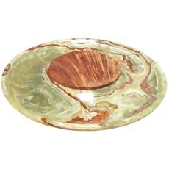

Slide 37
Truck Art: With its all colorful floral patterns, depiction of human heroes with creative aspect ratios, calligraphy of poetic verses and driver’s words of wisdom, this form of art is truly a part of Pakistani transport tradition.
These truck bodies are immaculately painted by the street artists who can be found at Truck stands all across the country. e.g. Hawkes Bay/Mauripur Road Road Karachi, Pir Wadhai Rawalpindi, Badami Bagh Lahore, Sariab Road Quetta etc.

Slide 38
These hired artists then paint the whole truck in brightly colored patterns. It is said that everty city’s artists have perfected their art in their own signature way. Trucks decorated in Quetta and Peshawar get lots of wood trimming where as those in Rawalpindi get lots of plastic decoration. Karachi excels in using reflective tapes, also called ‘chamak patty’ in local language. Camel bone decoration is used by artists of rural Sindh.

Slide 39
Pakistani trucks are also used as means of displaying the owner or the Painter’s Poetic taste. It also serves as a calligraphic board as well as a notice board for public messages.
The truck owners and truck artists of Pakistan also pay homage to their heroes and heroines in their own innocent ways. These painting do not strictly follow the aspect ratio of real life figures.

Slide 40
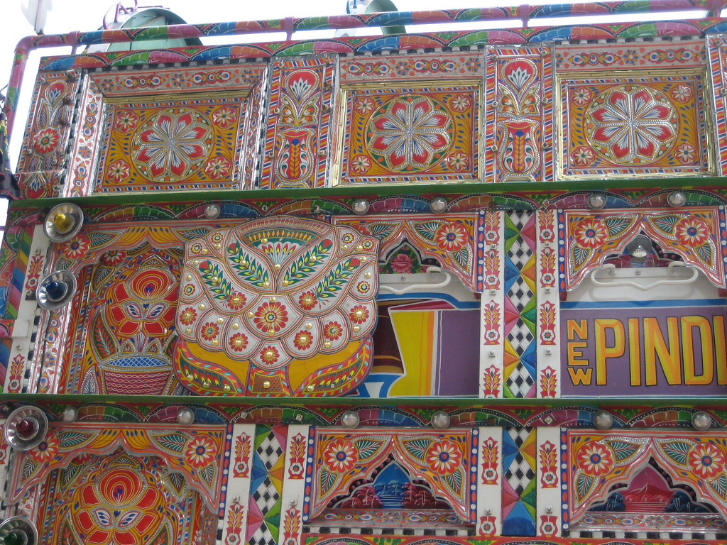

Slide 41
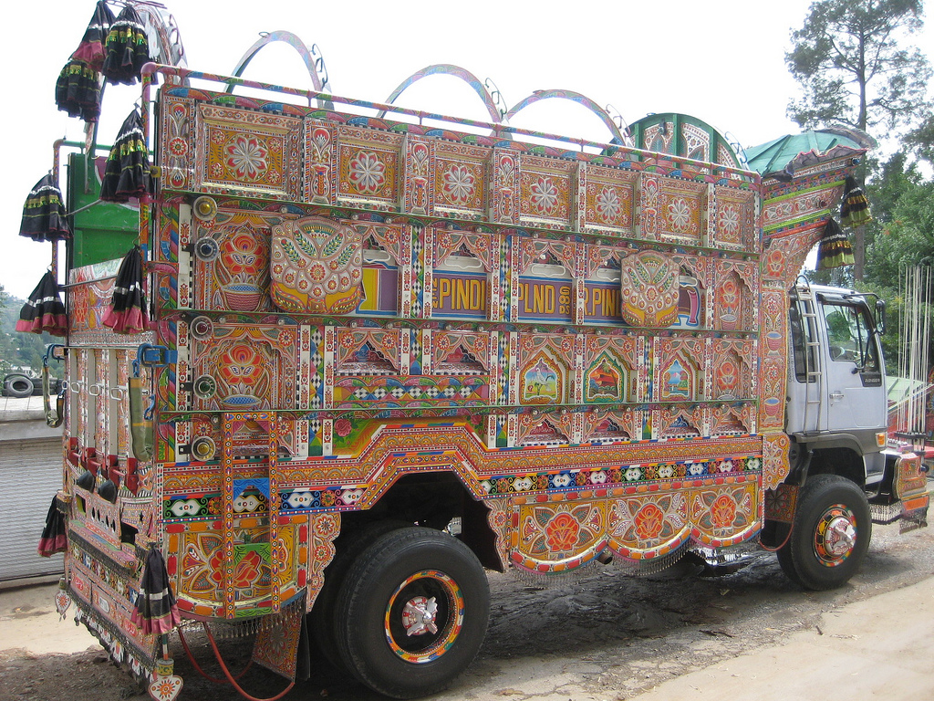

Slide 42
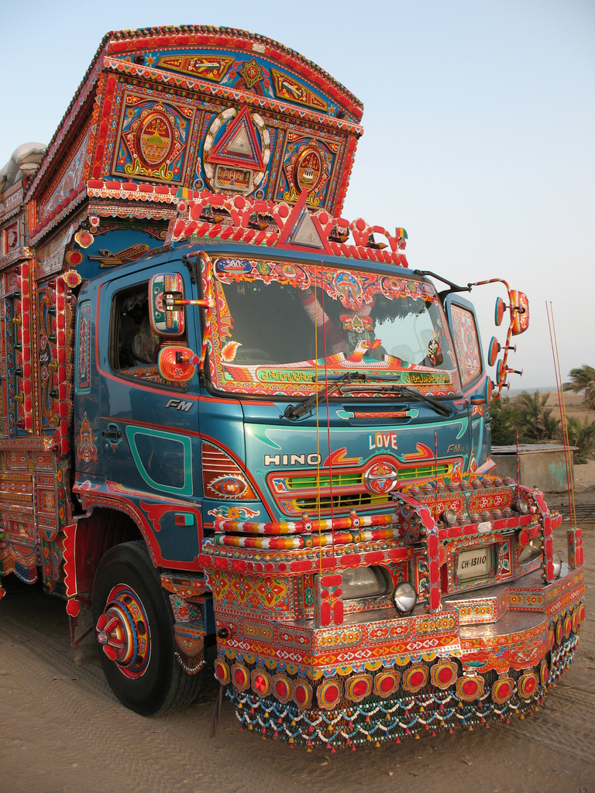

Slide 43


Slide 44
Sindhi Hand Embroidery: The Breathtakingly Sizzling Designs
It is important to note certain points in mind regarding the fabulous designs and embroidery. Sindhi hand embroidery is not specifically practised in Sindh but also other regions of India such as Kutch and Kathiawar. It is strange yet interesting knowledge that the embroidery is also known as the interlacing embroidery. The designs of Sindhi embroidery are mostly chevrons and checks giving them a stylishly classic as well as traditional look which is sometimes created in bird or flower form.

Slide 45
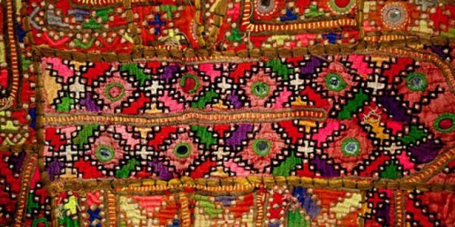
Colourful Threads Used in Sindhi Hand Embroidery

Slide 46
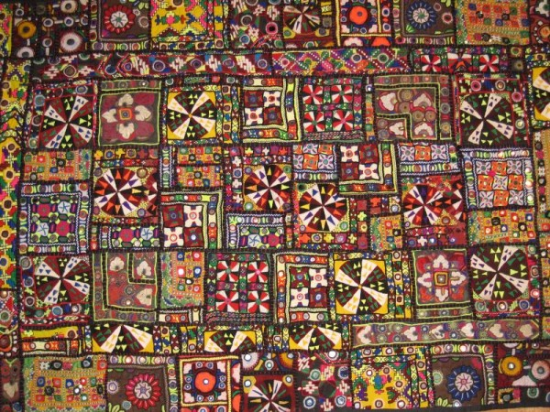

Slide 47
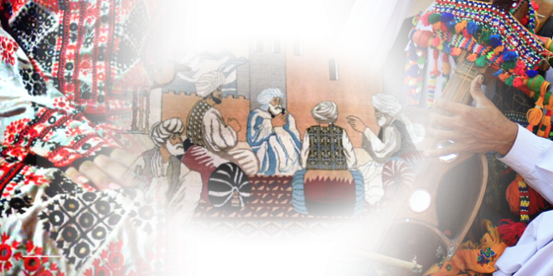
Pakistani Baloch Culture
Pakistani culture and its people always use to display various colorful customs, traditions. People of Balochistan constitute a number of tribes. Three major tribes are Pashtoon, Baloch Baloch & Brahvi. Balochistan portrays various groups. People speak different languages.

Slide 48
Baloch Culture
The people of Balochistan are very loving and leading a very simple life. The formation of villages with having houses made of mud, are a big attraction for the guests and tourists.

Slide 49
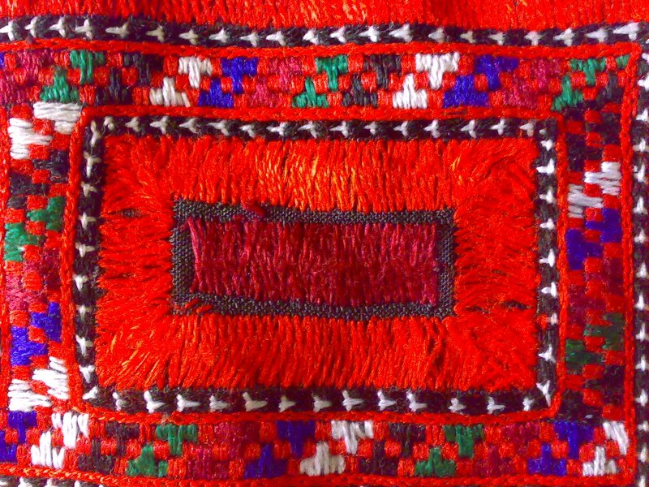

Slide 50
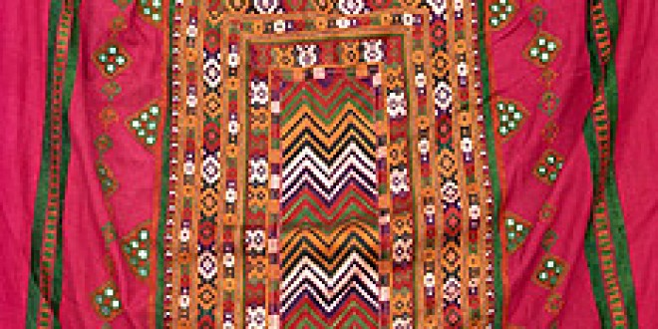

Slide 51
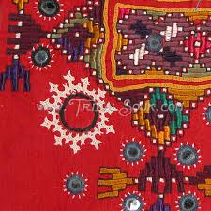

Slide 52
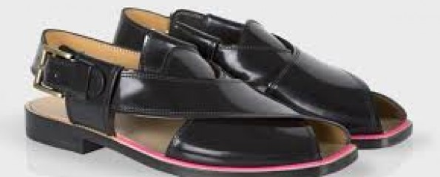

Slide 53
Pakistan frequently appear to debase their picture and everything connected to the Pakistani picture, if it be our customary shoes fabrics, accessories or anything other than connect to Pakistan tradition, Pakistan’s Peshawari chappal was embraced by one of the outside designer ” Paul Smith” looking to some extent like the traditional Peshawari chappal.

Slide 54
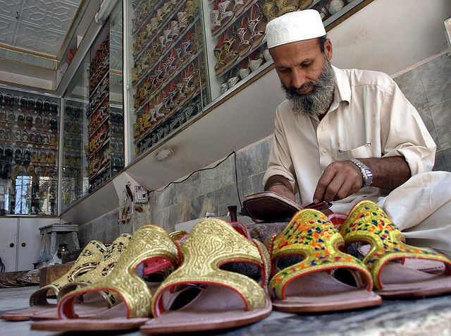

Slide 55
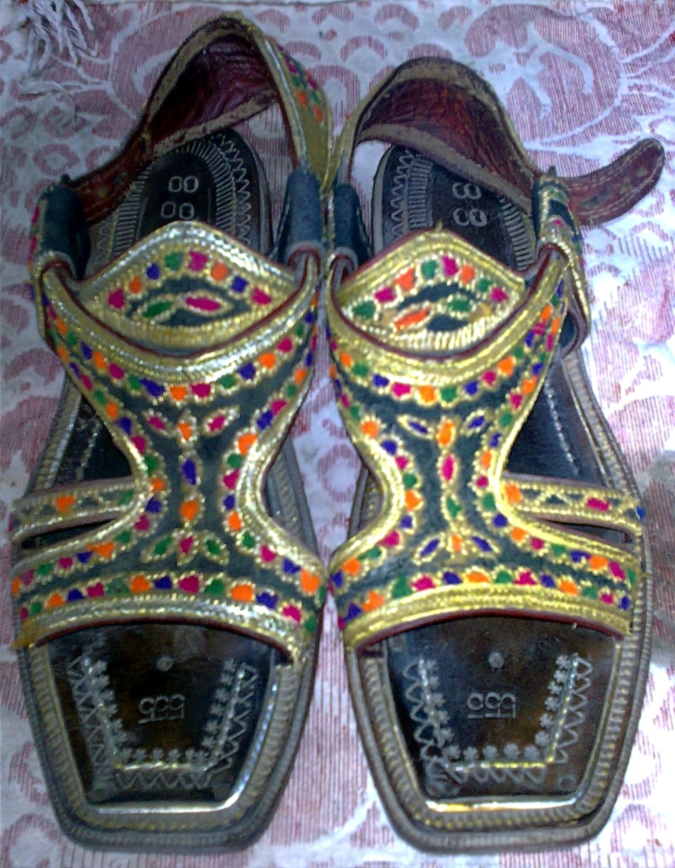

Slide 56
Khussa is a style of South Asian handcrafted footwear produced in Punjab Pakistan.
Khussa are made by artisans mostly using vegetable-tanned leather. The uppers are made of one piece of leather or textile embroidered and embellished with brass nails, cowry shells, mirrors, bells and ceramic beads. Even the bonding from the upper to the sole is done by cotton thread that is not only eco-friendly but also enmeshes the leather fibers with great strength. Some product range also uses bright and ornate threads

Slide 57
In ancient times these were worn by multitude and royalty. As it evolved through the centuries and is being produced by individual artisans, products vary in designs and colours. It encapsules cultural diversity, local ethos and ethnicity.
The ethnicity of the traditional skills accentuate into poetry when intermingled with the contemporary colours and designs. Applique in form of differently designed figures are cut out of leather and sewn on the vamp manually. The design would dictate the nature, colour and shape of the appliqué. It could range from an intricate appliqué which itself could incorporate other design features like embroidery, punches, weaves, etc., to a simple cut out shape from any material like leather, textile, synthetic, etc.

Slide 58
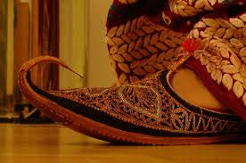

Slide 59
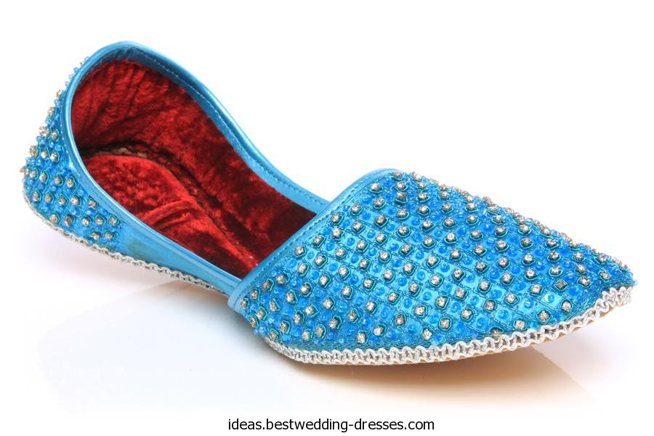

Slide 60
SUMMERY OF TODAY”S LECTURE

