Slide 1
LECTURE. 21. Unit. 3.
PAINTING:
Painting in different mediums
Water colour painting
Oil Painting
Acrylic Painting

Slide 2
Summery of Lecture .20. Unit. 3
Drawing
Pencil drawing, graphite drawing, crayons, Pastels, etc.
Shading techniques.

Slide 3
Step by Step Painting Techniques: Learn to Paint with Free Painting Tips on Making Corrections, Paint Texture and Painting Materials
Learning to paint can be an intimidating process, but with free expert tips, you can master basic painting techniques in no time. Learn to paint a picture you can be proud of by using our expert tips on how to paint texture, making corrections,

Slide 4
and selecting the appropriate painting supplies to accomplish different brushstrokes. This painting tutorial offers surface mixing tips for an extensive range of color using oil, watercolor, or pastel, and the importance of priming and staining to prevent surface absorption. Master basic painting tips and expert painting techniques today with this free eBook from Artist Daily!

Slide 5
Whether you're seeking tips on painting for beginners or you're a veteran painting artist, this free collection of techniques will teach you step-by-step techniques. This guide to painting techniques will be one you turn to again and again. Let expert painting artists guide you through the steps to learn how to paint a picture that is dynamic in color and full of texture. If you've always wanted to learn how to apply basic paint techniques to improve your art, this eBook is for you!

Slide 6
Painting Techniques: Priming and Staining
Both oils and acrylics can be applied to raw canvas, but the canvas will abs orb the first layer of paint, so it is customary to apply a coat of primer. This acts as a barrier between the paint and the canvas. Paper, which can be used for both acrylics and oils, can be primed in the same way.

Slide 7
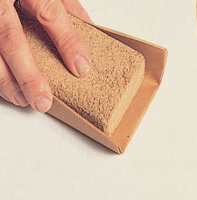
Learn essentials to preparing your work and the painting supplies needed for priming and staining your canvas or paper in this free eBook.

Slide 8
Painting Tips: Building Up Oil and Acrylic
The process of building up an oil or acrylic painting is largely an individual matter. Some painting artists like to cover the canvas as quickly as possible, starting with an under-painting in thin, diluted paint that dries very quickly. This allows them to establish the main blocks of tone and texture. Apply the skills you can learn from this free eBook to paint texture in your artwork.

Slide 9
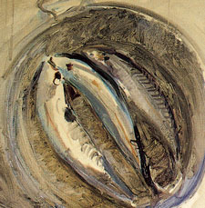

Slide 10
Paint Techniques: Surface Mixing
Unlike paints, pastel colors cannot be mixed in a palette before being applied to paper. Instead the colors are mixed on the paper itself. Even if you have an extensive range of pastel colors, some surface mixing is almost always necessary. Learn how to build up overlays of color to set the tonal key for your next painting. Learn to paint pieces that are lively and full of dynamic color using tips from this free eBook.

Slide 11
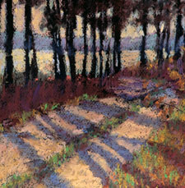

Slide 12
Learn to Paint Texture: Brushwork
The marks of the brush have played an important part in paint techniques since first Titian, then Rembrandt, began to exploit them in contrast to the smooth surfaces and subtle blends preferred by earlier painting artists. Brushwork can be very helpful for painting texture and adding detail to objects in your painting. The extent to which brushwork is used in an acrylic painting depends on the painting artist. One painting artist might use brushstroke similarly to their work with oil, while another might exploit the value acrylic has with flat color.

Slide 13
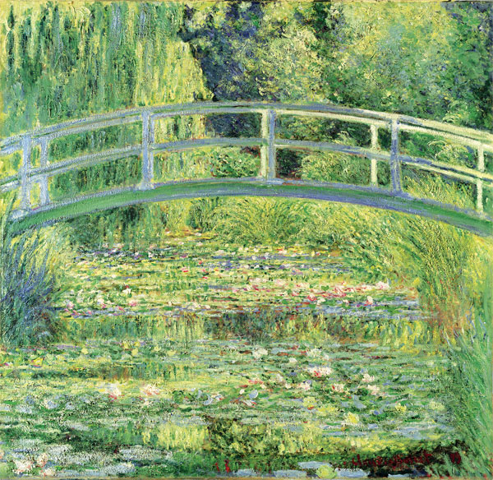

Slide 14
Painting Lessons: How to Make Corrections
Nothing is more frustrating than discovering halfway through a painting that something has gone awry; maybe the colors don't harmonize or object is in the wrong position. Thankfully it is often possible to put things right. In painting, for beginners especially, mistakes should be seen as part of the learning curve. There are easy ways to correct your mishaps. Learn easy tips from other painting artists that have worked for them in this free eBook.

Slide 15
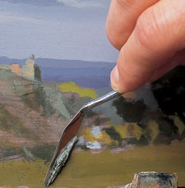

Slide 16
A painting that is free of error from the artist's perspective definitely takes skill. Sometimes the first try isn't always a success. Learn how to make corrections easily to improve your painting art at the early stages to avoid even more problematic fixes to your work later on. Download this free eBook full of free painting lessons today and begin understanding basic painting techniques to accomplish stunning artwork and the painting supplies you'll need to do so.

Slide 17
Start practicing your newly discovered painting techniques today to get the most satisfaction from your painting art. Painting, for beginners, can be a challenge. But with free tips in this eBook, you can discover how rewarding learning how to paint can be. Explore the painting techniques experts from Artist Daily find helpful in their painting art and apply it to your work. Step by Step Painting Techiques could be the first step of growth for anyone to learn to paint.

Slide 18
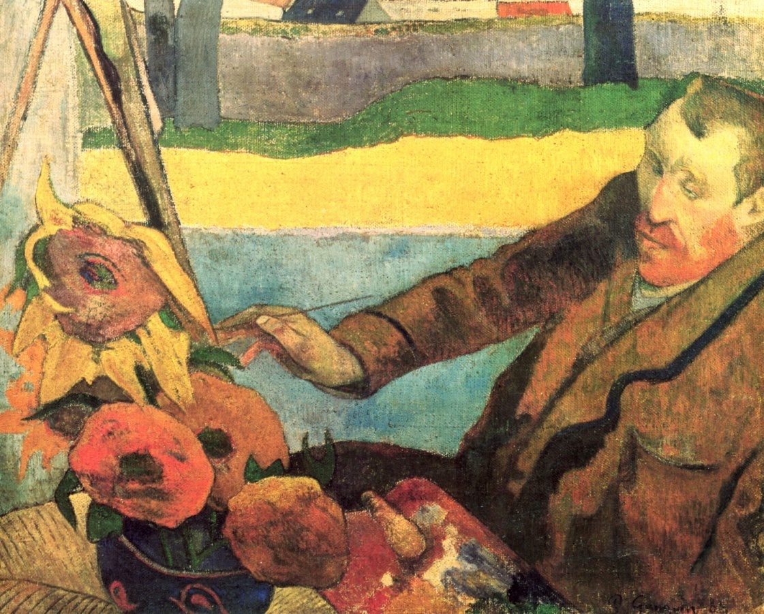

Slide 19
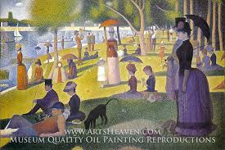

Slide 20
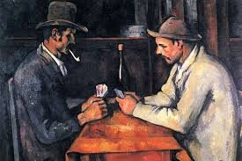

Slide 21
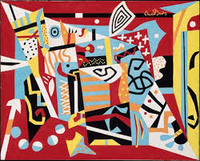

Slide 22
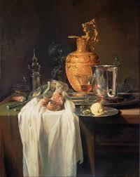

Slide 23
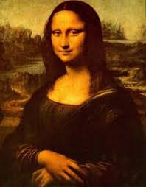

Slide 24
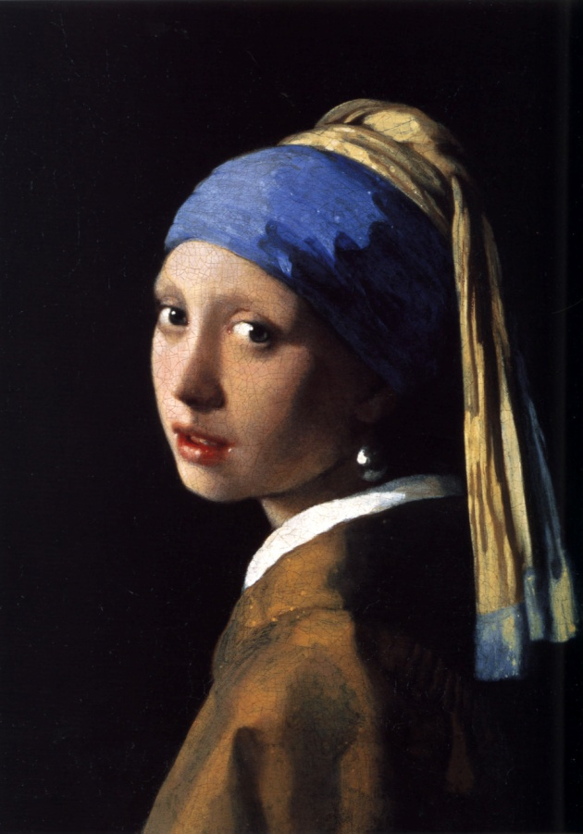

Slide 25
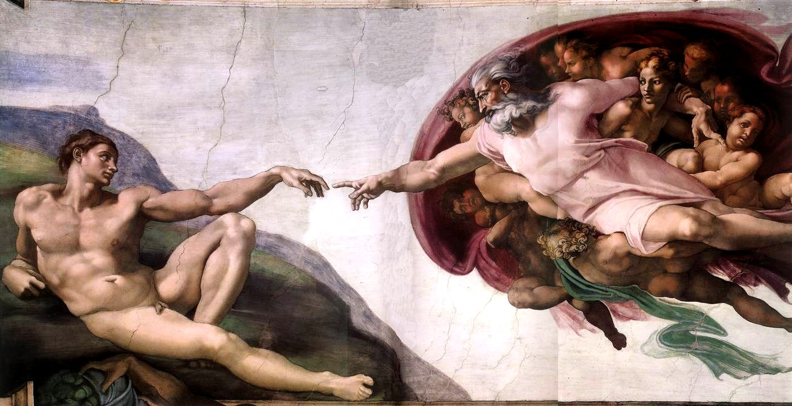

Slide 26
Playing with water colour with different techniques.
DRY BRUSH
WET BRUSH
SALT
Different artists have explored different creative ways to bring various forms of textures to their paintings. So we will discuss few techniques of water colour, but as we all know that art is not to restrict to any traditional ways but it is to experiment with different ways and materials.

Slide 27
Dry Brush technique:
Dry brush is a versatile and creative technique that places more pigmenr and less water onto the surface of paper. The technique works besrt on water colour paper. That has a nice texture to it, as cold pressure or rough.
How to do dry Brush technique:
First load brush with colour and blot several times onto a paper towel.

Slide 28
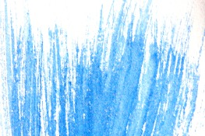
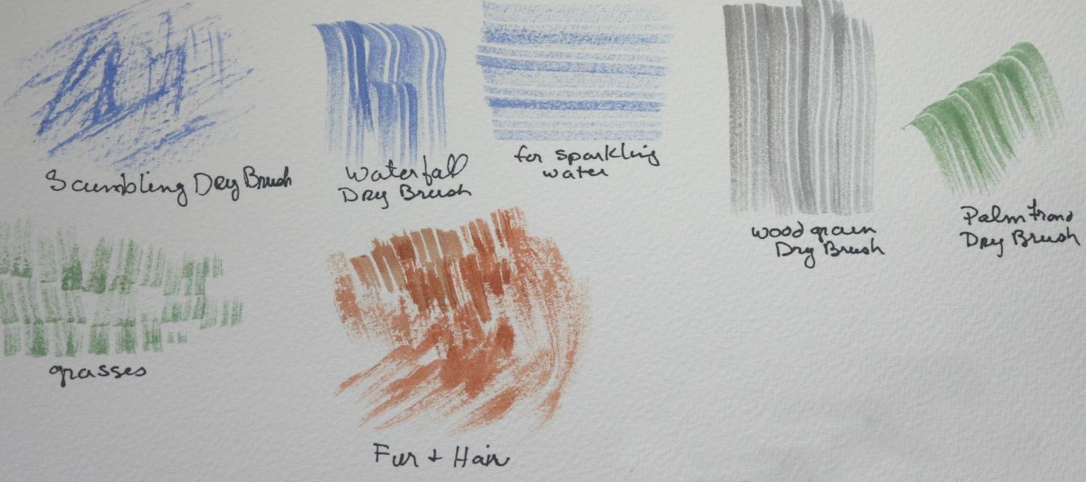

Slide 29
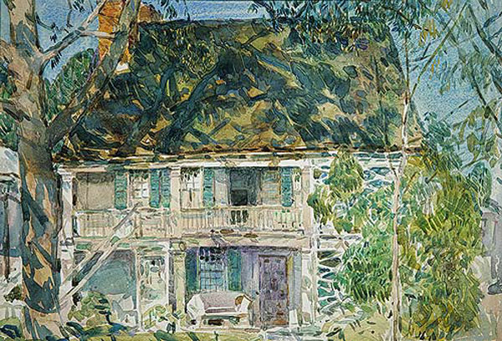

Slide 30
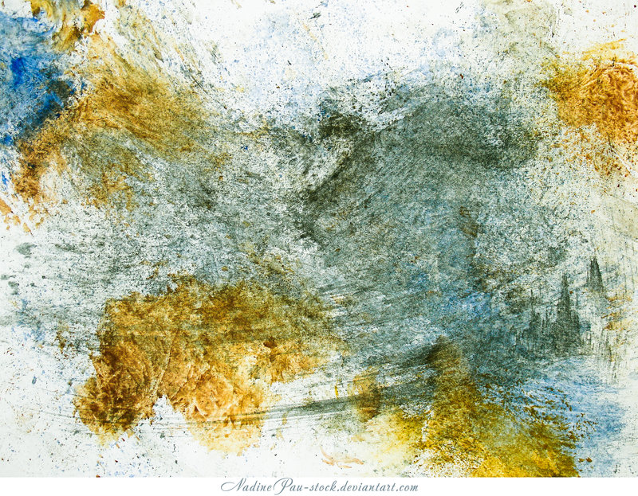

Slide 31
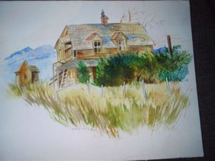

Slide 32
dUsing only the side of your brush hairs, light over the texture of the paper. To deepen the value, repeat the skimming strokes again, after the surface has been allowed to dry.

Slide 33
Wet to wet Technique
Wet to wet is another versatile and popular technique where water colour, water, is dropped onto a wet surface. This is a great background in your painting.
How to do wet on wet technique:
First apply clen water to the area you will be painting. When the sheen is almost gone, begin painting in your colours. You can also water on top to creat more effects.

Slide 34
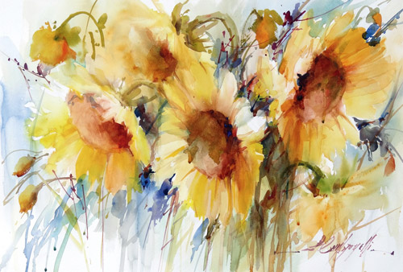

Slide 35
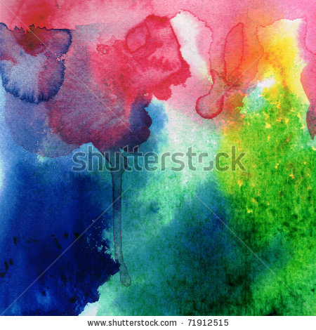

Slide 36
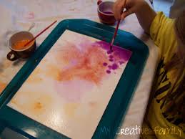

Slide 37
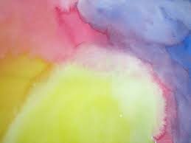

Slide 38
For cteatiing best results , keep the values of your colours close to the same. Also wait for the sheen to be almost gone before dropping another colour on top of a previous one. Otherwise, your surface, your surface will be too wet and the colours may not create the right effect.
d

Slide 39
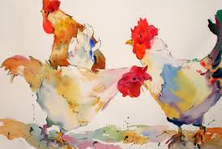

Slide 40
Salt Technique
The salt technique is both a fun and creative way to add a different type of texture to your painting. You can use table salt to achieve a smaller and tighter appearance, or sea salt which will give you a larger pattern and effect

Slide 41

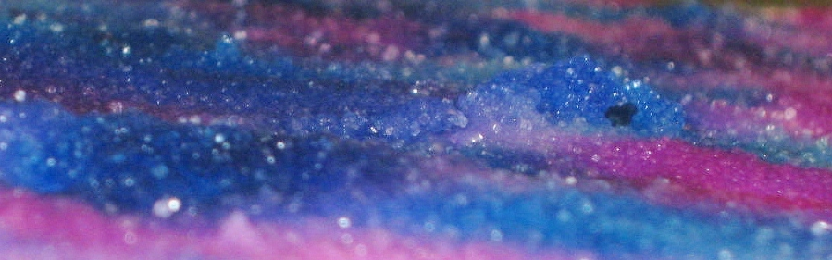

Slide 42
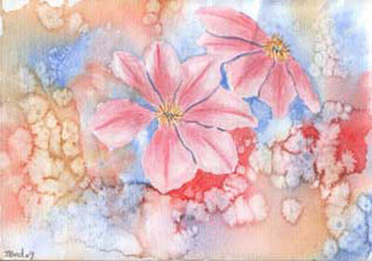

Slide 43
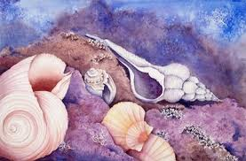

Slide 44
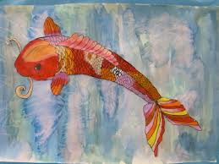

Slide 45
How to do the salt painting:
First paint the area where you would like to apply salt. When the sheen is almost gone, e a pinch of salt and sprinkle over the area you would like to see the texture. Let dry completely, but do not leave the salt on your painting. As soon as the salted area is completely dry, lightly brush away the salt with a paper towel.

Slide 46
How to paint in Acrylics;
Painting is one of the most rewarding ways to artistically express yourself, and starting that odyssey by learning how to use acrylic paint is a smart decision because the medium is flexible and durable. Using acrylic paint is considerably more affordable than working with oilsâ€”a significant boon for the beginning painter.

Slide 47
The First Lesson in Acrylic Painting: Understanding the Medium
Of the many acrylic painting lessons you will certainly learn, many would argue that the first lesson should be understanding the medium itself. Simply put, what is acrylic paint?

Slide 48
The answer is a water-soluble medium made from a synthetic resin binder mixed with pigments. The water soluble aspect of acrylic paints means that a painting dries quickly and you do not have to use solvents to dilute the paint or for cleaning brushes or a palette. But after an acrylic painting on canvas dries the surface becomes water resistant, and a canvas can be rolled up and stored with no fear of cracking or damaging.

Slide 49
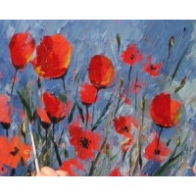

Slide 50
This is all in contrast to oil paints, which need to be thinned with solvents, take much longer to dry and harden as they do so, making them quite fragile and not so easily transported. Acrylic painting, for beginners, can be an exciting prospect because acrylics have so much versatility. Youâ€™ll notice when painting with acrylic paint that they dry to a flat finish.

Slide 51
But mediums abound that can be added to the paints to increase luminosity or to get a matte or semi-matte finish. Acrylic pigments can also be diluted with water or a medium to create watercolor-like transparent washes. You can add mediums that thicken acrylic paint as well, which is ideal if you want more noticeable brushstrokes as you put acrylic paint on canvas.

Slide 52
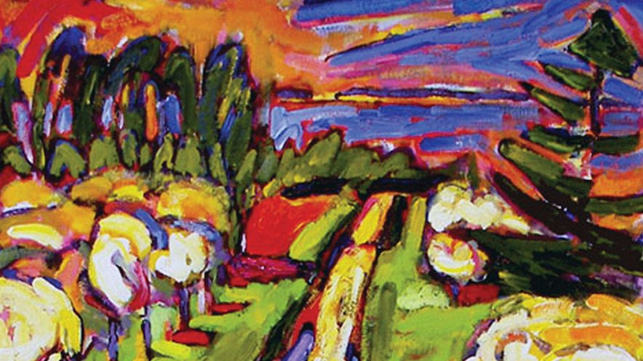

Slide 53
Getting Started: The Basics of Acrylic Painting
To get started, a few acrylic painting basics include choosing a painting surface that does not contain oil or wax, to which acrylic paints just wonâ€™t adhere. Also, certain pigments arenâ€™t always available by the same name from acrylic paint manufacturers. The brand of paint you choose will likely have the colors you want, but you just may have to search through a few name variations.

Slide 54
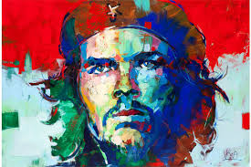

Slide 55
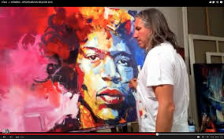

Slide 56
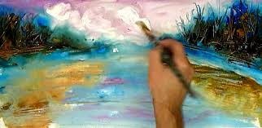
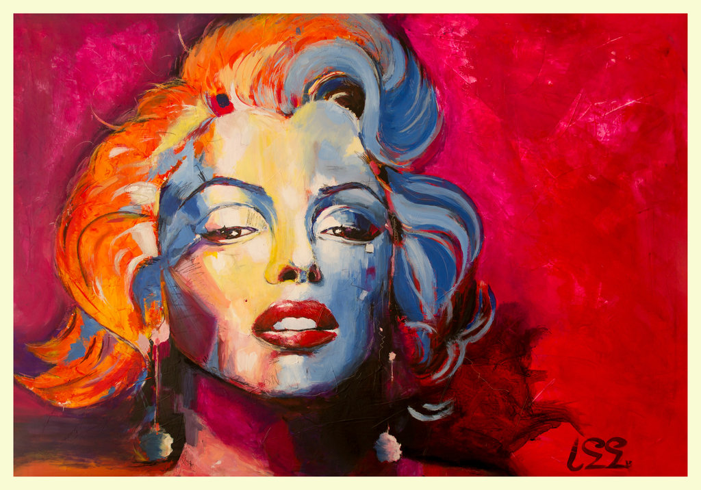

Slide 57
Another of our acrylic painting tips is try to resist mixing pigments too much or adding more than two or three colors to a mix because you run the risk of muddying your acrylic paints. Also, when acrylic paint is first put down, colors can look lighter than and not as bold as they will when they dry, so be patient as you first start out.

Slide 58
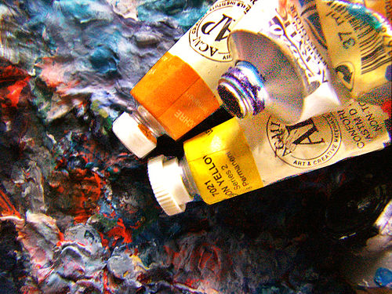
How to Make Better Oil Paintings: Tips & Techniques for Correctly Mixing Color
Do you want to paint beautiful, expressive paintings with oils? Here are some basics to guide you into the wonderful world of oil paints. Once you've mastered the basic techniques, the world is your canvas!

Slide 59
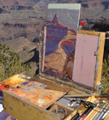

Slide 60
Choose your paints. Before you can even consider oil painting, you must get oil paints. Although there are dozens of brands of oil paint on the market, don’t be drawn in by the attraction of budget supplies. Buying cheap, poor quality supplies will make your painting difficult, tedious, and frustrating. Paying a few dollars more will give you paints that require one coat instead of two or three for the same vibrancy and blend-ability.

Slide 61
The most basic collection of oil paints should include the following colors: cadmium yellow, yellow ochre, cadmium red, alizarin crimson, ultramarine blue, titanium white, and mars black. You can use a combination of all of these colors to make any hue on the color wheel.

Slide 62
You will find that you likely will run out of white paint the fastest, so buy a large tube of this while purchasing small or medium tubes of paint for the others.
Avoid buying “student sets” of paint, as these will seem like a good deal, but offer the poorest quality supplies. Also avoid buying sets of paint that come with paint brushes, as the brushes will likely be of poor quality as well.

Slide 63
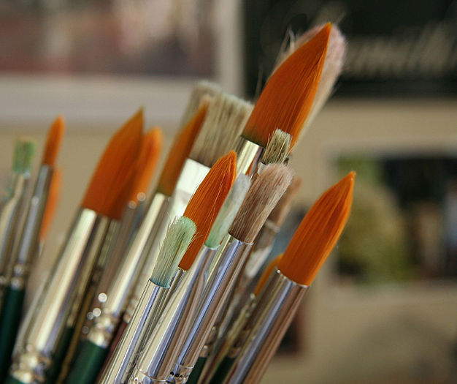

Slide 64
Get the rest of your materials. Beginning painters often fall under the tendency to avoid getting certain supplies to save money. While this is a perfectly all right practice, there are a few basic painting essentials you will need to make oil painting enjoyable and easy.

Slide 65
Choose a few basic paintbrushes of a high quality material. You don’t need many brushes to start out, but get a few of each kind. Start with differing sizes of round, flat, and bristle brushes.
Synthetic brushes are made of a very soft, fine bristle while natural hair brushes are a bit rougher. Use both for different painting techniques.

Slide 66
You will also need a palette knife for blending paints, a painting palette, canvas boards or stretched canvas, and some old rags and jars for cleaning your brushes. Use linseed oil, poppy oil, or terpentine to create a blending medium. Oil paint is very thick directly out of the tube, and must be made thinner for the first layers using a blending medium.
Optional supplies include an easel or drafting desk, an apron, a drop cloth, and a specialized box for carrying all your supplies.

Slide 67
Set up your work area. Because oil painting does require a lot of supplies, you will need a large area to use. Set up your easel or table in an area that is away from foot traffic and direct sunlight, if possible. If you have one, lay a drop cloth down to prevent any paint spills from ruining your floors. Oil paint can give off fumes, so make sure that your area is well ventilated with an open window or door.

Slide 68
If you are using an easel, adjust it to the correct standing or sitting position and angle. Make sure that it is sitting in such a way to make painting comfortable for you, not difficult.
Put on old paint clothes to protect your nice clothes and skin. Oil paint is notorious for being exceedingly difficult to clean off, so make sure that you take precautions to avoid coming into contact with it.
If you have long hair, pull it up into a ponytail or bun to make sure that it does not fall in the paint. Remove any rings or bracelets that you might be wearing.

Slide 69
Assessing Your Painting
Create a rough sketch. Use a hard pencil to create a light sketch of your subject. You can do this directly onto the canvas or onto tracing paper, and transfer it using a carbon copy. When you’re drawing your subject, keep in mind the composition and use of negative space.
  Composition is the placement of items on the canvas. Choose the best placement so that the eye is drawn around the entirety of the canvas, rather than left to linger on a single spot.

Slide 70
Negative space is the space around an object. If you are using an item in real life and are drawing it onto your canvas, draw difficult areas by looking at the space around the figure rather than at the figure itself. Consider what you will fill the negative space with once you start the painting in order to make your subject pop.
Make note of overlapping figures, as these add depth to your composition. If your subject doesn’t have any overlapping shapes, consider rearranging until you do. This will add realism to your painting.

Slide 71
Find the light source. To create a realistic painting, you must have obvious patches of light and dark. Look at your subject and determine the angle at which the light is coming from, and where shadows and highlights are located. All light sources cast shadows, but if they are directly above the subject it can be difficult to see them. Try moving your light or your subject so that the shadows and highlights are more obvious.
You may not have incredibly dark shadows or incredibly bright highlights.

Slide 72
In fact, you likely will have a range of values that are all very near each other. Don’t be concerned if your light source isn’t creating a strong definition of shadows and highlights.
Consider your colors. For new painters, it is often very difficult to match the colors of their subject to the colors they mix with their paint. This is because the brain provides an idealized color value; you see the sky is blue, so you mix blue paint, only to realize that your paint is much brighter and colorful than the actual sky. The trick is to get past the symbols of color our brain uses, and examine the actual colors being used. This will change the brightness of your paints.

Slide 73
A painting set at night will be darker and richer than one during the day, which is most likely brighter.
Check the color of the light source; on a bright sunny day, your subject will have a golden glow. On a gray day, the light is diffused through the clouds giving your subject a gray tint. You may also have actual colored lights - such as neon signs or tinted light bulbs - that affect the colors of your subject.

Slide 74
Look at the movement of your subject. Are you painting a still life with little to no movement? Or is your figure in a field on a windy day, creating a lot of motion? Paying attention to the movement of your subject is important for planning your brush strokes. Realistic paintings have brush strokes that create movement, or a lack thereof.

Slide 75
Mix your paints. Oil paint is extremely forgiving in the sense that it takes many days to begin to dry. However, it is nearly impossible to mix the same paint twice so mix your paints in large batches and preserve between painting sessions so that you always have enough of the right color. Use a color wheel to help you find colors to mix. The color wheel shows primary, secondary, and tertiary colors and how to make them.

Slide 76
Pure hues are colors that have not been mixed with either white or black. You can mix the primary colors to create the secondary colors.
To create a tint, add white to your paint. This will lighten it and make a more pastel color.
To make a shade, add black to any paint color.
To make a tone, add white to a shade (any color with black added). Tones are the most widely used, as they represent most of the everyday colors we see.

Slide 77
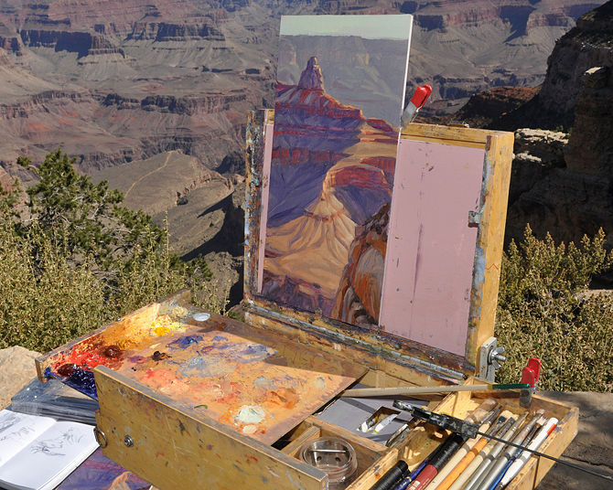

Slide 78
Begin painting. You can choose whatever painting technique you like, whether that be painting entire sections to completion or putting layers of paint over the entire canvas. When oil painting, though, use the thin-to-thick method in which you paint with thin paint before using thick paint. Try painting basic subjects. All figures are made up out of a few basic shapes: the cube, cone, cylinder, and ring. Paint these in the form of real subjects, such as a box or orange, or paint a flat form of each.

Slide 79
To thin your paint, use a blending medium (linseed oil or terpentine) mixed with your paint. Don’t use too much to start, but gradually add more until you get the consistency you want.
It takes three days for a layer of paint to dry enough to add a second layer to the top, so be patient while you wait for your paint to dry.

Slide 80
Try different techniques. There are dozens of ways to perfect your painting, but learning them all as a beginner can be overwhelming. instead, focus on picking up some of these techniques one at a time. Try blending your paints. This is the process by which you slowly fade two or more different colors (think of a sunset). To do this, add layers of paint so that they are directly adjacent to each other on the canvas. Then, use flat brush to smooth the paints together, working with the direction of the blend.
Try creating a glaze. This is when you use a solution of 1/3 linseed oil,1/3 terpentine, and 1/3 varnish to create a transparent color. You can use this mixed with any paint color to create a see-through hue over dried paint.

Slide 81
Use stippling to create small dots. Use a natural bristle brush (dry often works best), and tap it vertically against your canvas. You can build up these dots to create a more opaque figure.
Try using a palette knife to paint. This technique is great for landscapes and creating movement on your canvas. Scoop up a bit of paint on the bottom edge of the knife, and sweep it across the canvas to create thick layers of paint.^{[4]}

Slide 82
Finishing Your Painting
1.Correct any mistakes. You have about three days (while the oil paint is wet on the canvas) when you can alter any mistakes or remove them completely with a damp rag. Before you decide the painting is complete, take a step back and look at your painting in its totality to see if any changes are needed.

Slide 83
2. Save unused paint. If you have a lot of paint left on your palette that was not used, save it for your next painting. Scoop it into small containers or into piles on your palette and cover with saran wrap. Clean your paint brushes. Oil paint will ruin your brushes if it is allowed to dry, so clean your brushes immediately after use. Use turpentine and an old rag to wipe away as much of the paint as you can then rinse them under warm water with a little washing up liquid. You can brush the bristles against the palm of your hand to make sure all the paint has been removed. Put the clean brushes, bristle-end up, in a jar or cup to dry. Make sure that the brushes get adequate air circulation until they dry: Put your brushes them in an open area-- on a shelf or desk, for example, not in a closed cabinet or drawer.

Slide 84
4.Wait. For oil paint to dry completely, it may take up to 3 months, even longer if your painting has many thick layers of paint. Put your painting where it won’t be disturbed or damaged and allow it to air dry for the necessary time.
5. Add a coat of varnish. When your painting has dried completely, add a coat of varnish to protect it and preserve the color. When the protective varnish has dried, you’re done! Hang your beautiful creation for all to see!

Slide 85
Tips
Ivory black is very slow to dry: Avoid using it as an undercoat.
Avoid using linseed oil as a medium for light colors: They will yellow quickly.
To clean oil paints off your hands: Use baby oil or olive oil. Pour some baby oil onto a wipe or a rag, and wipe your hands off. Don't wash your hands before the oil paint comes off, or else this method may not work. Oil paint comes off easily off hands when combined with other oil, and when the paint is all off, then wash your hands with soap and water.

Slide 86
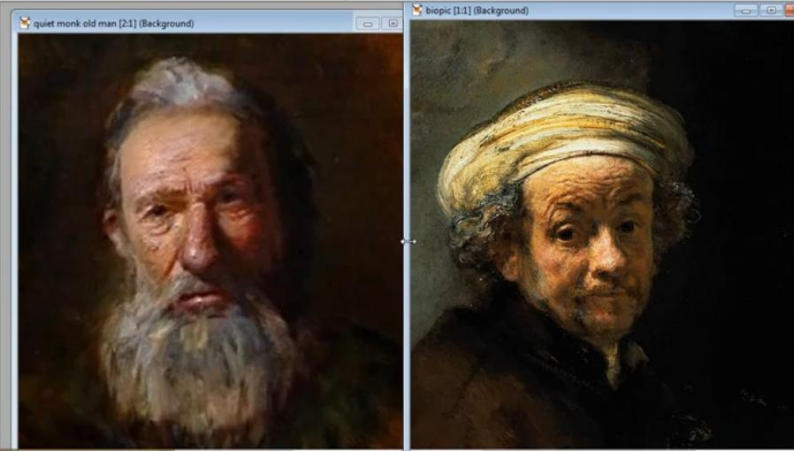

Slide 87
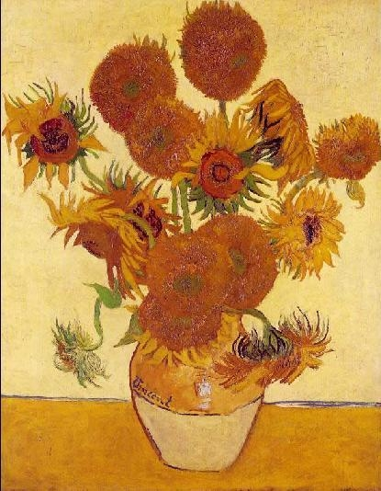

Slide 88
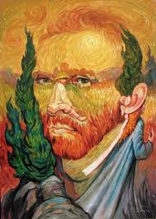

Slide 89
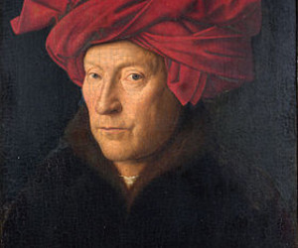

Slide 90
