Slide 1
Summery of previous lecture Art, craft, calligraphy introduction
COURSE DESCRIPTION
Teachers Education course
Knowledge on Art, Craft and Calligraphy with relation to Pakistani artist and Craftsman
Practice of making their own Art works
Roll of Art in child development
Importance of Art and craft in Curriculum and relationship with other subjects
Class room planning and Evaluation of Art works

Slide 2
COURSE GOALS
Student teacher will enhance the importance of art education in child development.
They will recognize and make their students recognize and appreciate the artists, art styles and work.
Origin and development of art and crafts in Pakistan.

Slide 3
Student teacher will learn a variety of making art.
Principles and elements of design and its application.
Discus links between art, craft and calligraphy and other subjects.
Evaluation and appreciation of art works by students.
presentation of portfolio related to their knowledge gathered after this course.

Slide 4
LEARNING AND TEACHING APPROACH
Student teacher in this practical oriented course will communicate the knowledge in an interactive way according to their learning abilities.
Personal interest will be inculcated in Art, Craft and Calligraphy, so that they could communicate with elementary class room.
Elementary students visits to the Museums art galleries and crafts man will be planed irrespective of place.
Portfolio making and portfolio assessment at the end of the course.

Slide 5
LECTURE 2. Unit 1.
Introduction to the Art, Craft and Calligraphy
Introduction to art education
Overview of the course.

Slide 6
LECTURE. 2. UNIT. 1
INTRODUCTION TO ART EDUCATION
Definition of art Education.
What is Art?
What is Craft?
What is Calligraphy?
Art and craft are related to each other like glass and jug or cup and saucer.
Creativity is essential for both.

Slide 7
Different definitions of art.
Art education is the area of learning that is based upon the visual, tangible arts—drawing, painting, sculpture, and design in jewelry, pottery, weaving, fabrics, etc. and design applied to more practical fields such as commercial graphics and home furnishings.

Slide 8
Meaning of art is debatable, and somewhat ambiguous.
Art is not a thing it’s a way.
Art is something less directed it is more creative.
Art has less defined goals.
Art enables us to find ourselves and as well as to loose ourselves.

Slide 9
There is actually no such definition that is convincing enough for all.
The expression or application of human creative skill and imagination, typically in a visual form such as painting, or sculpture, producing works to be appreciated primarily for their beauty or emotional power.

Slide 10
An other definition of art is
the various branches of creative activity, such as painting, music, literature, and dance.
Human effort to imitate, supplement, alter, or counteract the work of nature.

Slide 11
a. The conscious production or arrangement of sounds, colors, forms, movements, or other elements in a manner that affects the sense of beauty, specifically the production of the beautiful in a graphic or plastic medium.
b. The study of these activities.
c. The product of these activities; human works of beauty considered as a group.

Slide 12
The Definition of Art
First published Tue Oct 23, 2007; substantive revision Tue Oct 9, 2012
The definition of art is controversial in contemporary philosophy.

Slide 13
Whether art can be defined has also been a matter of controversy.
Contemporary definitions are of two main sorts. One distinctively modern, conventionalist, sort of definition focuses on art's institutional features, emphasizing the way art changes over time, modern works that appear to break radically with all traditional art.

Slide 14
The less conventionalist sort of contemporary definition makes use of a broader, more traditional concept of aesthetic properties that includes more than art-relational ones, and focuses on art's pan-cultural and trans-historical characteristics.

Slide 15
Definition and conclusion of art is equally difficult, but can be concluded that art is some thing that is creative, related to beauty or sometimes not related to beauty, but deals with the inner feeling as well as knowledge and concepts of art. Art also deals with skills and learning of the tools of art. The broader spectrum of art deals with the branches of art. Art is produced with lesser defined goals in the mind of the artist.

Slide 16
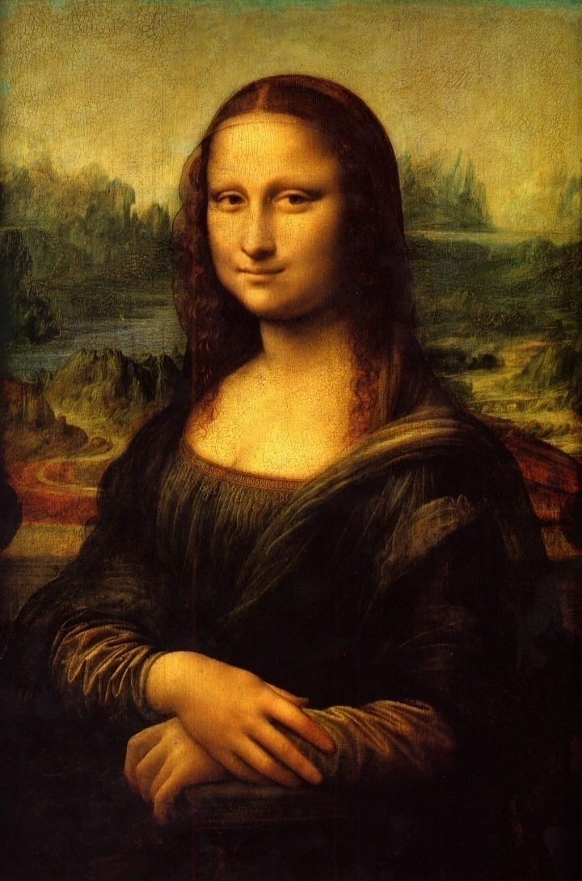
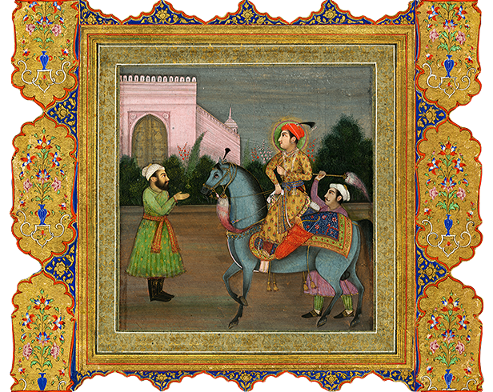
One of the important branch of art is painting, examples from eastern and western art

Slide 17
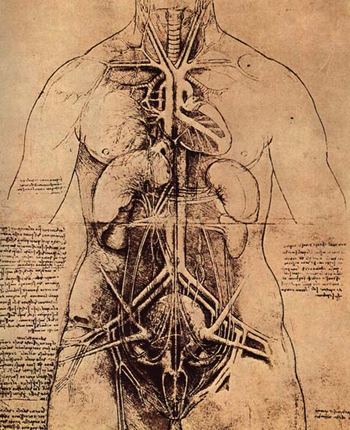
Drawing of Leonardo de Vinci

Slide 18
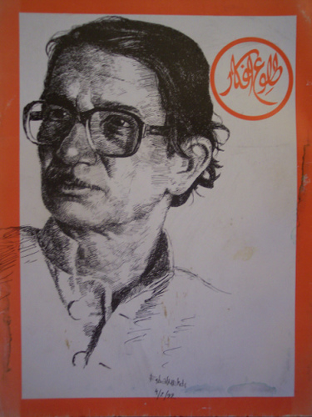
Self Portrait of Sadeqain

Slide 19
Now the second question related to this course is, What is craft?
Craft is an activity that uses specific materials with a certain goal in mind. Usually a craft has a set of directions and skills to make to a finished product. The creator of craft learns to follow directions and solve problems while working towards a goal.

Slide 20

Craft is something made with hand with a specific goal in mind for an end product

Slide 21
To have a convincing answer to what is craft? Lets discuss some more definitions of Craft.
Craft as a verb means, exercise skill in making (an object), typically by hand.
an activity that involves making something in a skillful way by using your hands

Slide 22
Craft is a job or activity that requires special skill.
crafts : objects made by skillful use of the hands.
A craft is an activity such as weaving, carving, or pottery that involves making things skillfully by hand, often in a traditional way. When craft has this meaning, its plural form is crafts.

Slide 23
CONCLUSION OF DIFFERENT DEFINITIONS OF CRAFT.
Craft is a tangible object produced by the craftsman manually with a well defined goal using his creative abilities.
an art, trade, or occupation requiring special skill, especially manual skill, that can be reproduced, in a skillful way at a mass scale.

Slide 24
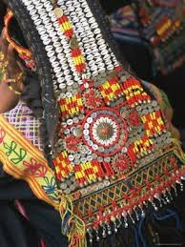
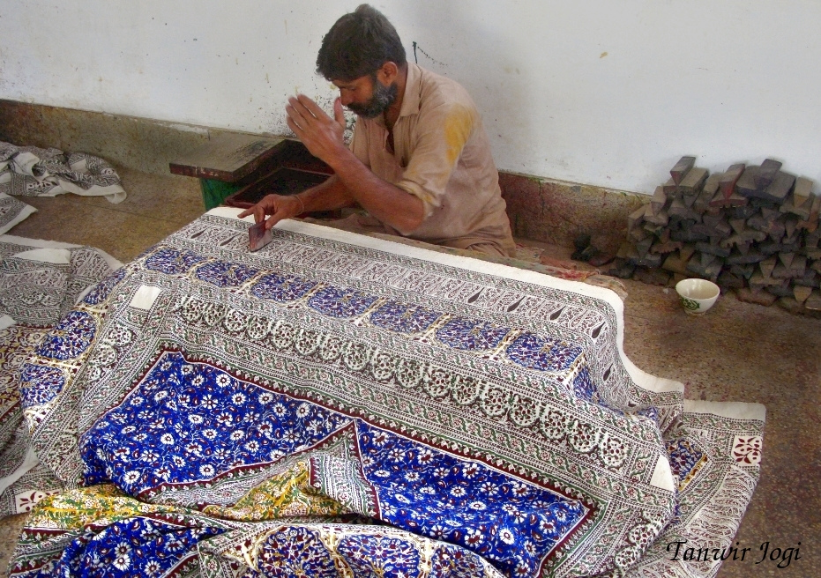
Examples from crafts

Slide 25
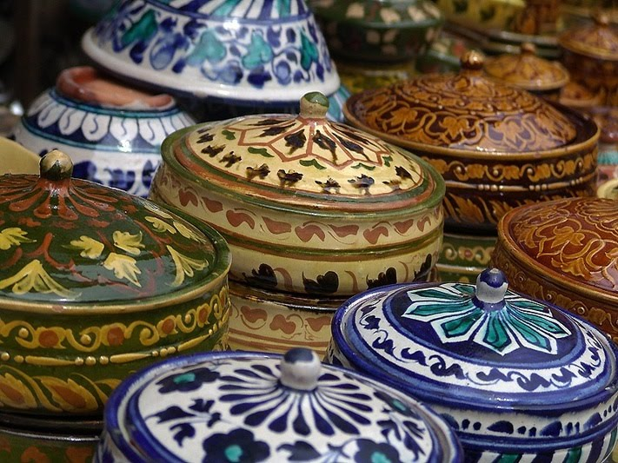
Craft

Slide 26
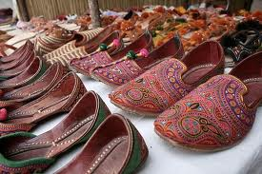
Craft

Slide 27
DIFFERENCES AND SIMILARITIES IN ART AND CRAFT
The difference between art and craft is that in art, object made are for beauty and decorative purposes while objects produced in crafts are mostly functional though also decorative. Crafts include ceramic pottery, glass and basketry while art includes painted portraits and sculptures. The distinction between the two terms increasingly becomes unclear as others consider them one and the same thing.

Slide 28
Art vs Craft
Most people do not see any difference between art and craft as they are both considered to be forms of creativity. Let’s consider how art and craft differ.
Art is a form of work that is the expression of emotions. Craft is a form of work, which results in a tangible output, for example, molding and carving.

Slide 29
Art is often described as unstructured and open ended. It has no limitations of expression, just like in painting. Craft on the other hand is structured, which means that it has a certain form that is visible.
While Craft can be quantified, this is more difficult to do with art.

Slide 30
Another thing that can be seen is that one can create duplicate craft forms, which is not possible with art. It can also be seen that art forms move people on an emotional level whereas crafts attract people.

Slide 31
For example, a piece of painting can create emotions in a person whereas a piece of jewellery or pottery can be an attraction.
Unlike craft, art is known to come out of the heart and soul. Crafts come out of the mind and need considerable practice to come out with world-class forms.

Slide 32
What is Calligraphy:
decorative handwriting or handwritten lettering.
the art of producing decorative handwriting or lettering with a pen or brush.
fancy penmanship, especially highly decorative handwriting, as with a great many flourishes.

Slide 33
Few definitions of Calligraphy:
A script, usually cursive, although sometimes angular, produced chiefly by brush, especially Chinese, Japanese, or Arabic writing of high aesthetic value.
Fine Arts. line or a group of lines either derived from or resembling letter forms and characterized by qualities usually associated with cursive writing, especially that produced with a brush or pen.

Slide 34
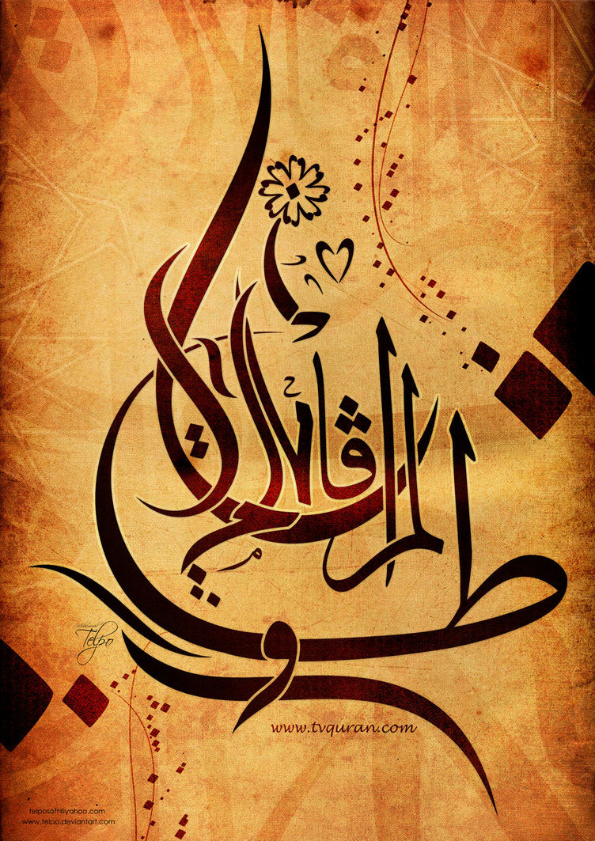
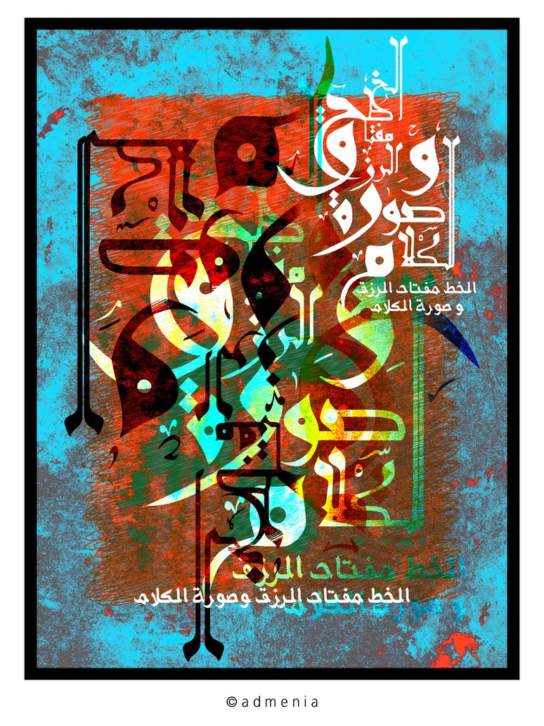
Arabic Calligraphy

Slide 35
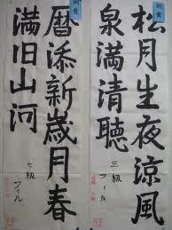
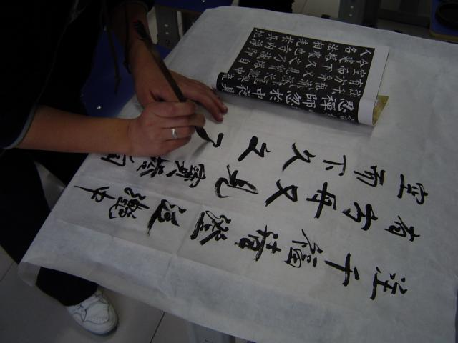
Japanese and Chinese calligraphy

Slide 36
handwriting, esp. beautiful handwriting considered as an art.
beautiful writing done using special pens or brushes.
Calligraphy (from Ancient Greek: κάλλος kallos "beauty" and γραφή graphẽ "writing") is a visual art related to writing.

Slide 37
It is the design and execution of lettering with a broad tip instrument or brush in one stroke (as opposed to built up lettering, in which the letters are drawn). A contemporary calligraphic practice can be defined as, "the art of giving form to signs in an expressive, harmonious, and skillful manner.

Slide 38
Modern calligraphy ranges from functional inscriptions and designs to fine-art pieces where the letters may or may not be legible. Classical calligraphy differs from typography and non-classical hand-lettering, though a calligrapher may practice both.

Slide 39
Calligraphy continues to flourish in the forms of wedding and event invitations, font design and typography, original hand-lettered logo design, religious art, announcements, graphic design and commissioned calligraphic art, cut stone inscriptions, and memorial documents.

Slide 40
It is also used for props and moving images for film and television, testimonials, birth and death certificates, maps, and other written works. Some of the finest works of modern calligraphy are charters and letters patent issued by monarchs and officers of state in various countries.

Slide 41
What is Calligraphy:
decorative handwriting or handwritten lettering.
the art of producing decorative handwriting or lettering with a pen or brush.
fancy penmanship, especially highly decorative handwriting, as with a great many flourishes.

Slide 42
In this course student teacher will understand and learn to practically perform some arts and crafts techniques.
These end products produced by them will be collected in a portfolio for final exhibition for assessment evaluation of the art works produced by the students.

Slide 43
Summery of today’s lectures
In this lecture we basically discussed the different definitions of Art, craft and calligraphy.
that art is some thing that is creative, related to beauty or sometimes not related to beauty, but deals with the inner feeling as well as knowledge and concepts of art. Art also deals with skills and learning of the tools of art. The broader spectrum of art deals with the branches of art. Art is produced with lesser defined goals in the mind of the artist.

Slide 44
What is craft?
Craft is a tangible object produced by the craftsman manually with a well defined goal using his creative abilities.
an art, trade, or occupation requiring special skill, especially manual skill, that can be reproduced, in a skillful way at a mass scale.

Slide 45
Craft is a tangible object produced by the craftsman manually with a well defined goal using his creative abilities.
an art, trade, or occupation requiring special skill, especially manual skill, that can be reproduced, in a skillful way at a mass scale.

Slide 46
What is Calligraphy:
decorative handwriting or handwritten lettering.
the art of producing decorative handwriting or lettering with a pen or brush.
fancy penmanship, especially highly decorative handwriting, as with a great many flourishes.

Slide 47
What is Calligraphy?
Decorative handwriting or handwritten lettering.
the art of producing decorative handwriting or lettering with a pen or brush.
fancy penmanship, especially highly decorative handwriting, as with a great many flourishes.

Slide 48
Introduction to art education
Art education to enhance the creative abilities of the students.

