Slide 1
LECTURE. 18. UNIT. 3.
Printing and patterns.
Printing. Vegetable printing, Leaf printing and Block printing
Pattern making. Geometric and organic patterns.

Slide 2
Summery of Lecture 17. unit. 3
Geometric shapes and forms.
Organic shapes and forms.
Texture.

Slide 3
Printing and Pattern
We have already done printing technique specially block printing technique with reference to Indus Valley Civilization.
Vegetable printing, Leaf Printing and Block Printing.

Slide 4
Vegetable and Leaf printing
How to Paint With Fruit and Vegetables
Are you fed up of eating the same old vegetables and fruit? Try something new! Instead of eating your vegetables and fruit, try painting with them.
Ingredients
vegetables or fruits that have interesting shapes when cut or sliced (but are not too wet), e.g. ladyfingers/okra; French beans, apples, pears
vegetables or fruits that can easily be cut into interesting shapes, e.g. potatoes, carrots

Slide 5
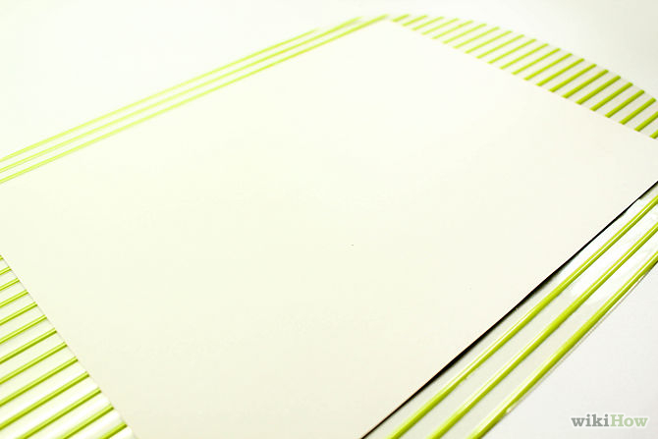
Set out your card or paper, or any other paper you want to paint on.

Slide 6
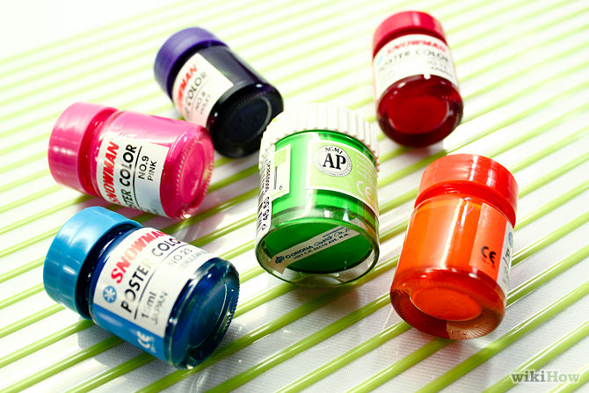
Prepare your paints (watercolors are not advised). Assemble a color palette. Make a special palette for the paint rather than dipping it directly into your usual paints; otherwise you may get pieces of vegetable or fruit stuck in there and they'll rot eventually!

Slide 7
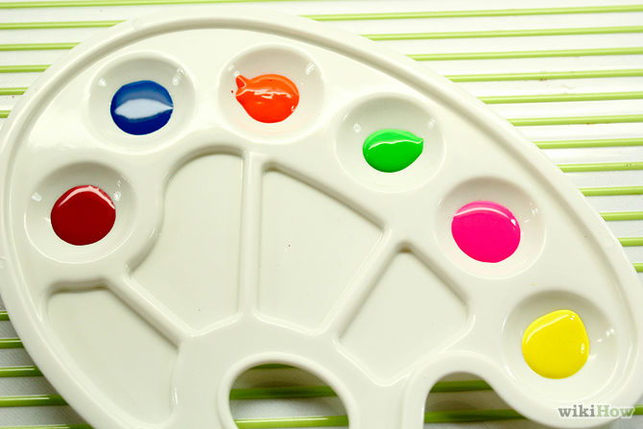
Keep the consistency of the paint thin and fluid without being watery. Don't make it too thick.

Slide 8
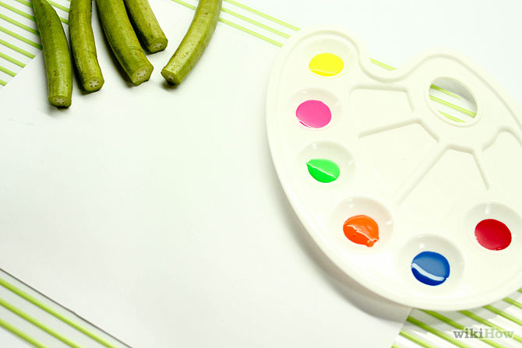
Create your first fruit and vegetable painting - a flower. The instructions follow in the next few steps.

Slide 9
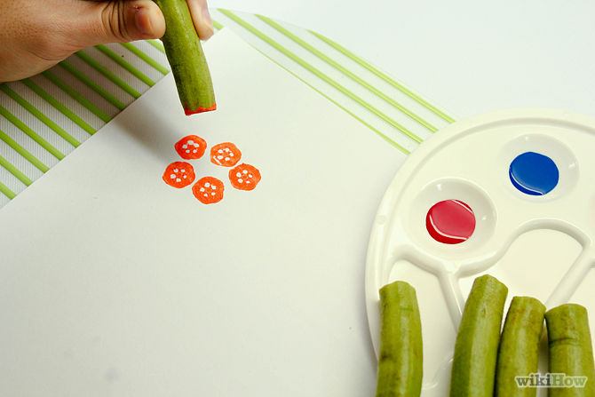
Paint the "flower" section first: Chop off a Ladyfinger's top portion, along the width. Discard the small cut-off end.
Dip the end of the long piece left into your color palette, choosing the color that you like most.

Slide 10
You are trying to create a flower, so think of colors for flowers. Stamp your ladyfinger like a rubber stamp on the desired area of your paper. Be sure not to stamp too hard or the design might smudge or even disintegrate.

Slide 11
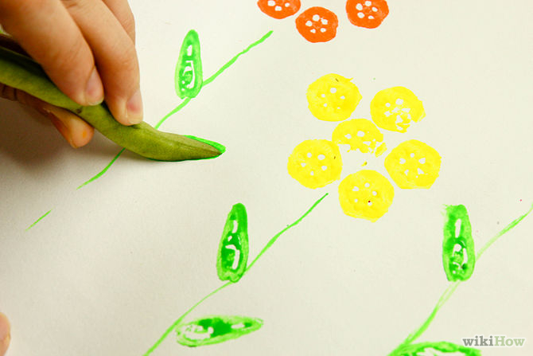
Paint the vegetable "leaves" next: Cut a pod of French beans along the width, in a slightly slanted direction. With these, you can make some leaves for the flower.
Dip them into green paint and stamp them below your ladyfinger flowers.
You can also make French bean petals and make the center using the rear end of a pencil.

Slide 12
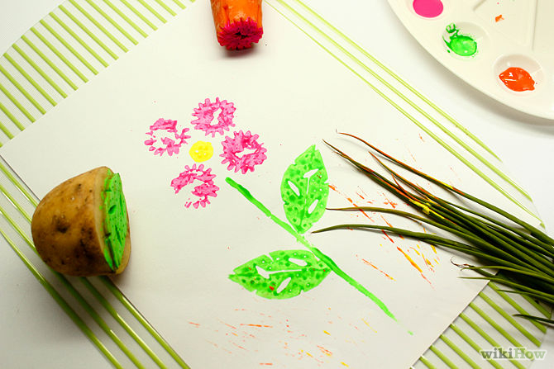
Try other sorts of vegetables and fruits. Potatoes are popular with young children (they are easy to hold) and you can carve them to create interesting raised shapes,

Slide 13
such as stars, half-moons, or circles. Look for fruit and vegetables that have interesting seeds that will make unusual patterns on your paper when you press them.

Slide 14
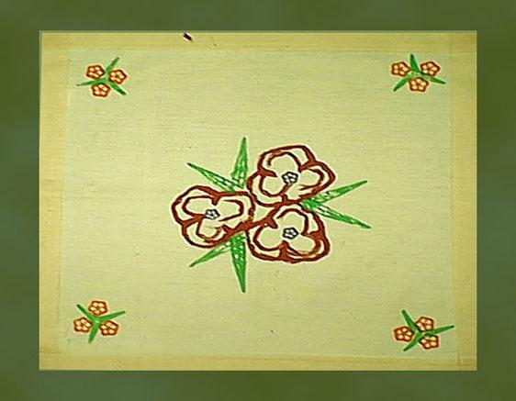
Vegetable printing on cloth

Slide 15
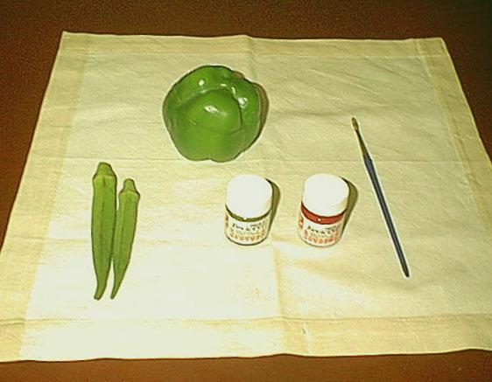
Materials : ›› Capsicum
›› Ladies Finger›› Fabric Paint›› Brush
›› Knife›› Cloth

Slide 16
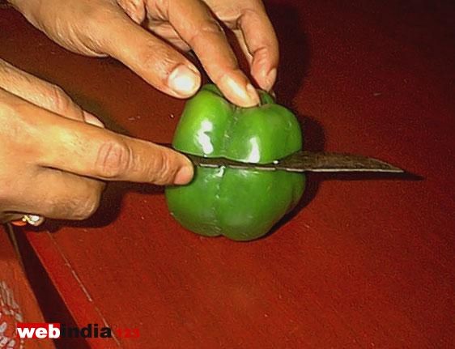
Vegetable printing is a simple art that even small children can try out. You need only some vegetables, a piece of cloth and fabric paints to make the print. Vegetables can be cut lengthwise or breadth wise to make beautiful patterns of flowers, leaves, etc. according to your ideas. Here is an example for you.

Slide 17
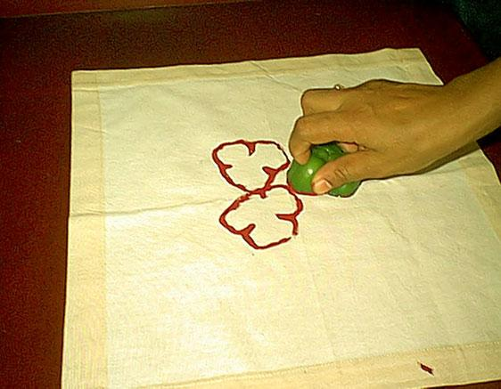
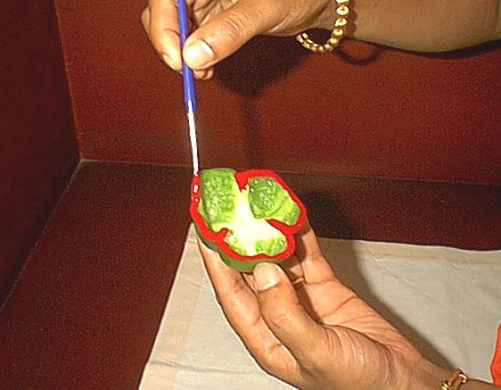
Apply fabric paint of your choice carefully on the brim of the capsicum piece. Take care not to smudge

Slide 18
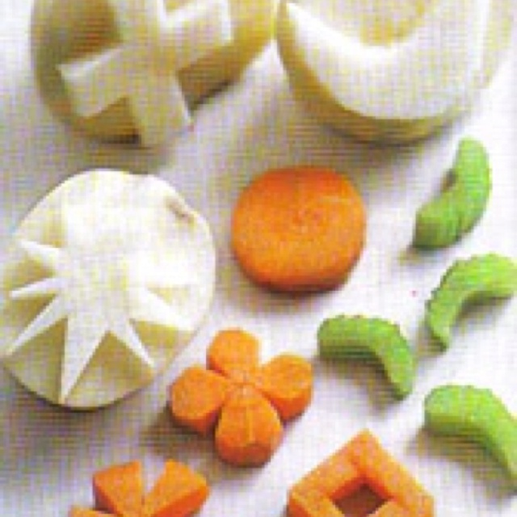
potato printing

Slide 19
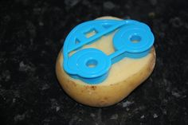
Potato Printing

Slide 20
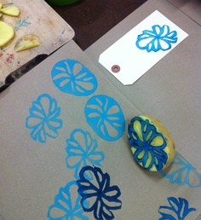
Potato Printing

Slide 21
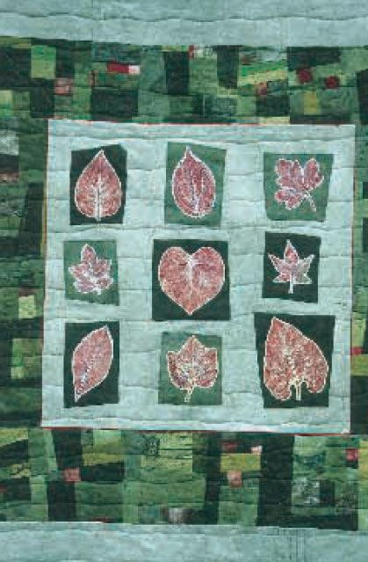
LEAF PRINTING It is really easy to create your own patterned fabric by using leaves picked from your garden and a few fabric paints. And the bonus is that you will end up with a unique fabric.

Slide 22
Some leaves produce better images than others. It is simply a matter of experimenting. Leaves with a raised pattern of veins or interesting outlines will give a good print. Experiment with all types of leaves from trees, shrubs and indoor plants. The best results are from spring, summer or autumn leaves.

Slide 23
Use them shortly after they have been picked while they are still fresh. Don’t press your leaves between the pages of a book to use later as this will depress the vein patterns and also make the leaf too fragile to use.

Slide 24
As far as fabrics are concerned, you can use plain white or coloured cotton; hand-dyed cotton looks particularly effective when printed. You could also try printing on commercial fabrics which makes secondary patterns.

Slide 25
As for paints there are various types and brands available from art shops or from companies who also sell fabric dyes. However, you should look for ordinary fabric paints not silk paints which are not thick enough.

Slide 26
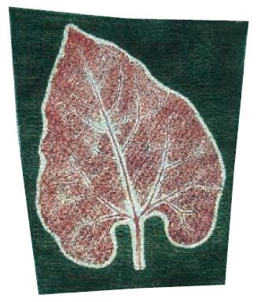
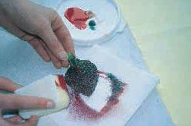
Negative and positive leaf printing

Slide 27
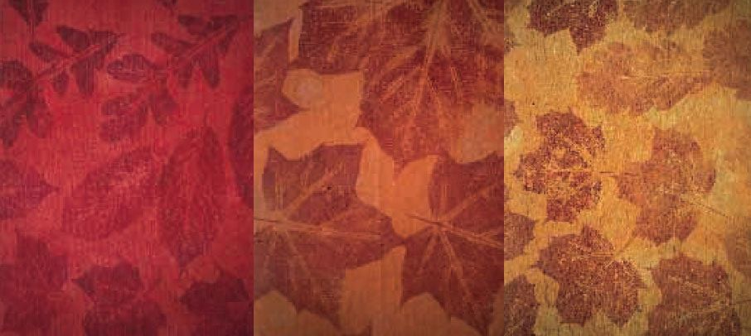
Leaf printing of Fabric

Slide 28
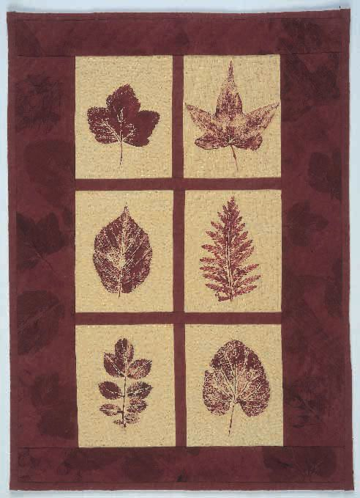
LEAF PRINTING ON FABRIC

Slide 29
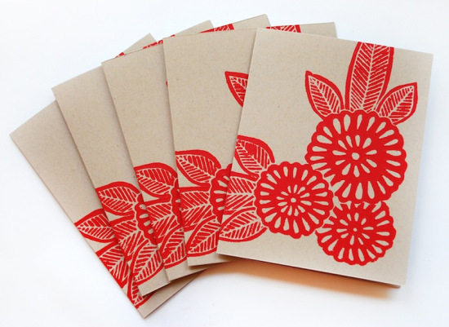
BLOCK PRINTING
This is a printing technique by Katharine Watson telling us about one of the oldest printing methods – a technique known as block printing.

Slide 30
What is Block Printing?
Block Printing is one of the oldest types of printmaking, and has been around for thousands of years. There is evidence that it existed as early as the fifth century BC, with actual fragments found from as early as the fifteenth century. It has been done around the world, with roots in India, China and Japan.

Slide 31
Since there is such a long history of block printing, there are many different techniques, but it is essentially using a carved material covered in ink to transfer an image on to paper or fabric. Block printing can be done with wood, linoleum, rubber, or many other materials, but I use linoleum for my work.

Slide 32
Images that are printed with this technique are typically much bolder than other types of printmaking: since the blocks are carved by hand, there is often less detail and more texture to the prints. It is possible however, when using a very small knife, to carve blocks with a huge amount of detail.

Slide 33
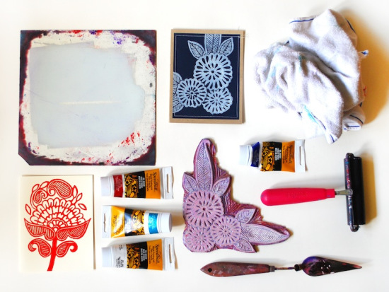

Slide 34
Block printing is also known as “relief printing” because the ink leaves a raised texture on the paper. This is different than letterpress where the image is applied with enough pressure to leave an indent on the paper; typically block printing is done by hand, so the ink sits on the surface adding a raised texture to the paper.

Slide 35
The Printing Process
The first step is to sketch the design. It is important to reverse the image if you are using text, as the printed image will be the reverse of what is on the block. Once I have the image ready, I then transfer the design on to the linoleum to give me an outline of where to carve.

Slide 36
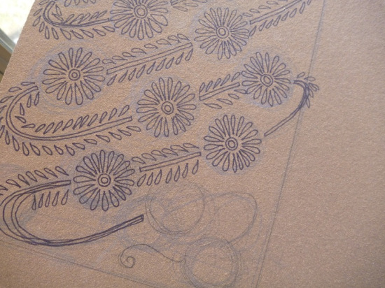
Drawing on wood block

Slide 37
The next step is to carve the design. I carve away the parts that I don’t want to print, as the ink will be applied to the raised surfaces to print the design. Whatever surface is untouched will be what prints onto the paper. Carving a block can take anywhere from an hour for a small piece, to several weeks or even months depending on the size and detail of the image.

Slide 38
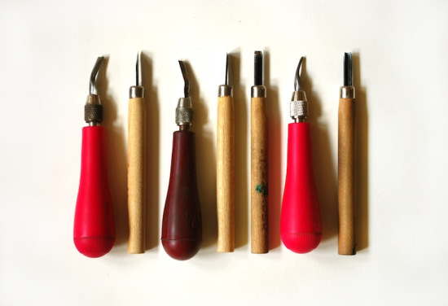
TOOLS

Slide 39
I use a range of knives, with very small-tipped knives for carving outlines and details, and much larger ones for cutting away the background. Carving the blocks takes a lot of patience, because if your hand slips it can ruin the whole piece. With practice, you can learn the amount of pressure it takes to carve the material, and the best techniques to use for certain designs.

Slide 40
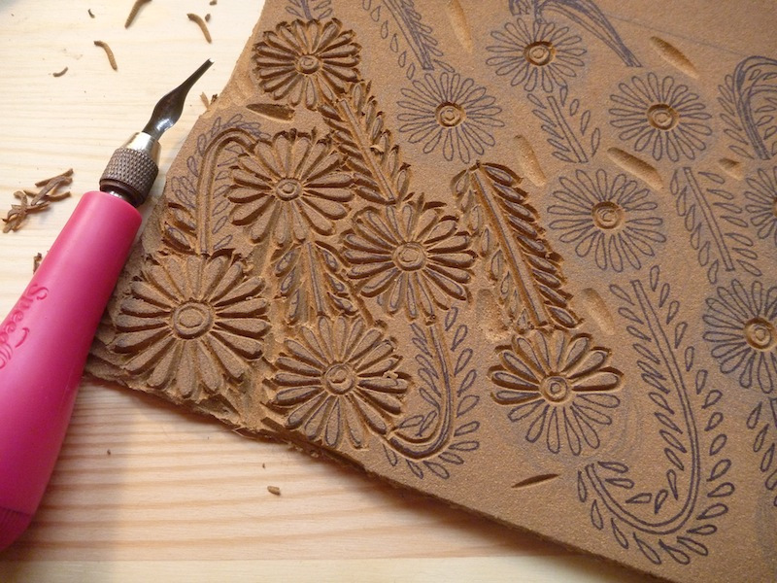

Slide 41
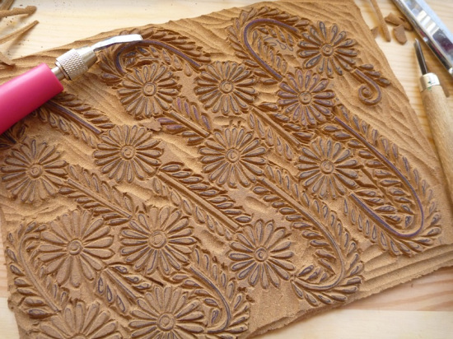

Slide 42
Once the block is carved, we trim the excess off with scissors to give it a straight edge, and then it is ready for printing. There are many different types of ink on the market, and it’s important to test them out to find the best one. we use oil-based inks because they give the best even coverage and print well on both fabric and paper, but there are lots of options out there.

Slide 43
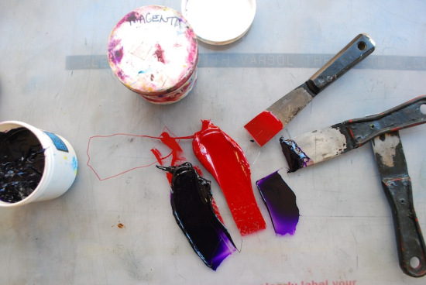
PRINTING INKS AND MATERIALS

Slide 44
To print, we squeeze a small amount of ink onto a piece of glass or plexiglass, and roll it out with a roller (also called a brayer). we do this to get a thin, even layer, because it’s important to apply the ink evenly to the block.

Slide 45
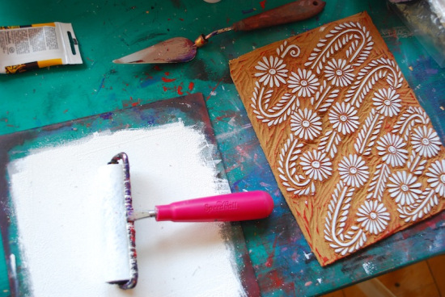

Slide 46
We then roll the ink on to the block, making sure there is a thin but even layer on the whole design. Then we take the block and press it down onto the paper or fabric. You can do this with your hands, a printing barren (a specific tool to apply pressure to a block), a rolling pin, by walking on it, or with a printing press – whatever it takes to apply even pressure.

Slide 47
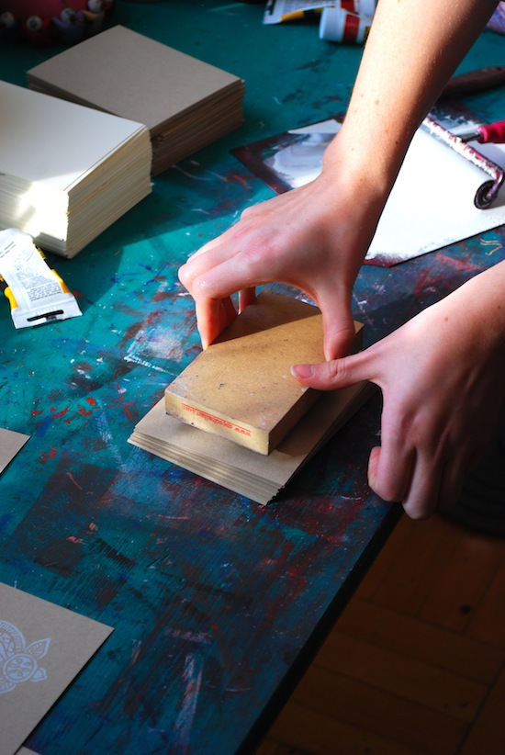

Slide 48
The most important part is applying the pressure evenly, since the color will be stronger in some areas of the print than others if uneven pressure is applied. This is also a step that takes some practice and perfecting.

Slide 49
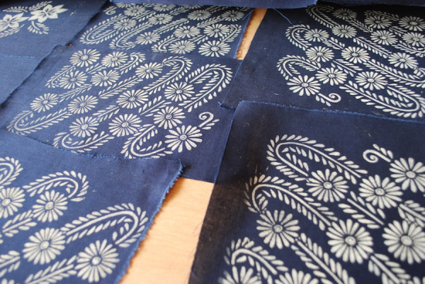

Slide 50
The ink then takes several days to dry, so unlike other printing processes, there is a long wait time before the prints are ready to use. The oil based inks can take from two days to a week to fully dry, whereas water-based inks will dry slightly faster. The inks are made to dry slowly so that you are able to print without having the ink dry on the block; if you print with a fast-drying ink or paint, it will sometimes start to dry before you have even finished the print, giving a very uneven coverage.

Slide 51
Tips and Advice
Block printing is loved by many because of the bold and simple designs that can be created, but that simplicity takes a lot of steps to achieve. The technique is excellent for images with just a few colors and fewer details, but can be difficult to use for images with lots of small text, or very fine details that tend to break off the block with too many uses.

Slide 52
One of the advantages of block printing is that it can be done on a surface of almost any size and texture. We print on fabric, paper, canvas, wood and other materials, and you don’t have to worry about fitting it through a printer or a press.

Slide 53
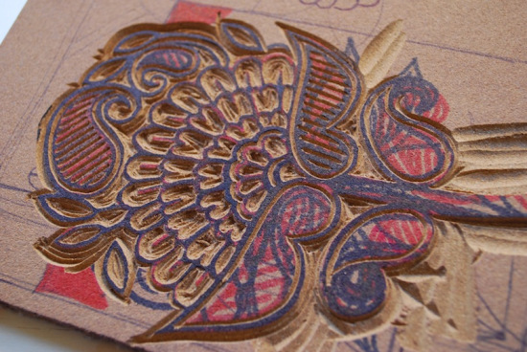

Slide 54
Block printing is also an excellent way to produce a something that is truly handmade, but can be very easily replicated. Carving the block is time consuming and requires a lot of patience, but once you have the block you can use it hundreds or thousands of times.
Block printing is also one of the easiest printing methods to get started with, since the materials needed to start are relatively inexpensive, and you don’t need a lot of equipment for printing. It’s a great way to get into printmaking!

Slide 55
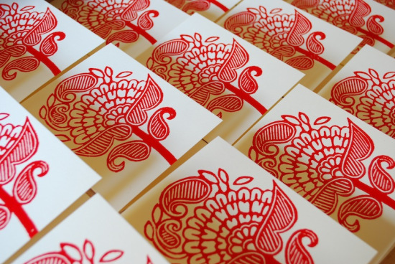

Slide 56
Organic Patterns and Geometric Patterns: What Is the Difference?
Have you ever heard the term “organic pattern?” It has nothing to do with sustainable farming methods! Read on to find out what “organic” means in relationship to interior design and how it differs from “geometric.”

Slide 57
There are two broad groups of patterns available for your home decorating pleasure. These patterns are used on fabrics, wallpapers, rugs, artwork and more, bringing interest and style to your space.
The first type of pattern is “geometric.” This pattern type is linear and …. well….geometric. They have more “structure” than organic patterns, and seem to be man-made designs instead of something that could be growing from the earth.

Slide 58
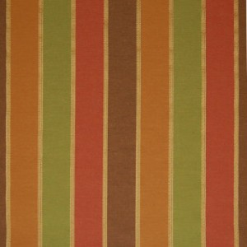
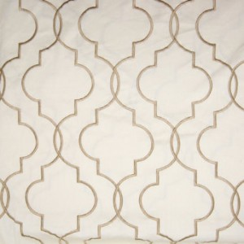
If you are looking for geometric patterns, check out stripes, checks, plaids, circles and other geometric patterns like these from Greenhouse Design:

Slide 59
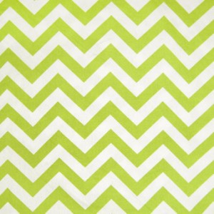
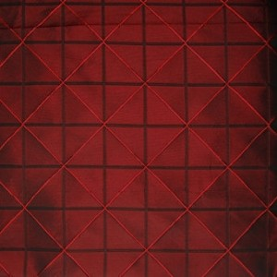

Slide 60
The other type of pattern in used in home decor is “organic.” Organic patterns are the opposite of geometric patterns – think “growing” when you think of an organic pattern. Instead of straight lines, organic patterns utilize curves, scrolls, vines, leaves, flowers and other curvilinear features. Fabrics like these from Greenhouse Design give you a good picture of what makes up an organic pattern:

Slide 61
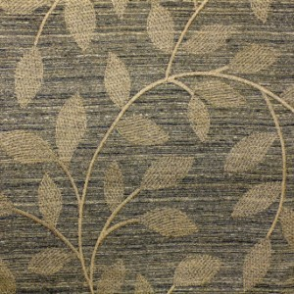

Slide 62
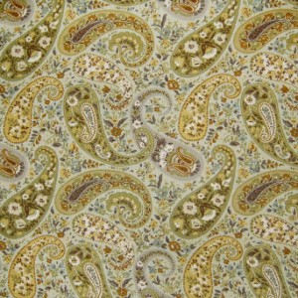

Slide 63
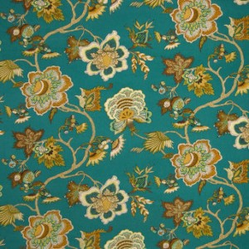

Slide 64
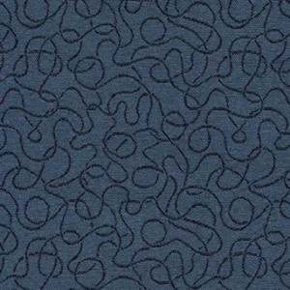

Slide 65
To create interest in your space, be sure to use some geometric patterns and some organic patterns in your decor. Mixing the patterns on your fabrics, rugs or wallpaper creates contrast – the key to a balanced and interesting room.

Slide 66
SUMMERY
Printing and patterns.
Printing. Vegetable printing, Leaf printing and Block printing
Pattern making. Geometric and organic patterns.

