Slide 1
LECTURE. 17. UNIT. 3.
Geometric shapes and forms.
Organic shapes and forms.
Texture.

Slide 2
Summery of Lecture. 16. Unit. 3.
Elements and principals of Design
Elements of Art and their importance. Line, shape, form, space, texture, Value and colour.
Lines and what they do in Art.
Types of lines. Vertical, horizontal, diagonal, zigzag and curved.
line variation, length, width and texture

Slide 3
An "organic" or "natural" form is loose and undefined. Often things found in nature are organic forms, like clouds. Clouds have no set form, and no geometric lines or angles.
"Geometric" or "inorganic" forms have hard, defined lines and angles, and don't vary too much. Often man-made things have these kinds of forms, which must be measured to come out "correctly."

Slide 4
Geometry
Geometry is all about shapes and their properties.
If you like playing with objects, or like drawing, then geometry is for you! Geometry can be divided into:

Slide 5

Plane Geometry is about flat shapes like lines, circles and triangles ... shapes that can be drawn on a piece of paper

Slide 6
Plane Geometry
If you like drawing, Geometry is for you!
Plane geometry is all about shapes like lines, circles and triangles ... shapes that can be drawn on a flat surface called a Plane (it is like on an endless piece of paper).

Slide 7
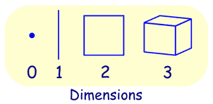
Point, Line, Plane and Solid
A Point has no dimensions, only position
A Line is one-dimensional
A Plane is two dimensional (2D)
A Solid is three-dimensional (3D)

Slide 8
Point
A point is an exact location. It has no size, only position.
Drag the points below (they are shown as dots so you can see them, but a point really has no size at all!)
View Larger
Points usually have a name, often a letter like "A", or even "W"

Slide 9
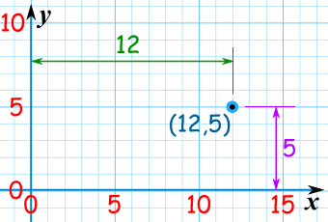
The exact location of a point can be shown using Cartesian Coordinates.
Here we see the point (12,5). Cartesian Coordinates
Cartesian coordinates can be used to pinpoint where you are on a map or graph.
Cartesian Coordinates
Using Cartesian Coordinates you mark a point on a graph by how far along and how far up it is:

Slide 10
A LINE: geometry a line:
is straight (no curves),
has no thickness, and
extends in both directions without end (infinitely).
A line has no ends!

Slide 11
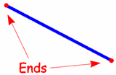
A line has no ends! Line Segment

Slide 12
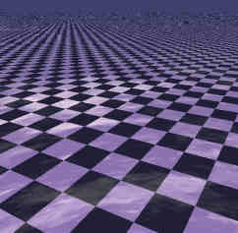
Plane
A plane is a flat surface with no thickness. Our world has three dimensions, but there are only two dimensions on a plane: length and width make a planex and y also make a plane And a plane goes on forever.

Slide 13
Examples
It is actually hard to give a real example!
When we draw something on a flat piece of paper we are drawing on a plane ...
... except that the paper itself is not a plane, because it has thickness! And it should extend forever, too. So the very top of a perfect piece of paper
that goes on forever is the right idea!
Also, the top of a table, the floor and a whiteboard are all like a plane.

Slide 14
A plane has 2 Dimensions (and is often called 2D):

Slide 15
Plane vs Plain
In geometry a "plane" is a flat surface with no thickness.
But a "plain" is a treeless mostly flat expanse of land ... it is also flat, but not in the pure sense we use in geometry.
Both words have other meanings too: Plane can mean an airplane, a level, or a tool for cutting things flat; Plain can mean without special things, or well understood.

Slide 16
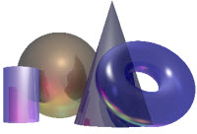
Solid Geometry
Solid Geometry is the geometry of three-dimensional space, the kind of space we live in .

Slide 17
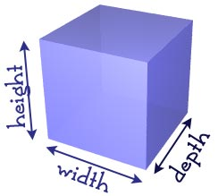
Three Dimensions
It is called three-dimensional, or 3D because there are three dimensions: width, depth and height.

Slide 18

Simple Shapes
Let us start with some of the simplest shapes:

Slide 19
Properties
Solids have properties (special things about them), such as:
volume (think of how much water it could hold)
surface area (think of the area you would have to paint)
how many vertices (corner points), faces and edges they have

Slide 20

Polyhedra and Non-Polyhedra
There are two main types of solids, "Polyhedra", and "Non-Polyhedra“
Polyhedra :(they must have flat faces)
:

Slide 21
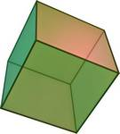
A cube is also called a hexahedron because it is a polyhedron that has 6 (hexa- means 6) faces.

Slide 22
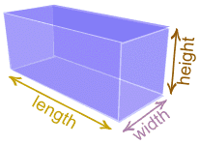
Cuboids, Rectangular Prisms and Cubes
A cuboid is a box-shaped object.
It has six flat sides and all angles are right angles.
And all of its faces are rectangles.
It is also a prism because it has the same cross-section along a length. In fact it is a rectangular prism.

Slide 23
Volume of a Cuboid
A cuboid is a 3 dimensional shape.
So to work out the volume we need to know 3 measurements Look at this shape.
There are 3 different measurements:
Length, Width, Height

Slide 24
The volume is found using the formula:
Volume = Length × Width × Height
Which is usually shortened to:
V = l × w × h

Slide 25
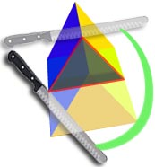
Prisms
A prism has flat sides and the same cross section all along its length !
A cross section is the shape you get when cutting straight across an object

Slide 26
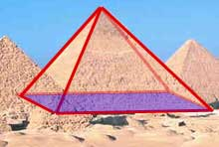
Pyramids
When we think of pyramids we think of the Great Pyramids of Egypt.
They are actually Square Pyramids, because their base is a Square

Slide 27
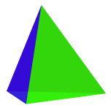
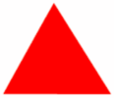
Types of Pyramids
There are many types of Pyramids, and they are named after the shape of their base.
Triangular Pyramid:

Slide 28
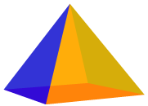
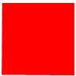
Square Pyramid:

Slide 29
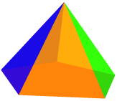

Pentagonal Pyramid:

Slide 30




Non-Polyhedra:
(if any surface is not flat)
Sphere. Torus
Cylinder Cone

Slide 31
Organic shapes and forms.
Organic shapes are figures that have a natural look and a flowing, curving appearance. Different from geometric shapes, they are often also referred to as curvilinear or free form shapes, as they can be made of angles, curves or both. Examples are found in leaves, plants, and animals.

Slide 32
This type of design appears primarily in landscaping, engineering and art. Although problems do exist in creating them, technology is positively changing the way people make these figures.
Difference from Geometric Shapes
Organic shapes are not the same as geometric shapes. They generally don't have measurements that are uniform or perfect.

Slide 33
From a practical standpoint, this makes it much more mathematically complex to calculate measurements such as area and volume.
Another key difference between organic shapes and geometric shapes is that organic shapes typically are not made by people, except in a handful of fields. They are found in the natural environment and in living things. Geometric shapes, by contrast, can be either made by individuals or appear naturally. A wall of a house, for instance, usually is square or rectangular, and honeycombs have a hexagonal pattern.

Slide 34
Positive and Negative
Free form figures may be positive or negative, similar to geometric ones. Positive means that the shape has something inside of it, such as the irregular image of a face where two eyes are drawn in. Negative means that only the outline is complete and that the figure is empty.

Slide 35
Organic and geometric shapes Comparison:
ORGANIC and GEOMETRIC SHAPES
A shape is an element of art. Specifically, it is an enclosed space, the boundaries of which are defined by other elements of art (i.e.: lines, colours, values, textures, etc.). Shapes are limited to two dimensions: length and width.

Slide 36
1. Geometric shapes:
Are circles, rectangles, squares, triangles and so on - have the clear edges one achieves when using tools to create them.
Most geometric shapes are made by humans, though crystals are also considered to be geometric despite the fact that they are made in nature.

Slide 37
2. Organic shapes:
Are shapes with a natural look and a flowing and curving appearance.
Organic shapes and forms are typically irregular or asymmetrical.
Organic shapes are associated with things from the natural world, like plants and animals.

Slide 38
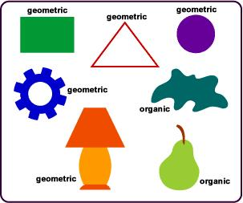

Slide 39
Artists use organic shapes and geometric shapes in different ways:
When attempting to create a piece that looks natural, flowing, soft or calming, organic shapes are generally the shapes of choice.
When attempting to create a sense of chaos, anger, or rigidity, geometric shapes are used. Geometric shapes may also be used to create abstract interpretations of things that would normally be depicted as organic shapes.

Slide 40
Differences between Geometric and Organic shapes:
Geometric Shapes
Shapes that are precise and require a guiding tool to
draw such as a ruler. Examples of Geometric shapes
are squares, circles, triangles, hexagons.
Organic Shapes
-Organic Shapes are free form and have no straight line

Slide 41
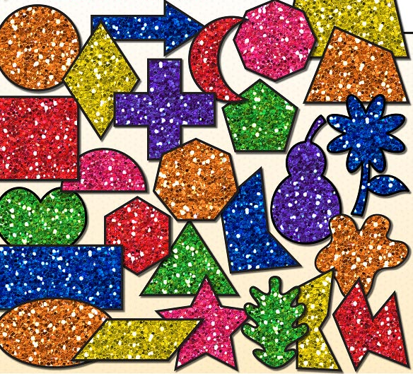

Slide 42
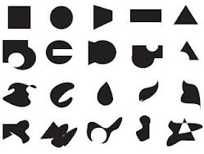

Slide 43
Texture, another element of art, is used to describe either the way a three-dimensional work actually feels when touched, or the visual "feel" of a two-dimensional work.
Take rocks, for example. A real, 3-D rock might feel rough or smooth, and definitely feels hard when touched or picked up. A painter, depicting a rock, would create the illusions of these qualities through use of color, line, shape, etc.

Slide 44
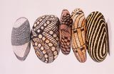

Slide 45
In the visual arts, texture is the perceived surface quality of a work of art. It is an element of two-dimensional and three-dimensional design and is distinguished by its perceived visual and physical properties. Use of texture, along with other elements of design, can convey a variety of messages and emotions.

Slide 46
Physical Texture
A bumpy texture of a sidewalk
Physical texture, also known as actual texture or tactile texture, are the actual variations upon a surface. This can include, but is not limited to, fur, wood grain, sand, smooth surface of canvas or metal, glass, and leather. It differentiates itself from visual texture by having a physical quality that can be felt by touch.

Slide 47
Specific use of a texture can affect the smoothness that an artwork conveys. For instance, use of rough surfaces can be visually active, whilst smooth surfaces can be visually restful. The use of both can give a sense of personality to a design, or utilized to create emphasis, rhythm, contrast, etc.
Light is an important factor for physical artwork, because it can affect how a surface is viewed. Strong lights on a smooth surface can obscure the readability of a drawing or photograph, whilst they can create strong contrasts in a highly textural surface such as moose or pigs.

Slide 48
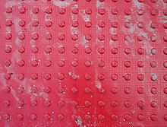

Slide 49
Visual Texture
Visual texture is the illusion of having physical texture. Every material and every support surface has its own visual texture and needs to be taken into consideration before creating a composition. As such, materials such as canvas and water colour paper are considerably rougher than, for example, photo-quality computer paper and may not be best suited to creating a flat, smooth texture. Photography, drawings and paintings use visual texture both to portray their subject matter realistically and with interpretation. Texture in these media are generally created by the repetition of shape and line.

Slide 50
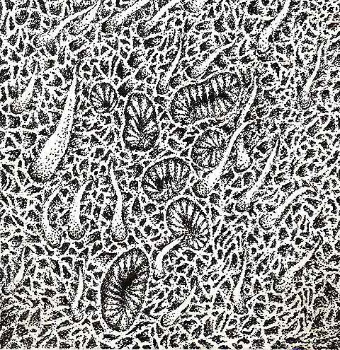

Slide 51


Slide 52
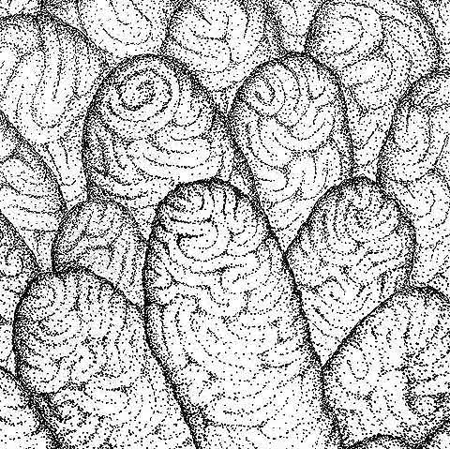

Slide 53
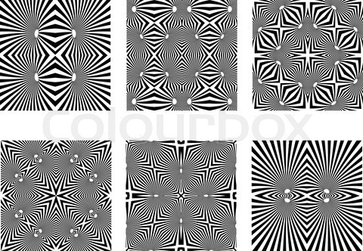

Slide 54
Summery of Today’s Lecture
Geometric shapes and forms.
Organic shapes and forms.
Texture.

